Slide 1
Grain boundaries and Complexions
Victor Venturi
JCD Leader
Notes:
Main title: 40 pt. Arial
Presenter Name: 16 pt. Arial
Presenters Title: 16 pt. Arial Italic

Slide 2
Outline
Initial motivation
Grain boundaries
Brief Classification
Coincidence Site Lattice
0-lattice
Complexions
Pure and non-pure materials
Types of complexions and transitions

Slide 3
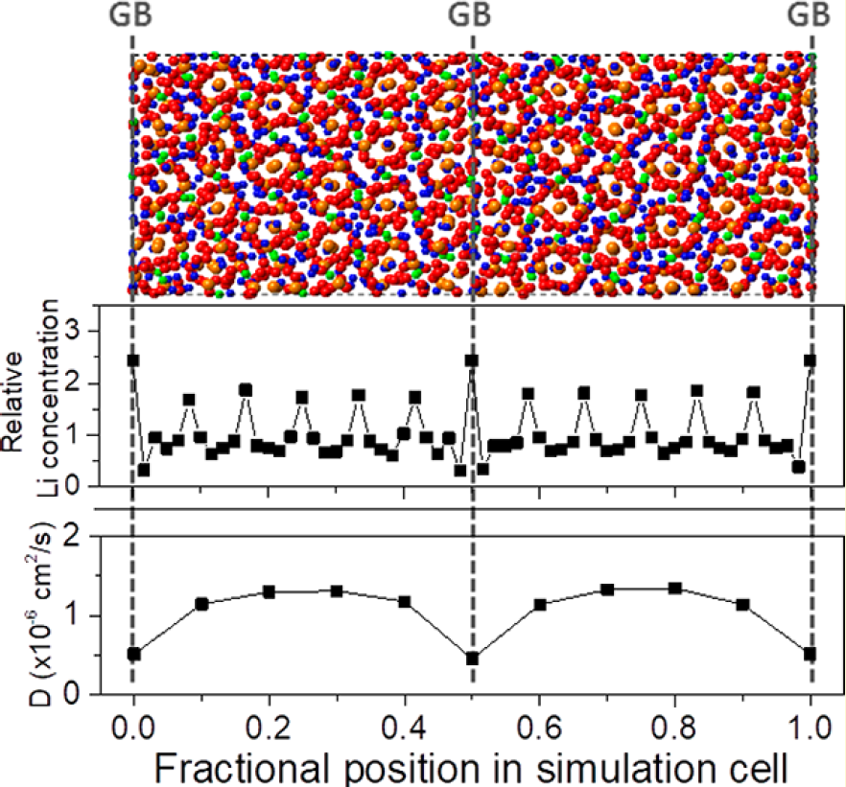
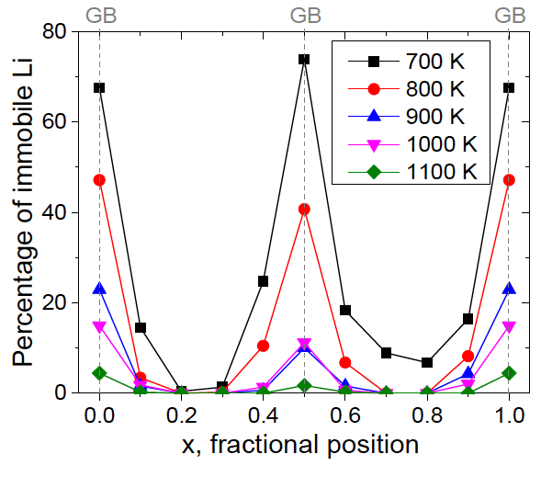
Initial motivation
Classical MD indicates LLZO grain boundaries hinder Li motion
Yu, S., et al. “Grain boundary contributions to Li-ion transport in the solid electrolyte LLZO" Chem. Mater. 29 (2017).

Slide 4
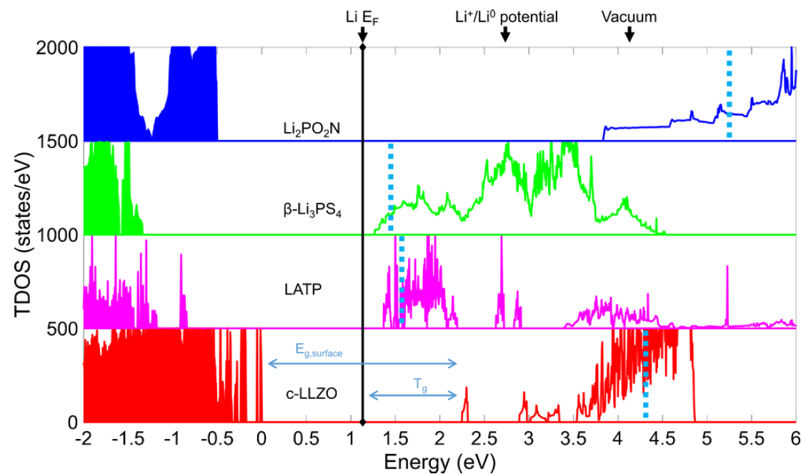
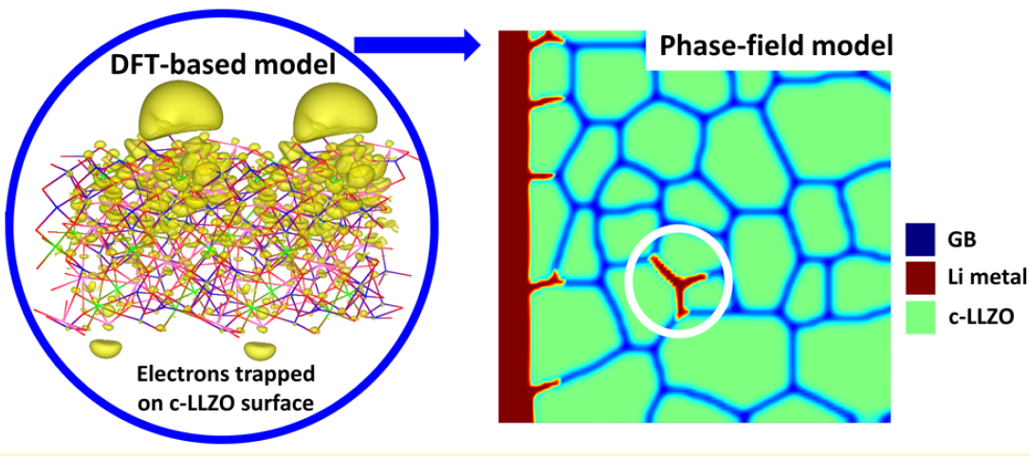
Initial motivation
Surface studies suggest LLZO grain boundaries allow for Li plating in the solid electrolyte!
Tian, H., et al. “Interfacial electronic properties dictate Li dendrite growth in solid electrolytes" Chem. Mater. 31 (2019).

Slide 5
What is a grain boundary?
Physical perspective
Interface between two grains of a crystal
Note: the crystal on either side need not be of the same material
How to define this mathematically?
First, define boundary by its normal vector $\hat{n}$
Next, define relative grain misorientation $R$ $=ω{\hat{u}}^{∗}$
How many variables are needed to fully describe a GB?
Geometric: 5
Thermodynamic: $C+1$ ($C$ is the number of components)
Total of $C+6$ (not accounting for translations along and orthogonal to the boundary)
*There are other ways to define the misorientation vector (such as quaternion), but for simplicity, we will stick with $ω\hat{u}$

Slide 6
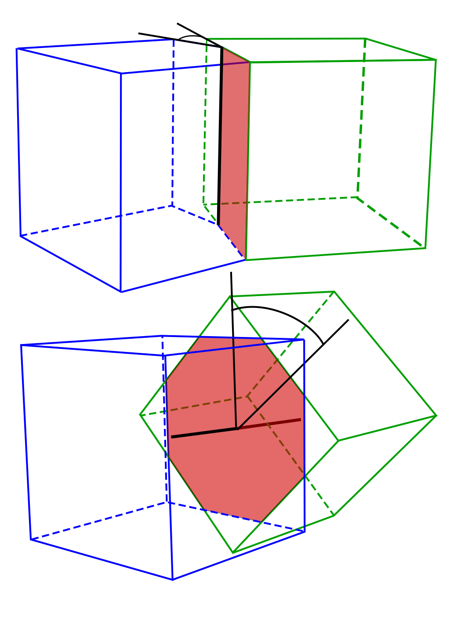
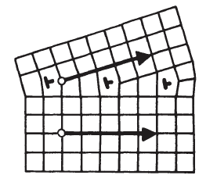
How to classify GBs?
Relative orientation of $R$ and $\hat{n}$
Pure tilt: $R⊥\hat{n}$
Pure twist: $R∥\hat{n}$
Total magnitude of $R$
Small angle
Frank’s formula (simple):
$$d={b^{∗}}/ω$$
Large angle
Combination is a “general” GB
Source: Slinky Puppet
* In theory, $b$ is the Burgers vector of the DSC lattice, but small $ω≡Σ1$ CSL

Slide 7
Special cases: CSL
Normally, regions along the GB where the crystals “disagree” increase the overall energy of the GB
One way to decrease this energy is by having atoms along the GB that are undisturbed in both sides of the boundary
Coincidence Site Lattice (and Displacement Shift Complete interlude)
Super-lattice composed of lattice points of both interpenetrating crystals that occupy the same position in space
Generally, ratio between volume of CSL and original crystal given by
$$Σ=α(h^{2}+k^{2}+ℓ^{2})$$
$$α=\left\{\begin{matrix}1 if\left(h^{2}+k^{2}+ℓ^{2}\right) \text{o}dd \\ 0.5 otherwise\end{matrix}\right.$$

Slide 8
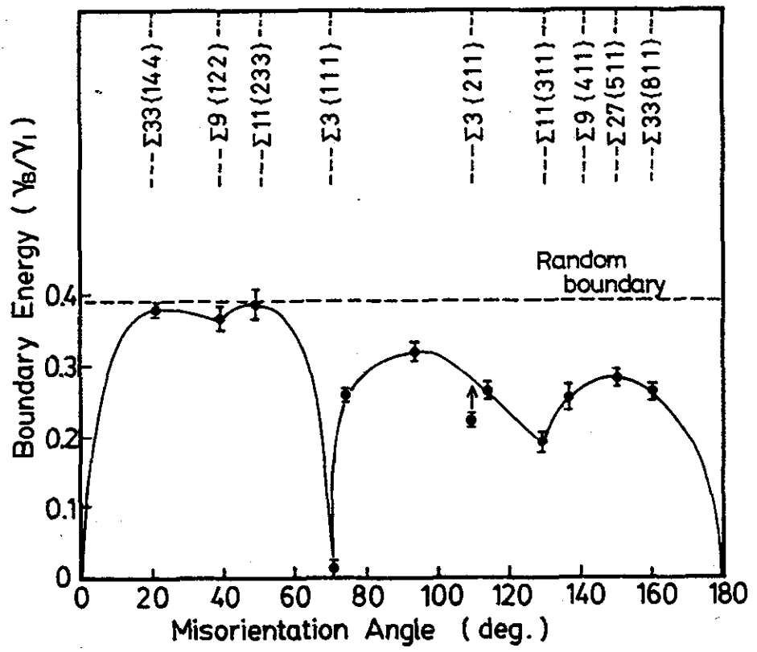
CSL energies for Cu
Monzen, R., et al. "Correlation between the boundary energy and precipitation in copper-[011] symmetric tilt boundaries." (1990).

Slide 9
0-lattice theory
Transformation from crystal 1 to crystal 2 with $\left|A\right|≠0$:
$$x^{(2L)}=Ax^{(1L)}$$
The points in each crystal can be binned into classes based on their internal coordinates (in each lattice): $x^{(1L)}\left(C^{(1L)}\right)+t^{(1L)}∈C^{\left(1L\right)}$
A coincidence site happens when ${x^{0}= x}^{(2L)}=Ax^{(1L)}∈C^{(1L)}$
$$x^{0}=Ax^{(1L)}=x^{(1L)}+t^{(1L)}⇒$$
$$x^{0}=A^{−1}x^{0}+t^{(1L)}⇒$$
$$x^{0}={\left(I−A^{−1}\right)}^{−1}t^{(1L)}$$
Some interesting aspects I will not talk about:
Different $A$ matrices can give origin to same crystal 2; which to pick?
What happens when rank$\left(I−A^{−1}\right)≠3$?
The “birth” of DSC
Bollmann, W. "Crystal Defects and Crystalline Interfaces, 1970." (1982).
Notes:
Bollmann also shows that the choice of origin does not matter

Slide 10
0-lattice closing comments
Pros
Fully mathematical
If you know the “misorientation” between the two crystals, you know what the ideal boundary looks like
Constructing GB for simulations becomes simpler
Formal introduction of DSC
Cons
From a computational standpoint, some 0-lattices can be too large
Small changes in $A$ matrix yield different 0-lattices, but that is not realistic.
Real grain boundaries rarely look ideal

Slide 11
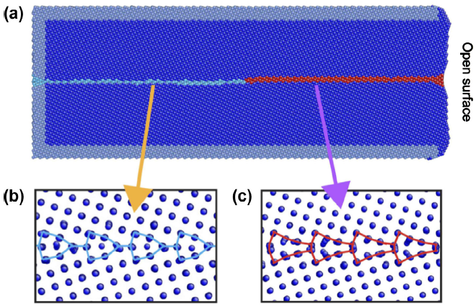
Grain boundary “phases”
At the interfaces between grains, new phases, sometimes different from bulk, can form
These new phases are commonly called complexions
They can exhibit phase-like transitions in their structure and chemistry
Cantwell, P. R., et al. “Grain boundary complexions" Acta Materialia 62 (2014).

Slide 12
Complexions in pure materials
Congruent transitions (rare)
No change in geometrical parameters of GB
Non-congruent transitions
Faceting: maintains the misorientation $R$, but forms different inclinations
Non-congruent transitions
Dissociation: creates two GBs separated by a bulk phase; $R_{1}+R_{2}=R$
Cantwell, P. R., et al. “Grain boundary complexions" Acta Materialia 62 (2014).
Notes:
Dissociation is also called wetting!

Slide 13
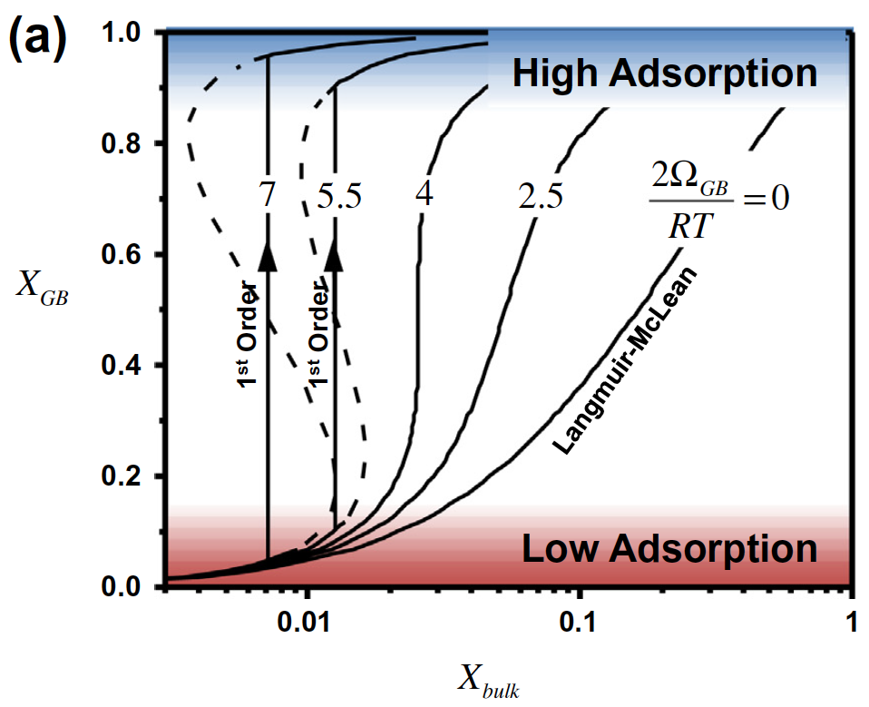
Complexions in non-pure materials
Adsorption/Segregation Langmuir-McLean model
Fixed number of adsorption sites per unit area
GB is an entity in equilibrium with bulk
GB is a regular solution with interaction $Ω_{GB}$
$$\frac{X_{GB}}{1−X_{GB}}=\frac{X_{bulk}}{1−X_{bulk}} exp⁡\left(\frac{ΔG_{ads}−2Ω_{GB}X_{GB}}{RT}\right)$$
Strong adsorbate-adsorbate attraction $\left(2Ω_{GB}>4RT\right)⇒$ 1st order phase transition
This is exactly the same as a regular solution!
Cantwell, P. R., et al. “Grain boundary complexions" Acta Materialia 62 (2014).

Slide 14
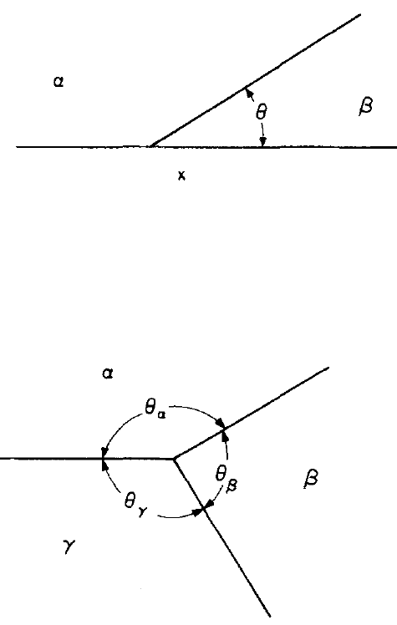
Complexions in non-pure materials
Prewetting
Introduction
Fixed wall: $σ_{αβ}\cos\left(θ\right)=σ_{αx}−σ_{βx}$
$σ_{αβ}=σ_{αx}−σ_{βx}⇒$ perfect wetting by $β$
Three phases in contact
$$\frac{σ_{αβ}}{\sin\left(θ_{γ}\right)}=\frac{σ_{βγ}}{\sin\left(θ_{α}\right)}=\frac{σ_{γα}}{\sin\left(θ_{β}\right)}$$
Cahn, J. W. “Critical point wetting" J. Chem. Phys. 66 (1977).

Slide 15
Complexions in non-pure materials
Prewetting: Cahn model / Critical Point Wetting – CPWT
Material with a miscibility gap between phases $α$ and $β$
Planar surface at $x=0$; short-range interaction energy with material given by $Φ(c_{s})$. Excess free energy of surface given by
$$ΔF=Φ\left(c_{s}\right)+\int_{0}^{∞}{\left[Δf+κ{\left(\frac{dc}{dx}\right)}^{2}\right]dx}$$
$c\left(∞\right)=c_{0}$ is the bulk composition
$Δf\left(c\right)=f\left(c\right)−f\left(c_{0}\right)−\left(c−c_{0}\right){\left(\frac{∂f}{∂c}\right)}_{c_{0}}$is the energy needed to create a unit volume with composition $c$ from a reservoir at $c_{0}$

Slide 16
Complexions in non-pure materials
Prewetting: Cahn model / CPWT
$ΔF$ is minimized when $Δf=κ{\left({dc}/{dx}\right)}^{2}$
At interface: ${dΦ}/{dc}=φ=2κ{\left({dc}/{dx}\right)}_{s}⇒φ=±2\sqrt{κΔf(c_{s})}$
Assume $φ<0⇒{dc}/{dx}<0⇒c_{s}≥c_{0}$
Getting a better feel for what this all means…
Notes:
The condition at the interface is called a ”natural condition”; it boils down to a force balance

Slide 17
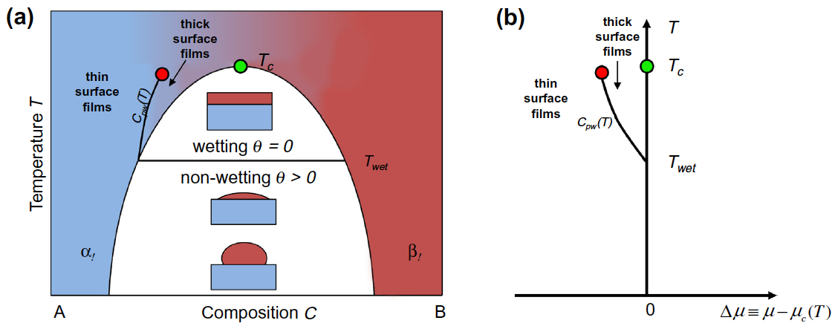
Complexions in non-pure materials
Prewetting: Cahn model / CPWT
Cantwell, P. R., et al. “Grain boundary complexions" Acta Materialia 62 (2014).

Slide 18
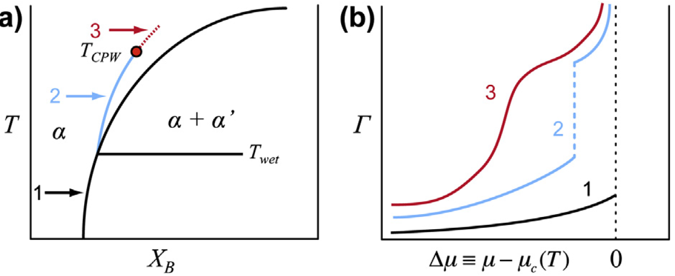
Complexions in non-pure materials
Prewetting: Cahn model / CPWT
At incoherent GB between solid phases with lattice mismatch, CPWT fails because it does not account for strain energy
Only considers short-range interactions at the surface: $Φ\left(c_{s}\right)$
Cantwell, P. R., et al. “Grain boundary complexions" Acta Materialia 62 (2014).

Slide 19
Complexions in non-pure materials
Premelting: Kobayashi-Warren-Carter (KWC)
Surfaces and interfaces melt at lower temperature than bulk $T_{sm}<T_{m}$
Melting can be understood as a special case of wetting
Mean-field modeling: excess free energy of planar GB at $x=0$
$$ΔF\left(η,θ,T\right)=\int_{−∞}^{∞}{\left[Δf\left(η,T\right)+\frac{ν^{2}}{2}{\left(\frac{dη}{dx}\right)}^{2}+g\left(η\right)\left|\frac{dθ}{dx}\right|\right]dx}$$
$η$ is a measure of crystallinity; $η=1$ is a perfect crystal
$θ$ measures grain misorientation
$g\left(η\right)$ is the penalty of a misorientation, with $g\left(0\right)=0$; $g^{′}\left(η\right)≥0$
But $ΔF$ is minimized when $θ\left(x\right)$ is a step function at $x=0$!
Cantwell, P. R., et al. “Grain boundary complexions" Acta Materialia 62 (2014).

Slide 20
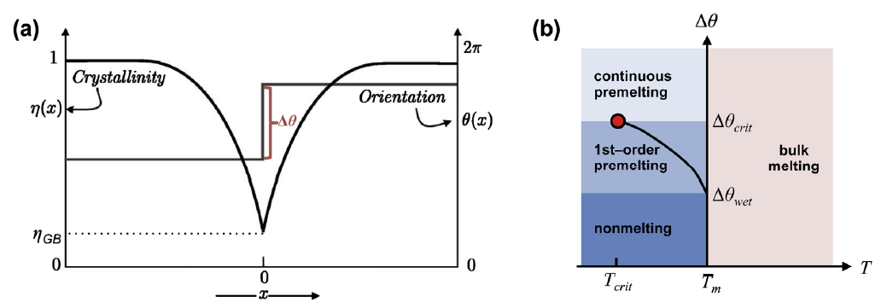
Complexions in non-pure materials
Premelting: KWC
$$ΔF\left(η,θ,T\right)=g\left(η_{GB}\right)Δθ+\int_{−∞}^{∞}{\left[Δf\left(η,T\right)+\frac{ν^{2}}{2}{\left(\frac{dη}{dx}\right)}^{2}\right]dx}$$
This is very similar to CPWT!!
Cantwell, P. R., et al. “Grain boundary complexions" Acta Materialia 62 (2014).

Slide 21
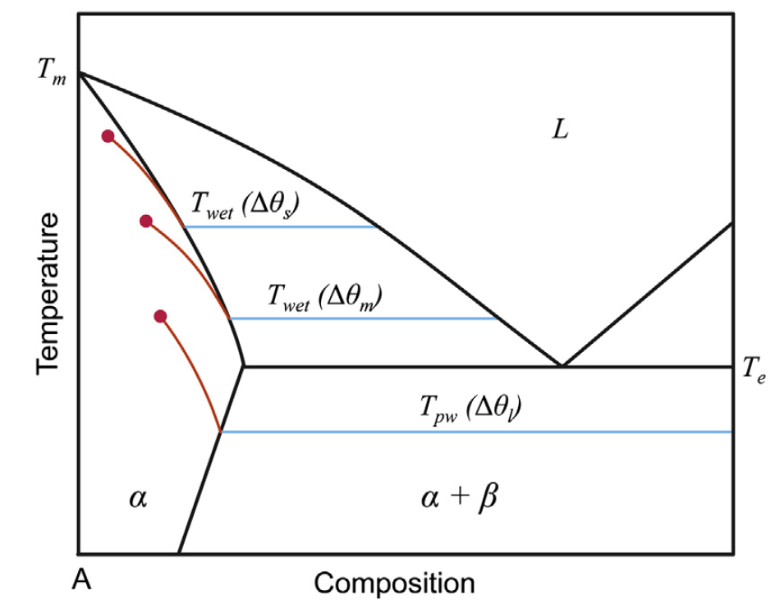
Complexions in non-pure materials
CPWT (composition) + KWC (order-disorder)
$$ΔF\left(c,η,θ,T\right)=g\left(η_{GB}\right)Δθ+Φ\left(c_{s}\right)+\int_{−∞}^{∞}{\left[Δf\left(c,η,T\right)+\frac{ν^{2}}{2}{\left(\frac{dη}{dx}\right)}^{2}+κ{\left(\frac{dc}{dx}\right)}^{2}\right]dx}$$
Cantwell, P. R., et al. “Grain boundary complexions" Acta Materialia 62 (2014).

Slide 22
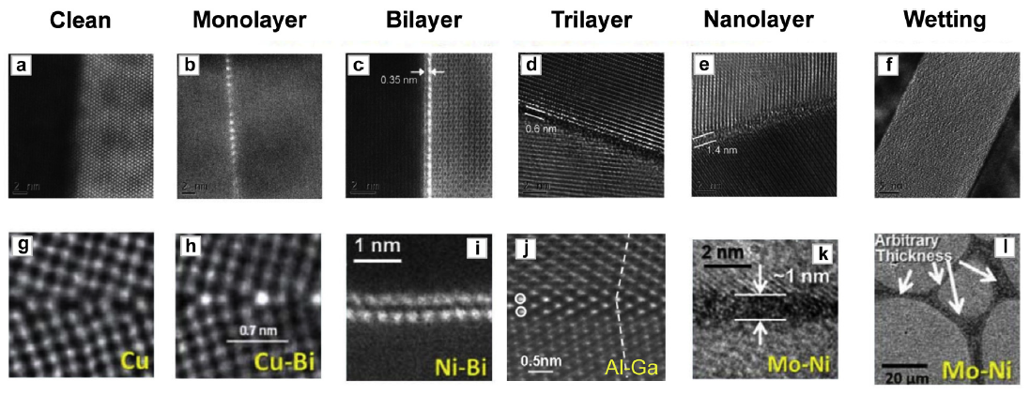
Complexions in non-pure materials
Discrete complexions: Dillon-Harmer
Experimentally observed GBs with discrete thicknesses
Cantwell, P. R., et al. “Grain boundary complexions" Acta Materialia 62 (2014).

Slide 23
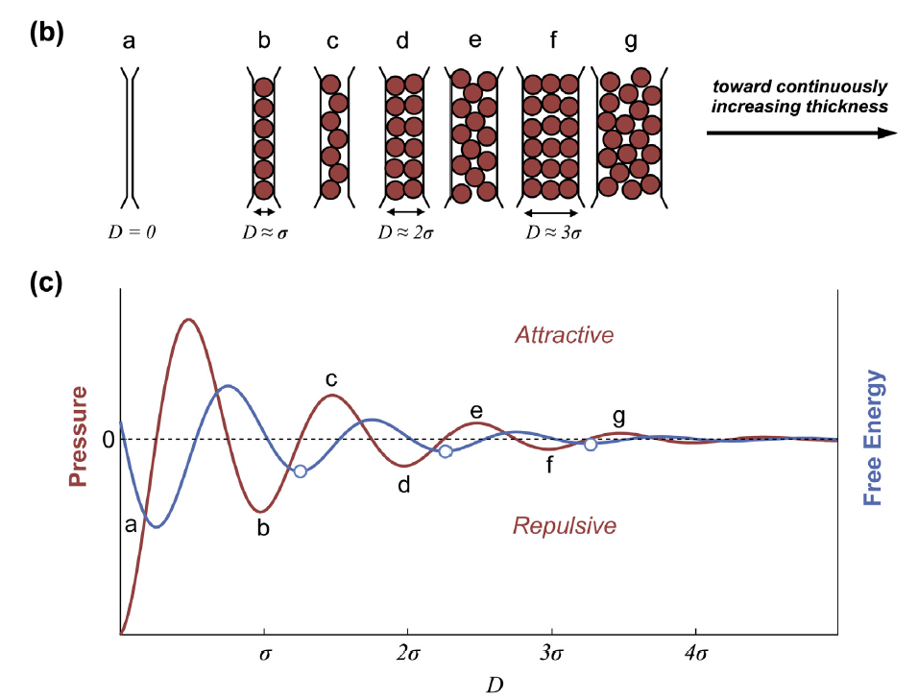
Complexions in non-pure materials
Discrete complexions: Dillon-Harmer
Colloidal theories suggest $D=\left(n+.25\right)σ$
Beyond a certain point, the barrier to increase the thickness is so small we can consider these complexions as continuous but finite inter-granular films
Cantwell, P. R., et al. “Grain boundary complexions" Acta Materialia 62 (2014).

Slide 24
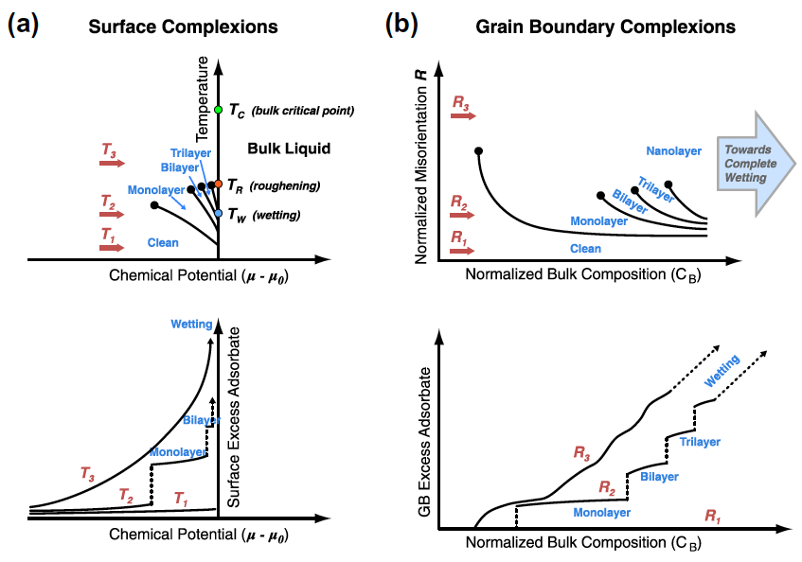
Complexions in non-pure materials
Cantwell, P. R., et al. “Grain boundary complexions" Acta Materialia 62 (2014).

Slide 25
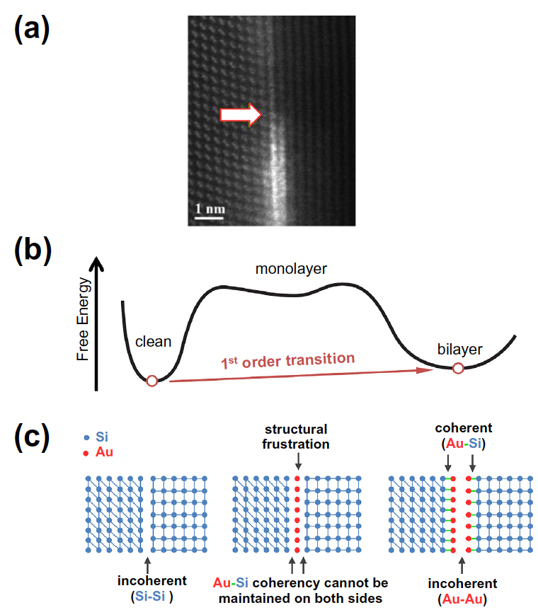
Complexions in non-pure materials
Dillon-Harmer “shortcomings”
Cantwell, P. R., et al. “Grain boundary complexions" Acta Materialia 62 (2014).

Slide 26
Complexions in non-pure materials
Final remarks
GB complexions formation and transitions are quite complex and material dependent, and this not accounting for:
Directional bonds
Cations and anions
Electrostatic space charge
van der Waals interactions
Cantwell, P. R., et al. “Grain boundary complexions" Acta Materialia 62 (2014).

Slide 27
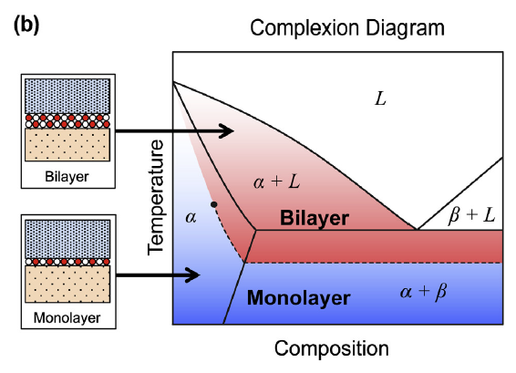
Complexion diagrams
How to represent a phase diagram when there are $C+6$ variables?
Holding all geometric parameters constant, this becomes similar to a phase diagram
Overlay bulk and complexion diagram
Cantwell, P. R., et al. “Grain boundary complexions" Acta Materialia 62 (2014).

Slide 28
Complexion diagrams
Thermodynamic approach
Here, only for quasi-liquid complexions
Stability when $Δγ=2γ_{sl}−γ_{GB}^{0}<0$
Relative interfacial energy can be expressed as
$$G\left(h\right)−γ_{GB}^{0}=Δγ+hΔG_{amorph}^{vol} +ΔG_{η,∇}\left(h\right)+σ_{int}(h)$$
Maximum thickness of quasi-liquid inter-granular film
$$λ=−\frac{Δγ}{ΔG_{amorph}}$$
partial order and gradient
other interfacial interactions
Cantwell, P. R., et al. “Grain boundary complexions" Acta Materialia 62 (2014).
Notes:
$γ_{GB}^{0}$ is the excess free energy of “dry” GB without any complexion

Slide 29
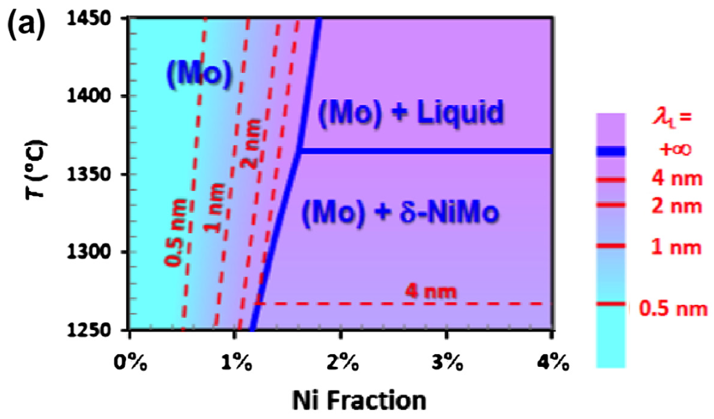
Complexion diagrams
Cantwell, P. R., et al. “Grain boundary complexions" Acta Materialia 62 (2014).

Slide 30
Complexion terminology
Transitions
Geometry
Congruent vs. Non-congruent: do $R$ or $\hat{n}$ change?
Structural: $(R, \hat{n}$) held constant and $(T,p,μ_{i})$ change; atomic structure changes
Faceting: $\hat{n}$ changes but $R$does not
Dissociation/wetting: $R$changes but $\hat{n}$ does not
Order/composition
Prewetting: nanolayer of different composition forms near wetting
Premelting: disordered liquid-like structure below melting point
Adsorption: dramatic change in solute adsorption
Cantwell, P. R., et al. “Grain boundary complexions" Acta Materialia 62 (2014).

Slide 31
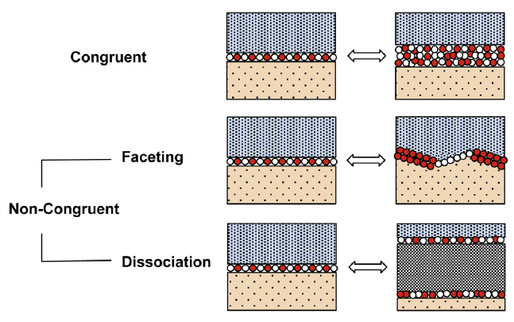
Complexion terminology
Cantwell, P. R., et al. “Grain boundary complexions" Acta Materialia 62 (2014).

Slide 32
Complexion terminology
Types
Composition
Intrinsic: pure material, complexion composition equal to bulk, but density might be different
Extrinsic: non-pure material; complexion composition usually different from bulk
Thickness (and composition)
Dry (clean; monolayer), Moist (bi/tri/nanolayer), Wet (bulk film)
Periodicity
Ordered vs. Disordered
Cantwell, P. R., et al. “Grain boundary complexions" Acta Materialia 62 (2014).

Slide 33
How can complexions affect the material?
Embrittlement
GB mobility and abnormal grain growth
Diffusivity along complexion
Empirical observation: $E_{a}^{GB}∝E_{a}^{bulk}−γ_{GB}$
Some evidence that complexions can affect electrical, thermal, optical, chemical, and magnetic properties
Example: decrease in thickness of Y₂O₃-based intergranular film in AlN is correlated with an increase in bulk thermal conductivity of 24%
More tangible example: lithium phosphate based surficial films on cathode particles can enhance discharge rate

Slide 34
(My) Final thoughts
Metallurgic thrust during the 1900s: need for better understanding of GB
Several studies on GB for pure metallic systems, binary systems; few on other simpler systems; myriad of important strides were made. However:
Difficulties in experimentally observing complexion transitions; most measurements are done “indirectly”; many complexions only stable at high temperatures but quenching freezes them at low temperature
Hard to validate theoretical models, which are already relatively simplistic (they are still difficult to understand, but they don’t account for a lot of stuff) $⇒$ case-by-case basis without a general unifying theory
Mechanism and kinetics of complexion transitions relatively unknow
More complicated materials (such as solid electrolytes) may have an even larger plethora of complexions and transitions!

Slide 35
0-lattice behavior upon translation of lattice 2
Translate crystal 2 by $d^{(2)}$: $x^{(2L)}=Ax^{(1L)}+d^{(2)}=x^{(1L)}+t^{(1L)}=x^{(0d)}$
$$x^{(1L)}=A^{−1}\left(x^{\left(0d\right)}−d^{\left(2\right)}\right)$$
$$\left(I−A^{−1}\right)x^{(0d)}=t^{(1L)}−A^{−1}d^{(2)}$$
Decompose displaced 0-lattice: $x^{(0d)}=x^{0}+d^{(0)}$
$$\left(I−A^{−1}\right)x^{0}+\left(I−A^{−1}\right)d^{(0)}=t^{(1L)}−A^{−1}d^{(2)}$$
$$\left(I−A^{−1}\right)d^{(0)}=−Ad^{(2)}$$

Slide 36
Equivalence between surface energy and tension
Apply a stress $P=F/h$ to edge of a surface to extend the other edge by $s$
This stress is equal in magnitude to the surface tension
Increase in area $ΔA=hs$
Increase in total energy of surface
$$ΔE=σΔA=hsσ$$
Work done by force
$$W=Fs=Phs=hsP$$
Surface energy and surface tension are “equivalent”
$$h$$
$$s$$

Slide 37
Premelting curves
Tang, M., et al. “Diffuse interface model for structural transitions of grain boundaries" Physical Review B 73 024102 (2006).

