Slide 1


(Learned) Frequency Estimation Algorithms
Ali Vakilian
MIT (will join WISC as a postdoctoral researcher)
Joint works with Anders Aamand, Chen-Yu Hsu, Piotr Indyk and Dina Katabi

Slide 2
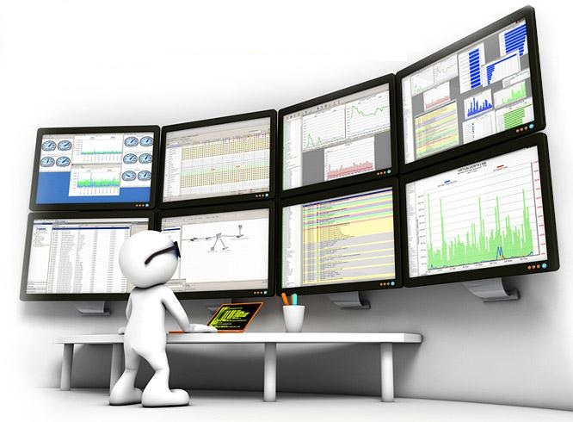
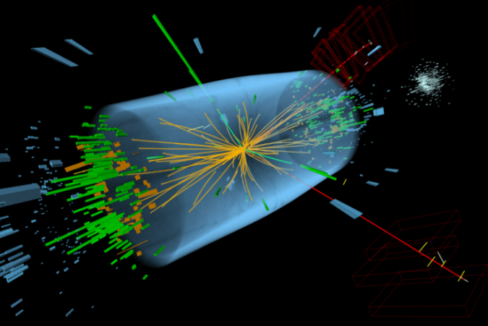
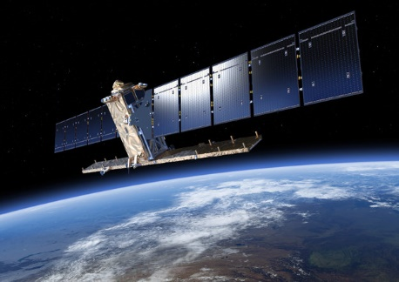
Massive Streams
Network Monitoring
  High-speed links
  Low space (and CPU)
  Applications: anomaly detection, network billing, …
Scientific Data Generation
  Satellite Observation
    Sentinel satellite only: 4TB/day
  CERN
    LHCb experiment: 4TB/s
Databases, Medical Data, Financial Data, …
Notes:
In fact, many of these (massive) data sets take a form of a data stream.
Network Monitoring..
Applications in Scientific Data

Slide 3
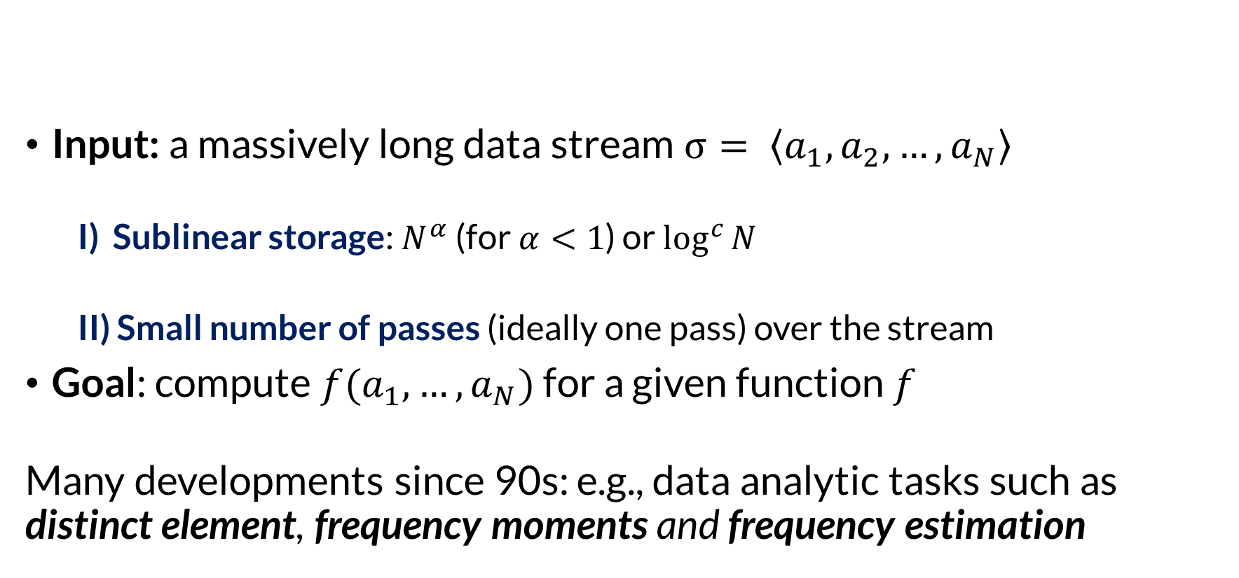
Streaming Model
Available memory is much smaller than the size of the input stream
Input: a massively long data stream $σ= \left\langle a_{1},a_{2},…,a_{N}\right\rangle$
  I) Sublinear storage: $N^{α}$ (for $α<1$) or $\log^{c}{N}$
  II) Small number of passes (ideally one pass) over the stream
Goal: compute $f(a_{1},…,a_{N})$ for a given function $f$
Many developments since 90s: e.g., data analytic tasks such as distinct element, frequency moments and frequency estimation
Notes:
This led to streaming model of computation

Slide 4
Frequency Estimation Problem
8, 1, 7, 4, 6, 4, 10, 4, 4, 6, 8, 7, 5, 4, 2, 5, 6, 3, 9, 2
Fundamental subroutine in Data Analysis
Applications in
    Computational Biology, NLP, Network Measurements, Database Optimization, …
Hashing-based approaches
  E.g., Count-Min [Cormode&Muthukrishnan’03] (also [Estan&Varghese’02] and [Fang et al.’98])
  and Count-Sketch [Charikar,Chen,Farach-Colton’04]

Slide 5
Learning-Based Approaches
Augment classical algorithms for frequency estimation s.t.
  Better performance when the input has nice patterns
    “Via Machine Learning (mostly DL) based approaches”
  Provide worst-case guarantees
      (Ideally) “no matter how the ML-based module performs”

Slide 6
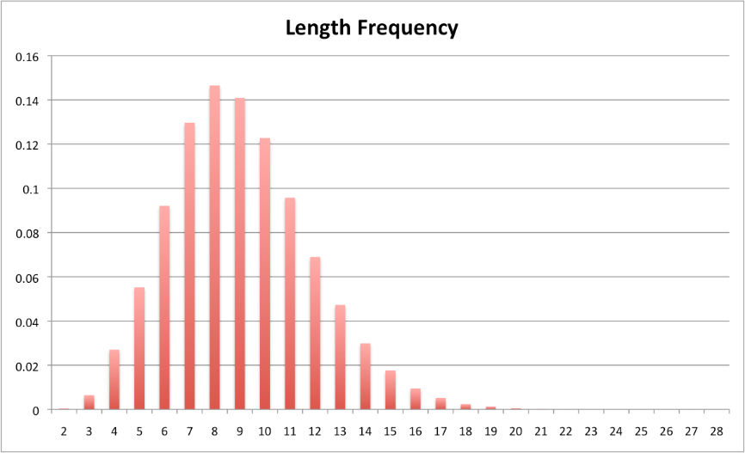
Why Learning Can Help
“Structure” in the data
  Word (related) Data
  E.g., it is known that shorter words tend to be used more frequently
  Network Data
  Some domains (e.g., ttic.edu)
  are more popular

Slide 7

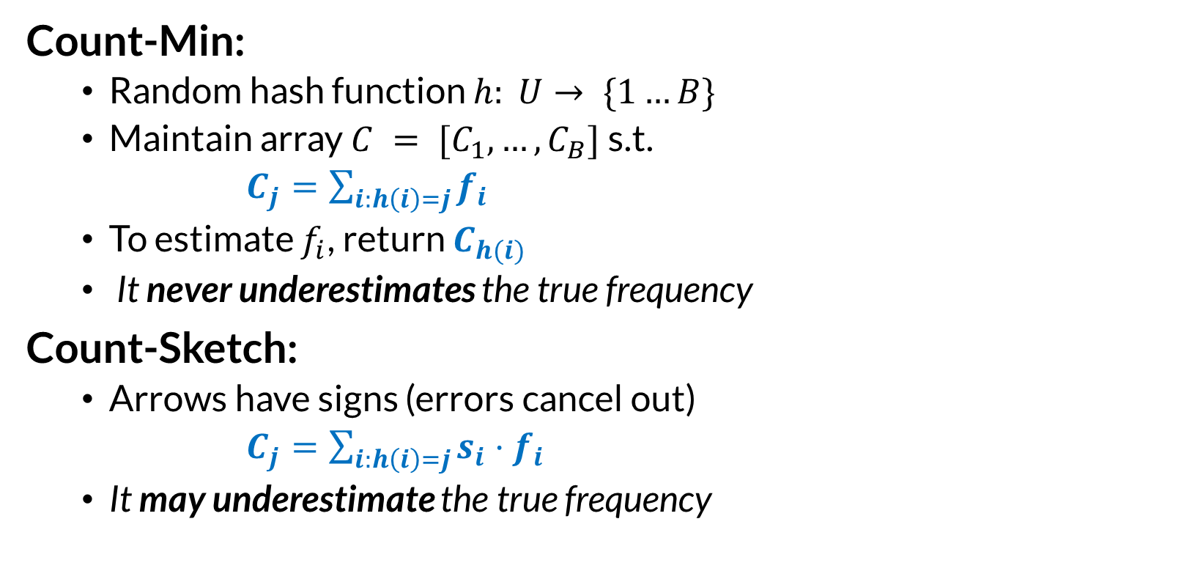

Sketches for Frequency Estimation
Count-Min:
  Random hash function $h: U→ \{1…B\}$
  Maintain array $C = [C_{1},…,C_{B}]$ s.t.
  $C_{j}=\sum_{i:h\left(i\right)=j}{f_{i}}$
  To estimate $f_{i}$, return $C_{h(i)}$
  It never underestimates the true frequency
Count-Sketch:
  Arrows have signs (errors cancel out)
  $C_{j}=\sum_{i:h\left(i\right)=j}{s_{i}⋅f_{i}}$
  It may underestimate the true frequency
$f_{i}$
${\tilde{f}}_{i}$

Slide 8
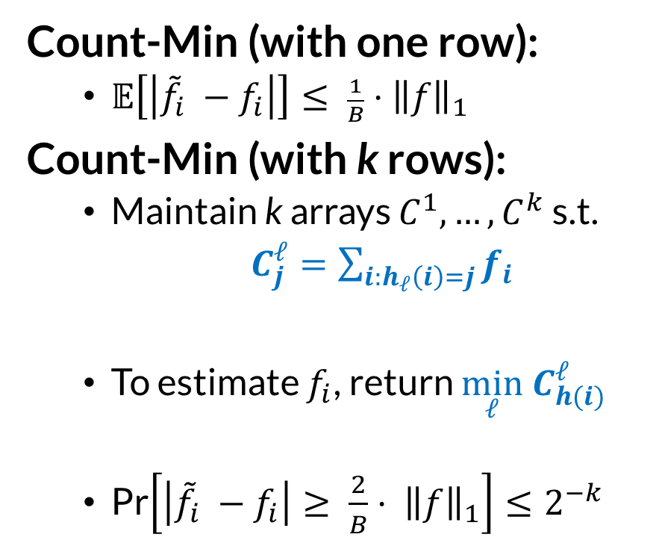
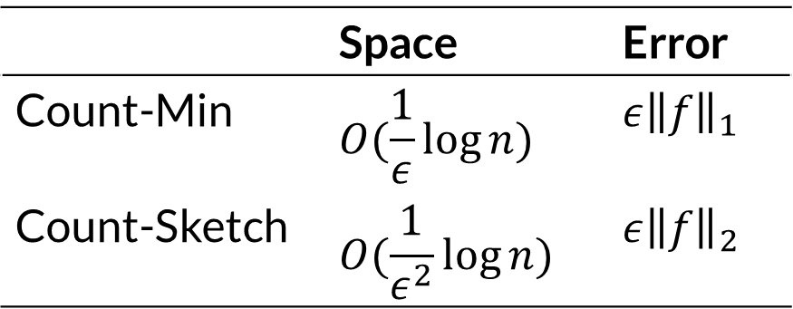




Sketches for Frequency Estimation (contd.)
Count-Min (with one row):
  $\text{𝔼}\left[\left|{\tilde{f}}_{i} −f_{i}\right|\right]≤ \frac{1}{B}⋅{\left\|f\right\|}_{1}$
Count-Min (with k rows):
  Maintain k arrays $C^{1},…,C^{k}$ s.t.
  $C_{j}^{ℓ}=\sum_{i:h_{ℓ}\left(i\right)=j}{f_{i}}$
  To estimate $f_{i}$, return $\min_{ℓ} C_{h(i)}^{ℓ}$
  Pr$\left[\left|{\tilde{f}}_{i} −f_{i}\right|≥ \frac{2}{B}⋅ {\left\|f\right\|}_{1}\right]≤2^{−k}$
$f_{i}$
$$C^{1}$$
$$C^{2}$$
$$C^{3}$$
 | Space | Error
Count-Min | $$O(\frac{1}{ε}\log{n})$$ | $$ε{\left\|f\right\|}_{1}$$
Count-Sketch | $$O(\frac{1}{ε^{2}}\log{n})$$ | $$ε{\left\|f\right\|}_{2}$$

Slide 9
Source of Error?
Avoid Collisions
with Heavy (i.e. frequent) Items

Slide 10

Learning-based Frequency Estimation
Not Heavy
Sketching Alg (e.g. CM)
Train an oracle to detect “heavy” elements
Treat heavy elements differently
Next in the stream
Learned Oracle
…8, 1, 7, 4, 6, 4, 10, 4, 4, 6,
8, 7, 5, 4, 2, 5, 6, 3, 9, 2, …
Unique Bucket
Heavy
Notes:
Query distribution is proportional to the frequency of items

Slide 11
Empirical Evaluation
Data sets:
  Network traffic from CAIDA data set
    A backbone link of a Tier1 ISP between Chicago and Seattle in 2016
    One hour of traffic; 30 million packets per minute
    Used the first 7 minutes for training
    Remaining minutes for validation/testing
  AOL query log dataset:
    21 million search queries collected from 650k users over 90 days
    Used first 5 days for training
    Remaining minutes for validation/testing
Oracle: Recurrent Neural Network
  CAIDA: 64 units
  AOL: 256 units
Almost Zipfian Distribution

Slide 12

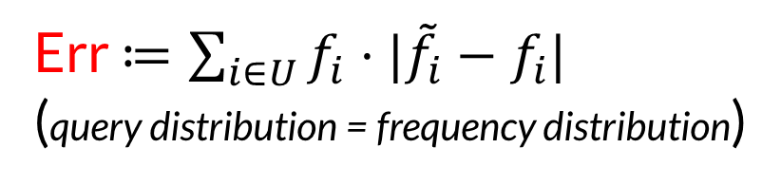
Theoretical Results
Zipfian Distribution ($f_{i}∝1/i$)
Err $≔\sum_{i∈U}{f_{i}⋅|{\tilde{f}}_{i}−f_{i}|}$
(query distribution = frequency distribution)

Slide 13



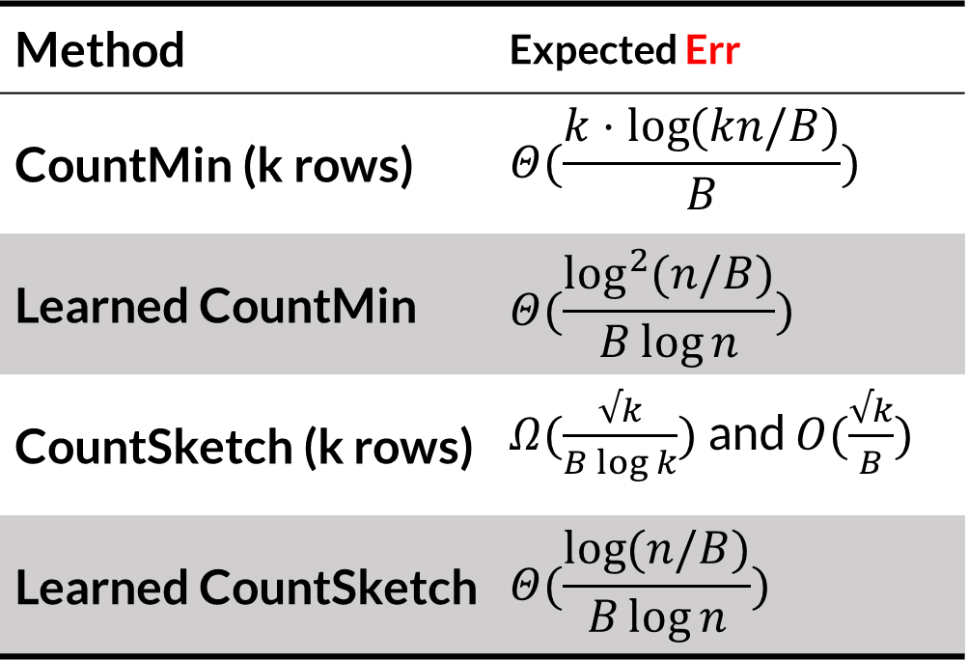
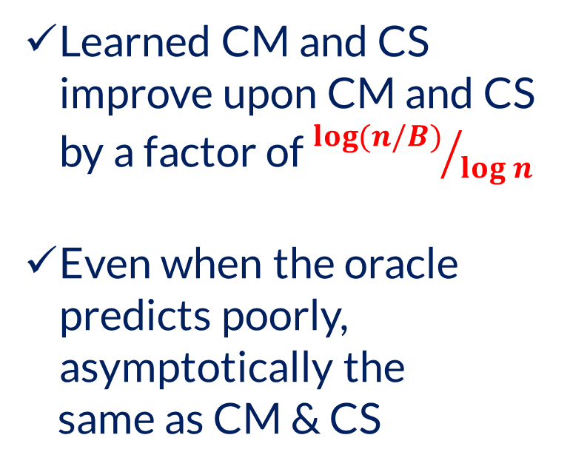
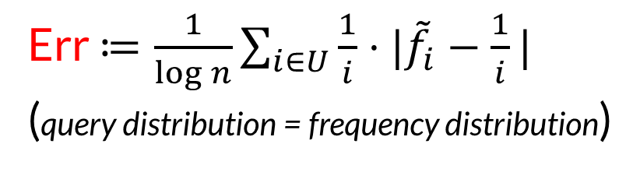
Theoretical Results
Zipfian Distribution ($f_{i}∝1/i$)
Err $≔\frac{1}{\log{n}}\sum_{i∈U}{\frac{1}{i}⋅|{\tilde{f}}_{i}−\frac{1}{i}|}$
(query distribution = frequency distribution)
n: #items with non-zero frequency
B: amount of available space in words
Method | Expected Err
CountMin (k rows) | $$Θ(\frac{k⋅\log{(kn/B)}}{B})$$
Learned CountMin | $$Θ(\frac{\log^{2}{(n/B)}}{B\log{n}})$$
CountSketch (k rows) | $Ω(\frac{√k}{B\log{k}})$ and $O(\frac{√k}{B})$
Learned CountSketch | $$Θ(\frac{\log{(n/B)}}{B\log{n}})$$
Learned CM and CS improve upon CM and CS by a factor of ${\log{(n/B)}}/{\log{n}}$
Even when the oracle predicts poorly, asymptotically the
same as CM & CS
$$\frac{\log\left(\frac{n}{B}\right)}{\log{n}}$$
$$\frac{\log\left(\frac{n}{B}\right)}{\log{n}}$$

Slide 14
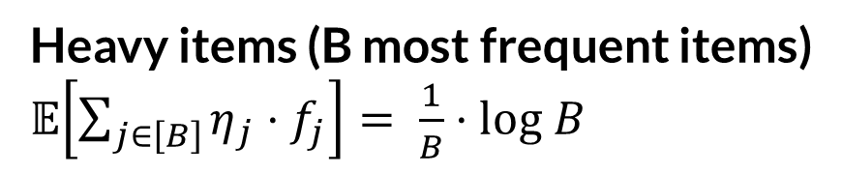
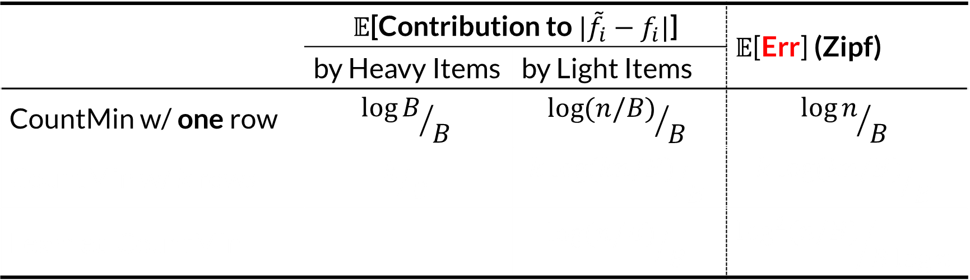
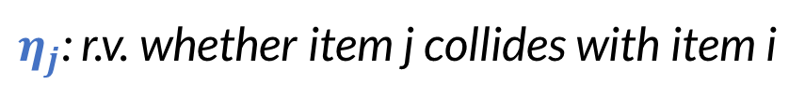
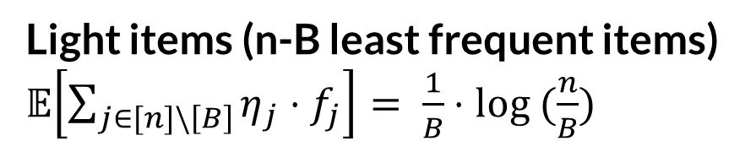
How “Heavyhitters” Oracle helps
 | 𝔼[Contribution to ${|\tilde{f}}_{i}−f_{i}|$] |  | 𝔼[Err] (Zipf)
 | by Heavy Items | by Light Items
CountMin w/ one row | $${\log{B}}/B$$ | $${\log{(n/B)}}/B$$ | $${\log{n}}/B$$
CountMin w/ k rows | $$k/B$$ | $${k log{(kn/B)}}/B$$ | $${k log{(kn/B)}}/B$$
Learned CountMin |  | $${\log{(n/B)}}/B$$ | $${\log^{2}{(n/B)}}/{B\log{n}}$$
B: amount of available space in words
$η_{j}$: r.v. whether item j collides with item i
Heavy items (B most frequent items)
𝔼$\left[\sum_{j∈\left[B\right]}{η_{j}}⋅f_{j}\right]= \frac{1}{B}⋅log B$
Light items (n-B least frequent items)
𝔼$\left[\sum_{j∈[n]\backslash \left[B\right]}{η_{j}}⋅f_{j}\right]= \frac{1}{B}⋅log (\frac{n}{B})$

Slide 15
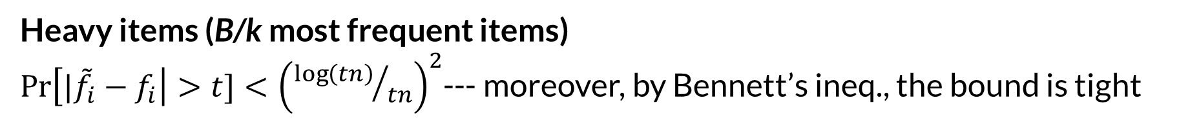
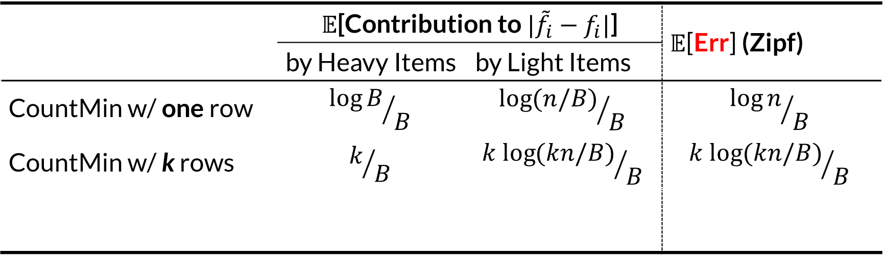
How “Heavyhitters” Oracle helps
 | 𝔼[Contribution to ${|\tilde{f}}_{i}−f_{i}|$] |  | 𝔼[Err] (Zipf)
 | by Heavy Items | by Light Items
CountMin w/ one row | $${\log{B}}/B$$ | $${\log{(n/B)}}/B$$ | $${\log{n}}/B$$
CountMin w/ k rows | $$k/B$$ | $${k log{(kn/B)}}/B$$ | $${k log{(kn/B)}}/B$$
Learned CountMin |  | $${\log{(n/B)}}/B$$ | $${\log^{2}{(n/B)}}/{B\log{n}}$$
B: amount of available space in words
Heavy items (B/k most frequent items)
$\operatorname{Pr}\left[{|\tilde{f}}_{i}−f_{i}\right|>t]<{\left({\log\left(tn\right)}/{tn}\right)}^{2}$--- moreover, by Bennett’s ineq., the bound is tight

Slide 16
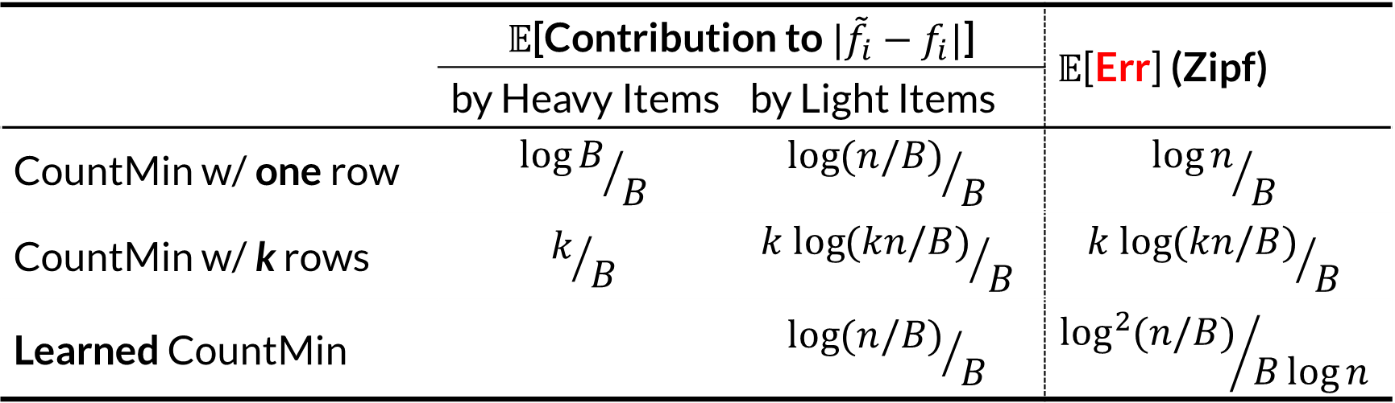
How “Heavyhitters” Oracle helps
 | 𝔼[Contribution to ${|\tilde{f}}_{i}−f_{i}|$] |  | 𝔼[Err] (Zipf)
 | by Heavy Items | by Light Items
CountMin w/ one row | $${\log{B}}/B$$ | $${\log{(n/B)}}/B$$ | $${\log{n}}/B$$
CountMin w/ k rows | $$k/B$$ | $${k log{(kn/B)}}/B$$ | $${k log{(kn/B)}}/B$$
Learned CountMin |  | $${\log{(n/B)}}/B$$ | $${\log^{2}{(n/B)}}/{B\log{n}}$$
B: amount of available space in words
Heavy items have no contribution in the estimation error of other items
The estimation errors of heavy items are zero

Slide 17
How “Heavyhitters” Oracle helps
 | 𝔼[Contribution to ${|\tilde{f}}_{i}−f_{i}|$] |  | 𝔼[Err] (Zipf)
 | by Heavy Items | by Light Items
CountMin w/ one row | $${\log{B}}/B$$ | $${\log{(n/B)}}/B$$ | $${\log{n}}/B$$
CountMin w/ k rows | $$k/B$$ | $${k log{(kn/B)}}/B$$ | $${k log{(kn/B)}}/B$$
Learned CountMin |  | $${\log{(n/B)}}/B$$ | $${\log^{2}{(n/B)}}/{B\log{n}}$$
B: amount of available space in words
Theorem. Learned CountMin is an asymptotically optimal CountMin.

Slide 18
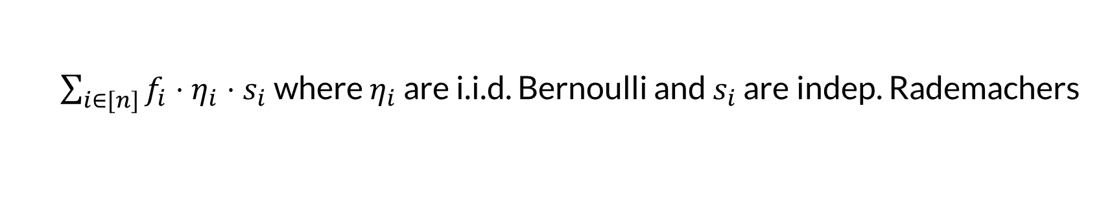
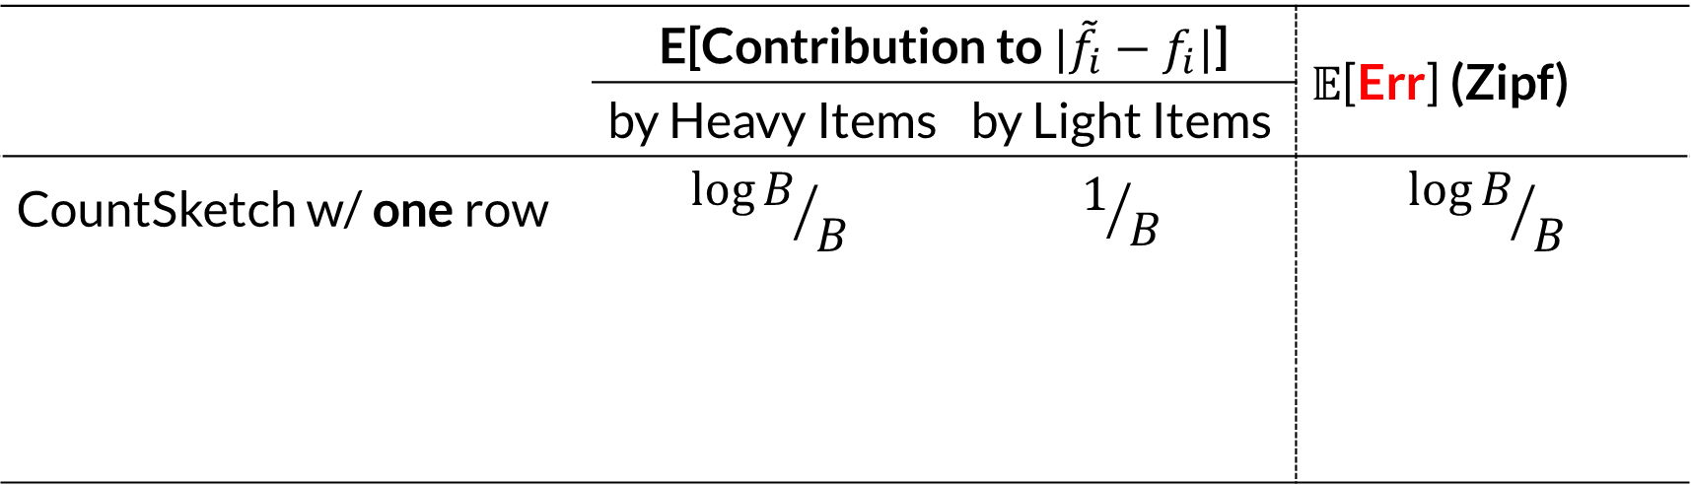
How “Heavyhitters” Oracle helps (contd.)
 | E[Contribution to ${|\tilde{f}}_{i}−f_{i}|$] |  | 𝔼[Err] (Zipf)
 | by Heavy Items | by Light Items
CountSketch w/ one row | $${\log{B}}/B$$ | $$1/B$$ | $${\log{B}}/B$$
CountSketch w/ k rows | $${√k}/B$$ | $$1/B$$ | $${√k}/B$$
Learned CountSketch |  | $$1/B$$ | $${\log{(n/B)}}/{B\log{n}}$$
$\sum_{i∈[n]}{f_{i}⋅η_{i}⋅s_{i}}$ where $η_{i}$ are i.i.d. Bernoulli and $s_{i}$ are indep. Rademachers
Light items (n-B least frequent items)
By Khintchine inequality

Slide 19
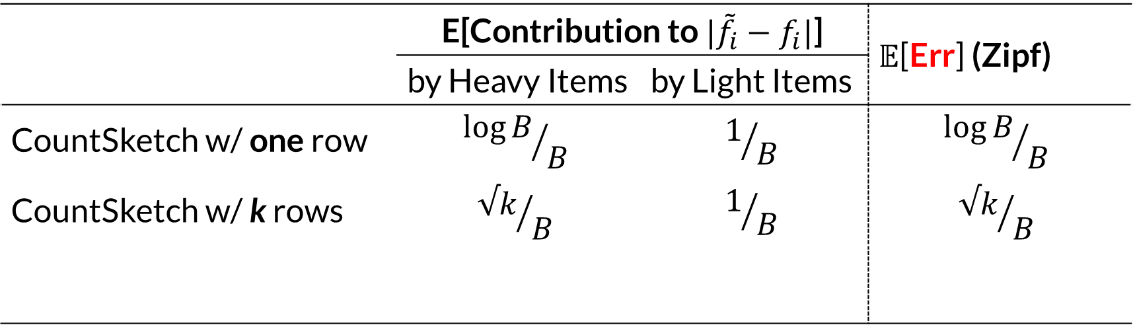
How “Heavyhitters” Oracle helps (contd.)
 | E[Contribution to ${|\tilde{f}}_{i}−f_{i}|$] |  | 𝔼[Err] (Zipf)
 | by Heavy Items | by Light Items
CountSketch w/ one row | $${\log{B}}/B$$ | $$1/B$$ | $${\log{B}}/B$$
CountSketch w/ k rows | $${√k}/B$$ | $$1/B$$ | $${√k}/B$$
Learned CountSketch |  | $$1/B$$ | $${\log{(n/B)}}/{B\log{n}}$$
$\sum_{i∈[n]}{f_{i}⋅η_{i}⋅s_{i}}$ where $η_{i}$ are i.i.d. Bernoulli and $s_{i}$ are indep. Rademachers
Light items (n-B least frequent items)
Littlewood-Offord bound

Slide 20
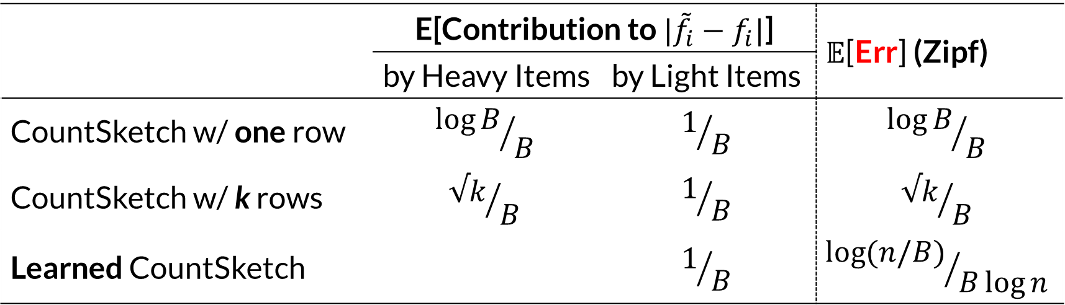
How “Heavyhitters” Oracle helps (contd.)
 | E[Contribution to ${|\tilde{f}}_{i}−f_{i}|$] |  | 𝔼[Err] (Zipf)
 | by Heavy Items | by Light Items
CountSketch w/ one row | $${\log{B}}/B$$ | $$1/B$$ | $${\log{B}}/B$$
CountSketch w/ k rows | $${√k}/B$$ | $$1/B$$ | $${√k}/B$$
Learned CountSketch |  | $$1/B$$ | $${\log{(n/B)}}/{B\log{n}}$$
$\sum_{i∈[n]}{f_{i}⋅η_{i}⋅s_{i}}$ where $η_{i}$ are i.i.d. Bernoulli and $s_{i}$ are indep. Rademachers
Heavy items have no contribution in the estimation error of other items
The estimation errors of heavy items are zero

Slide 21
Empirical Evaluation
Internet Traffic Estimation (20th minute)
Search Query Estimation (50th day)
Table lookup: oracle stores heavy hitters from the training set
Learning augmented (Nnet): our algorithm
Ideal: with a perfect heavyhitter oracle
Space amortized over multiple minutes (CAIDA) or days (AOL)

Slide 22
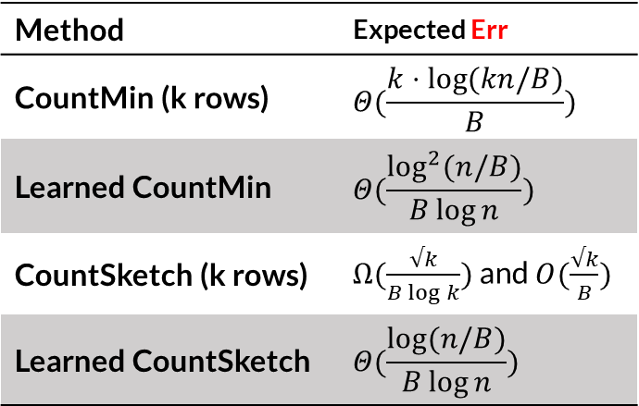
Method | Expected Err
CountMin (k rows) | $$Θ(\frac{k⋅\log{(kn/B)}}{B})$$
Learned CountMin | $$Θ(\frac{\log^{2}{(n/B)}}{B\log{n}})$$
CountSketch (k rows) | $Ω(\frac{√k}{B\log{k}})$ and $O(\frac{√k}{B})$
Learned CountSketch | $$Θ(\frac{\log{(n/B)}}{B\log{n}})$$
Not Heavy
Sketching Alg (e.g. CM)
Next in the stream
Learned Oracle
…8, 1, 7, 4, 6, 4, 10, 4, 4, 6,
8, 7, 5, 4, 2, 5, 6, 3, 9, 2, …
Unique Bucket
Heavy
Question. Learning-Based (Streaming) Algorithms?
  low-rank approximation (with Indyk and Yuan)
Thank You!

