Slide 1
Learning to Plan via Neural Exploration-Exploitation Trees
Le Song
Georgia Tech
Joint work with Binghong Chen and Bo Dai

Slide 2
Path Planning Problem
Obstacle
Free space $𝒮_{free}$
Start $s_{0}∈𝒮_{free}$
Collision-free path $Ξ≔\left\{ξ\left(⋅\right):\left[0,1\right]→𝒮_{free}\right\}$
Goal region $𝒮_{goal}∈𝒮_{free}$
Cost function $c\left(⋅\right):Ξ→ℝ$
Optimal path planning as an optimization problem:
$$ξ^{∗}={\text{argmin}}_{ξ∈Ξ} c\left(ξ\right), \text{s}\text{.}\text{t}\text{. }ξ\left(0\right)=s_{0}, ξ\left(1\right)∈𝒮_{goal}$$

Slide 3
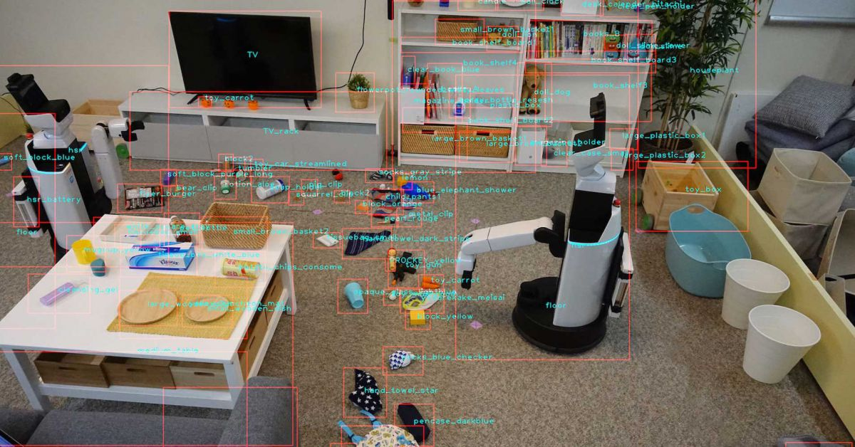
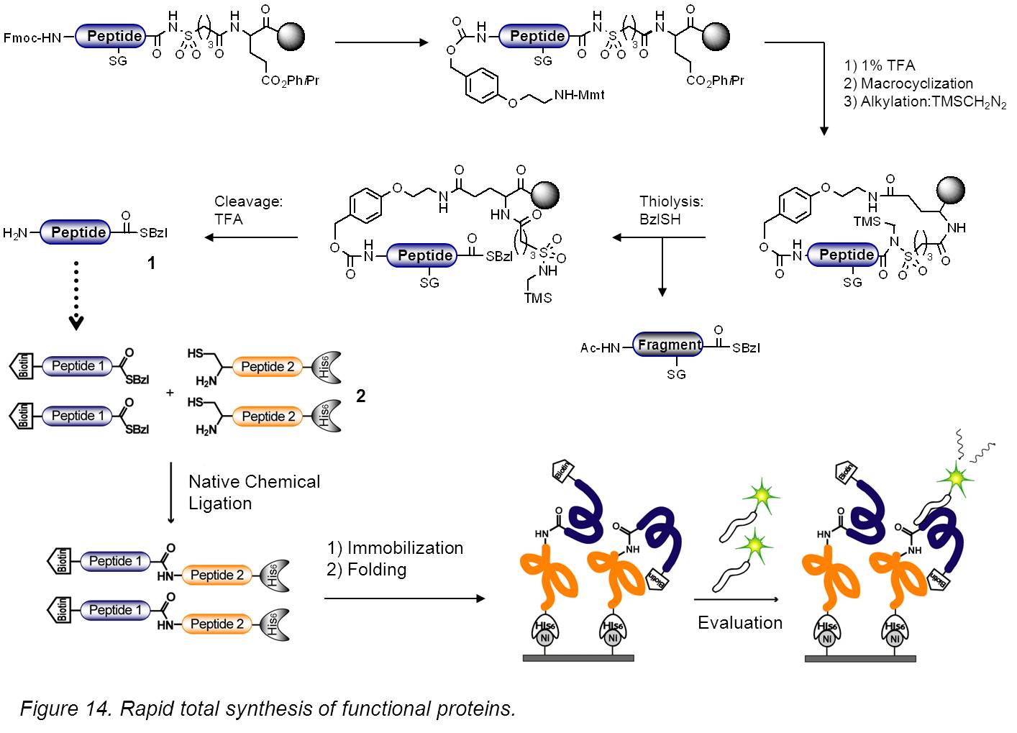
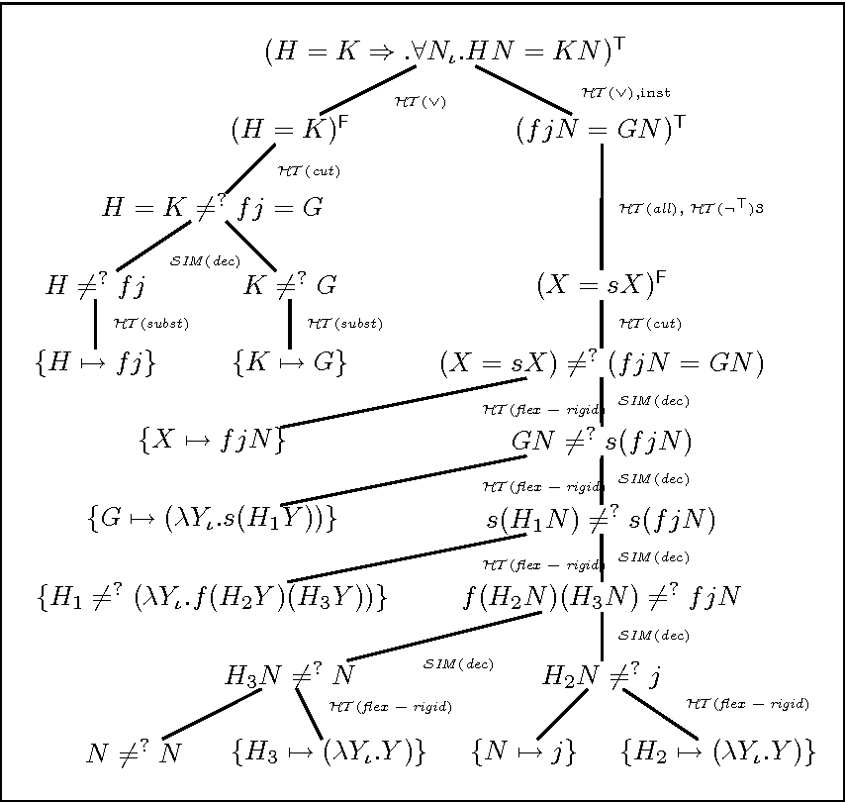
Applications
Robot Planning
Chemical Synthesis
Theorem Proving

Slide 4
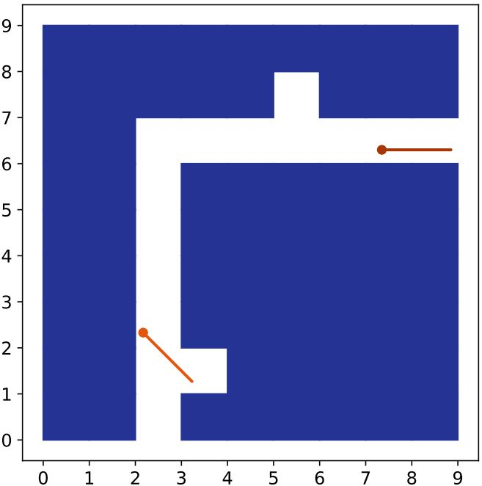
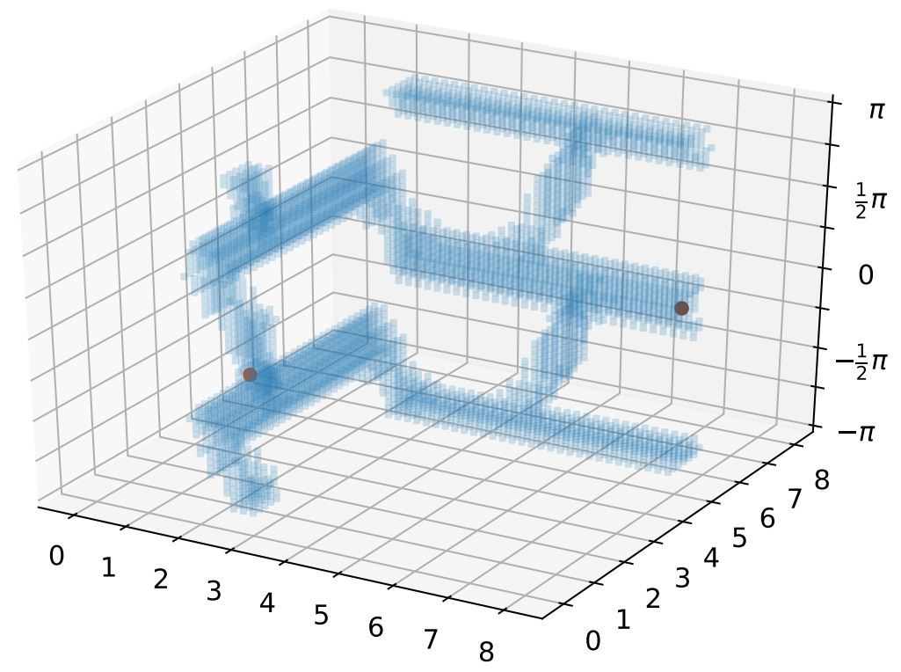
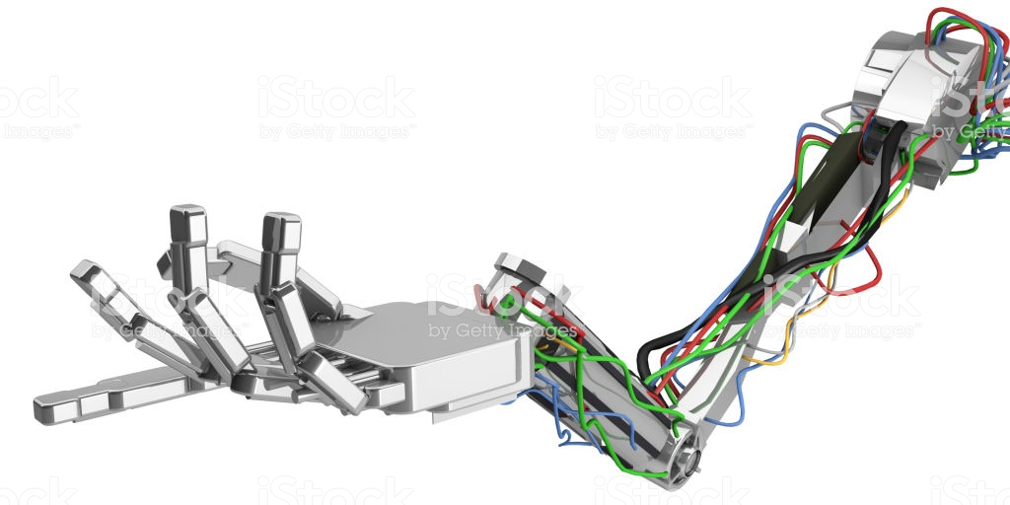
Challenges in High Dimensions
Configuration space high dimensional, not explicit, query only
Nonparametric form: $ξ≔\left\{\left[s_{0},s_{1}\right], \left[s_{1},s_{2}\right],…, \left[s_{T−1}, s_{T}\right]\right\}$
$c\left(ξ\right)≔\sum_{i=1}^{T}{c(\left[s_{i−1}, s_{i}\right])}$
$$y$$
Obstacle
Free space
$$θ$$
Goal
Start
$$y$$
$$x$$
$$x$$
Workspace View
Configuration Space View
Notes:
Free space doesn’t have an easy-to-optimize parametric form.

Slide 5
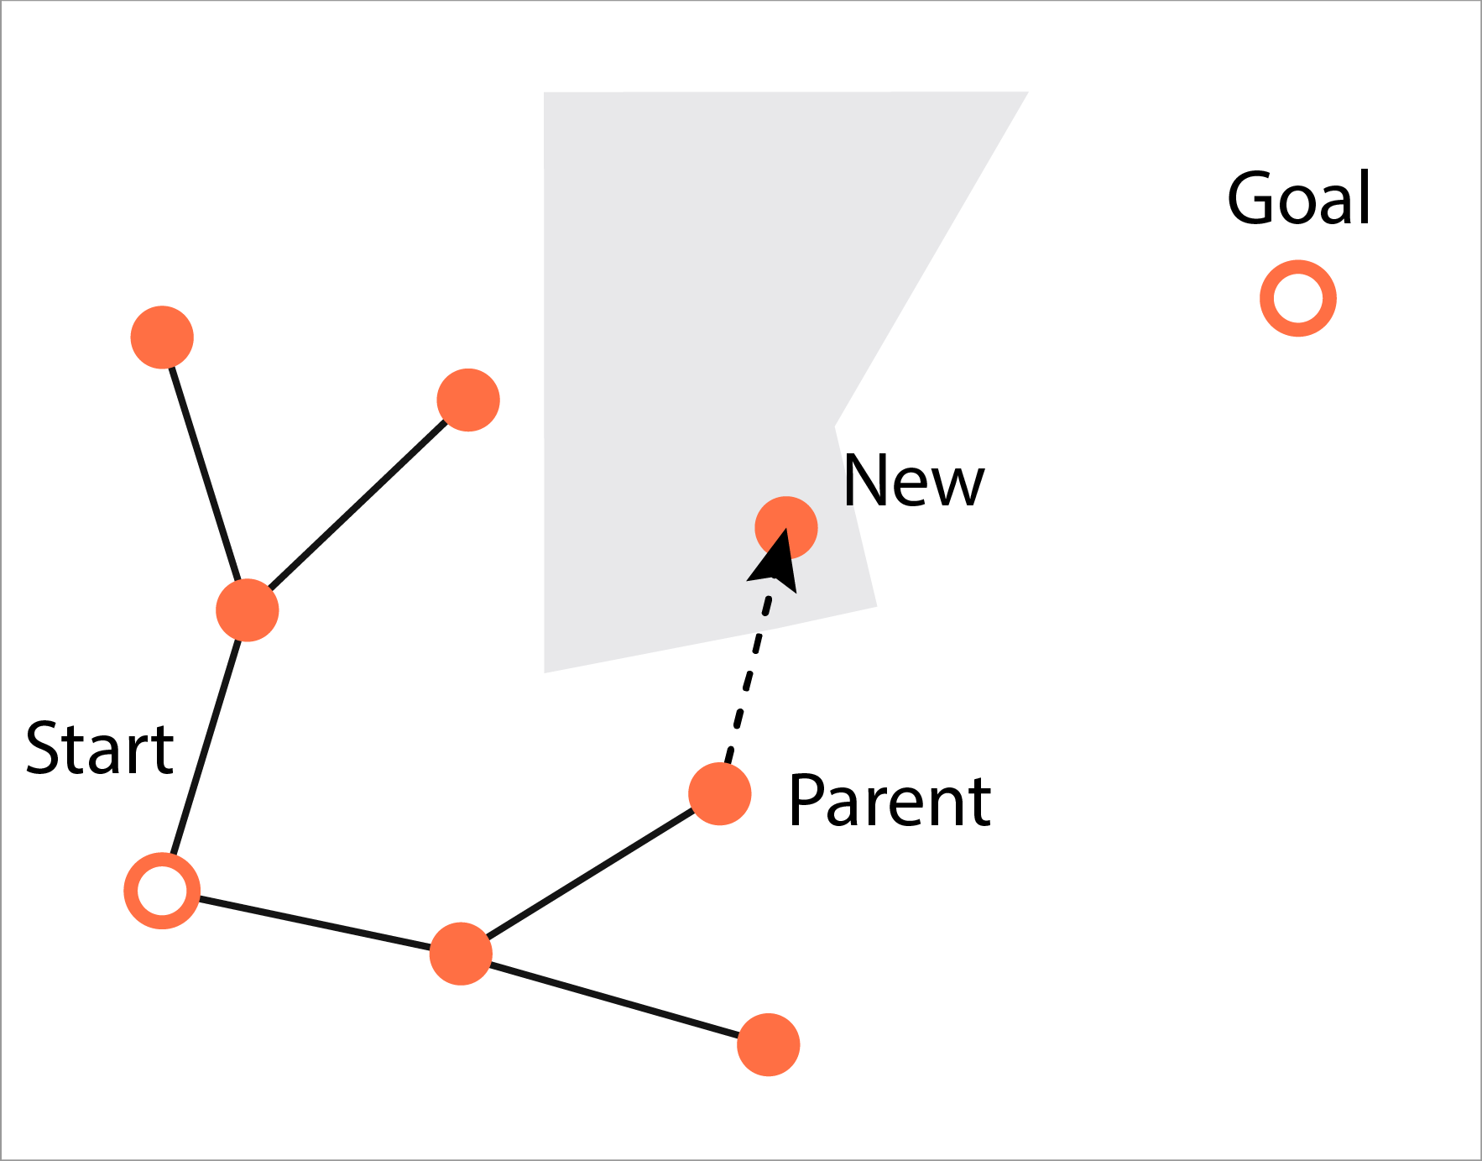
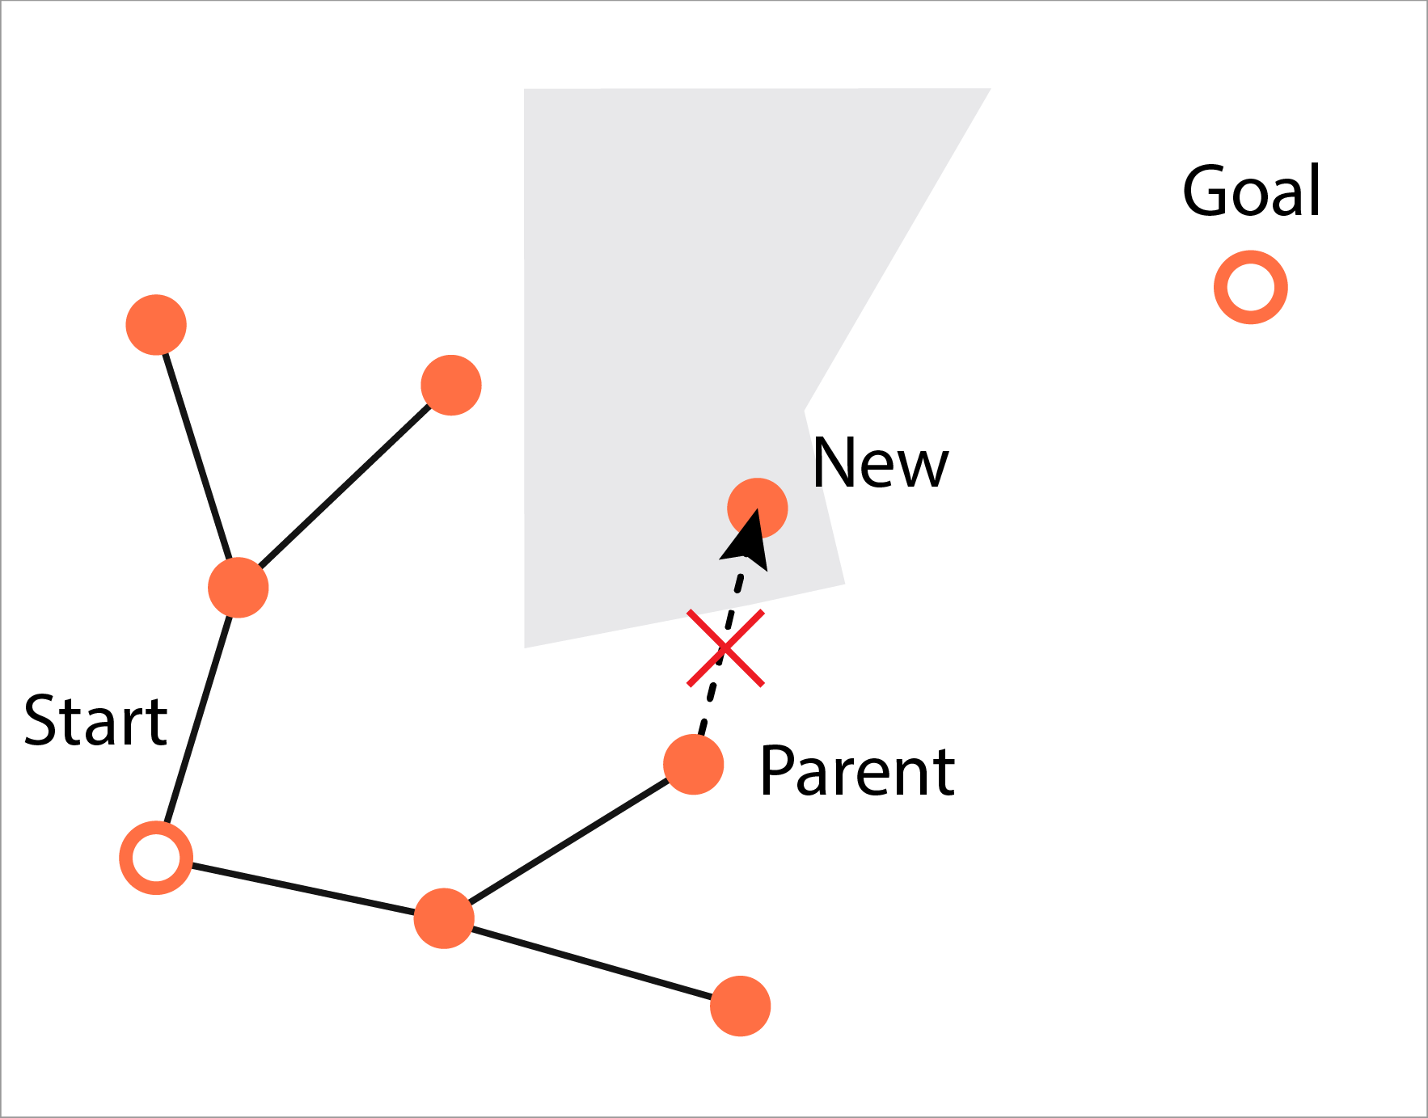
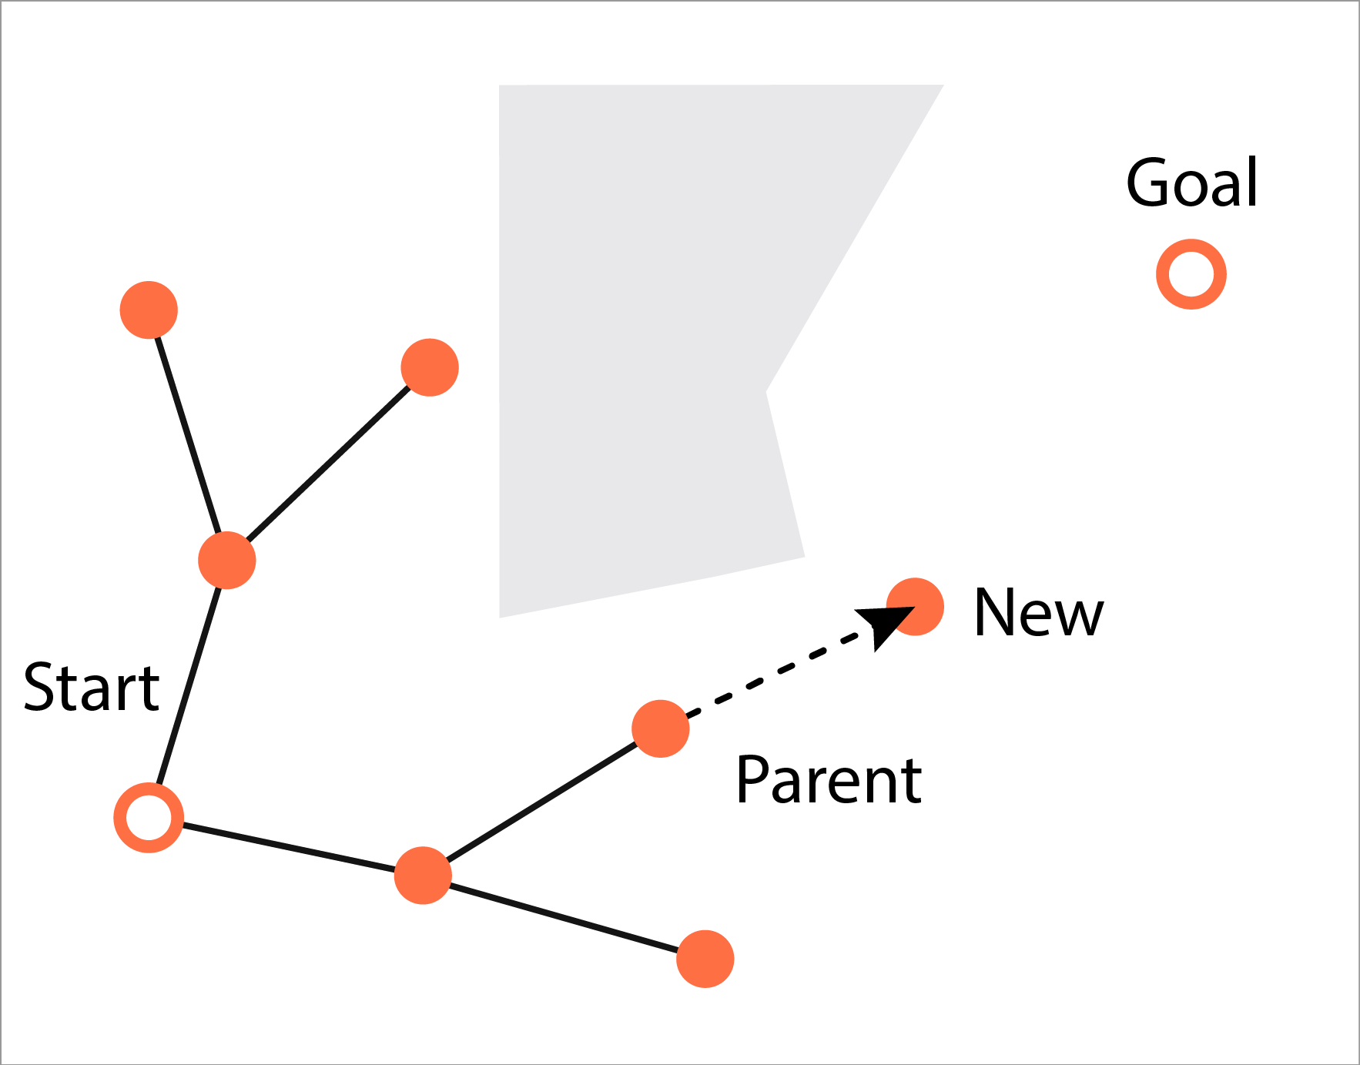
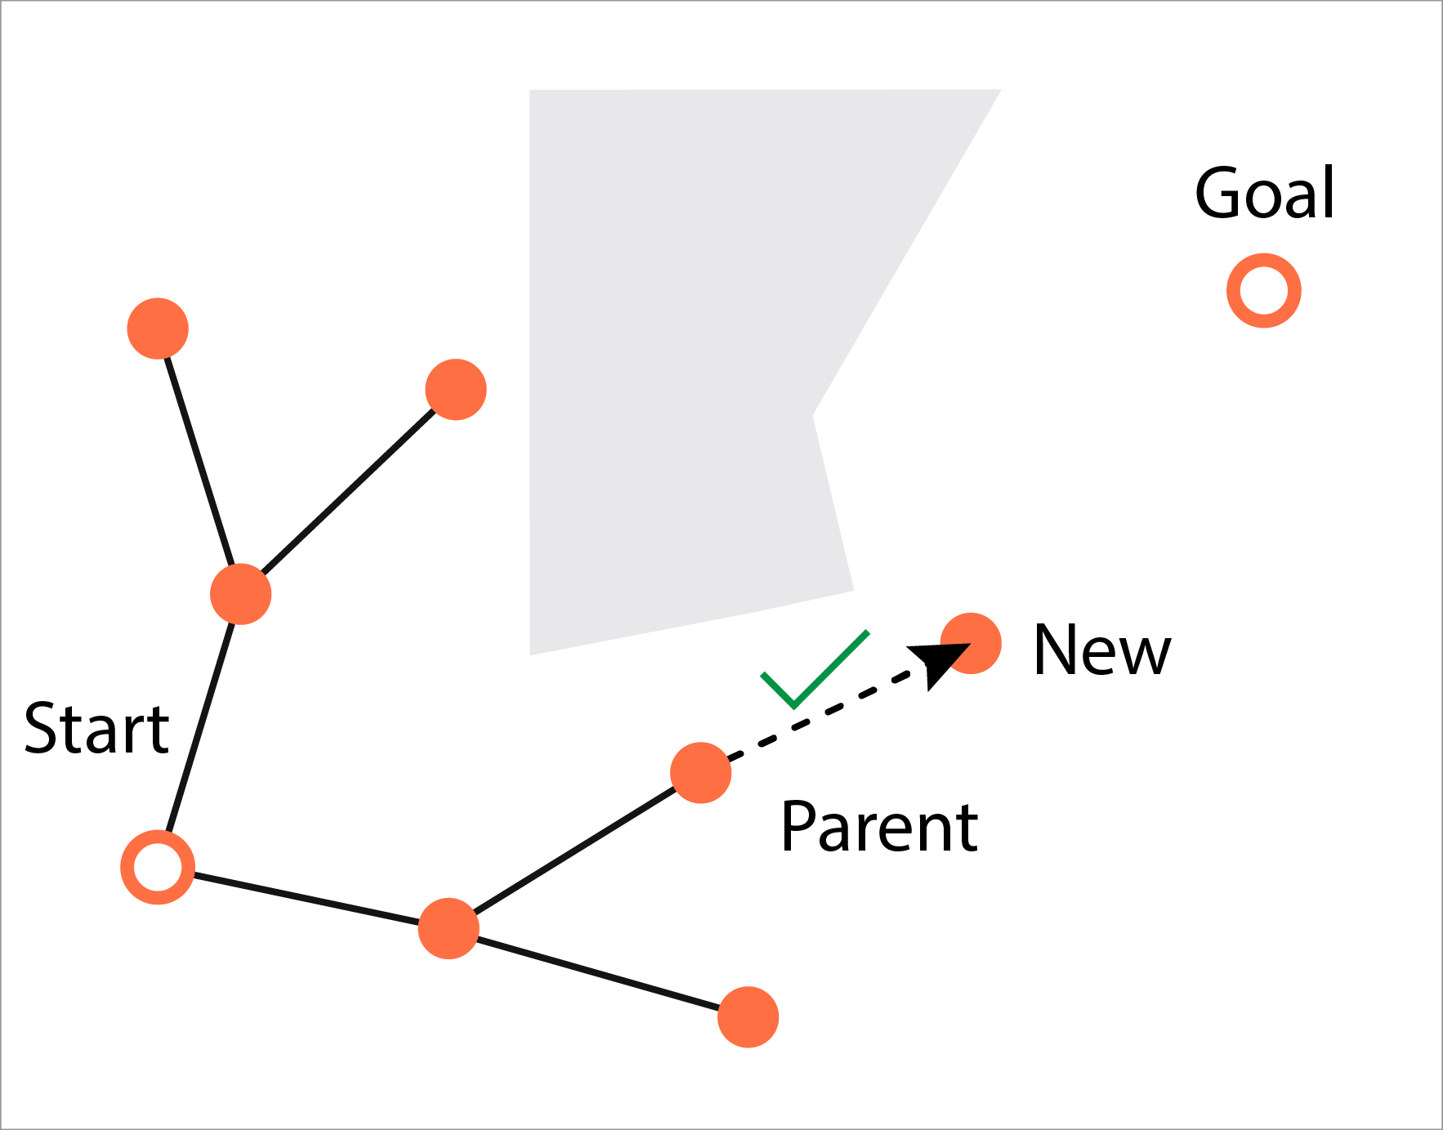
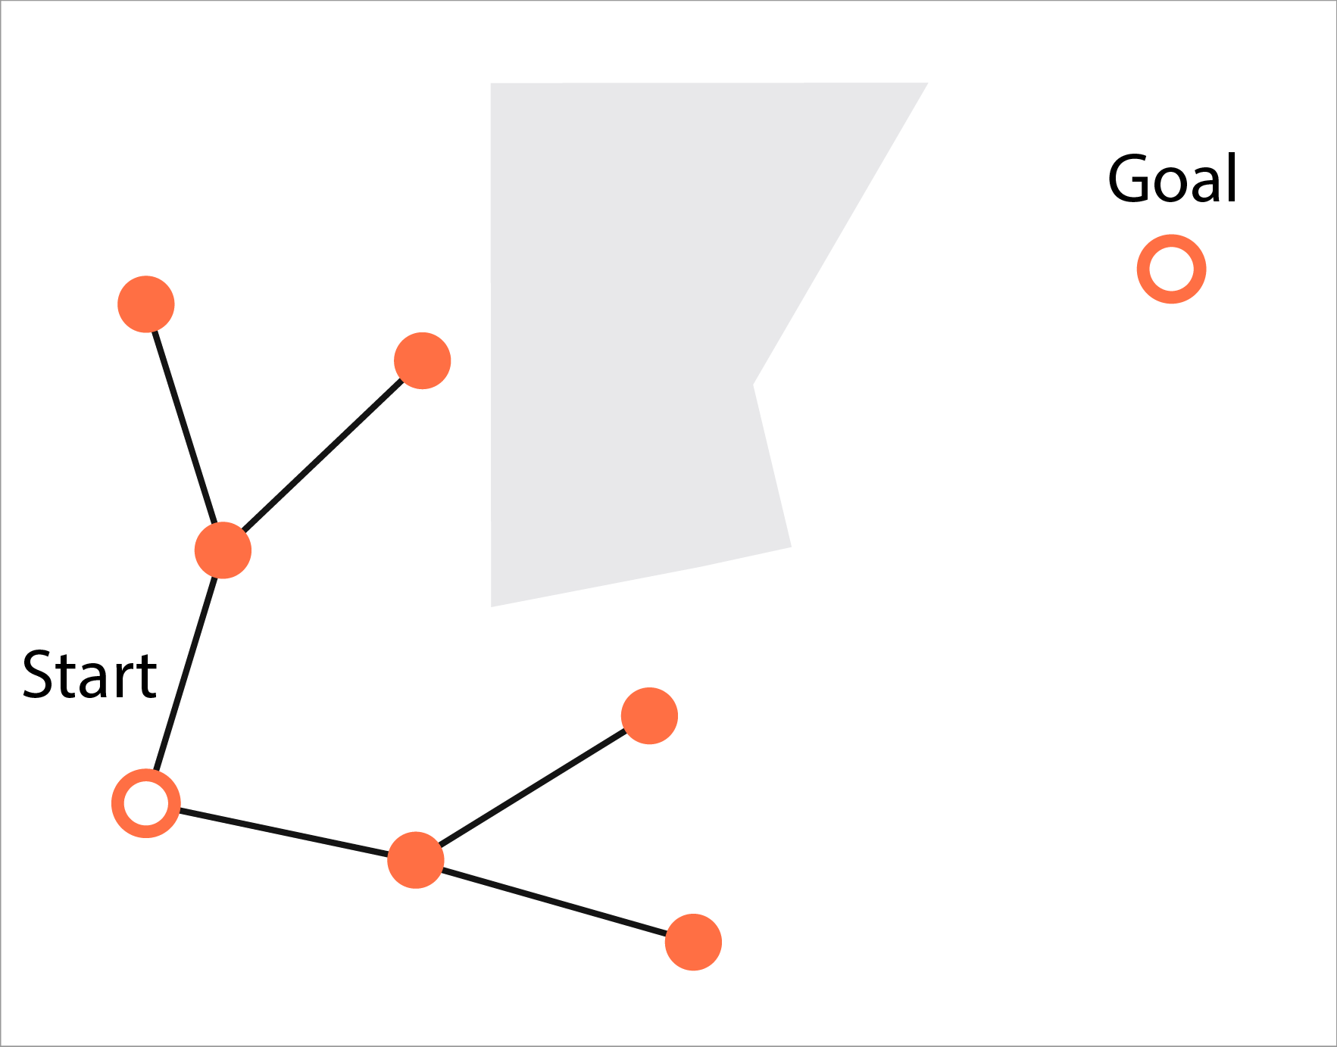
Tree-based Sampling Algorithm (TSA)
Repeat
Sample a point $s_{new}$;
Find the nearest point $s_{parent}$ in current tree $𝒯$;
Collision check;
If no collision, add $s_{new}$ to $𝒯$;
Until $𝒯$ reaches $𝒮_{goal}$.

Slide 6
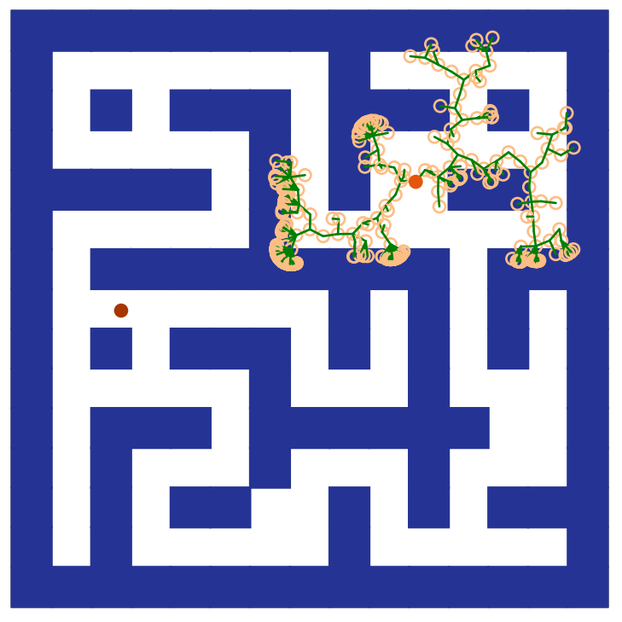
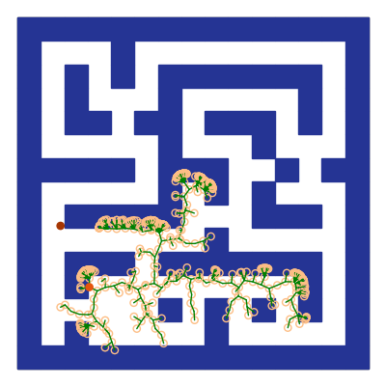
Limitation: Sample Inefficient
Ineffective samples from uniform distribution:
Over 80% of the samples collide with the obstacles.
Much higher probability of sampling in a open space than in a narrow passage.
Notes:
The performance of TSA heavily depends on the quality of the samples.
However, TSA typically samples from uniform random distributions, which is very uninformative and inefficient, especially in high dimensions.
Need a more effective sampler to bias search in promising directions.

Slide 7
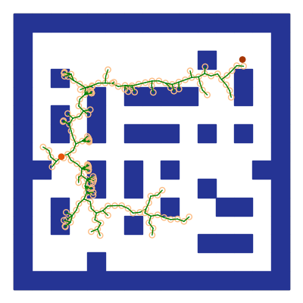
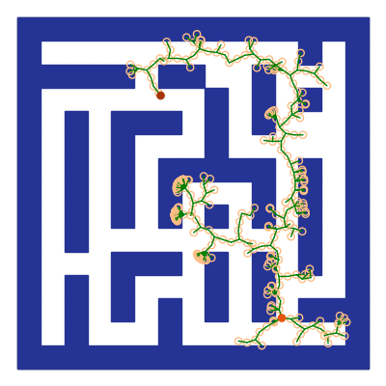
Limitation: Ignore Global Pattern
Similar global planning patterns, eg. first go vertically, then go horizontally.
Notes:
However, TSA does not improve itself after seeing/solving many similar problems.
Need to exploit past planning experience.

Slide 8
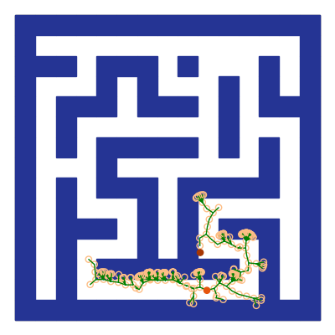
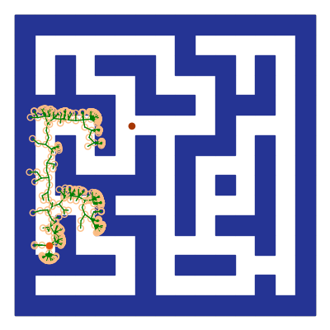
Limitation: Ignore Local Pattern
Similar local patterns, eg., a U-turn pattern
.
Can we improve by learning?
Notes:
However, TSA does not improve itself after seeing/solving many similar problems.
Need to exploit past planning experience.

Slide 9
Learn to Expand Tree: $(V, π)$
KEY idea:
For selecting $s_{parent}$, learn a value function $V(s|U)$
For selecting $s_{new}$, learn a policy $π\left(s^{′} | s,U\right)$
$$\sim π(⋅|\text{parent})$$
$$={\text{argmax}}_{s}V(s)$$
Learn representation for global and local information (workspace map, start and goal)?
$$\text{TSA}∷\text{Expand}(𝒯,U)$$
$s_{parent}={\text{argmax}}_{s∈𝒯}V\left(s | U\right);$
$s_{new}\sim π\left(⋅ | s_{parent},U\right).$

Slide 10
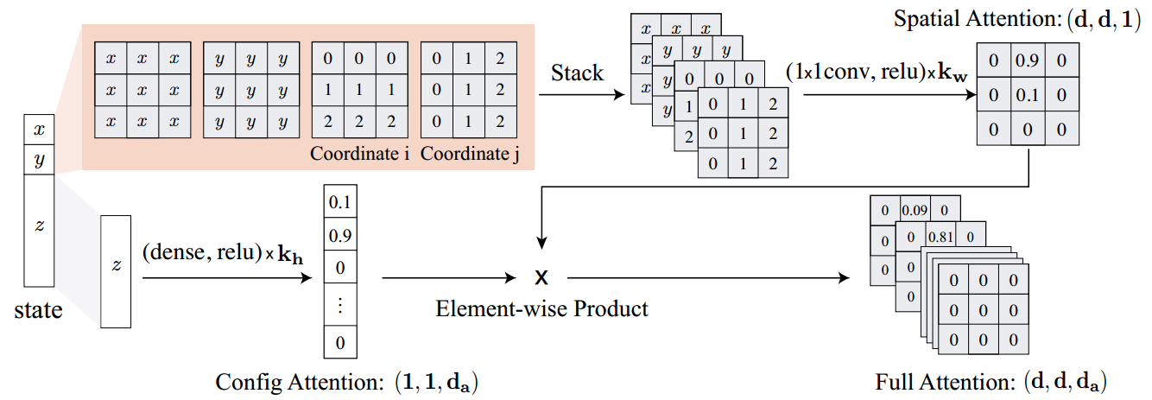
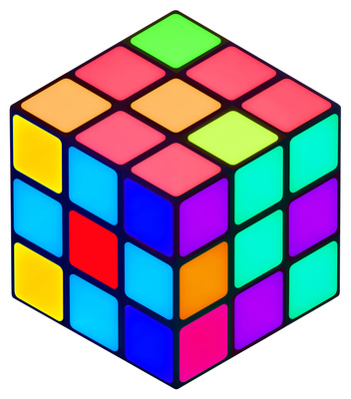
Attention-based State Embedding
Workspace state, i.e. spatial locations
softmax
Attention-based state embedding module. For illustration purpose, assume workspace is 2d and map shape is 3x3.

Slide 11
Attention-based State Embedding
Remaining state, i.e. configurations
softmax
softmax
Attention-based state embedding module. For illustration purpose, assume workspace is 2d and map shape is 3x3.

Slide 12
Attention-based State Embedding
softmax
entries >= 0
sum to 1
outer product
softmax
Attention-based state embedding module. For illustration purpose, assume workspace is 2d and map shape is 3x3.

Slide 13
Value Iteration Network
$$V^{∗}\left(s\right)=\max_{a} c\left(s,a\right)+\sum_{s^{′}}{P\left(s^{′} | s,a\right)}V^{∗}(s^{′})$$
Parametrize as convolution filter
Neuralized value
iteration
Embedded value iteration for parametrizing $π$ and $V$.
Image from Tamar, Aviv, et al. "Value iteration networks." Advances in Neural Information Processing Systems. 2016.

Slide 14
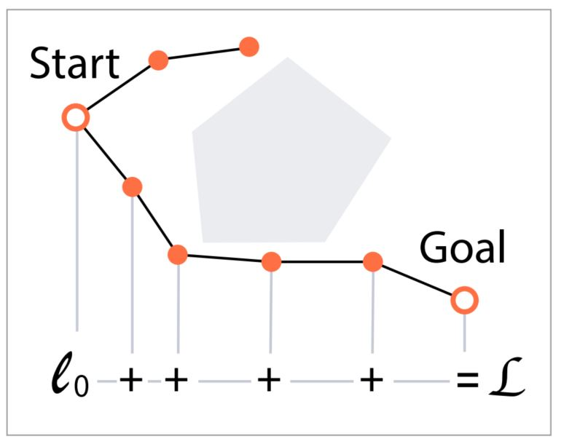
Imitation Learning
Extract the shortest paths from past RRT* plans
Two adjacent points ($s_{j}$, $s_{j+1}$) in a path as state $s_{j}$ and actions $s_{j+1}$,
The value $v_{j}$ for each state $s_{j}$ as the negative cost of the remaining path to the goal,
Minimize
$$\sum_{i=1}^{n}{(−\sum_{j=1}^{m−1}{\log{π\left(s_{j+1}^{i} | s_{j}^{i}\right)}}+\sum_{j=1}^{m}{{\left(V\left(s_{j}^{i}\right)−v_{j}^{i}\right)}^{2}})}$$

Slide 15
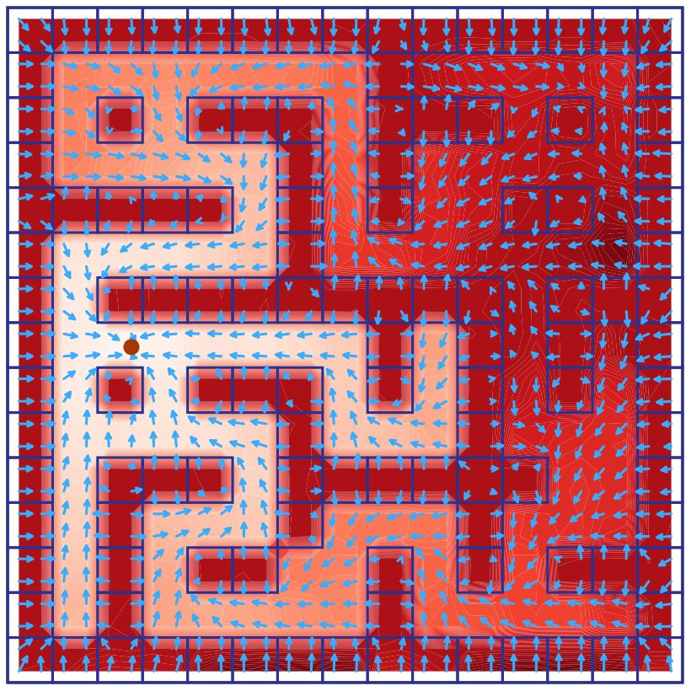
Learned Policy and Value Function
The learned policy is pointing to the goal and avoiding the obstacles.
The learned value (heatmap) decreases as it moves away from the goal.

Slide 16
Search Tree Comparisons (2D)

Slide 17
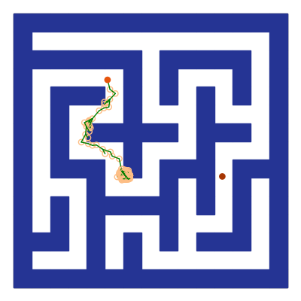
No Backtracking Mechanism
$$\sim π(⋅|\text{parent})$$
$$={\text{argmax}}_{s}V(s)$$
$$\text{TSA}∷\text{Expand}(𝒯,U)$$
$s_{parent}={\text{argmax}}_{s∈𝒯}V\left(s | U\right);$
$s_{new}\sim π\left(⋅ | s_{parent},U\right).$
Learned policy may get you stuck.

Slide 18
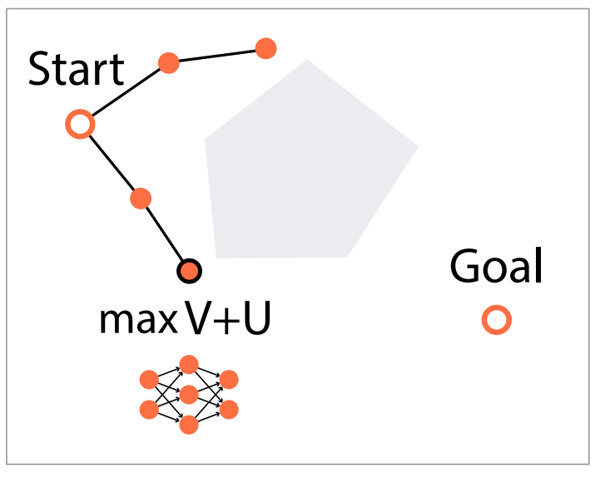
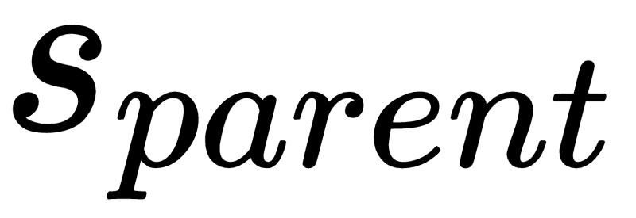
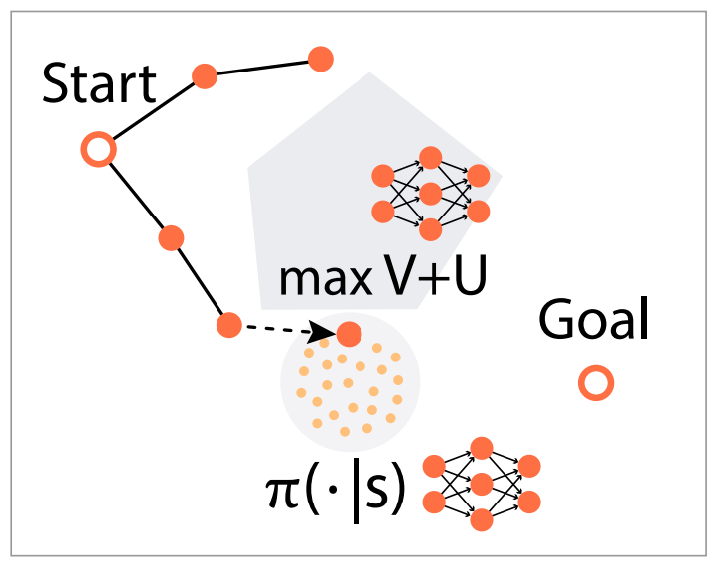
Expand with Exploration-Exploitation
Step 1, select from tree $𝒯$ with:
Step 2, expand in the neighborhood of $s_{parent}$ with:
Step 1
Promote exploration
kernel
smoothed reward
Step 2
kernel
smoothed count
Notes:
Guide progressive expansion
Naively applying UCB is not doable since:
The number of arms for sampling $s_{parent}$ is changing as $𝒯$ grows;
The arms for sampling $s_{new}$ are continuous;
Reward obtained from random roll-out is extremely sparse.

Slide 19
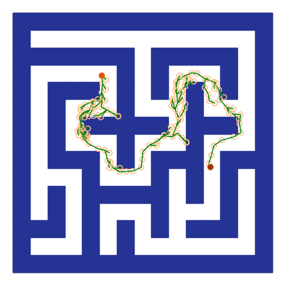
Escape from Bad Region
Stuck at some place where $π$ is making a bad prediction.
Successfully escape from it with guided progressive expansion!

Slide 20
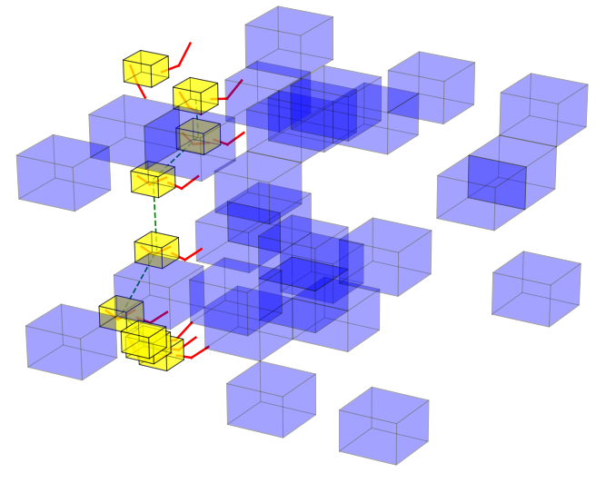
More Experiments
2D workspace; 2D state space
2D workspace; 3D state space
2D workspace; 5D state space
3D workspace; 7D state space

Slide 21
Experimental Settings
2D
( )
3D
distinct maps
(planning problems)
per environment
⨉ 3000
5D
2000 Training (SL/RL/MSIL)
7D
1000 testing

Slide 22
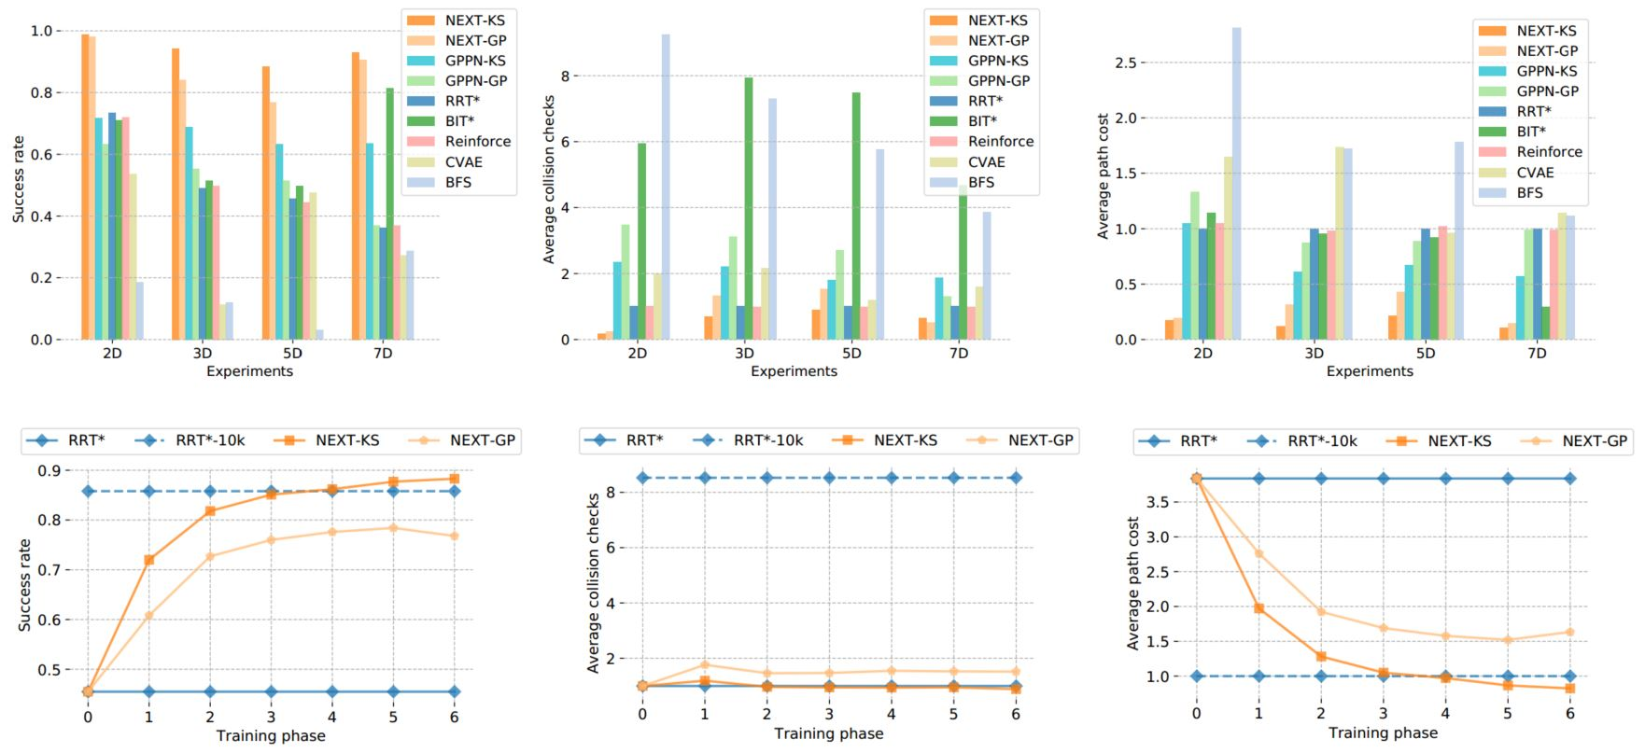
Results
Success rate / Average collision checks / Average path cost
Notes:
NEXT -- MSIL using training set.
NEXT-KS -- use kernel smoothing to define $φ$.
NEXT-GP -- use Gaussian process to define $φ$.
Traditional TSA -- no training needed.
RRT* -- TSA representative.
BIT* -- One of the most effective sampling- based planning algorithm.
Learning-based TSA -- SL/RL using training set.
CVAE-plan -- supervised by RRT* output.
Reinforce-plan -- use a learned rejection sampling policy trained by REINFORCE

Slide 23
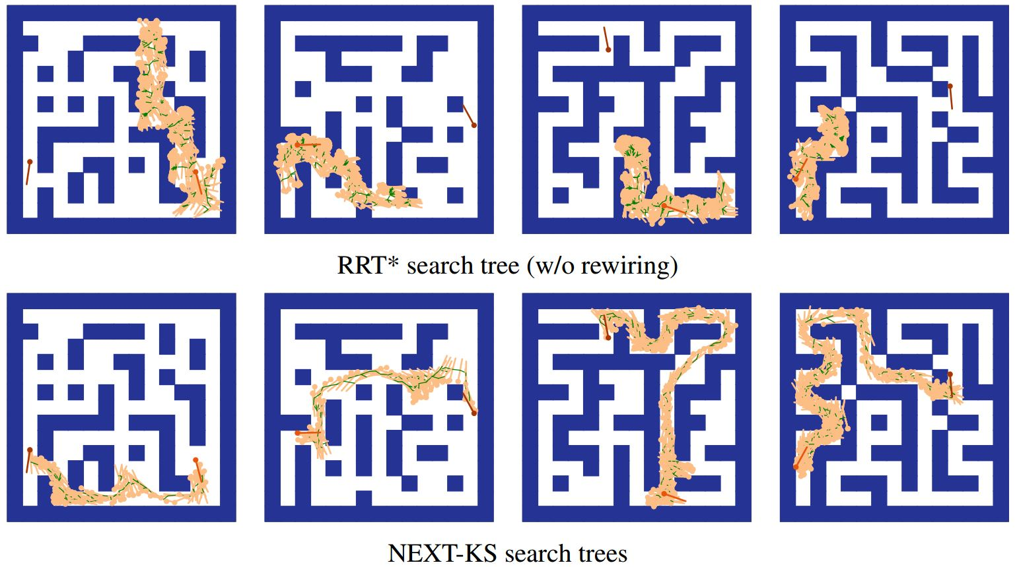
Search Tree Comparisons (3D)

Slide 24
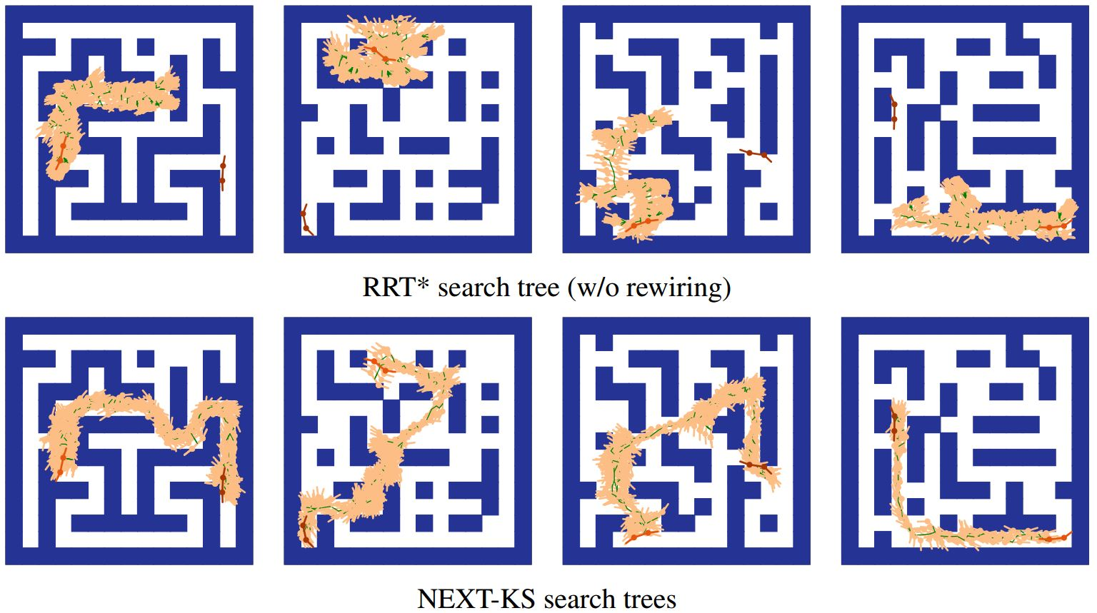
Search Tree Comparisons (5D)

Slide 25
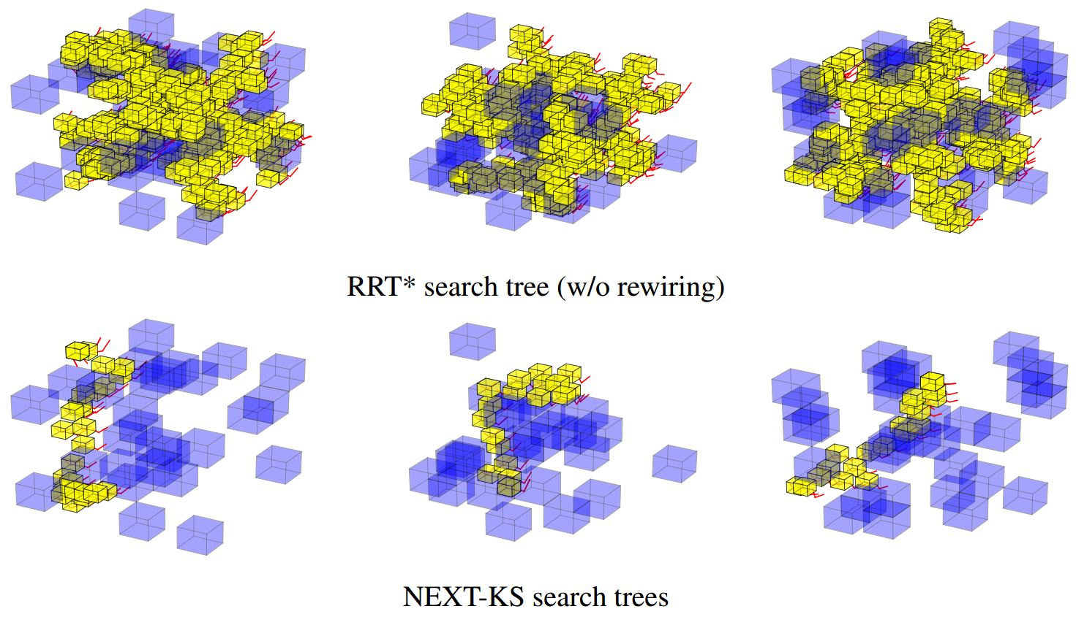
Experiments: Search Tree Comparisons (7D)

Slide 26
Conclusion and Future Works
Enhance existing algorithm with learned component
Neural Exploration Exploitation Tree (NEXT)
Fine-tune the model using RL algorithms
Planning with uncertainty
Uncertainty about the current state
Uncertainty about workspace map
Uncertainty about both
SLAM
Experiment with more planning problems!

