Slide 1
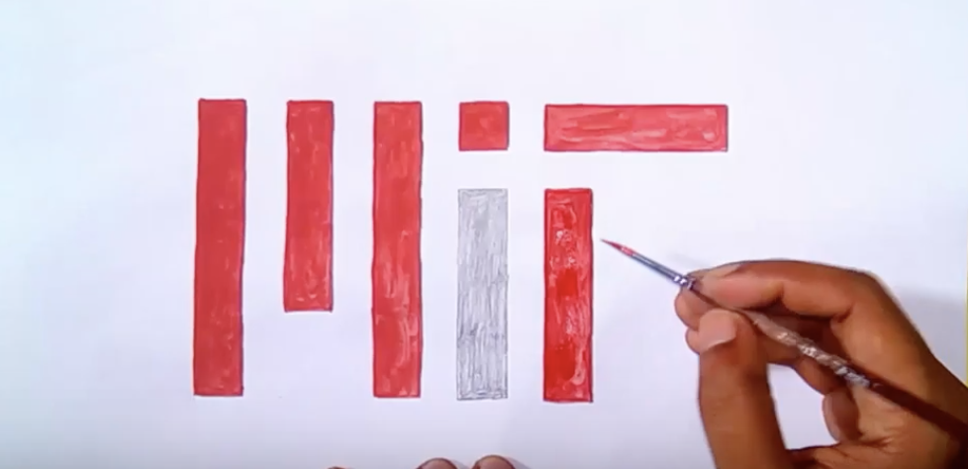
Learning-Based Low-Rank Approximations
Piotr Indyk Ali Vakilian Yang Yuan
MIT

Slide 2
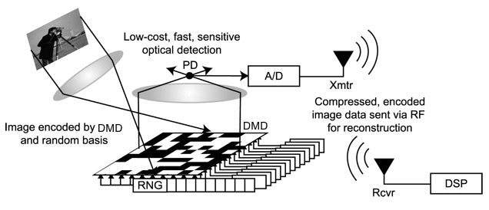

Linear Sketches
Many algorithms are obtained using linear sketches:
  Input: represented by x (or A)
  Sketching: compress x into Sx
    S=sketch matrix
  Computation: on Sx
Examples:
  Dimensionality reduction (e.g., Johnson-Lindenstrauss lemma)
  Streaming algorithms
    Matrices are implicit, e.g. hash functions
  Compressed sensing
  Linear algebra (regression, low-rank approximation,..)
  …
Count-Min sketch
$x_{i}$

Slide 3
Learned Linear Sketches
S is almost always a random matrix
  Independent, FJLT, sparse,...
  Pros: simple, efficient, worst-case guarantees
  Cons: does not adapt to data
Why not learn S from examples ?
  Dimensionality reduction: e.g., PCA
  Compressed sensing: talk by Ali Mousavi
    Autoencoders: x → Sx →x’
  Streaming algorithms: talk by Ali Vakilian
  Linear algebra ? This talk
Not Heavy
Sketching Alg (e.g. CM)
Stream element
Learned Oracle
Unique Bucket
Heavy

Slide 4
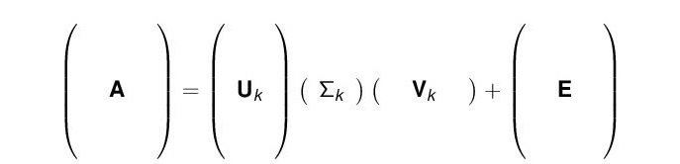
Low Rank Approximation
Singular Value Decomposition (SVD)
Any matrix A = U Σ V, where:
U has orthonormal columns
Σ is diagonal
V has orthonormal rows
Rank-k approximation: A_{k} = U_{k} Σ_{k} V_{k}
Equivalently: A_{k} = argmin_{rank-k matrices B} ||A-B||_{F}

Slide 5

Approximate Low Rank Approximation
Instead of
A_{k} = argmin_{rank-k matrices B} ||A-B||_{F}
output a rank-k matrix A’, so that
||A-A’||_{F} ≤ (1+ε) ||A-A_{k}||_{F}
Hopefully more efficient than computing exact A_{k}
  Sarlos’06, Clarkson-Woodruff’09,13,….
  See Woodruff’14 for a survey
Most of these algos use linear sketches SA
  S can be dense (FJLT) or sparse (0/+1/-1)
  We focus on sparse S

Slide 6
Sarlos-ClarksonWoodruff
Streaming algorithm (two passes):
  Compute SA (first pass)
  Compute orthonormal V that spans rowspace of SA
  Compute AV^{T} (second pass)
  Return SCW(S,A):= [AV^{T}]_{k} V
Space:
  Suppose that A is n x d, S is m x n
  Then SA is m x d, AV^{T} is n x m
  Space proportional to m
  Theory: m = O(k/ε)

Slide 7
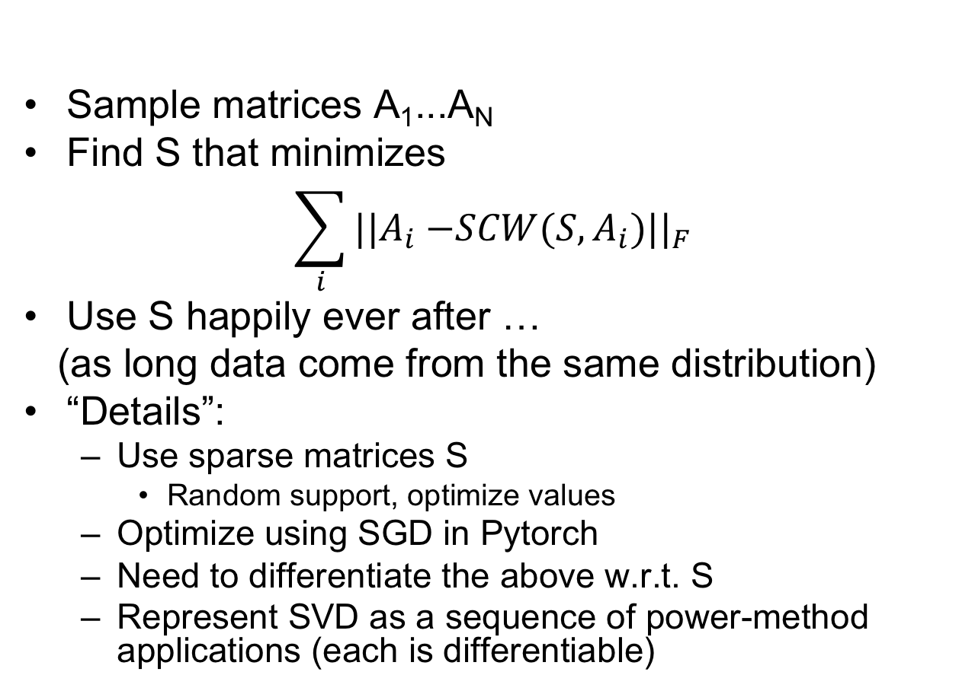
Learning-Based Low-Rank Approximation
Sample matrices A₁...A_{N}
Find S that minimizes
$$\sum_{i}{|{|A}_{i}{−SCW(S,A_{i})||}_{F}}$$
Use S happily ever after …
(as long data come from the same distribution)
“Details”:
  Use sparse matrices S
    Random support, optimize values
  Optimize using SGD in Pytorch
  Need to differentiate the above w.r.t. S
  Represent SVD as a sequence of power-method applications (each is differentiable)

Slide 8
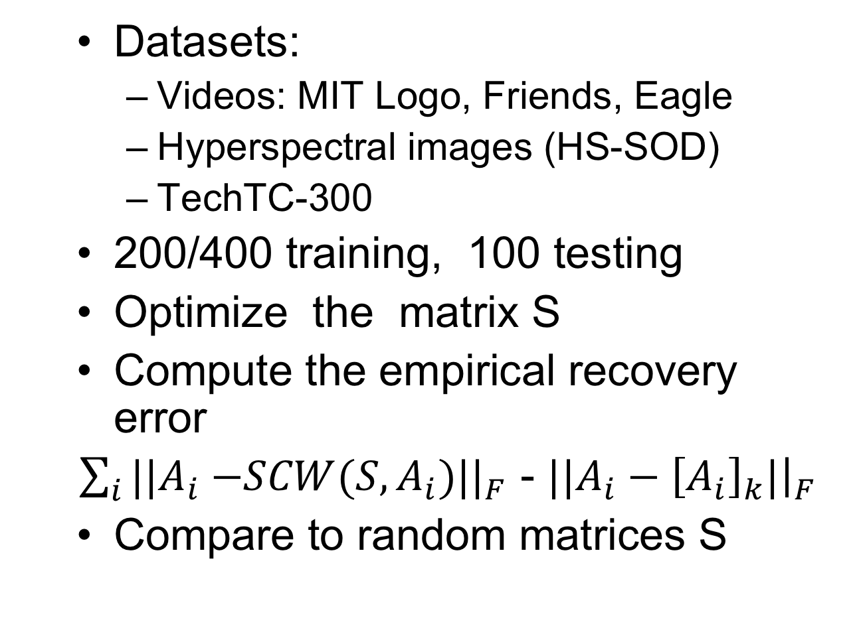
Evaluation
Datasets:
  Videos: MIT Logo, Friends, Eagle
  Hyperspectral images (HS-SOD)
  TechTC-300
200/400 training, 100 testing
Optimize the matrix S
Compute the empirical recovery error
$\sum_{i}{|{|A}_{i}{−SCW(S,A_{i})||}_{F}}$ - ${||A}_{i}−{\left[A_{i}\right]}_{k}|{\left.​\right|}_{F}$
Compare to random matrices S

Slide 9
Results k=10
Tech
Hyper
MIT Logo

Slide 10
Fallback option
Learned matrices work (much) better, but no guarantees per matrix
Solution: combine S with random rows R
Lemma: augmenting R with additional (learned) matrix S cannot increase the error of SCW
  “Sketch monotonicity”
The algorithm inherits worst-case guarantees from R

Slide 11
Mixed matrices - results
k | m | Sketch | Logo | Hyper | Tech
10 | 20 | Learned | 0.1 | 0.52 | 2.95
10 | 20 | Mixed | 0.2 | 0.78 | 3.73
10 | 20 | Random | 2.09 | 2.92 | 7.99
10 | 40 | Learned | 0.04 | 0.28 | 1.16
10 | 40 | Mixed | 0.05 | 0.34 | 1.31
10 | 40 | Random | 0.45 | 1.12 | 3.28

Slide 12
Conclusions/Questions
Learned sketches can improve the accuracy/measurement tradeoff for low-rank approximation
  Improves space
Questions:
  Improve time
    Requires sketching on both sides, more complicated
  Guarantees:
    Sampling complexity
    Minimizing loss function (provably)
  Other sketch-monotone algorithms ?

Slide 13
Wacky idea
A general approach to learning-based algorithm:
  Take a randomized algorithm
  Learn random bits from examples
The last two talks can be viewed as instantiations of this approach
  Random partitions → learning-based partitions
  Random matrices → learning-based matrices
“Super-derandomization”: more efficient algorithm with weaker guarantees
  (as opposed to less efficient algorithm with stronger guarantees)

