Slide 1


Learning to Schedule Through Experience
Mohammad Alizadeh

Slide 2
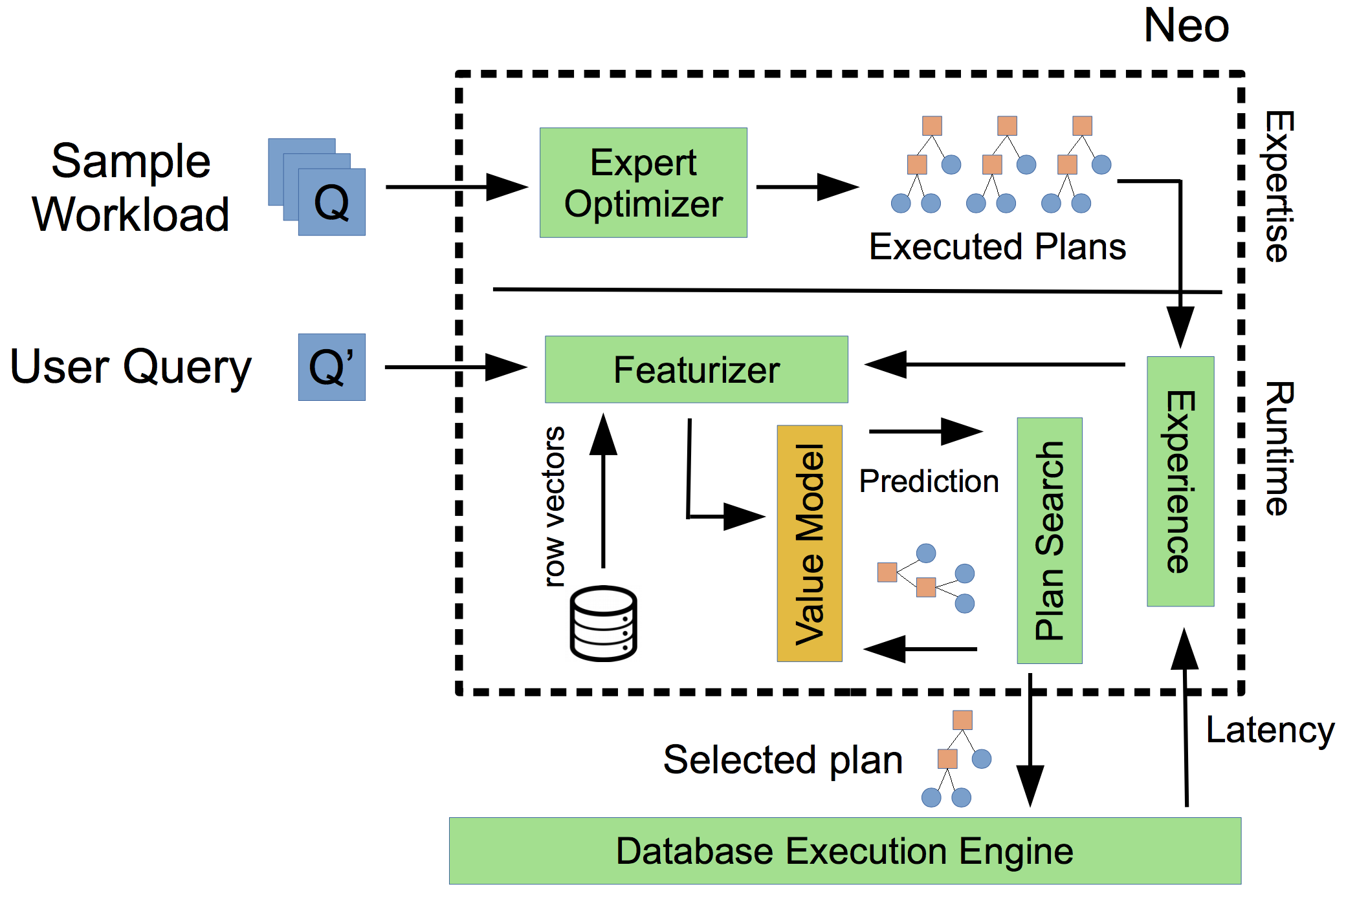



ML-Based Decision Making in Computer Systems
Video streaming
(Pensieve)
Cluster scheduling
(Decima)
ML device placement
(PlaceTo)
Query optimization
(Neo)
Jobs
Workers
Bandwidth
Time
720P
RL Techniques

Slide 3

Motivation
Scheduling is a fundamental task in computer systems
Cluster management (e.g., Kubernetes, Mesos, Borg)
Data analytics frameworks (e.g., Spark, Hadoop)
ML training (e.g., Tensorflow)
Database systems (e.g., Postgress)
Today’s systems use simple generalized heuristics
FIFO, Fair, Shortest-job-first, …
Ignore workload characteristics

Slide 4

Decima: A Learned Cluster Scheduler
Learns workload-specific scheduling algorithms for jobs with dependencies (represented as DAGs)
“Stages”: Identical tasks that can run in parallel
Executor 1
Executor 2
Scheduler
Data dependencies
Job 1
Job 2
Job 3
Executor m

Slide 5
Decima: A Learned Cluster Scheduler
Learns workload-specific scheduling algorithms for jobs with dependencies (represented as DAGs)
Executor 1
Executor 2
Scheduler
Job 2
Job 1
Executor m
Job 3

Slide 6
Designing Optimal Schedulers is Intractable
Must consider many factors for optimal performance:
Job dependency structure
Degree of parallelism
Job sizes & priorities
Data locality
Placement constraints
….
No “one-size-fits-all” solution:
Best algorithm depends on specific workload and system

Slide 7
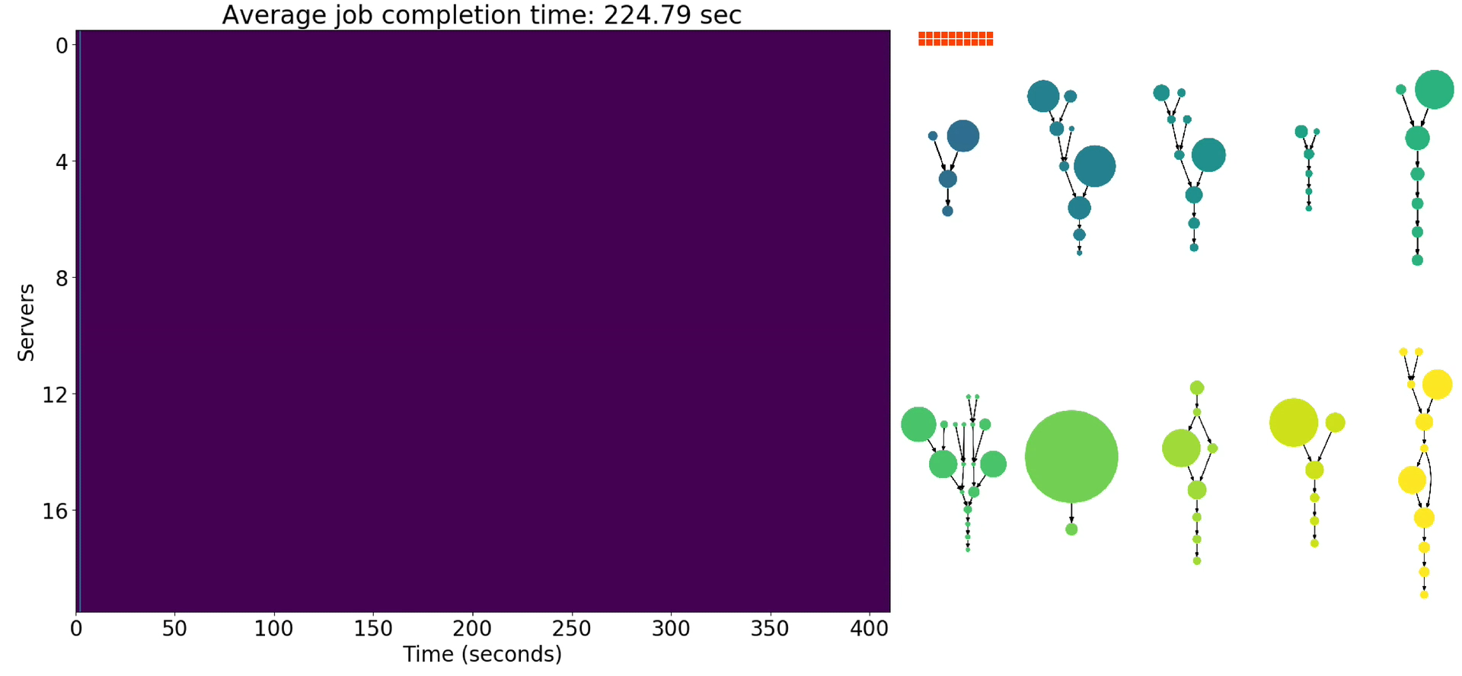
Scheduling policy: FIFO
Number of servers working on this job
Average Job Completion Time:
225 sec

Slide 8
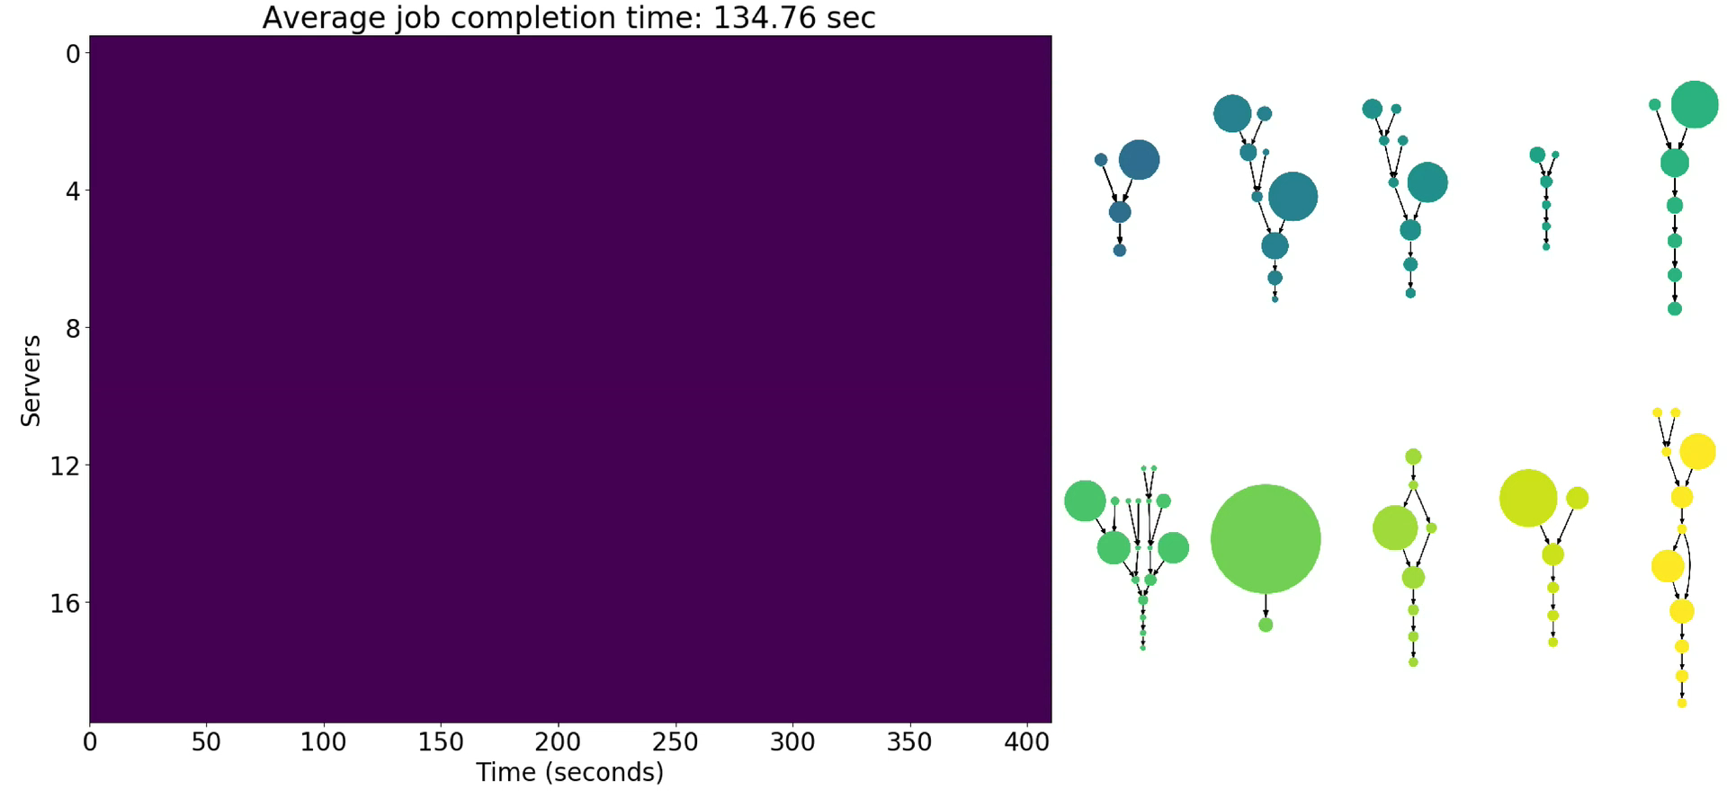
Scheduling policy: Shortest-Job-First
Average Job Completion Time:
135 sec

Slide 9
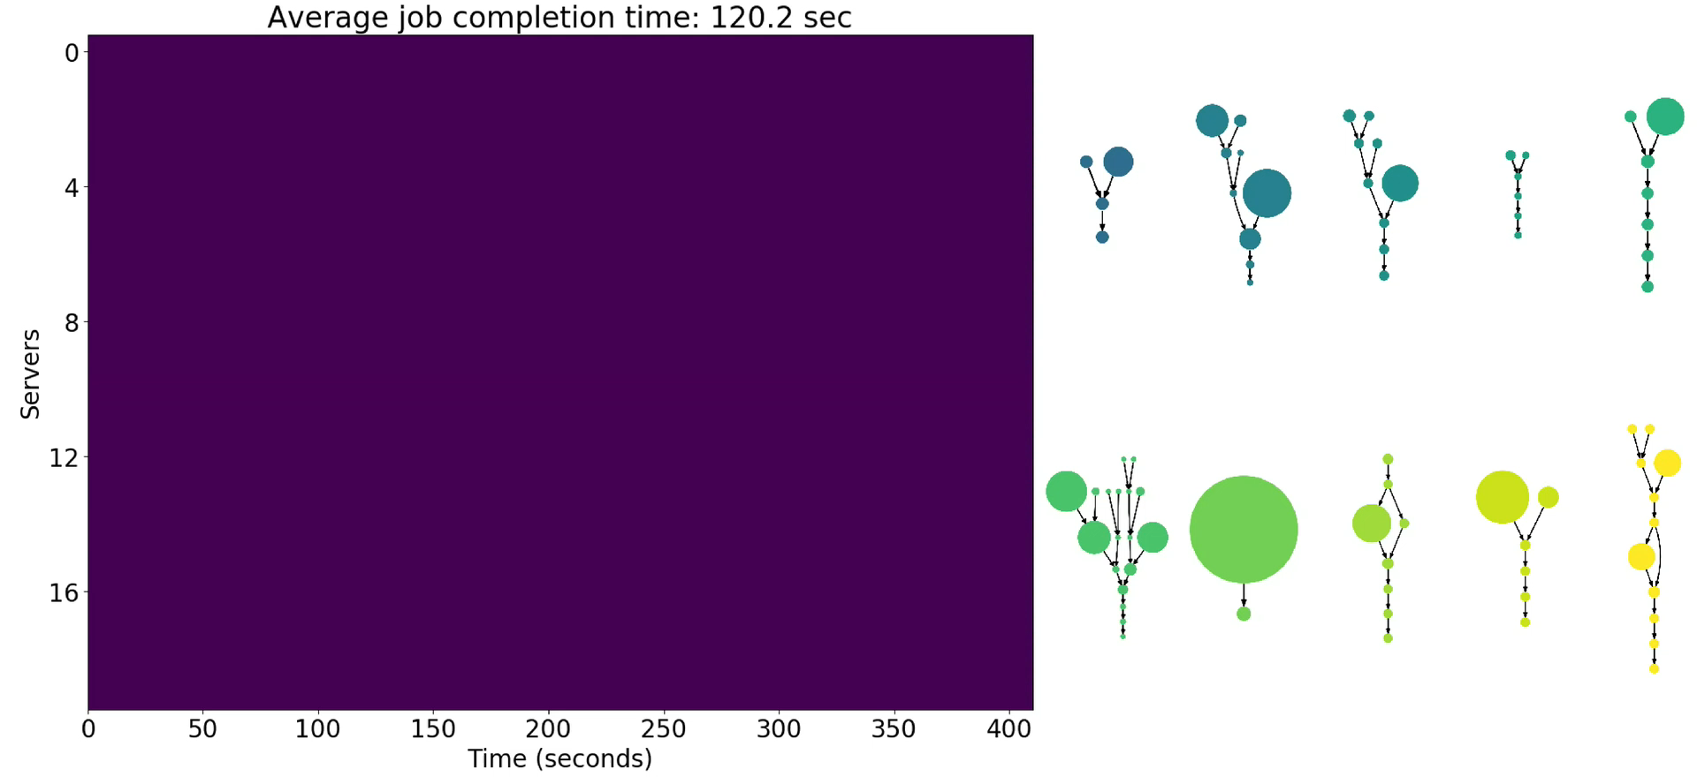
Scheduling policy: Fair
Average Job Completion Time:
120 sec

Slide 10
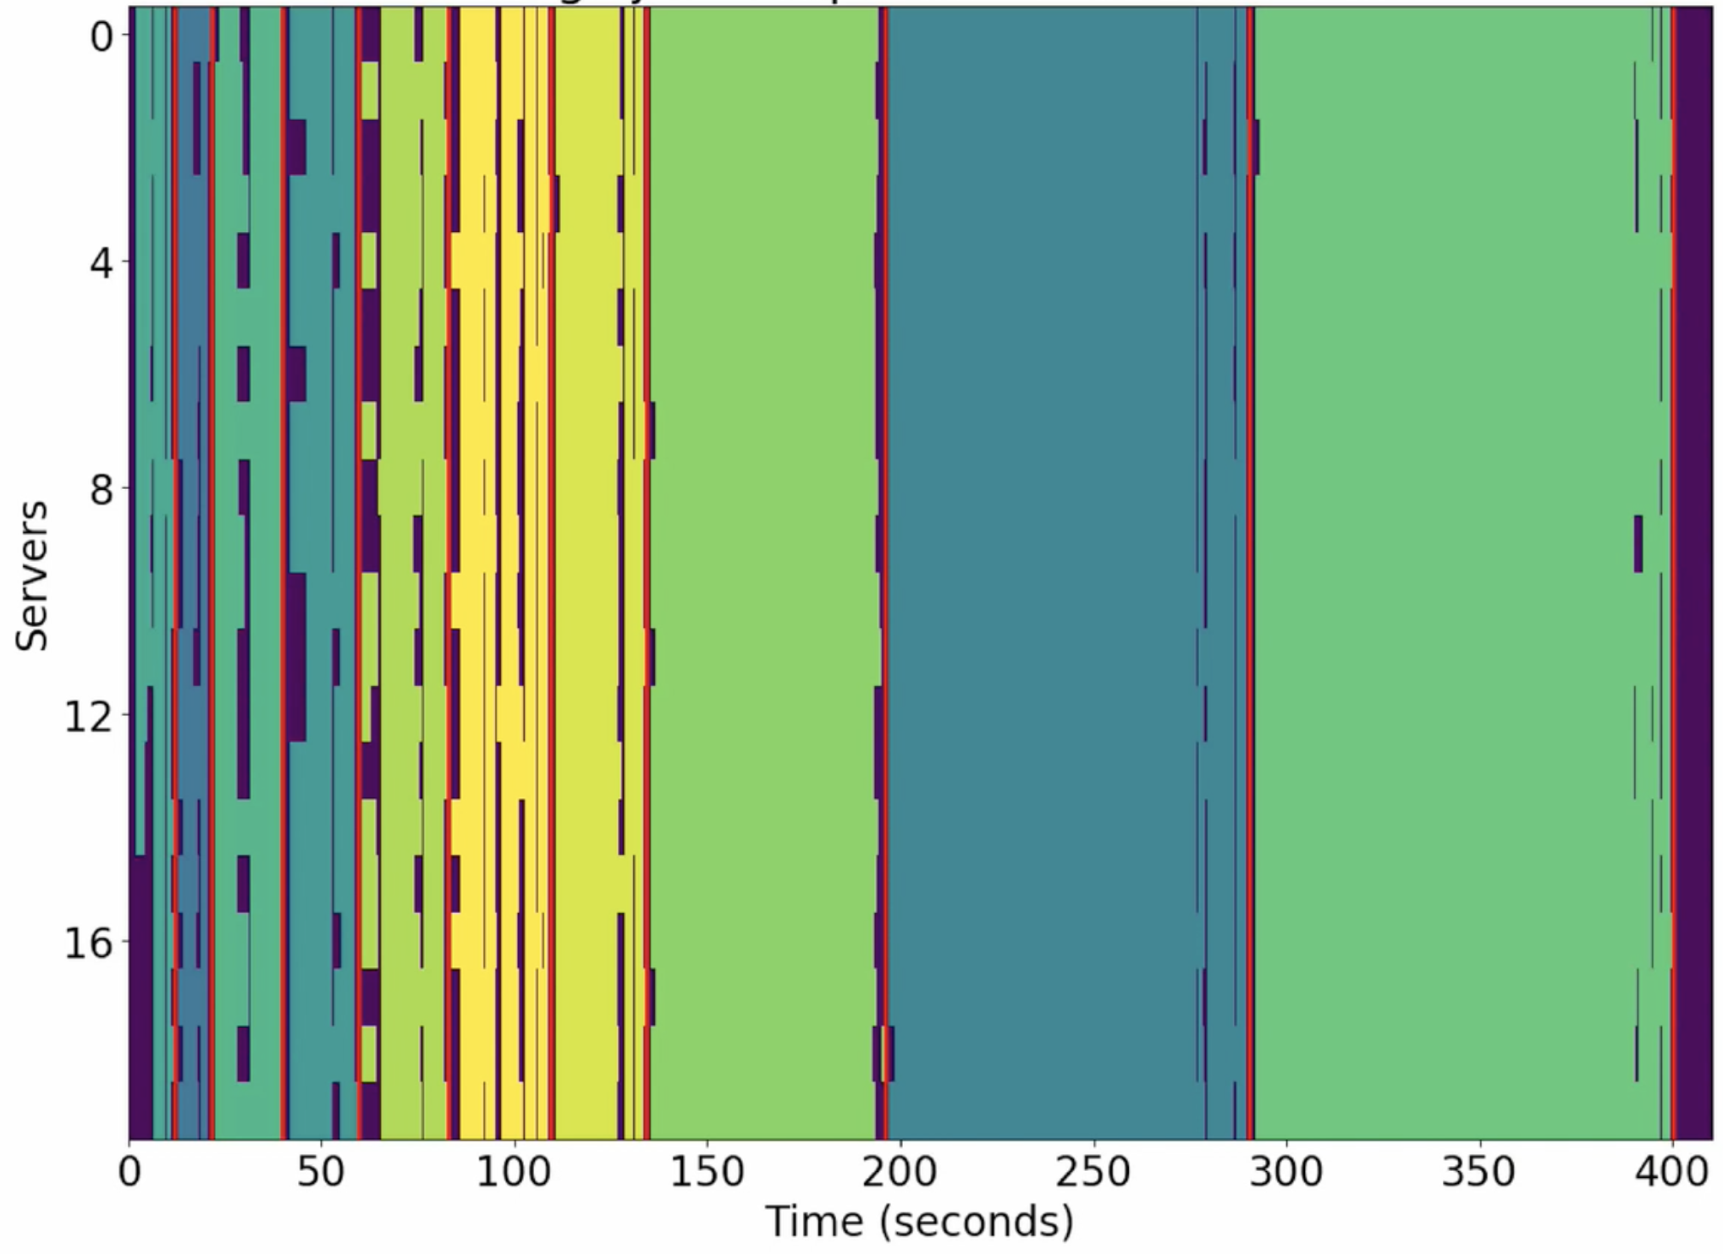
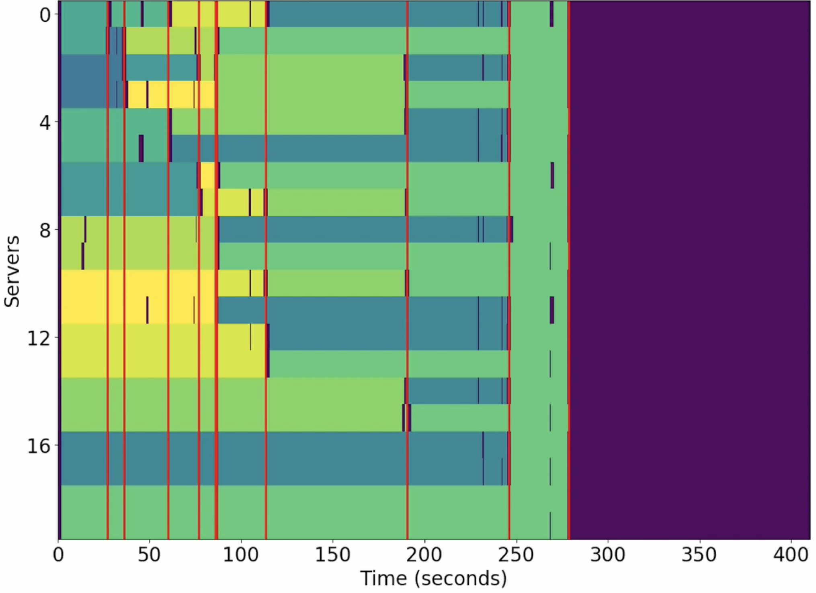
Shortest-Job-First
Fair
Average Job Completion Time:
135 sec
Average Job Completion Time:
120 sec

Slide 11

Scheduling policy: Decima
Average Job Completion Time:
98 sec

Slide 12
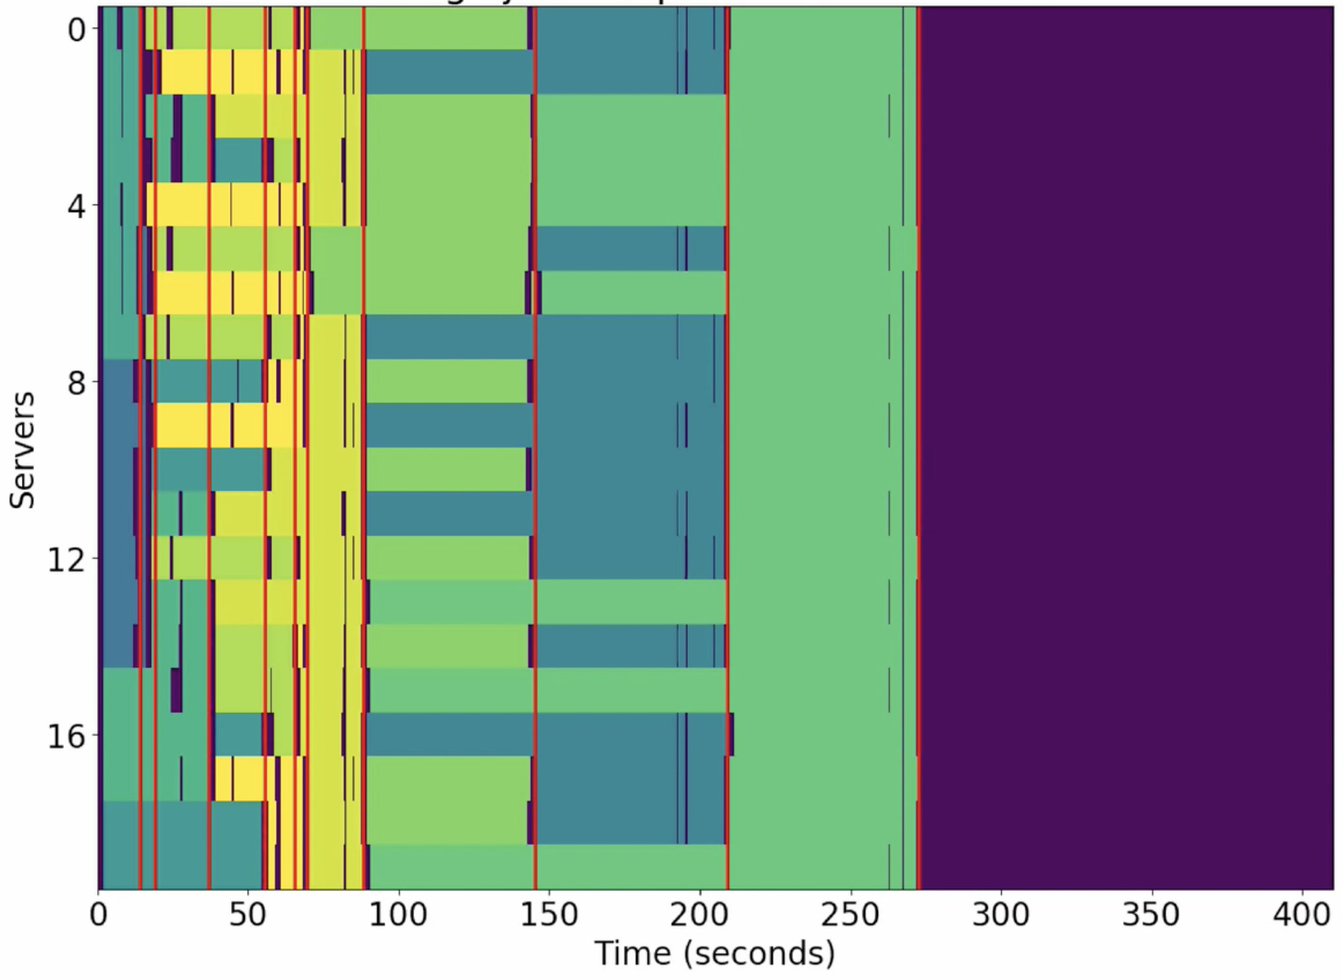
Decima
Fair
Average Job Completion Time:
98 sec
Average Job Completion Time:
120 sec

Slide 13
Decima
it=0
166 sec
20 Spark jobs (TPC-H queries), 50 executors

Slide 14
Decima
it=3000
160 sec

Slide 15
Decima
it=6000
148 sec

Slide 16
Decima
it=9000
145 sec

Slide 17
Decima
it=12000
142 sec

Slide 18
Decima
it=15000
126 sec

Slide 19
Decima
it=18000
111 sec

Slide 20
Decima
it=21000
108 sec

Slide 21
Decima
it=24000
107 sec

Slide 22
Decima
it=27000
93 sec

Slide 23
Decima
it=30000
89 sec

Slide 24
Design

Slide 25
Decima: Overview
Two key challenges
1. Huge state and action space → Scalable graph neural network to express scheduling policies
2. Training for online job arrivals → New variance reduction techniques for RL in “input-driven” systems

Slide 26
Decima: System Design
Scheduling Events
Executor 1
Job DAG 1
Node features:
# of tasks
avg. task duration
# of executors currently assigned to the node
are free executors local to this job?
Executor 2
Set of identical
free executors
Executor 3
x_{v}
Executor 4
Job DAG n
Challenge: How to encode scheduling decisions as actions?
Executor m

Slide 27
Option 1: Assign all Executors in 1 Action
Executor 1
Job DAG 1
Executor 2
Executor 3
Executor 4
Job DAG n
Problem: huge action space
Executor m

Slide 28
Option 2: Assign 1 Executor per Action
Executor 1
Job DAG 1
Executor 2
Executor 3
Executor 4
Job DAG n
Problem: long action sequences
Executor m

Slide 29
Decima: Assign Groups of Executors per Action
Executor 1
Use 1 executor
Job DAG 1
Executor 2
Use 1 executor
Executor 3
Use 3 executors
Executor 4
Job DAG n
Action = (node, parallelism limit)
Executor m

Slide 30
Training

Slide 31
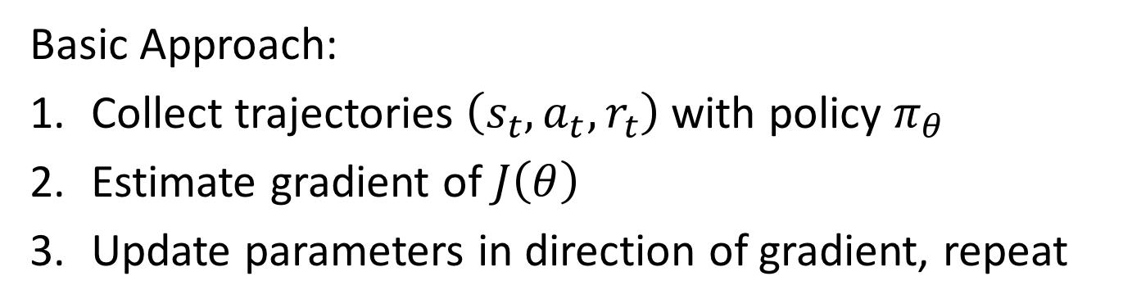
Review: Policy Gradient RL Methods
maximize $J\left(θ\right)=𝔼_{π_{θ}}\left[\sum_{t=0}^{T−1}{r_{t}}\right]$
$π_{θ}(s,a)$ : policy with parameters θ
Basic Approach:
Collect trajectories $\left(s_{t},a_{t},r_{t}\right)$with policy $π_{θ}$
Estimate gradient of $J\left(θ\right)$
Update parameters in direction of gradient, repeat

Slide 32
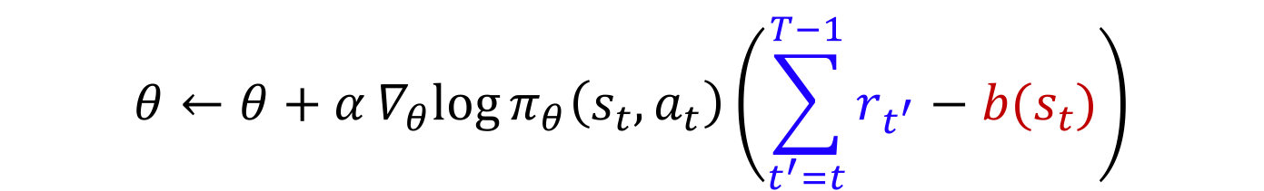
Review: Policy Gradient RL Methods
$$θ←θ+α∇_{θ}log{π_{θ}\left(s_{t},a_{t}\right)\left(\sum_{t^{′}=t}^{T−1}{r_{t^{′}}}−b(s_{t})\right)}$$
“return” from step t
“baseline”
Expected return from state s_{t}
Increase probability of actions with better-than-expected returns

Slide 33
Training with Online Job Arrivals
Problems
Early in training, the learned policy is unstable, and a huge backlog of jobs accumulates with a long input sequence
Variance caused by random job arrival process confuses RL training algorithms
Scheduler
→ start with short input sequence, and increase gradually (curriculum learning)

Slide 34
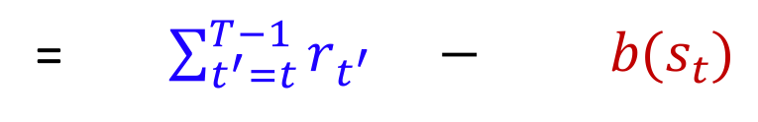

RL in “Input-Driven” Environments
Future
workload #1
action a_{t}
Job size
Must take the future input into account
when scoring actions during training
Future
workload #2
Time
t
Score for action a_{t} = (reward after a_{t}) $−$ (baseline for s_{t})
= $\sum_{t^{′}=t}^{T−1}{r_{t^{′}}} − b(s_{t})$
$$b(s_{t},future input)$$

Slide 35
“Input-Driven” Markov Decision Process
Dynamics driven by an exogenous stochastic input process
input process
z_{t-1}
z_{t}
z_{t+1}
Standard MDP
s_{t-1}
s_{t}
s_{t+1}
a_{t-1}
a_{t}
a_{t+1}
The input does not depend on the states and actions

Slide 36
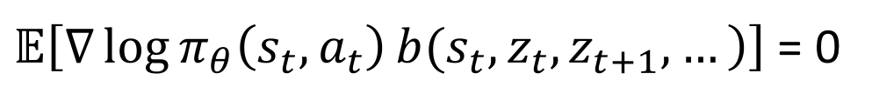
Input-Dependent Baseline
Score for action a_{t} = $\sum_{t^{′}=t}^{T−1}{r_{t^{′}}} − b(s_{t})$
Score for action a_{t} = $\sum_{t^{′}=t}^{T−1}{r_{t^{′}}} − b(s_{t},z_{t},z_{t+1},…)$
Expected reward for trajectories from state s_{t} with input sequence z_{t}, z_{t+1}, …
Theorem: Input-dependent baselines reduce variance without adding bias
$𝔼\left[\left.∇\log{π_{θ}\left(s_{t},a_{t}\right)}b({s_{t},z}_{t},z_{t+1},…\right)\right]$ = 0
Mao et al., Variance reduction for reinforcement learning in input-driven environments, ICLR 2019

Slide 37
Results

Slide 38
Decima vs. Baselines: Batched Arrivals
20 TPC-H queries sampled at random; input sizes: 2, 5, 10, 20, 50, 100 GB
Decima improves average job completion time by 21%-3.1x
over baseline schemes

Slide 39
Decima with Online Job Arrivals
1000 jobs (TPC-H queries) arrive as a Poisson process with avg. inter-arrival time = 25 sec
Decima achieves 28% lower average JCT than best heuristic,
and 2X better JCT in overload

Slide 40
Flexibility: Multi-Resource Scheduling
Industrial trace (Alibaba): 20,000 jobs from production cluster
4 types of executors:
1 core + {0.25, 0.5, 0.75, 1} memory units

Slide 41
Other Applications of Input-Dependent Baselines

Slide 42
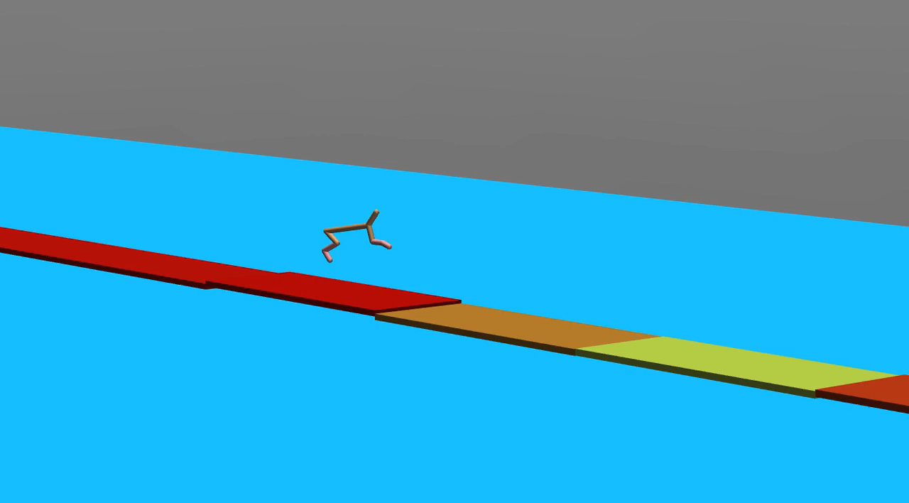
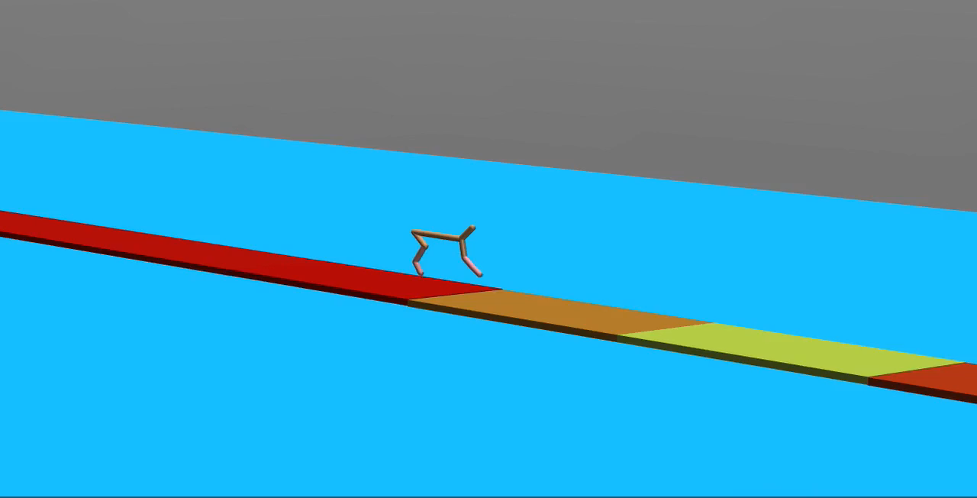
Example: Half-Cheetah on Floating Tiles
Train with standard baseline
Train with input-dependent baseline

Slide 43
Looking Ahead
ML has the potential to change how we design computer systems
Systems are a challenging domain for ML; can lead to new techniques
Many questions remain
  Robustness
  Safe training & deployment
  Interpretability
  …
Success hinges on systematic & reliable design methodologies

