Slide 1
Lecture 17:
Sublinear-time algorithms
COMS E6998-9 F15
Notes:
Left to the title, a presenter can insert his/her own image pertinent to the presentation.

Slide 2
Administrivia, Plan
Admin:
  My office hours after class (CSB517)
Plan:
  Finalize embeddings
  Sublinear-time algorithms
  Projects
Scriber?

Slide 3
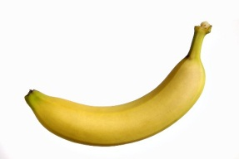
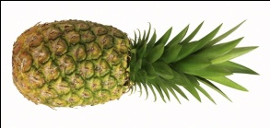
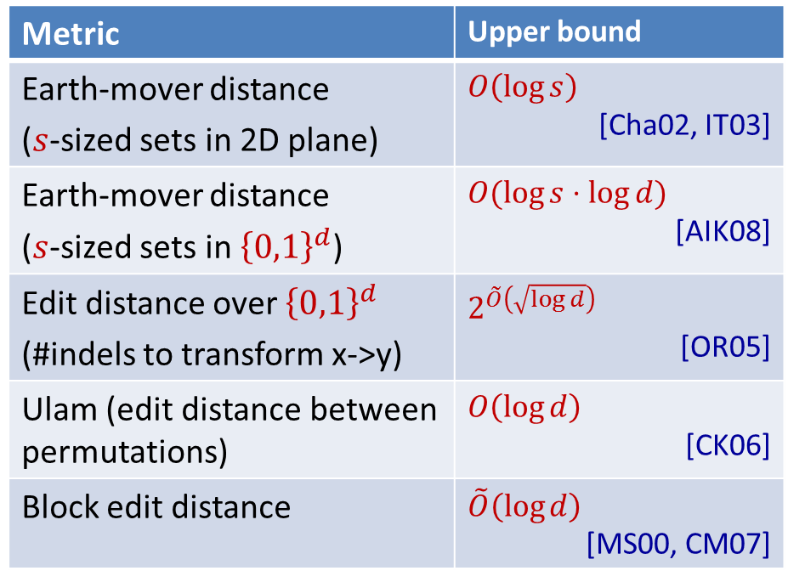

Embeddings of various metrics into $ℓ_{1}$
edit( banana ,
ananas ) = 2
Metric | Upper bound
Earth-mover distance ($s$-sized sets in 2D plane) | $$O\left(\log{s}\right)$$ [Cha02, IT03]
Earth-mover distance ($s$-sized sets in ${\left\{0,1\right\}}^{d}$) | $$O(\log{s}⋅\log{d})$$ [AIK08]
Edit distance over ${\left\{0,1\right\}}^{d}$ (#indels to transform x->y) | $$2^{\tilde{O}\left(\sqrt{\log{d}}\right)}$$ [OR05]
Ulam (edit distance between permutations) | $$O\left(\log{d}\right)$$ [CK06]
Block edit distance | $$\tilde{O}\left(\log{d}\right)$$ [MS00, CM07]
edit(1234567,
7123456) = 2

Slide 4
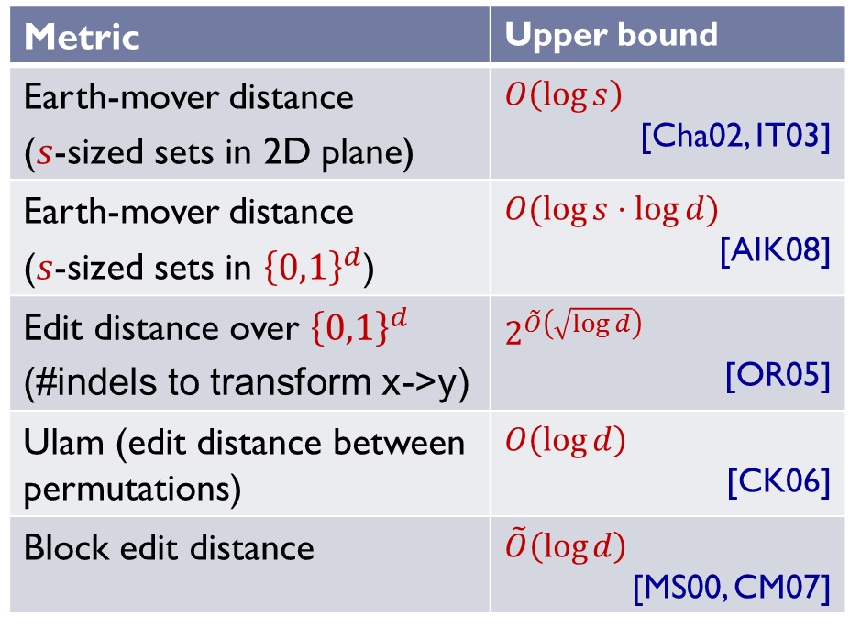

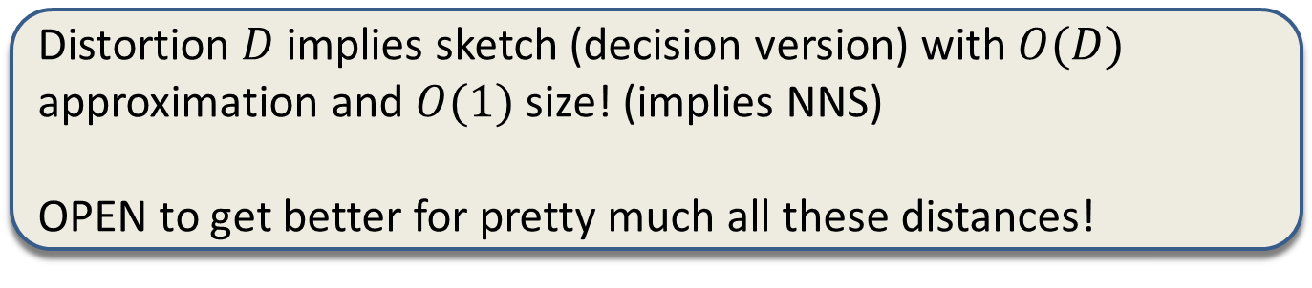
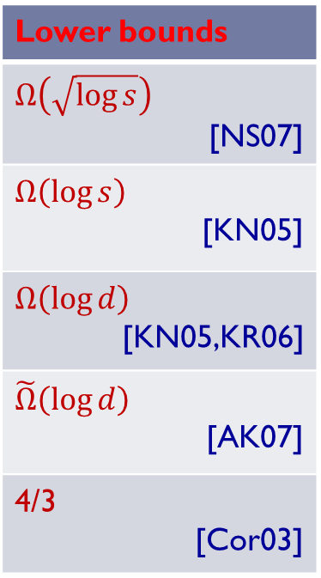
Non-embeddability into $ℓ_{1}$
Distortion $D$ implies sketch (decision version) with $O(D)$ approximation and $O(1)$ size! (implies NNS)
OPEN to get better for pretty much all these distances!
Metric | Upper bound
Earth-mover distance ($s$-sized sets in 2D plane) | $$O\left(\log{s}\right)$$ [Cha02, IT03]
Earth-mover distance ($s$-sized sets in ${\left\{0,1\right\}}^{d}$) | $$O(\log{s}⋅\log{d})$$ [AIK08]
Edit distance over ${\left\{0,1\right\}}^{d}$ (#indels to transform x->y) | $$2^{\tilde{O}\left(\sqrt{\log{d}}\right)}$$ [OR05]
Ulam (edit distance between permutations) | $$O\left(\log{d}\right)$$ [CK06]
Block edit distance | $$\tilde{O}\left(\log{d}\right)$$ [MS00, CM07]
Lower bounds
$$Ω\left(\sqrt{\log{s}}\right)$$ [NS07]
$$Ω\left(\log{s}\right)$$ [KN05]
$$Ω\left(\log{d}\right)$$ [KN05,KR06]
$$\tilde{Ω}\left(\log{d}\right)$$ [AK07]
4/3 [Cor03]

Slide 5
Sublinear-time algorithms

Slide 6




Setup
Can we get away with not even looking at all data?
  Just use a sample…
Where do we get samples?
  stored on disk, passing through a router, etc
  Data comes as a sample
  Observation of a “natural” phenomenon
2
5
7
5
5

Slide 7
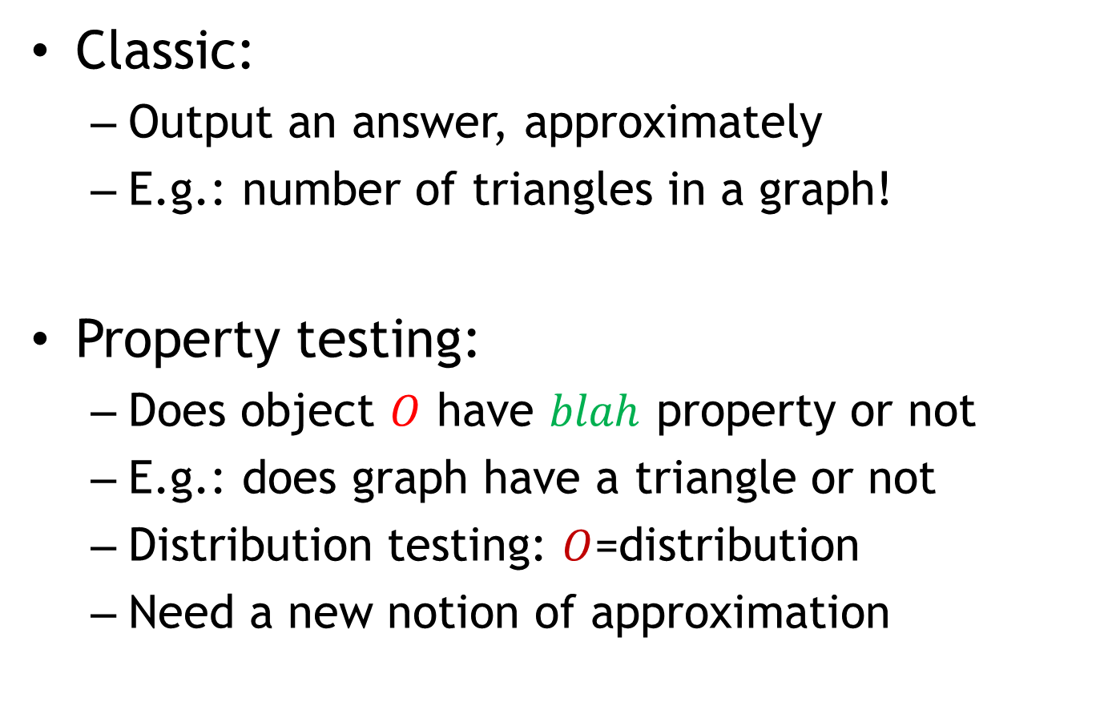
Two types of algorithms
Classic:
  Output an answer, approximately
  E.g.: number of triangles in a graph!
Property testing:
  Does object $O$ have $blah$ property or not
  E.g.: does graph have a triangle or not
  Distribution testing: $O$=distribution
  Need a new notion of approximation

Slide 8
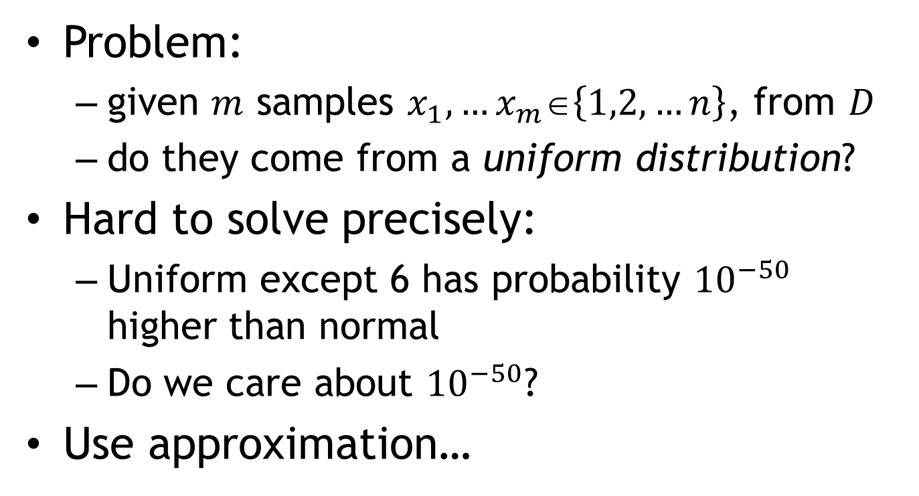
Distribution Testing
Problem:
  given $m$ samples $x_{1}, …x_{m}∈\left\{1,2,…n\right\}$, from $D$
  do they come from a uniform distribution?
Hard to solve precisely:
  Uniform except 6 has probability ${10}^{−50}$ higher than normal
  Do we care about ${10}^{−50}$?
Use approximation…
1
2
3
4
5
6
7
8

Slide 9
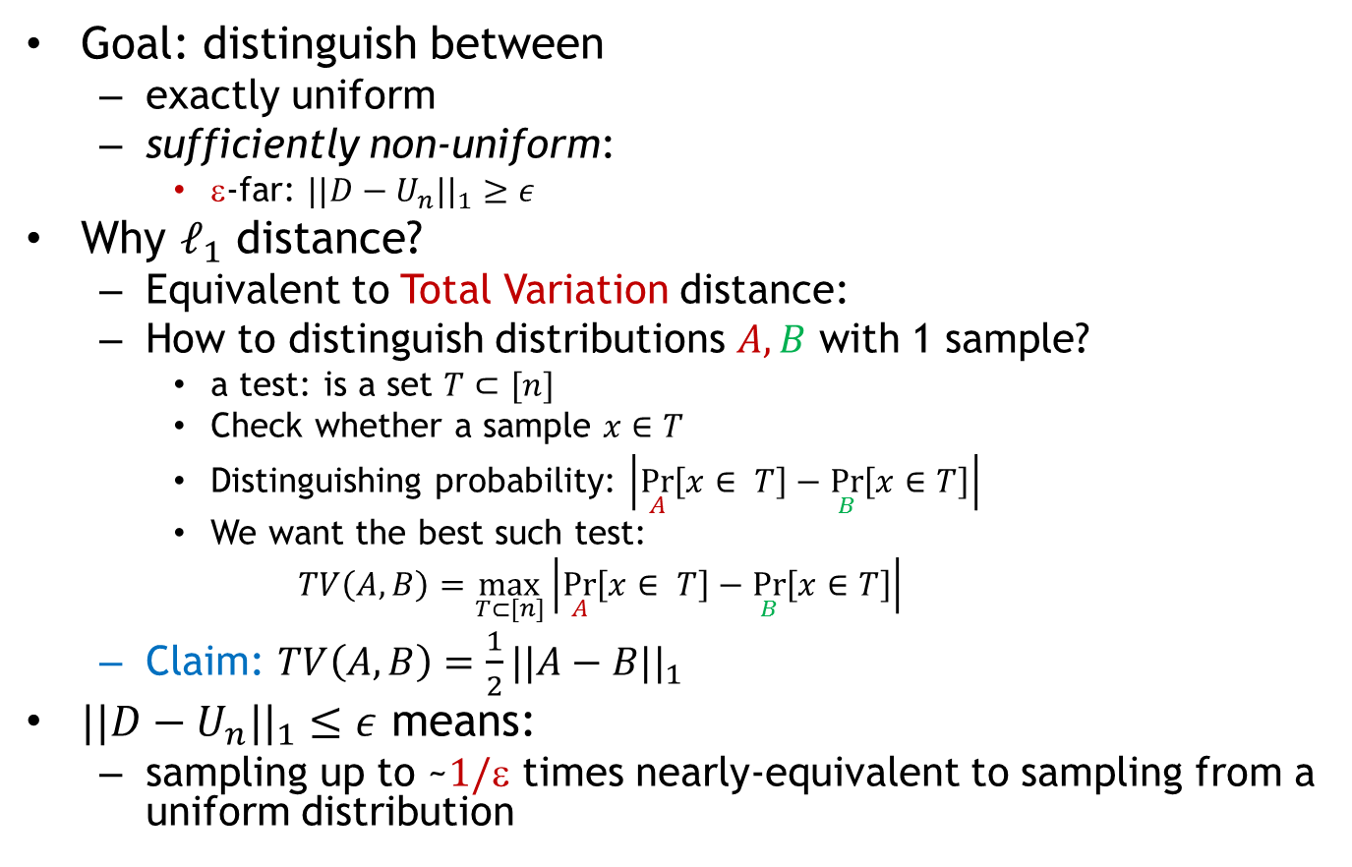
Approximation: total variation
Goal: distinguish between
  exactly uniform
  sufficiently non-uniform:
    $$-far: $||D−U_{n}||_{1}≥ε$
Why $ℓ_{1}$ distance?
  Equivalent to Total Variation distance:
  How to distinguish distributions $A,B$ with 1 sample?
    a test: is a set $T⊂[n]$
    Check whether a sample $x∈T$
    Distinguishing probability: $\left|\underset{A}{Pr}\left[x∈ T\right]−\underset{B}{Pr}\left[x∈T\right]\right|$
    We want the best such test:
    $$TV\left(A,B\right)=\max_{T⊂[n]}\left|\underset{A}{Pr}\left[x∈ T\right]−\underset{B}{Pr}\left[x∈T\right]\right|$$
  Claim: $TV\left(A,B\right)=\frac{1}{2}||A−B||_{1}$
    $||D−U_{n}||_{1}≤ε$ means:
  sampling up to ~$1/$ times nearly-equivalent to sampling from a uniform distribution

Slide 10
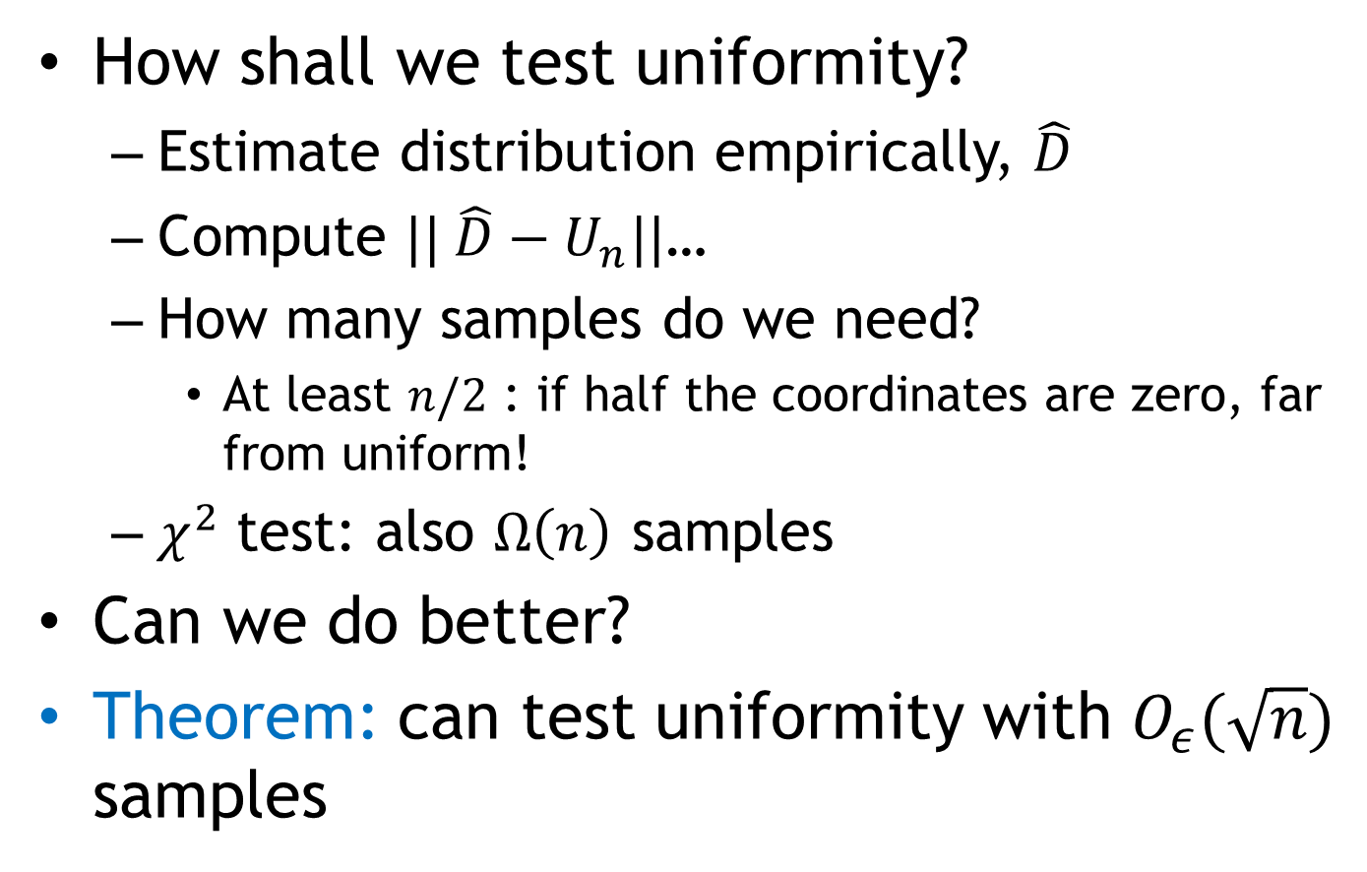
Algorithm attempt
How shall we test uniformity?
  Estimate distribution empirically, $\hat{D}$
  Compute $|| \hat{D}−U_{n}||$…
  How many samples do we need?
    At least $n/2$ : if half the coordinates are zero, far from uniform!
  $χ^{2}$ test: also $Ω\left(n\right)$ samples
Can we do better?
Theorem: can test uniformity with $O_{ε}(\sqrt{n})$ samples

Slide 11
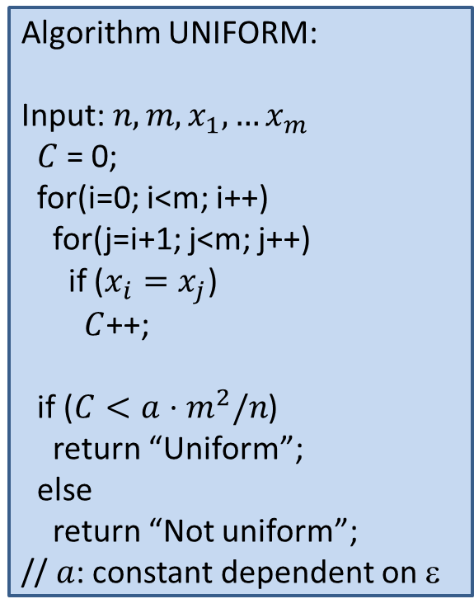
Algorithm for Uniformity
Algorithm UNIFORM:
Input: $n, m, x_{1},…x_{m}$
$C$ = 0;
for(i=0; i<m; i++)
for(j=i+1; j<m; j++)
if ($x_{i}=x_{j}$)
$C$++;
if ($C<a⋅m^{2}/n$)
return “Uniform”;
else
return “Not uniform”;
// $a$: constant dependent on $$
Counts the number of collisions
Intuition:
  If not uniform, more likely to have more collisions
1
2
3
4
5
6
7
8

Slide 12
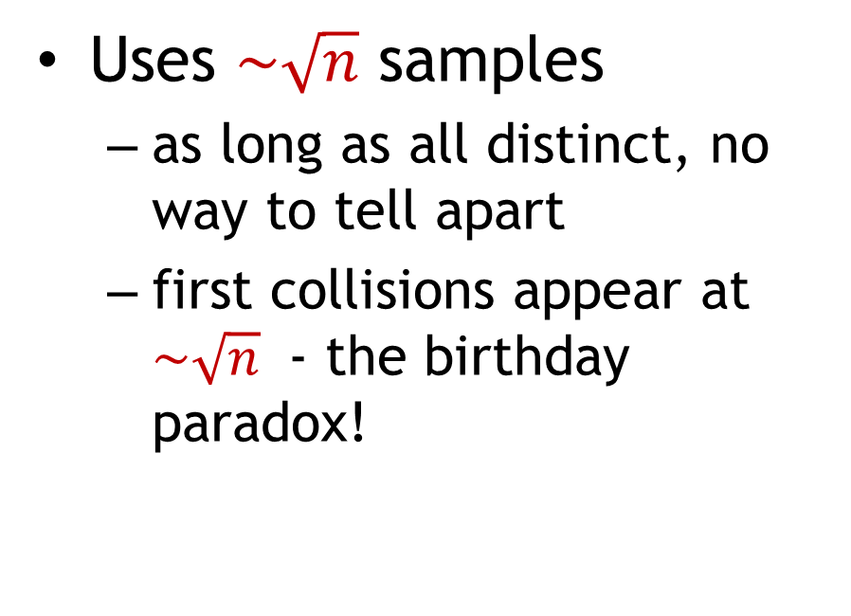
Algorithm intuition
Algorithm UNIFORM:
Input: $n, m, x_{1},…x_{m}$
$C$ = 0;
for(i=0; i<m; i++)
for(j=i+1; j<m; j++)
if ($x_{i}=x_{j}$)
$C$++;
if ($C<a⋅m^{2}/n$)
return “Uniform”;
else
return “Not uniform”;
// $a$: constant dependent on $$
Uses $\sim \sqrt{n}$ samples
  as long as all distinct, no way to tell apart
  first collisions appear at $\sim \sqrt{n}$ - the birthday paradox!
1
2
3
4
5
6
7
8
1
2
3
4
5
6
7
8

Slide 13
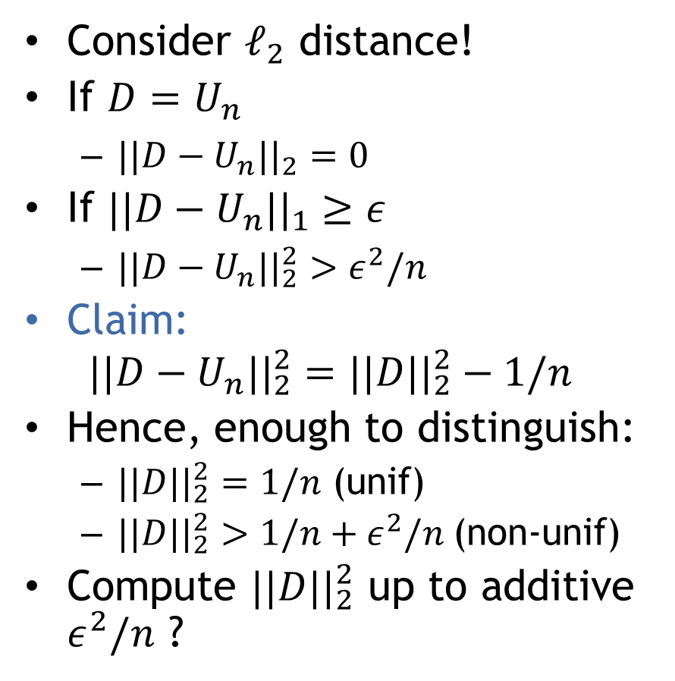
Analysis
Algorithm UNIFORM:
Input: $n, m, x_{1},…x_{m}$
$C$ = 0;
for(i=0; i<m; i++)
for(j=i+1; j<m; j++)
if ($x_{i}=x_{j}$)
$C$++;
if ($C<a⋅m^{2}/n$)
return “Uniform”;
else
return “Not uniform”;
// $a$: constant dependent on $$
Consider $ℓ_{2}$ distance!
If $D=U_{n}$
  $||D−U_{n}||_{2}=0$
If $||D−U_{n}||_{1}≥ε$
  $||D−U_{n}||_{2}^{2}>ε^{2}/n$
Claim:
$$||D−U_{n}||_{2}^{2}=||D||_{2}^{2}−1/n$$
Hence, enough to distinguish:
  $||D||_{2}^{2}=1/n$ (unif)
  $||D||_{2}^{2}>1/n+ε^{2}/n$(non-unif)
Compute $||D||_{2}^{2}$ up to additive $ε^{2}/n$ ?

Slide 14
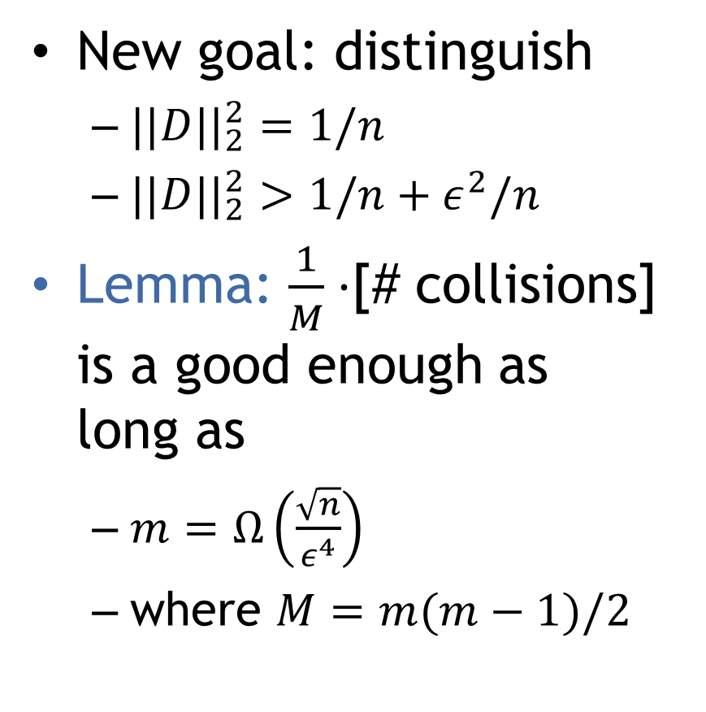
Analysis
Algorithm UNIFORM:
Input: $n, m, x_{1},…x_{m}$
$C$ = 0;
for(i=0; i<m; i++)
for(j=i+1; j<m; j++)
if ($x_{i}=x_{j}$)
$C$++;
if ($C<a⋅m^{2}/n$)
return “Uniform”;
else
return “Not uniform”;
// $a$: constant dependent on $$
New goal: distinguish
  $||D||_{2}^{2}=1/n$
  $||D||_{2}^{2}>1/n+ε^{2}/n$
Lemma: $\frac{1}{M}⋅$[# collisions] is a good enough as long as
  $m=Ω\left(\frac{\sqrt{n}}{ε^{4}}\right)$
  where $M=m(m−1)/2$

Slide 15
Projects

