Slide 1
MSEG 803
Equilibria in Material Systems
8: Statistical Ensembles
Prof. Juejun (JJ) Hu
hujuejun@udel.edu

Slide 2
Micro-canonical ensemble: isolated systems
Fundamental postulate: given an isolated system in equilibrium, it is found with equal probability in each of its accessible microstates
Probability of finding the state in a microstate r is:
When considering two system A and A’ that only interact with each other, we can always treat the composition system A + A’ as an isolated system!
when E < E_{r} < E + dE
otherwise
1
Normalization condition:
C =
# of accessible states

Slide 3
Canonical ensemble: systems interacting with a heat reservoir
A small system A kept in thermal equilibrium with a large heat reservoir A’ (DOF of A << DOF of A’)
The probability of the isolated system A + A’ in a microscopic state with total energy E₀ is C₀ , a constant
The probability of system A in one specific microscopic state with energy E_{r} is:
Ω₀ , E₀ = constant
A’
A
δQ
Ω_{r} , E_{r}
Ω’ , E’

Slide 4
Canonical ensemble: systems interacting with a heat reservoir
Since A’ is much larger than A:
A and A’ are in thermal equilibrium:
Ω₀ , E₀ = constant
A’
A
δQ
Normalization:
Ω_{r} , E_{r}
Ω’ , E’

Slide 5
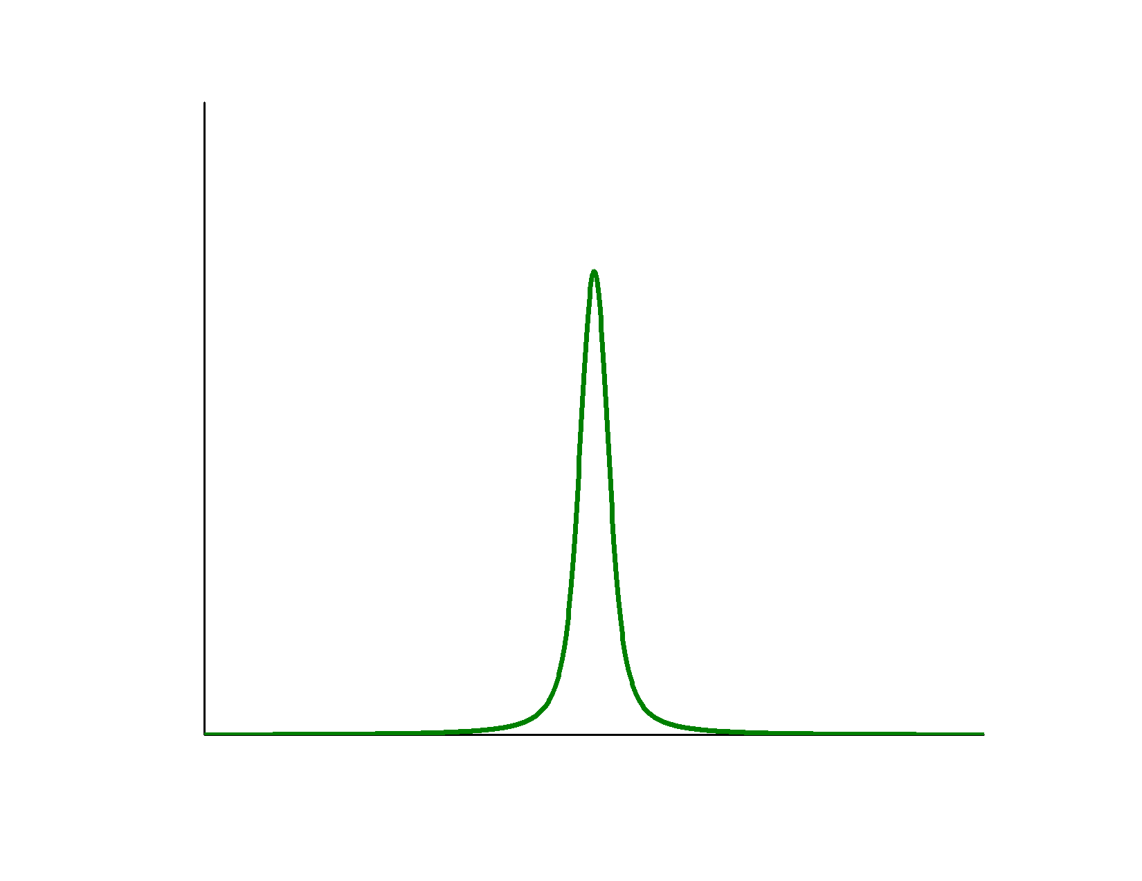
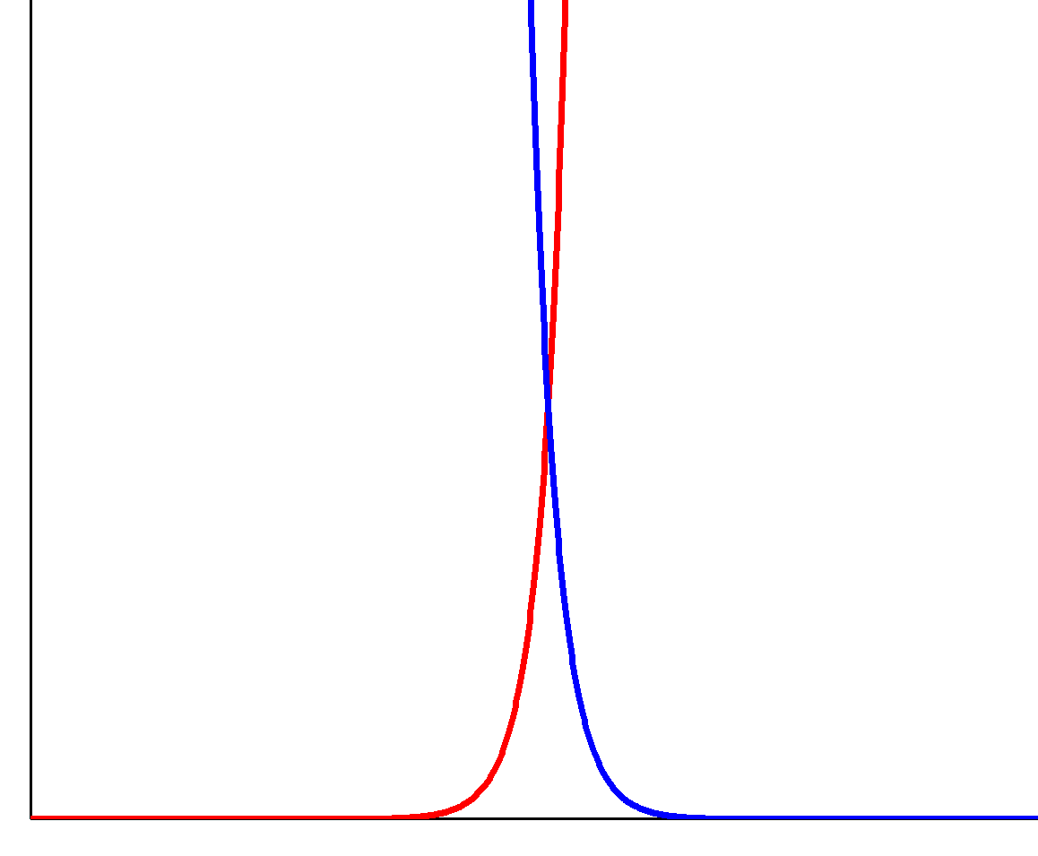
Canonical ensemble: systems interacting with a heat reservoir
The probability of finding A in any of the microscopic states with energy E :
Normalization:
Boltzmann factor:
Degeneracy factor:
Ensemble average of extensive variable x:
The sums are performed over all states r

Slide 6
Average energy and intensive variables
Average energy in a canonical ensemble:
Ensemble average of intensive variable y (conjugate of x):
e.g. ensemble average of p:
Partition function:
Notes:
The definitions of “generalized force” in Callen and Reif differ by a negative sign! Here we follow Callen’s definition.

Slide 7
Partition function and Helmholtz potential
Helmholtz potential

Slide 8
Partition function and Helmholtz potential
The probability distribution of system energy in a canonical ensemble peaks at:
where

Slide 9
Properties of canonical partition function
Classical approximation:
where is the (arbitrary) volume of one state in the phase space
Energy values are relative; entropy has absolute values
Weakly interacting systems:

Slide 10
Summary of canonical ensembles
Probability in one microscopic state r :
Probability in any state with energy E :
The probability function maximizes when:
Partition function
Thermodynamic potential
Ensemble average of energy E and intensive variable y:
which is equivalent to:

Slide 11
Procedures of calculating macroscopic properties of canonical ensembles
Determine the energy levels of the system
Calculate the partition function
Evaluate the statistical ensemble average

Slide 12
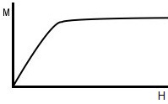
Paramagnetism and the Curie’s Law
Consider one atom with a magnetic dipole:
Two states (+): , (-):
Probability (+): , (-):
Average magnetic dipole:
Curie’s law

Slide 13
Maxwell velocity distribution of ideal gas
One classical ideal gas molecule enclosed in a rigid container at constant temperature T
Energy of gas:
Probability of the molecule having a coordinate between (r ; r + dr) and momentum between (p ; p + dp):

Slide 14
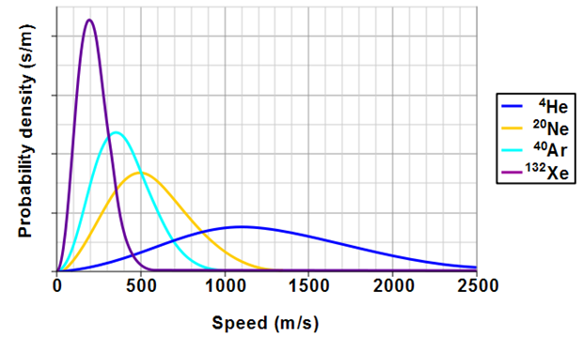
Maxwell velocity distribution of ideal gas
Maxwell velocity distribution of N molecules:
T = 298 K (25 °C)

Slide 15
Number of molecules striking a surface
The # of molecules with velocity between
v and v + dv which strike a unit area of
the wall per unit time:
Total molecular flux:
Application: impurity incorporation during film deposition
θ
dA
vdt

Slide 16
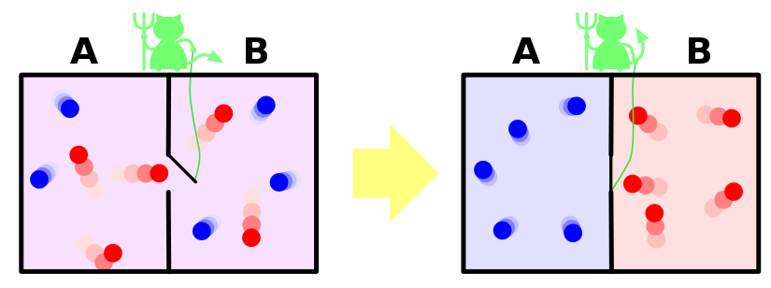
Maxwell’s Demon
A demon opens the door only to allow the “hot” molecules to pass to the right side and the “cold” molecules to pass to the left side → S decrease!
Maxwell’s Demon in action: he is devilishly COOL

Slide 17
Partition functions for general ensembles
Evaluate the boundary conditions for the system
  Determine the variables that are kept constant
Determine the thermodynamic potential for the system
Multiply the TD potential by -β and exponentiate
Sum over all degrees of freedom (energy levels)
Boundary condition
TD potential
Multiply & exponentiate
Sum over energy levels
Canonical ensemble:
thermal interactions only: T & V constant
Helmholtz potential F

Slide 18
Grand canonical ensembles: systems with indefinite number of particles
δQ
T, μ are constant
TD potential: φ = U – TS – μN
Grand canonical partition function:
Probability to be at one microscopic state with energy E_{r} and particle number N_{r} :
Average energy and particle number:
dN
System
Heat & particle source

Slide 19
Grand canonical probability distribution
δQ
dN
Ω_{r} , E_{r}
Ω’ , E’
(thermal equilibrium)
(chemical equilibrium)

Slide 20

Equivalence of ensembles
Microcanonical and canonical ensembles are equivalent in the thermodynamic weak coupling limit
The constant T (canonical ensemble)
and the constant E (microcanonical
ensemble) are connected by:

