Slide 1
MSEG 803
Equilibria in Material Systems
6: Phase space and microstates
Prof. Juejun (JJ) Hu
hujuejun@udel.edu

Slide 2
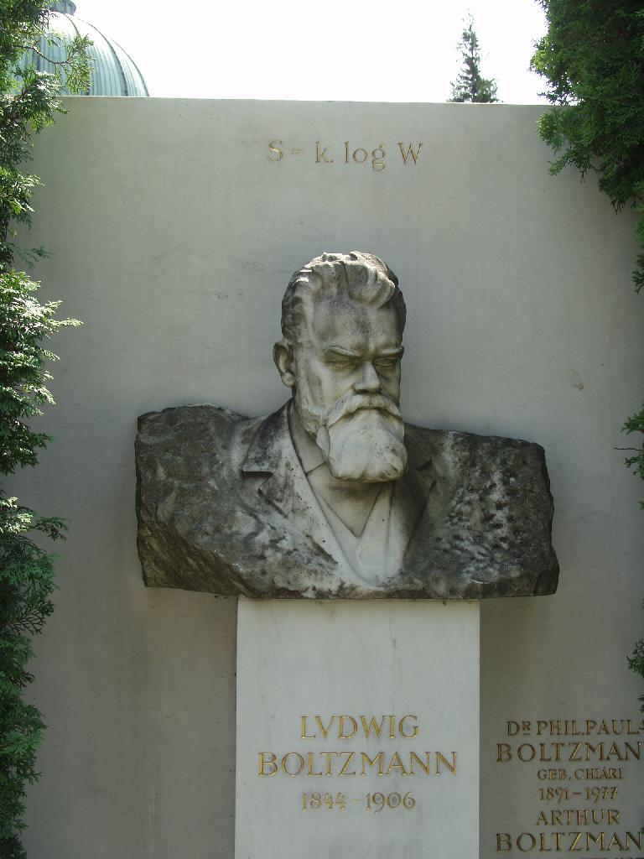
Ludwig Boltzmann
(1844-1906)

Slide 3
Classical description of atomic motion
“Each possible motion of particles that comprise a system consistent with laws of force is called a state.”
1-D motion: coordinate q and momentum p
Newton’s law:
Law of motion:
p
Trajectory
q
Initial state
Phase space
Notes:
The local density of states in the phase space is infinite in the classical picture (or a constant according to the Liouville theorem)

Slide 4
Classical description of atomic motion
For a system consisting of N particles free to move in 3-D space, the phase space has 6N coordinates
In classical mechanics, all particles are distinguishable
Newton’s law:
Law of motion:
p
Trajectory
q
Initial state
Phase space
Notes:
The # of coordinates in the phase space equals the degrees of freedom of the system

Slide 5
Quantum mechanical description
Single particle quantum mechanical states are represented by a vector (or a wave function Ψ )
Normalization condition:
Physical observables are represented by Hermitian operators whose eigenvectors form a complete set
Position:
Momentum:
Energy (Hamiltonian):

Slide 6
Quantum mechanical description
Eigenstates: where is an observable and a is the eigenvalue
Measurement performed on a state with respect to the observable can only yield the eigenvalues
If the measurement of the observable is taken many times on the state , the average of all the results obtained will be:
The eigenstate of the Hamiltonian is time-invariant
provided that is normalized
Notes:
Example: particle in a box

Slide 7
Quantum mechanical description
Time evolution of state
The uncertainty principle
Each state occupies a volume
of ~ in the phase space: phase space quantization
The phase space coordinates are generally operators
Trajectory
Phase space

Slide 8
Example: particle in a box
Solve the Schrodinger eq. for energy eigenstates
where n_{x} and n_{y} are integers (quantum numbers)

Slide 9
Comparing classical and quantum descriptions
Classical mechanics
Quantum mechanics
Trajectory in phase space
Each state has well-defined p and q (a geometric point)
Local density of states in the phase space is infinite (or an arbitrary constant), i.e. the phase space is continuous
Particles are distinguishable
Trajectory in phase space
Each state’s p and q satisfies the uncertainty principle:
The phase space is quantized; each state occupies a volume of ~
Identical particles
Notes:
When identical particles interact (wave function overlaps), it becomes impossible to distinguish between them

Slide 10
Statistical ensemble
An idealization consisting of a large number of mental copies of a system, considered all at once, each of which represents a possible state that the real system might be in
Fundamental postulate: given an isolated system in equilibrium, it is found with equal probability in each of its accessible microstates (microcanonical ensemble)
Notes:
1) Accessible states: states that are consistent with the macroscopic constraints; in this case, the states that have the specified energy and volume
2) The postulate can only be verified by experiments

Slide 11
Example: particle spin in a magnetic field H
3 particle system, each with spin ½
Spin can be (½) up or down (-½), corresponding to magnetic moment m₀ or - m₀
State # | Particle 1 | Particle 2 | Particle 3 | Total M | Energy
1 | 1/2 | 1/2 | 1/2 | 1.5 m₀ | 3 m₀H
2 | 1/2 | 1/2 | -1/2 | 0.5 m₀ | m₀H
3 | 1/2 | -1/2 | 1/2 | 0.5 m₀ | m₀H
4 | -1/2 | 1/2 | 1/2 | 0.5 m₀ | m₀H
5 | 1/2 | -1/2 | -1/2 | -0.5 m₀ | - m₀H
6 | -1/2 | -1/2 | 1/2 | -0.5 m₀ | - m₀H
7 | -1/2 | 1/2 | -1/2 | -0.5 m₀ | - m₀H
8 | -1/2 | -1/2 | -1/2 | -1.5 m₀ | -3 m₀H

Slide 12

Example: simple 1-D harmonic oscillator
Energy:
States with an energy between E and E + dE fall on an eclipse in the phase space
All of these states are equally accessible
Potential
Kinetic
x
E + dE
p
dx
dx
B₁
E
A
Area A is larger than B₁ and B₂ combined: the system is more likely to be found in the states within area A
x
B₂

Slide 13
Relating macroscopic properties with probability distribution of microscopic states
Probability of finding the system in states with the desired property (in a microcanonical ensemble):
Macroscopic parameter X is calculated by integration of summation over the entire phase space:
# of states (systems) with the desired property
Total number of states (systems in the ensemble)
Classical: continuous phase space
Quantum: quantized phase space

Slide 14
Density of states
: number of states having energy between E and E + dE
: number of states having energy less than E
For a system with f degrees of freedom
Density of states (DOS):

Slide 15
Example: particles in a box
1-D case:
# of particles:
# | P 1 | P 2 | P 3 | P 4 | P 5 | P 6 | E
1 | 0 | 0 | 0 | 0 | 0 | 0 | 0
3 | 1 | 1 | 0 | 0 | 0 | 0 | 2
5 | 1 | 1 | 1 | 1 | 0 | 0 | 4
6 | 2 | 0 | 0 | 0 | 0 | 0 | 4
… | … | … | … | … | … | … | …
 | 3 | 3 | 2 | 2 | 2 | 0 | 30
 | 4 | 2 | 2 | 2 | 1 | 1 | 30
 | 4 | 3 | 2 | 1 | 0 | 0 | 30
 | 5 | 2 | 1 | 0 | 0 | 0 | 30
 | 5 | 1 | 1 | 1 | 1 | 1 | 30
Density of states increases rapidly with energy

Slide 16
Example: classical ideal gas
Consider monatomic gas:
Ideal gas consists of non-interacting particles:
p_{y}
R
p_{x}
Notes:
General procedures of deriving omega: 1) write system energy as a function of p and q; 2) integrate in phase space over E to E+dE to get the number of states (proportional to the phase space volume between E and E+dE)

Slide 17
Example: classical ideal gas (cont’d)
p_{y}
R
p_{x}

Slide 18
DOS is determined by external parameters
Ideal gas: where B is a constant independent of V and E
Generally, energy levels of a system is a function of the external paramaters:
where x_{i} are external parameters of the system (extensive or intensive state variables)
Example: energy levels in a magnetic material depends on its volume and applied field

