Slide 1
MSEG 803
Equilibria in Material Systems
4: Formal Structure of TD
Prof. Juejun (JJ) Hu
hujuejun@udel.edu

Slide 2
1st law and 2nd law in a simple system
1st law:
2nd law:
The functions U(S, V, N) and S(U,V, N) are called fundamental equations of a system. Each one of them contains full information about a system.
Generally
energy representation
entropy representation
Notes:
Note the sign difference of generalized work terms in the entropy representation!

Slide 3
Equations of state
The intensive variables in the fundamental equations written as functions of the extensive variables (for fixed mole numbers):
Generally

Slide 4
Chemical potential and partial molar quantities
Chemical potential μ_{i} for the component i
Quasi-static chemical work
The partial molar quantity x (x is an extensive function) associated with the component i (when T, P are constant)
  partial molar volume

Slide 5
Euler relation
U and S are both homogeneous first order functions of extensive parameters
λ is a constant
Let λ = 1
Simple systems

Slide 6
Gibbs-Duhem relation
1st law of TD:
in simple systems
In a single component simple system:

Slide 7
Summary of the formal structure of TD
The fundamental equation by itself contains full information about the system
# of conjugate variables: N
# of generalized work terms: N - 1
# of variables: 2N
# of independent variables (thermodynamic degree of freedom): N - 1
# of equations of state: N
  An individual equation of state does not completely characterize the system
  All equations of state together contain full information about the system (Euler relation)

Slide 8
Example: ideal gas
Not an eq. of state in the energy representation
Not a fundamental equation
Gibbs-Duham eq. in the entropy representation
Combine all 3 equations of state:
Notes:
In a specific problem, either energy or entropy representation may be used – the mathematically convenient representation is usually the preferred choice.
In the resulting fundamental equation, an integrating constant remains because only two equations of state (there are 3 in total) are known and thus we do not have complete information about the system.

Slide 9
Energy minimum principle
Entropy maximum principle: in an isolated system, equilibrium is reached if S is maximized
  When dU = 0 (isolated system), S is maximized in equilibrium
Energy minimum principle: for a given value of total entropy of a system, equilibrium is reached if U is minimized
  When dS = 0, U is minimized in equilibrium

Slide 10
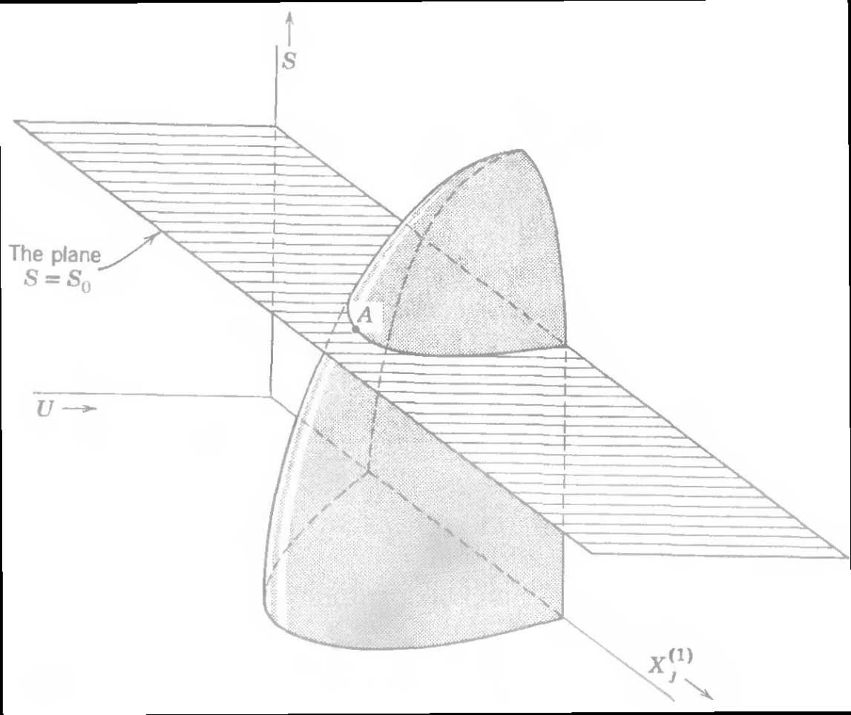
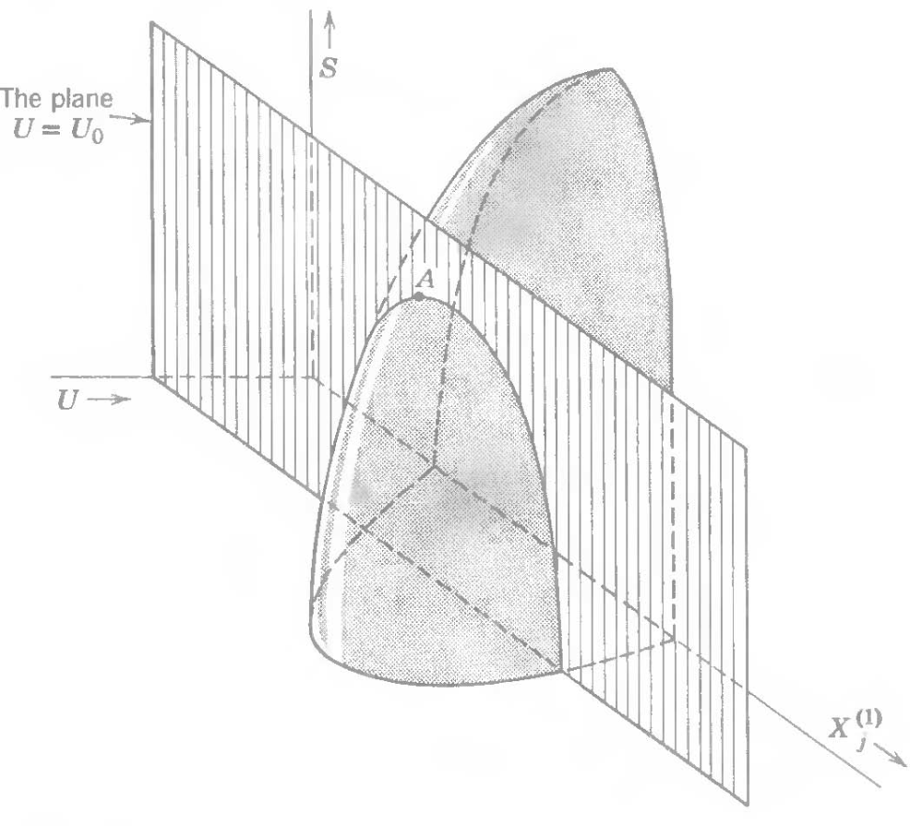
Energy minimum principle
At state A, S takes the maximum value if U is taken as a constant; similarly, U takes the minimum value if S is taken as a constant.

Slide 11
Energy minimum principle
Start with
See Callen section 5-1
Notes:
Energy minimum principle can be proven with a simple argument: if the energy U is not minimized for the given entropy value S at equilibrium (i.e. there exists a state whose internal energy is U’ < U and entropy is still S ), then we can always add energy (U – U’) into the system so that the internal energy reaches U, but now the entropy is greater than S, which contradicts the entropy maximum principle.

Slide 12
Example 1: equilibrium in an isolated system after removal of an adiabatic partition (i.e. only allows heat flow between sub-systems)
T₁
T₂
Constraint:
is a constant
thermal equilibrium
Now, instead of the enclosure condition (dU = 0), let’s start from the new constraint that dS_{tot} = dS₁ + dS₂ = 0
thermal equilibrium: the same equilibrium state results!
Notes:
Note that the physical meaning of dS_{tot} = 0 is a bit vague, as the condition of constant entropy is difficult to realized in practice.

Slide 13
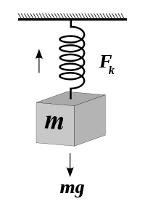
Simple mechanical systems
Entropy remains constant in a purely mechanical system
where
k is the spring constant
x

Slide 14
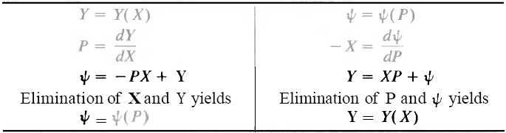
Legendre transformations
Both S and U are functions of extensive variables; however, in practical experiments typically the controlled variables (constraints) are the intensive ones!
Legendre transformations: fundamental relations expressed as functions of intensive variables
Legendre transformations preserve the informational content
Legendre transform of a fundamental equation is also a fundamental equation

Slide 15
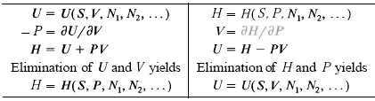
Enthalpy H(S, P, N) = U + PV = TS + μN
Partial Legendre transform of U: replaces the extensive parameter V with the intensive parameter P
For a composite system in mechanical contact with a pressure reservoir the equilibrium state minimizes the enthalpy over the mani-fold of states of constant pressure (equal to that of the reservoir).
Enthalpy change in an isobaric process is equal to heat taken in or given out from the simple system
Differential:

Slide 16
Enthalpy minimization principle
Consider a composite system where all sub-systems are in contact with a common pressure reservoir through walls non-restrictive with respect to volume
Apply U minimum principle to reservoir + system:
The system is in mechanical equilibrium with the reservoir:

Slide 17
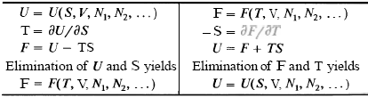
Helmholtz potential F(T, V, N) = U - TS = - PV + μN
Partial Legendre transform of U: replaces the extensive parameter S with the intensive parameter T
For a composite system in thermal contact with a thermal reservoir the equilibrium state minimizes the Helmholtz potential over the manifold of states of constant temperature (equal to that of the reservoir).
Differential:

Slide 18
Helmholtz free energy
System in thermal contact with a heat reservoir
The work delivered in a reversible process, by a system in contact with a thermal reservoir, is equal to the decrease in the Helmholtz potential of the system
Helmholtz “free energy”: available work at constant temperature
Heat reservoir at T
δQ
System
δW
State A → B: dF

Slide 19
Work performed by a system in contact with heat reservoir
A cylinder contains an internal piston on each side of which is one mole of a monatomic ideal gas. The cylinder walls are diathermal, and the system is immersed in a heat reservoir at temperature 0°C. The initial volumes of the two gaseous subsystems (on either side of the piston) are 10 L and 1 L, respectively. The piston is now moved reversibly, so that the final volumes are 6 L and 5 L, respectively. How much work is delivered?
Solution 1: direct integration of PdV (isothermal process)
Solution 2: ΔW = ΔF
Notes:
Callen section 6-2 Example 1

Slide 20
Helmholtz potential minimization principle
Consider a composite system where all sub-systems are in thermal contact with a common heat reservoir through walls non-restrictive with respect to heat flow
Apply U minimum principle to reservoir + system:
The system is in thermal equilibrium with the reservoir:

Slide 21
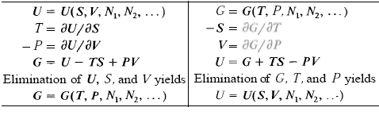
Gibbs potential G(T, P, N) = U - TS + PV = μN
Legendre transform of U: replaces both S and V with the intensive parameters T and P
For a composite system in contact with a thermal reservoir and a pressure reservoir the equilibrium state minimizes the Gibbs potential over the manifold of states of constant temperature and pressure.
Differential:
Notes:
Complete Legendre transform of U vanishes

Slide 22
Gibbs free energy and chemical potential
Simple systems:
Single component systems:
molar Gibbs potential
partial molar Gibbs potential
Multi-component systems:
Consider a chemical reaction:
chemical equilibrium condition
Notes:
Heat released/absorbed in a chemical reaction equals the enthalpy change

Slide 23
First order phase transition
At T_{m} = 0 °C and 1 atm, liquid water and ice can coexist
  dG_{water-ice} = d(H - TS) = 0 at T_{m} = 0 °C, 1 atm
  ΔS_{water-ice} = ΔH_{water-ice}/T_{m} ~ ΔU_{water-ice}/T_{m} at T_{m} = 0 °C, 1 atm
  The discontinuity of H and U are characteristic of first order phase transition
At T > 0 °C and 1 atm, ice spontaneously melts
  dG_{water-ice} = d(H - TS) > 0 at T > 0 °C, 1 atm
  ΔS_{water-ice} > ΔH_{water-ice}/T = ΔQ_{water-ice}/T: irreversible process

Slide 24
Constraints | Thermodynamic potential | Extremum principle | Example
U, V constant dU = 0, dV = 0 | S(U, V, N) = U/T + PV/T - μN/T dS = 1/T*dU + P/T*dV - μ/T*dN | S max dS = 0, d²S < 0 | Isolated systems
S, V constant dS = 0, dV = 0 | U(S, V, N) = TS - PV + μN dU = TdS - PdV + μdN | U min dU = 0, d²U > 0 | Simple mechanical systems consisting of rigid bodies
S, P constant dS = 0, dP = 0 | H(S, P, N) = TS + μN dH = TdS + VdP + μdN | H min dH = 0, d²H > 0 | Systems in contact with a pressure reservoir during a reversible adiabatic process
T, V constant dT = 0, dV = 0 | F(S, V, N) = - PV + μN dF = - SdT - PdV + μdN | F min dF = 0, d²F > 0 | Reactions in a rigid, diathermal container at room temperature
T, P constant dT = 0, dP = 0 | G(T, P, N) = μN dG = - SdT + VdP + μdN | G min dG = 0, d²G > 0 | Experiments performed at room temperature and atmospheric pressure

Slide 25
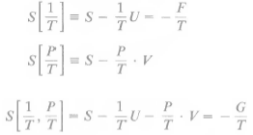
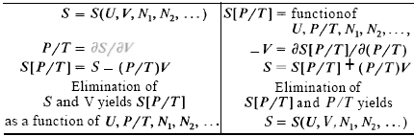
Generalized Massieu functions
Legendre transforms of entropy S
Maximum principles of Massieu functions apply

Slide 26
General case
Legendre transform replaces a variable with its conjugate
For a thermodynamic system, its TD function will be the Legendre transform where the variables are constrained
Controlled variables: ε_{zz}, σ_{xx}, σ_{yy}
is the TD potential that
is minimized in equilibrium
wall
wall
Beam
y
z
x

Slide 27
Deriving equilibrium conditions
Equilibrium in a system surrounded by diathermal, impermeable walls in contact with a pressure reservoir after removal of an impermeable partition (i.e. allows mass flow between sub-systems).
P^{r}
T, N₁
T ,N₂
P^{r}
Constraints:
are constants
is a constant
Gibbs potential minimization:
chemical equilibrium

Slide 28
Coupled equilibrium
+
+
+
+
A box of an electrically conductive solution containing a positively charged ion (+Ze) species is separated into two parts by an impermeable, electrically insulating internal partition. A voltage ΔV is applied across
+
+
+
+
+
-
ΔV_{e}
the two parts. If the partition becomes permeable to the ion but still remains insulating, what is the equilibrium condition with respect to the ion (assuming constant temperature and pressure)?
Fundamental equation:
Constraints:

Slide 29
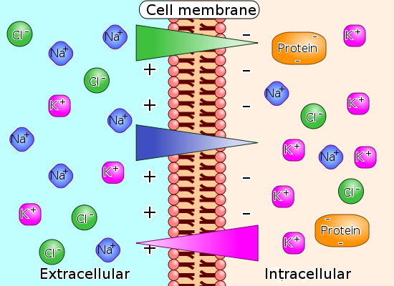
Electrochemical potential
Describes the equilibrium condition of charged chemical species (ions, electrons)
Chemical potential:
Electrochemical potential:
where Z is the valence number of the ion (dimensionless), e is the elementary charge, and V is the local electrical potential
Example: ion diffusion across cell membrane
Notes:
It is common in both solid-state physics and electrochemistry to discuss the chemical potential and electrochemical potential of an electron. However, in the two fields, the definitions of these two terms are sometimes swapped. In electrochemistry, the electrochemical potential of an electron (or any other species) is by definition constant across a device in equilibrium, while the chemical potential is equal to the electrochemical potential minus the local electric potential energy of the electron.[1] In solid-state physics, the opposite definitions are occasionally[2] (but not always)[3] used, where the chemical potential of an electron is by definition constant across a device in equilibrium; while the electrochemical potential is equal to the chemical potential minus the local electric potential energy of an electron.

