Slide 1
MSEG 803
Equilibria in Material Systems
3: Second Law of TD
Prof. Juejun (JJ) Hu
hujuejun@udel.edu

Slide 2
Generalized first law of TD
Energy is conserved!
Can all processes that obey the law of energy conservation proceed spontaneously?
intensive
extensive
Notes:
If this is indeed the case, there will be no “energy crisis” whatsoever in the world!

Slide 3
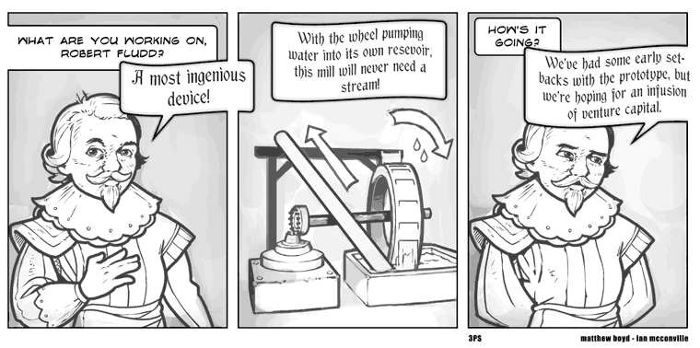
Perpetual motion machines of the 1st kind
Produce work without input of energy
Over 600 patents on perpetual motion machines were granted from 1635 to 1903 in UK only!
Some examples of perpetual motion machines

Slide 4

Perpetual motion machines of the 2nd kind
Spontaneously converts heat into work
H_{out} (ice)
ΔH_{water-ice} = 2261 J/g
To produce 1 hp of power,
Only 330 g of water needs to be turned into ice per second!
work
H_{in} (water)
Notes:
There must be a fundamental limit to the efficiency of converting heat to work; there is no limit on the efficiency of converting work to heat!

Slide 5
Entropy S
Extensive state function S(U, V, N, … ) or S(U₁, U₂, …, V₁, V₂, …, N₁, N₂, … ) for a composite system
Monotonically increases with U, i.e.
and satisfies the relation:
where the equality holds only in reversible processes
The function S has the following property: the values assumed by the extensive parameters in the absence of an internal constraint are those that maximize S over the manifold of constrained equilibrium states.
Notes:
A fundamental postulate and descriptive definition: does not involve any microscopic system properties

Slide 6
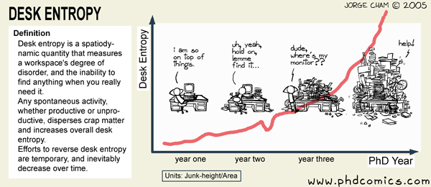
Entropy S
Microscopically, entropy S is a measure of the degree of disorder (# of accessible microscopic states) in a system
An isolated system can spontaneously evolves into a state of higher degree of disorder but not vice versa

Slide 7
Directionality (reversibility) of processes
State A
State B
A → B:
B → A:
Reversible only when

Slide 8
Process reversibility
dS = 0 in an isolated/closed system
  Isolated system: one that cannot exchange energy in the form of heat or work with any other system, i.e. (U = constant)
  dS > 0 in irreversible processes
Reversibility requires the system to be in equilibrium with environment at all times (zero driving force), i.e. reversible processes have to be quasi-static
A quasi-static process, however, is not necessarily reversible
  Friction
Notes:
A lot of textbooks (including Reif) use “quasi-static” and “reversible” interchangeably. Either way is fine as long as friction is noted and separately considered.

Slide 9
Process reversibility (cont’d)
Reif 3.2: Consider an isolated system which evolves from an initial state to a final state due to removal of an internal constraint
  If imposing the constraint on the final state can restore the initial state, then the process is reversible
  If the initial state cannot be restored even with imposition of the constraint, the process is irreversible
Reversibility is a property of a process not a system

Slide 10
Final state : P₁ = P₂
Driving force: P₁ - P₂
P₁ > P₂ : dV change is irreversible
P₁ = P₂ : dV change is reversible
T, P₁
T, P₂
Constraint with respect to volume
Final state : T₁ = T₂
Driving force: T₂ - T₁
T₂ > T₁ : δQ change is irreversible
T₂ = T₁ : δQ change is reversible
T₁, P
T₂, P
Adiabatic partition: constraint with respect to heat flow
Final state : C_{A,1} = C_{A,2}; C_{B,1} = C_{B,2}
Driving force: concentration gradient
dN_{A} and dN_{B} : irreversible
Molecule A
Molecule B
Impermeable partition: constraint with respect to molecular flow
Notes:
Pressure difference: work done by the two parts is different leading to dissipation of energy (lost in viscous flow of gas: internal friction)
Driving force: gradient of some intensive state function(s) – roughly in analogy to bring a mass downhill/uphill
The two ways of identifying process reversibility: zero driving force and restoration after constraint imposition are equivalent

Slide 11
A cylinder of gas separated by a piston which has (arbitrarily) low thermal conductance. As the thermal conductance is low, at any given time, gas in each side of the cylinder can be described by a set
T₁, P₁, V₁
T₂, P₂, V₂
of state functions T_{i}, P_{i}, V_{i} (i = 1, 2). A small heat transfer δQ occurs between the two parts of gas. Is this a reversible process?
Entropy change of sub-system 1:
Entropy change of sub-system 2:
Total entropy change:
Thus the process is irreversible (nor a quasi-static process as the driving force, i.e. temperature difference is not zero).
Notes:
1) Heat spontaneously flow from objects of high temperature to objects of low temperature: dS > 0
2) Heat reservoir and reversible process construction
3) A similar example: micro-free expansion of gas
4) The definition of quasi-static process may vary from one textbook to another in terms of wording.
Callen: A quasi-static process is thus defined in terms of a dense succession of equilibrium states
Reif: A process carried out so slowly that the system remains arbitrarily close to equilibrium at all stages of the process (with reference to relaxation time)
According to Callen, introduction of a non-vanishing thermal conductance fundamentally alters the system property and the heat transfer is no longer quasi-static as the system is not in thermal equilibrium at any stage of the process (in analogy to successive free micro-expansion of gas).
According to Reif, we may argue that the relaxation time of the system is inversely proportional to the piston thermal conductance and thus the system is never “close” to equilibrium no matter how slow the process goes.

Slide 12
Properties of entropy S
Additive: S is an extensive state function
  s(u, v) = S(U, V, N)/N : molar entropy (intensive)
  λS(U, V, N) = S(λU, λV, λN), where λ is a constant (S is a homogeneous first order function of the extensive variables)
S of a system is path independent
S is not conserved
  Example: converting work to heat (Joule experiment)
S of an open system can decrease at the expense of entropy increase of another system
System
δQ
Environment
Notes:
1) Homogeneous first order function does not necessarily imply a linear function!
2) S path independency: e.g. isothermal and free expansion of ideal gas
3) Examples of system S decrease: see slide 9

Slide 13
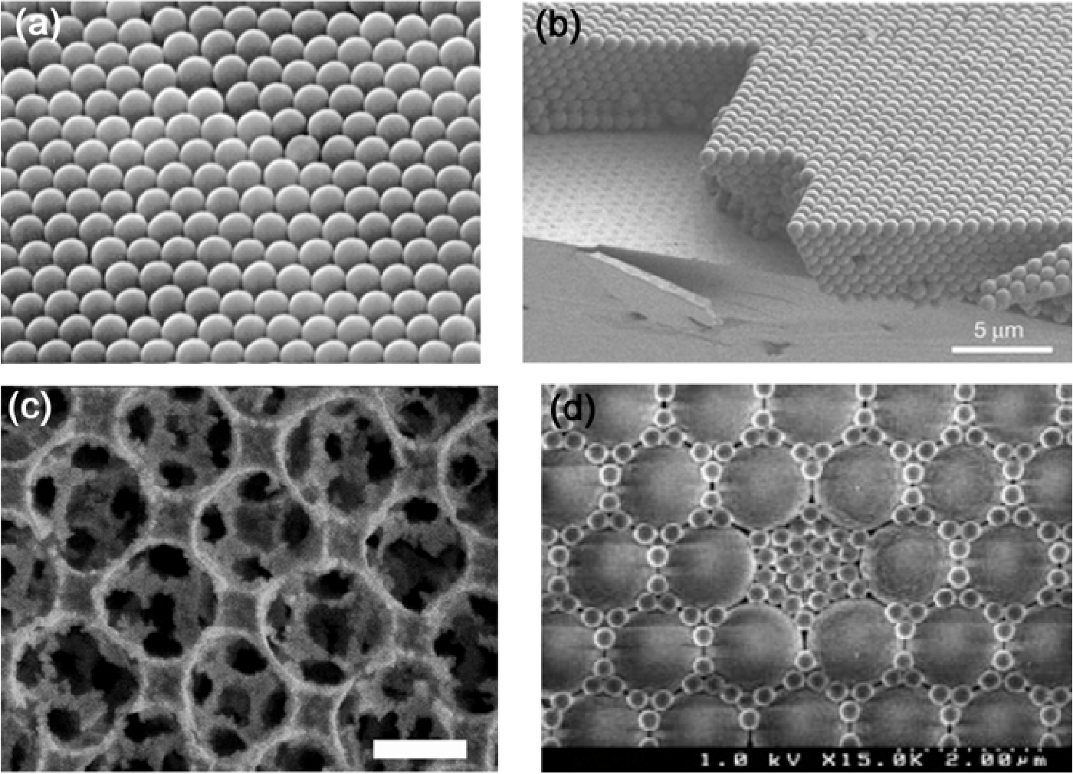
Colloidal crystals: an example of self-assembled structures
Ph.D. thesis, Lindsey Brooks Jerrim Stamm, North Carolina State University (2009).
Notes:
Decrease of gravitational energy (converted to heat) in the sedimentation process leads to overall entropy increase

Slide 14
Deriving equilibrium conditions
In an isolated system, S always maximizes at equilibrium over the set of thermodynamic states consistent with the constraints (the manifold of constrained TD states)
  Equilibrium is attained through re-distribution of some unconstrained extensive parameters
  Equilibrium is reached if: 1) the conjugate intensive parameter (“potential”) of the unconstrained extensive parameter becomes uniform in the system; 2) dS = 0 when the unconstrained extensive parameter is re-distributed by an infinitesimal amount

Slide 15
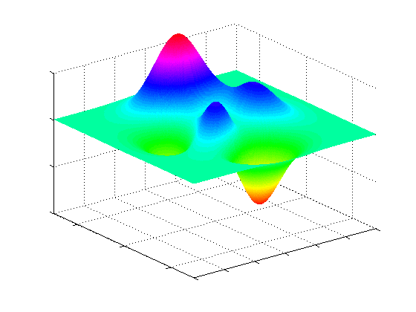
Deriving equilibrium conditions
S
equilibrium state
S
x_{k}
S(x_{k}) when x_{i} = x_{i0}
Constraint: x_{i} = x_{i0}
Unconstrained parameter: x_{k}
At equilibrium, x_{k} assumes the value where S is maximum, i.e. dS = 0 when x_{k} is changed by an infinitesimal amount dx_{k}
x_{k}
(e.g. U₁)
x_{i} = x_{i0}
x_{i} (e.g. V₁)

Slide 16
Deriving equilibrium conditions
Solving equilibrium condition in a composite system after removal of internal constraints
  Apply dS = 0 (maximizing S) under given constraints
Example 1: equilibrium in an isolated system after removal of an adiabatic partition (i.e. only allows heat flow between sub-systems)
T₁
T₂
Constraint:
is a constant
Apply dS = 0:
thermal equilibrium
Notes:
The condition dS = 0 here is not to be confused with dS = 0 in reversible processes: here dS = 0 suggests maximum entropy among the manifold of constrained equilibrium states
For procedures of determining constraints refer to Callen p51 Example 1
If U(S, V, N) for both sub-systems are explicitly known, then the equilibrium condition T1 = T2 can be used in conjunction with the fundamental equations to solve for the final U1 and U2 values
Stability: verify that it is a maximum rather than minimum

Slide 17
Example 2: equilibrium in an isolated system after removal of an adiabatic, rigid partition (i.e. allows both heat flow and volume change of sub-systems)
T₁, V₁
T₂, V₂
Constraint 1:
is a constant
Constraint 2:
is a constant
Apply dS = 0:
and
thermal equilibrium
mechanical equilibrium
Notes:
For proof of dS/dV = - P/T refer to Callen book Appendix A
The terms dS/dy play the role of ‘potentials’ that determines the direction of ‘flow’ of extensive quantities

Slide 18
Example 3: equilibrium in an isolated system after removal of a rigid partition (i.e. allows only volume change of sub-systems)
T₁, V₁
T₂, V₂
Constraint 1:
is a constant
Constraint 2:
is a constant
mechanical equilibrium
Apply dS = 0:
Indeterminate problem

Slide 19
Re-examining
In an irreversible process:
  Dissipation: loss of useful work
To calculate entropy change of a system in an irreversible process, a reversible process can usually be constructed which brings the system under investigation from the same initial state to end state as the irreversible process does
Notes:
Examples: 1) friction
2) Free expansion vs. adiabatic quasi-static expansion: same end state, different dW: extra heat generation due to internal friction of gas
3) Spontaneous heat transfer: adding a “buffer” heat reservoir

Slide 20
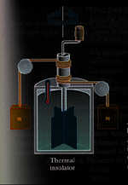
Example: Joule’s experiment
Enclosed by an adiabatic wall
Mechanical work W
Water (system)
Water (system)
Conversion of work to heat
  ΔQ = 0, ΔU > 0
  Entropy change of water ΔS > 0 as
A reversible process can be constructed by successively bringing the system (water) into contact with a series of heat reservoirs

Slide 21
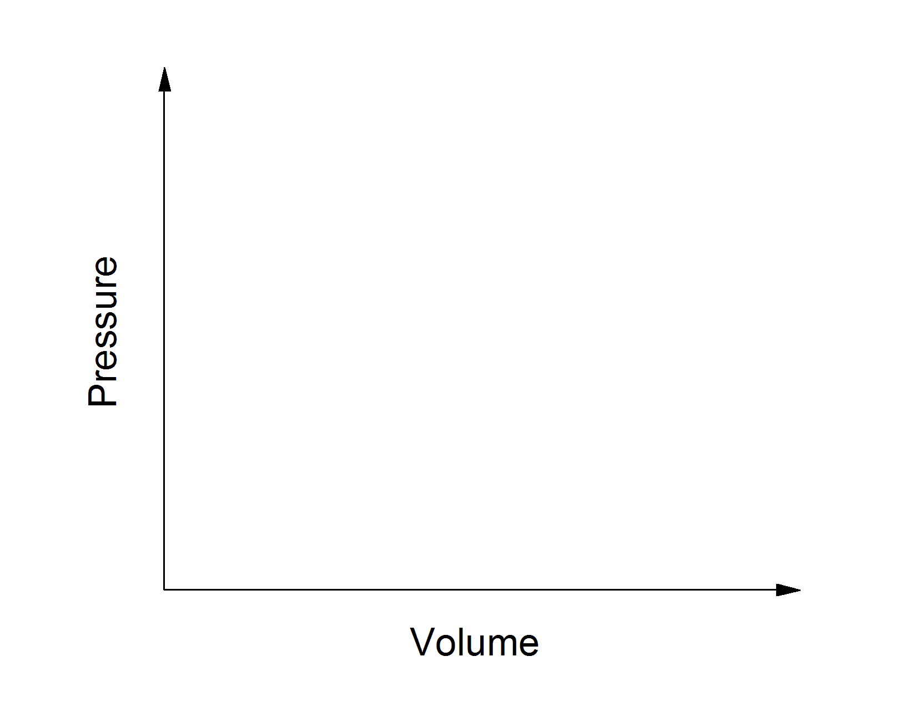
Example: free expansion of ideal gas
Initial state A
Ideal gas
Vacuum
PV = constant
End state B
Ideal gas
C
Notes:
Dotted line is used on the P-V plot for the isotherm as free expansion is not quasi-static and cannot be represented with a curve on the plot
Note that the mole number of gas is implicitly contained in C_{V} = Nc_{v}

Slide 22
The maximum work theorem
For all processes leading from the specified initial state to the specified final state of the primary system, the delivery of work is maximum for a reversible process
Heat reservoir at T
δQ
System
δW
State A → B: dU
Notes:
Note that the sign of dW is negative if we want the system to perform work!
Example: expansion of gas; non-reversible processes such as free expansion and friction decreases useful work

Slide 23
Heat engine
Heat reservoir at T
δQ
System
δW
State A → … → A: dU = 0
Kelvin’s formulation of the 2nd law of TD: it is impossible to construct a perfect heat engine which converts heat to work with 100% efficiency
The system has to restore its initial state for sustainable output
Notes:
Heat can be converted to work with 100% efficiency if the auxiliary system’s entropy increases in the process! e.g. quasi-static isothermal expansion

Slide 24
Heat engine (cont’d)
“Hot” heat reservoir at T₁
δQ₁
System
δW
δQ₂
“Cold” heat reservoir at T₂
Engine efficiency
State A → … → A: dU = 0
Notes:
All engines involving reversible processes (and the same T₁ and T₂) have identical efficiency

Slide 25
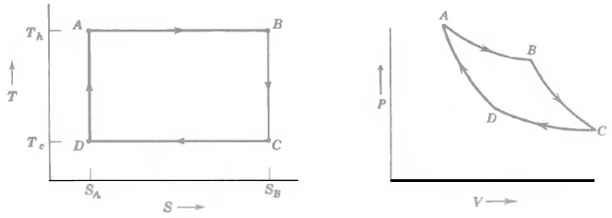
Carnot cycle
A to B (isothermal expansion): dT = 0, δQ > 0, dS > 0, δW < 0
B to C (adiabatic expansion): dT < 0, δQ = 0, dS = 0, δW < 0
C to D (isothermal compression): dT = 0, δQ < 0, dS < 0, δW > 0
D to A (adiabatic compression): dT > 0, δQ = 0, dS = 0, δW > 0
Notes:
It is not limited to ideal gas, so dU might not vanish for processes A to B and C to D
Efficiency of Carnot cycle

Slide 26
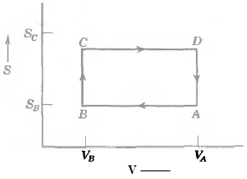
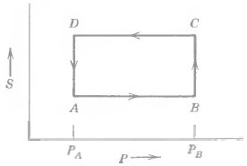
Other reversible heat engine cycles
Otto cycle
Joule cycle
All reversible heat engine cycles have the same efficiency!

Slide 27
Heat pump
Transfers heat from a low temperature reservoir to a high temperature reservoir
Heat pump coefficient of performance:
Can be greater than unity!
“Hot” heat reservoir at T₁
δQ₁
System
δW
for cooling
δQ₂
for heating
“Cold” heat reservoir at T₂
State A → … → A: dU = 0

Slide 28
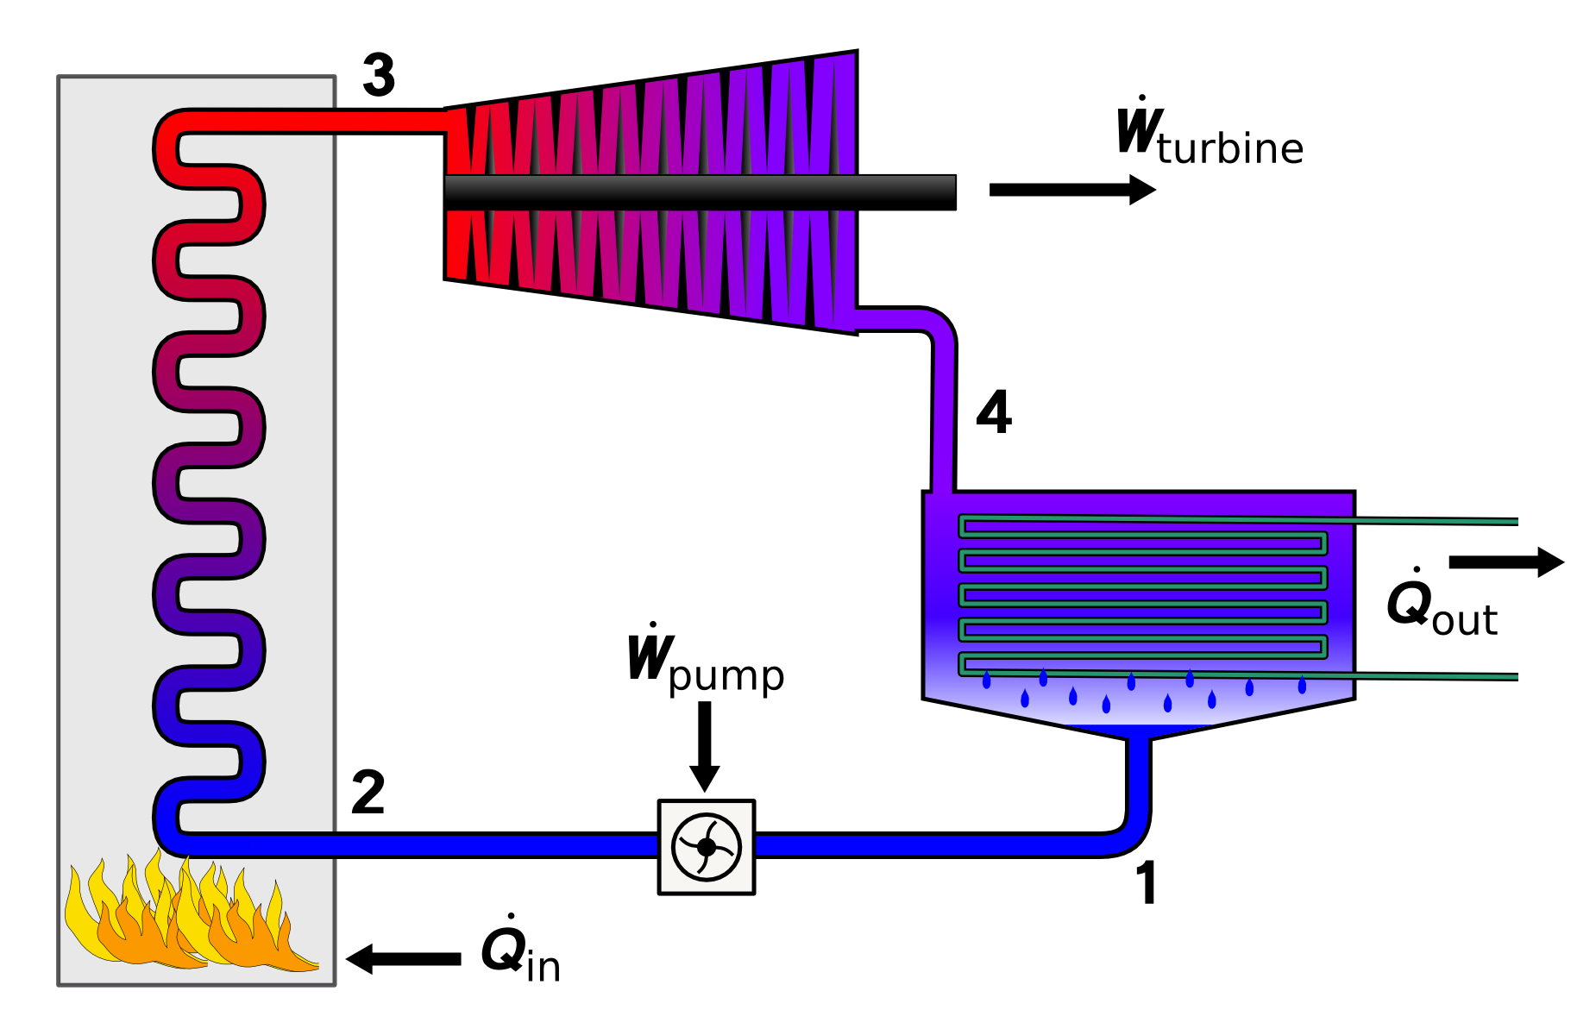
Practical heat engine design: Rankine cycle
Working substance: liquid rather than gas
  Ease of transporting liquid through the system
Turbine
Condenser
Boiler

Slide 29
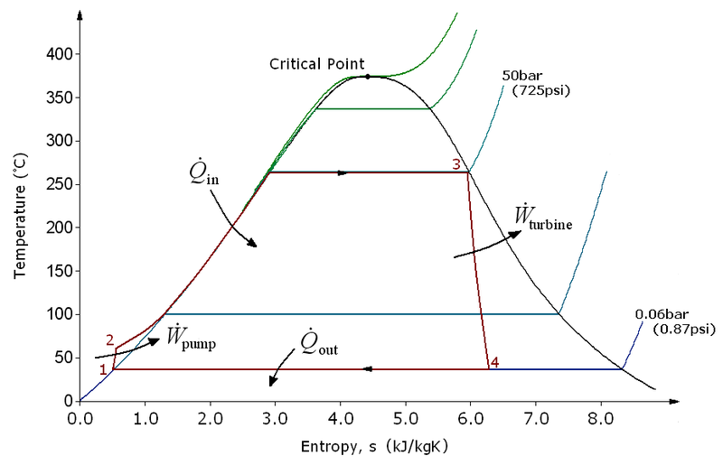
Practical heat engine design: Rankine cycle
Working substance: liquid rather than gas
  Ease of transporting liquid through the system

Slide 30
Entropy of materials
When phase change is not involved:
When phase change is involved:
S
slope: C_{liquid} /T
step: ΔH_{fus} /T_{m}
slope: C_{solid} /T
0
T
Notes:
At low T, dS/dT scales with T^2 (Debye model) – so the straight line in the figure is only a schematic illustration

Slide 31
The 3rd law of thermodynamics
The entropy of any TD system vanishes (S → 0) in as temperature approaches absolute zero
The change of entropy ΔS → 0 in any reversible isothermal process at T → 0 K (Nernst statement)
Heat capacity C → 0 as T → 0 K
In classical thermodynamics, the absolute value of S has no physical significance
  S → 0 can only be derived by statistical mechanics
is a finite number!
Notes:
Glasses are not in thermal equilibrium and their entropy does not vanish at T = 0 K.

Slide 32
Unattainability of absolute zero
We cannot achieve absolute zero by heat transfer alone
δW < 0, dU < 0: the only way to reduce T is to let the system perform work through reversible processes
S
V = V₂ > V₁
(or x = x₂ < x₁)
V = V₁
(or any extensive function x = x₁)
http://ltl.tkk.fi/wiki/LTL/World_record_in_low_temperatures
T
0
Notes:
Note the sign difference between V and x
In practice, magnetization rather than volume is the extensive variable used in cooling (adiabatic demagnetization)

