Slide 1
MSEG 803
Equilibria in Material Systems
11: Phase Transition
Prof. Juejun (JJ) Hu
hujuejun@udel.edu

Slide 2
Ehrenfest classification of phase transitions
First order phase transition
  Transitions that exhibit a discontinuity in the first derivative of TD potential with respect to some thermodynamic variable
  Boiling: liquid-vapor phase transition
  Both S and V are discontinuous in liquid-vapor transitions
Second order phase transition
  Transitions that are continuous in the first order derivative of TD potential discontinuous (divergent) in a second derivative
  Second order derivatives:

Slide 3
Equilibrium between phases
At constant T and P :
For a single phase, stable system: dG = - SdT + VdP
G
G
T
P

Slide 4
Gibbs free energy of phases
G
Vapor
At T_{m},
Liquid
Solid
T_{s}
T_{m}
T_{b}
T

Slide 5
Calculating phase transition temperature
At 293 K, the enthalpy and entropy changes during the vapor-liquid phase transition of water is 44.17 kJ/mol and 119.5 J/mol·K⁻¹, respectively. Estimate T_{b} of water.
At boiling point, ΔG = 0
Deviation from 373 K due to:

Slide 6
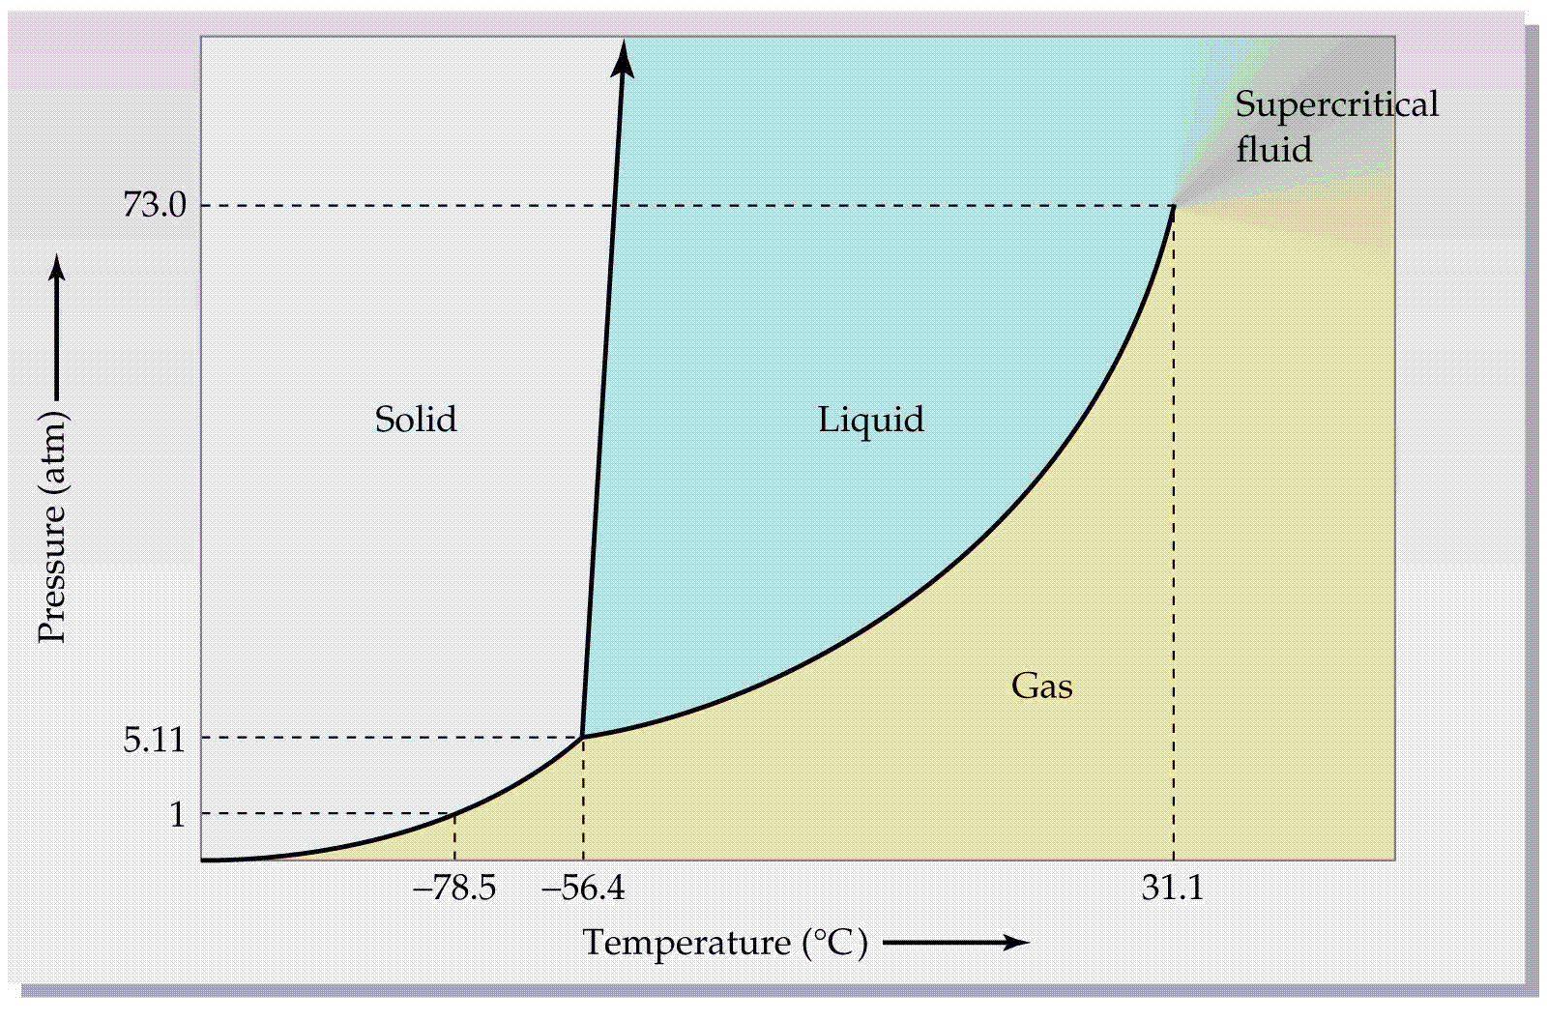
Phase diagram (CO₂)
Critical point
Triple point

Slide 7
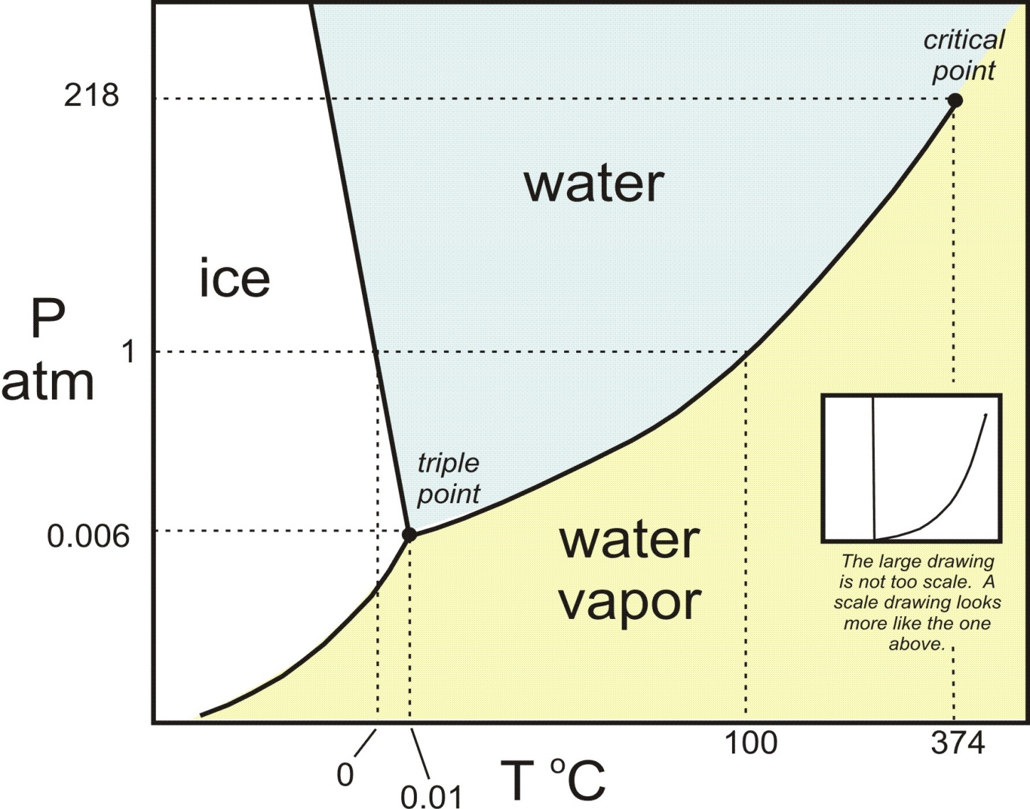
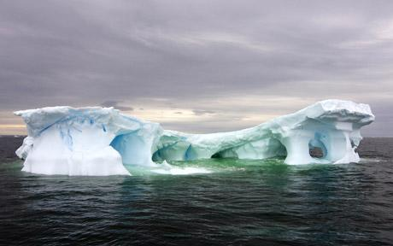
Phase diagram (H₂O)
Negative slope

Slide 8
Slope of P-T coexistence lines
Along the coexistence curve dG = 0, i.e. ,
Clapeyron equation
P
P
α
α
2
1
β
β
T
T

Slide 9
Ice melting under pressure
A bag of mass M = 8 kg are hung by a rope over a rod of ice. The contact area between the rope and the ice rod is S = 20 mm². The latent heat of fusion of water is 336 J/gram, the density of liquid water is 1 gram/cc and ice cubes float with ~ 0.8 of their volume submerged. Calculate the melting point of ice under the rope.
Solution:
Ice melts faster under high pressure

Slide 10
Clapeyron equation
The impact of pressure on phase transition temperature is most significant for liquid-vapor transition
  If you try to cook an egg in boiling water while camping in the Rocky Mountains at an elevation of 10,000 feet, you will find that it takes longer for the egg to cook because water boils at only 90ºC at this elevation
The coexistence curve between solid-liquid phases are almost perpendicular to the temperature axis
  Typical values:

Slide 11
Clausius-Clapeyron equation and vapor pressure
Vapor-liquid phase transition
  Neglect the volume of liquid phase:
  Assume the gas is ideal:
Clausius-Clapeyron equation
If is temperature-independent:
If ,

Slide 12
Generalized Clapeyron equation
General system
Legendre transform:
Generalized Clausius-Clapeyron equation

Slide 13
Degrees of freedom in single component systems
Variables in a single component system: T, P, and μ
In a single phase system, μ can be written as a function
of T and P (Gibbs-Duhem relation ),
thus the independent variables are T and P
In a system containing two phases I and II, chemical
equilibrium condition reduces the number of
independent variables to 1
In a system containing three phases I, II and III, two
chemical equilibrium conditions leads to a
unique set of T and P values (0 independent variables at
the triple point)

Slide 14
Gibbs Phase rule
Consider a system containing r components and M phases in equilibrium. The complete set of variables are T, P, and x₁, x₂, … x_{r-1} for each phase, where x_{i} is the molar fraction of the component i
Only r-1 molar fractions are independent as
The total number f of variables are thus 2 + M·(r-1)
Between each two phases I and II, chemical equilibrium holds for all r components giving r·(M-1) equations:
Thus the total number f of independent variables are:

Slide 15
Binary phase diagrams
Variables: T, P, and x₁
Usually plotted for constant P values:
An excellent phase diagram library:
Categories
  Solid solution: two components completely miscible
  Eutectic
  Peritectic
http://www1.asminternational.org/asmenterprise/apd/

Slide 16
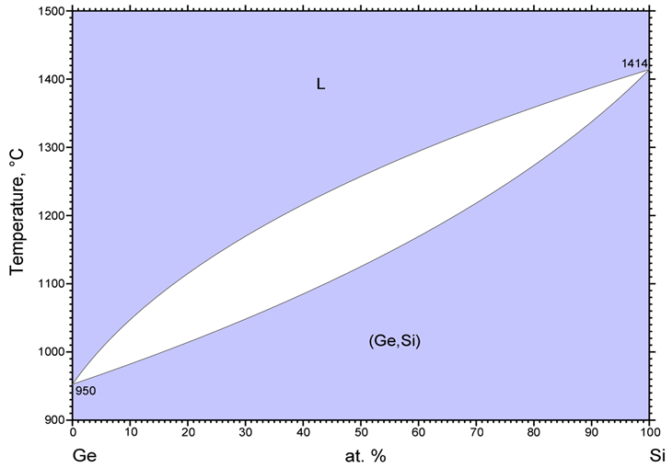
Solid solution
36%
66%

Slide 17
Calculating phase composition
Lever rule
  1 and 2 two phases coexist in a x-y two component system
  System composition: x component a%, y component (1-a)%
  Phase 1 composition: x component a₁%, y component (1-a₁)%
  Phase 2 composition: x component a₂%, y component (1-a₂)%
  The system contains phase 1 b₁% and phase 2 b₂%
Example: 0.5 Si - 0.5 Ge alloy at 1200 °C
  a% = 50%, a₁% = 36%, a₂% = 66%

Slide 18
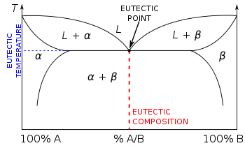
Eutectic
liquidus
solidus

Slide 19
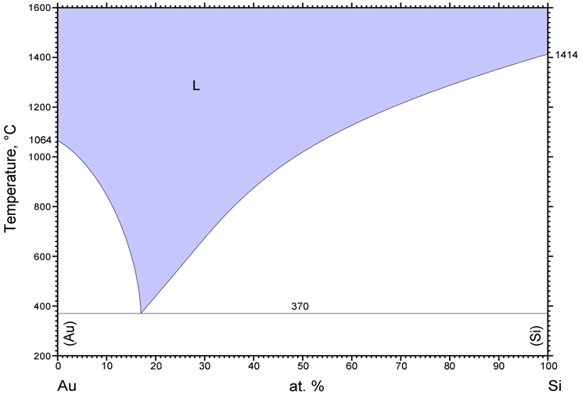
Eutectic
Notes:
The concept of “line compounds”

Slide 20

Vapor-Liquid-Solid (VLS) growth of silicon nanowires
Interface where growth continues
SiCl₄ vapor + H₂
Growth direction
Melted gold nano-particles saturated with SiH₄
Substrate
Substrate
Heterogeneous nuleation of Si at the interface
Diameter of nanowire is determined by the gold droplet size
Temperature for Si deposition on a planar substrate (requires homogeneous nucleation): ~ 800 ˚C

Slide 21
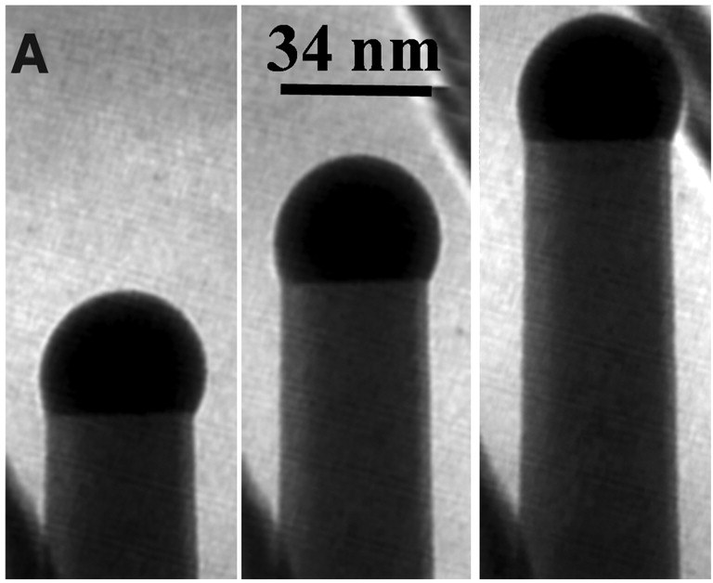
Nanowires formed by VLS growth
Gold nano-particle
Growth direction
“Germanium Nanowire Growth Below the Eutectic Temperature,”
S. Kodambaka, J. Tersoff, M. C. Reuter, and F. M. Ross, Science 316, 729 (2007).

Slide 22
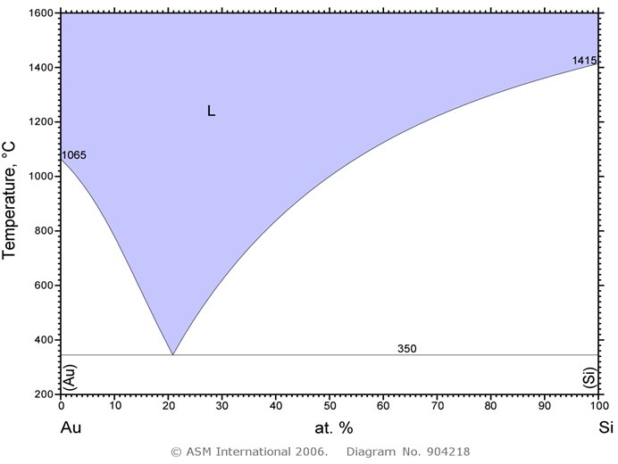
Why gold?
Reason #1:
Low eutectic temperature
Question: what would happen if we were to grow nanowires at high temperature?
“The influence of the surface migration of gold on the growth of silicon nanowires,” Nature 440, 69-71 (2006).

Slide 23
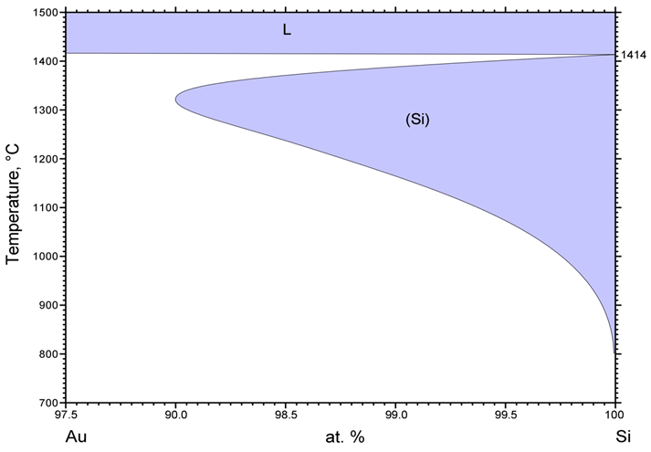
Why gold?
Reason #2:
Small gold solubility in Si (Eutectoid transformation)
Question: why is such small solubility important?
99.8%
Solubility: 0.2%
Albert P. Levitt, Whisker Technology (1975).

Slide 24
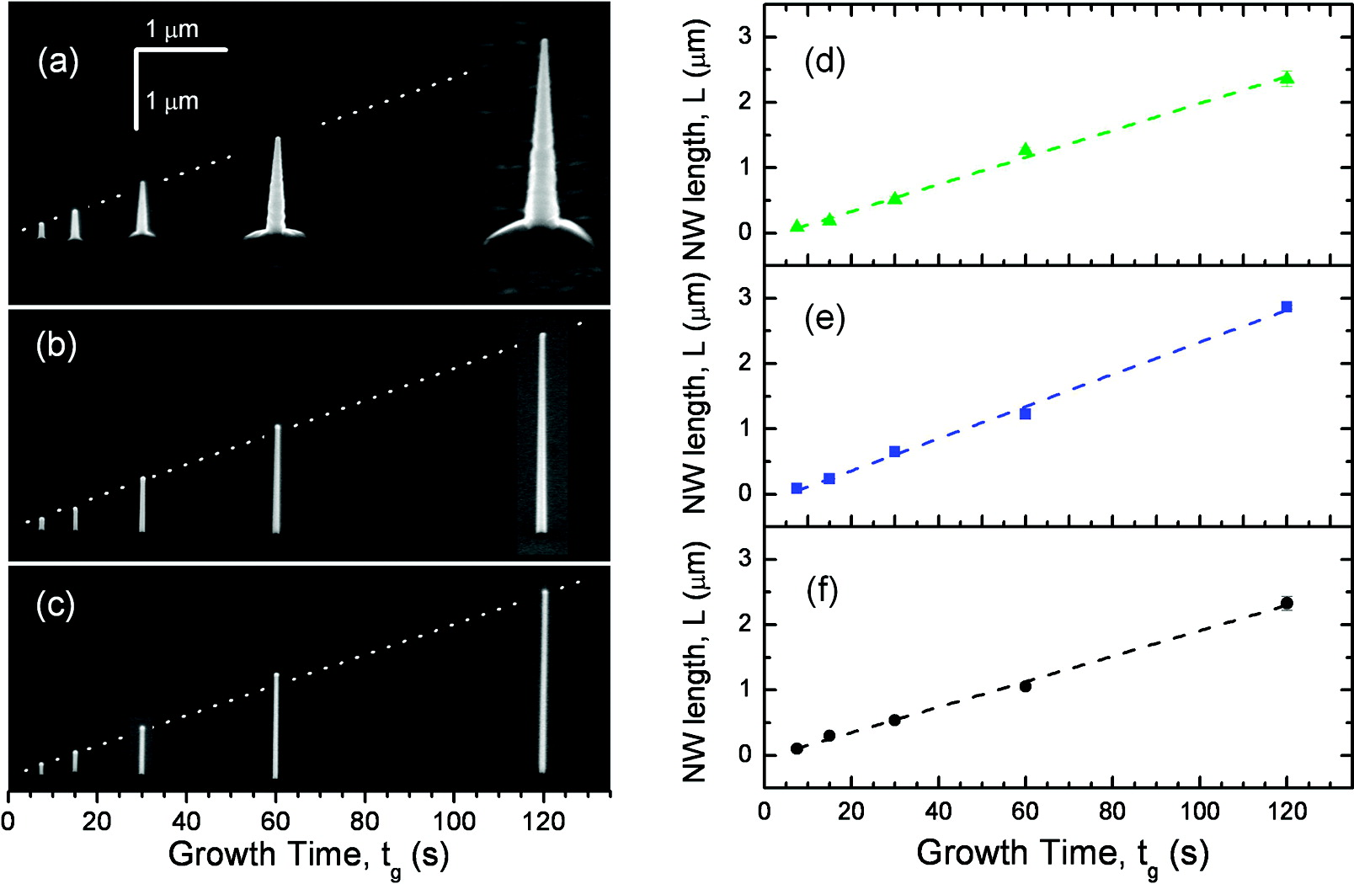
Tapering during nanowire growth
“A Systematic Study on the Growth of GaAs Nanowires by Metal-Organic Chemical Vapor Deposition,” Nano Lett. 8, 4275-4282 (2008).

Slide 25
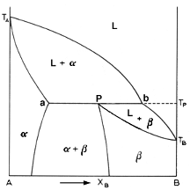
Peritectic

Slide 26
