Slide 1
MIT 3.156/3.46
Photonic Materials and Devices
9: Nonlinear Optics
Juejun (JJ) Hu
hujuejun@mit.edu

Slide 2
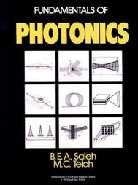
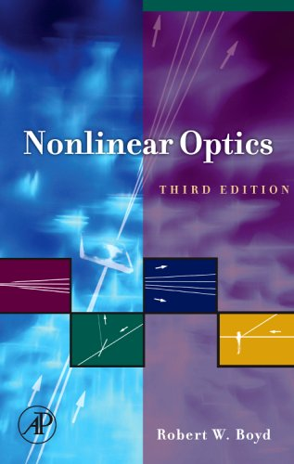
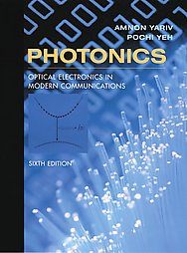
References
Fundamentals of Photonics
  Ch. 18 and 19
Nonlinear Optics
  R. W. Boyd
Photonics: Optical Electronics in Modern Communications
  A. Yariv and P. Yeh
  Ch. 8, Ch. 9 and Ch. 14

Slide 3



“The study of non-linear physics is like the study of non-elephant biology.”
-- Stanislaw Ulam, a mathematician
Non-elephant biology???

Slide 4

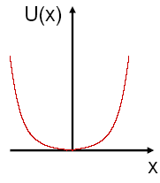
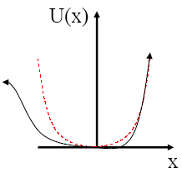
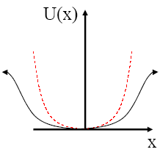
Atomic origin of optical nonlinearity
Induced dipole moment
Atomic nucleus
Charge density
Electron charge
Displacement
Simple harmonic oscillator model (linear)
Restoring force
Lorentz-Drude
Damping
Restoring
Driving
Electronic charge
Linear polarization: parabolic potential
2nd order nonlinearity: Pockels media
3rd order nonlinearity: Kerr media
2nd order nonlinearity is absent in crystals with centro-symmetry!
F = kx
F = kx + k₂x²
F = kx + k₃x³

Slide 5
Nonlinear polarization
Linear medium: low field intensity
Nonlinear medium: high field intensity
Linear polarization
Nonlinear polarization
Linear susceptibility tensor
2nd order nonlinear susceptibility tensor
3rd order nonlinear susceptibility tensor
i, j, k = x, y, z
Summation over repeated indices
Notes:
Dijkgraaf

Slide 6
Symmetry and nonlinearity
Symmetry of susceptibility tensors
In lossless media, the nonlinear coefficients are invariant under reshuffling of their indices
  The 2nd order susceptibility tensor of a lossless medium contains 10 independent nonlinear coefficients
2nd order nonlinearity is absent in crystals with centro-symmetry as well as in glasses/liquids
permutation of the indices jkl
Centro-symmetry

Slide 7
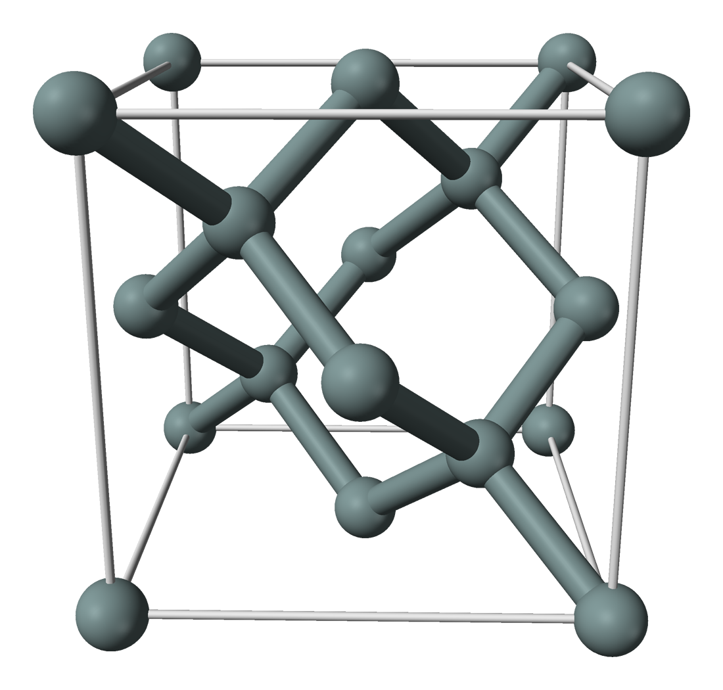
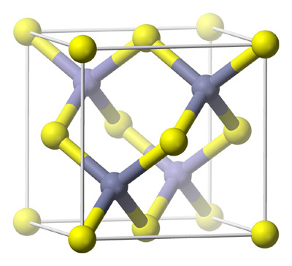
Symmetry and nonlinearity: Si vs. GaAs
Inversion center
Silicon: diamond structure
GaAs: zinc blende structure
3rd order nonlinearity only
2nd & 3rd order nonlinearity

Slide 8
Glass/polymer poling produces 2nd order nonlinearity
Glass bulk
DC (kV)
where the frozen-in E_{DC} results from movement of alkaline ions
T > T_{g}
Material | d ⁽²⁾ (pm/V) | Component
GaAs | 181 | d₁₄
LiNbO₃ | 8.8 / 5.8 | d₁₅ / d₂₂
Ge-Sb-S | 8.0 | d₂₂
Thermal poling:
Apply a high voltage (E_{DC} ~ 10⁶ V/m) at T < T_{g} and then quench the sample to RT w/o removing the electric field to “freeze in” the polarization.
Adv. Funct. Mater. 17, 3284-3294 (2007).
Opt. Express 14, 1524-1532 (2006).

Slide 9
Nonlinear optical effects
2nd order optical nonlinear effects
  Pockels/electro-optic effect
  Second harmonic generation (SHG)
  Sum/difference frequency generation (SFG/DFG)
  Optical parametric amplification/oscillation (OPA/OPO)
3rd order optical nonlinear effects
  Optical Kerr effect/quadratic Pockels effect
  Third harmonic generation (THG)
  Four wave mixing (FWM)
  Two photon absorption (TPA)
  Stimulated Raman/Brillion scattering (SRS/SBS)

Slide 10


General methodology for nonlinear optics
Write the expression of electric field in medium
  e.g. in an optical waveguide
Calculate the linear and nonlinear polarization
Substitute in to the electromagnetic wave equation
Focus on the terms
with relevant frequencies
And then go do the math !
Source term

Slide 11
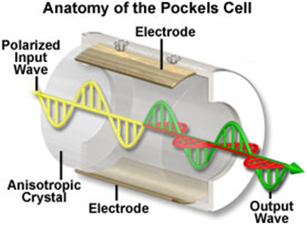
Pockels effect / Electro-optic (EO) effect
2nd order optical nonlinearity
Externally applied electric field modifies the optical properties of materials
  Refractive index, bifringence, etc.
Total electric field:
(E₀ << E_{ex})
Polarization oscillating at the optical frequency
Dielectric constant change due to 2nd order nonlinearity
Static polarization

Slide 12
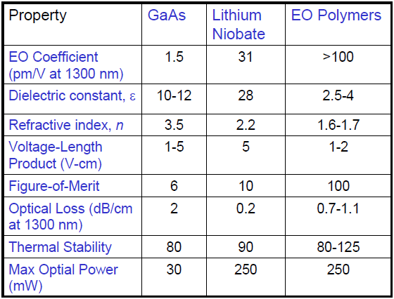
Electro-optic materials
Electro-optic coefficient r_{ij}
MIT 6.731 Semiconductor Optoelectronics: Theory and Design

Slide 13
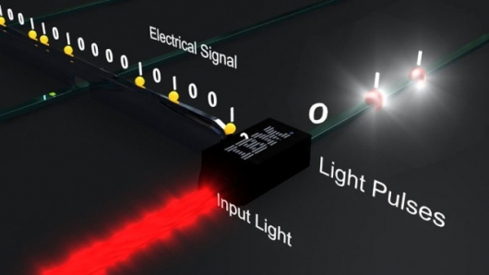
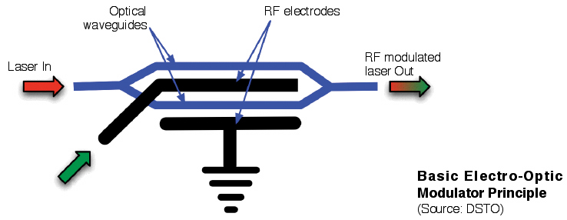
Electro-optic modulators
Encodes 1/0 signal streams onto an optical beam
Electro-optic materials: LiNbO₃, III-V, EO polymers
Mach-Zehnder interferometer E-O modulator

Slide 14
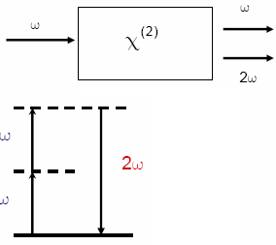
Second harmonic generation (SHG)
2nd order optical nonlinearity
Use light with wavelength λ = λ₀ to generate light with λ = λ₀ / 2
  Frequency doubling ω = 2ω₀
Energy is conserved
Total electric field:
Radiating dipole with a frequency ω = 2ω₀
Rigorous solution:

Slide 15
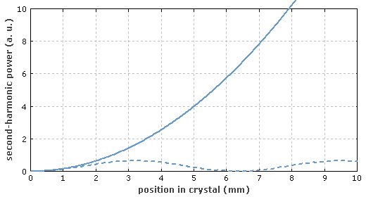
Phase matching condition
Only when 2k₁ = k₂ will SHG be efficient
  n (λ₁) = n (λ₂)
General rule for parametric processes
  SHG, SFG/DFG, THG, FWM
  Momentum conservation
~ 100% SHG conversion efficiency is possible by optimizing phase matching!
2k₁ = k₂
2k₁ ≠ k₂

Slide 16

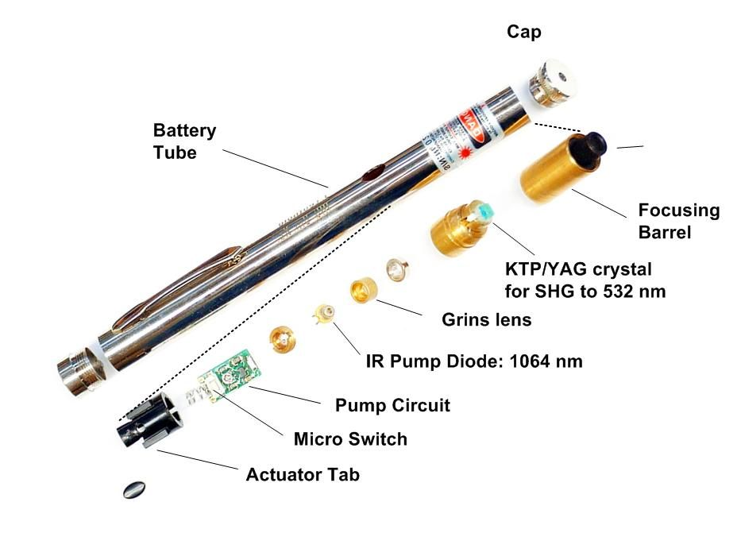
Green lightsaber ???
Diode pumped solid state (DPSS) laser

Slide 17
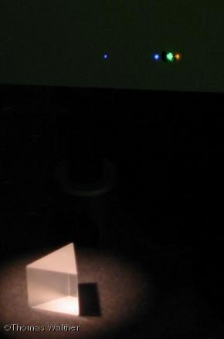
Sum frequency generation (SFG)
Difference frequency generation (DFG)
2nd order optical nonlinearity
Start with two beams ω = ω₁ and ω = ω₂
  SFG: ω₃ = ω₁ + ω₂ , k₃ = k₁ + k₂
  DFG: ω₃ = ω₁ - ω₂ , k₃ = k₁ - k₂
SFG/DFG for photodetection
  Use a 1060 nm laser to convert 10 μm mid-infrared radiation to 960 nm near-infrared radiation that can be handled by low-cost detectors
SHG
Laser emission
Sum frequency
Pump laser
"Mid-infrared single-photon counting," Opt. Lett. 31, 1094-1096 (2006).
Image courtesy of Institut für Angewandte Physik

Slide 18
Optical Kerr effect
Third harmonic generation (THG)
3rd order optical nonlinear effects
3rd order optical nonlinearity is present in all materials
Total electric field:
Optical Kerr effect: light-induced refractive index change
Consider the ω term
Change of the maginary part of non-linear index: two photon absorption
Third harmonic generation (THG): frequency tripling
Consider the 3ω term

Slide 19
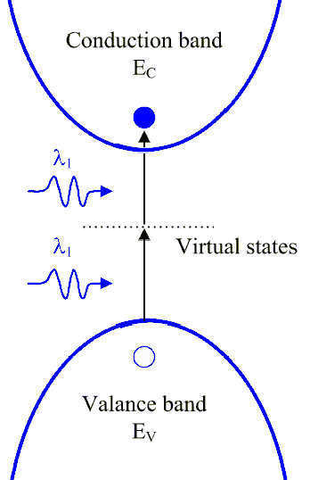
Two photon absorption (TPA)
Bimolecular process
  Absorption depends quadratically on light intensity
  Absorption coefficient
Superior spatial confinement of photo-physical and photo-chemical reactions
  3-d patterning using two photon polymerization (TPP)
  Resolution beyond the diffraction limit

Slide 20
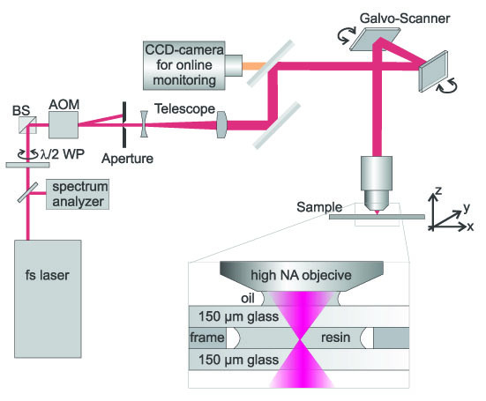
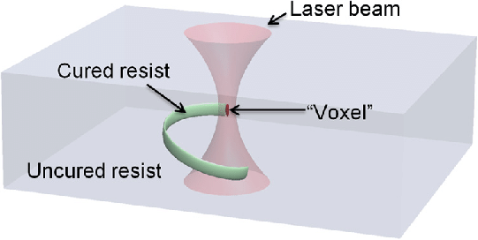
Two photon absorption (TPA)
Opt. Express 12, 5221 (2004)
Bimolecular process
  Absorption depends quadratically on light intensity
  Absorption coefficient
Superior spatial confinement of photo-physical and photo-chemical reactions
  3-d patterning using two photon polymerization (TPP)
  Resolution beyond the diffraction limit

Slide 21
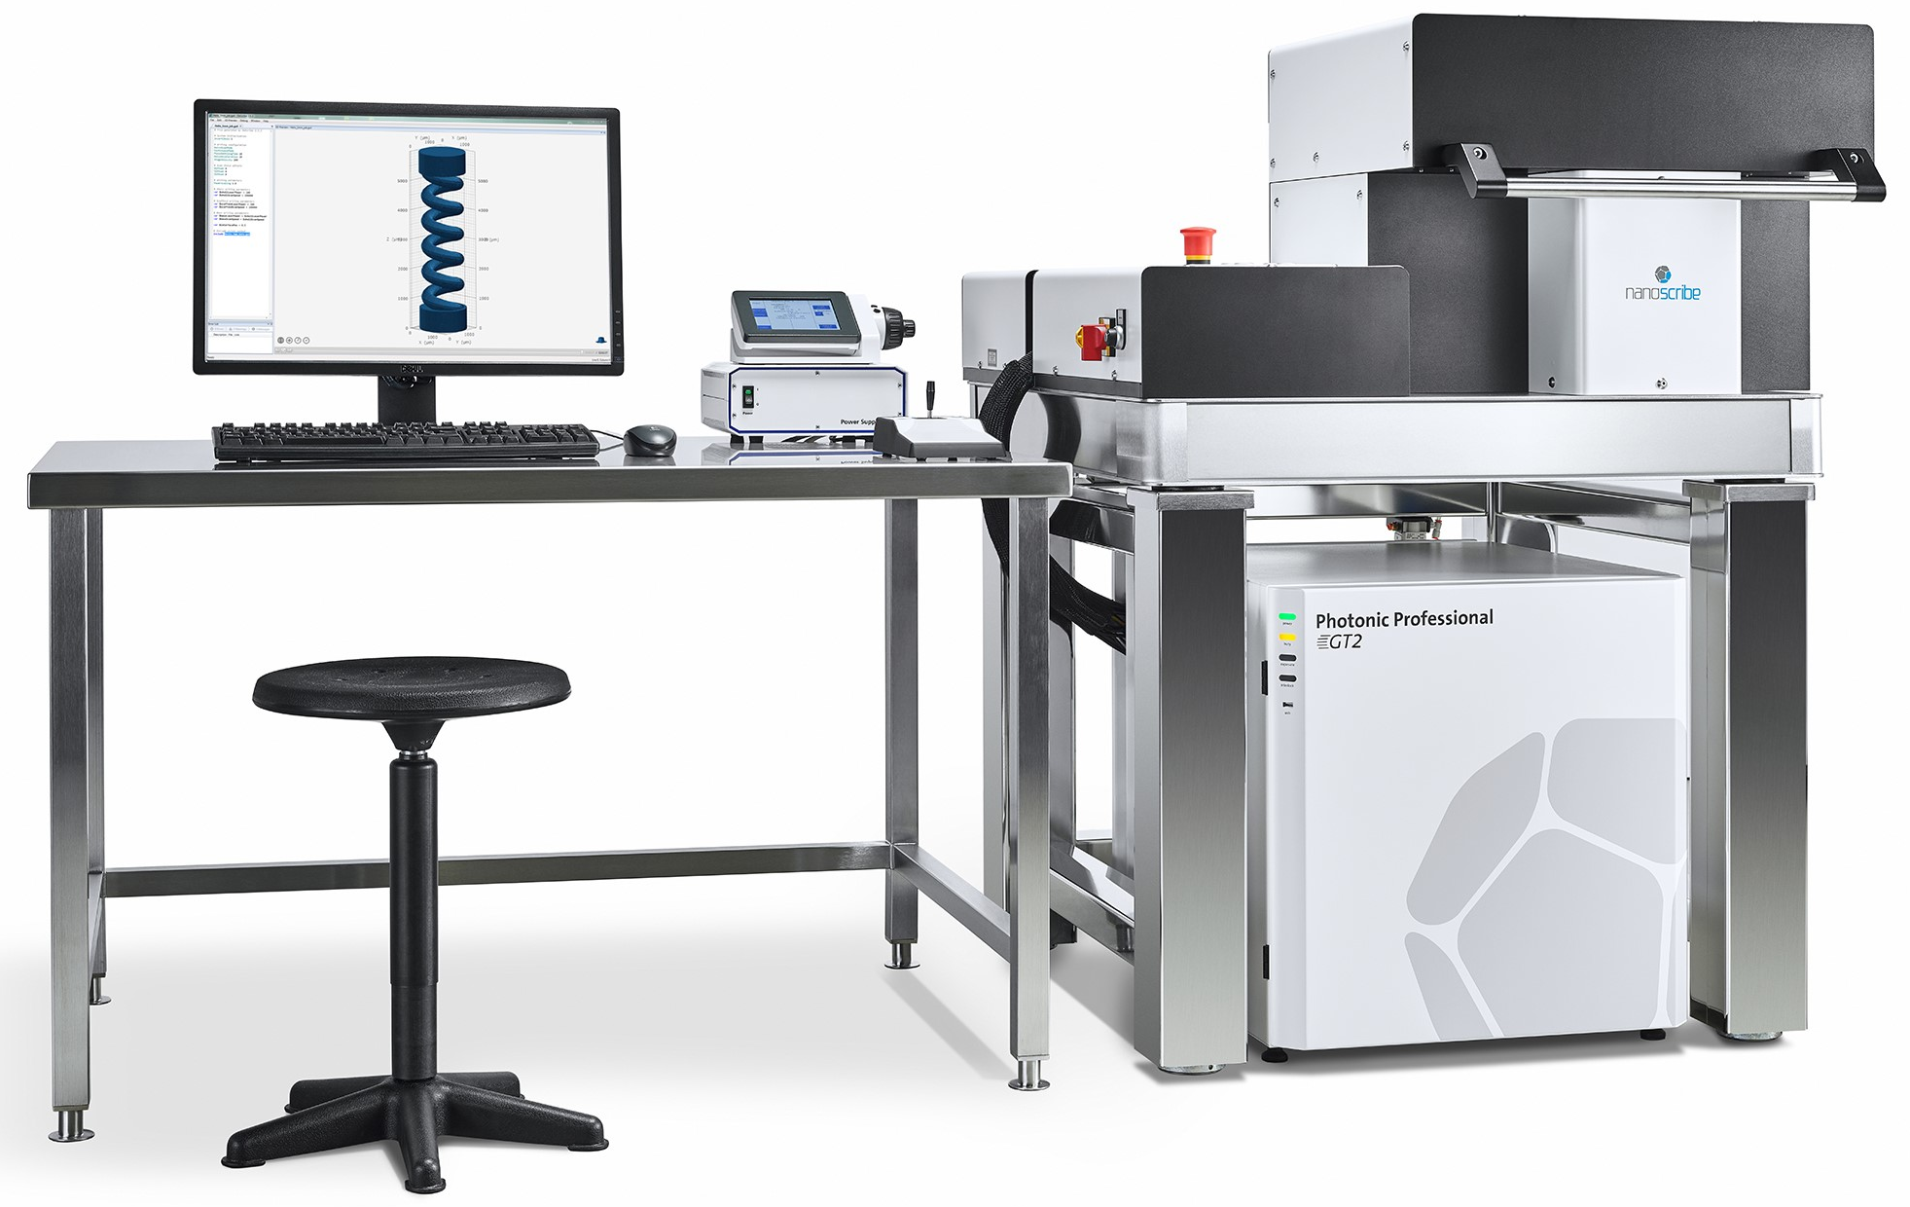

Two photon absorption (TPA)
Bimolecular process
  Absorption depends quadratically on light intensity
  Absorption coefficient
Superior spatial confinement of photo-physical and photo-chemical reactions
  3-d patterning using two photon polymerization (TPP)
  Resolution beyond the diffraction limit
Photonic Professional GT2
Wavelength |  | 780 nm
Minimum XY feature size |  | 160 nm typical; 200 nm specified
Build volume |  | 100 × 100 × 8 mm³
Scan speed |  | ≥ 100 mm/s

Slide 22
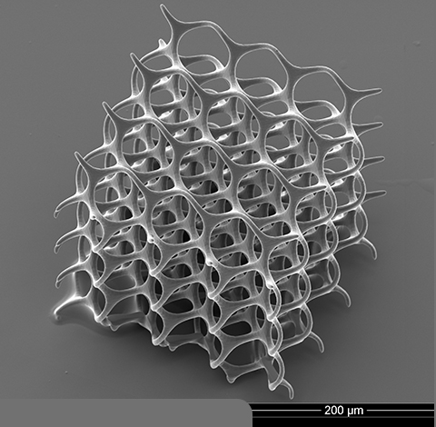
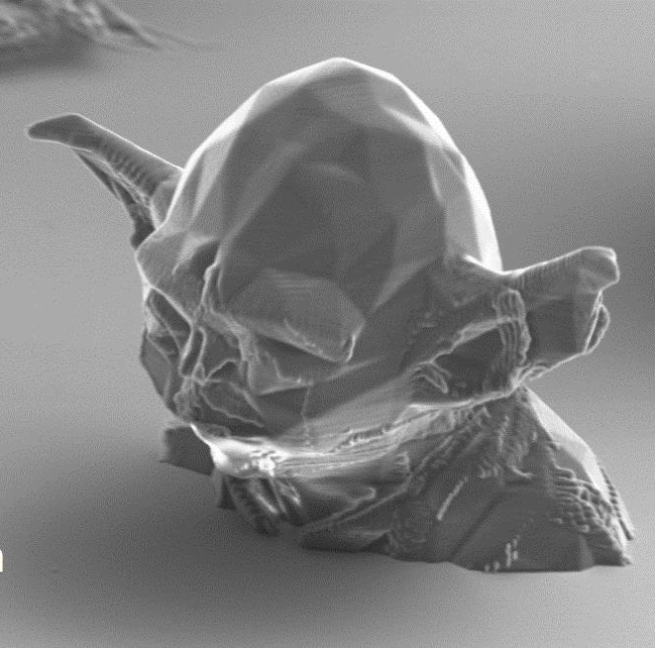
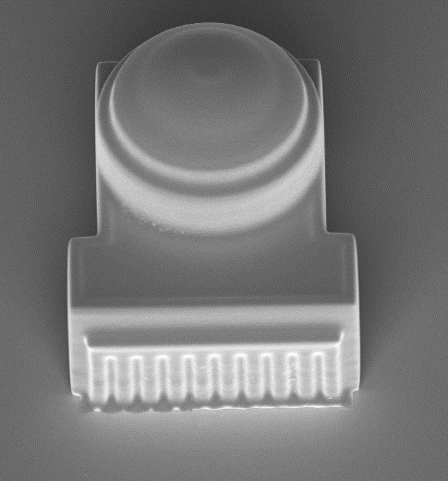
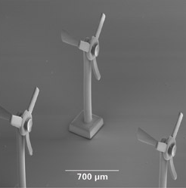
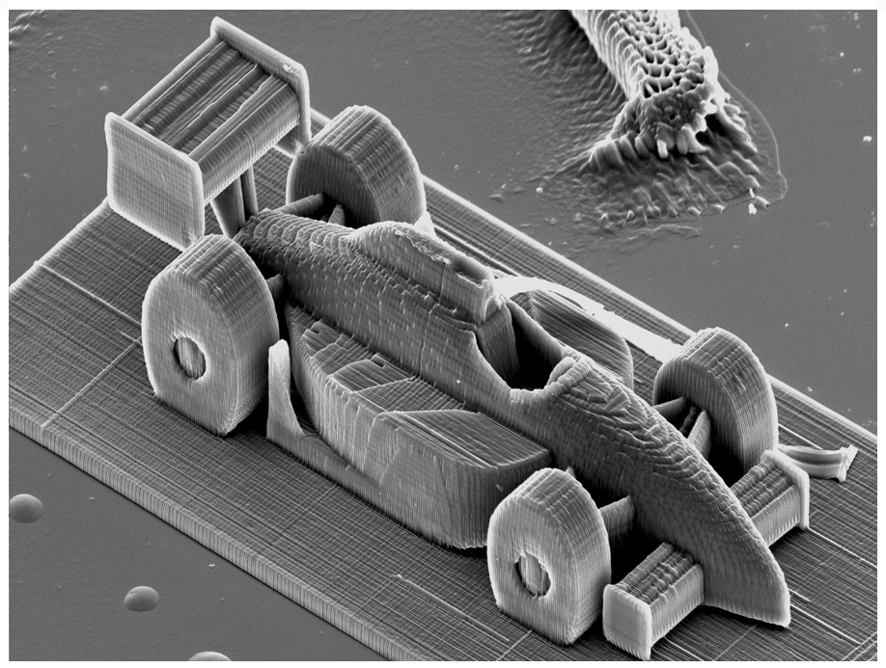

Structures produced by TPP
10 μm

Slide 23
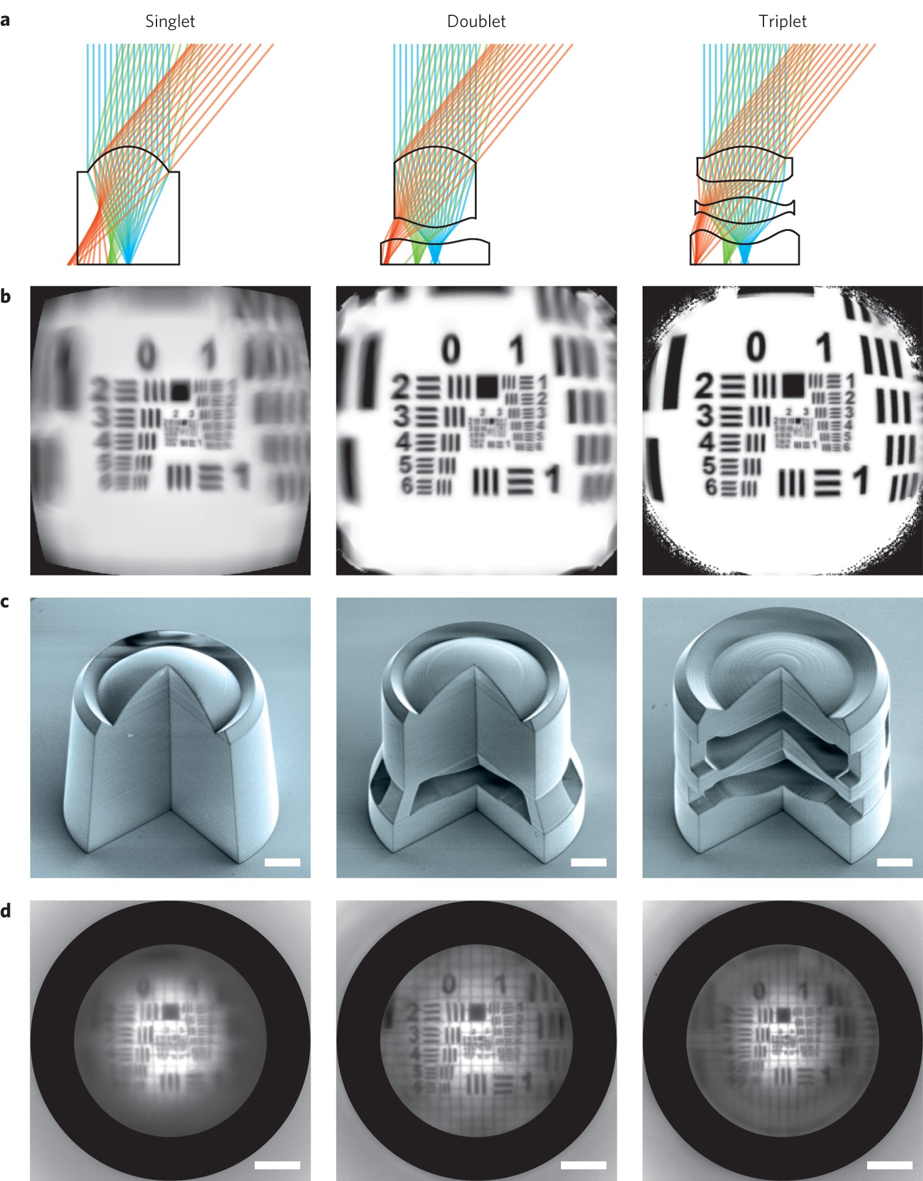
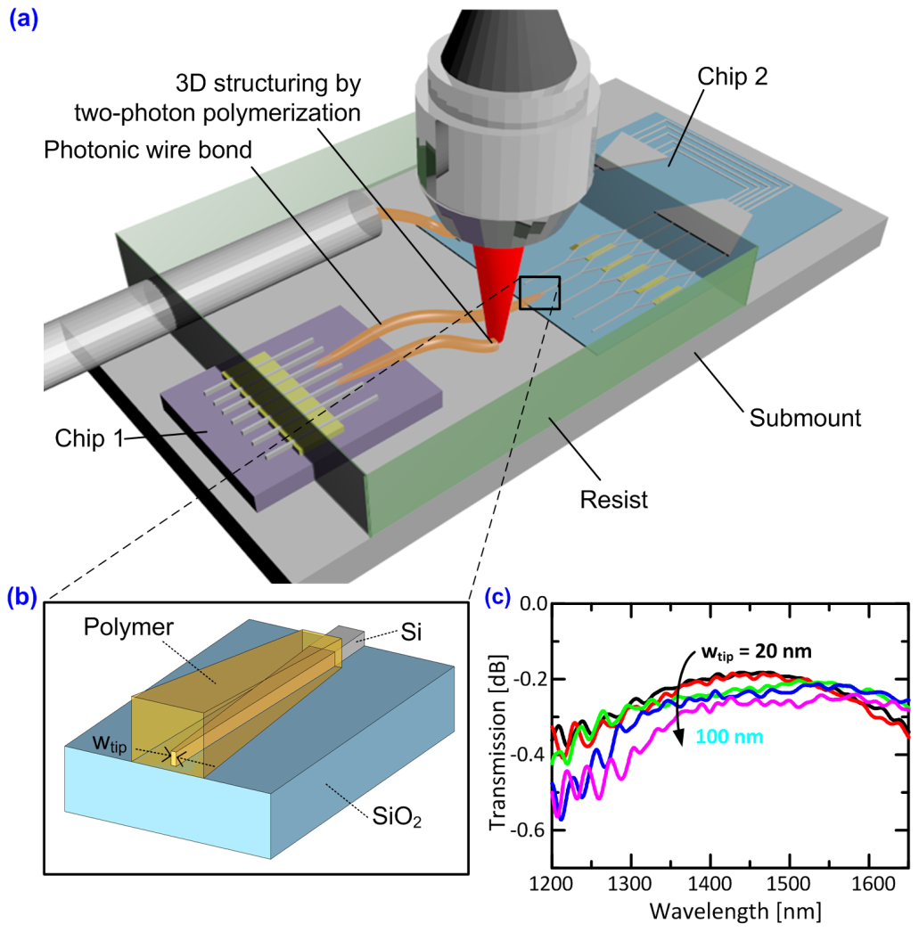
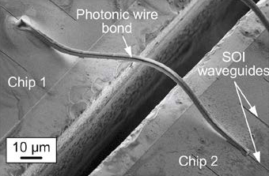
Applications of TPP
Photonic wire bonding
Micro-optics fabrication
Opt. Express 20, 17667 (2012)
Nat. Photonics 10, 554 (2016)

Slide 24
Optical Kerr nonlinearity Figure-of-Merit (FOM)
Time scale of electronic Kerr effect: ~ 50 fs
Material | Nonlinear index n₂ (10⁻²⁰ m²/W) | TPA α₂ (10⁻¹² m/W) | FOM ( n₂/α₂λ )
Silica (SiO₂) | 2.2 | ‒ | ‒
c-Si | 440 | 8.4 | 0.4
a-Si | 7400 | 41 | 1.4
a-As₂S₃ | 290 | < 0.01 | > 10
a-As₂Se₃ | 1200 | 1.0 | 2
Data quoted for λ = 1550 nm: B. Luther-Davies et al., Opt. Express 15, 9205 (2007); K. Wang and A. Foster, Opt. Lett. 37, 1331-1333 (2012).

Slide 25
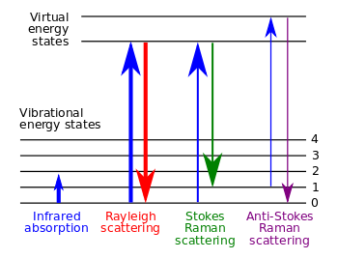
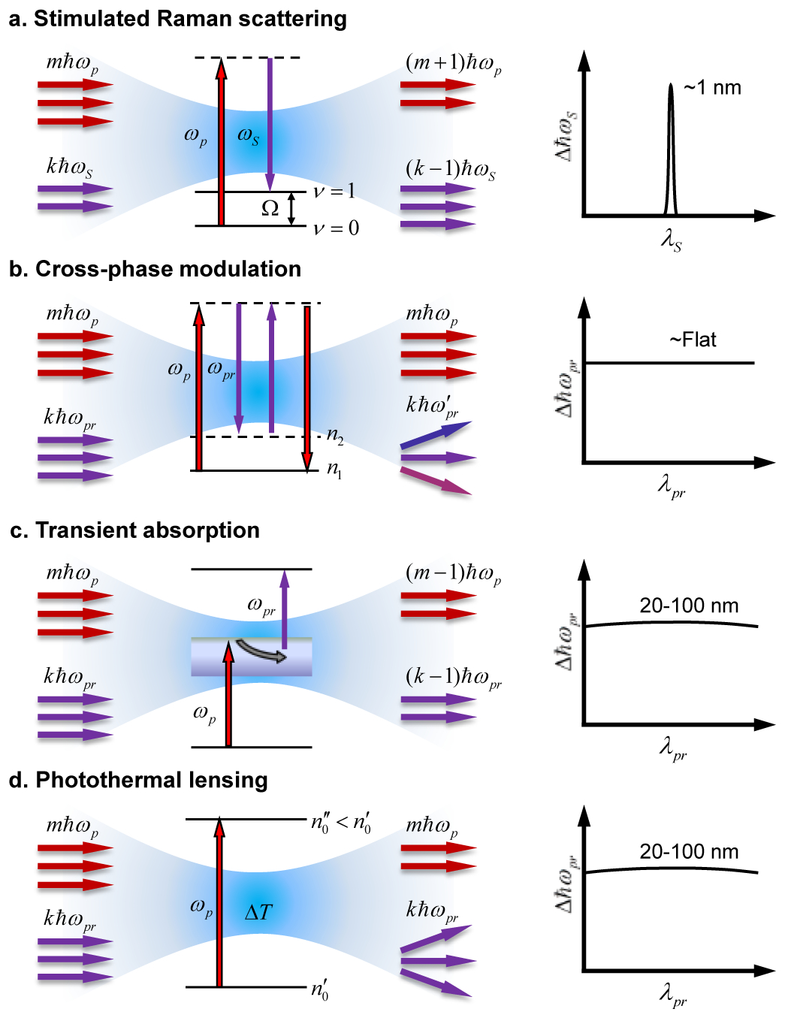
(Spontaneous) Raman scattering
Raman scattering: inelastic interaction of photons with phonons
  Photon – phonon = Stokes line
  Photon + phonon = anti-Stokes line
Spontaneous Raman scattering is a linear process
ω_{p}
ω_{p}
ω_{s}

Slide 26
Stimulated Raman scattering (SRS)
Each spontaneous scattering process has a stimulated analog
3rd order optical nonlinearity:
-
+
Opt. Express 21, 13864 (2013)
Notes:
Typical values of the Raman gain factor g: 1 cm/GW

Slide 27

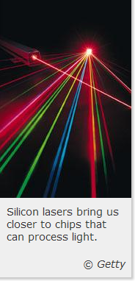
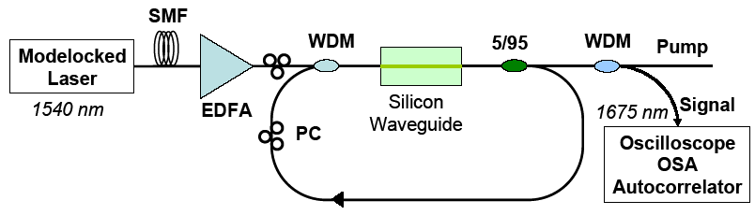
Si Raman lasers that make the headline
First silicon laser pulses with life
Gain: Raman amplification
Loss: free carrier absorption due to TPA
Solution 1: pulsed operation
  Pulse width << τ_{carrier} << pulse period
O. Boyraz and B. Jalali, “Demonstration of a silicon Raman laser,” Opt. Express 12, 5269 (2004).

Slide 28
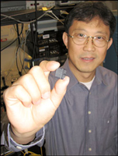
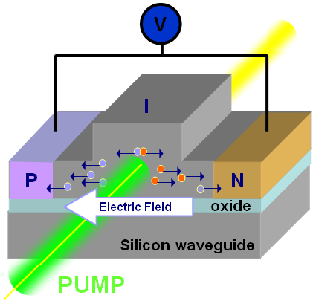
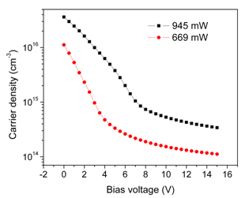
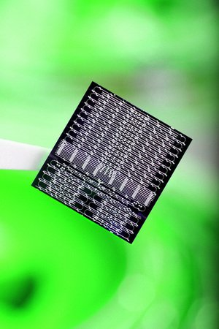
Si Raman lasers that make the headline
A continuous-wave Raman silicon laser
Loss: free carrier absorption due to TPA
Solution 2: reverse biased p-i-n diode
  Sweep out free carriers generated by TPA
H. Rong et al., “A continuous-wave Raman silicon laser,” Nature 433, 725 (2005).

Slide 29

Si Raman lasers that make the headline
Loss: free carrier absorption due to TPA
What is your solution to the loss issue?
Solution 3: reduce free carrier life-time
  Introduce deep level impurities: e.g. Au/Ag
  Reduce waveguide size: enhanced surface recombination
  Increase recombination center defect density
Other innovative solutions?
?

Slide 30
List of symbols
P – electric polarization (density)
n_{e} – electron density
r – displacement of electrons
D – electric displacement
ε₀ – vacuum permittivity, 8.854 × 10⁻¹² C/Vm
E – electric field
m – reduced mass
γ – damping coefficient
ω_{b} – characteristic oscillation frequency of bound electrons

Slide 31
List of symbols
U – potential energy or waveguide modal profile depending on context
χ – electric (linear) susceptibility
ε_{r} – relative permittivity or dielectric constant
χ_{ij} / d_{ijk} / χ_{ijkl} – linear / 2nd order nonlinear / 3rd order nonlinear susceptibility
P_{L} / P_{NL} – linear / nonlinear polarization (density)
P⁽²⁾ – 2nd order nonlinear polarization (density)
χ⁽²⁾ / χ⁽³⁾ – 2nd order / 3rd order nonlinear susceptibility
t – time

Slide 32
List of symbols
T – temperature
T_{g} – glass transition temperature
E_{light} / E_{ex} – electric field associated with incident light / applied DC voltage bias
ω – angular frequency of light
c.c. – complex conjugate
r_{ij} – electro-optic coefficient
n – refractive index
ε_{static} – permittivity at low frequencies (microwave frequencies in particular)

Slide 33
List of symbols
λ / λ₀ – wavelength of light
k – wave vector
I₀ – light intensity
n₂ – (Kerr) nonlinear index
Δn / Δα – change of refractive index / absorption coefficient due to nonlinear effects
α₂ – two photon absorption coefficient
E_{g} – bandgap energy
ћ – reduced Planck constant, 1.055 × 10⁻³⁴ J·s
ω_{p} – angular frequency of pump light

Slide 34
List of symbols
ω_{s} – angular frequency of Stokes scattered light
I_{s} – Stokes light intensity
I_{p} – pump light intensity
g – Raman gain factor
τ_{carrier} – carrier lifetime

