Slide 1
MIT 3.156/3.46
Photonic Materials and Devices
7: Surface Plasmon Polaritons
Juejun (JJ) Hu
hujuejun@mit.edu

Slide 2

References
Principles of Nano-optics, Ch. 12
Surface Plasmons on Smooth and Rough Surfaces and on Gratings
  H. Raether, Springer-Verlag
  Ch. 2

Slide 3
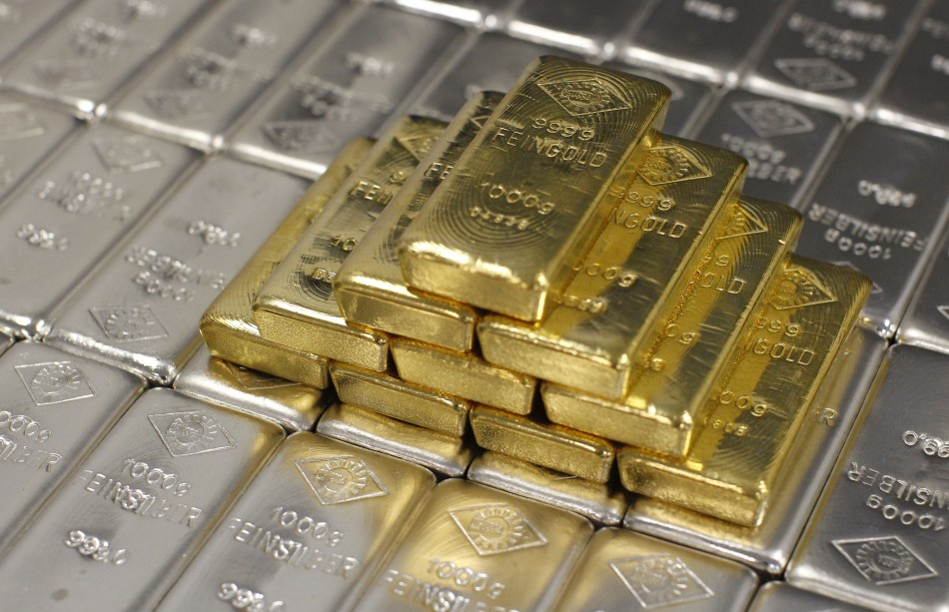
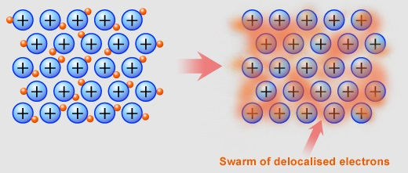
Optical properties of metals
Properties of metals are largely determined by free electrons
Electrons populate states whose energy E_{e} < E_{F}
Dielectrics
Metals

Slide 4
Drude-Sommerfeld model for free electrons
Dynamic equation describing electron motion:
where
plasma frequency

Slide 5
Drude-Sommerfeld model for free electrons
Noble metals: gold, silver
  High free electron density (~ 10²³/cm³): large ω_{p}
  Low damping (large electron mobility): small γ
In the visible-IR wavelength regime:
e.g. in gold:

Slide 6
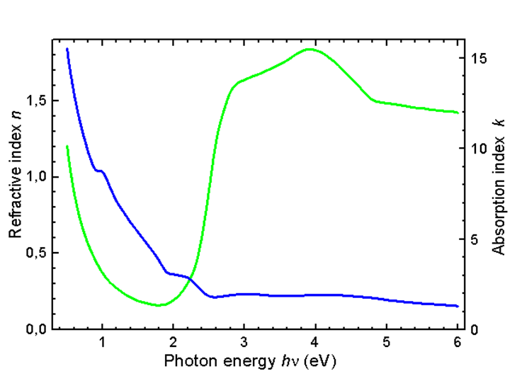
Complex refractive index of gold
Visible spectrum
In visible and NIR
Refractive index n
Absorption index K
http://www.ioffe.ru/SVA/NSM/nk/Metals/Gif/au.gif

Slide 7
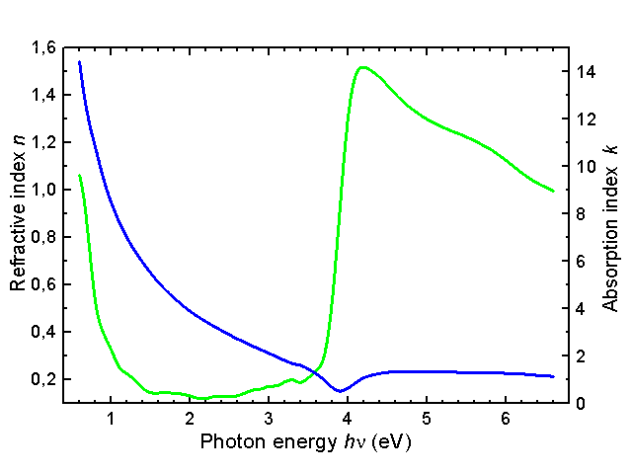
Complex refractive index of silver
Visible spectrum
Refractive index n
In visible and NIR
Absorption index K
http://www.ioffe.ru/SVA/NSM/nk/Metals/Gif/ag.gif

Slide 8
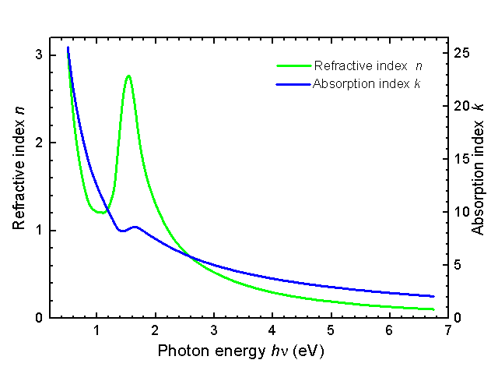
Complex refractive index of aluminum
In visible, Al is more lossy than Ag!
Refractive index n
Absorption index K
Visible spectrum
http://www.ioffe.ru/SVA/NSM/nk/AluminumCompounds/Gif/al.gif

Slide 9
Lorentz-Drude model for bound electrons
Interband transitions: bound electron oscillations
Dynamic equation describing electron motion:
Overall relative dielectric constant of metal:
contributions from both free and bound electrons
Notes:
K-K relation holds for the Lorentz-Drude mode: https://web.pa.msu.edu/courses/2019fall/PHY842/LECTURE_NOTES/4-9.oct30.pdf

Slide 10
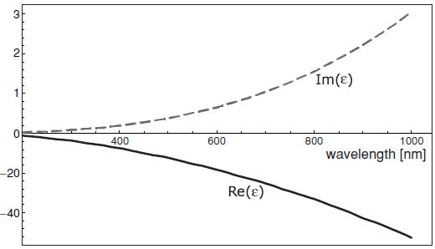
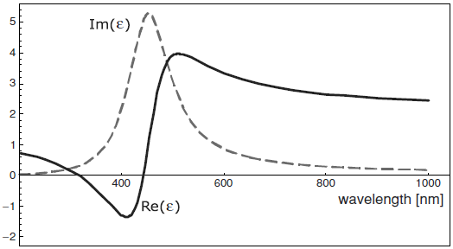
Drude models applied to metal gold
Free electrons
Bound electrons
Images quoted from Principles of Nano-optics
Large negative real part
Small positive imaginary part: low optical loss
Resonance absorption peaks at ω = ω_{b}
Relatively minor contribution
Multiple interband transitions occur at short wavelengths (λ < 500 nm for gold)

Slide 11
Lorentz-Drude model for dielectric materials
Wavelength/frequency dependent dielectric response
 | ε_{r} (static, ω = 0) | n (ω)
Ge | 16 | 4
Si | 11.7 | 3.5
LiNbO₃ | 43 | 2.27
BaTiO₃ | 3600 | 2.46
n
Atomic polarizability
1
Electronic polarizability
λ
X-ray
UV
Visible
IR
Static

Slide 12
Surface plasmon polariton (SPP) mode
SPP mode on planar metal-dielectric interfaces
  Field components: E_{x}, E_{z}, H_{y}
  Localized at the interface: field exponentially decays in both the metal and dielectric sides
Waveguide modes in dielectric slabs
  TM field components: E_{x}, E_{z}, H_{y}
  TE field components: H_{x}, H_{z}, E_{y}
  Localized at the high index core: field exponentially decays in the low index cladding
SPP mode
Dielectric
x
y
z
Metal
Dielectric waveguide mode
x
y
z

Slide 13
Derivation of SPP mode fields
Field components
Boundary conditions
SPP mode
Dielectric
x
y
z
Metal

Slide 14
Derivation of SPP mode fields (cont’d)
Ampère's circuital law:
is a vector:

Slide 15
Derivation of SPP mode fields (cont’d)
Dispersion relations of SPP mode
Large negative real part
Small positive imaginary part
In the case of
The SPP mode propagates along the z-axis (real k_{z}) and is localized at the interface (imaginary k_{x})
Dielectric
x
y
z
Metal

Slide 16


SPP mode and electron oscillation
The primary E-field component is longitudinal
In metal, E_{x} is delayed by π/2 in phase relative to E_{z}
Negative ε _{m} suggests that electron displacement is in the same direction as the external electric field
E_{xm}
E_{z}
Dielectric
$$\frac{E_{xm}}{E_{z}}=−i⋅\sqrt{\frac{ε_{d}}{−ε_{m}}}$$
E_{xm}
E_{z}
++
- -
++
- -
++
Electron motion
Metal

Slide 17

Lossless SPP mode in ideal metal
Ideal metal:
K is the absorption index, right?
Loss of guided modes scales with the imaginary part of wave vector along the propagation direction (k_{z} or β); on the other hand, imaginary wave vector along the transverse direction (k_{x} and k_{y}) creates optical confinement rather than loss!
Plane wave in metal
SPP mode in ideal metal
k_{z} is imaginary
If
k_{z} is a real number

Slide 18
Length scales of SPP mode
Transverse confinement
  Dielectric side: 1/Im(k_{xd}) ~ 100 to 1000 nm
  Metal side: 1/Im(k_{xm}) ~ 10 to 100 nm
  Gold @ λ = 600 nm:
  1/Im(k_{xd}) = 390 nm, 1/Im(k_{xm}) = 24 nm
  Silver @ λ = 600 nm:
  1/Im(k_{xd}) = 280 nm, 1/Im(k_{xm}) = 31 nm
Propagation distance
  1/Im(k_{z}) ~ 10 to 1000 μm
  Silver @ λ = 514.5 nm: 1/Im(k_{z}) = 22 μm
  Silver @ λ = 1060 nm: 1/Im(k_{z}) = 500 μm
SPP mode
Dielectric
Metal
x
y
z

Slide 19
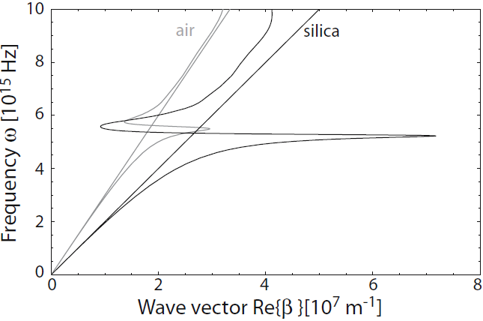
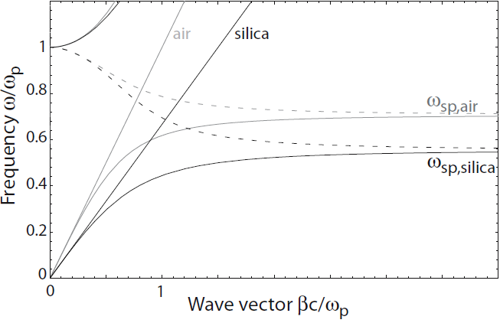
SPP mode dispersion relation
ω
Drude-Sommerfeld:
Light line in dielectric
i.e.
k_{z}
From Plasmonics: Fundamentals and Applications, S. Maier, Springer (2007).

Slide 20
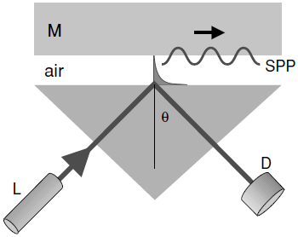
Coupling to SPP mode
ω
Light line in prism
Vacuum light line
Direct coupling from free space to SPP mode is prohibited
Phase matching methods:
  Prism coupling:
  1) Otto configuration
  2) Kretschmann configuration
  Grating coupling
k_{z}

Slide 21
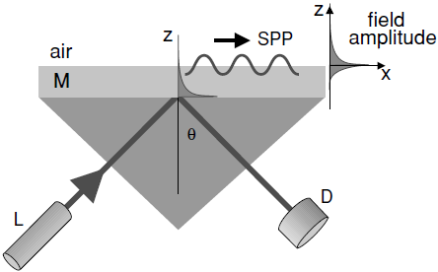
Coupling to SPP mode
ω
Light line in prism
Vacuum light line
Direct coupling from free space to SPP mode is prohibited
Phase matching methods:
  Prism coupling:
  1) Otto configuration
  2) Kretschmann configuration
  Grating coupling
k_{z}

Slide 22
Coupling to SPP mode
ω
Vacuum light line
Λ
θ_{i}
Metal gratings
Direct coupling from free space to SPP mode is prohibited
Phase matching methods:
  Prism coupling:
  1) Otto configuration
  2) Kretschmann configuration
  Grating coupling
k_{z}

Slide 23
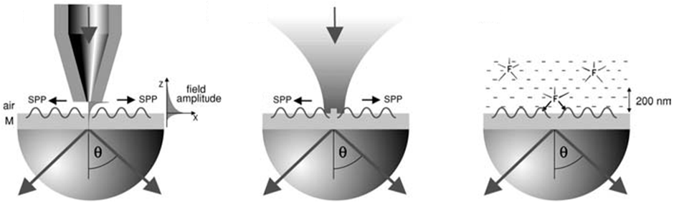
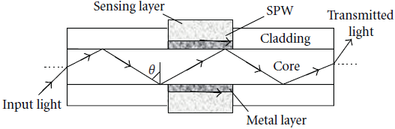
Coupling to SPP mode
(a)
(b)
(c)
(d)
NSOM probe excitation
Nanoparticle scattering
Fluorescence emission
Fiber-optic coupling
A. Sharma et al., IEEE Sens. J. 7, 1118 (2007).

Slide 24
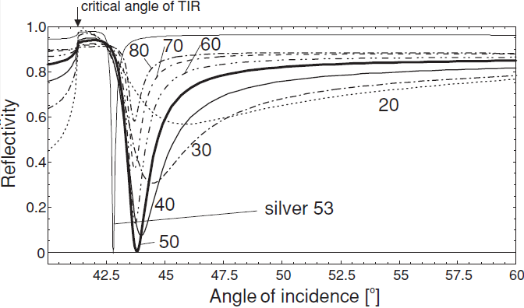
Coupling to SPP mode
The phase matching condition is satisfied only at specific incident angle & wavelength combinations
Back coupling (leakage) into radiative modes
Prism:
Grating:
Surface plasmon “resonance” indicates phase matching
Only TM light couples to SPP
SPP mode shows lower loss in Ag than in Au at λ = 633 nm
The phase matched coupling condition is very sensitive to dielectric constant changes
Image quoted from Principles of Nano-optics

Slide 25




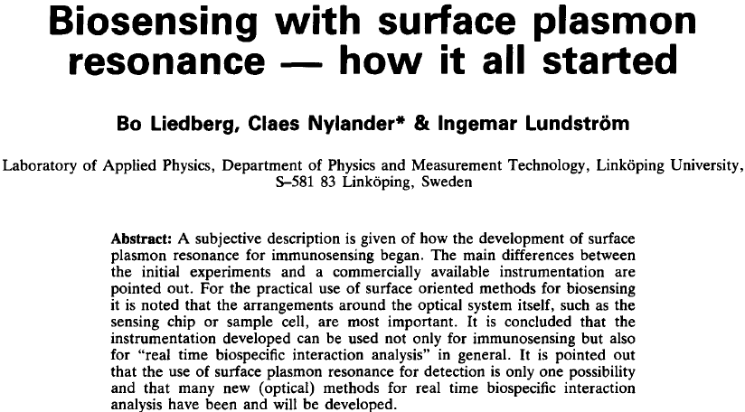

Surface plasmon resonance (SPR) sensors: a historic perspective
Biosensors & Bioelectronics 10, 1-4 (1995).
http://www.biacore.com/lifesciences/history/index.html

Slide 26
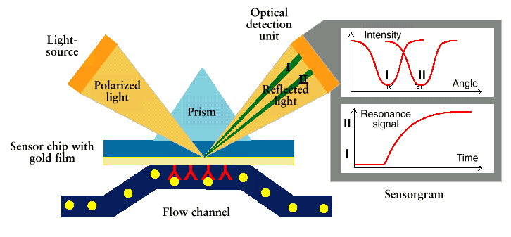
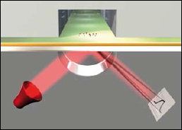
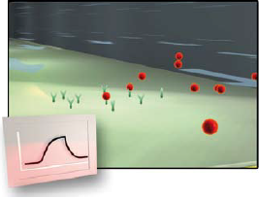
SPR sensing: mechanism
Coupling design
  Prism coupling
  Grating coupling (GC-SPR)
  Waveguide/fiber excitation
Interrogation scheme
  Angular interrogation
  Wavelength interrogation
  Intensity/phase
J. Homola et al.,“Surface plasmon resonance sensors: review,” Sens. Actuators, B 54, 3-15 (1999).
Biacore Tech Note 23: Label-free interaction analysis in real-time using surface plasmon resonance
Handbook of Surface Plasmon Resonance, R. Schasfoort and A. Tudos Ed., RSC Publishing (2008).

Slide 27
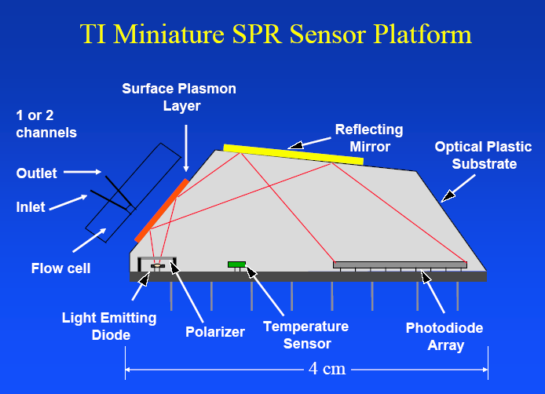

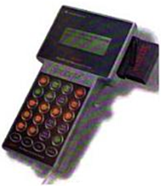

SPR sensing: instrument design
Disposable cartridge
Bulk RI detection limit: 5 × 10⁻⁶
Hand-held reader
© Sensata

Slide 28
SPR vs. resonant cavity sensors
Performance metrics
  RI sensitivity: resonance peak shift per unit bulk refractive index change
  Resonators (cavity perturbation):
  SPR (phase matching): > 10⁴ nm/RIU
  Spectral width of resonance peak (Q)
  Dielectric resonators: Q ~ 10,000
  SPR: Q ~ 100 due to optical loss
ω
Δω
Phase matching
k_{z}
< 10³ nm/RIU
w/o index change
with index change
Z. Yu et al., Opt. Express 19, 10029-10040 (2011).
J. Hu et al., J. Opt. Soc. Am. B. 26, 1032-1041 (2009).

Slide 29
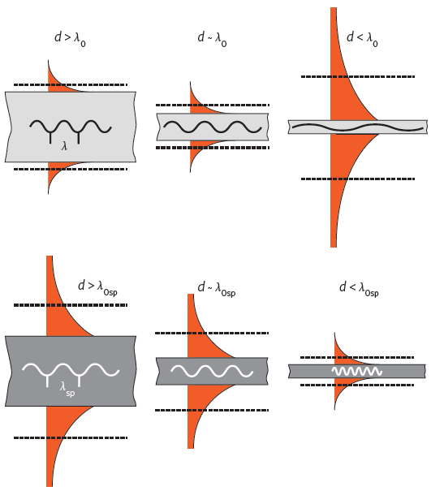
Surface plasmon waveguides
Dielectric guided mode
  As waveguide size shrinks:
  poor transverse confinement and eventually cut-off
Channel plasmon polariton (CPP) mode
  As waveguide size shrinks:
  improved transverse confinement: no cut-off !
x
y
z
D. Gramotnev et al., Nat. Photonics 4, 83-91 (2010).
M. Stockman, Phys. Rev. Lett. 93, 137404 (2004).

Slide 30
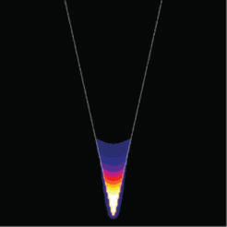
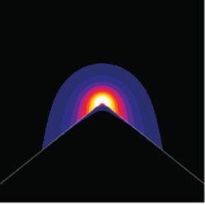
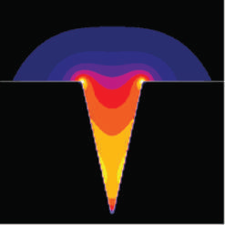
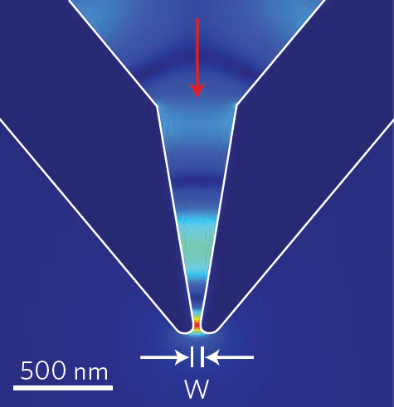
Channel plasmon polariton modes and tapers
Groove mode
Wedge mode
Hybridized mode
Sub-diffraction-limit (< λ/10) confinement
Typical propagation length ~ 1 μm
Nanofocusing tapers
D. Pile et al., “Theoretical and experimental investigation of strongly localized plasmons on triangular metal wedges for subwavelength waveguiding,” Appl. Phys. Lett. 87, 061106 (2005).
E. Moreno et al., “Channel plasmon-polaritons: Modal shape, dispersion, and Losses,” Opt. Lett. 31, 3447-3449 (2006).
H. Choi et al., “Compressing surface plasmons for nanoscale optical focusing,” Opt. Express 17, 7519-7524 (2009).

Slide 31
List of symbols
E_{e} – energy of electron
p – momentum of electron
m – electron mass
k – wave vector
E_{F} – Fermi energy
k_{F} – wave vector of electrons at Fermi surface
ћ – reduced Planck constant (1.055 × 10⁻³⁴ J·s)
n_{e} – electron density
– position vector indicating electron position
t – time

Slide 32
List of symbols
γ – damping coefficient
or E – electric field
e – elementary charge (1.602 × 10⁻¹⁹ C)
ω – angular frequency of oscillating electric field
– amplitude of electron oscillation
– electric polarization (density)
ε₀ – vacuum permittivity (8.854 × 10⁻¹² C/Vm)
ε_{r,e} / ε_{r,b} – free / bound electron contribution to relative permittivity (dielectric constant)
ω_{p} – plasma frequency
n – real part of refractive index

Slide 33
List of symbols
K – imaginary part of refractive index or extinction coefficient
ω_{b} – characteristic oscillation frequency of bound electrons
ε_{r} – relative permittivity or dielectric constant
H – magnetic field
E_{d} / E_{m} – electric field in dielectric / metal
H_{d} / H_{m} – magnetic field in dielectric / metal
k_{z} – propagation constant of guided mode (i.e. wave vector along propagation direction z)
k₀ – free space wave vector

Slide 34
List of symbols
ε_{m} / ε_{d} – permittivity of metal / dielectric
c – speed of light in dielectric medium
c₀ – speed of light in vacuum (2.99792458 × 10⁸ m/s)
θ_{i} – incident angle of excitation light
n_{p} – refractive index of prism
– reciprocal lattice vector of grating along z direction
Λ – grating period
δλ – resonant wavelength shift
λ₀ – resonant wavelength
Γ – modal confinement factor

