Slide 1
MIT 3.156/3.46
Photonic Materials and Devices
6: Optical Diffraction
Juejun (JJ) Hu
hujuejun@mit.edu

Slide 2
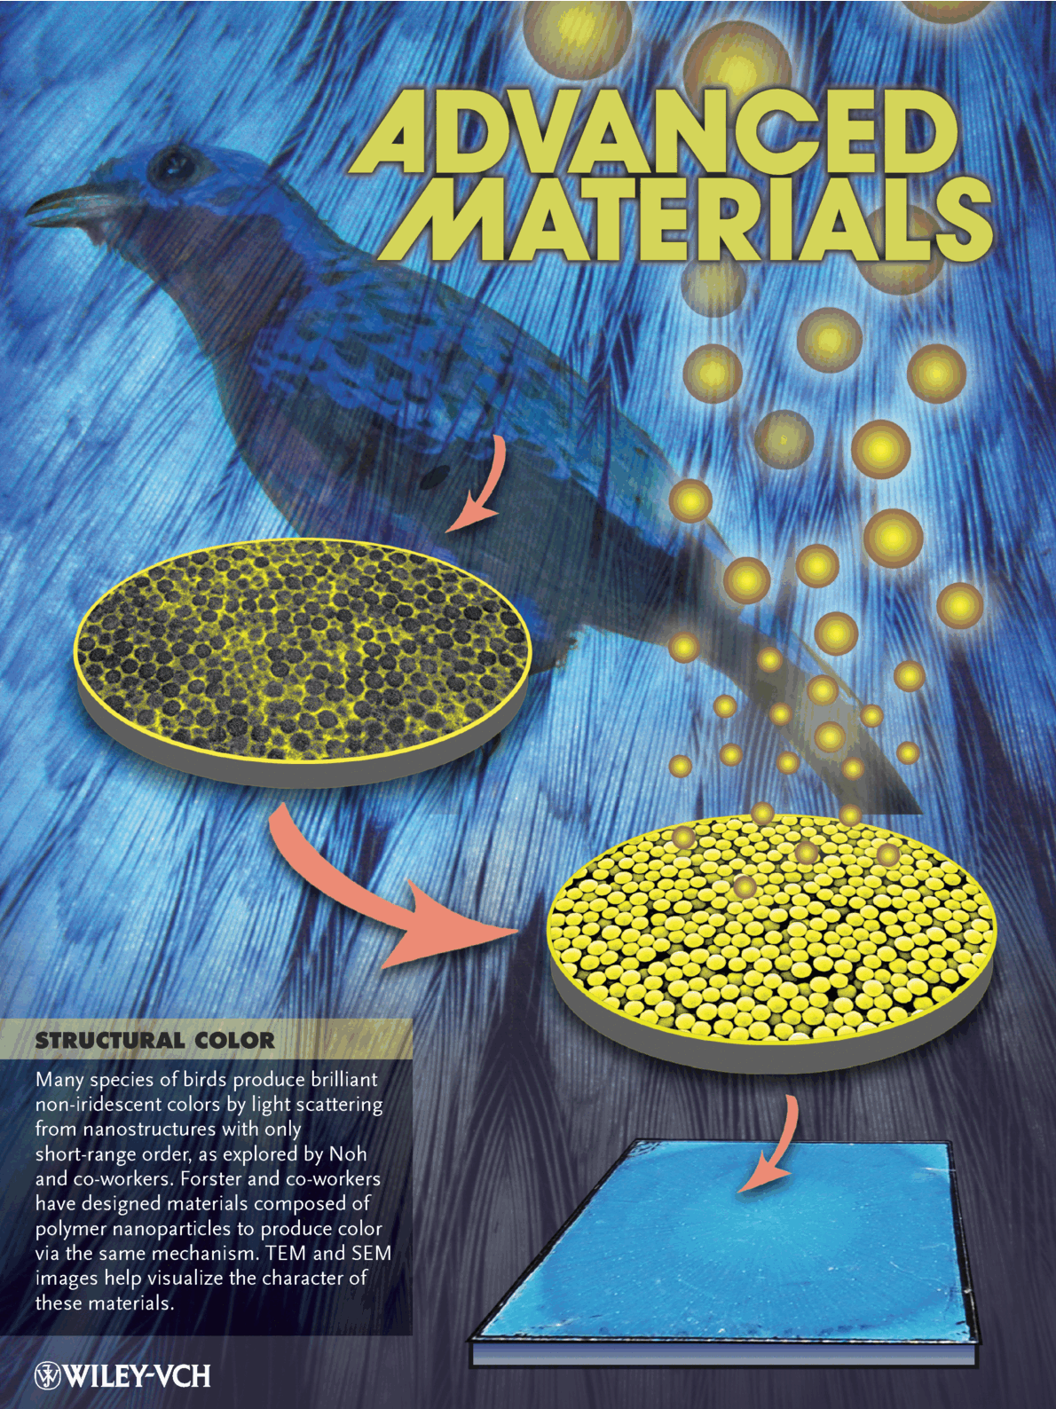
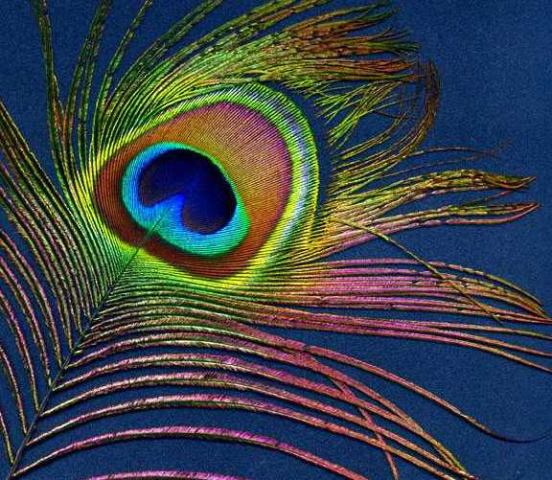
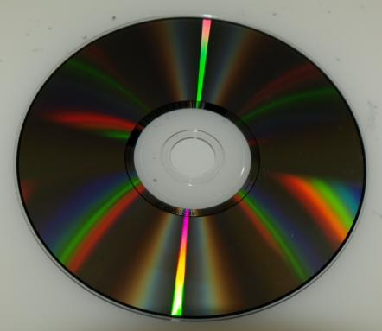
Diffraction: scattering of light by periodic structures
Wikipedia: a diffraction grating is an optical component with a periodic structure, which splits and diffracts light into several beams travelling in different directions
Origin of structural color: optical diffraction

Slide 3
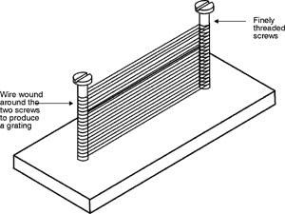
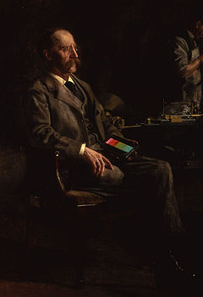
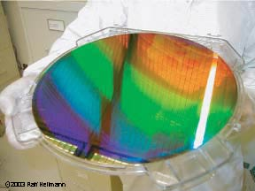
Grating fabrication:
An evolution from artisanry to nanotechnology
“Rowland’s gratings consist of pieces of metal or glass ruled by a diamond point with parallel lines.”
The very first diffraction grating consisted of a grid formed by winding fine wires on two screw threads.
H. Rowland (1848 – 1901)
The MIT “nanoruler”, made by interference lithography (2004)

Slide 4
Reciprocal lattice
Fourier transform of a periodic structure (e.g. crystal lattice) in real space
Consider a periodic array of points in real space, we define its reciprocal lattice as a set of points in the reciprocal space given by:
The dimension of distance in the reciprocal lattice is inverse length (unit: m ⁻¹)
Reciprocal lattice is a purely geometric model, and it has nothing to do with the material properties of gratings

Slide 5
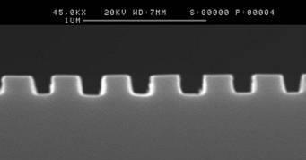
Examples of reciprocal lattices
1-D grating cross-section
T. Ang et al., IEEE PTL (2000)
3-D point array (Bravais lattice)
Its reciprocal lattice is a Bravais lattice with the basis set:
1-D gratings: a set of parallel lines
Reciprocal lattice:
z
y
x
Λ

Slide 6
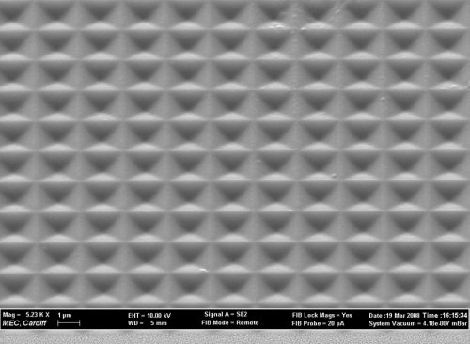
Examples of reciprocal lattices (cont’d)
2-D gratings with a rectangular lattice (2-D point array)
Reciprocal lattice:
y
x
Λ_{y}
Λ_{x}
Top-view of 2-D gratings fabricated by FIB at Cardiff University

Slide 7
Far-field plane wave diffraction
Incident plane wave vector:
Diffracted/scattered plane wave vector:
Diffraction: interference between waves scattered by different structural units in the periodic array
Conditions for diffraction (elastic scattering):
“Momentum” conservation:
Energy conservation:
i.e. frequency of light remains unchanged

Slide 8
Derivation of diffraction conditions
Each structural unit (point) in the periodic grating serves as a scattering center
Complex amplitude of incident wave at the scattering center:
Complex amplitude of scattered wave:

Slide 9
Derivation of diffraction conditions (cont’d)
At an observation point in the far field, the complex amplitude of the scattered wave is:
where
Total complex amplitude
measured at :

Slide 10
Derivation of diffraction conditions (cont’d)
Total complex amplitude measured at
Fourier transform of the real space structure
This conclusion holds even if the light scattering structure is NOT periodic!
The “momentum conservation” condition:
guarantees that all scattered waves constructively interfere
i.e.

Slide 11
Diffraction orders of 1-D gratings
1-D gratings: a set of parallel lines
Reciprocal lattice:
The grating equation:
z
θ_{s}
y
x
θ_{i}
z
y
x
Λ

Slide 12
More on the grating equation
Consider a 1-D reflective grating engraved on a substrate:
Will the diffraction angle for a given diffraction order m’ change if we change the substrate material?
If the grating is immersed in water instead of air, will the diffraction angle change for the same diffraction order?
θ_{s,s}
θ_{s,g}
(a)
θ_{i}
θ_{i}
(b)
Si
Glass
(c)
(a)
(b)
(c)
(d) It depends on the order number m’

Slide 13
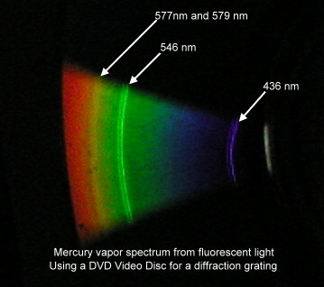
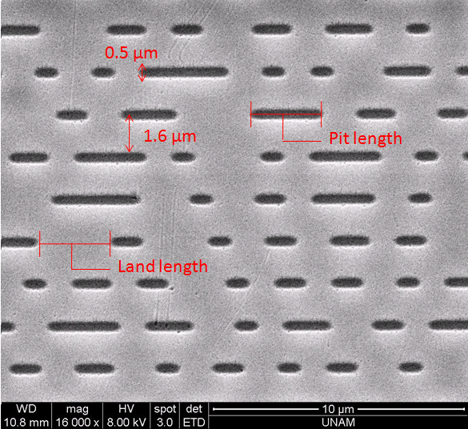
CDs and DVDs as 1-D diffraction gratings
Track pitch (period)
  CD: 1.6 μm
  DVD: 0.74 μm
  Blu-ray DVD: 0.32 μm
The grooves on a CD are not perfectly periodic. What is the impact on diffraction?
SEM top-view of a CD

Slide 14
Diffraction efficiency and the blaze condition
Diffraction efficiency: fraction of incident optical power diffracted into a particular order
Blaze condition: when the relationship between the incident light and the mth-order diffracted light describes mirror reflection with respect to the reflective grating facet surface, most of the energy is concentrated into the mth-order diffracted light
Littrow configuration:
Facet normal
Grating normal
θ_{s}
θ_{i}
θ_{B}
Blaze angle

Slide 15
Rigorous coupled-wave analysis (RCWA)
RCWA: a rigorous computational method solving the electromagnetic fields in periodic dielectric structures
-2
-1
i
0
A
1
where
B
Bloch theorem
C
-3
0
z
-2
-1
Then use the Helmholtz equation to solve the expansion coefficients
y
x
J. Opt. Soc. Am. 71, 811 (1981).
Open-source RCWA solver: Reticolo

Slide 16
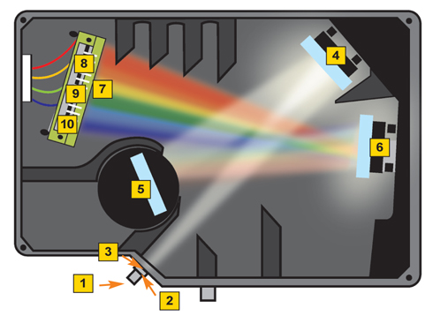

Grating spectrophotometers
1: Broadband source input
2,3: Input slit and filter
4: collimating mirror
5. Diffraction grating
6: Focusing mirror
7: High-order diffraction filter
8, 9, 10: Linear detector array
High-order diffraction: integral frequency multiples

Slide 17
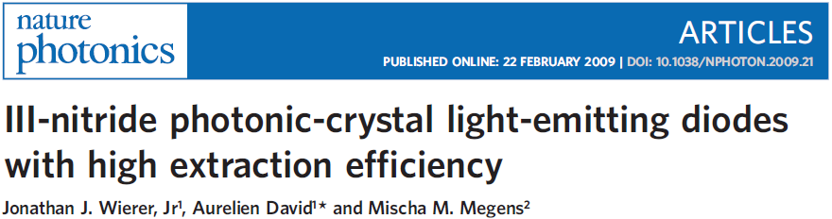
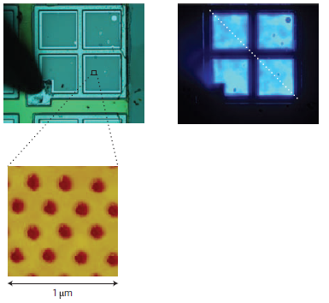
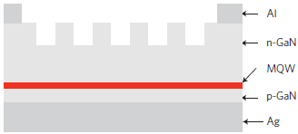
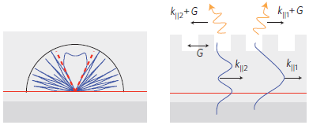
In a planar LED, only light emitted into the extraction cone will not be trapped by waveguiding and can escape to air:
y
x

Slide 18
In LEDs with 2-D gratings (PhCs), guided modes can be diffracted into the extraction cone and extracted to free space if:
Ewald construction in reciprocal space:
Escape cone
k_{i,xy}
O
y
G_{xy}
z
x

Slide 19
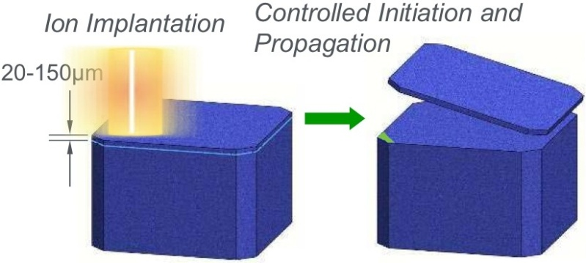
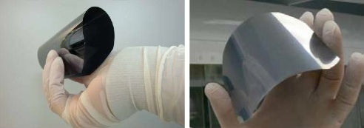
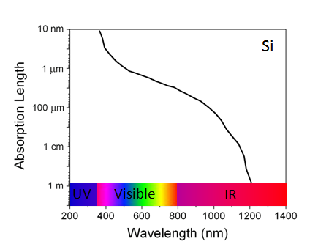
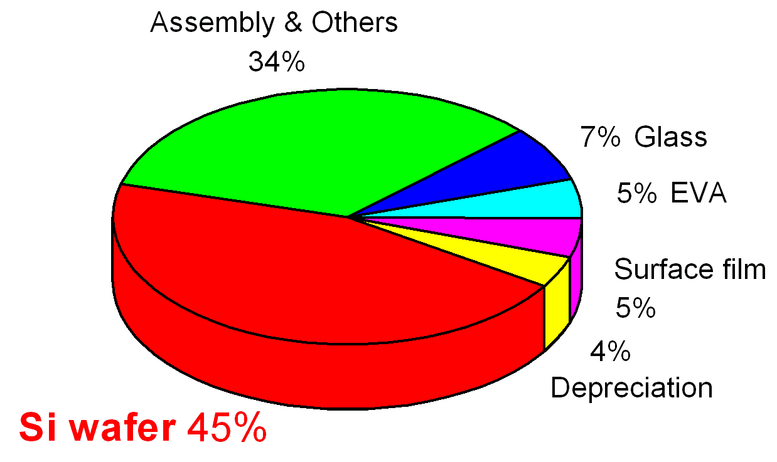
Light trapping in thin c-Si and thin film solar cells
Kerfless thin c-Si wafer production by exfoliation
Thin c-Si: 50 μm
Bulk: 500 μm

Slide 20

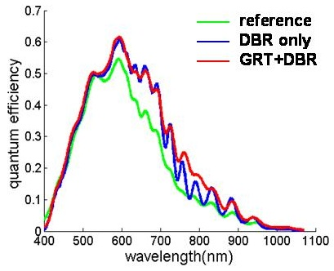
Light trapping in thin c-Si and thin film solar cells
Absorption occurs during mode propagation
Cell
Diffraction couples light into waveguided modes
Waveguided modes leak back to free space when the phase matching condition is met
L. Zeng et al., ‘High efficiency thin film Si solar cells with textured photonic crystal back reflector’, Appl. Phys. Lett., 93, 221105 (2008).
J. Mutitu et al., "Thin film solar cell design based on photonic crystal and diffractive grating structures," Opt. Express 16, 15238-15248 (2008).
Z. Yu et al., "Fundamental limit of light trapping in grating structures," Opt. Express 18, A366-A380 (2010).
X. Sheng et al.,“Design and non-lithographic fabrication of light trapping structures for thin film silicon solar cells”, Adv. Mater. 23, 843 (2011).

Slide 21
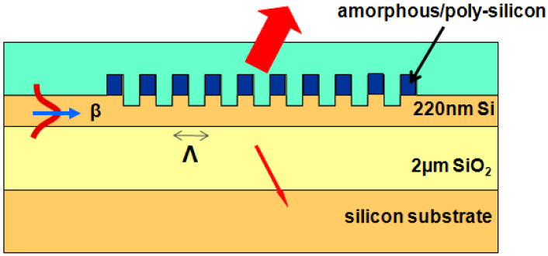
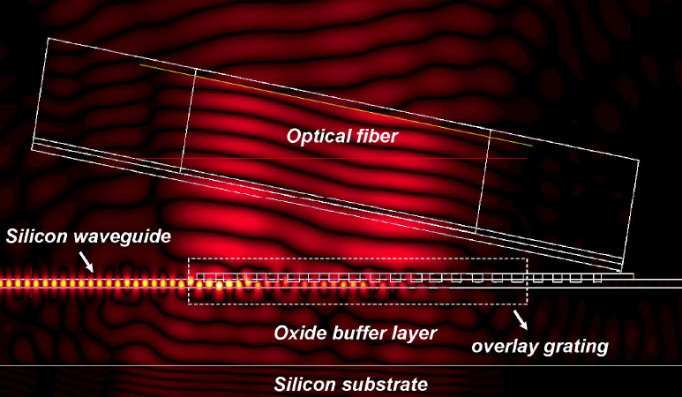
Fiber-to-waveguide grating couplers
Phase matching condition prohibit direct coupling of light from free space into waveguides
Butt coupling vs. grating coupling
Fiber tilting to prevent second order Bragg reflection
G. Roelkens et al., "High efficiency Silicon-on-Insulator grating coupler based on a poly-Silicon overlay," Opt. Express 14, 11622-11630 (2006).

Slide 22
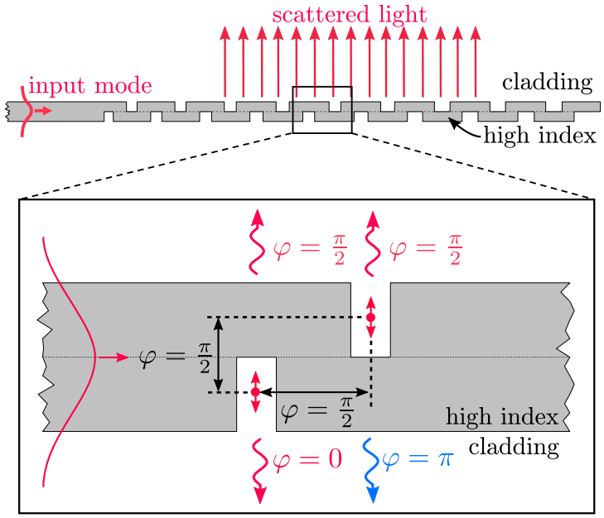
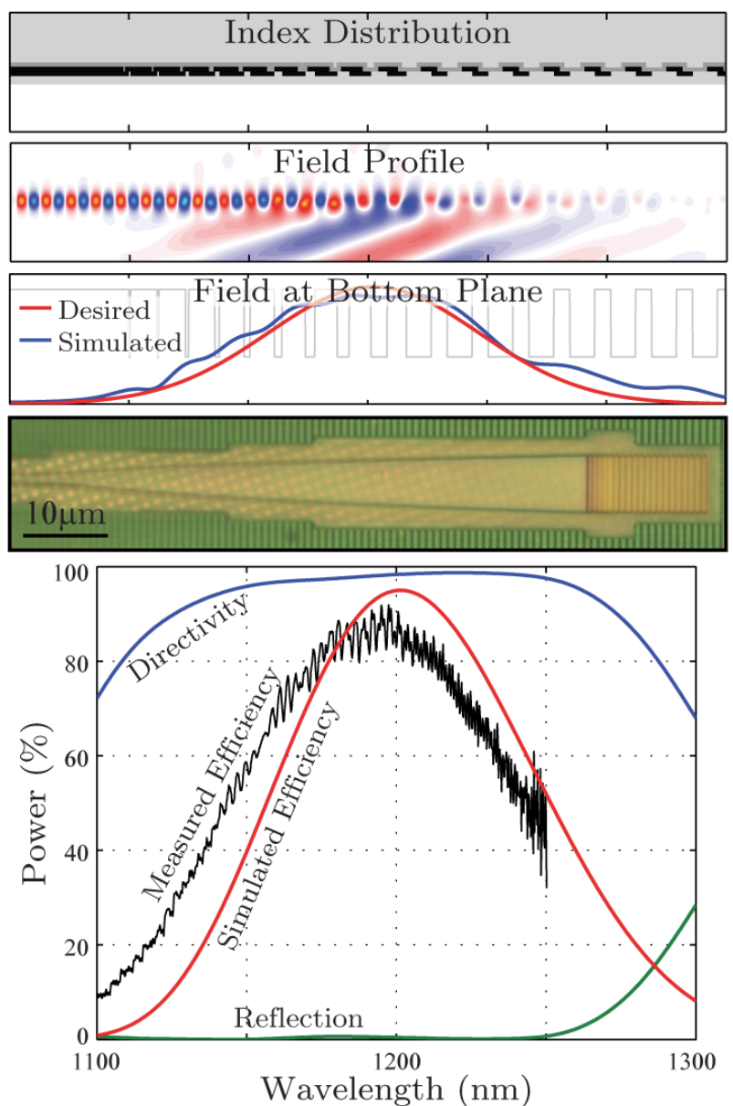
Breaking mirror symmetry in grating couplers
Coupling efficiency: 99% (0.04 dB)
Experiment: OFC M2I.5 (2016)
Simulation: Opt. Express 26, 4766-4779 (2018)

Slide 23

Resources: VM-Lab Simulations
Grating couplers
  Fiber angle
  Grating period
  Wavelength dependence
  Fiber angle vs. grating period

Slide 24
List of symbols
, – position vector in real space
– reciprocal lattice vector
Λ – grating period
/ / – unit vectors along x / y / z axis
/ – wave vector of incident / scattered light
A_{i} / A_{s} – amplitude of incident / scattered wave
σ – parameter characterizing scattering strength of scatterer, here defined as σ = A_{s} / A_{i}
– position vector of an observation point where the scattered wave amplitude is measured

Slide 25
List of symbols
θ_{i} / θ_{s} – incident / scattering angle
θ_{B} – grating blaze angle
k – wave number in medium
λ – wavelength
m’ – grating diffraction order
E_{A} / E_{B} / E_{C} – electric field in region A / B / C
θ_{c} – critical angle
k₀ – free space wave vector

