Slide 1
MIT 3.156/3.46
Photonic Materials and Devices
12: Photodetectors
Juejun (JJ) Hu
hujuejun@mit.edu

Slide 2
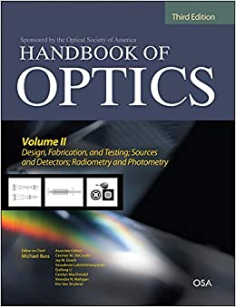
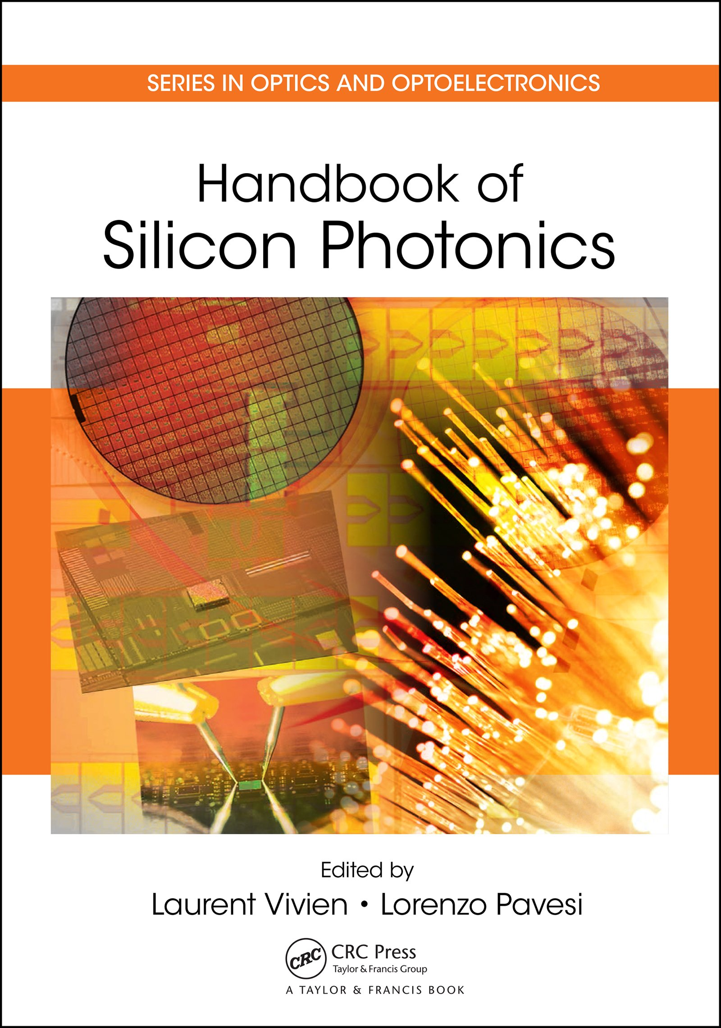
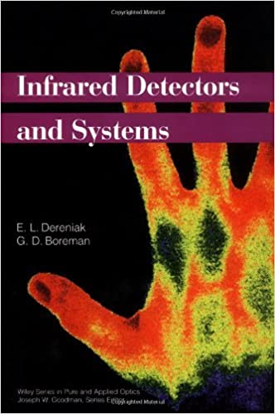
References
Fundamentals of Photonics
  Ch. 17
Photonics: Optical Electronics in Modern Communications
  Ch. 10 & 11
Handbook of Silicon Photonics
  Ch. 10, J. Michel et al.
Handbook of Optics, Volume II
  Ch. 26, J. Bowers and Y. Wey
Infrared Detectors and Systems
  E. L. Dereniak and G. D. Boreman

Slide 3
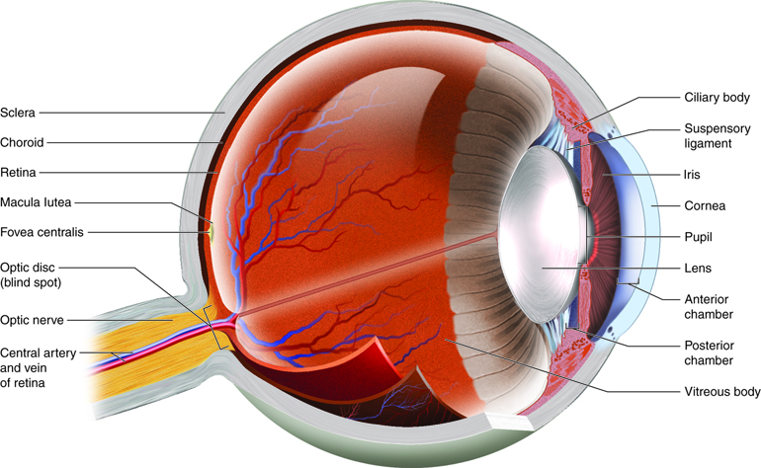
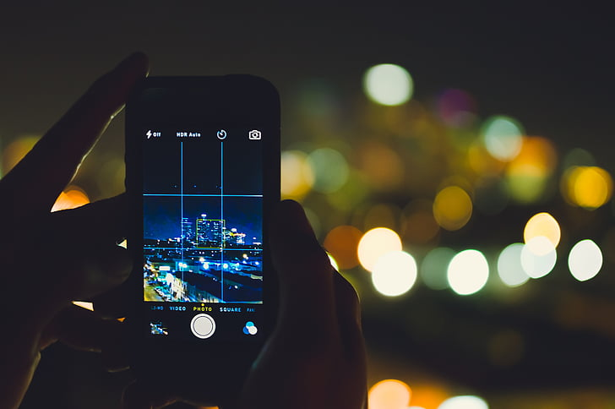
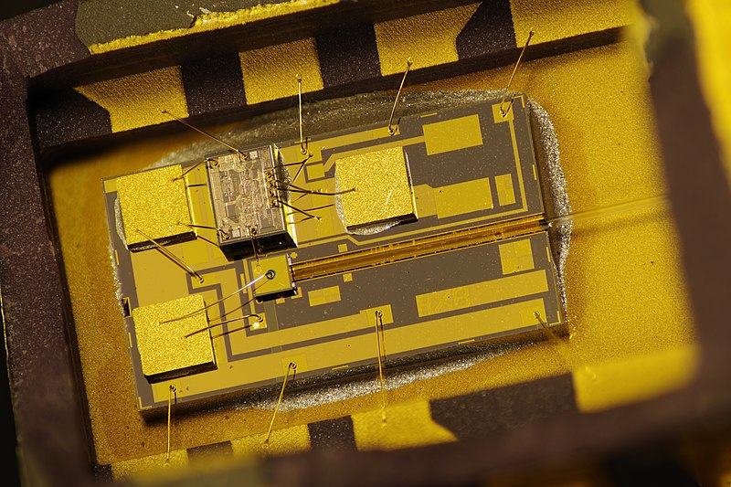
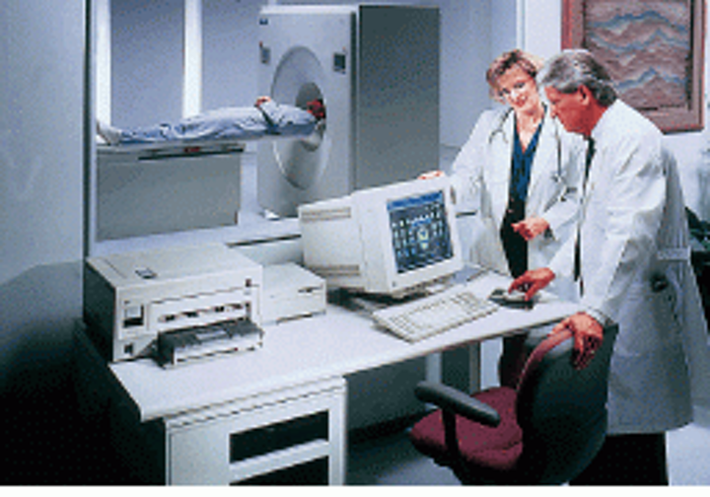
Photodetectors: devices used for detection of light
Vision
Digital photography
Communications
Medical imaging

Slide 4
Classification of photodetectors
Thermal detectors
Thermopile
Bolometer
Pyroelectric detector
…
Photon detectors
Photoconductor
Photovoltaic detector
MSM detector
Photomultiplier
Quantum well infrared photodetector (QWIP)
Schottky barrier diode
…
Reference:
https://www.rp-photonics.com/thermal_detectors.html

Slide 5
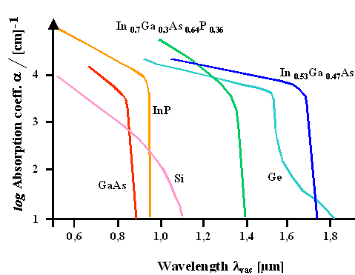
Absorption in semiconductors
Sze, Physics of Semiconductor Devices
Wavelength-energy conversion: λ (μm) = 1.24 / E_{g} (eV)
Heavier atoms generally result in smaller bandgap

Slide 6
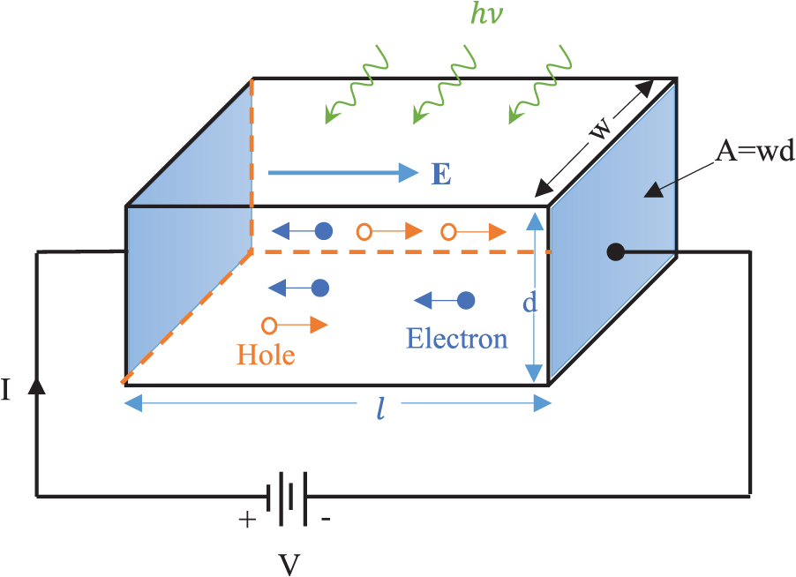
Photoconductive detector
I
Light
S = wd
Ohmic contacts
Dark
V
Ch. 13, Principles of Biophotonics
Quantum efficiency:
Carrier photo-generation rate:

Slide 7
Photoconductive detector
I
Light
S = wd
Ohmic contacts
Dark
V
Ch. 13, Principles of Biophotonics
Photo-generated carrier density:
Photoconductivity:

Slide 8
Photoconductive detector
I
Light
S = wd
Ohmic contacts
Dark
Constant voltage
V
Ch. 13, Principles of Biophotonics
Photocurrent:
Responsivity

Slide 9
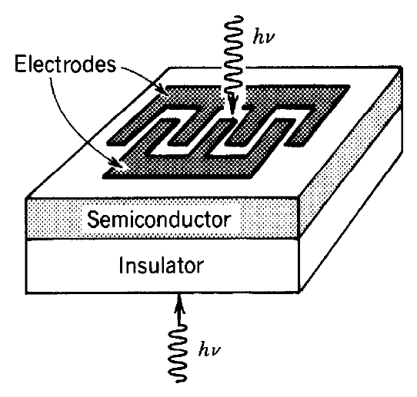
Responsivity, speed, and linear dynamic range
Geometric dimensions
Semiconductor properties
Voltage
Optical absorption
Unit: A/W
Responsivity of photo-conductive detectors is dependent on measurement mode and detector geometry
After Fundamentals of Photonics

Slide 10
Responsivity, speed, and linear dynamic range
Geometric dimensions
Semiconductor properties
Voltage
Optical absorption
Unit: A/W
Response time of photoconductors is primarily dictated by lifetime of photo-generated carriers
Inherent trade-off between responsivity and speed
Linear dynamic range is bound by the detector saturation limit and noise floor

Slide 11
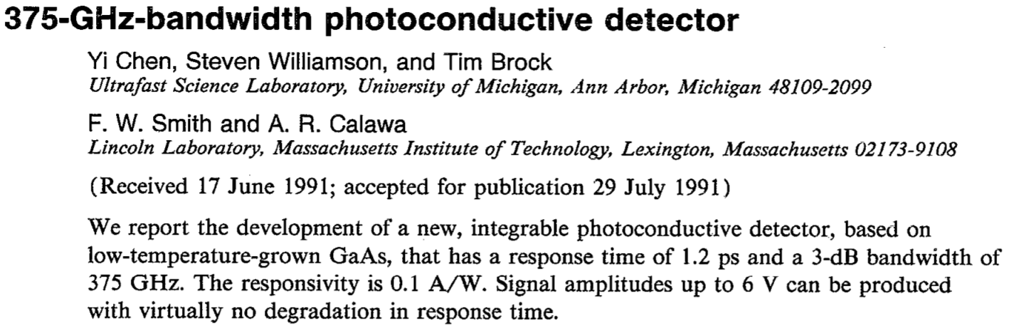
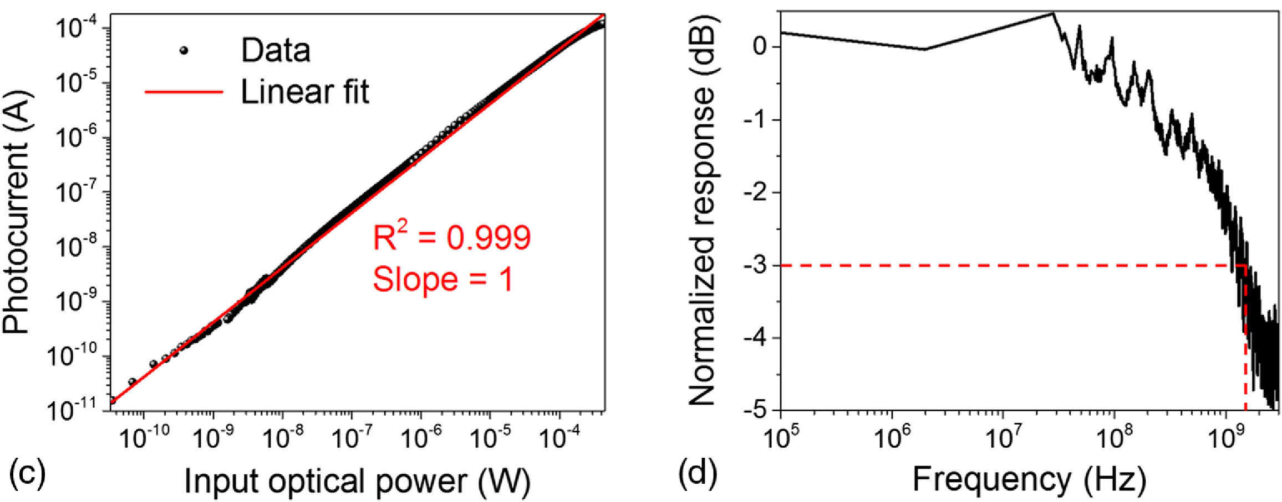
Responsivity, speed, and linear dynamic range
High-speed photo-conductors based on semiconductors with short lifetime
70.7% current amplitude, i.e. 50% electrical power
Relationship Between Rise Time and Bandwidth for a Low-Pass System
Optica 5, 44-51 (2018)

Slide 12
Photoconductive gain
Detector gain
Transit time
Wavelength in μm
Responsivity in A/W
External circuit injects carriers into the semiconductor to ensure charge neutrality
+
+
-
+
+
-

Slide 13
Photoconductor: constant current measurement
I
Light
S = wd
Constant current
Dark
V
Ch. 13, Principles of Biophotonics
Photovoltage:
Responsivity
(V/W)
Notes:
The equations assume that the photoconductivity is considerably smaller than the dark conductivity

Slide 14
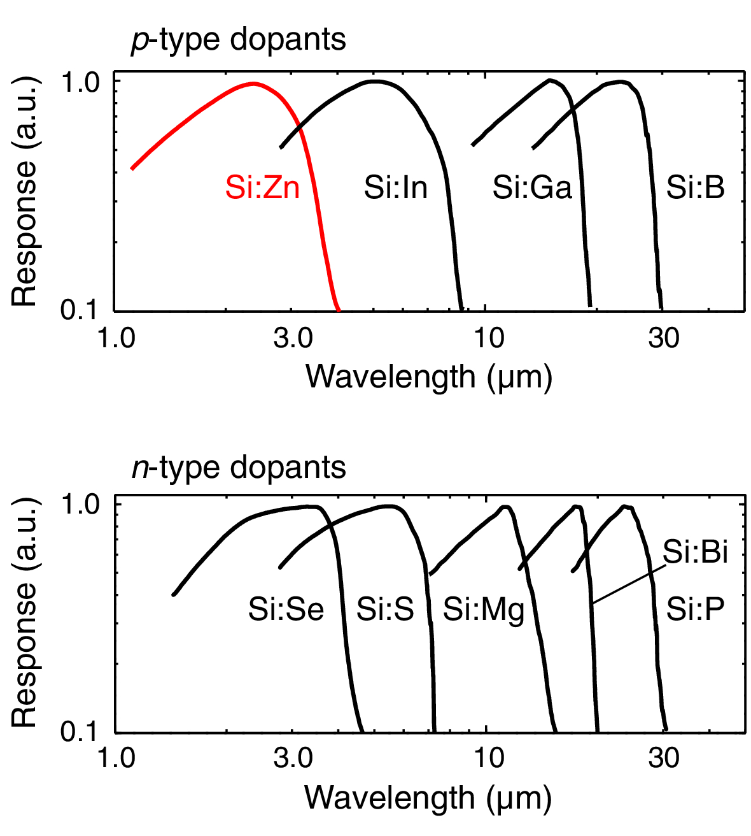
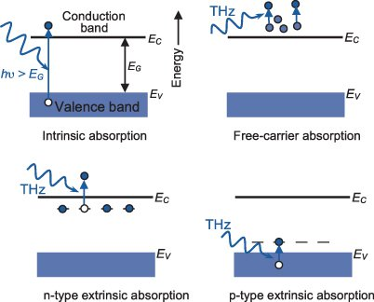
Extrinsic photoconductive detectors
Extrinsic Semiconductor Detectors; Optica 1, 264 (2014)

Slide 15
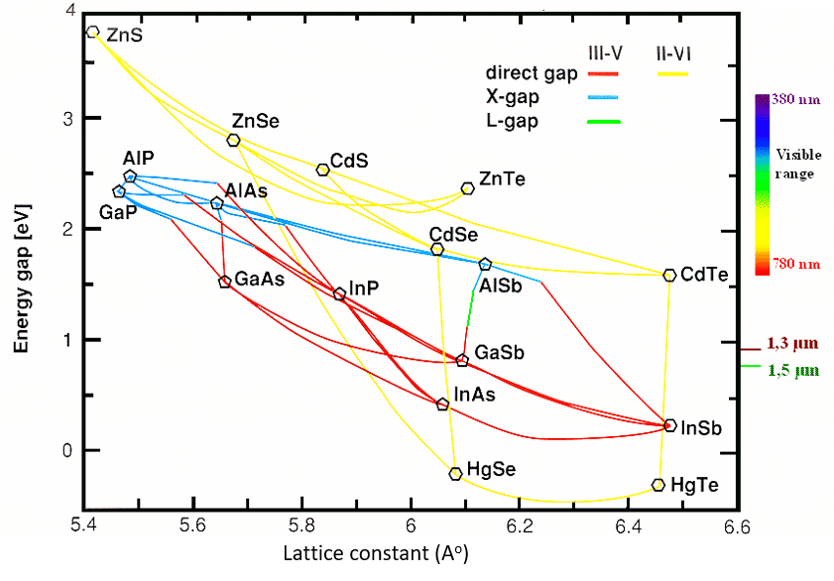
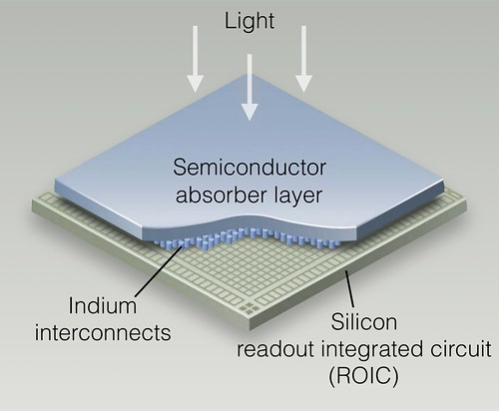
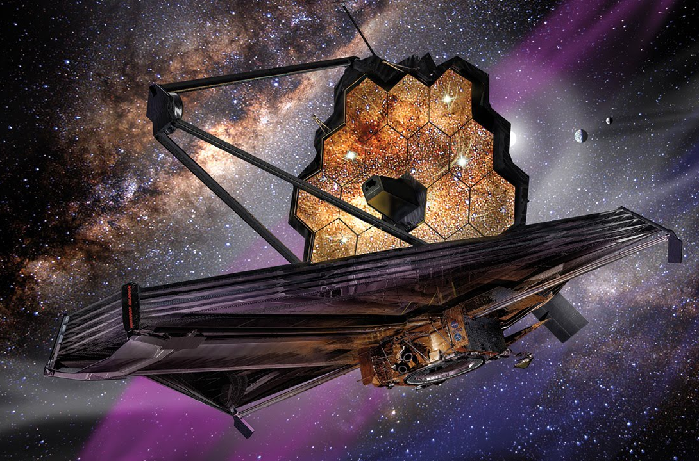
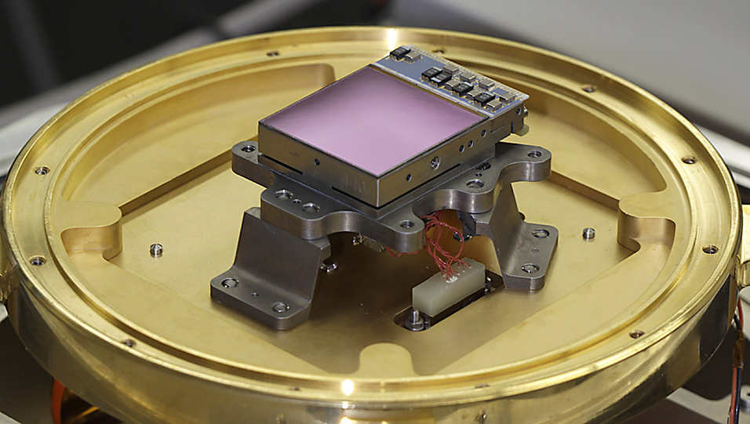
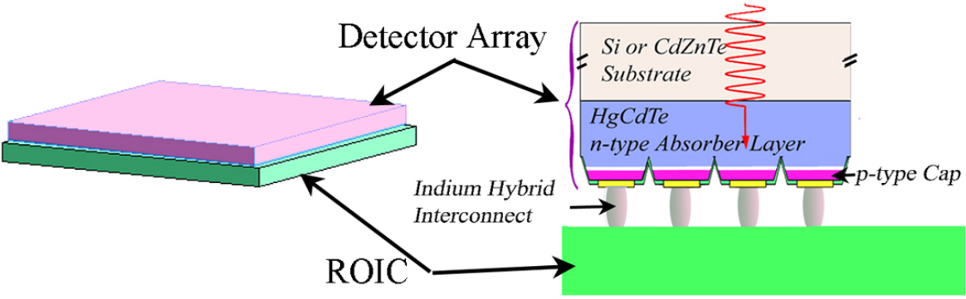
HgCdTe (MCT) photoconductive detectors
© NASA
James Webb Space Telescope
Tunable band gap
High electron mobility (~ 10⁵ cm²/Vs)
Hybrid integration with ROIC
© NASA
Advances in Infrared Detector Array Technology

Slide 16
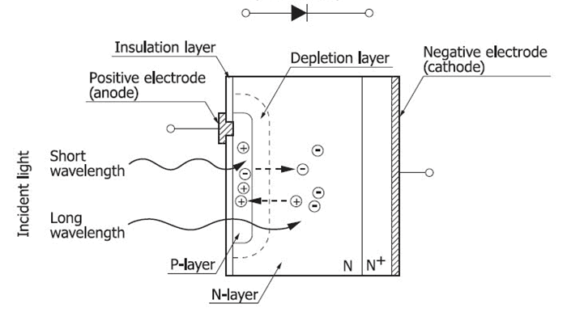
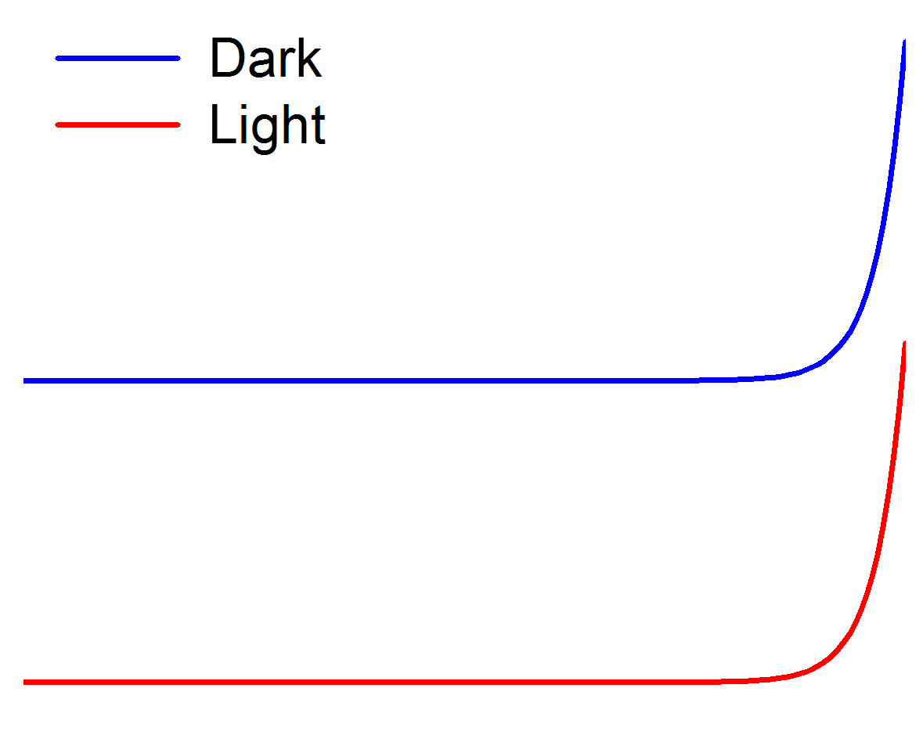
Photovoltaic detector (photodiode)
I
Reverse biased or zero bias
Dark
Ohmic contact
Photo-current
V
Light
Quantum efficiency:
Responsivity
in the absence of gain
Notes:
The carrier collection efficiency can be estimated by considering the carrier transit time and the carrier lifetime. It should be close to unity in a well-designed photodiode.

Slide 17
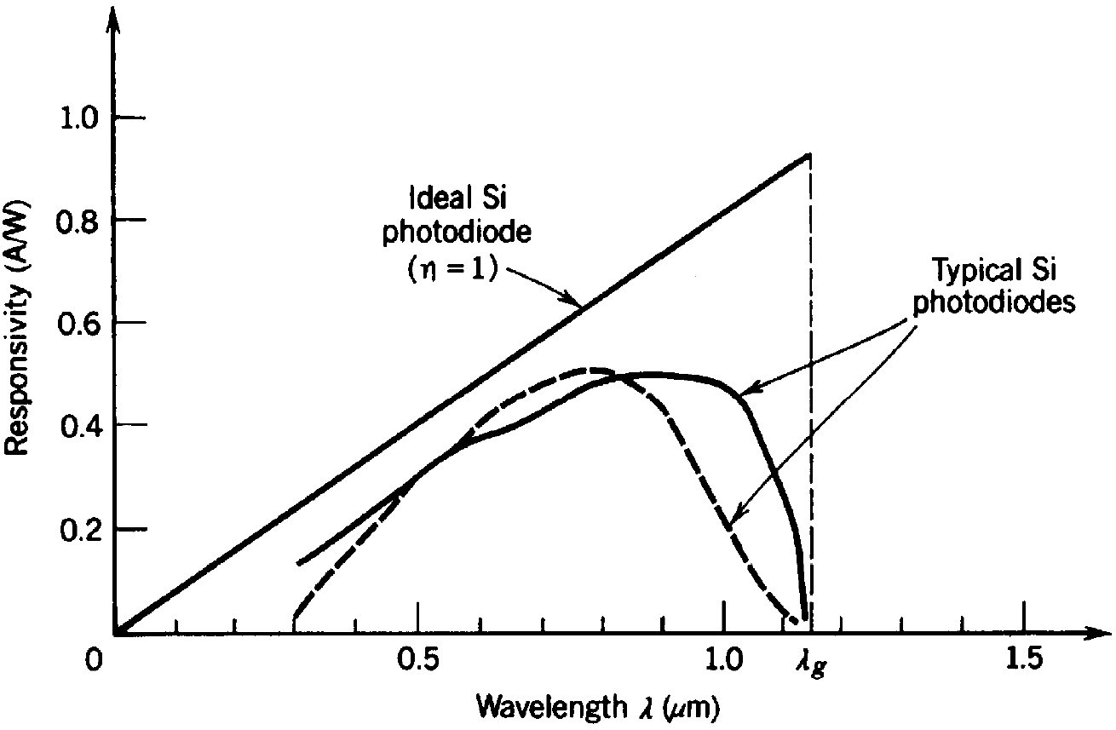
Spectral response
After Fundamentals of Photonics
Surface recombination
Weak band edge absorption

Slide 18
Speed of photovoltaic detectors: carrier transit
I_{ph}
t
I_{PD}
Diffusion region
Drift current
Diffusion current
t
Drift region
Carriers generated outside the depletion zone are not efficiently collected (η ↓)
Slow diffusion current component

Slide 19
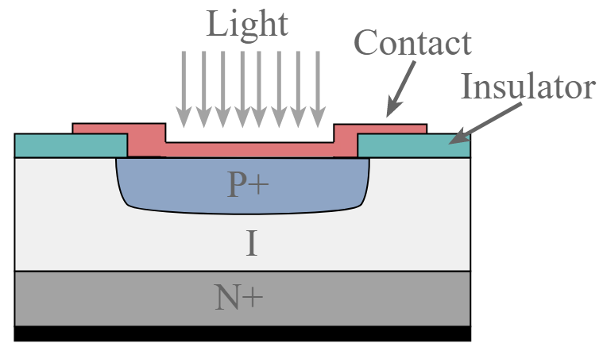
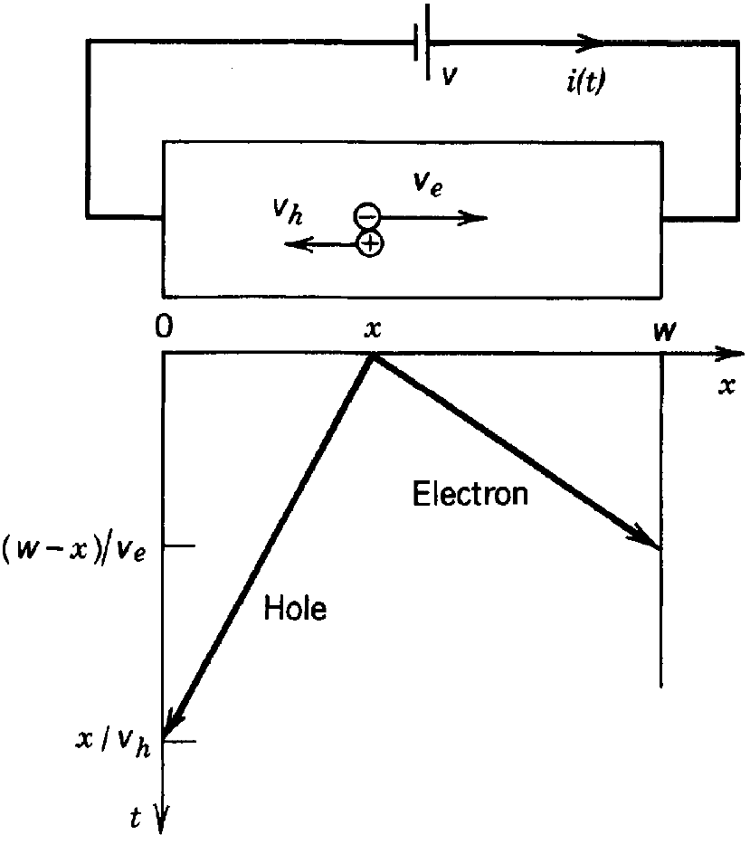
Speed of photovoltaic detectors: carrier transit
l
Image from electronics-notes.com
l
Fully depleted p-i-n diode enhances carrier collection and speed
After Fundamentals of Photonics

Slide 20
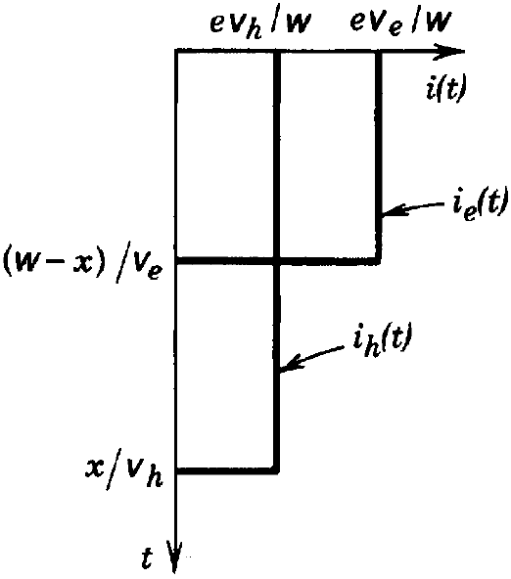
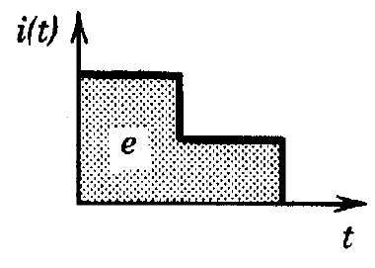
Speed of photovoltaic detectors: carrier transit
l
l
l
l
l
Shockley-Ramo
Each electron-hole pair contributes e collected charge
After Fundamentals of Photonics
Notes:
The Shockley-Ramo theorem refers to current signals induced on grounded conductors due to moving charges in the space between the conductors. The negative sign is there because it is referring to current generated in the external circuit.

Slide 21
Speed of photovoltaic detectors: carrier transit
Transit-time-limited 3-dB bandwidth
For top-bottom contacted photodiodes
l
Transit time spread
Electron and hole velocity difference
Carrier generation at different locations
l
After Fundamentals of Photonics

Slide 22
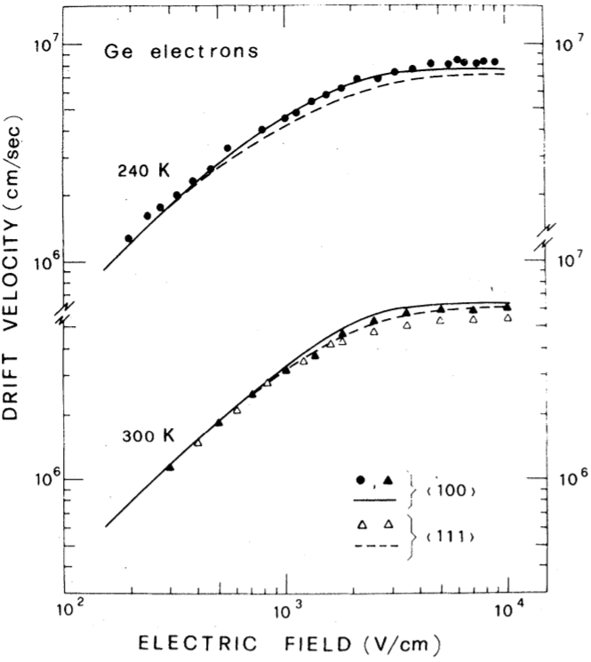
Speed of photovoltaic detectors: carrier transit
Transit-time-limited 3-dB bandwidth
For top-bottom contacted photodiodes
Saturated velocity
Phys. Rev. B 24, 1014 (1981)
Notes:
As the applied electric field increases beyond a certain value, the carrier velocity no longer increases because the carriers lose energy through increased levels of interaction with the lattice, by emitting phonons and even photons as soon as the carrier energy is large enough to do so.

Slide 23
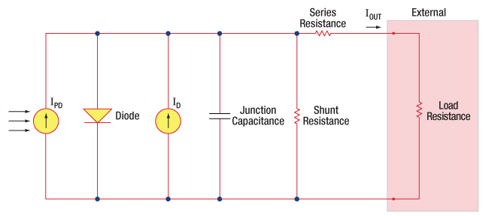
Speed of photovoltaic detectors: RC delay
Equivalent circuit of a photodiode
C
R
Junction capacitance of p-n photodiodes
Junction capacitance of p-i-n photodiodes

Slide 24
Optimizing speed of free-space photodiodes
p
i
d
n
J. Liu, Handbook of Silicon Photonics, Ch. 10.3
For a given device area, there is an optimal thickness for vertical p-i-n detectors

Slide 25
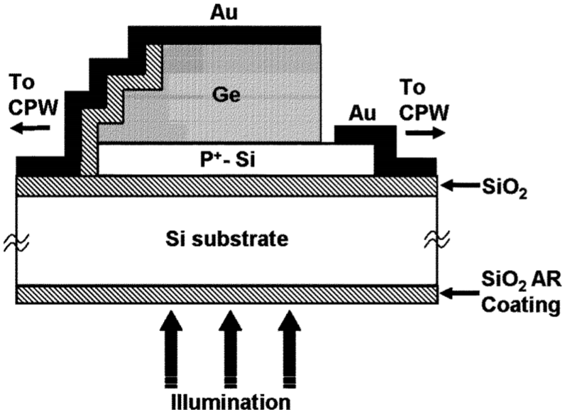
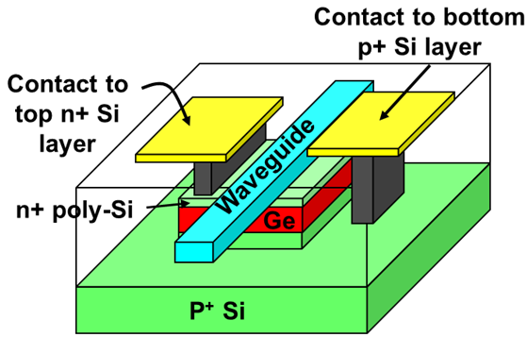
Overcoming the bandwidth-responsivity trade-off
Waveguide integration
Orthogonal light propagation and carrier collection path
Noise suppression
IEEE Photon. Technol. Lett. 17, 175 (2005)
Resonant cavity enhancement
Absorption enhancement
Spectral bandwidth penalty
Opt. Express 15, 3916 (2007)

Slide 26
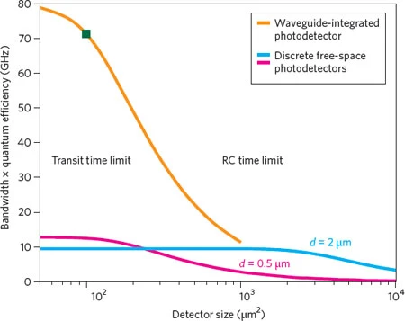
Waveguide-integrated photodetectors
Nat. Photonics 4, 527 (2010)
Handbook of Silicon Photonics, Ch. 10.3
10x improvement in bandwidth-efficiency product

Slide 27
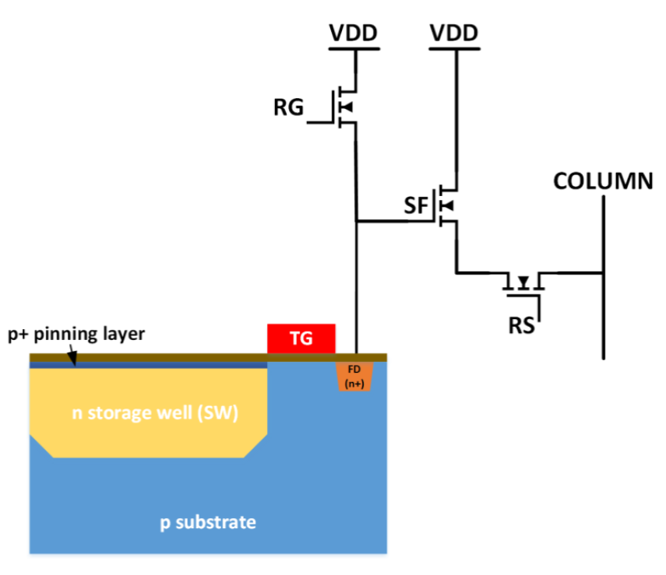
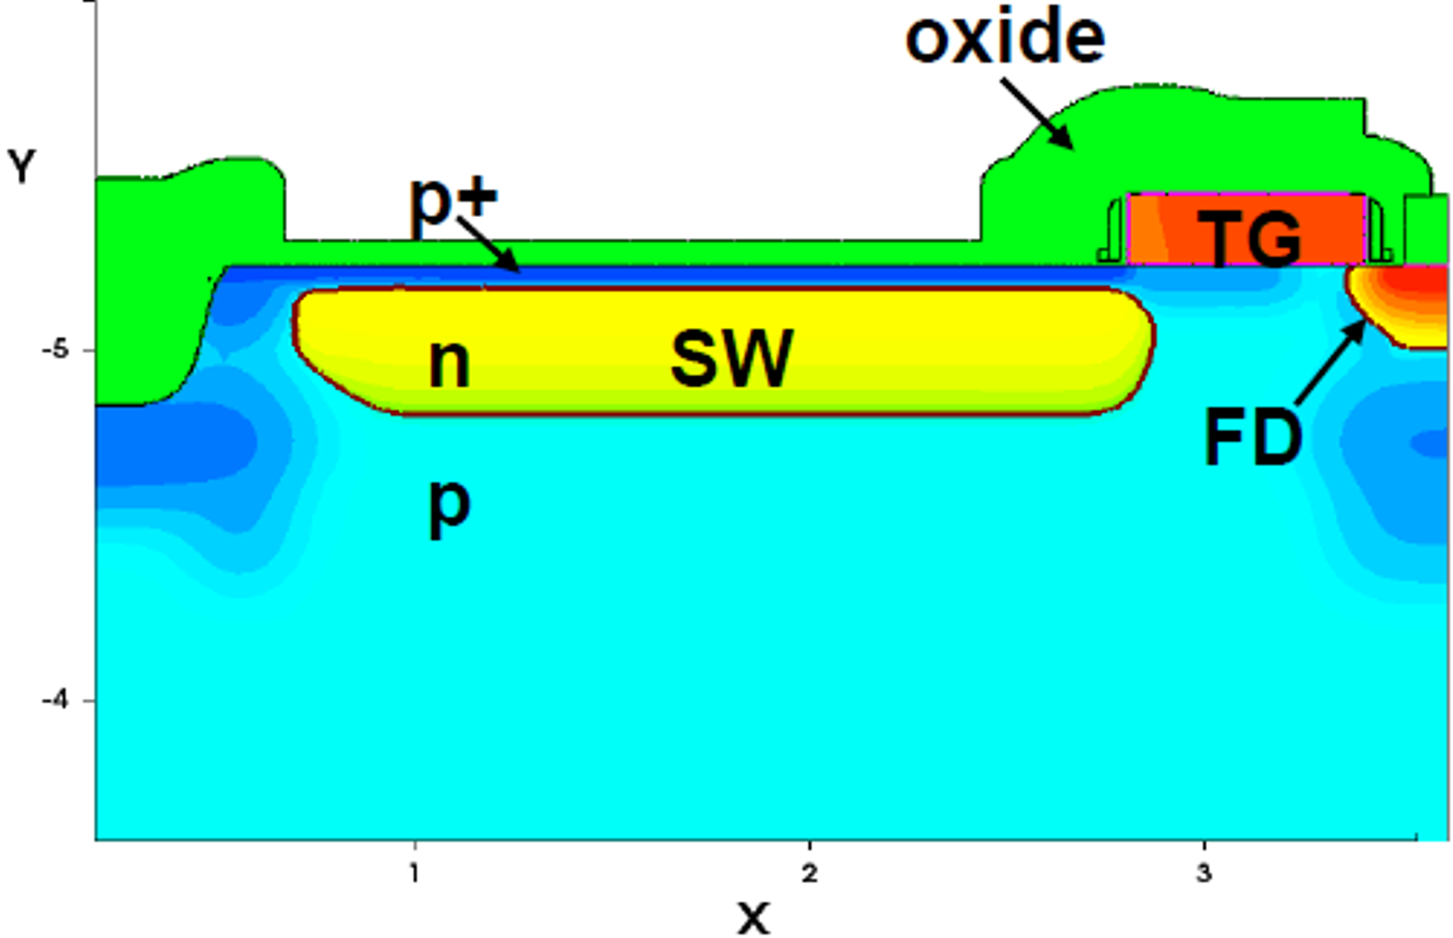
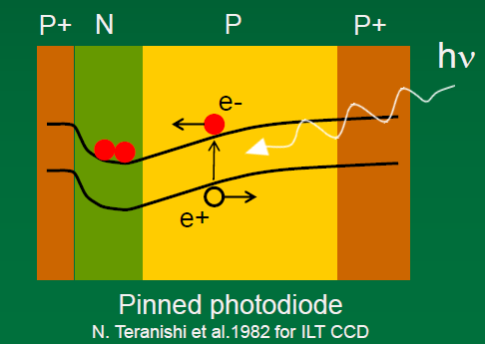
CMOS/CCD image sensors
Reset gate
Source follower
Row selector
Electric potential
IEEE J. Electron Devices Soc. 2, 33 (2014)
Photoelectrons collected in a n-type storage well (SW)
Upon reach out, the transfer gate (TG) is turned on such that photoelectrons are transferred to a capacitor known as “float diffusion” (FD)
This induced a voltage change of ΔV=Q/C, which drives the source follower (SF) transistor for transductance gain

Slide 28
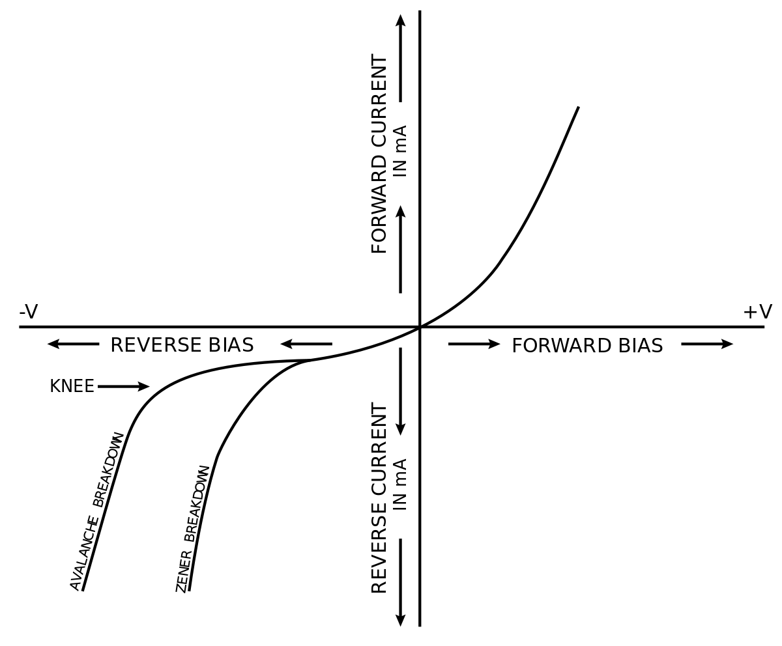
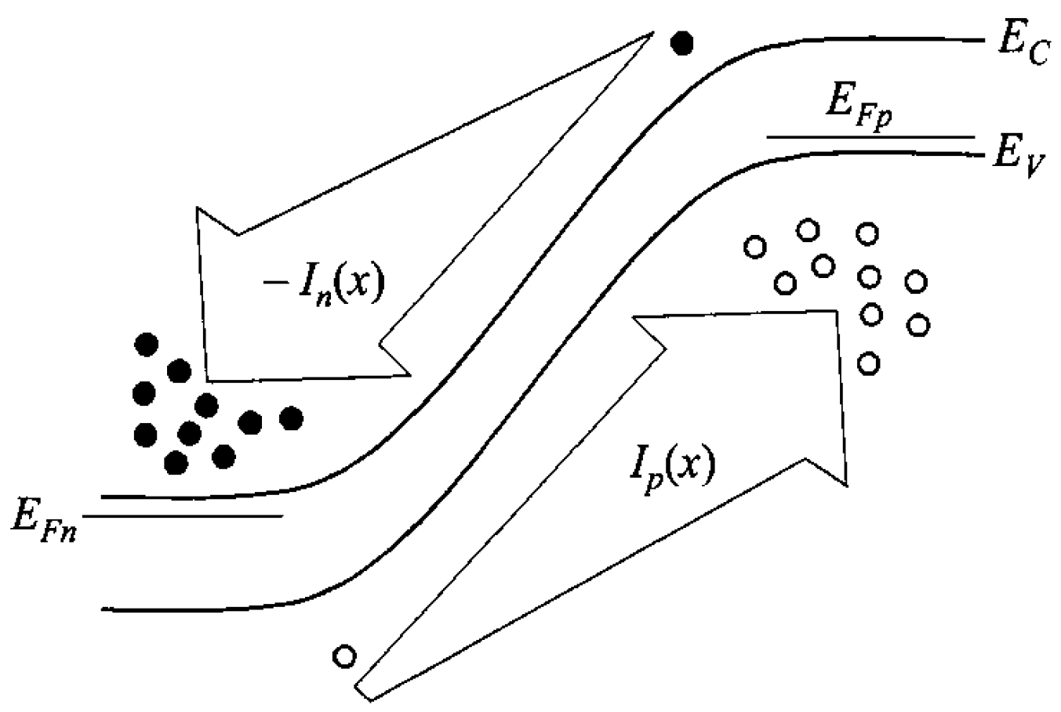
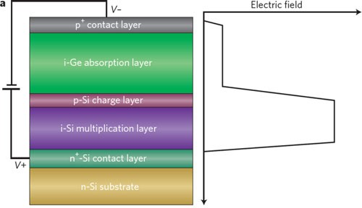
Avalanche photodiode (APD)
Sze, Physics of Semiconductor Devices
Nat. Photonics 4, 527 (2010)
Avalanche breakdown: carrier multiplication via impact ionization
Separate-absorption-charge-multiplication (SACM) structure
Ionization ratio should be minimized to reduce avalanche gain noise and increase bandwidth
Notes:
Ionization ratio: ratio of multiplication rates of two types of carriers

Slide 29
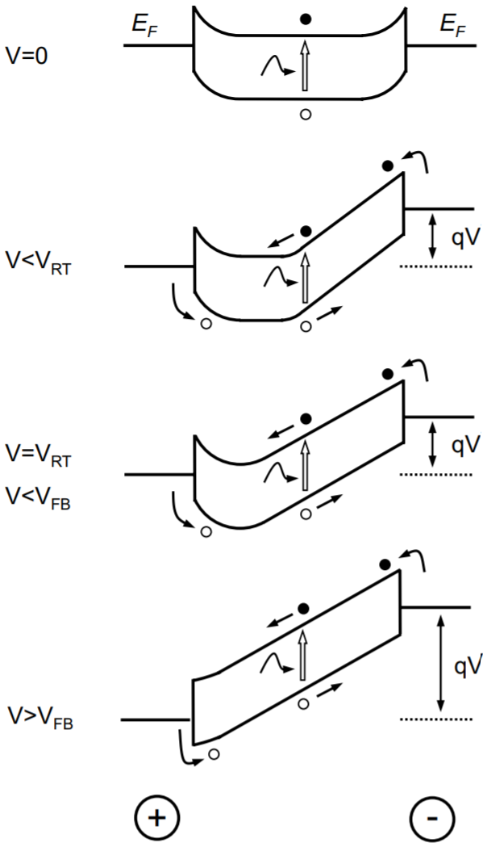
Metal-semiconductor-metal (MSM) detectors
Schottky contacts
After Fundamentals of Photonics
Two back-to-back metal-semiconductor Schottky junctions
J. Brouckaert, Ph.D. Thesis

Slide 30
Metal-semiconductor-metal (MSM) detectors
I
V
Dark
Carriers trapped in potential well: low current
Light
J. Brouckaert, Ph.D. Thesis

Slide 31
Metal-semiconductor-metal (MSM) detectors
I
Current increases due to barrier height decrease
V
Dark
Light
J. Brouckaert, Ph.D. Thesis

Slide 32
Metal-semiconductor-metal (MSM) detectors
Barrier vanishes; current saturates
I
V_{FB}
V
Dark
Light
J. Brouckaert, Ph.D. Thesis

Slide 33
Metal-semiconductor-metal (MSM) detectors
MSM vs. p-i-n detectors
Simpler structure
Smaller capacitance per unit area: transit-time-limited high speed
Lower responsivity: electrode shadowing (back illumination, waveguide integration, transparent contact)
Dark current leakage: contact quality (Schottky barrier enhancement layer)
After Fundamentals of Photonics

Slide 34
Detector noise
I
Measured signal i(t)
Standard deviation of noise
Signal-to-noise ratio (SNR)
Noise-free signal
t
Time domain
with frequency-domain filter

Slide 35
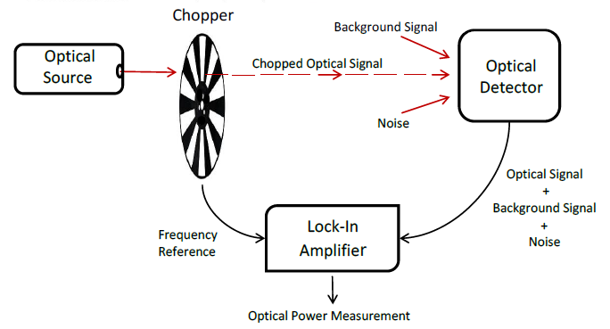
Detector noise
Photonics: Optical Electronics in Modern Communications, Ch. 10
I
Measured signal i(t)
Noise-free signal
t
Time domain
PSD
www.ophiropt.com/laser--measurement/knowledge-center/article/10378
B
SNR can be improved by selecting a proper measurement frequency (if the noise is non-white) and decreasing noise bandwidth
frequency
f_{c}
Frequency domain
Notes:
B = 1/2t applies to rectangular pulse: see Dereniak and Boreman Ch. 5.5

Slide 36
Detector noise mechanisms
Photon shot noise
Dark current shot noise
  Shot noise is absent in photoconductors (with the exception of quantum shot noise)
Thermal noise (Johnson-Nyquist noise)
Generation-recombination noise (G-R noise)
1/f noise (flicker noise)
Circuit noise
Johnson–Nyquist Noise in Photodiode Circuits
Notes:
https://www.hamamatsu.com/resources/pdf/ssd/e02_handbook_si_photodiode.pdf

Slide 37
Detector SNR performance metrics
Noise equivalent power (NEP)
  Optical power producing unity SNR at 1 Hz noise bandwidth
  NEP measurement protocols
(Specific) detectivity D*
  Figure-of-merit (FOM) for evaluating a free-space detector’s SNR performance
  Assumption:
not applicable to photoconductors

Slide 38
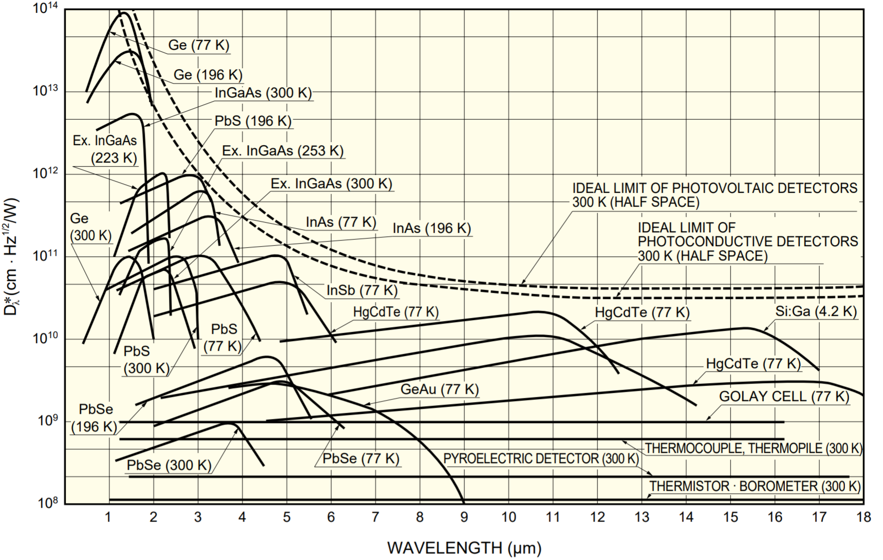
D* of different detectors
Characteristics and use of infrared detectors
D* is lower in narrow-gap semiconductors
Cooling improves D*
Photon detectors have higher D* compared to thermal detectors

Slide 39
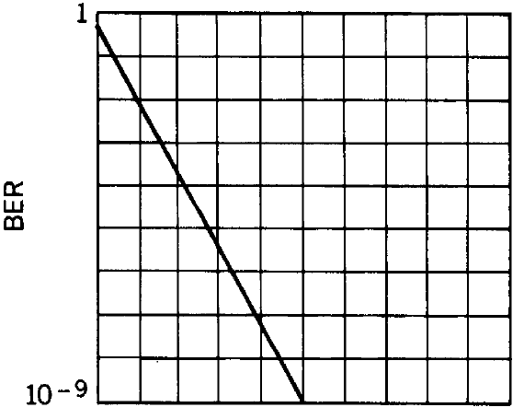
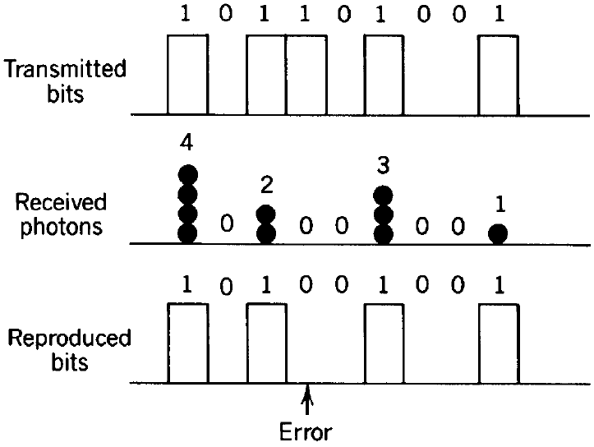
Bit error rate (BER)
After Fundamentals of Photonics
On-off keying (OOK)
Received photon number m follows Poisson distribution
0
20
40
Notes:
Assumptions: 1) the 0 bit is defined as no photon received and 1 bit is defined as non-zero photon received; 2) no other noise than photon shot noise is considered, i.e. there is no noise associated with the 0 bit; and 3) the 0 and 1 bits have equal probability to appear

Slide 40
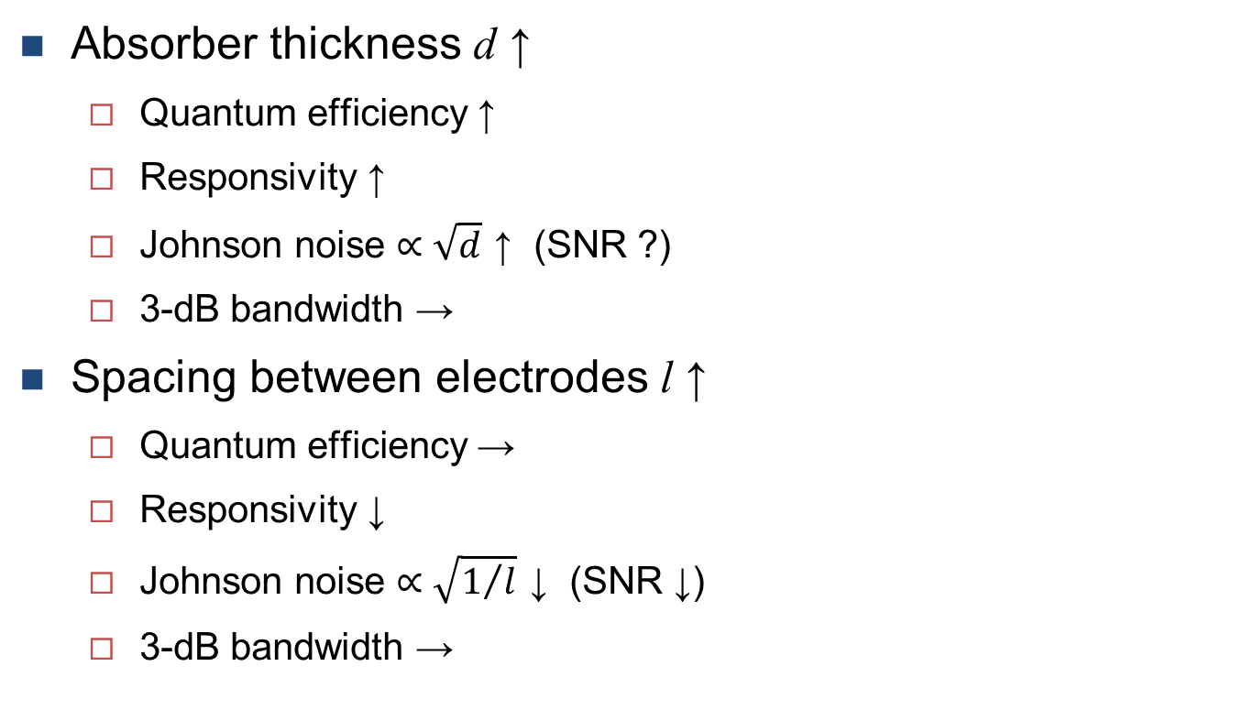
Detector design optimization: photoconductors*
Absorber thickness d ↑
  Quantum efficiency ↑
  Responsivity ↑
  Johnson noise $∝\sqrt{d}$ ↑ (SNR ?)
  3-dB bandwidth →
Spacing between electrodes l ↑
  Quantum efficiency →
  Responsivity ↓
  Johnson noise $∝\sqrt{1/l}$ ↓ (SNR ↓)
  3-dB bandwidth →
*Constant current mode & in-plane electrode configuration

Slide 41
Detector design optimization: photodiodes*
Absorber thickness d ↑
  Quantum efficiency ↑
  Responsivity ↑
  Current shot noise → (SNR ↑)
  3-dB bandwidth ↓
Detector active area A ↑
  Quantum efficiency →
  Responsivity →
  Current shot noise ↑ (SNR ↑, NEP ↑, D* →)
  3-dB bandwidth ↓
*Top-bottom contacted vertical p-i-n junction

Slide 42
List of symbols
λ – free-space wavelength
E_{g} – band gap energy
I – electric current
V – voltage
E – electric field
d – thickness of absorber (photoconductor), or thickness of depletion layer (photodiode)
τ – photo-generated carrier lifetime (which is also the time constant of photoconductive detectors)
Δn / Δp – photo-generated carrier density

Slide 43
List of symbols
η – quantum efficiency
α – absorption coefficient
R_{λ} – optical reflectance on detector surface
l / w – length / width of absorber
I_{ph} – irradiance of incident light (optical power per area)
A – active area of free-space detector
V_{d} – active volume of detector
ћ – reduced Planck constant, 1.055 × 10⁻³⁴ J·s
ω – angular frequency of light
Δσ – photoconductivity

Slide 44
List of symbols
– responsivity
g – detector gain
q – charge collected by circuit per photo-electron generated
v – drift velocity of carriers
f_{3dB} – 3-dB bandwidth
τ_{r} – 10%-to-90% rise time
n / p – electron / hole density
ζ – carrier collection efficiency
i – instantaneous electric current signal

Slide 45
List of symbols
I_{PD} – photocurrent generated by a photodiode
Q – charge carried by the particle
f_{tr} – transit-time-limited 3-dB bandwidth
I_{D} – dark current
τ_{RC} – RC time constant
R – load resistance
C – detector junction capacitance
f_{RC} – RC-limited 3-dB bandwidth
ε – permittivity of detector active material at radio frequency

Slide 46
List of symbols
d_{opt} – optimal depletion layer thickness in a free-space detector that yields maximum bandwidth
V_{RT} – reach-through voltage, beyond which MSM structure becomes fully depleted
V_{FB} – flat-band voltage
σ_{i} – noise current
– mean of current signal
f – frequency
PSD – noise power spectral density
B – noise bandwidth

Slide 47
List of symbols
τ_{int} – measurement integration time
σ_{i,tot} – total noise current including all noise contributions
e – elementary charge, 1.602 × 10⁻¹⁹ C
k_{B} – Boltzmann constant, 1.38 × 10⁻²³ m²·kg·s⁻²·K⁻¹
T – thermodynamic temperature
NEP – noise equivalent power
D* – (specific) detectivity
BER – bit error rate
m – photon number received by the detector in a bit
P₀ / P₁ – probability of mistaking a 0-bit for 1 / a 1-bit for 0

Slide 48
List of symbols
– average photon number received by the detector in a 1-bit
P(m) – probability of receiving m photons in a 1-bit

