Slide 1
MIT 3.156/3.46
Photonic Materials and Devices
10: Optoelectronic Properties
Juejun (JJ) Hu
hujuejun@mit.edu

Slide 2
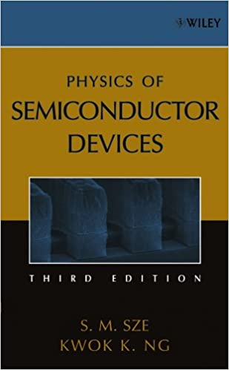
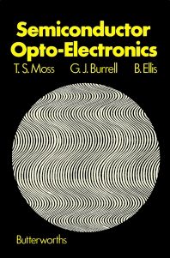
Optoelectronics
Optoelectronics is the study and application of electronic devices and systems that source, detect and control light
Optoelectronics is based on the quantum mechanical effects of light on electronic materials, especially semiconductors
References
Fundamentals of Photonics, Ch. 15
Physics of Semiconductor Devices, Ch. 1
Semiconductor Opto-Electronics, Ch. 3 & 7

Slide 3
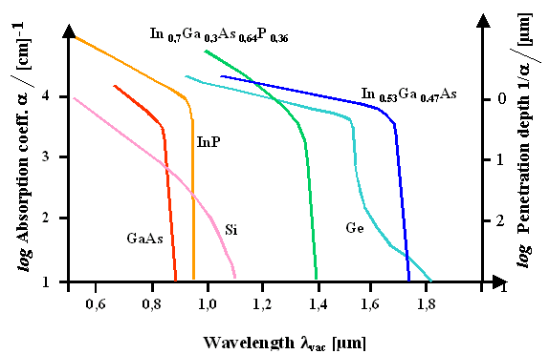
Optical absorption in semiconductors

Slide 4
Band structure of semiconductors near band edge
E
E
E_{g}
E_{g}
k
k
Direct gap semiconductors:
compound semiconductors
Indirect gap semiconductors:
group IV semiconductors

Slide 5
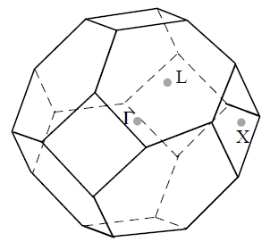
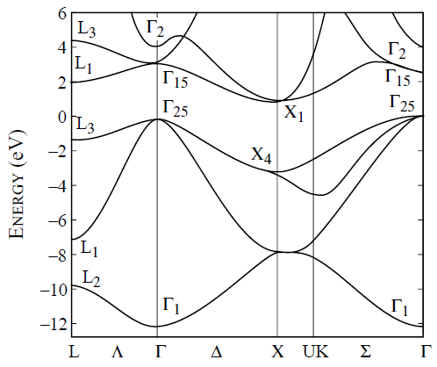
Band structure of silicon
Γ :
L :
X :
a = 5.43 Å

Slide 6
Energy and crystal momentum conservation
Energy conservation
Crystal momentum conservation
Thermalised electron momentum
Photon momentum
E
k

Slide 7
Energy and crystal momentum conservation
Parabolic band approximation
Energy conservation
E
E_{C0}
k
E_{V0}
Reduced mass:

Slide 8
Energy and crystal momentum conservation
Energy conservation
E
E_{C0}
k
E_{V0}
For a given photon energy, only a narrow band of states contribute to absorption!

Slide 9
Electronic density of states in energy bands
In the k-space each electronic state occupies a volume of
where V is the volume of the system
Dispersion relation
Beware of spin degeneracy!

Slide 10
Absorption in direct gap semiconductors
Photon absorption rate is proportional to the joint density of states: the density of states (pairs) that can participate in the absorption process
Optical transition typically does not flip the electron spin state

Slide 11
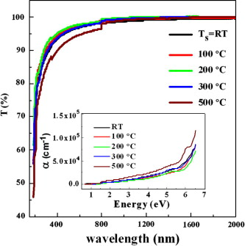
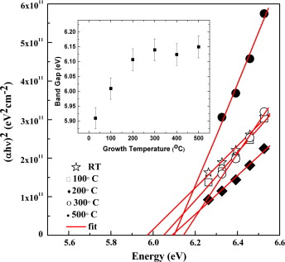
Direct band gap energy determination
V. Mudavakkat et al., Opt. Mater. 34, Issue 5, 893-900 (2012).

Slide 12
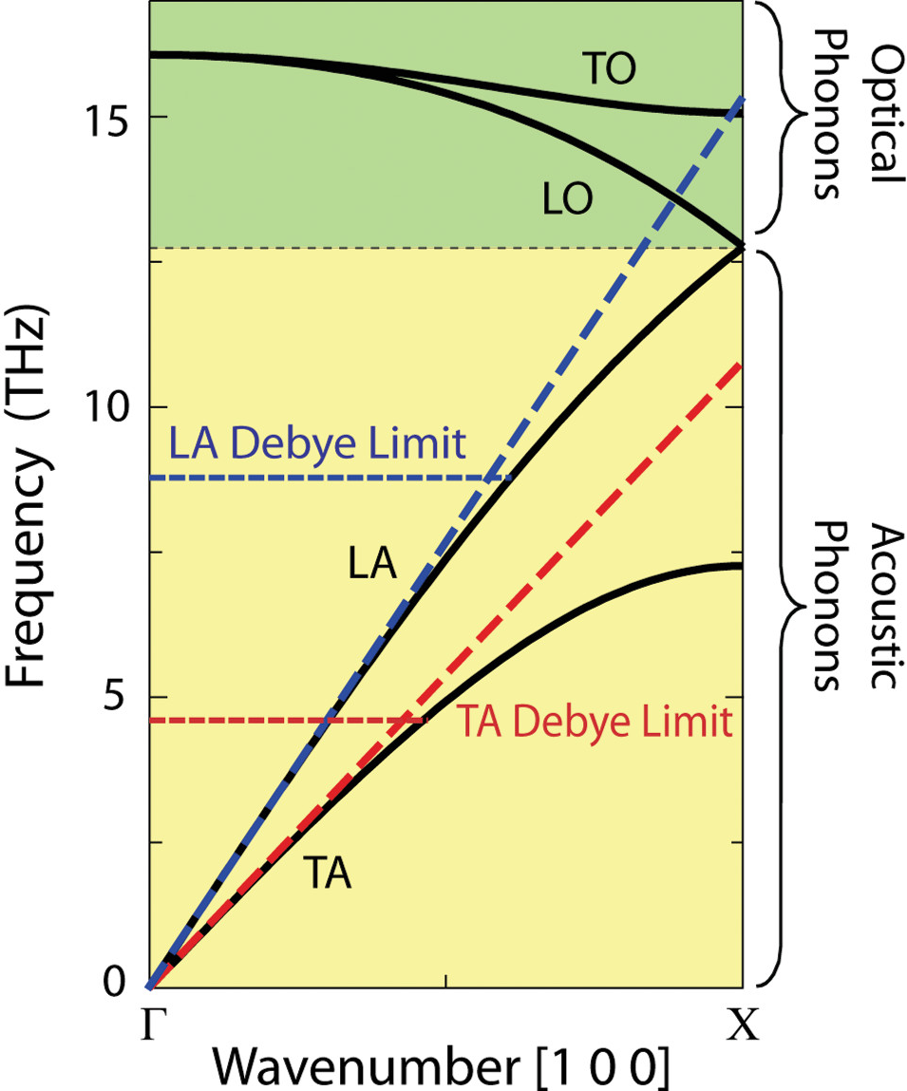
Absorption in indirect gap semiconductors
Conservation laws
E
k
AIP Adv. 1, 041403 (2011)
Typical optical phonon energy in Si: 60 meV

Slide 13
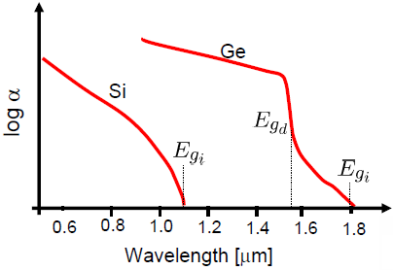
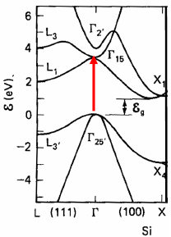
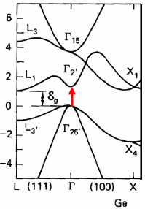
Absorption in indirect gap semiconductors
Phonon-assisted absorption:

Slide 14
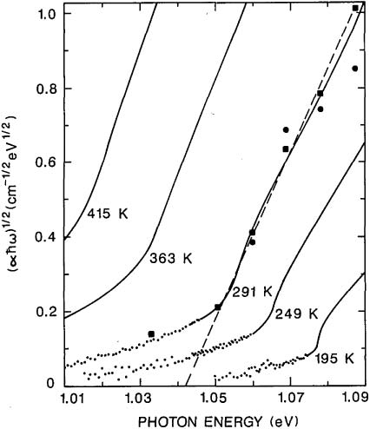
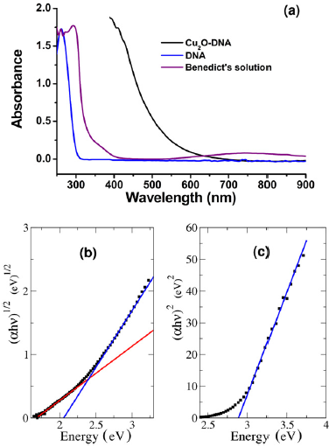
Indirect band gap energy determination
Si
Appl. Opt. 27, 3777-3779 (1988).
Nanotechnology 23, 075601 (2012).

Slide 15
Moss-Burstein effect
E
E
Doping
k
k
Increase of apparent bandgap energy in degenerately doped semiconductors
Inhibition of transition due to the Pauli's exclusion principle

Slide 16
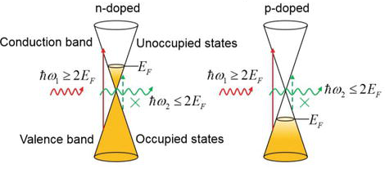
Pauli blocking
Carrier doping via electrostatic gating
Inhibition of transition due to the Pauli's exclusion principle
Graphene-Enhanced Optical Signal Processing, DOI: 10.5772/67491

Slide 17
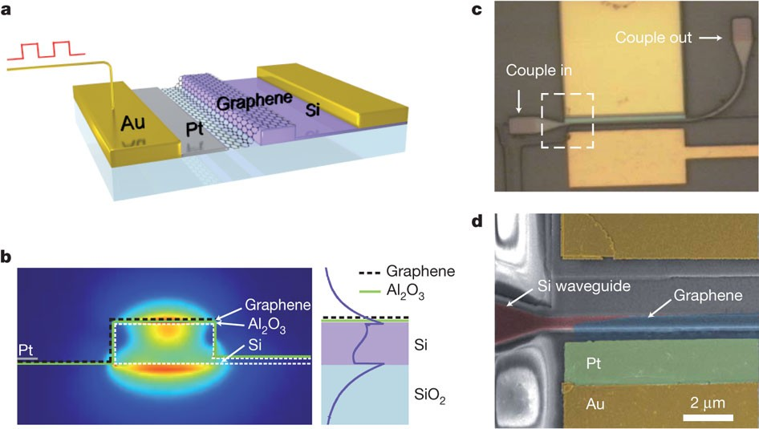
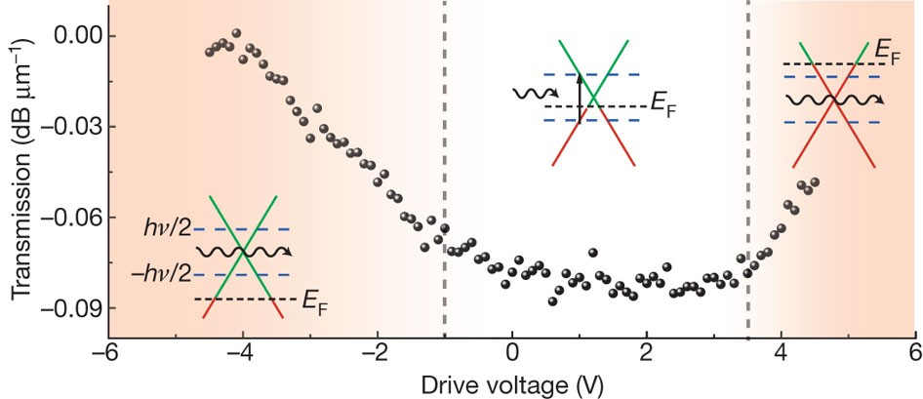
A graphene-based waveguide modulator
Nature 474, 64 (2011)

Slide 18
Quasi-Fermi levels in non-equilibrium semiconductors
Optical or electrical injection increases the density of both types of carriers
In semiconductors displaced from equilibrium, separate quasi-Fermi levels, E_{Fn} and E_{Fp} must be used for electrons and holes, respectively (E_{Fn} = E_{Fp} in equilibrium)
Quasi-thermal equilibrium within bands: electron relaxation time within a band is much smaller than across the band gap
Occupation probability in the conduction band:
Occupation probability in the valence band:

Slide 19
Absorption saturation effect
At high injection levels, the available empty states for electrons in the conduction band are depleted
E
E
Pumping
k
k
Equilibrium
High injection level

Slide 20
Absorption saturation effect
E
E
Pumping
k
k
Equilibrium
High injection level
Absorption coefficient in the presence of saturation:
Here E_{C} and E_{V} are the energies of the initial and end states

Slide 21
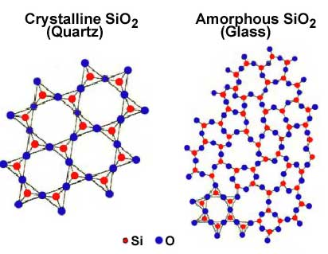

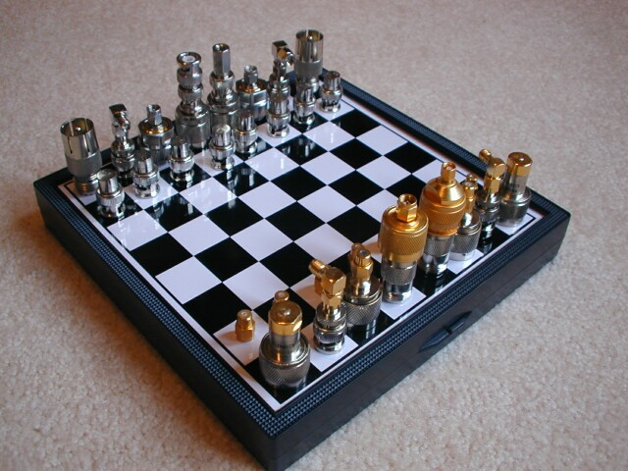
Amorphous solids
Short range order (SRO)
Lack of long range order (LRO)
Properties pertaining to SRO
  Energy band formation
  Density of states
Properties pertaining to lack of LRO
  Crystal momentum (not a good quantum number anymore!)
  Localized states (Anderson localization)
Random
Amorphous
Unlike gases, amorphous solids are NOT completely random
vs.

Slide 22
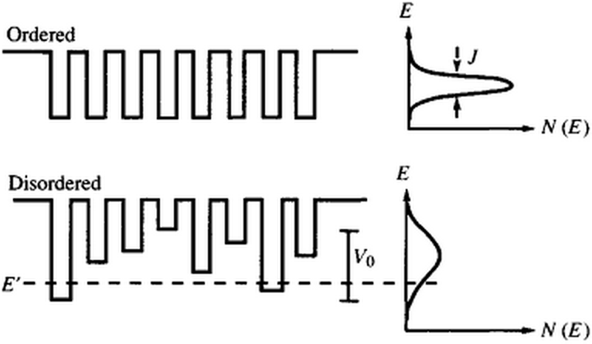
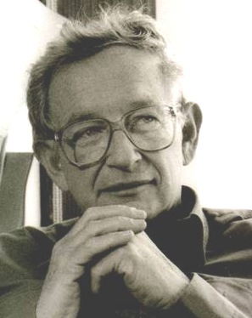
Anderson localization in disordered systems
Localization criterion: sufficiently large variations
P. W. Anderson
Disorder leads to (electron, photon, etc.) wave function localization

Slide 23
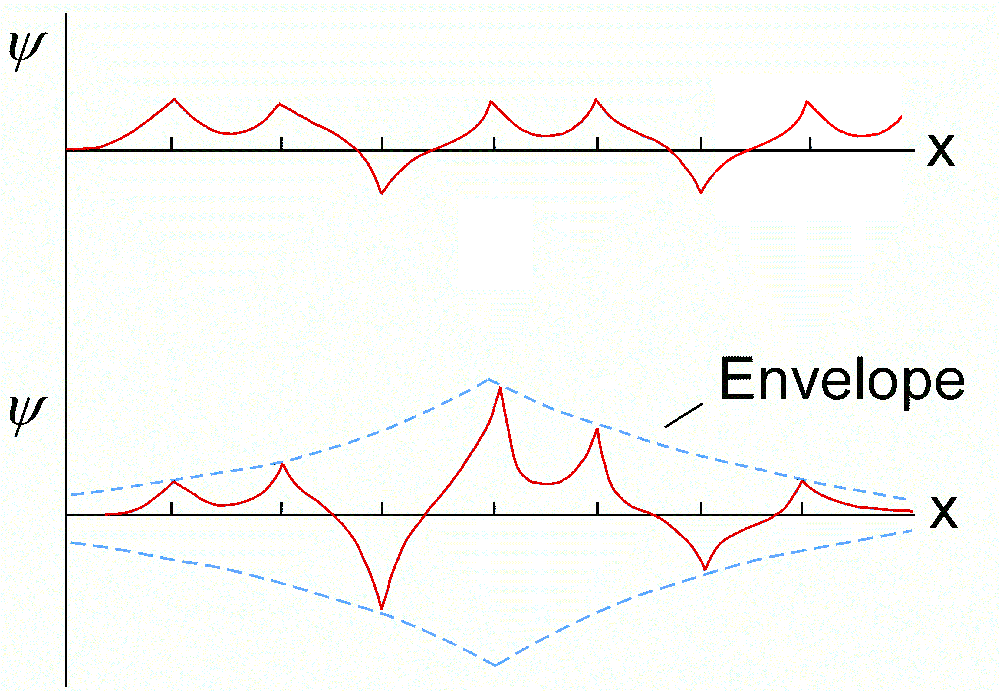
Anderson localization in disordered systems
Extended states (Bloch states)
Localized states

Slide 24
Density of states (DOS) in crystalline and amorphous solids
E
E
Conduction band
Conduction band
Urbach tail
Defect states
Band gap
Mid-gap states
Mobility edge
Valence band
Valence band
DOS
DOS
Crystalline solids
Amorphous solids

Slide 25
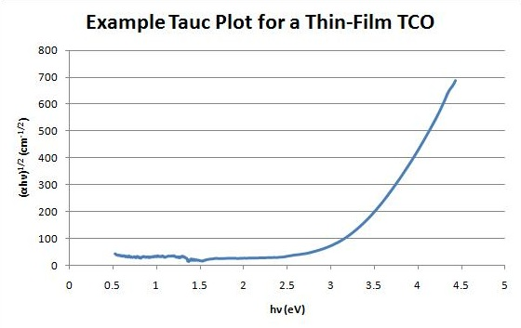
Tauc gap and Tauc plots
Tauc gap E_{T} definition:
It is merely a fitting parameter and has little physical significance!
E_{T} = 3.3 eV

Slide 26
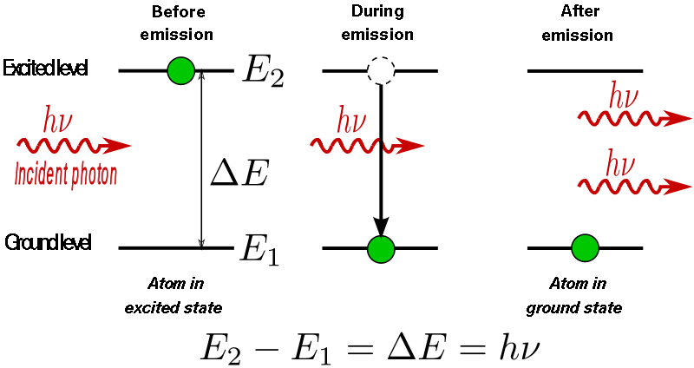
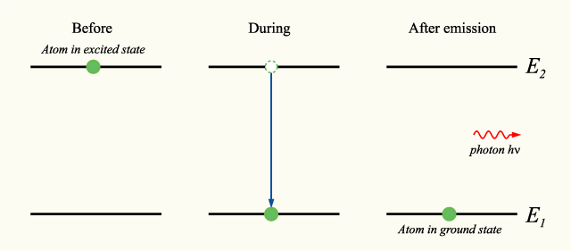
Stimulated and spontaneous emission
Stimulated emission
Spontaneous emission

Slide 27
Stimulated emission
The reverse process of optical absorption
Electron-hole recombination to emit a photon in the presence of an external electromagnetic field excitation
Energy conservation
Optical gain
E
where ω is the angular frequency of the external field as well as the emitted photon
k

Slide 28
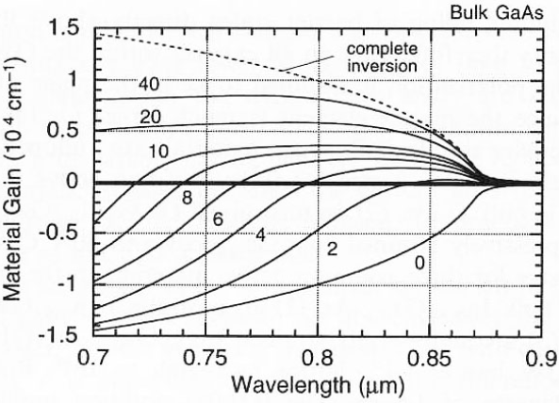
Net gain and optical amplification
Net gain = gain – loss
In practical applications, additional loss sources (scattering, FCA, etc.) need to be considered in the loss term as well
Population inversion
L. A. Coldren and S. W. Corzine, Diode Lasers and Photonic Integrated Circuits

Slide 29
Single-mode rate equation
Consider a semiconductor with uniform carrier density
n : carrier density n_{p} : photon number
No carrier injection
Absorption rate
Stimulated emission rate
Spontaneous emission rate
k_{abs} , k_{stim} , k_{sp} : absorption, stimulated and spontaneous emission coefficients, which are environment-independent

Slide 30
Single-mode blackbody radiator
In thermal equilibrium
Energy conservation:
Hot blackbody ( ):
Cold blackbody ( ):
Fermi-Dirac distribution
Planck distribution

Slide 31
Single-mode “hot” blackbody radiator
In thermal equilibrium
Absorption and stimulated emission dominate over spontaneous emission in a “hot” blackbody
Thermal equilibrium
At high temperatures, occupation probability of all states are equal

Slide 32
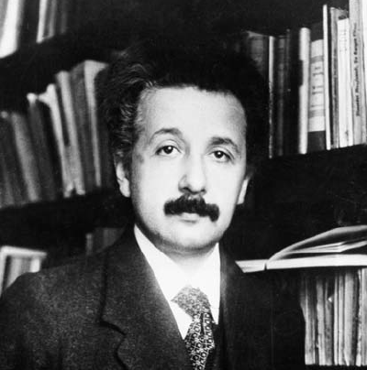
Single-mode “cool” blackbody radiator
In thermal equilibrium
Rereading Einstein on Radiation
All the rate constants are the same specified by detailed balance
Note: the rate constant k_{a-e} is NOT a material constant as it depends on the optical mode under investigation

Slide 33
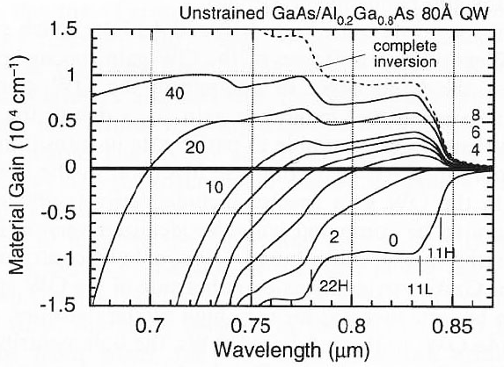
Optical gain in semiconductors
The absorption curve at zero injection level and the gain curve at complete inversion are symmetric with respect to the horizontal axis
Their shape reflects the joint DOS in the material

Slide 34
Optical amplification
Gain medium
Under steady-state carrier injection:
Optical amplification:
Optical injection
Net radiative recombination
Non-radiative recombination
Current injection

Slide 35
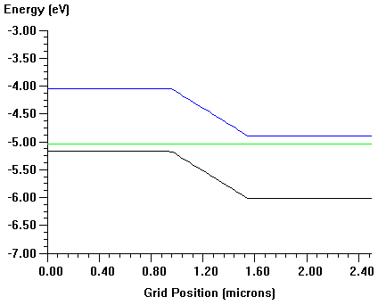
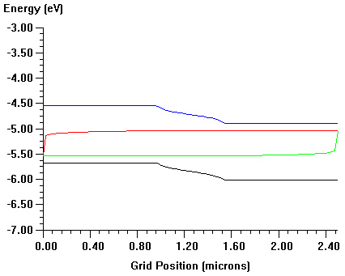
Carrier density in semiconductor devices
Solving the current continuity and the Poisson equations
Current continuity
Poisson equation
0 V bias
0.5 V forward bias
1-D semiconductor device simulator:
SimWindows download

Slide 36

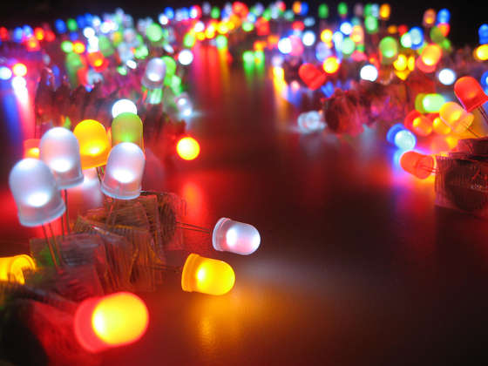
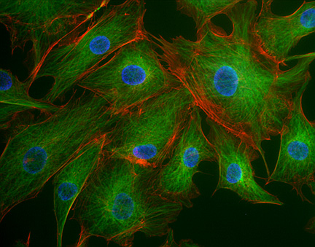
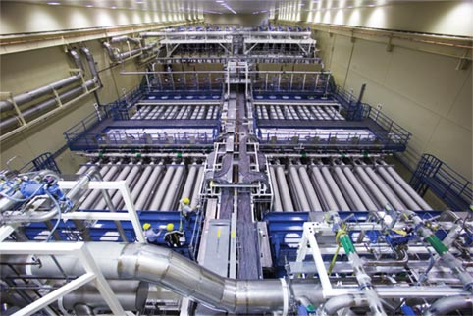
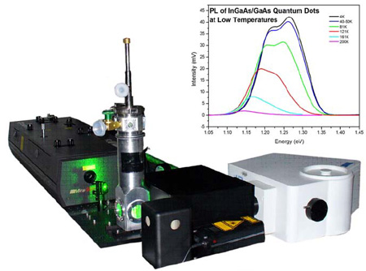
Stimulated emission and spontaneous emission in technical applications
Stimulated emission
Spontaneous emission
Optical amplifiers
LEDs
Lasers
Fluorescence imaging
Photoluminescence spectroscopy

Slide 37
Engineering spontaneous emission rate: Purcell effect
Fermi’s golden rule:
No photon states: suppressed spontaneous emission (SE)
  Photonic band gap
Large photon density of states: enhanced (i.e. faster) SE rate
  Optical resonant cavity
Enhancement factor (Purcell factor) of SE in a cavity:
Initial state ψ_{i}
electron in CB + 0 photon
Final state ψ_{f}
electron in VB + 1 photon
n : refractive index Q: cavity Q-factor*
λ : wavelength V: cavity mode volume
Notes:
In defining Purcell factor, the Q is given as min(Q_cavity, Q_emitter linewidth)

Slide 38
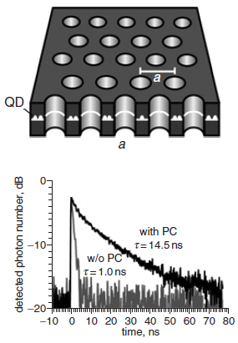
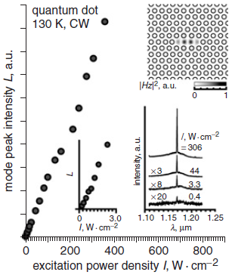
Engineering spontaneous emission rate: Purcell effect
SE suppression
SE enhancement
"Investigation of spontaneous emission from quantum dots embedded in two-dimensional photonic-crystal slab," Electron. Lett. 41, 1402-1403 (2005).

Slide 39
List of symbols
E – energy
E_{g} – band gap energy
k / k_{e} – electron wave vector
a – lattice constant
ћ – reduced Planck constant, 1.055 × 10⁻³⁴ J·s
ω – angular frequency of light
E_{C} / E_{V} – energy of a state in conduction / valence band
E_{C0} / E_{V0} – energy of conduction / valence band edge
k_{C} / k_{V} – wave vector of a state in conduction / valence band

Slide 40
List of symbols
m_{e}* – electron effective mass
β – photon wave vector
k_{B} – Boltzmann constant, 1.38 × 10⁻²³ m²·kg·s⁻²·K⁻¹
T – thermodynamic temperature
c – speed of light in vacuum, 2.99792458 × 10⁸ m/s
m_{r} – reduced mass
ρ – electronic density of state
V – volume
ρ_{C} – density of state of conduction band
ρ_{j} – joint density of state

Slide 41
List of symbols
α – absorption coefficient
ω_{q} / k_{q} – angular frequency / wave vector of phonon
E_{T} – Tauc gap
E_{F} – Fermi energy
E_{Fn} / E_{Fp} – quasi-Fermi level for conduction / valence band
f_{C} / f_{V} – occupation probability in conduction / valence band
s – gain coefficient
g – net gain coefficient

Slide 42
List of symbols
n / p – electron / hole density
t – time
R_{abs} / R_{stim} / R_{sp} – absorption / stimulated emission / spontaneous emission rate
k_{abs} / k_{stim} / k_{sp} – absorption / stimulated emission / spontaneous emission coefficient
n_{p} – photon density
k_{a-e} – absorption-emission coefficient
G – optical injection rate of electronic carriers
J_{n} – electronic current density

Slide 43
List of symbols
Γ – waveguide modal confinement factor
D – electric displacement
ρ_{f} – free charge density
E – electric field
ε – (absolute) permittivity
Φ – electric potential
N_{A} / N_{D} – acceptor / donor concentration
e – elementary charge, 1.602 × 10⁻¹⁹ C
Γ_{i-f} – transition probability per unit of time
H – Hamiltonian of perturbation

Slide 44
List of symbols
E_{i} / E_{f} – energy of initial / final state
ψ_{i} / ψ_{f} – wave function of initial / final state
F_{P} – Purcell enhancement factor
Q – quality factor
λ – free-space wavelength

