Slide 1
MIT 3.071
Amorphous Materials
9: Glass Strengthening
Juejun (JJ) Hu
hujuejun@mit.edu

Slide 2
After-class reading list
Fundamentals of Inorganic Glasses
  Ch. 13.8, Ch. 18.12
Introduction to Glass Science and Technology
  Ch. 9, Section 4.4

Slide 3

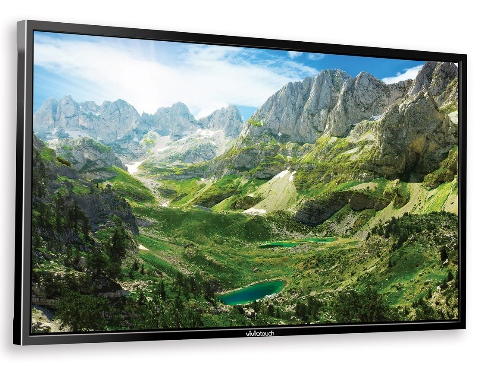
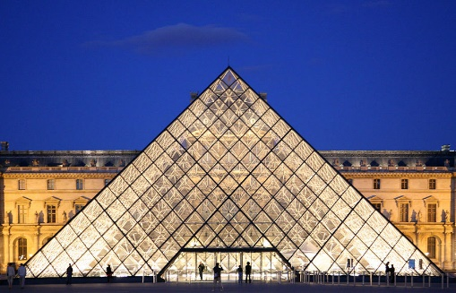


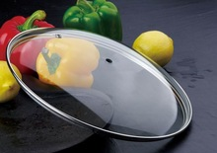
Solar panels
Display
Architecture
Strengthened Glass
Defense
Automobile & aviation
Consumer product

Slide 4
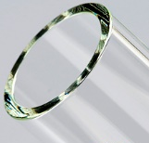
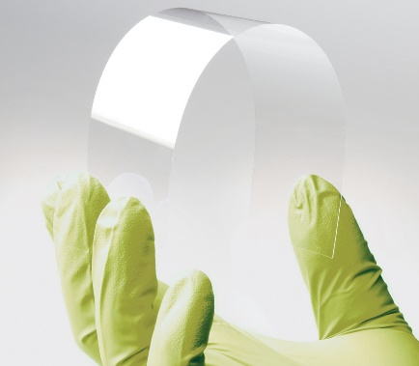

Glass strengthening techniques
Engineer chemistry and microstructure (improve K_{Ic})
Reduce defect density or severity (decrease K_{I})
Introduce surface compressive stress (increase σ_{f})
Crystallization
Composites
Engineer glass structures
Fire polishing
Surface etching
Surface coating
Heat treatment / tempering
Ion exchange
Notes:
Strengthening by surface crystallization is actually based upon two principles. Firstly, the relative contraction of the surface from the set point of the glass to room temperature after the onset of surface crystallization is less for the surface layers than for the glass substrate. Secondly, second-phase inclusions act to increase the effective Klc, which leads to strengthening for an assumed initial flaw distribution.

Slide 5
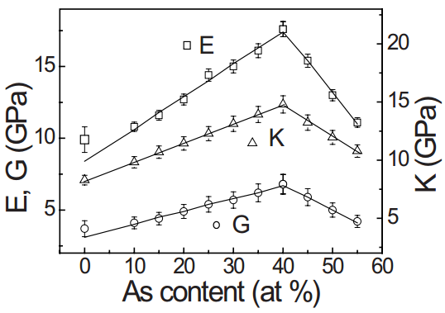
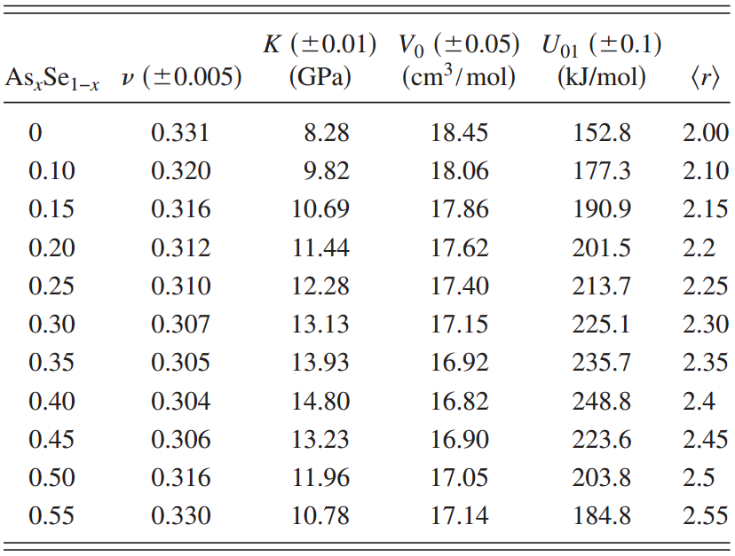
Mechanical property dependence on mean coordination number in network glasses
In brittle materials, fracture toughness is determined by elastic modulus and bond energy
Mechanical property evolution in As-Se glass
Phys. Rev. B 82, 195206 (2010)
Notes:
In the figure K denotes bulk modulus and G shear modulus

Slide 6
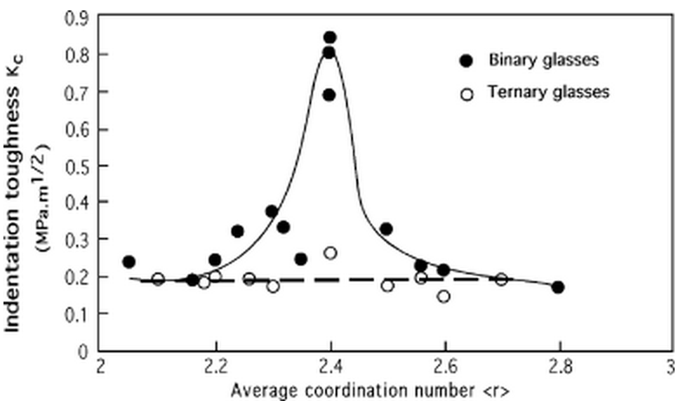
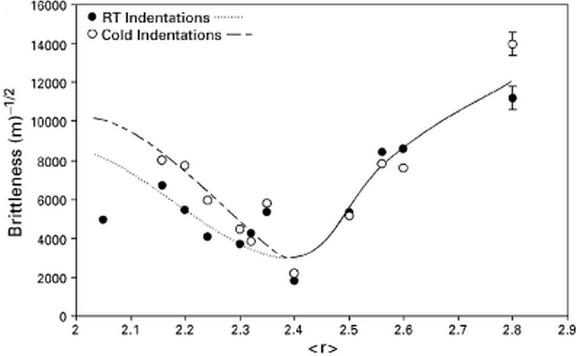
Mechanical property dependence on mean coordination number in network glasses
In brittle materials, fracture toughness is determined by elastic modulus and bond energy
Mechanical property evolution in Ge-Se and Ge-Sb-Se glasses
J. Am. Cer. Soc. 90, 177 (2007)

Slide 7
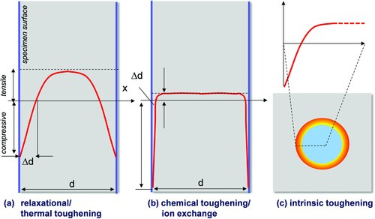
Thermal and chemical glass strengthening
Δd: case depth
Adv. Mater. 23, 4578 (2011)

Slide 8
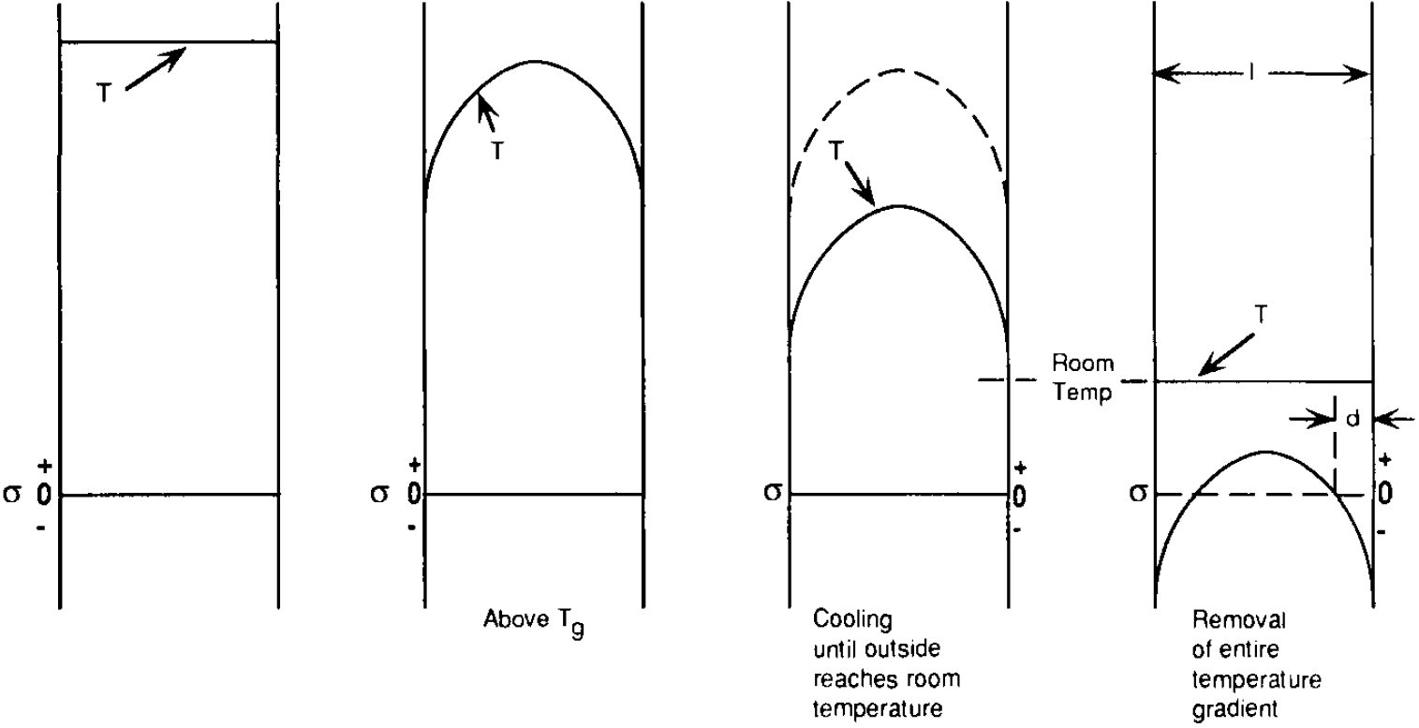
Heat-strengthened / tempered glass
Glass heated to 600 – 650 °C and force-cooled to generate surface compression

Slide 9
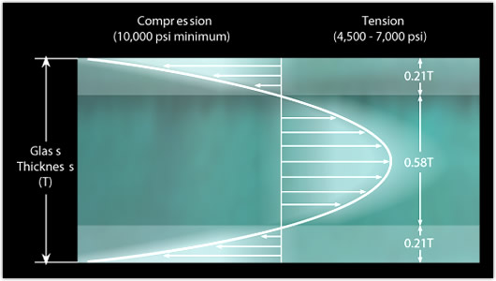
Heat-strengthened / tempered glass
Glass heated to 600 – 650 °C and force-cooled to generate surface compression
Parabolic temperature & stress distribution
http://www.cardinalst.com/
Notes:
Here c_P denotes volumetric heat capacity

Slide 10
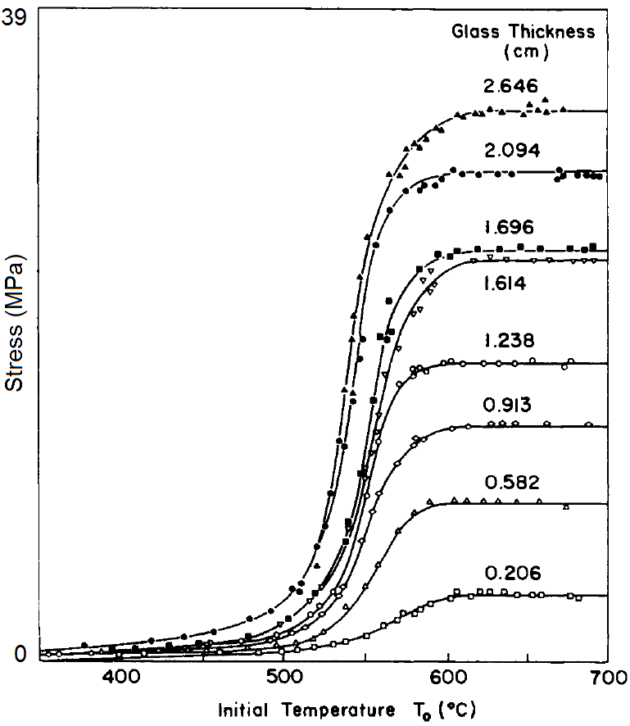
Heat-strengthened / tempered glass
Glass heated to 600 – 650 °C and force-cooled to generate surface compression
Air quenched
(normal convective cooling)
D : glass thickness
Additional stress contributions
  Fictive temperature gradient
  Viscoelastic relaxation

Slide 11
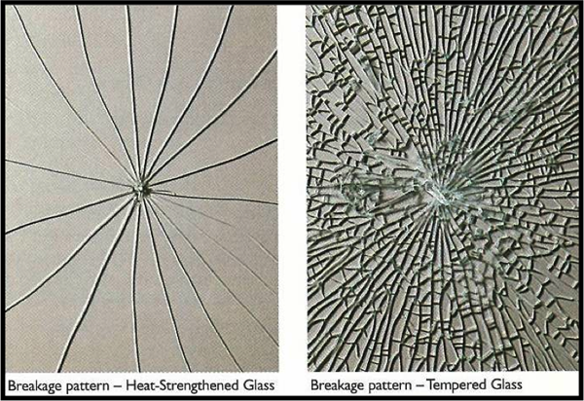
Heat-strengthened / tempered glass
Glass heated to 600 – 650 °C and force-cooled to generate surface compression
ASTM C1048 standard
  Heat-strengthened glass: surface stress between 24 – 52 MPa, about twice stronger than annealed (untreated) glass
  Tempered glass: surface stress > 69 MPa (10,000 Psi), 4 to 5 times stronger than untreated glass
http://www.legardien.com/architectural-products
Notes:
Tempered glass cannot be obtained by normal convective cooling (see previous slide).
Tempering methods: https://www.gage-glass.com/glass-tempering-method-n.html

Slide 12

Glass goes ballistic: Bullet vs. Prince Rupert's Drop
Notes:
Triboluminescence: https://www.youtube.com/watch?v=k5MORochIDw

Slide 13
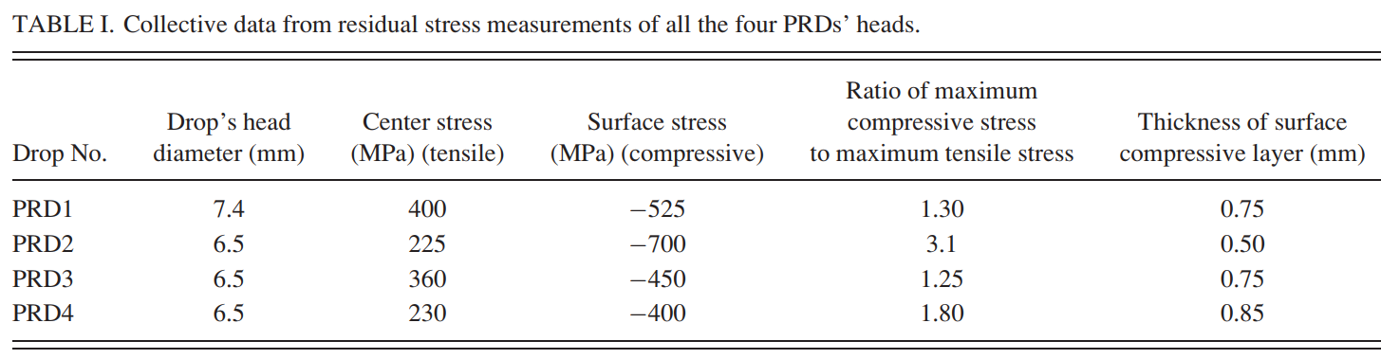
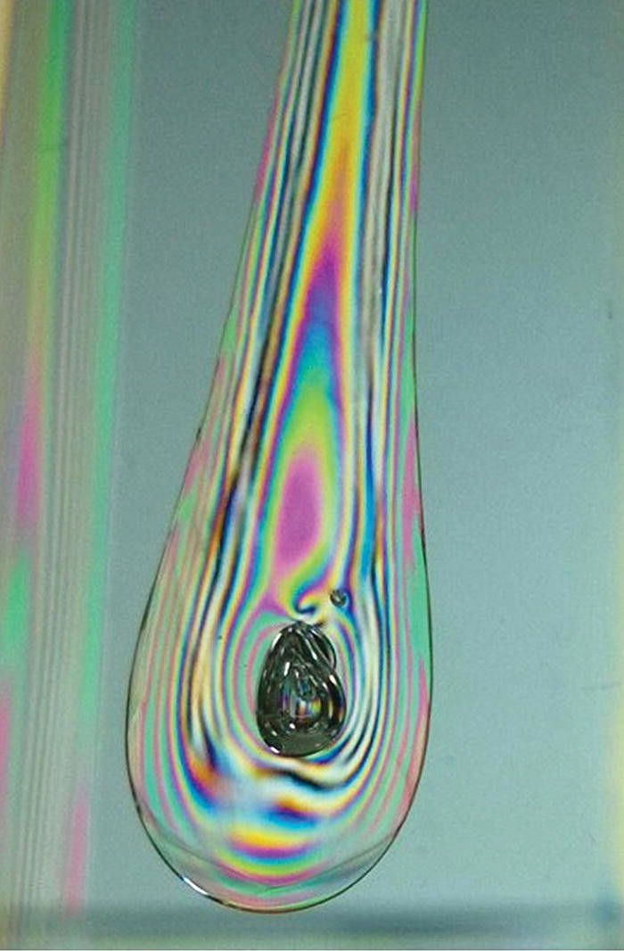
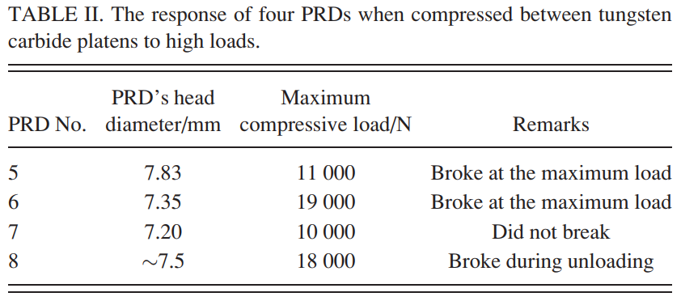
Quantifying the strength of Prince Rupert's drops
Appl. Phys. Lett. 109, 231903 (2016)

Slide 14
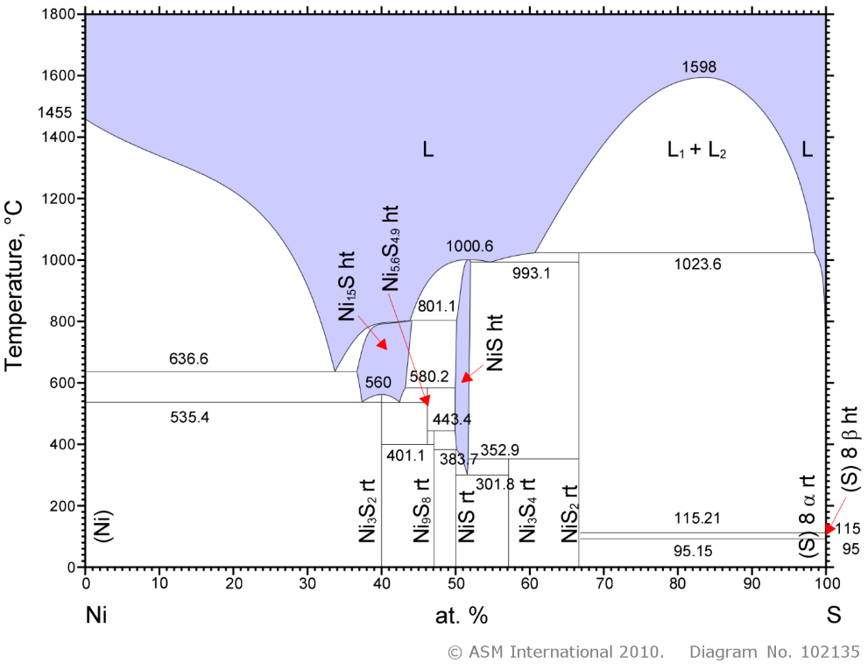
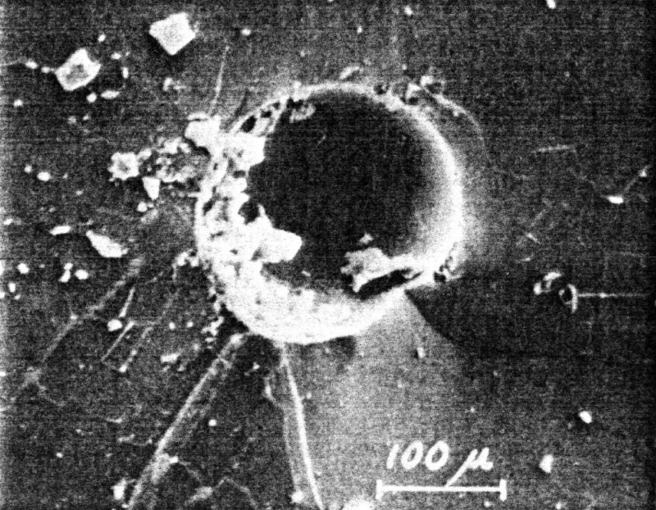
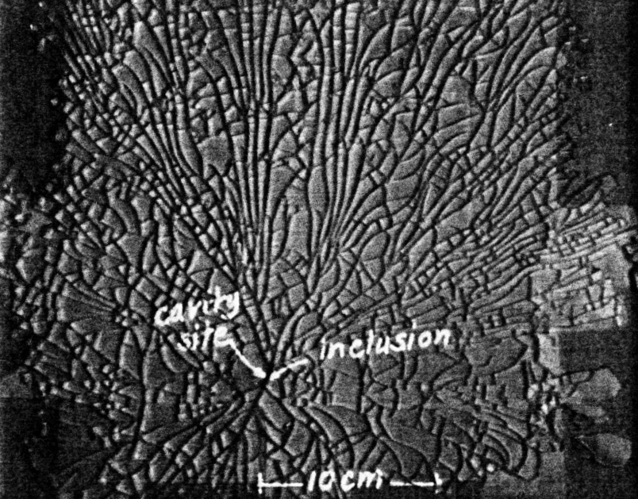
Premature fracture of tempered glass
Nickel sulfide inclusion induced subcritical crack growth
Sulfur is introduced in a fining agent (Na₂S) in glass making
The origin of nickel is unclear but likely due to contamination
Heat soaking: a destructive test to trigger NiS phase change
Fracture 3, 985 (1977)
Notes:
https://www.vitroglazings.com/media/acmdf3a5/vitro-td-138.pdf

Slide 15
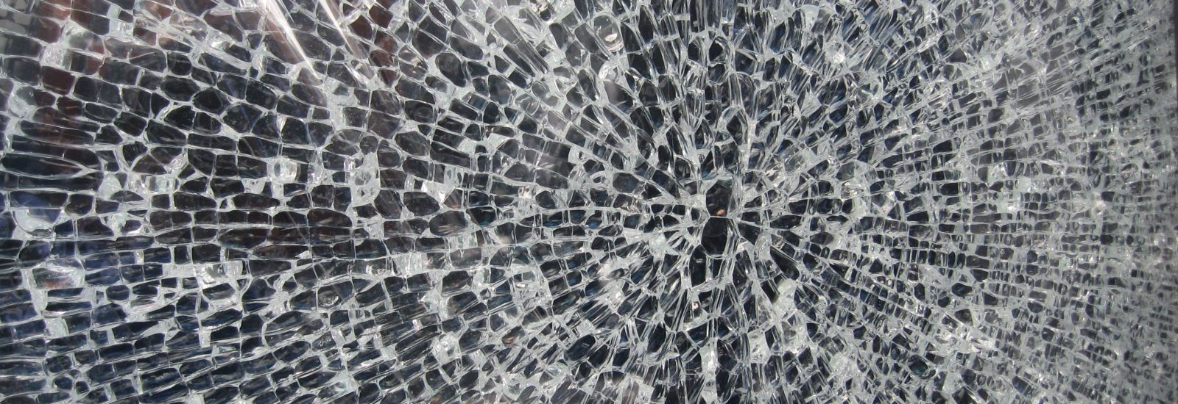
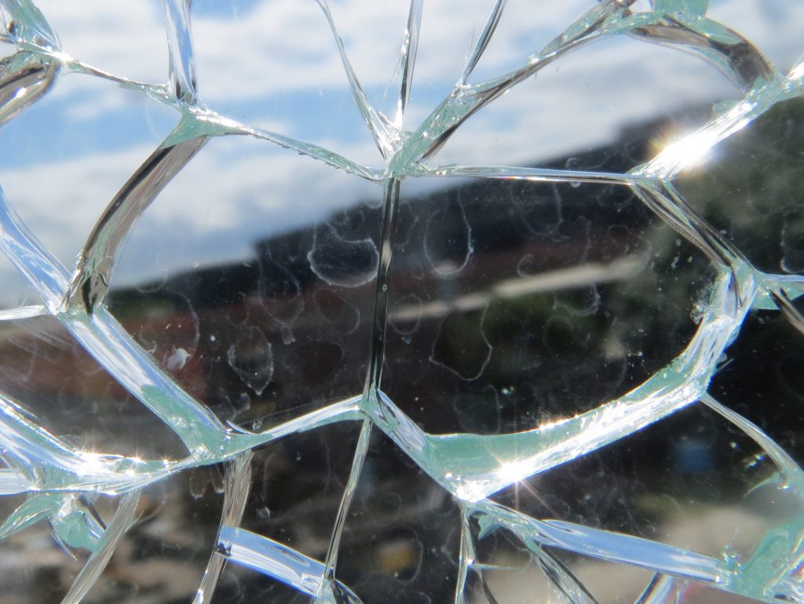
Premature fracture of tempered glass
Nickel sulfide inclusion induced subcritical crack growth
Sulfur is introduced in a fining agent (Na₂S) in glass making
The origin of nickel is unclear but likely due to contamination
Heat soaking: a destructive test to trigger NiS phase change
The “butterfly” pattern often associated with NiS-induced breakage
Notes:
https://www.wintech-group.com/news/2020/04/the-glass-butterfly-effect/

Slide 16
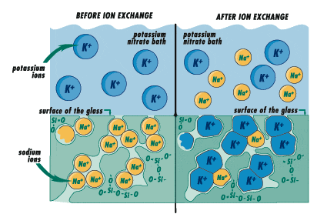
Chemical strengthening
Ion exchange in salt bath
Interdiffusion process
  Kinetics limited by slow-moving ion species
  Compressive strain impedes diffusion
Only applies to alkali/alkali earth glasses
Typical case depth in soda-lime glass: 25 to 35 μm
Int. J. Appl. Glass Sci. 1, 131 (2010)
Notes:
The process temperature has to be lower than the annealing point to prevent stress relaxation
Advantages over tempering: higher surface stress, the possibility of application to shaped articles (curved or hollow) and of limited thickness, minimal optical distortion, absence of premature failure due to NiS inclusions

Slide 17
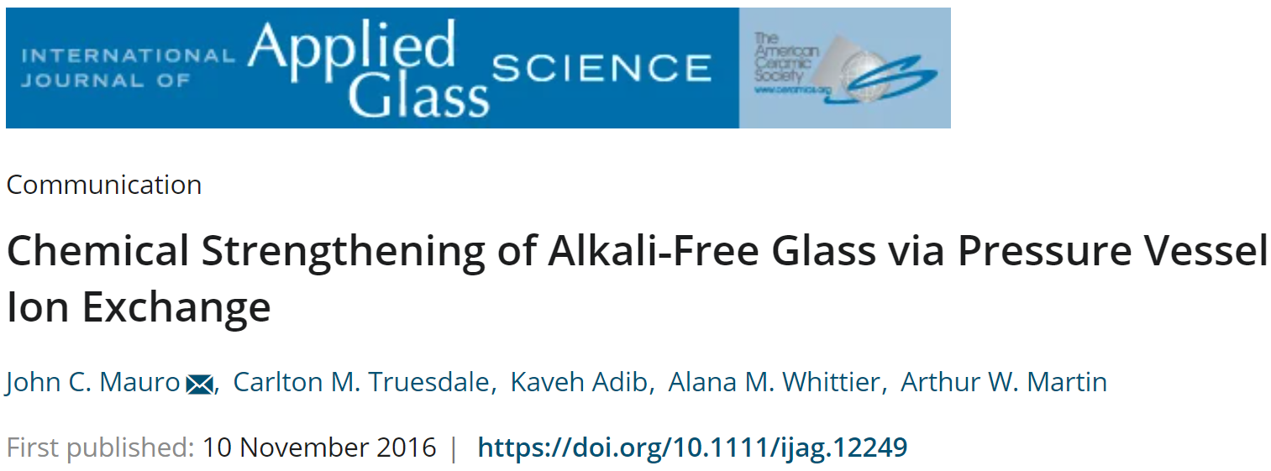
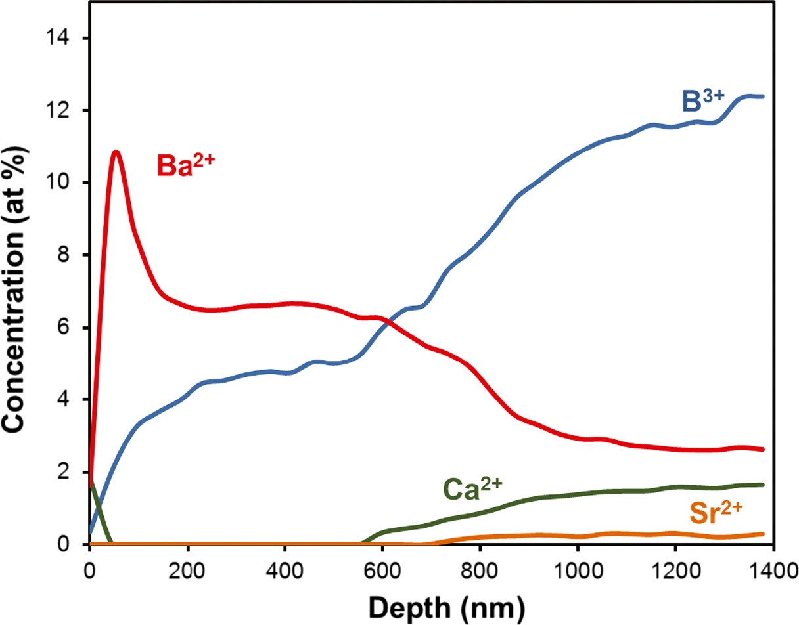
Thermal tempering is not applicable to thin glass
Alkaline earth salts have high melting points, tend to decompose into oxides, and are highly corrosive
Ion exchange in subcritical aqueous solutions
Ba(NO₃)₂ solution at 330°C for 3 h under a pressure of 45 MPa

Slide 18
Methods to increase case depth
Electric field, sonic or microwave assisted ion exchange
Use alkali aluminosilicate glasses with an alkali/alumina ratio of ~ 1
Use lesser size-disparity alkali pair for exchange: e.g. Li⁺ / Na⁺ instead of Na⁺ / K⁺
Add minor quantities of MgO or CaO in glass
Use mixed salt bath
Int. J. Appl. Glass Sci. 1, 131 (2010)
Notes:
The high parent glass transition temperature and reduced NBOs in alkali aluminosilicate glasses with an alkali/alumina ratio of ~ 1 allow faster and deeper exchanges at higher immersion temperatures
Mixed salt bath: K from the bath replaces Na in the glass over a short distance and the Na from
the bath replaces Li in the glass over a larger penetration distance.

Slide 19
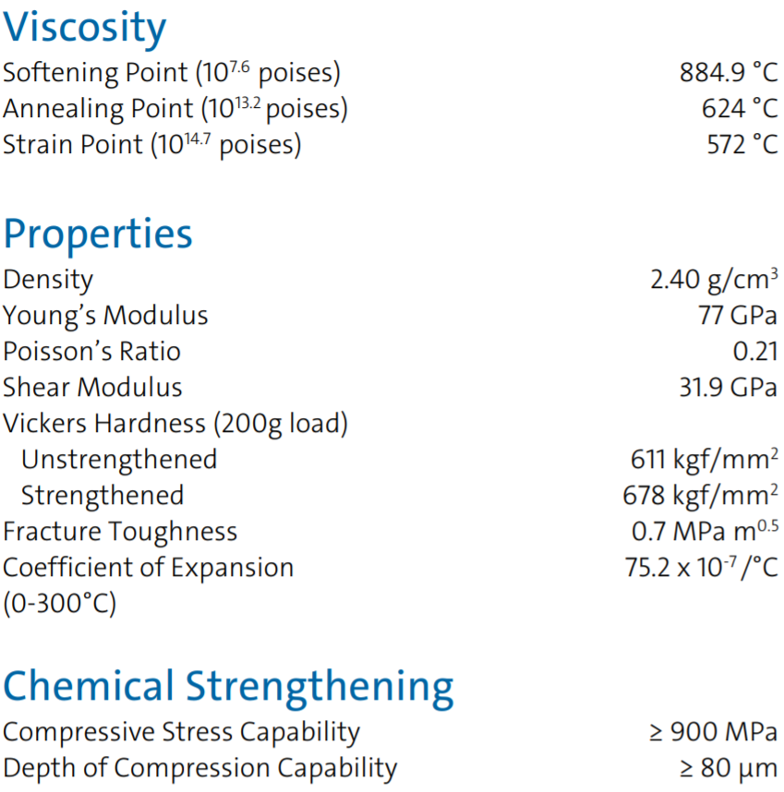
Example: Corning Gorilla 6 (sodium aluminosilicate glass)
Addition of aluminum increases softening temperature and T_{g}
brittle
Increased surface hardness and minor impact on fracture toughness
Increasing stress & larger case depth compared to prior generations
Data from Corning product information
Notes:
The fracture toughness number quoted is measured using a Chevron notch test before ion exchange.
In the case of strengthened glass, the “apparent” fracture toughness depends on crack geometry and testing method. See for example: Influence of Surface Stress on indentation Cracking, J. Am. Cerac. Soc. 69, 223 (1986).

Slide 20
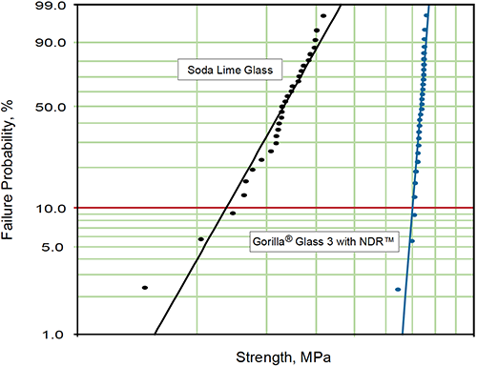
Weibull analysis on Gorilla glass
Enhanced mean strength
Larger Weibull modulus: improved consistency

Slide 21
Sapphire vs. strengthened glass
 | Sapphire | Strengthened glass
Refractive index (633 nm wavelength) | 1.75 – 1.77 | 1.50 – 1.52
Density | 3.97 g/cm³ | 2.4 – 2.5 g/cm³
Fracture toughness | 2.3 MPa·m^{0.5} | 0.7 MPa·m^{0.5}
Tensile strength | 0.27 – 0.41 GPa | N/A
Flexural strength | 0.9 GPa | > 0.8 GPa
Young’s modulus | 345 GPa | 60 – 75 GPa
Shear modulus | 145 GPa | 26 – 30 GPa
Vickers Hardness | 21.5 GPa | 5.8 – 7 GPa
Data compiled based on specifications of the following products:
GT ASF Sapphire Cover; Schott Sapphire Glass; Corning Gorilla 6 Glass; Schott Xensation Cover Glass; Asahi Dragontrail Glass

Slide 22
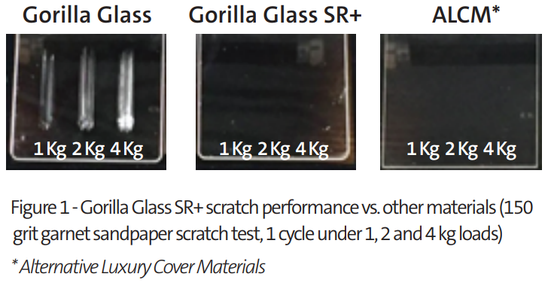
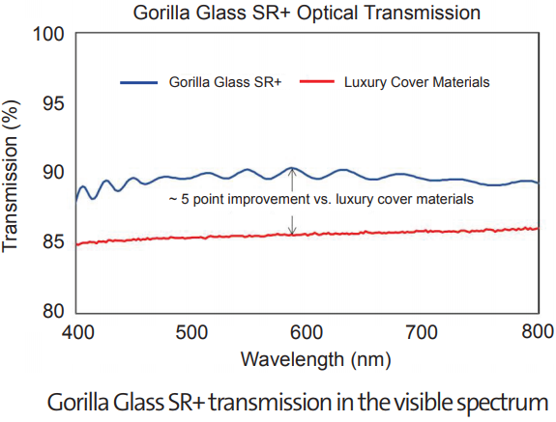
Glass still has more to offer: scratch resistance
Data from Corning product information
A surface coating layer with ~ 2.25 μm thickness and an index 0.03 higher (or lower) than the substrate glass at 600 nm wavelength

Slide 23
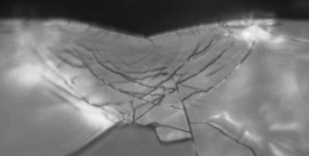
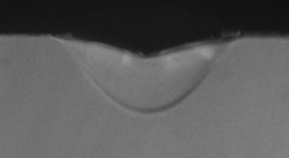
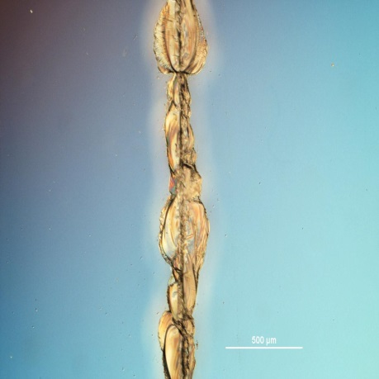
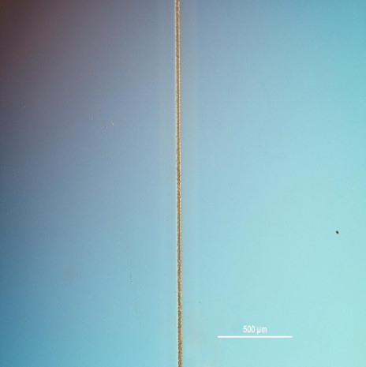

Glass still has more to offer: native damage resistance (NDR)
Alternative cover glass experiences Lateral Cracking
Glass with NDR better absorbs the force with Densification
Glass better absorbs the force
No starter flaws in the deformed region
Lower residual stress
Many starter flaws in deformed region
High residual stress
Competitive Aluminosilicate Glass
After Ion Exchange
7 Newton Scratch
Glass with NDR
7 Newton Scratch
.
© J. Mauro, Corning Incorporated.
.
Science and Technology Division

Slide 24
Glass still has more to offer: native damage resistance (NDR)
B₃ → B₄ conversion
O
O
O
+
→
B
O
1/2 Na₂O
B⁻
Na⁺
O
O
O
Trigonal boron creates a more open glass structure that is able to densify via plastic deformation upon mechanical compression to avoid crack initiation
Chem. Mater. 28, 4267-4277 (2016)

Slide 25
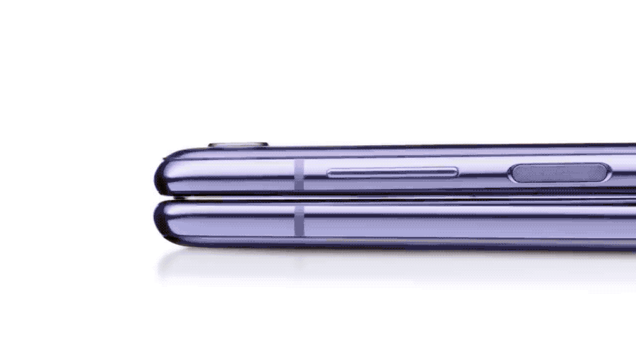
The first foldable phone with a glass screen
Samsung Galaxy Z Flip

Slide 26

Ultra-thin glass (UTG)

Slide 27
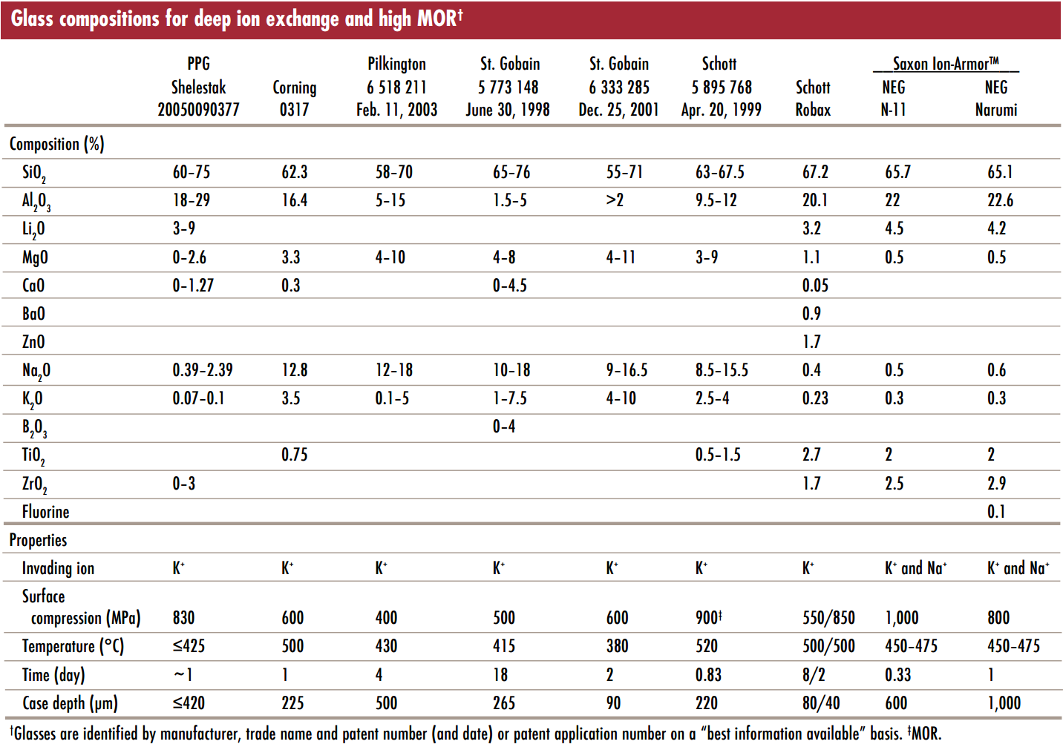
Notes:
MOR: Modulus of Rupture, i.e. flexural strength

Slide 28
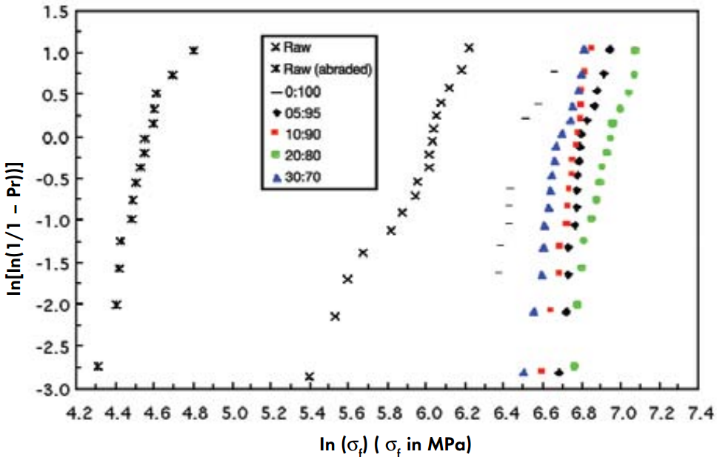
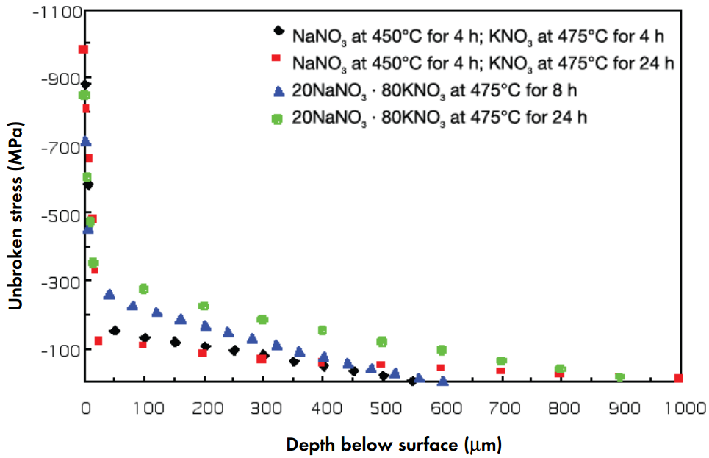
Chemical strengthening of lithium aluminosilicate glass
Weibull plot after strengthening in varying ratios of NaNO₃ + KNO₃ baths
Am. Cer. Soc. Bull. 88, 27 (2009)

Slide 29
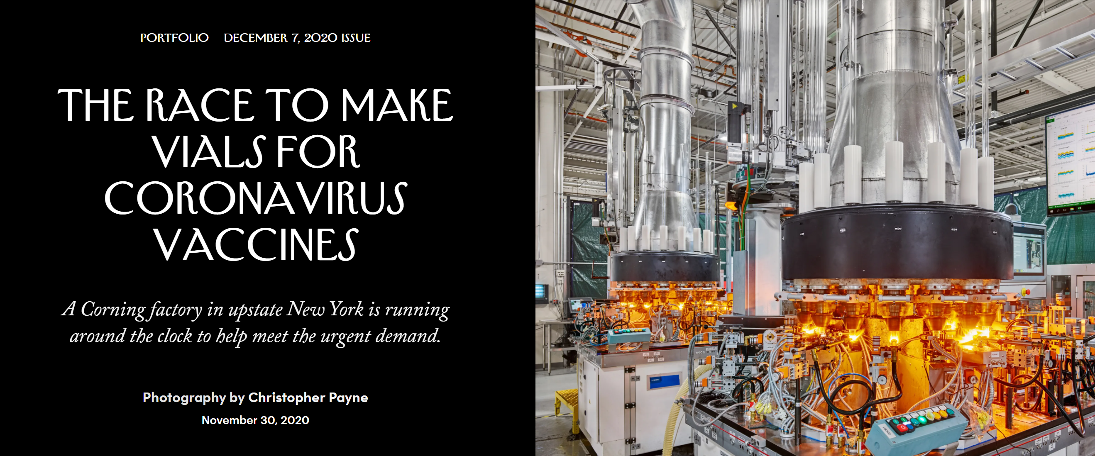

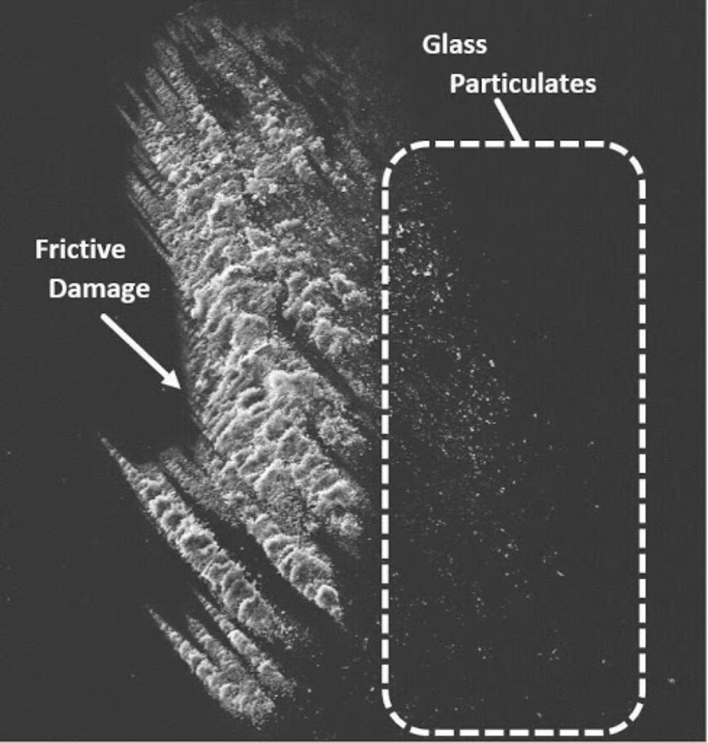
Boron-free formulation to minimize delamination
Surface coating to reduce friction and wear
Ion exchange to boost mechanical strength
Notes:
https://timesofindia.indiatimes.com/spotlight/heres-why-corning-valor-glass-is-significant-in-manufacturing-and-distributing-covid-19-vaccines/articleshow/79800881.cms

Slide 30
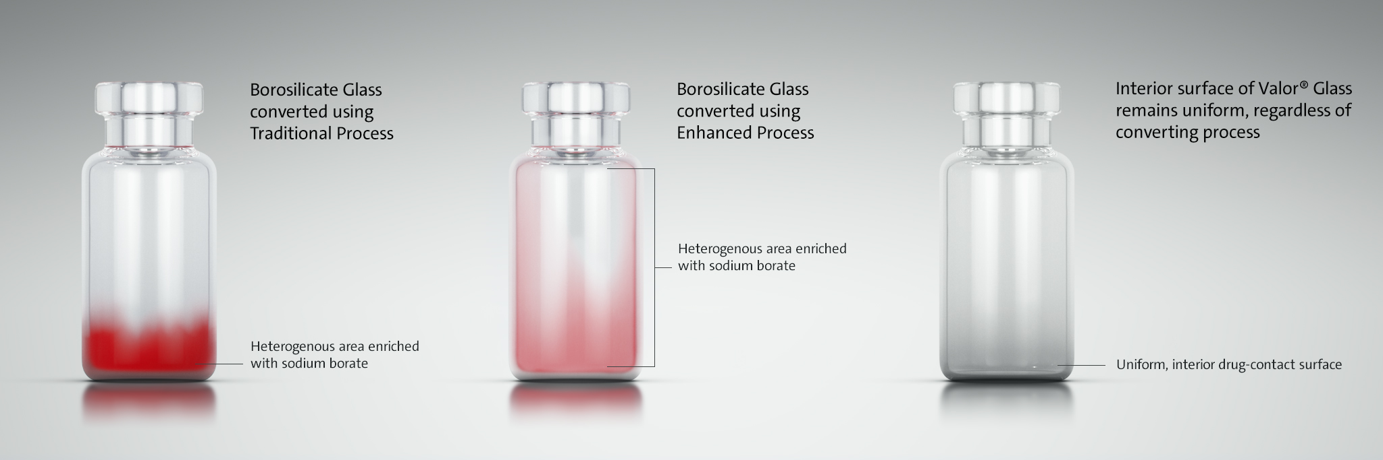

Slide 31
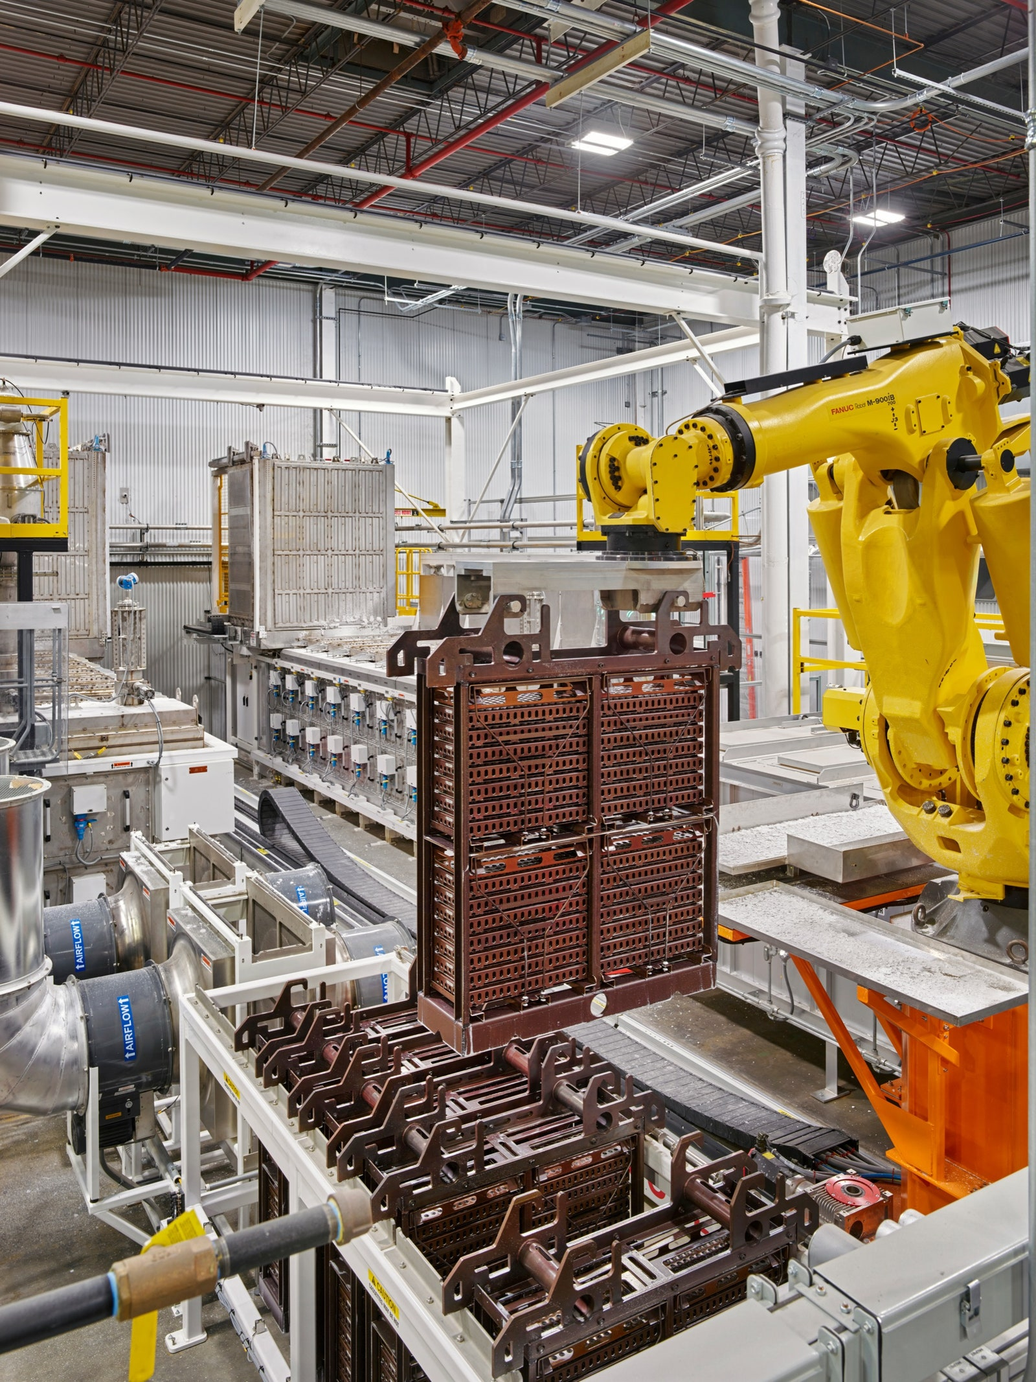
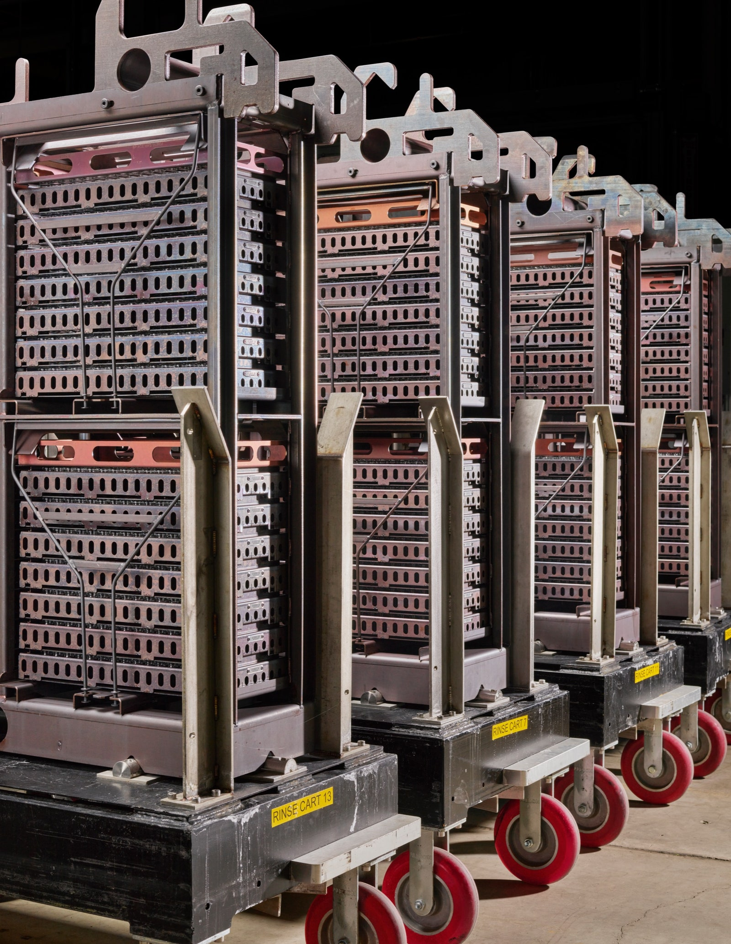
A robotic arm dunks racks of vials into molten salt to strengthen the glass.
After removal from the salt bath, the vials are submerged in water for an initial rinse.
Notes:
https://www.newyorker.com/magazine/2020/12/07/the-race-to-make-vials-for-coronavirus-vaccines

Slide 32
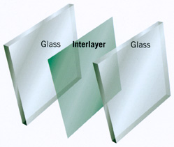
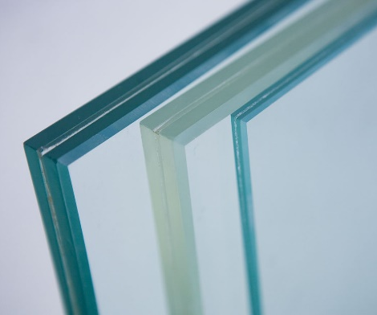
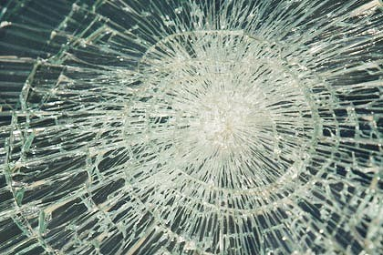
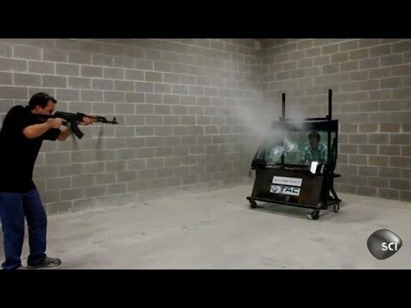

Configurational design: laminated glass
Two or more layers of glass (annealed, heat-strengthened or tempered) bonded together by polymer interlayer(s)
Breaking pattern
Skywalk, Grand Canyon

Slide 33
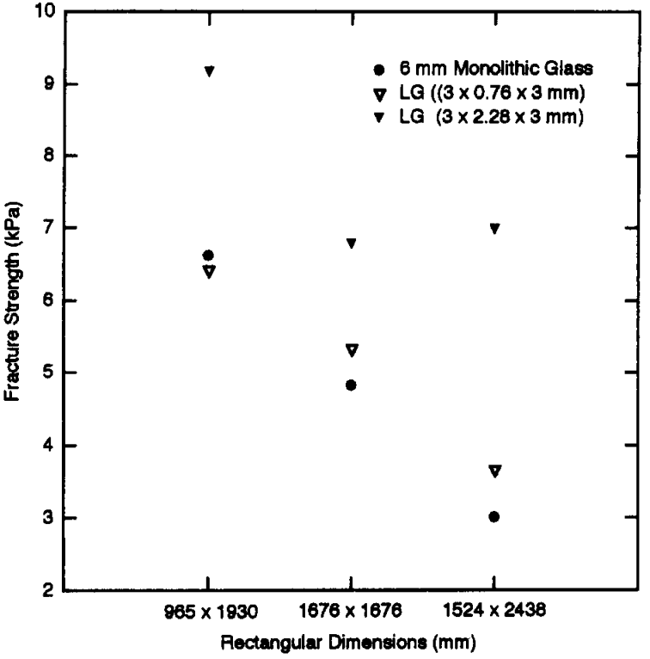
Facture toughness of laminated glass
Laminated glass is tougher than monolithic glass sheets
J. Eng. Mech. 124, 46 (1998)

Slide 34
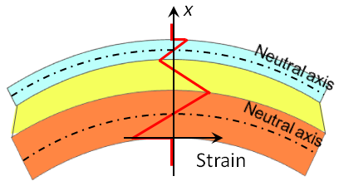
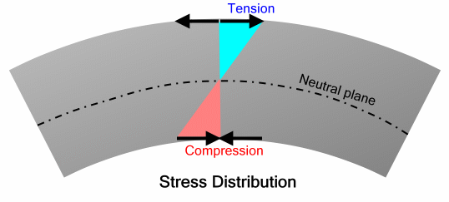

Properly design laminated structures are tougher than monolithic glass
 | Classical multilayer bending theory | The multi-neutral-axis theory
Formulation
Assumption | No shear strain | The soft layer relieves the strain by shear deformation
Device Placement | Fixed near the substrate center | Readily tuned by adjusting the elastic contrast
Nat. Photonics 8, 643-649 (2014)

Slide 35
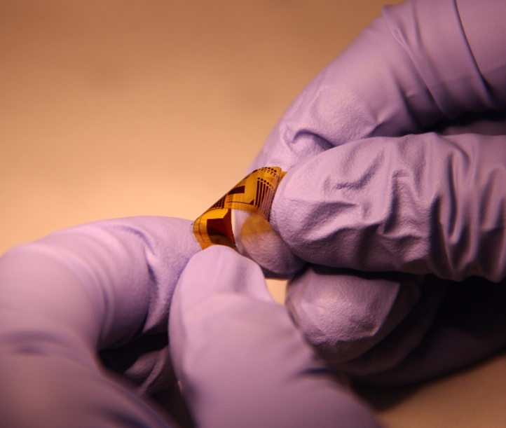



Bend… but don’t break!
R ~ 0.3 mm
The multi-neutral axis design enables foldable, robust photonic circuits
Nat. Photonics 8, 643-649 (2014)

Slide 36

Light Sci. Appl. 7, e17138 (2018)

Slide 37



Making stretchable photonics out of rigid glass
Grating coupler
Devices on locally stiffened islands interconnected by serpentine waveguides
Resonator
Light Sci. Appl. 7, e17138 (2018)

Slide 38


Stretching serpentine glass waveguides
36% elongation
Before 3000 cycles @ 42%
After 3000 cycles @ 42%
0% elongation
Serpentine waveguides are robust against repeated stretching
Light Sci. Appl. 7, e17138 (2018)

Slide 39

Nacre-inspired toughened glass
Science 364, 1260 (2019)

Slide 40


Nacre-inspired toughened glass
Science 364, 1260 (2019)

Slide 41


Nacre-inspired toughened glass
Science 364, 1260 (2019)

Slide 42
Summary
In many cases, glasses with critically connected network possess high modulus and toughness
Strengthening methods capitalizing on surface compressive stress
Configurational design can further enhance mechanical properties
 | Heat strengthened glass | Tempered glass | Chemically strengthened glass
Surface stress | 24 – 52 MPa | > 69 MPa | Up to 1 GPa
Compressive stress depth | ~ 20% pane thickness | ~ 20% pane thickness | ~ 100 μm
Heat treatment temperature T | T_{g} < T < T_{soft} | T_{g} < T < T_{soft} | T < T_{g}
Risk of premature failure | N | Y | N

