Slide 1
MIT 3.071
Amorphous Materials
17: Glass Bridge
Juejun (JJ) Hu
hujuejun@mit.edu

Slide 2

Tempered vs. annealed glass

Slide 3


Tempered vs. annealed glass
“When it’s lit on the side, then you can see faint stain marks.”

Slide 4
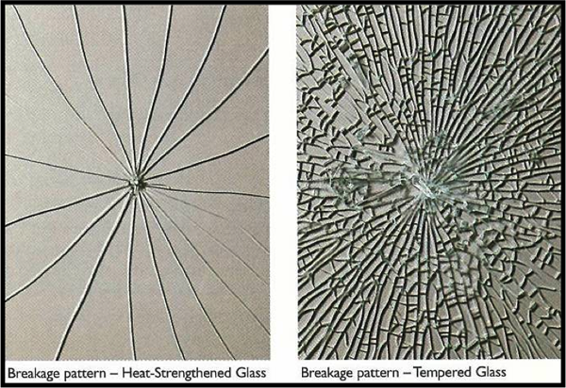
Heat-strengthened / tempered glass
Glass heated to 600 – 650 °C and force-cooled to generate surface compression
ASTM C1048 standard
  Heat-strengthened glass: surface stress between 24 – 52 MPa, about twice stronger than annealed (untreated) glass
  Tempered glass: surface stress > 69 MPa (10,000 Psi), 4 to 5 times stronger than untreated glass
http://www.legardien.com/architectural-products
Notes:
Tempered glass cannot be obtained by normal convective cooling (see previous slide).
Tempering methods: https://www.gage-glass.com/glass-tempering-method-n.html

Slide 5
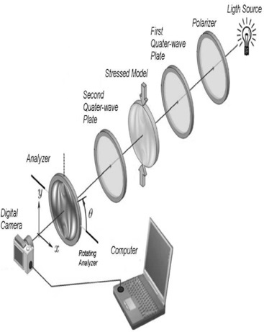
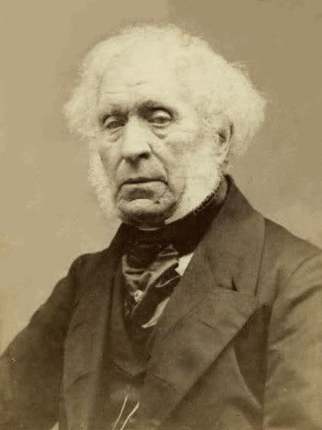
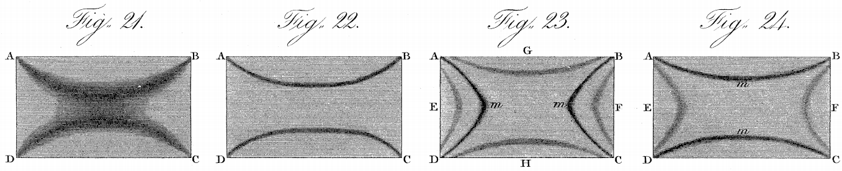
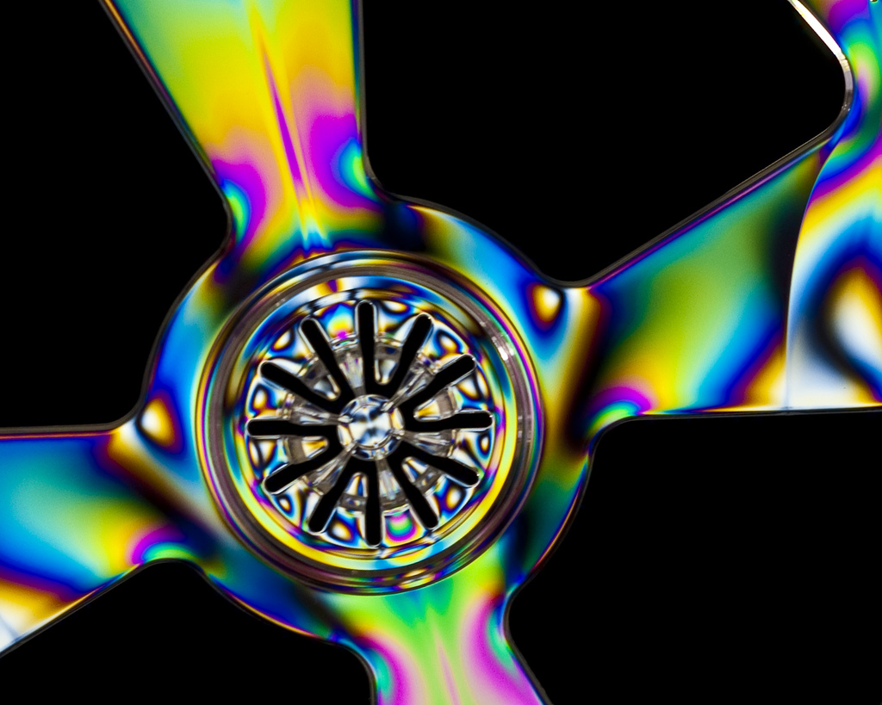
Strain-optical coupling: photoelasticity
“The experiments now described, furnish us with a method of rendering visible, and even of measuring the mechanical changes which take place during the compression, dilation, or bending or transparent bodies.”
Phil. Trans. R. Soc. Lond. 106, 156-178 (1816)
Sir D. Brewster

Slide 6
Photoelastic coupling in materials
Photo-elastic tensor
where
Strain:
Relative dielectric impermeability:
Nye, Physical Properties of Crystals, Oxford University Press, Oxford, UK (1957).

Slide 7
Photoelastic coupling in isotropic materials
Photoelastic birefringence
where
Shear photo-elasticity
Stress:
3 unknown parameters

Slide 8
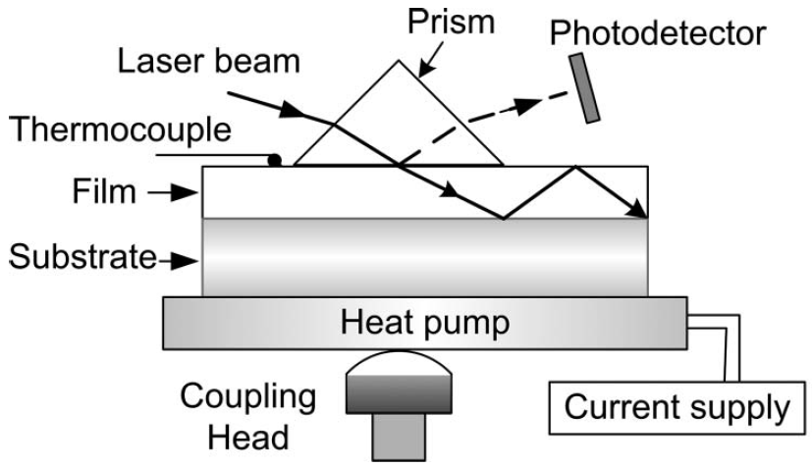
Photoelastic tensor measurement in thin films
Subtract thermo-optic contributions
Known CTE of film and substrates
Simulate stress distribution
Fitting to obtain photoelastic tensor
Films coated on different substrates
Index as a function of temperature
Requires prior knowledge about the material
Limited accuracy
Index measurement using prism coupling
Appl. Opt. 49, 403 (2010)

Slide 9
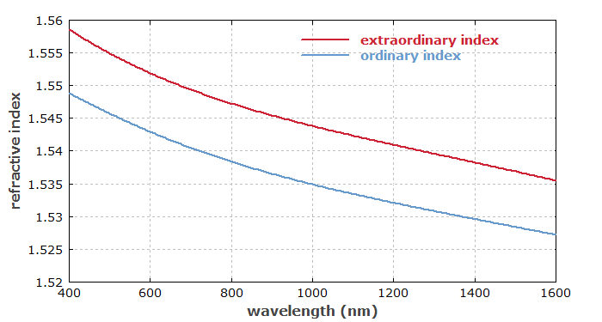
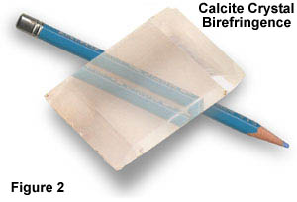
Birefringence
Anisotropy of permittivity tensor: refractive index depends on the polarization direction of light
Double refraction
Refractive indices of α-quartz vs. wavelength

Slide 10
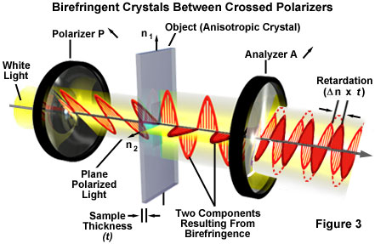
Characterizing birefringence using polariscope
https://www.olympus-lifescience.com/en/microscope-resource/primer/lightandcolor/birefringence/

Slide 11
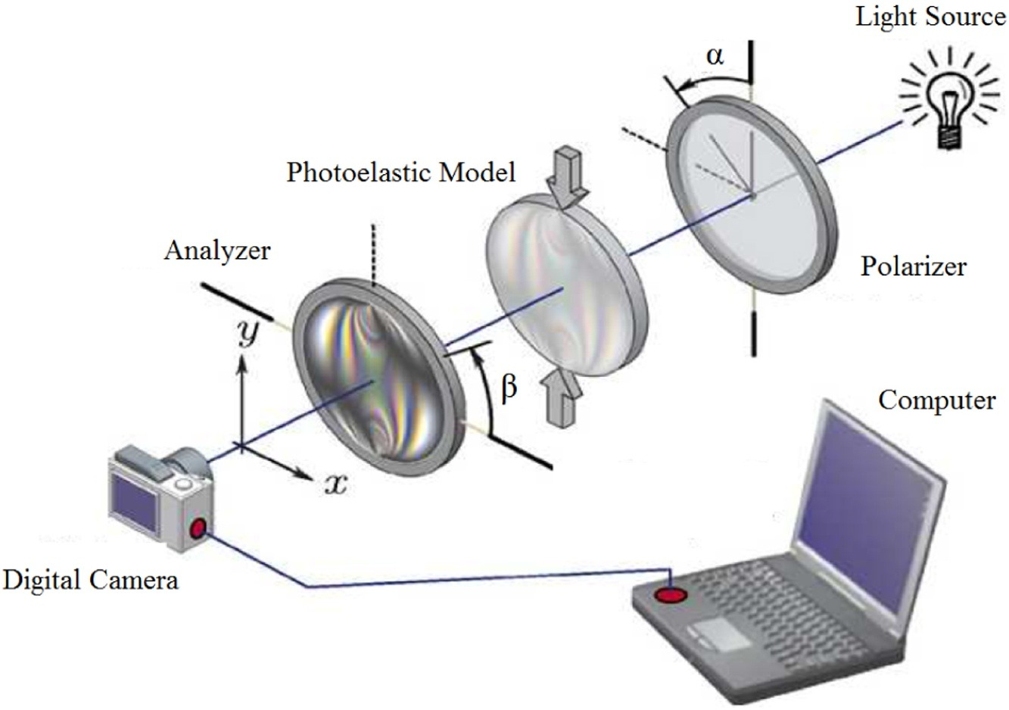
Polariscope for photoelastic stress analysis
Optik 130, 213 (2017)

Slide 12
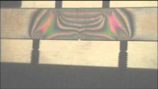
Photoelastic stress analysis

Slide 13
Tempered vs. annealed glass

Slide 14
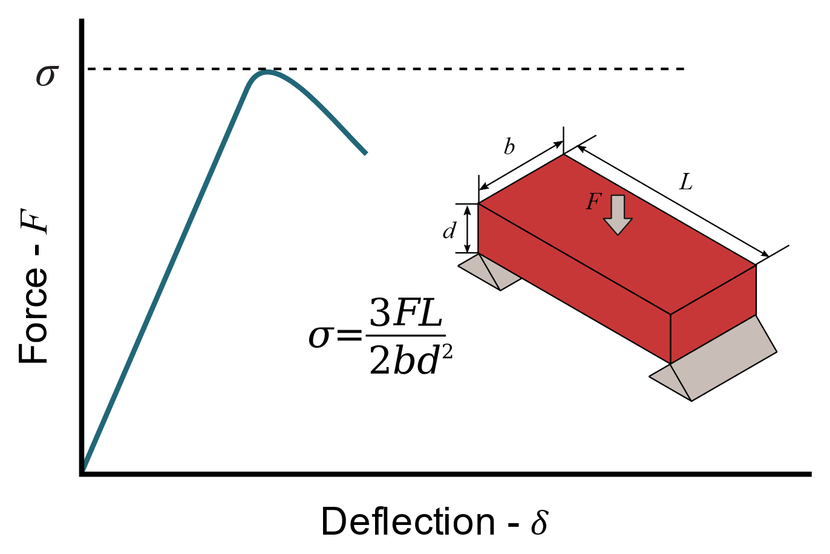
Mechanical strength of the glass bridge
F = 600 N
L = b = 1 m

Slide 15
Mechanical strength of the glass bridge
Possible thickness of glass panels in Squid Games
With compressive stress in tempered glass
Tensile strength of soda-lime glass
Two persons
One person

Slide 16

A more realistic case
With compressive stress in tempered glass
Tensile strength of soda-lime glass
F = 2000 N
F = 500 N

