Slide 1
MIT 3.071
Amorphous Materials
16: Machine Learning in Glass Design
Juejun (JJ) Hu
hujuejun@mit.edu

Slide 2
After-class reading list
Machine Learning for Glass Modeling, Springer Handbook of Glass
“Machine learning for glass science and engineering: A review,” J. Non-Cryst. Solids 557, 119419 (2021)
“Unveiling the predictive power of static structure in glassy systems,” Nat. Phys. 16, 448 (2020)

Slide 3
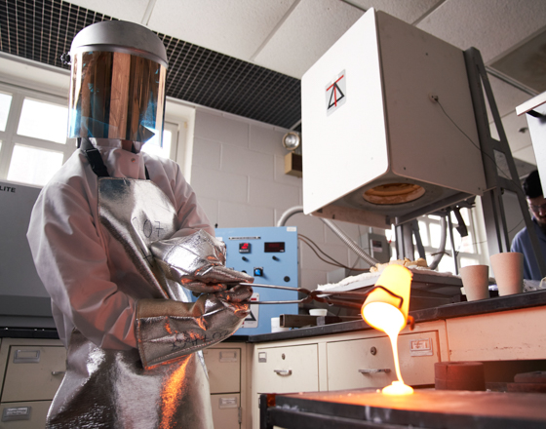
The case for machine learning (ML) in glass design
Trial-and-error glass design is prohibitively expensive and time-consuming
Vast composition space
Continuous stoichiometry
Lack of physically predictive model
Date-driven ML is capable of learning from example by analyzing existing data and elucidating patterns that are not readily discernible

Slide 4
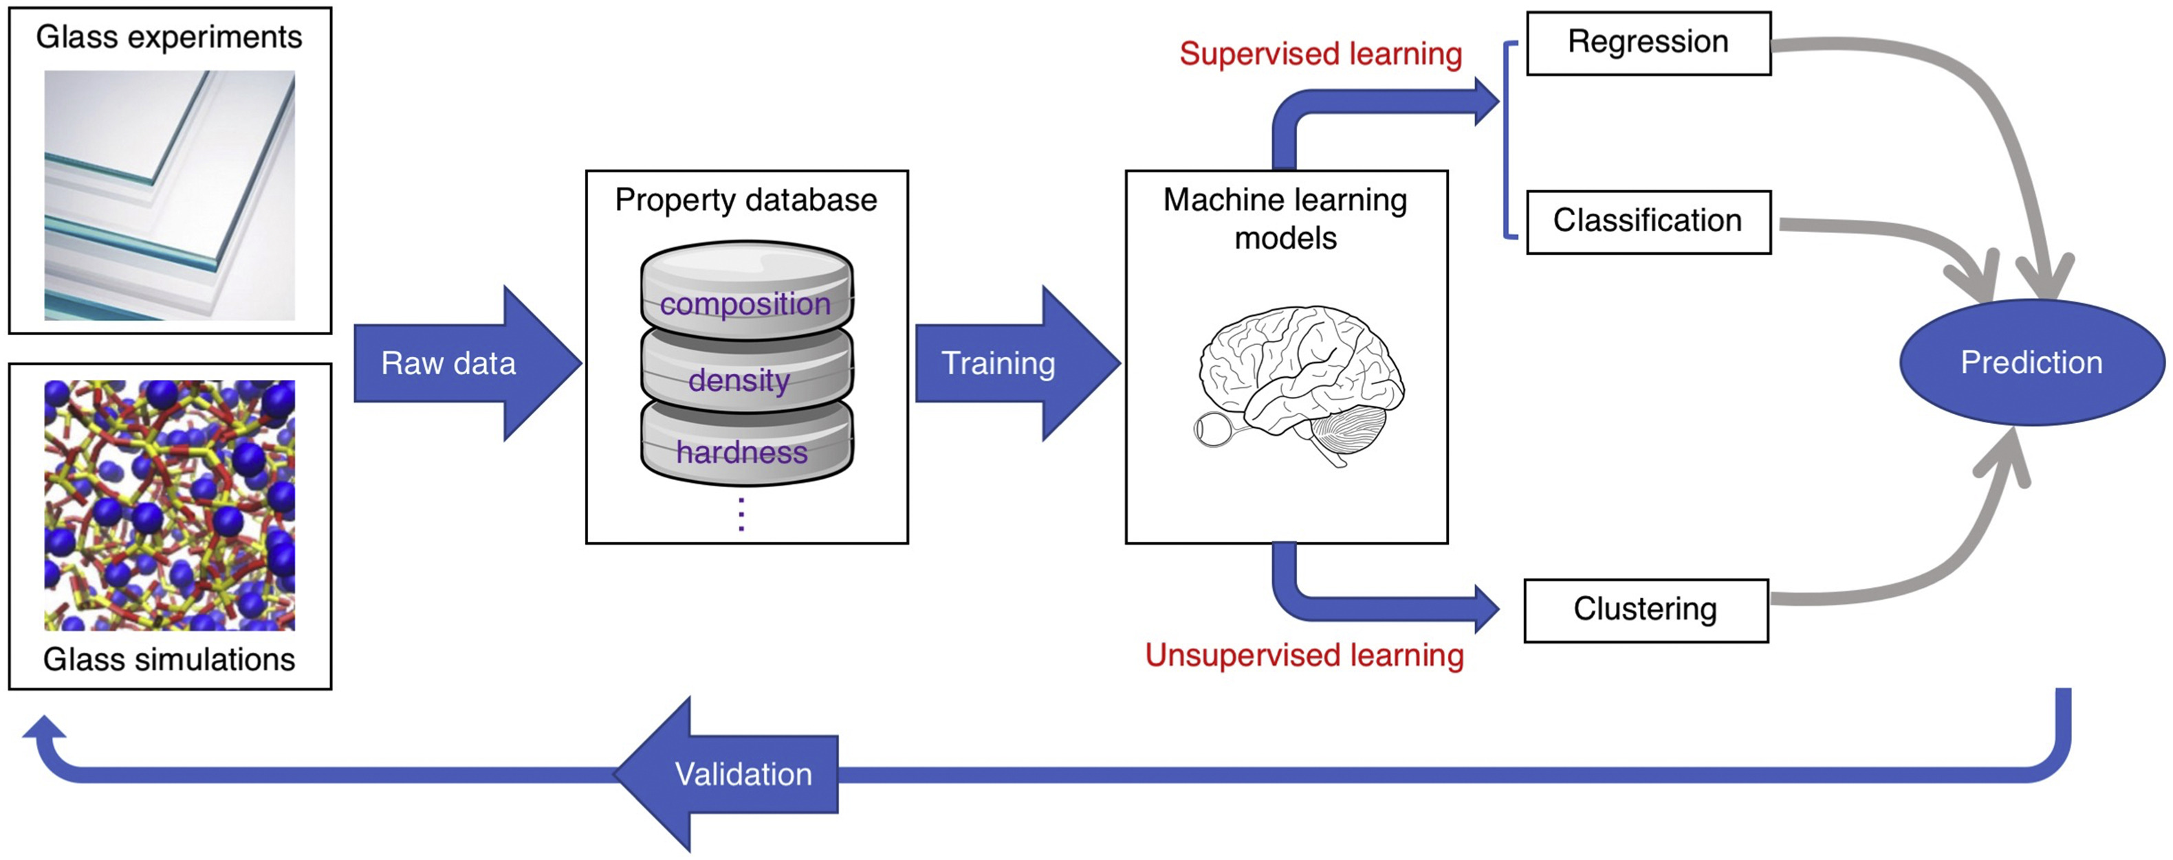
Machine learning for glass design
Data consolidation & cleaning
J. Non-Cryst. Solids 557, 119419 (2021)
Using data to build models and predict glass properties

Slide 5
Challenges of applying ML to glass design
Availability of high-quality data
  Glass databases: SciGlass & INTERGLAD
  Nonequilibrium & processing history-dependent
  Experimental error & clustering
  Using modeling data to complement experiment: depending on specific properties of interest
A black box: conventional ML is driven by data only
  Limited potential for extrapolation outside initial training set

Slide 6
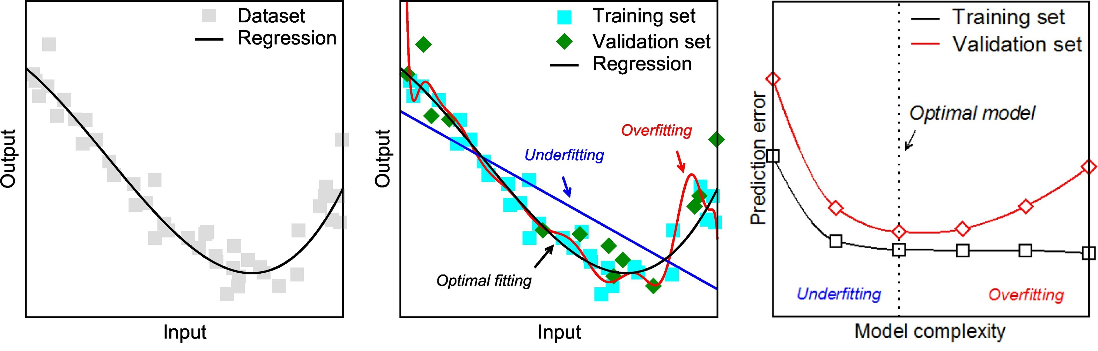
Supervised learning techniques
Regression
  Fitting data to establish a functional relationship between inputs and outputs
  Parametric & nonparametric regression
J. Non-Cryst. Solids 557, 119419 (2021)

Slide 7
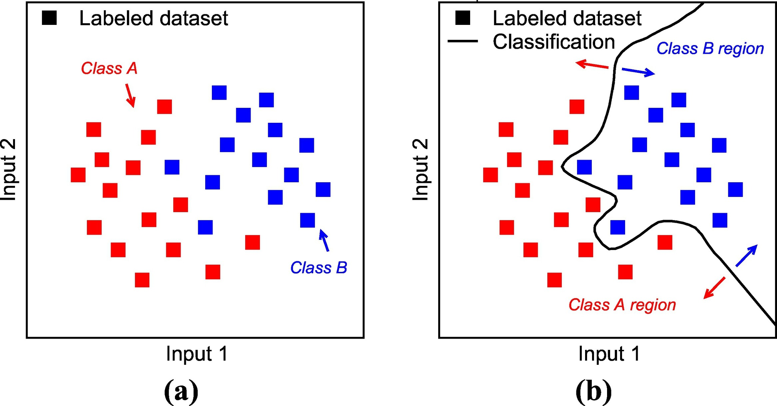
Supervised learning techniques
Classification
  A special case of regression with discrete output

Slide 8
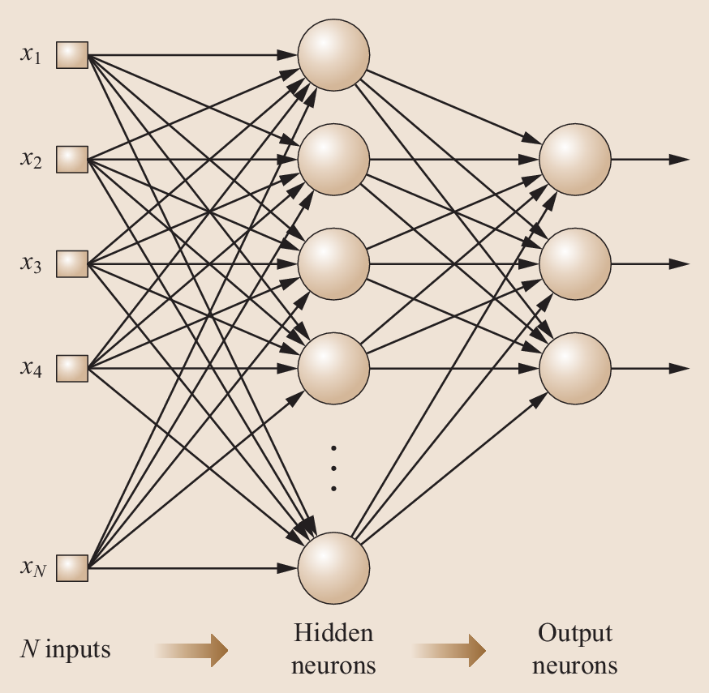
Supervised learning techniques
Artificial neural network (ANN)
  A multilayer structure comprising (1) an input monolayer, (2) some hidden multilayer, and (3) an output monolayer
  Each neuron corresponds to a nonlinear operator
© Springer Handbook of Glass

Slide 9
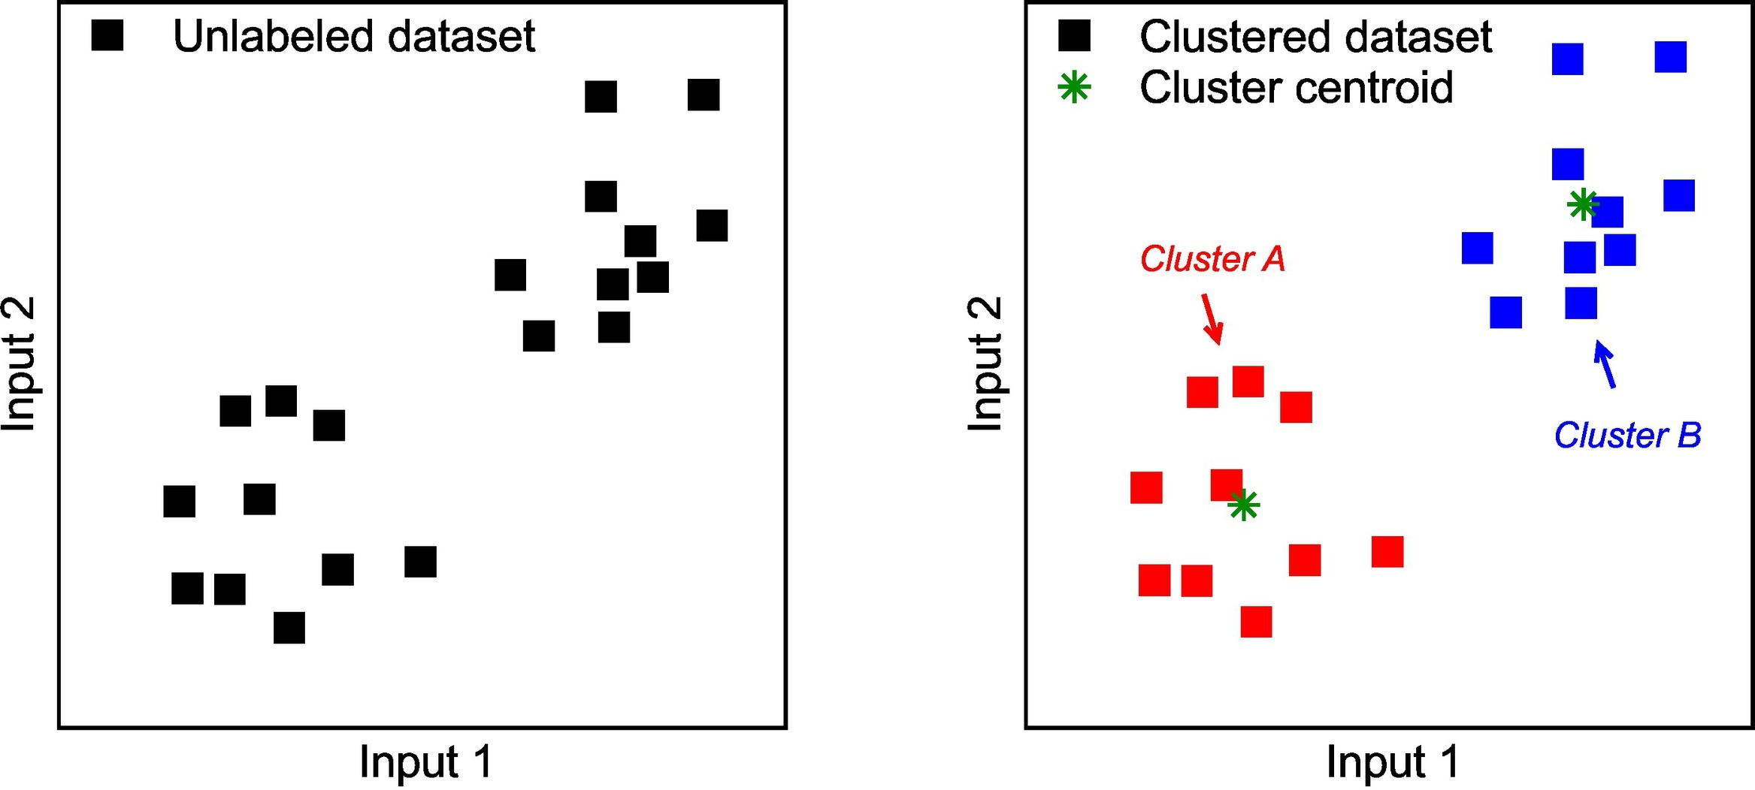
Unsupervised learning techniques
Clustering
  Cluster: a group of data that present similar features
  Helps to identify outliers or misbehaving data

Slide 10
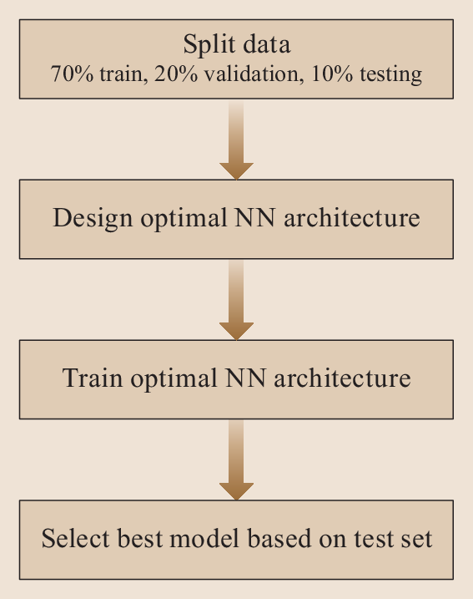
Liquidus temperature prediction
Liquidus temperature: the temperature at which the first crystalline phase precipitates from the melt with very small cooling rate
An important parameter for glass manufacturing and processing
Neural network training
  Determination of network architecture

Slide 11
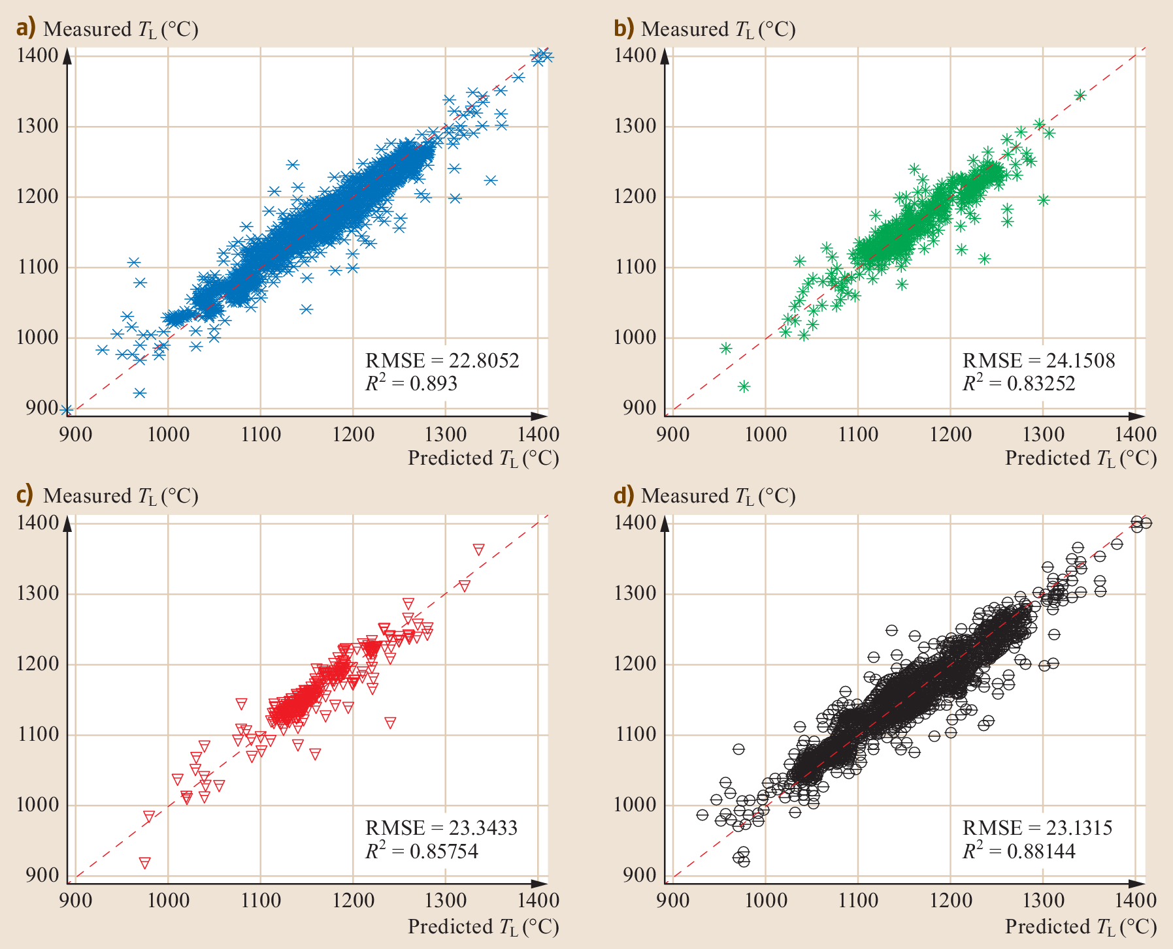
Liquidus temperature prediction
Full data set
Training data
Fitting the entire data set yields large errors
Validation data
Test data
© Springer Handbook of Glass

Slide 12
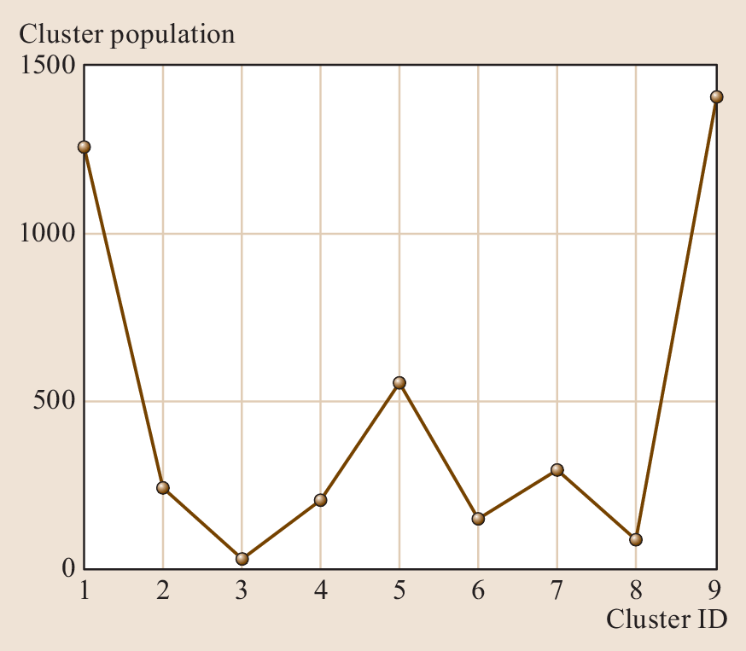
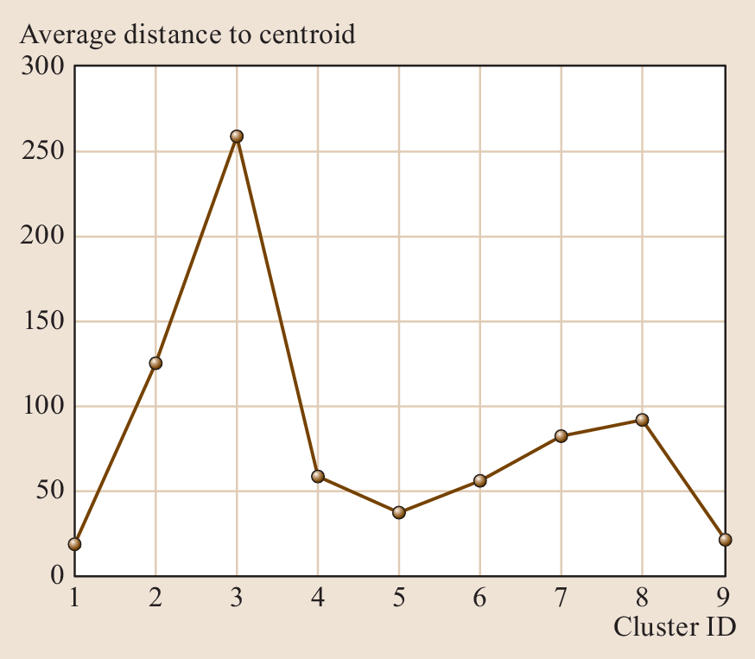
Liquidus temperature prediction
Cluster analysis reveals data set belonging to different groups

Slide 13
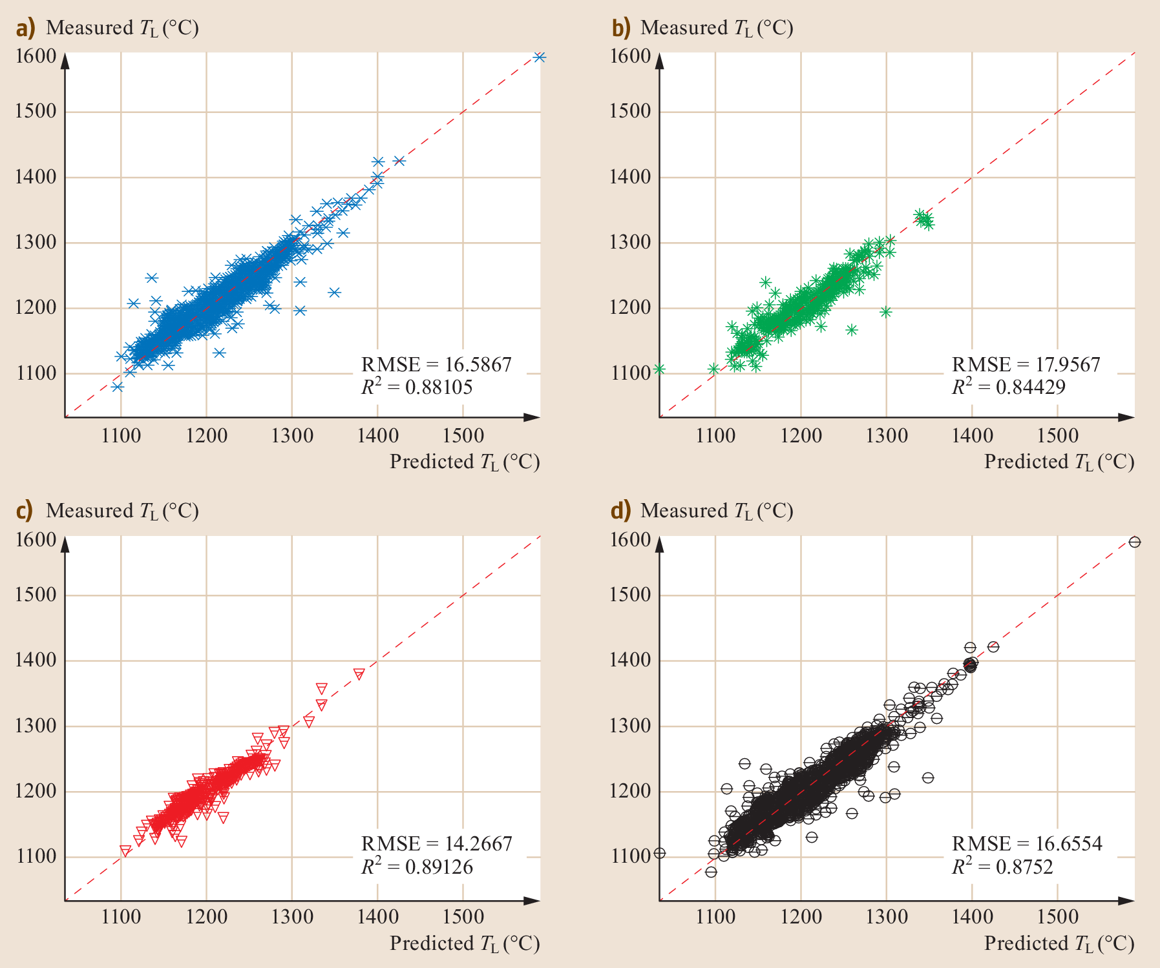
Liquidus temperature prediction
Full data set
Training data
Fitting data set within a cluster improves the prediction accuracy
Validation data
Test data
© Springer Handbook of Glass

Slide 14
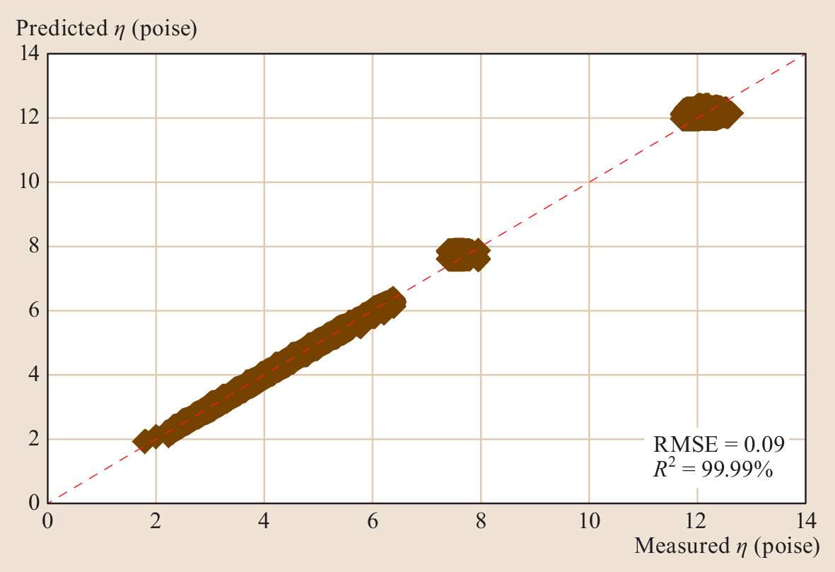
Viscosity prediction
Brute force fitting of temperature dependent viscosity with NNs using two layers (9, 6) of neurons and a tanh activation function
Direct fitting of viscosity yields considerable deviations

Slide 15
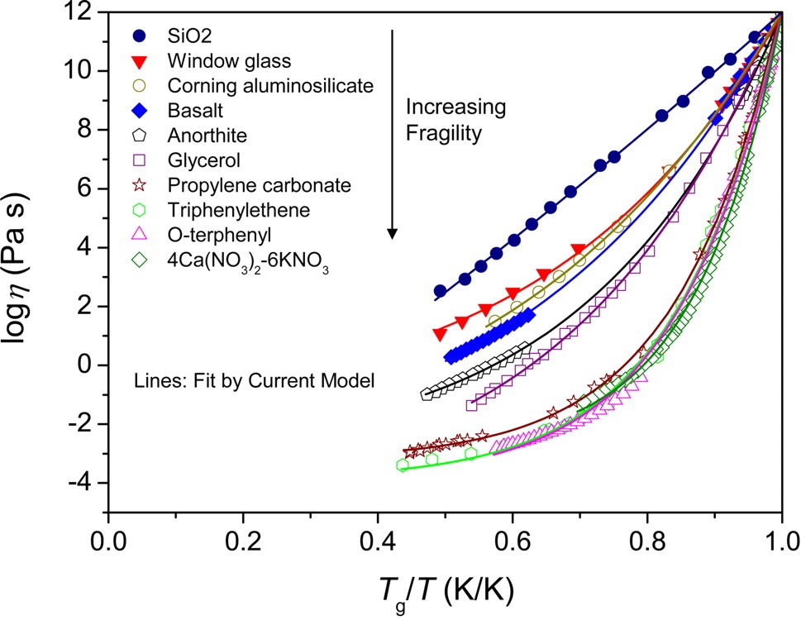
The MYEGA equation of viscosity
The VFT equation diverges at low temperature
The Mauro-Yue-Ellison-Gupta-Allan (MYEGA) equation:
Proc. Nat. Acad. Sci. U.S.A. 106, 19780-19784 (2009)

Slide 16
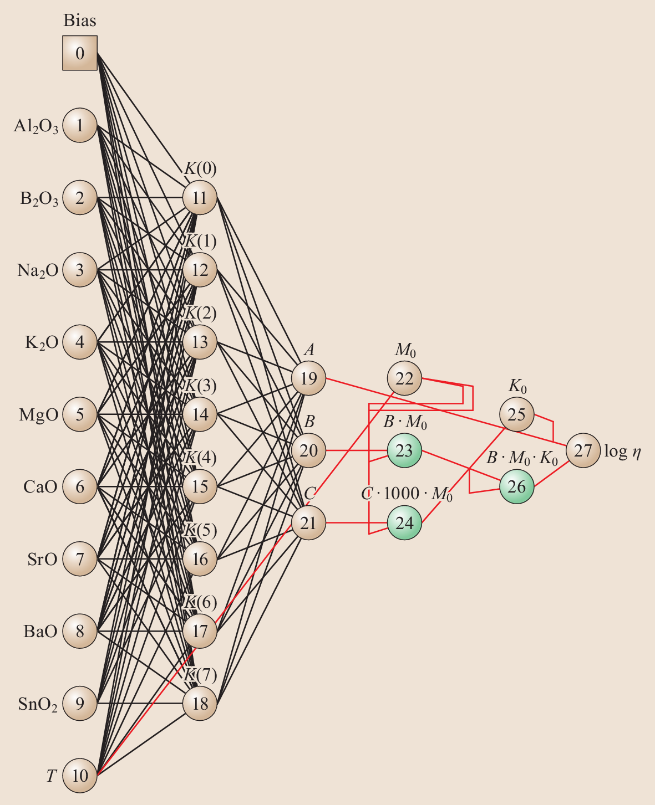
A “gray-box” model
The Mauro-Yue-Ellison-Gupta-Allan (MYEGA) equation:
© Springer Handbook of Glass

Slide 17
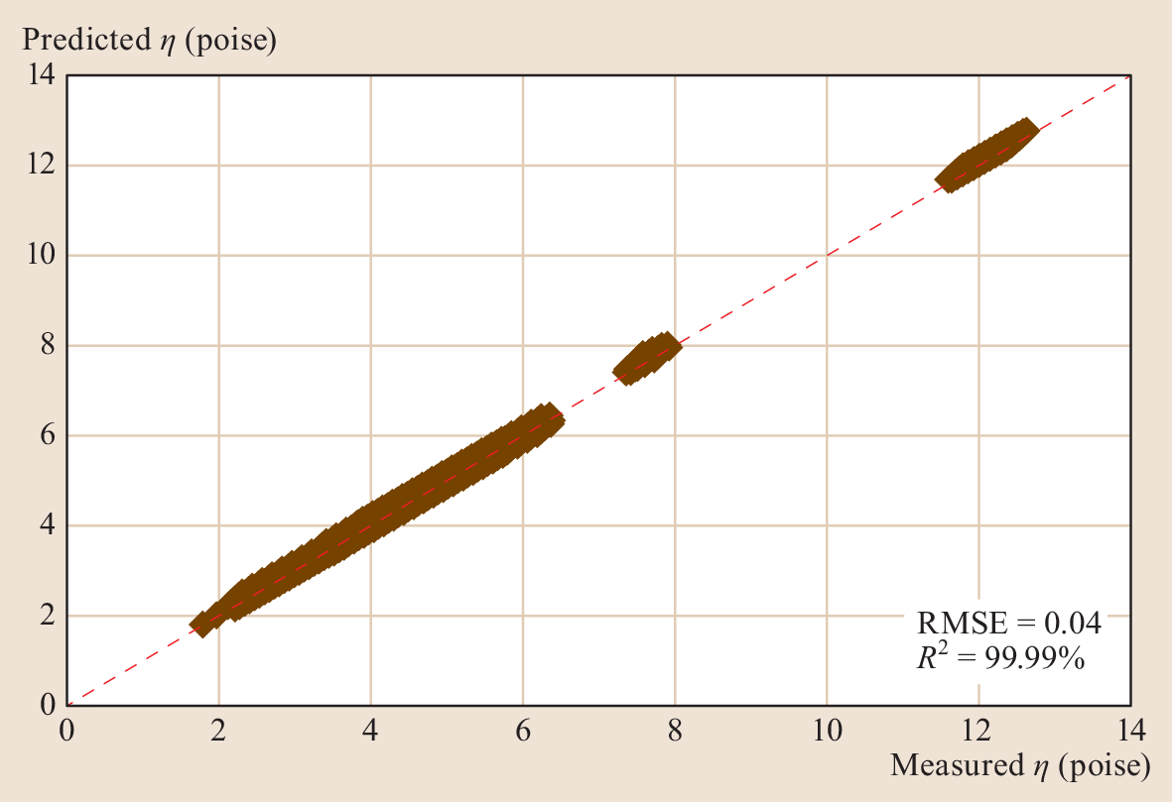
Viscosity prediction
Fitting of MYEGA equation parameters instead of viscosity yields reduced errors

Slide 18
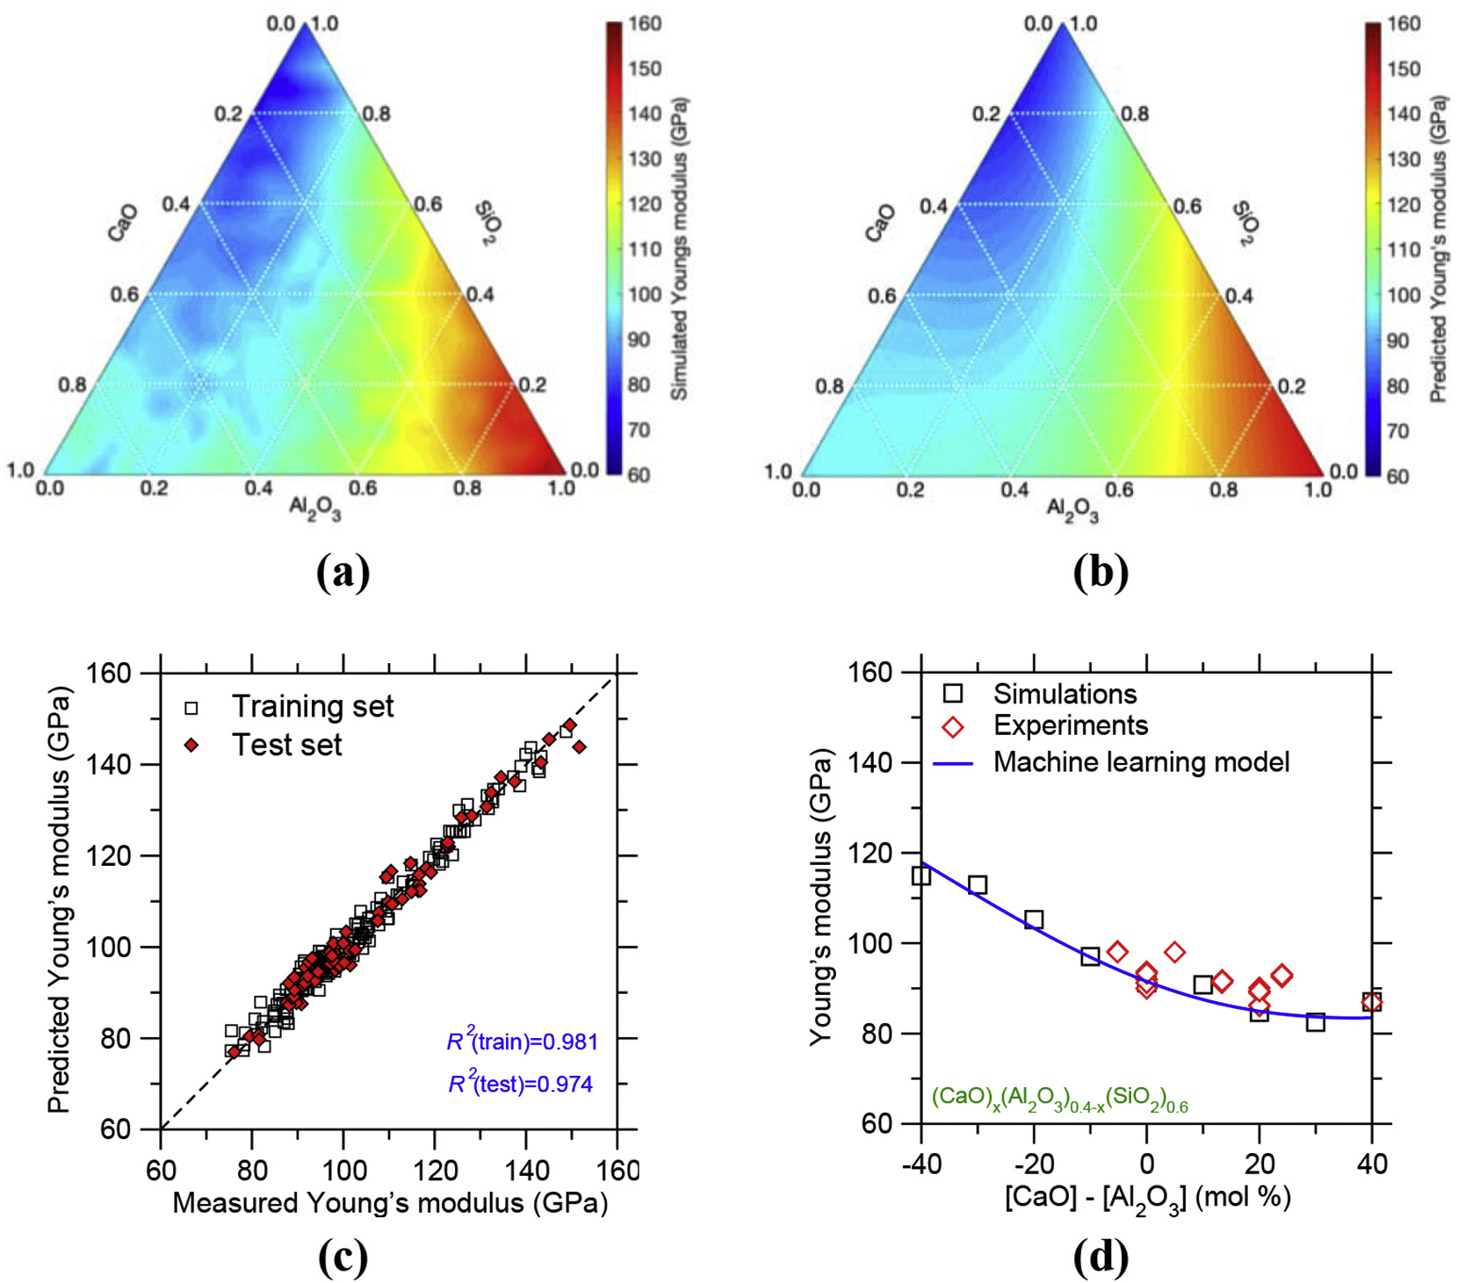
Modeling elastic modulus
Sci. Rep. 9, 8739 (2019)
Neural network trained using molecular dynamics simulation results

Slide 19
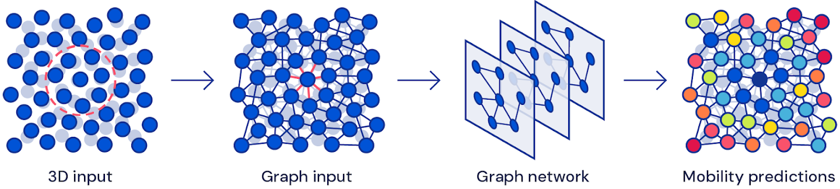
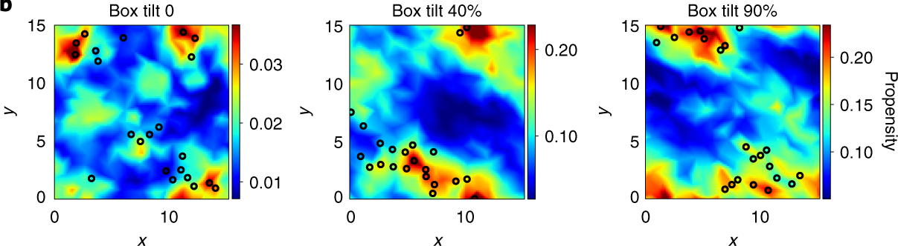
Understanding glass using graphic neural networks
Prediction of particle motion in shear deformation
Nat. Phys. 16, 448 (2020)

Slide 20
Some take-away messages
Glass presents both an opportunity and a challenge for data-driven ML
High-quality data are essential
Choosing the optimal model
  Liquidus temperature: data grouping
  Viscosity: physics-informed model
  Elastic modulus: using high-throughput simulation to supplement experimental data
  Atomic mobility: graphic neural network

