Slide 1
MIT 3.071
Amorphous Materials
15: Characterizing the Amorphous State
Juejun (JJ) Hu
hujuejun@mit.edu

Slide 2
 | Technique | Information
Structure | X-ray/electron/ neutron diffraction | Crystallinity, pair distribution function, medium range order
 | X-ray absorption spectroscopy (XAS) | Local structure, electronic state
 | Raman spectroscopy | Phonon spectra, structural clusters
 | Nuclear magnetic resonance (NMR) | Local atomic configurations
Glass chemistry | Atomic emission spectroscopy (AES) | Elemental composition
 | Energy-dispersive X-ray spectroscopy (EDX) | Elemental composition
 | Infrared spectroscopy | Chemical bonding, impurity concentration, optical absorption
 | X-ray photoelectron spectroscopy (XPS) | Valence state of constituents, electron density of states

Slide 3
 | Technique | Information
Thermal analysis | Differential thermal analysis (DTA) | Glass transition temperature (T_{g}), crystallization (T_{x})
 | Differential scanning calorimetry (DSC) | Glass transition temperature (T_{g}), crystallization (T_{x})
 | Thermogravimetric analysis (TGA) | Chemical decomposition
 | Thermomechanical analysis (TMA) | Thermal expansion, softening point, glass transition (T_{g})
Electrical properties | Temperature-dependent electrical conductivity measurement | Conduction mechanism, activation energy, density of states at Fermi level (for VRH)
 | Impedance spectroscopy (AC conductivity) | Conductivity, dielectric constant
 | Electron paramagnetic resonance (EPR) | Defects (e.g. dangling bonds)

Slide 4
 | Technique | Information
Mechanical and rheological behavior | Indentation | Hardness
 | Ultrasonic wave propagation | Elastic modulus
 | Fracture toughness test | Fracture toughness
 | 3/4-point bending test | Elastic modulus, flexural stress
 | Viscometry | Viscosity
Optical properties | UV-Vis spectroscopy | Optical attenuation, Tauc gap
 | Ellipsometry | Refractive index dispersion, attenuation (k > 0.001)
 | Prism coupling | Refractive index (bulk and thin film), optical attenuation
 | Optical fiber/waveguide transmission | Optical attenuation (thin films with k < 0.001)
 | Photoluminescence | Defect states

Slide 5
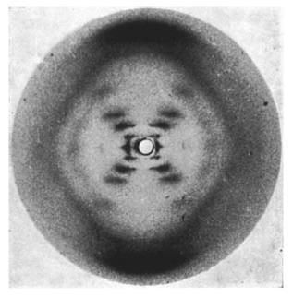
Diffraction techniques
Photo 51, X-ray diffraction pattern of DNA
Image courtesy:
Raymond Gosling
& Rosalind Franklin

Slide 6
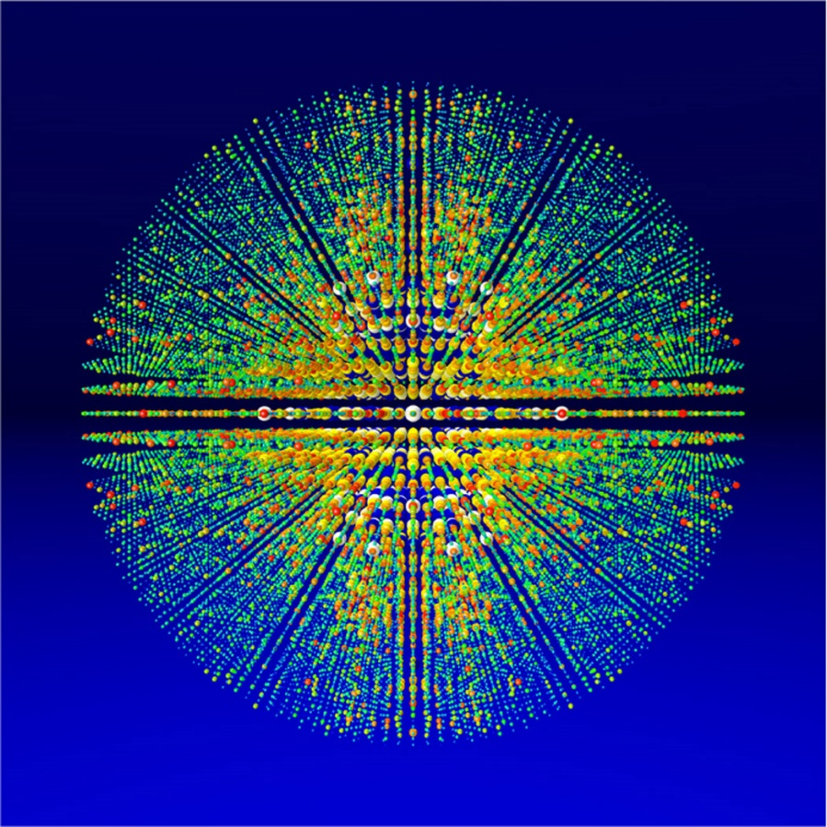
Diffraction techniques
Full 3-D X-ray structure factors of Photosystem I, a protein complex
Image courtesy:
Thomas White, CFEL

Slide 7
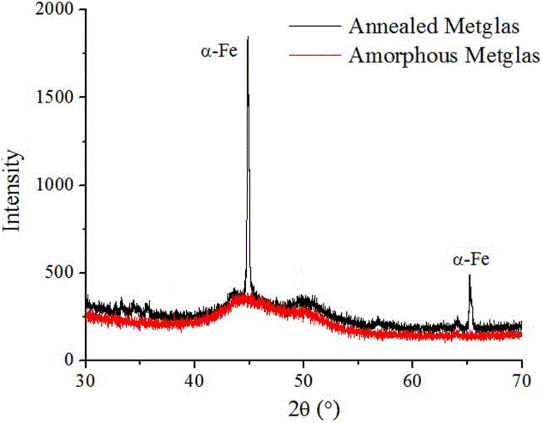
X-ray diffraction (XRD)
Crystals:
Strong scattering
Localized, intense peaks
Glass:
Weak scattering
Broad scattering background across the entire reciprocal space
Amorphous background
Appl. Phys. Lett. 102, 082404 (2013)

Slide 8
X-ray diffraction in solids
Incident wave
Assumptions:
Approximate incident and diffracted X-ray as mono-chromatic plane waves
Elastic scattering: wavelength of X-ray remains the same after scattering
Neglect X-ray attenuation in the solid sample
Diffracted wave
Sample
r_{m} : position vector of atom m

Slide 9
X-ray diffraction by a single atom m
Incident wave
Complex amplitude of incident wave:
Field amplitude of the incident wave at r_{m} :
Complex amplitude of wave scattered by atom m:
Diffracted wave
Sample
E : field amplitude of incident X-ray
k_{i} : wave vector of incident X-ray
k_{s} : wave vector of scattered X-ray
f_{m} : scattering factor of atom m
Q = k_{s} - k_{i} : scattering vector

Slide 10
X-ray diffraction in solids
Incident wave
Total scattered amplitude from the sample :
Total scattered intensity:
Diffracted wave
Sample
S (Q) : (static) structure factor
N : total number of atoms in the sample

Slide 11
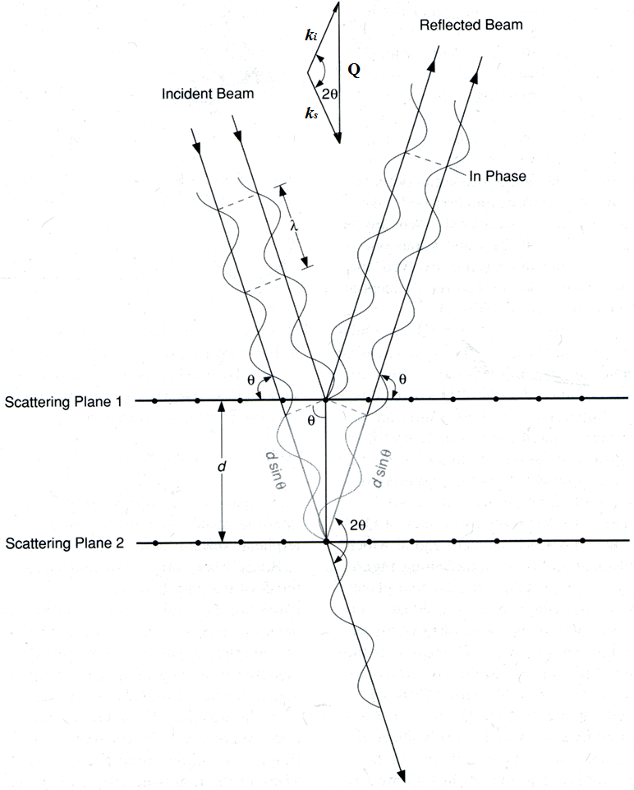
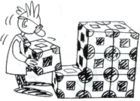
X-ray diffraction in crystals
The condition for a Bragg peak to appear is:
or:
The Bragg peak intensity scales with:
where the sum is over all atoms in a unit cell
T. Proffen, Characterization of Materials using the PDF
Unit cell: the repeating unit of a crystal

Slide 12
Quantitative description of glass structure
Structural descriptions of amorphous materials are always statistical in nature
Pair distribution function (PDF): g(r)
  Consider an amorphous material with an average number density of atom given by:
  The number density of atoms at a distance r from an origin atom is given by
  When
  When
N : number of atoms V : material volume

Slide 13
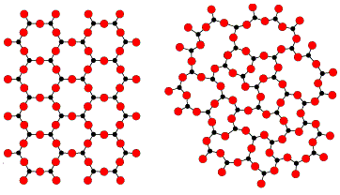
PDFs of ideal (hard sphere) crystals vs. glasses
g(r)
1st coordination shell
2nd coordination shell
r
g(r)
1
r
0

Slide 14
Mathematical description of PDF
Probability density for finding an atom at r :
Probability density for finding an atom pair at r and r’ :
Pair distribution function:
Homogeneous solid
Homogeneous, isotropic solid
Notes:
The definition follows r→0, g→0 and r→∞, g→1

Slide 15
Structure factor of isotropic amorphous solids
where
In isotropic solids structure factor is related to the Fourier transform of PDF
Notes:
In general, the particle positions are not fixed and the measurement takes place over a finite exposure time and with a macroscopic sample (much larger than the interparticle distance). The experimentally accessible intensity is thus an averaged one.

Slide 16
Debye scattering equation
Isotropic amorphous media:
The inverse transform:
where
XRD spectra can be used to infer PDF of isotropic amorphous solids

Slide 17
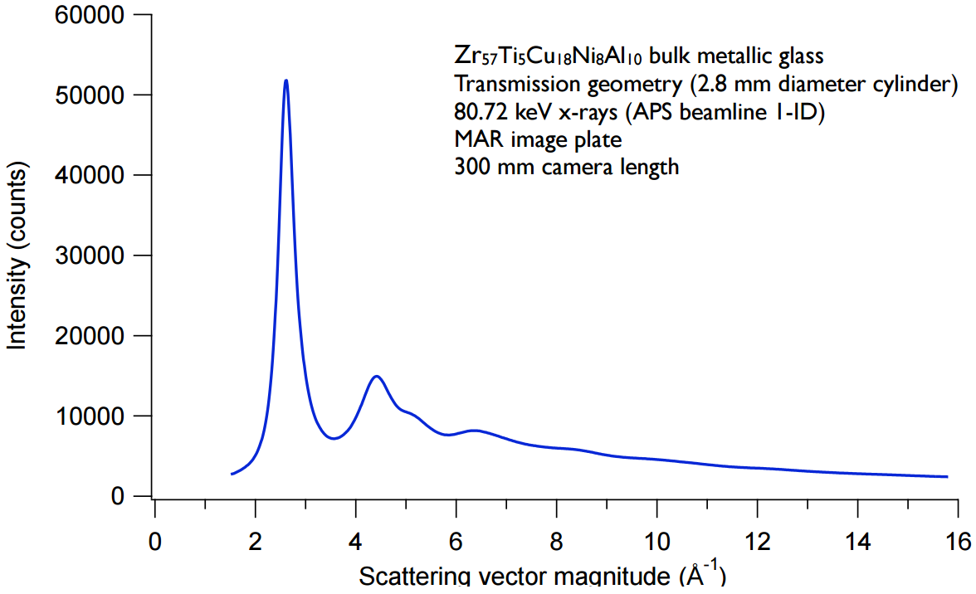
Solving PDF from experimental XRD spectra
Raw XRD data
Data correction
Structure factor normalization
Transform to real space
Data from T. C. Hufnagel, Johns Hopkins University

Slide 18
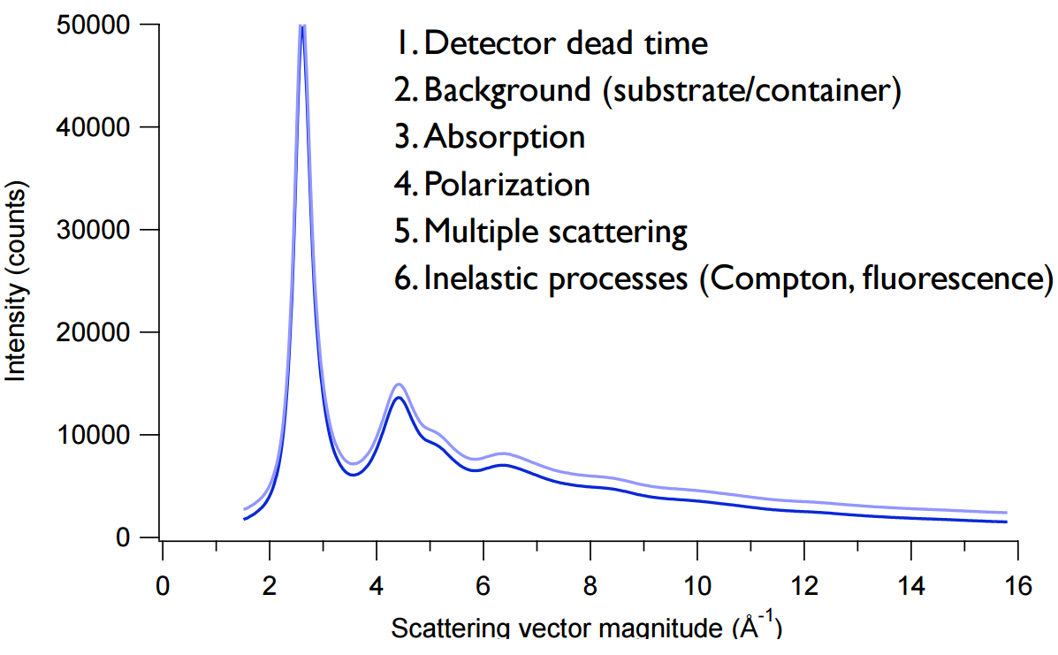
Solving PDF from experimental XRD spectra
Raw XRD data
Data correction
Structure factor normalization
Transform to real space
Data from T. C. Hufnagel, Johns Hopkins University

Slide 19
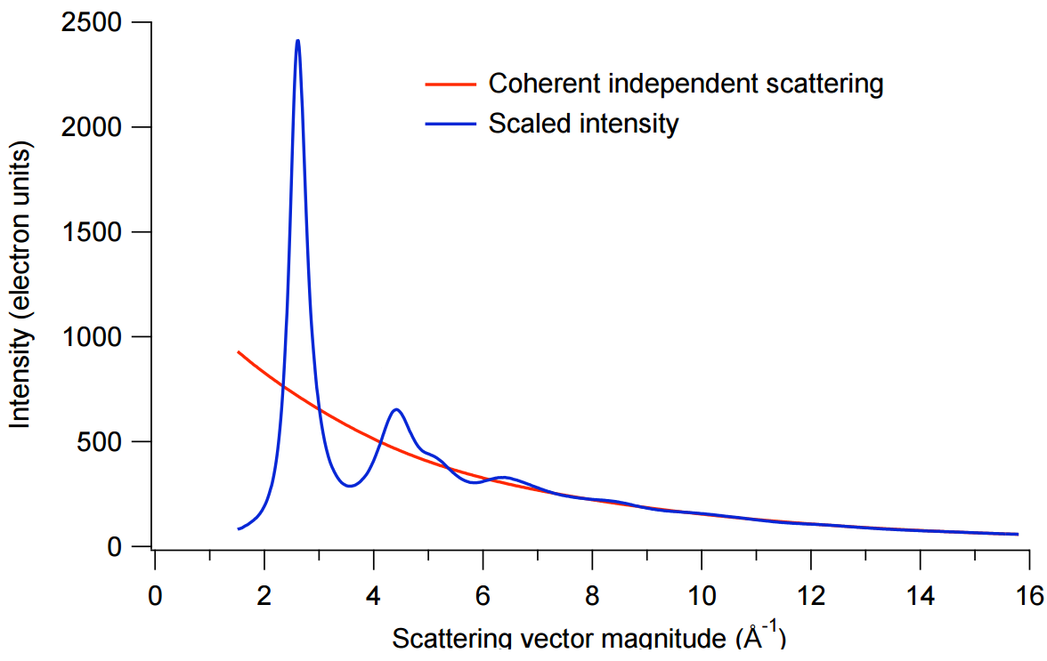
Solving PDF from experimental XRD spectra
Raw XRD data
Data correction
Structure factor normalization
Transform to real space
Scattered intensity oscillates around the coherent independent scattering at large Q values
Data from T. C. Hufnagel, Johns Hopkins University

Slide 20
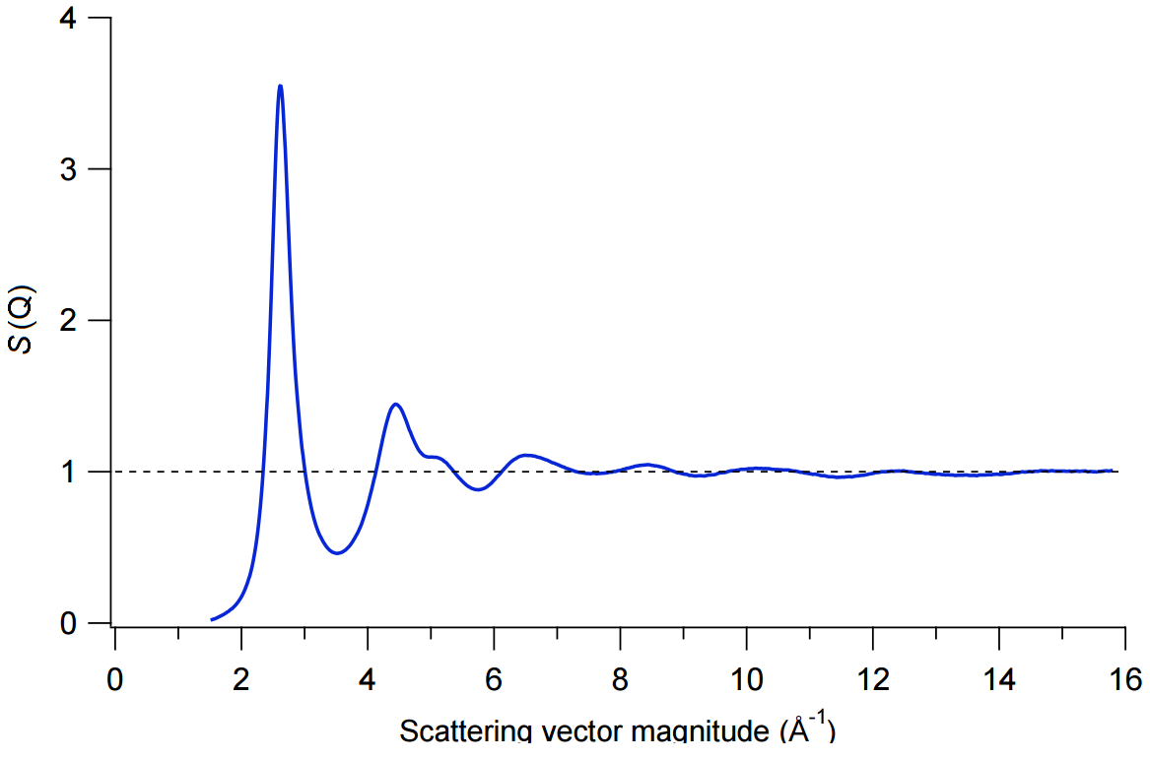
Solving PDF from experimental XRD spectra
Raw XRD data
Data correction
Structure factor normalization
Transform to real space
Structure factor oscillates around unity at large Q values
Data from T. C. Hufnagel, Johns Hopkins University

Slide 21
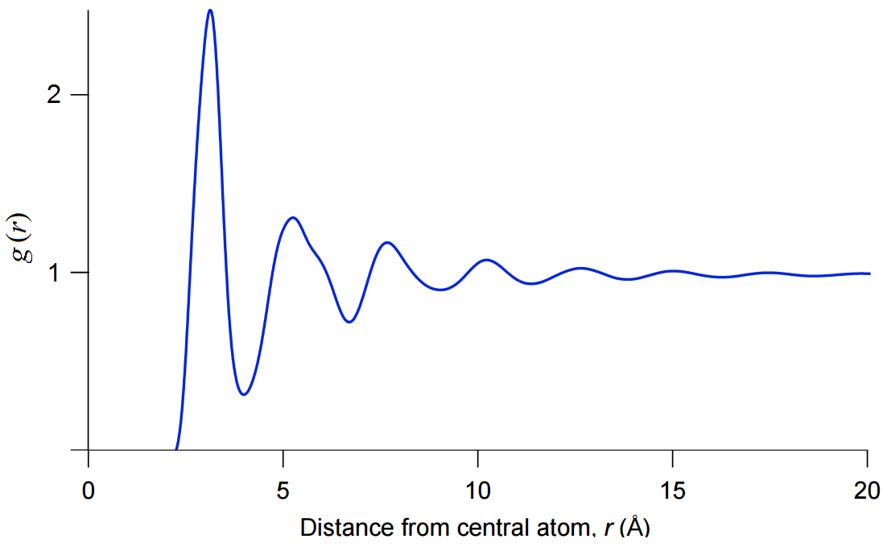
Solving PDF from experimental XRD spectra
Raw XRD data
Data correction
Structure factor normalization
Transform to real space
Data from T. C. Hufnagel, Johns Hopkins University

Slide 22
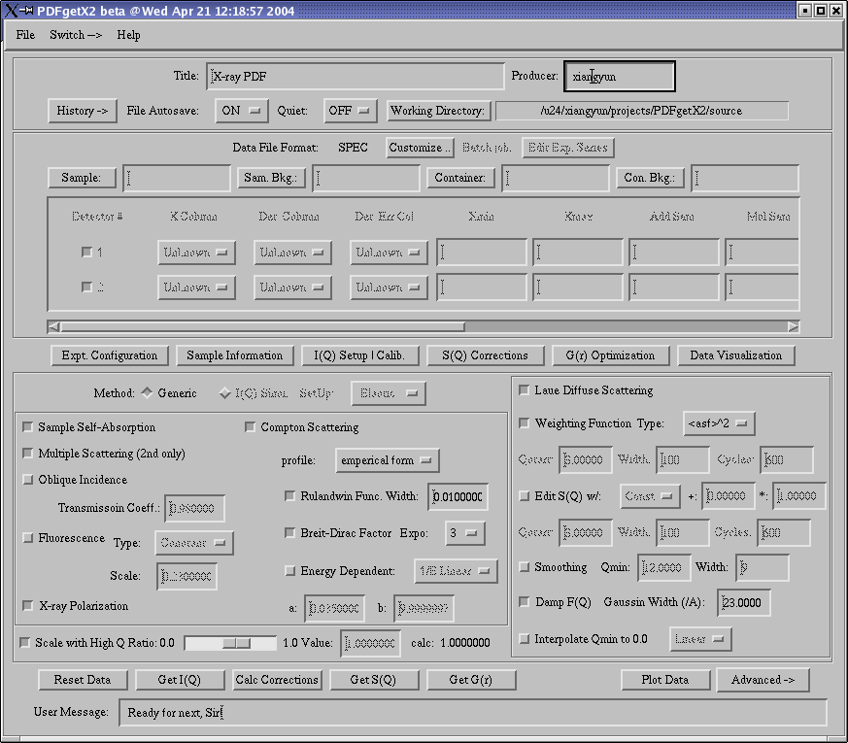
Solving PDF from experimental XRD spectra
Sources of error
  S(Q) data truncation error
  X-ray photon shot noise
  Finite resolution
Mitigation strategies
  Use Mo (λ_{Kα} = 0.71 Å) or Ag (λ_{Kα} = 0.56 Å) sources instead of Cu source (λ_{Kα} = 1.54 Å)
  Use synchrotron sources
  Increase collection time
Determination of Pair Distribution Functions (PDF) from Bruker
PDFGetX2 homepage
J. Appl. Cryst. 37, 678 (2004)

Slide 23
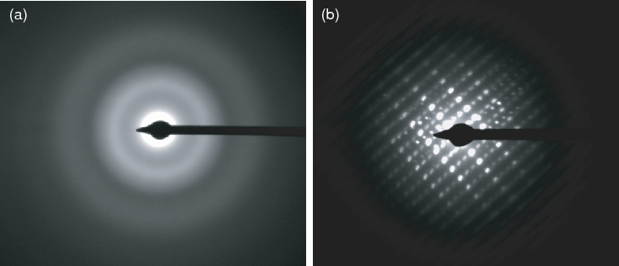
Electron and neutron diffraction
Electron diffraction
  Much smaller wavelength (e.g. λ ~ 2 pm for 300 keV electrons)
  Small spot size (e.g. in the case of SAED)
Neutron diffraction
  Interacts with nuclei rather than electrons
  Can discriminate neighboring elements or isotopes
Amorphous Ta₂O₅
Crystalline Ta₂O₅
Electron diffraction patterns
  Can detect light elements
Class. Quantum Grav. 27, 225020 (2010)

Slide 24
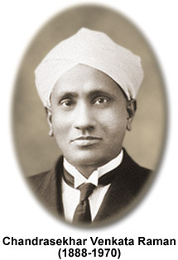
Raman spectroscopy
When asked about his inspiration behind the Nobel Prize winning optical theory, Raman said he was inspired by the "wonderful blue opalescence of the Mediterranean Sea" while he was going to Europe in 1921.

Slide 25
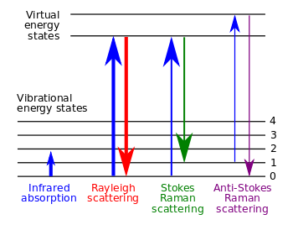
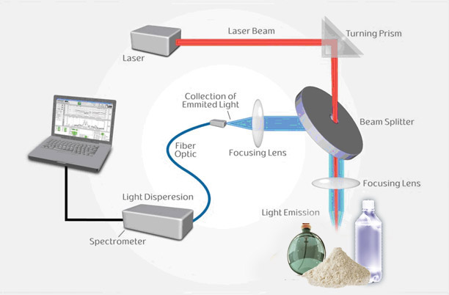
Raman spectroscopy
Raman scattering: inelastic interaction of photons with phonons
  Photon – phonon = Stokes line
  Photon + phonon = anti-Stokes line
laser-detect.com/technology-methods/

Slide 26
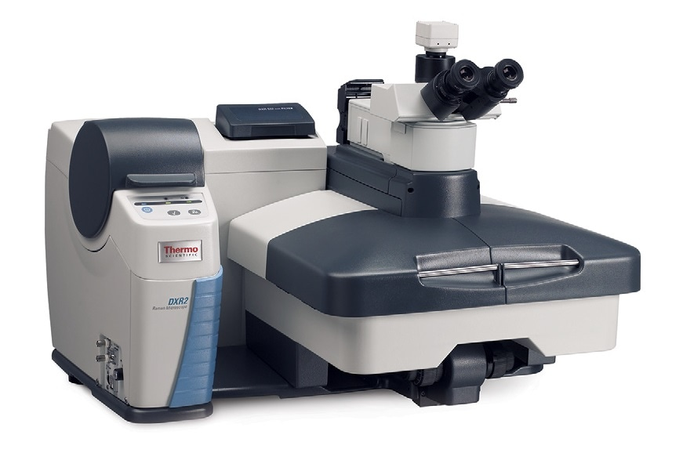
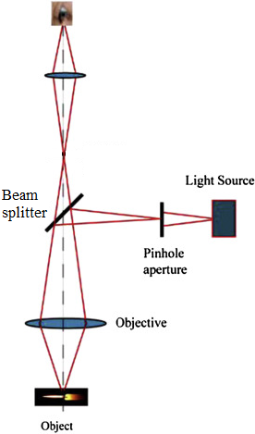
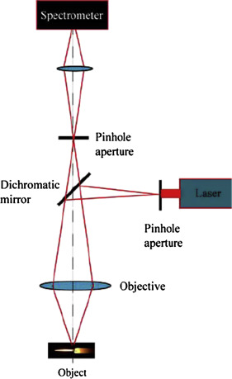
(Confocal) micro-Raman system
Raman Microscope
Confocal micro-Raman spectroscopy: depth resolution at the expense of signal strength
Bright field microscopy
(Confocal) Raman spectroscopy
“Confocal Raman Spectroscopy,” Micro and Nano Technologies Ch. 7, 141-161 (2017)

Slide 27
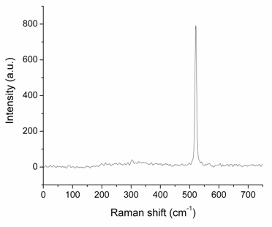
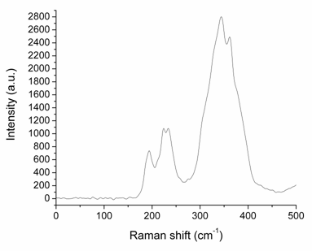
Raman spectra of amorphous materials
Amorphous materials typically have broad Raman peaks
  Dispersion of local structures and phonon energy
  Breakdown of selection rule
Raman spectrum of c-Si
Raman spectrum of As₂S₃ glass

Slide 28
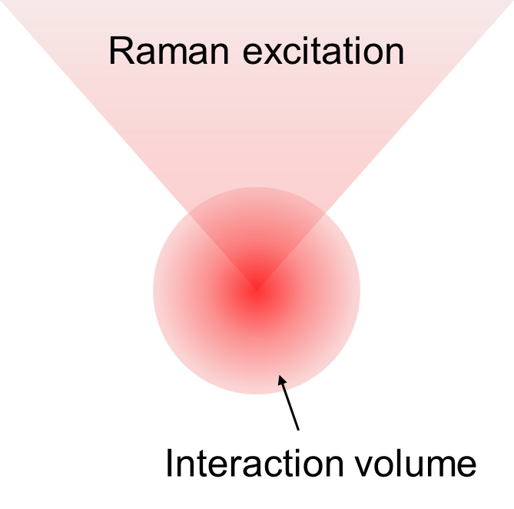
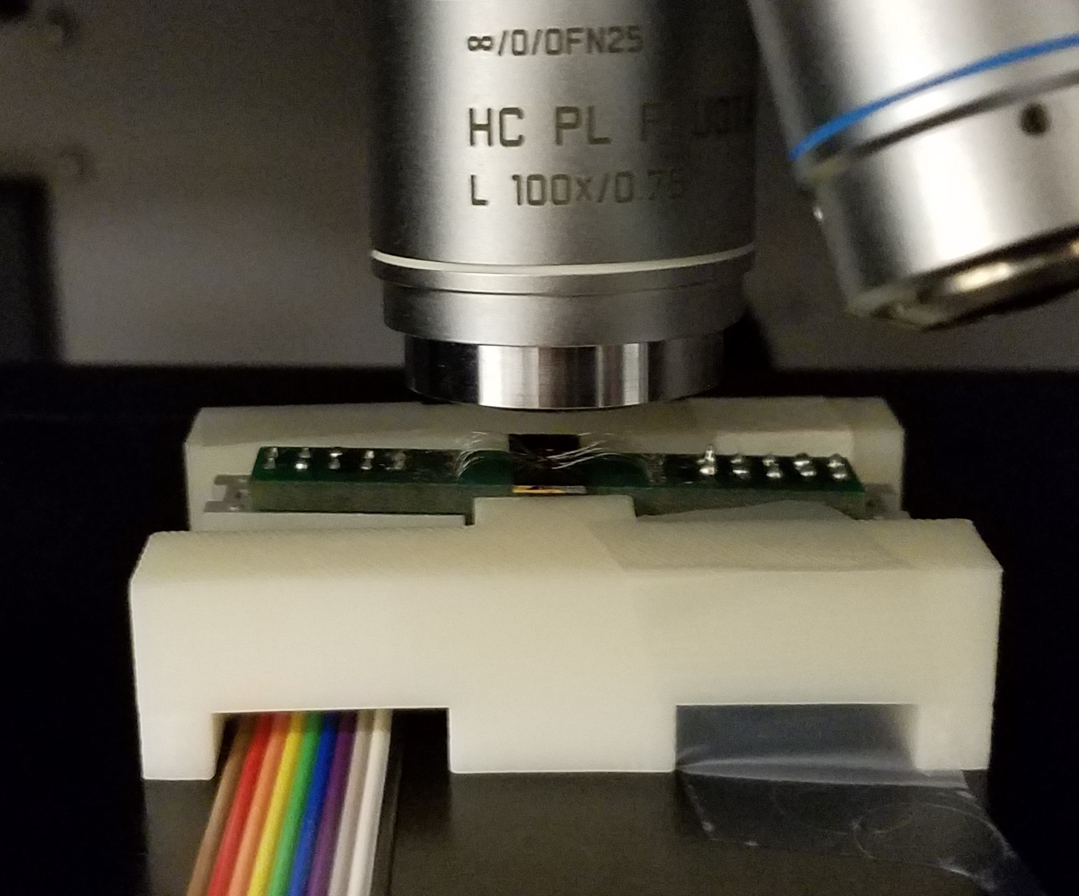
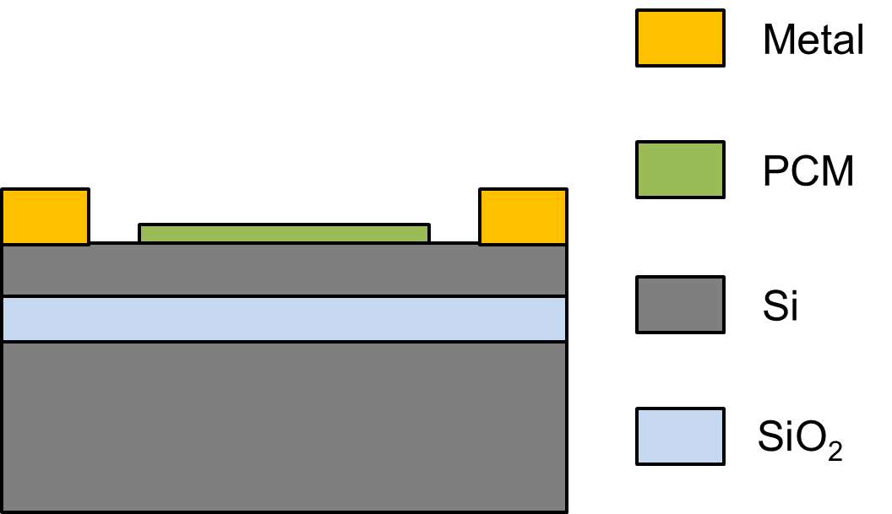
Probing phase transition kinetics in PCM
In-situ Raman probing concurrently reveals PCM structure and heater temperature
Adv. Photonics Res. 3, 2200202 (2022)

Slide 29
Probing phase transition kinetics in PCM
In-situ Raman probing concurrently reveals PCM structure and heater temperature
Adv. Photonics Res. 3, 2200202 (2022)

Slide 30
Probing phase transition kinetics in PCM
In-situ Raman probing concurrently reveals PCM structure and heater temperature
Adv. Photonics Res. 3, 2200202 (2022)

Slide 31
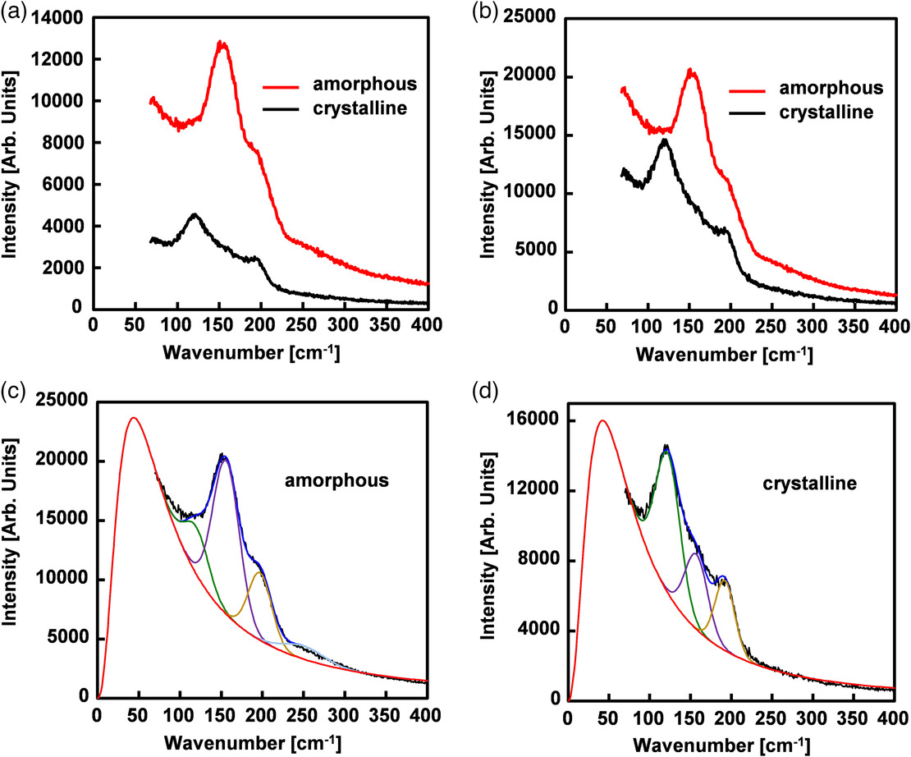
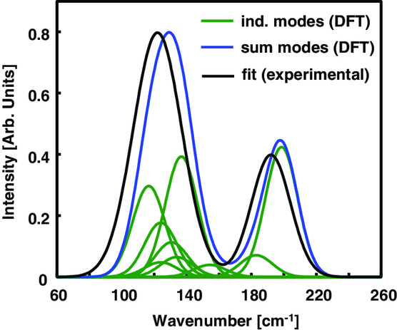
Probing phase transition kinetics in PCM
Boson peak

Slide 32
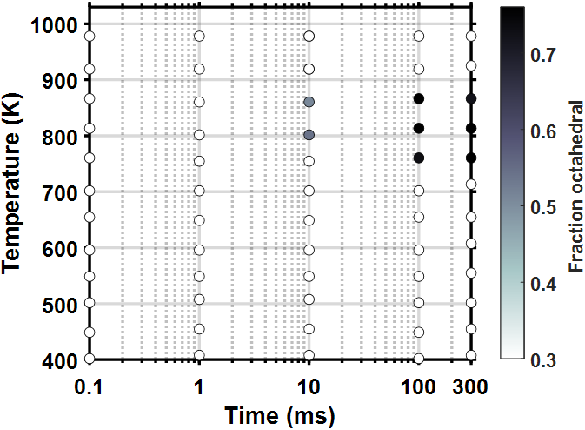
Measuring TTT diagrams of PCMs
A facile method for experimental quantification of true TTT diagram in PCMs
Crystallization
Adv. Photonics Res. 3, 2200202 (2022)

Slide 33
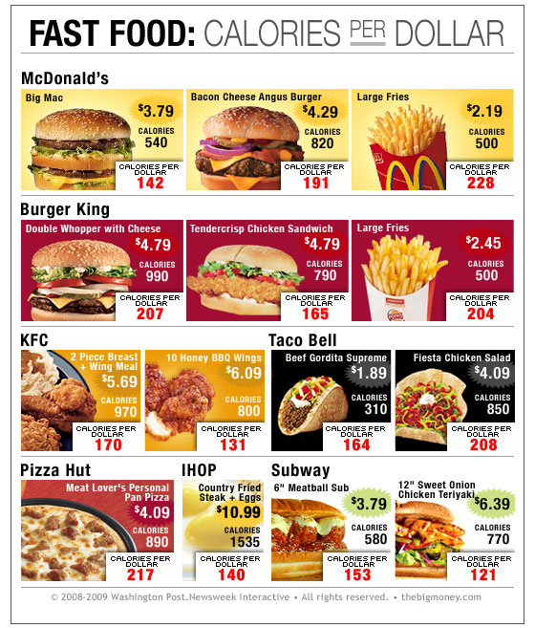
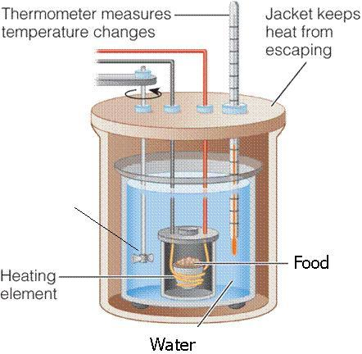
Calorimetry (thermal analysis)
Notes:
https://zhuanlan.zhihu.com/p/30794181

Slide 34

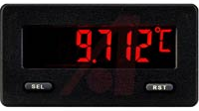
Differential Scanning Calorimetry (DSC) | Differential Thermal Analysis (DTA)
Both techniques involve a sample and an inert reference with known heat capacity both undergoing controlled heating or cooling
Heating rate is kept constant for both the sample and the reference, and heat flow to the sample minus heat flow to the reference is recorded | Both the sample and the reference undergo identical thermal cycle and temperature difference between sample and reference is recorded
Sample
Reference
Sample
Reference
Heater
Heater
Heater
Computer control to ensure identical heating rate
Thermal couples record temperature difference

Slide 35
Differential scanning calorimetry of glass materials
Melting
Endothermic
Steady state
Differential heat flow
Area under a DSC peak is proportional to the heat released or absorbed during a phase change
Glass transition
Crystallization
Exothermic
Temperature
Notes:
Sometimes the direction of the vertical axis is flipped

Slide 36
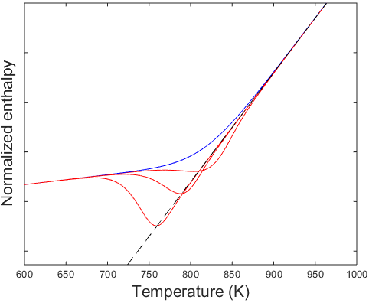
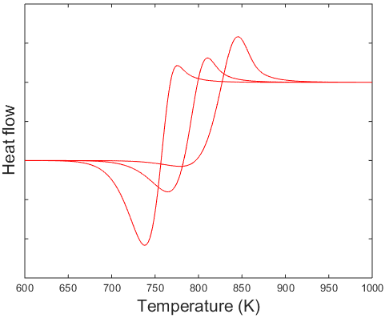
Glass transition regime behavior in DSC
Cooling rate: 10 °C/s
Varying reheating rate
10 °C/s
10 °C/s
1 °C/s
1 °C/s
0.1 °C/s
0.1 °C/s
Shape of DSC curve at the glass transition regime depends on heating rate and the sample’s thermal history

Slide 37
Differential thermal analysis of glass materials
K : thermal conductance
Exothermic
Steady state
Temperature difference
Melting
Crystallization
Endothermic
Glass transition
Temperature

Slide 38
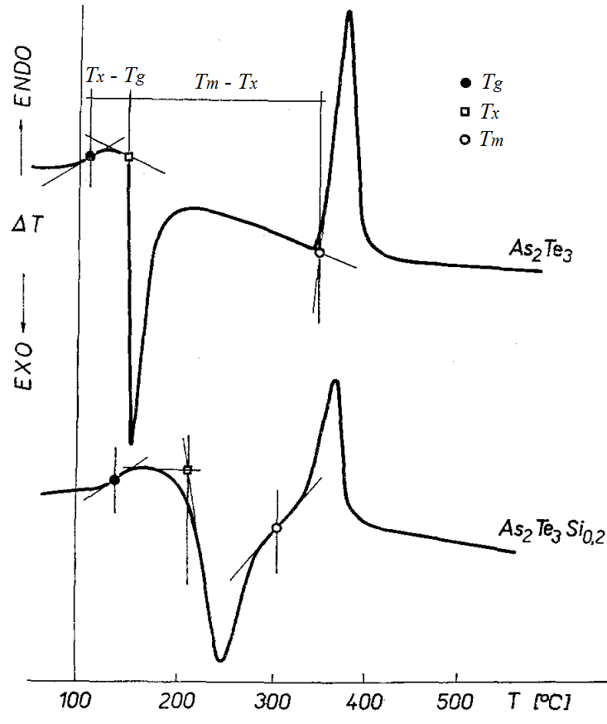
Evaluation of glass forming ability
FOM for glass stability:
Hruby coefficient
Addition of Si increases glass melt viscosity and improves glass forming ability
Czech. J. Phys. B 22, 1187 (1972)
DTA

Slide 39

Ultrafast DSC using on-chip heater & sensor

Slide 40
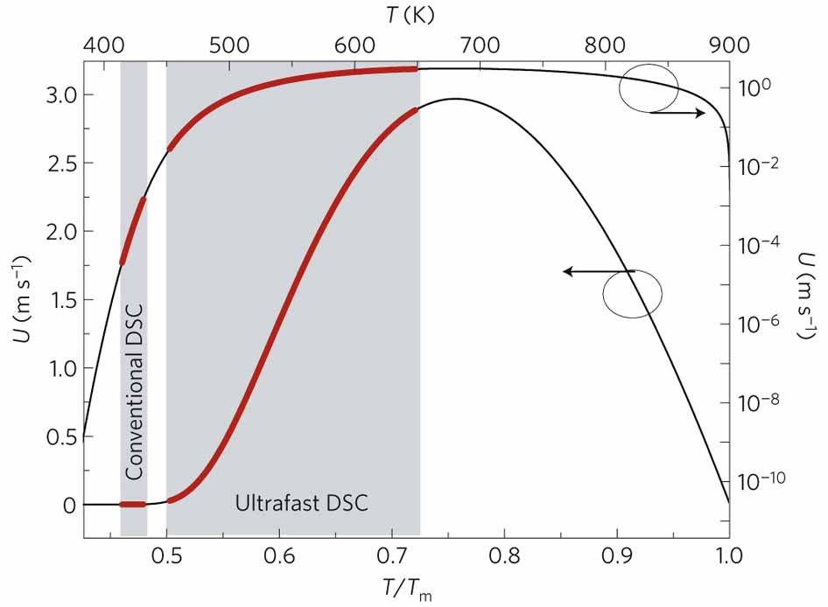
Ultrafast calorimetry for material analysis
Crystal growth rate in Ge₂Sb₂Te₅
Nat. Mater. 11, 279 (2012)

Slide 41
Summary
Diffraction
  Debye diffraction equation: relation between structure factor and PDF in homogeneous, isotropic amorphous solids
  Solving PDF from experimentally measured XRD spectra: corrections and normalization
  X-ray, electron, and neutron diffraction
Raman spectroscopy
  Broad Raman peaks: phonon energy dispersion
Thermal analysis
  DSC vs. DTA: data interpretation
  Glass transition regime behavior

