Slide 1
MIT 3.071
Amorphous Materials
11: Electrical and Transport Properties
Juejun (JJ) Hu
hujuejun@mit.edu

Slide 2
After-class reading list
Fundamentals of Inorganic Glasses
  Ch. 14, Ch. 16
Introduction to Glass Science and Technology
  Ch. 8

Slide 3
Basics of electrical conduction
Electrical conductivity
Einstein relation
σ : electrical conductivity
n : charge carrier density
Z : charge number
e : elementary charge
μ : carrier mobility
D : diffusion coefficient
v : carrier drift velocity
E : applied electric field
Both ions and electrons contribute to electrical conductivity in glasses

Slide 4
Ionic conduction in crystalline materials
Vacancy mechanism
Interstitial mechanism

Slide 5
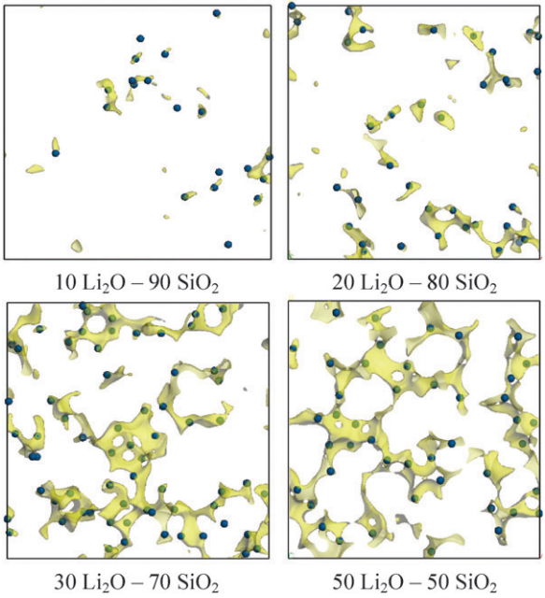
Ionic conduction pathway in amorphous solids
There are low energy “sites” where ions preferentially locate
Ionic conduction results from ion transfer between these sites
Ionic conduction is thermally activated
2-D slices of regions with Li site energies below a threshold value in Li₂O-SiO₂ glasses
Phys. Chem. Chem. Phys. 11, 3210 (2009)

Slide 6
A tale of two valleys
Electric field E = 0
Assuming completely random hops, the average total distance an ion moves after M hops in 1-D is:
Average diffusion distance:
+
(1-D)
Average spacing between adjacent sites: d
(3-D)
For correlated hops:
(1-D)
(3-D)
Ion hopping frequency: ν

Slide 7
A tale of two valleys
Electric field E = 0
Attempt (vibration) frequency: ν₀
Frequency of successful hops (ion hopping frequency):
+
Barrier height ΔE_{a}
Equal probability of hopping along all directions: zero net current

Slide 8
A tale of two valleys
Electric field E > 0
Energy difference between adjacent sites: ZeEd
Hopping frequency → :
Hopping frequency ← :
Net ion drift velocity:
ΔE_{a}
+
ZeEd
Notes:
Note that the symbol v for velocity is bold and is different from the hopping frequency Nu
The ½ factor signifies bidirectional hopping

Slide 9
A tale of two valleys
Electric field E > 0
Ion mobility
Electrical conductivity (1-D, random hop)
Einstein relation (3-D, correlated hops)
ΔE_{a}
+
ZeEd

Slide 10
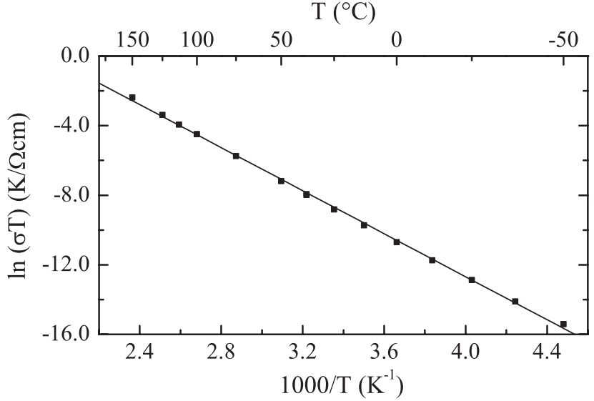
Temperature dependence of ionic conductivity
Dispersion of activation energy in amorphous solids leads to slight non-Arrhenius behavior
1/T (× 1,000) (K⁻¹)
Phys. Rev. Lett. 109, 075901 (2012)

Slide 11
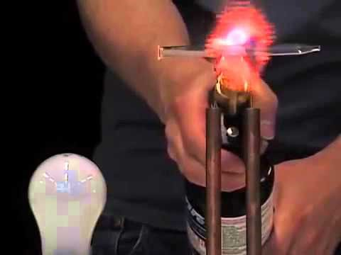
Ionic conductivity in soda-lime glass

Slide 12
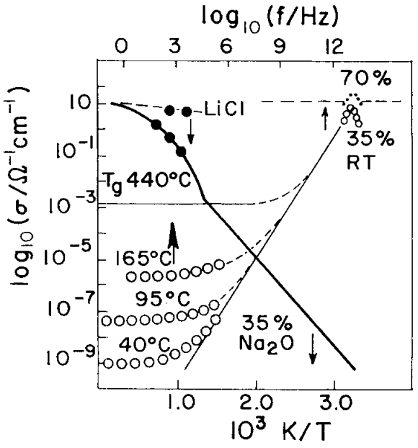
Theoretical ionic conductivity limit in glass
Note that σ₀ has a unit of Ω·cm·K
When T → ∞, σ → σ₀ /T
Extrapolation of the Arrhenius plot agrees with infrared spectroscopic measurements in ionic liquids (molten salts)
Solid State Ionics 18&19, 72 (1986)
Annu. Rev. Phys. Chem. 43, 693 (1992)
Notes:
IR conductivity represents the limiting high value when all ion motions are conductive (oscillating locally), and this is reduced by the Boltzmann probability in the case of DC ionic conductivity

Slide 13
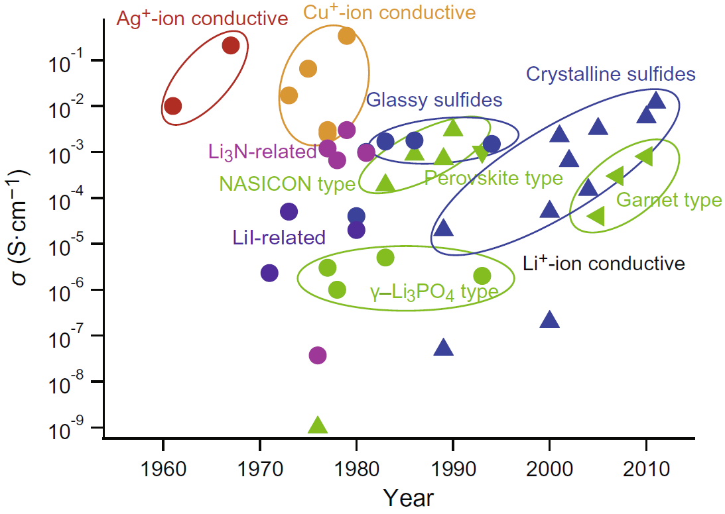
Fast ion conductors / superionic conductors
Acta Mater. 61, 759 (2013)
Notes:
Some glasses are more conductive than their crystalline counterparts and some are not

Slide 14
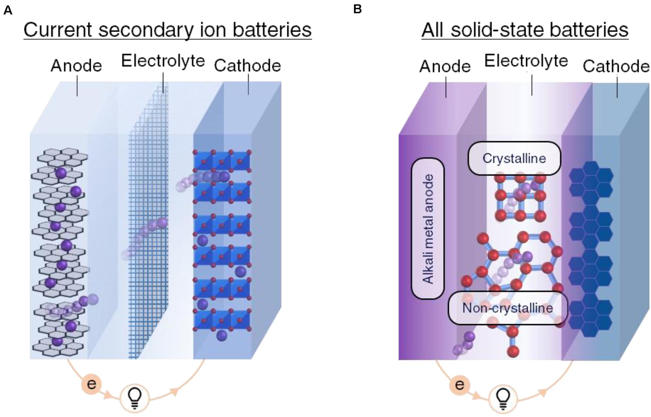
Solid-state battery based on glass electrolytes
Front. Energy Res. 8, 218 (2020)

Slide 15
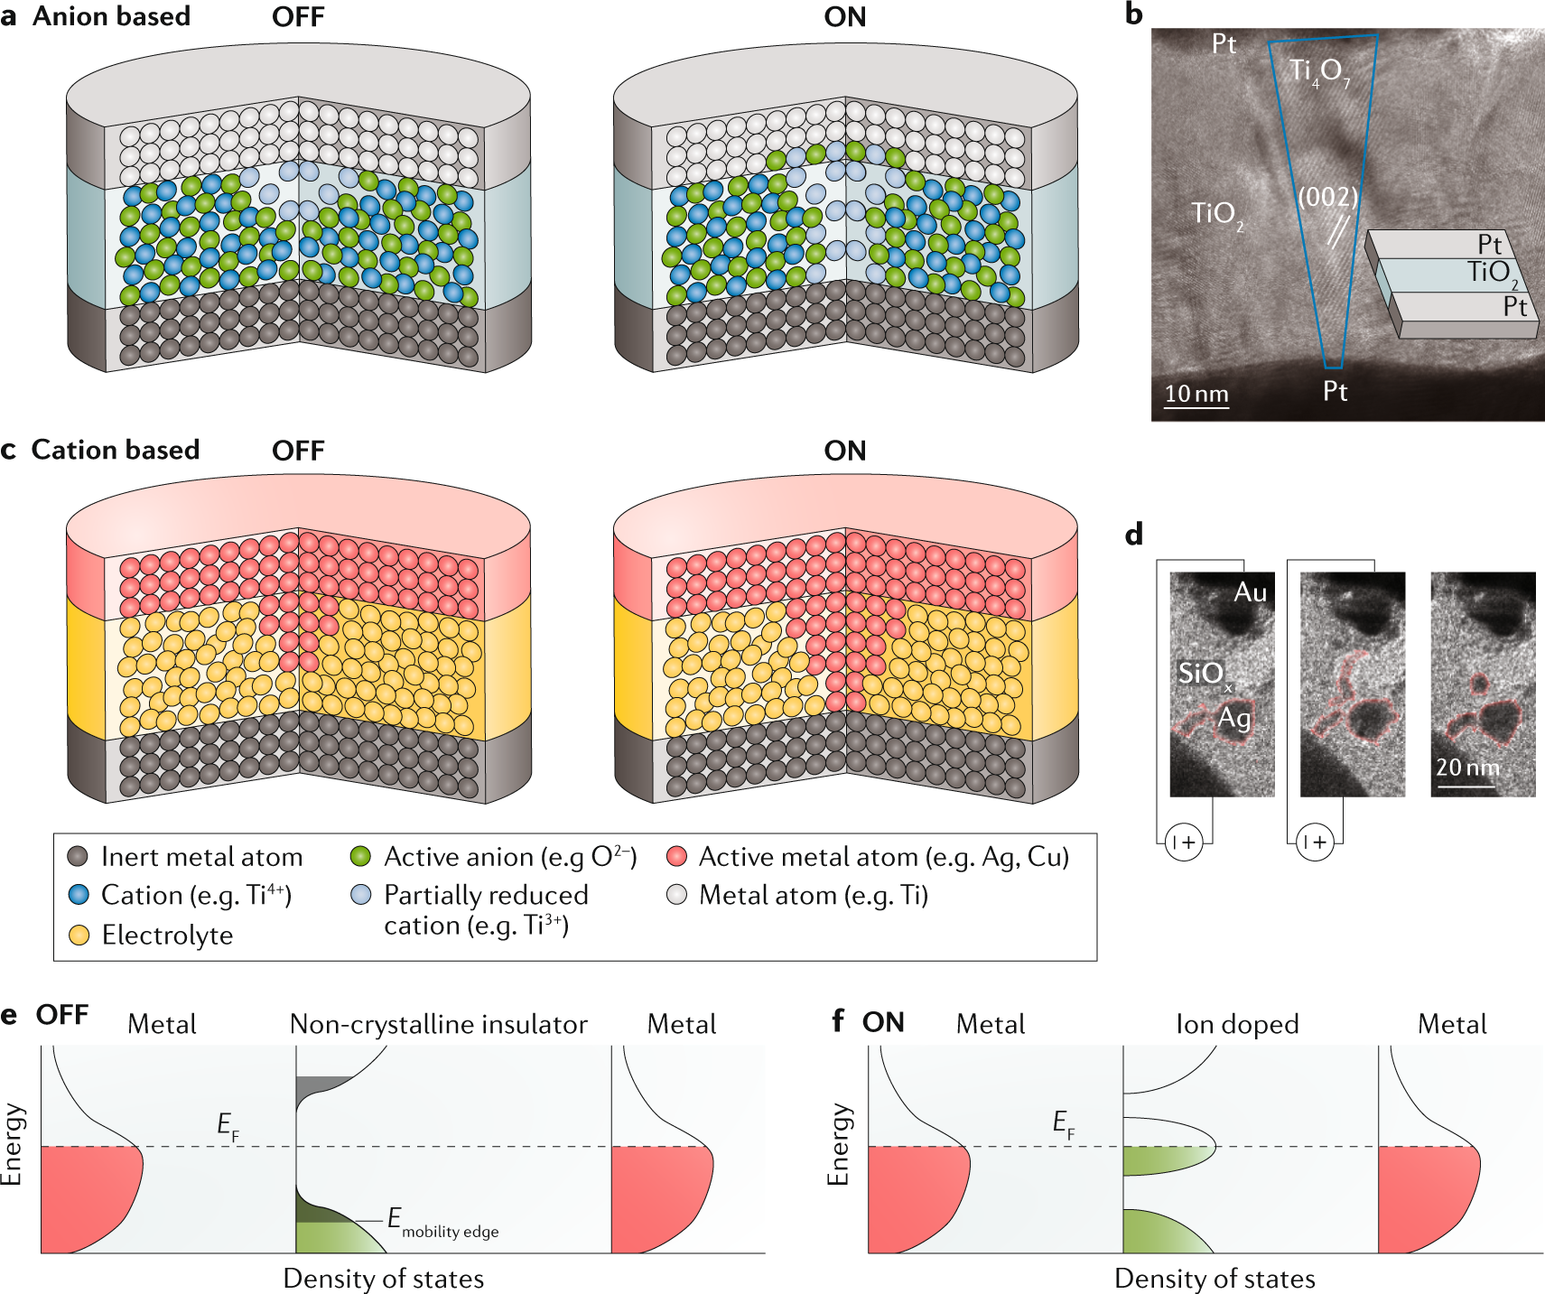
Resistive switching in amorphous materials
Conductive filament created by redox reaction of ions
Nat. Rev. Mater. 5, 173 (2020)

Slide 16
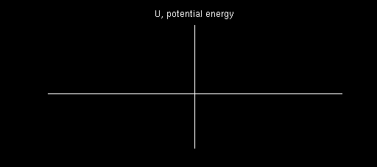
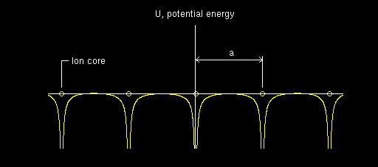
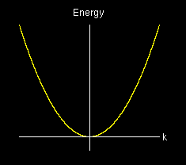
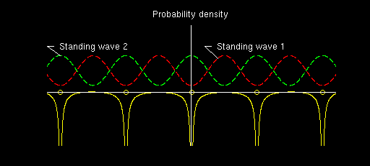
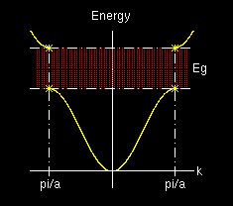
Band structures in defect-free crystalline solids
All electronic states are labeled with real Bloch wave vectors k signaling translational symmetry
All electronic states are extended states
No extended states exist in the band gap

Slide 17
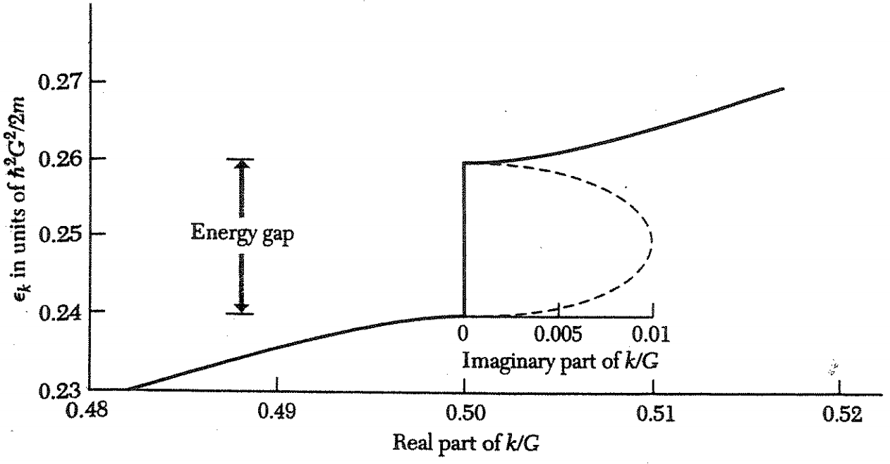
Band structures in defect-free crystalline solids
In the band gap, wave equation solutions have complex wave vectors k
Kittel, Introduction to Solid State Physics, Ch. 7

Slide 18
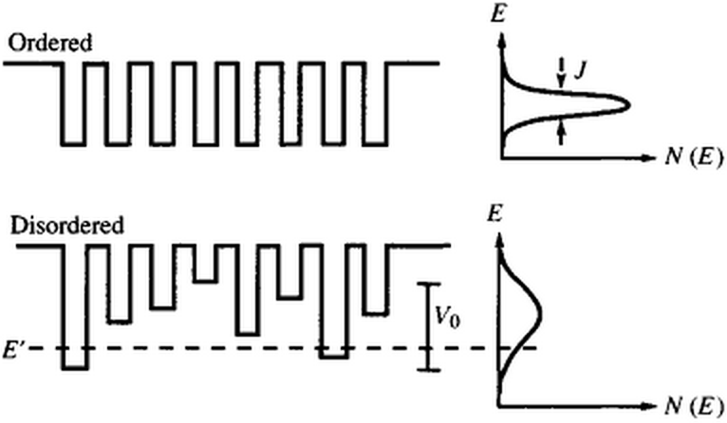

Anderson localization in disordered systems
Localization criterion: sufficiently large V₀ / J
P. W. Anderson
Disorder leads to (electron, photon, etc.) wave function localization

Slide 19
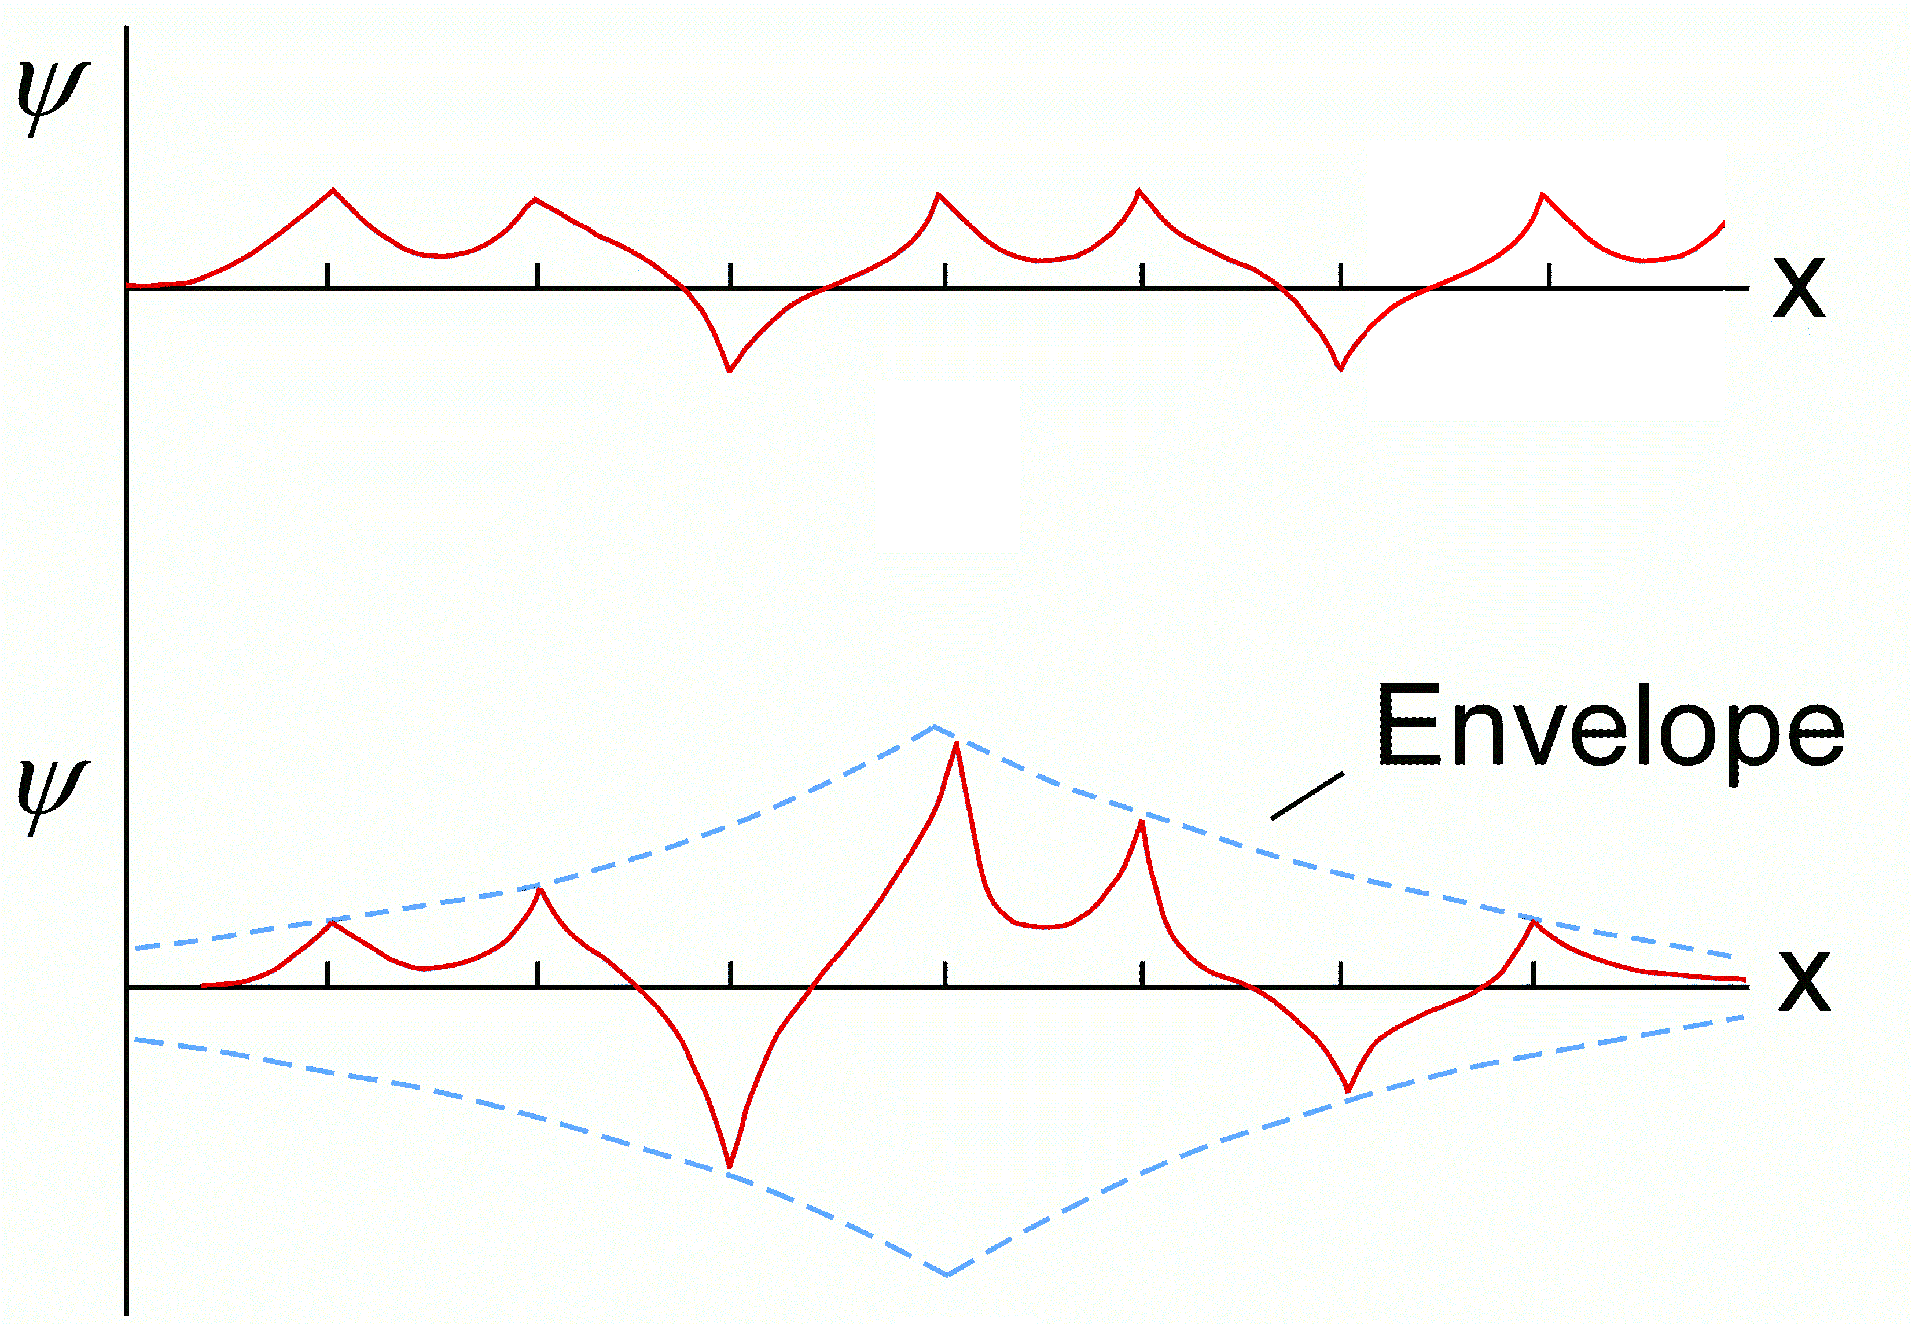
Anderson localization in disordered systems
Extended states (Bloch states)
Localized states

Slide 20
Density of states (DOS) in crystalline and amorphous solids
E
E
Conduction band
Conduction band
Urbach tail
Defect states
Band gap
Mid-gap states
Mobility edge
Valence band
Valence band
DOS
DOS
Crystalline solids
Amorphous solids

Slide 21
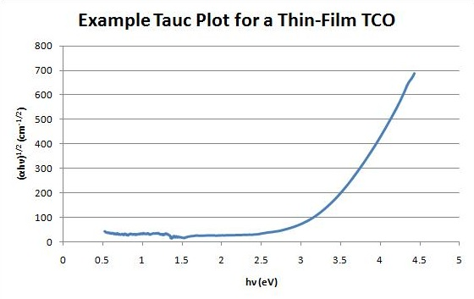
Tauc gap and Tauc plots
Tauc gap E_{T} definition:
It is merely a fitting parameter and has little physical significance!
α – absorption coefficient
ħω – photon energy
E_{T} = 3.3 eV
Notes:
Experimental measurement of mobility edge: https://www.nature.com/articles/nphys3339

Slide 22
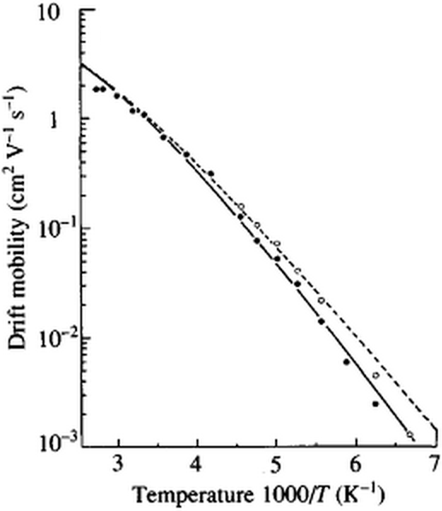
Extended state conduction
Extended state conductivity:
Drift mobility μ_{ex} increases with temperature (T → ∞, f_{trap} → 0)
Extended state conductivity follows Arrhenius dependence
Electron drift mobility in a-Si:H
μ₀ : free mobility
f_{trap} : fraction of time in trap states
Electron mobility in c-Si: 1400 cm² V⁻¹ s⁻¹
R. Street, Hydrogenated Amorphous Silicon, Ch. 7

Slide 23
Hopping conduction via localized states
Fixed range hopping: hopping between nearest neighbors
  Hopping between dopant atoms at low temperature
Variable range hopping (VRH)
  Hopping between localized states near E_{F}
E
Mobility edge
  E_{F}
R
y
x
g
z
DOS

Slide 24
Variable range hopping
Hopping probability
Within distance R, the average minimal energy difference ΔE is:
Optimal hopping distance:
R
y
x
z

Slide 25
DC conductivity in amorphous semiconductors
lnσ
Extended state conduction
VRH is most pronounced at low temperature
Measured DC conductivity
Variable range hopping
1/T

Slide 26
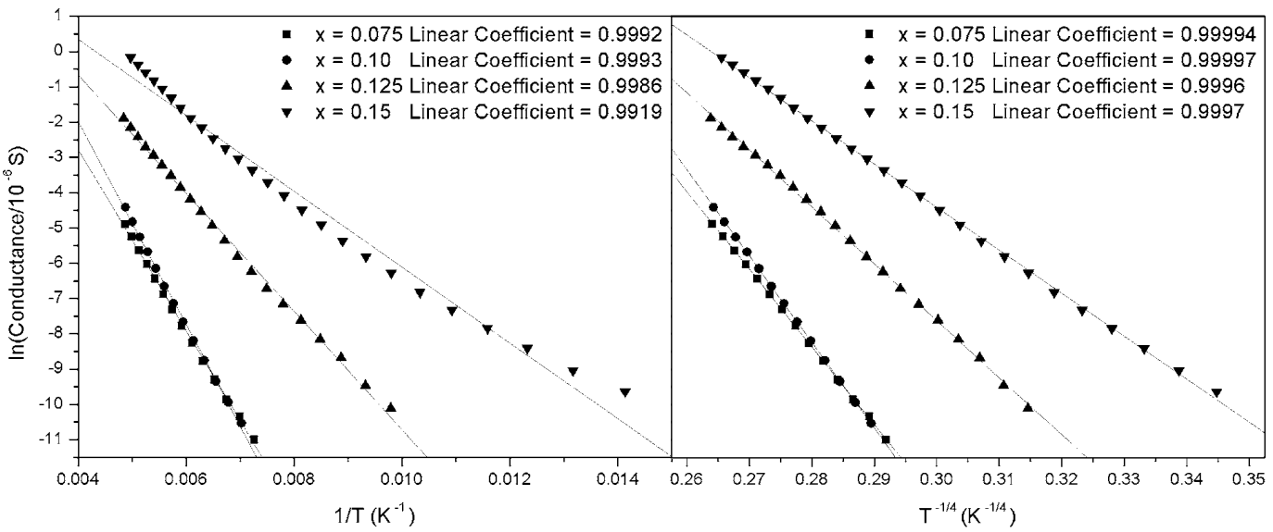
VRH in As-Se-Te-Cu glass
Near room temperature, mixed ionic and extended state conduction
At low temperature, variable range hopping dominates
J. Appl. Phys. 101, 063520 (2007)

Slide 27
Summary
Basics of electrical transport
  Conductivity: scalar sum of ionic and electronic contributions
  Einstein relation
Ionic conductivity
  Occurs through ion hopping between different preferred “sites”
  Thermally activated process and non-Arrhenius behavior

Slide 28
Summary
Electronic structure of amorphous semiconductors
  Anderson localization: extended vs. localized states
  Density of states
  Mobility edge
  Band tail and mid-gap states
Extended state conduction
  Free vs. drift mobility
  Thermally activated process
Localized state conduction
  Fixed vs. variable range hopping
  Mott’s T ^{-1/4} law of VRH
E
Conduction band
Urbach tail
Mid-gap states
Mobility edge
Valence band
DOS

