Slide 1
MIT 3.022
Microstructural Evolution in Materials
9: Surface Energy
Juejun (JJ) Hu
hujuejun@mit.edu

Slide 2
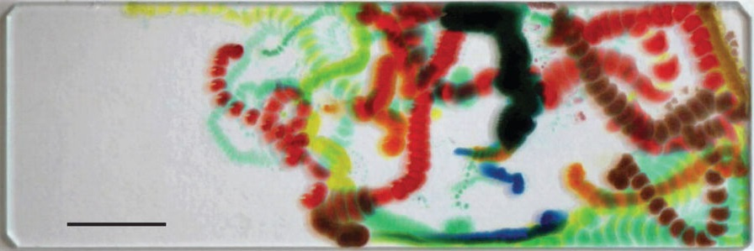
Surface: where exciting new physics continues to surface
The dancing droplets: the magic of surface energy
Cira et al., Nature 519, 446-450 (2015); used with permission

Slide 3
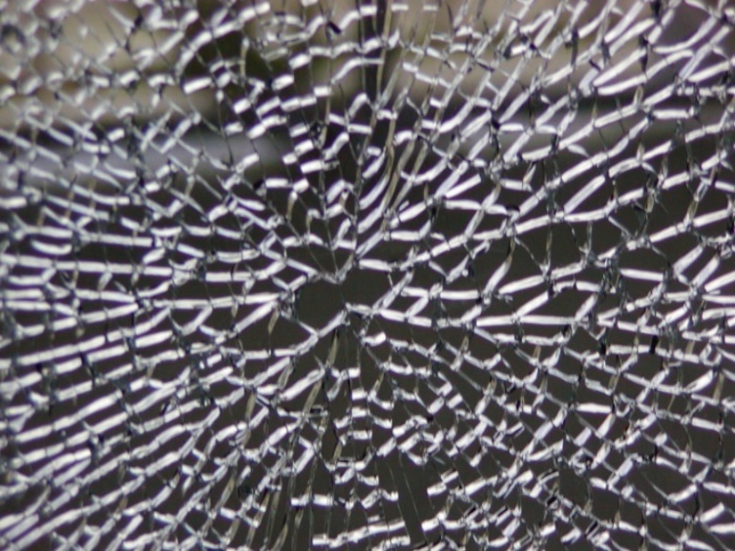
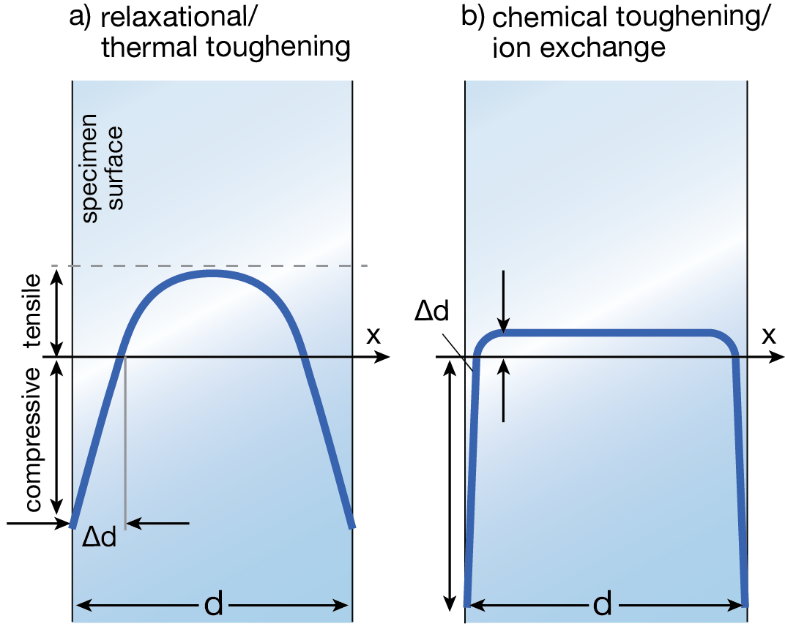
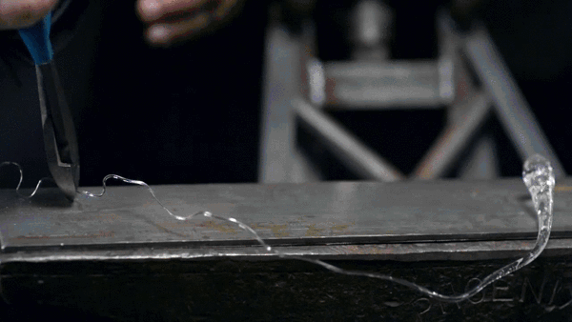
It takes energy to create new surfaces
Why does tempered glass tend to break into small pieces?

Slide 4
Microscopic origin of surface energy
In a system with fixed mole number:
Surface energy results from broken chemical bonds on surface
Γ : number of broken chemical bonds per unit surface area
E_{b} : bond energy
F
F

Slide 5
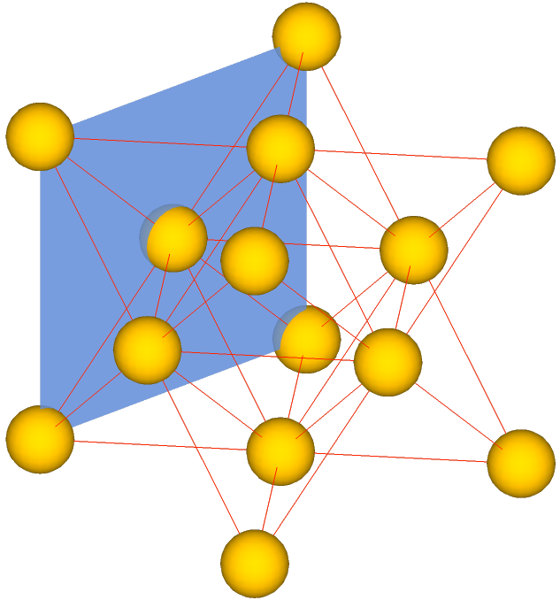
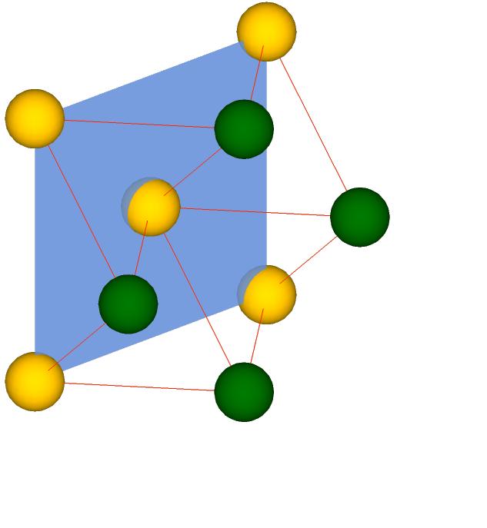
Surface energy and crystal structure: FCC (100)
Lattice constant a
Area of a (100) surface in a unit cell: a²
Number of broken bonds: 4 + 8/2 = 8
Surface energy
(100)

Slide 6
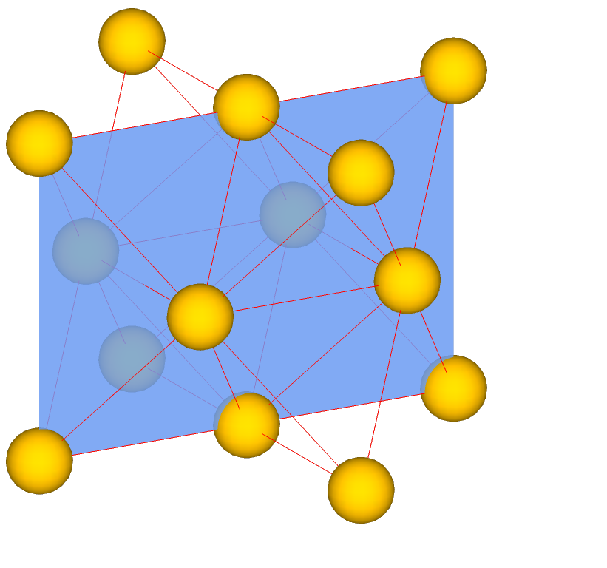
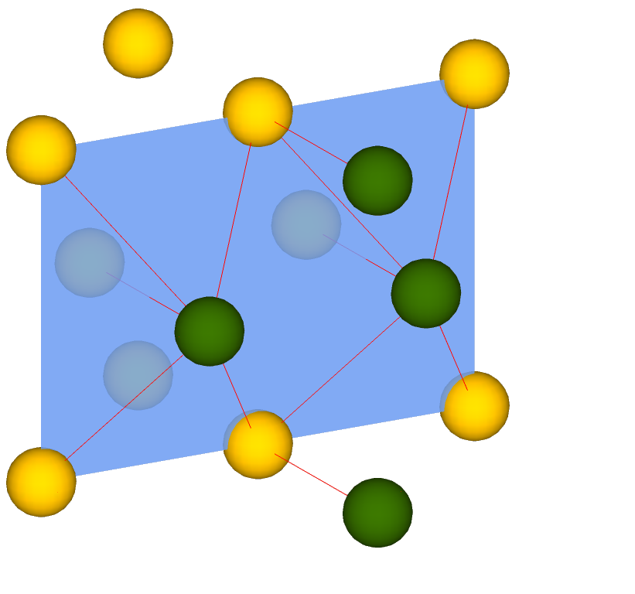
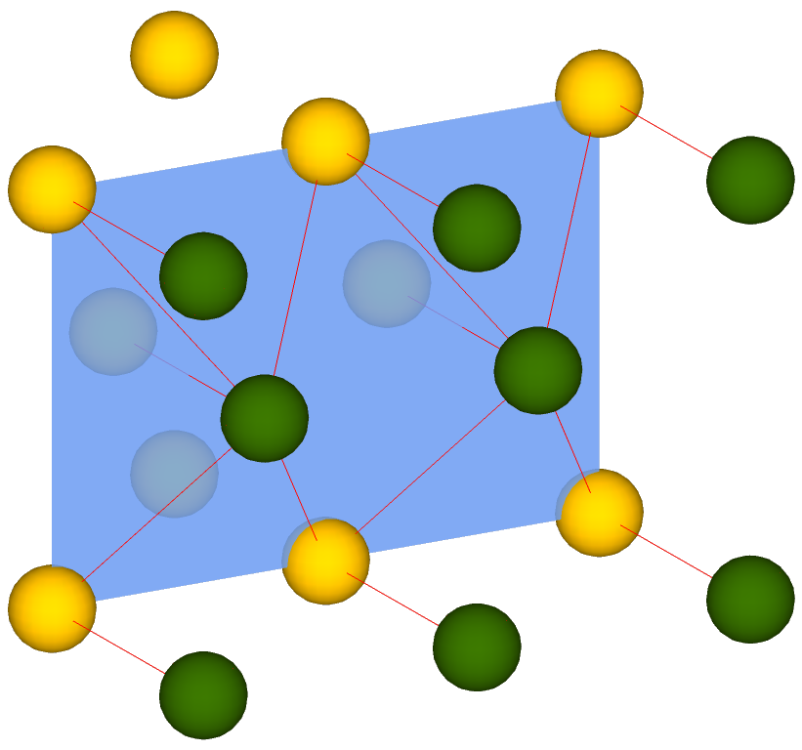

Surface energy and crystal structure: FCC (110)
Area of a (110) surface in a unit cell: $\sqrt{2}$ a²
Number of broken bonds: 10 + 2/2 + 4/4 = 12
Surface energy
(110)
Notes:
The result is different from that on the lecture note

Slide 7
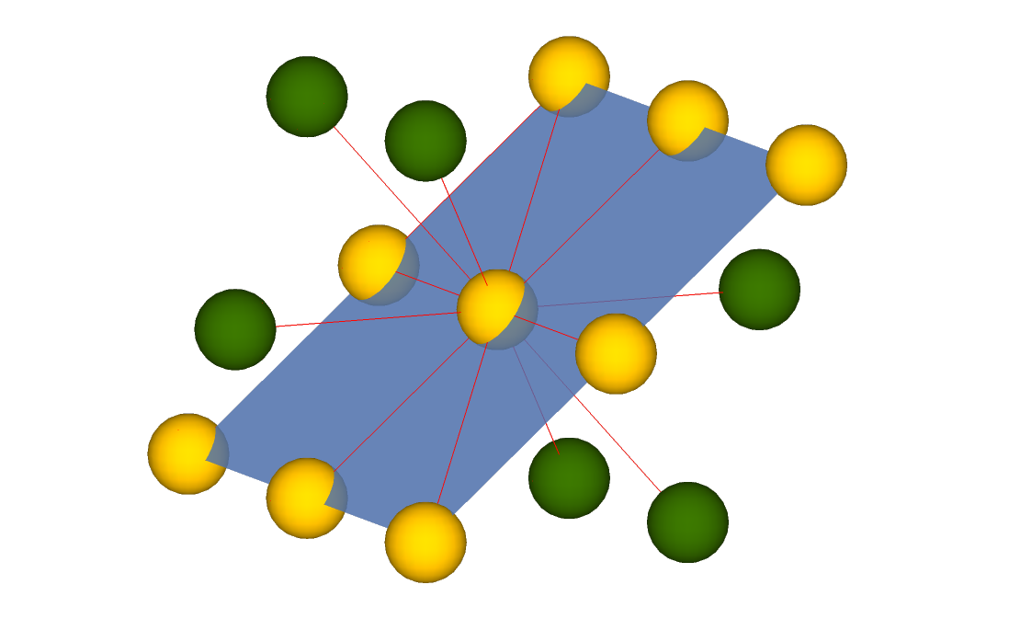
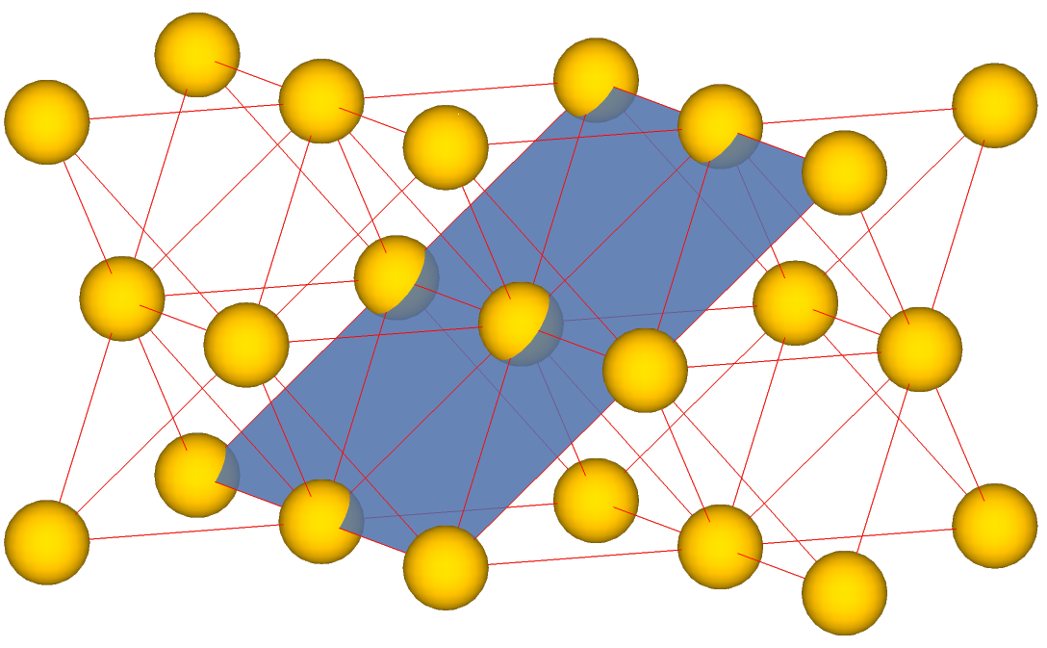

Surface energy and crystal structure: FCC (111)
Area occupied by an atom on (111) surface: $0.25\sqrt{3}$ a²
Number of broken bonds per atom: 3
Surface energy
(111)
Surface energy in FCC crystal: γ (111) < γ (100) < γ (110)

Slide 8
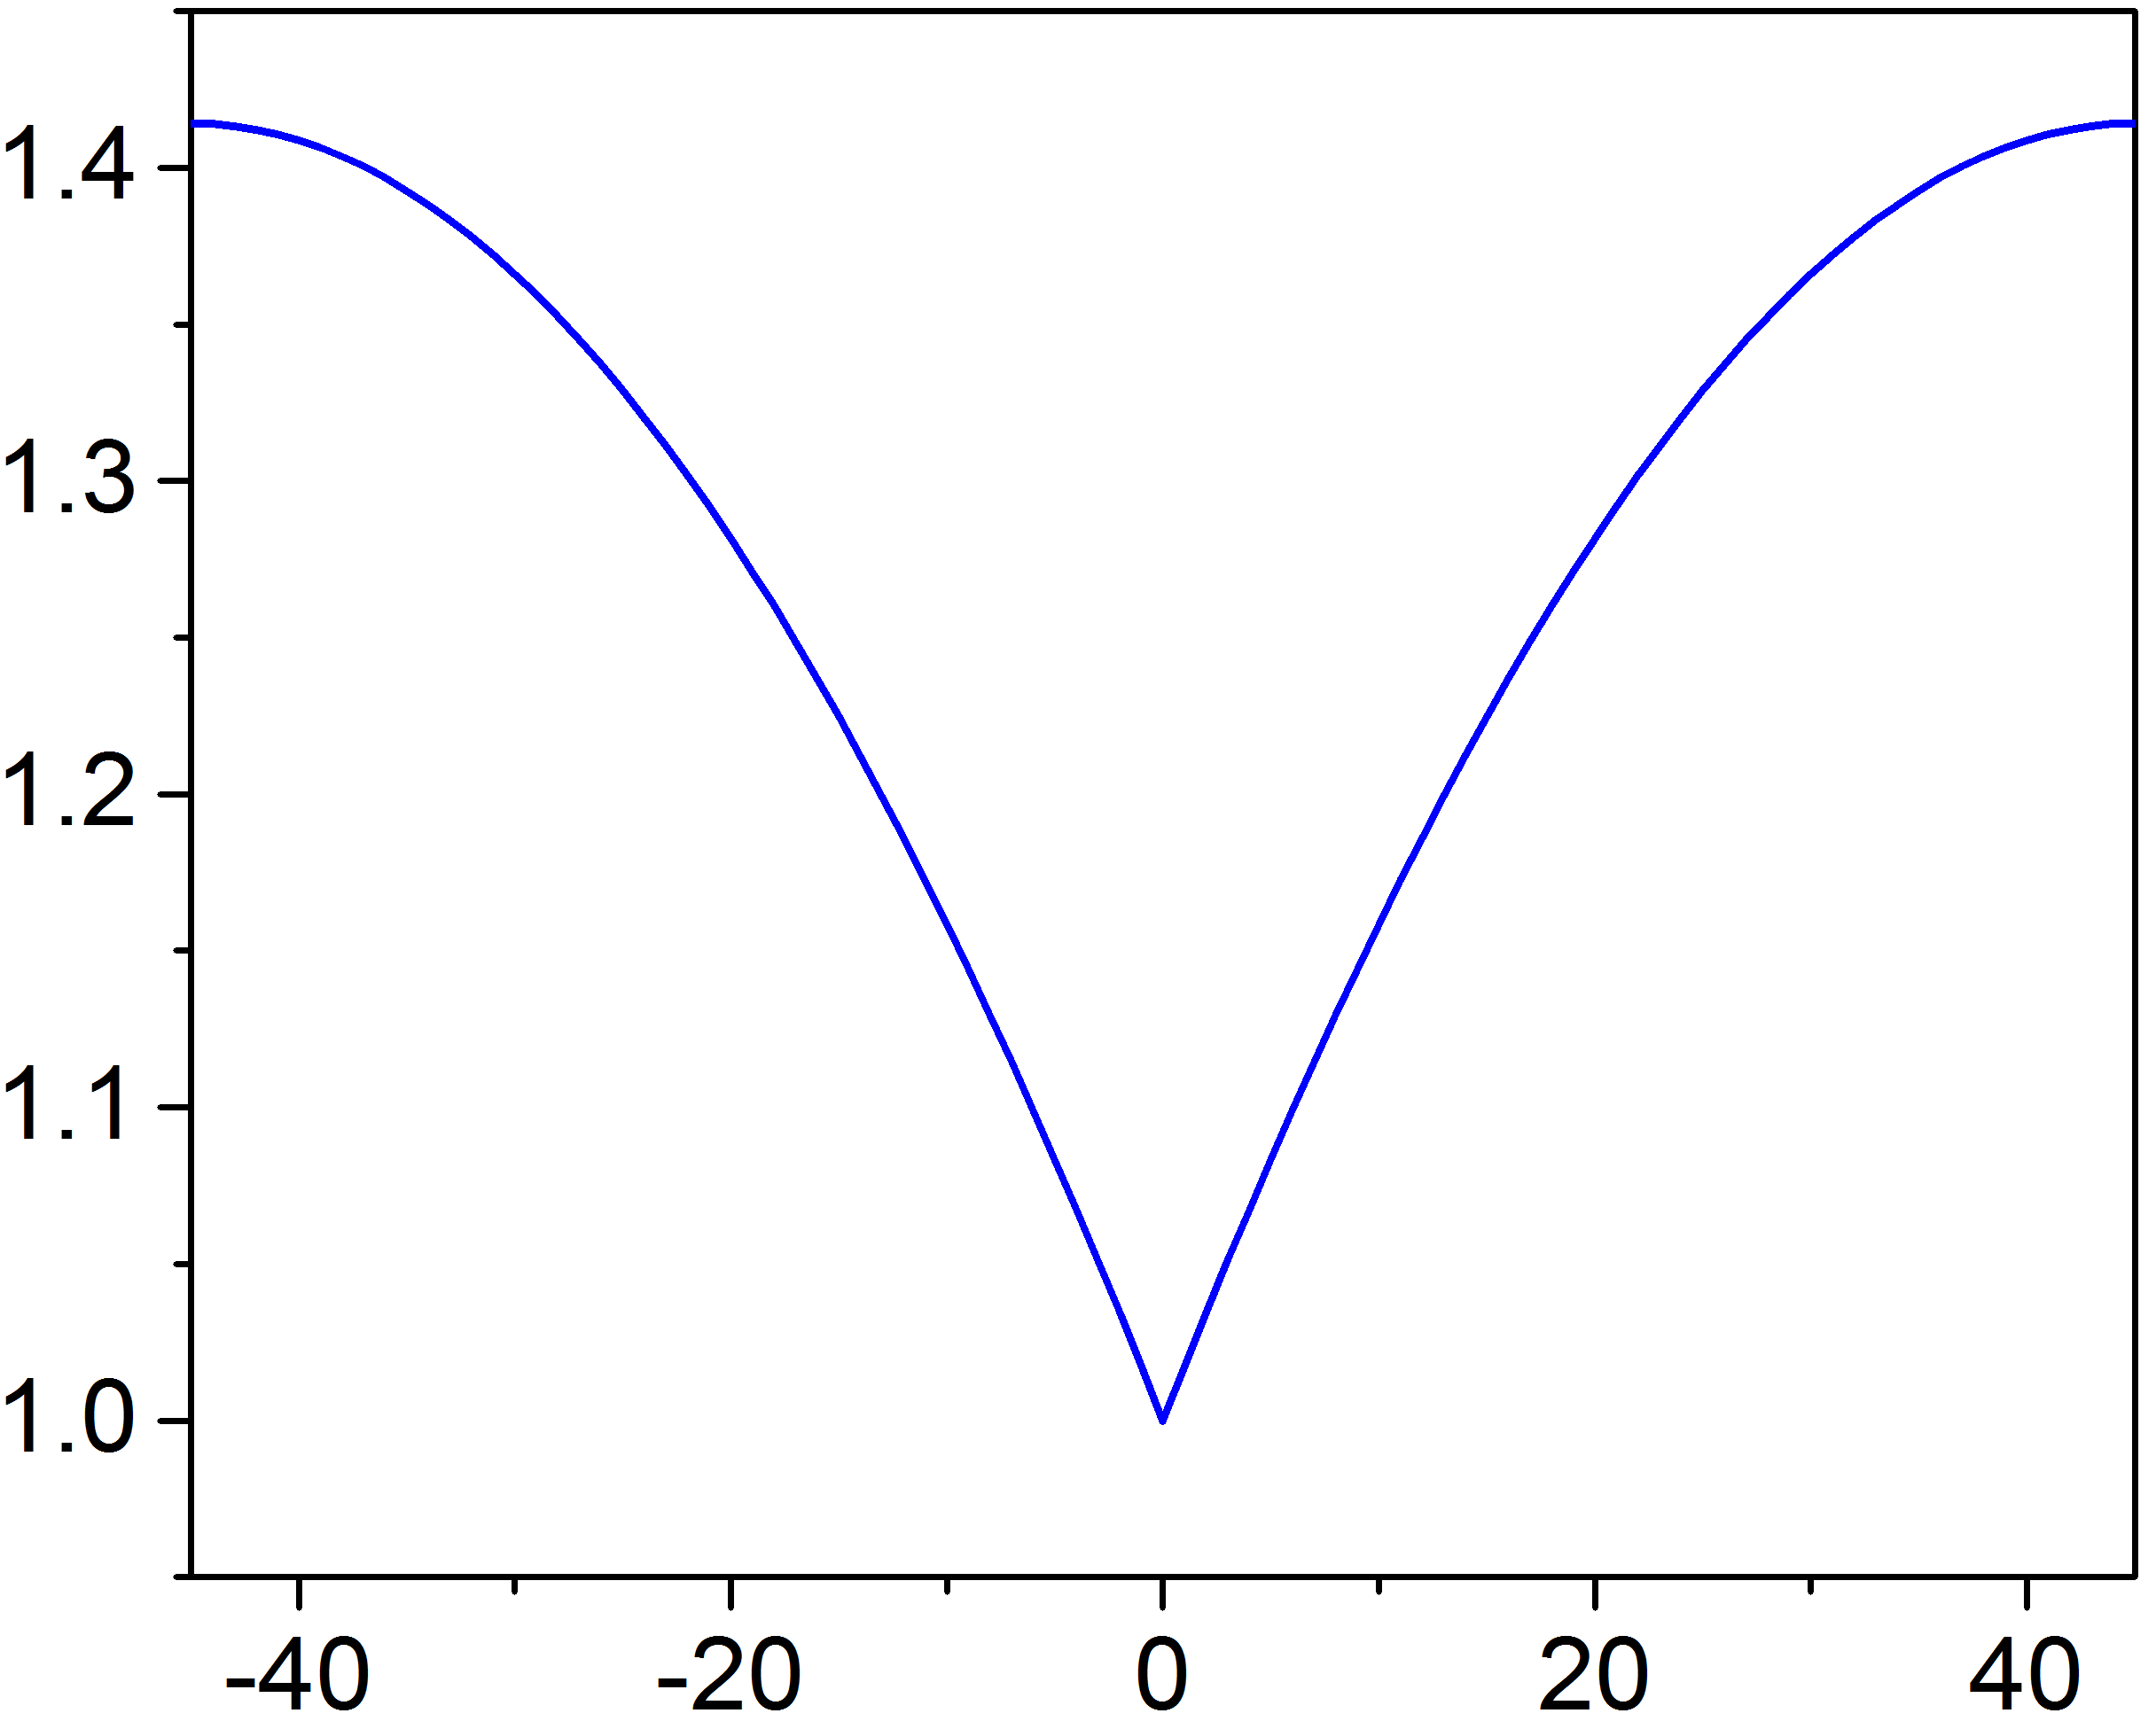
Surface energy of high-index planes
cusp
A
Surface 2: A∙sinθ
θ
Surface 1: A∙cosθ
for simple cubic crystals

Slide 9
Wulff construction: equilibrium shape of crystals
In thermal equilibrium, a single crystal exhibits a shape that minimizes its total surface energy
[100]
[110]
D
A
E
B
F
[010]
O
C
G
Equilibrium crystal shape
Notes:
Zeitschrift für Kristallographie, 34, 449 (1901): DOI: 10.1524/zkri.1901.34.1.449
Phys. Rev. 82, 87 (1951): http://dx.doi.org/10.1103/PhysRev.82.87

Slide 10
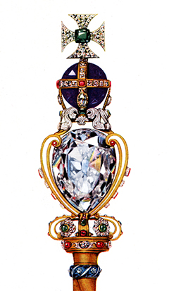
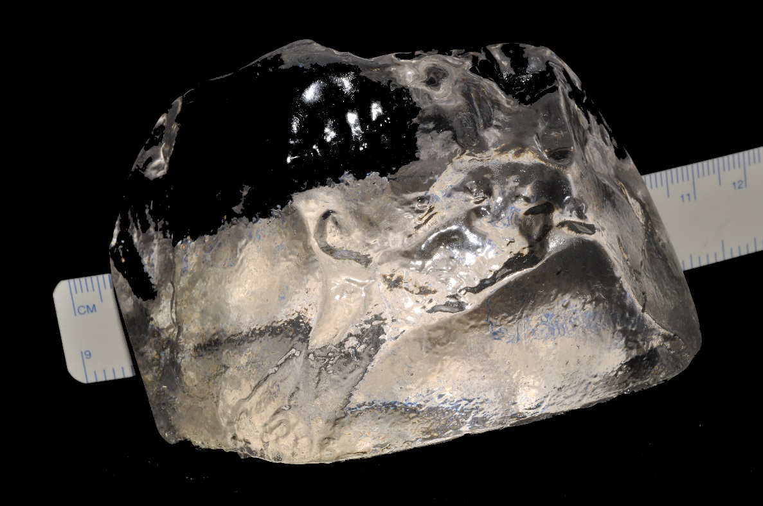
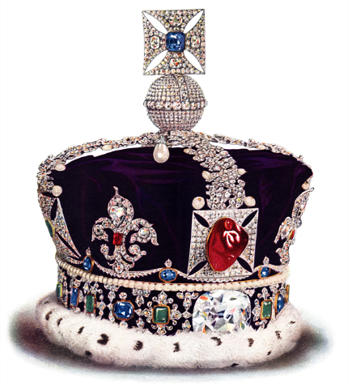
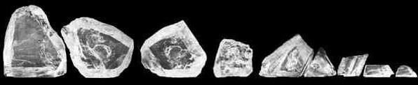
Crystallography and diamond cleavage
Scepter of the British Crown Jewels
Cullinan Diamond
Imperial State Crown
Cleaved pieces from Cullinan Diamond
Images from Wikipedia

Slide 11

Crystallography and diamond cleavage
http://www.langantiques.com/university/index.php/A_History_Of_Diamond_Cutting
Notes:
Finding terraces/ledges on crystalline facets help to identify the cleavage directions

Slide 12
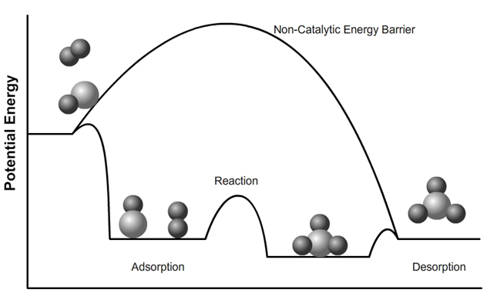
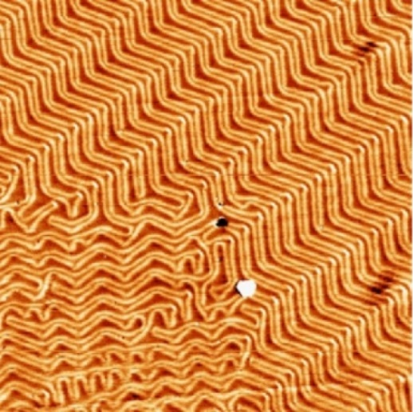
Surface adsorption and reconstruction
Adsorption: adhesion of atoms, ions, or molecules from a gas, liquid, or dissolved solid to a surface
Reconstruction: atoms at the surface of a crystal assume a different structure than that of the bulk
Heterogeneous catalysis
Reconstructed Au (111) surface
Notes:
In glass, the fresh surface energy is 3.5 J/m^2, in contrast to the interfacial surface energy of 0.35 J/m^2 with adsorbed species.
Remember that adsorption and absorption are different. In adsorption a molecule binds to the surface of the material whilst in absorption it is taken in to the body of the material.

Slide 13
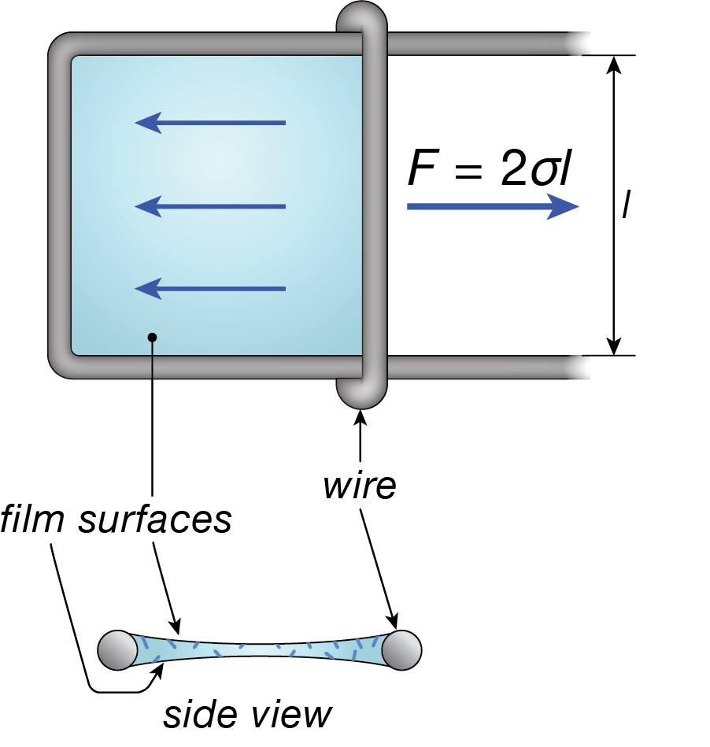
Surface energy = surface tension ?
In a system with fixed mole number:
Surface tension (stress) σ
Surface energy and surface stress are generally not identical in solids
Refer to the link for a rigorous proof of the relation
Surface tension of soap film
l

Slide 14
Surface and chemical potential
In a system with varying number of molecules:
In general, area A is a function of molecule number N:
Chemical potential:
For a spherical particle with radius r :
When r → ∞ :
“bulk” chemical potential

Slide 15
Surface and chemical potential (cont’d)
Vapor pressure is a function of chemical potential:
Vapor pressure of spherical particle with radius r :
Material | γ (mJ/m²) | P / P^{(P)}
 |  | 10 μm | 1 μm | 0.1 μm
Water (298 K) | 72.8 | ~ 1 | 1.01 | 1.11
Hg (298 K) | 480 | 1.01 | 1.06 | 1.77
Cu (1000 K) | 1670 | ~ 1 | 1.03 | 1.33

Slide 16
Surface and chemical potential (cont’d)
Vapor pressure of particles with curved surfaces:
Vapor pressure in a spherical bubble embedded in material:
Vapor pressure of a cubic particle with edge length b :

Slide 17

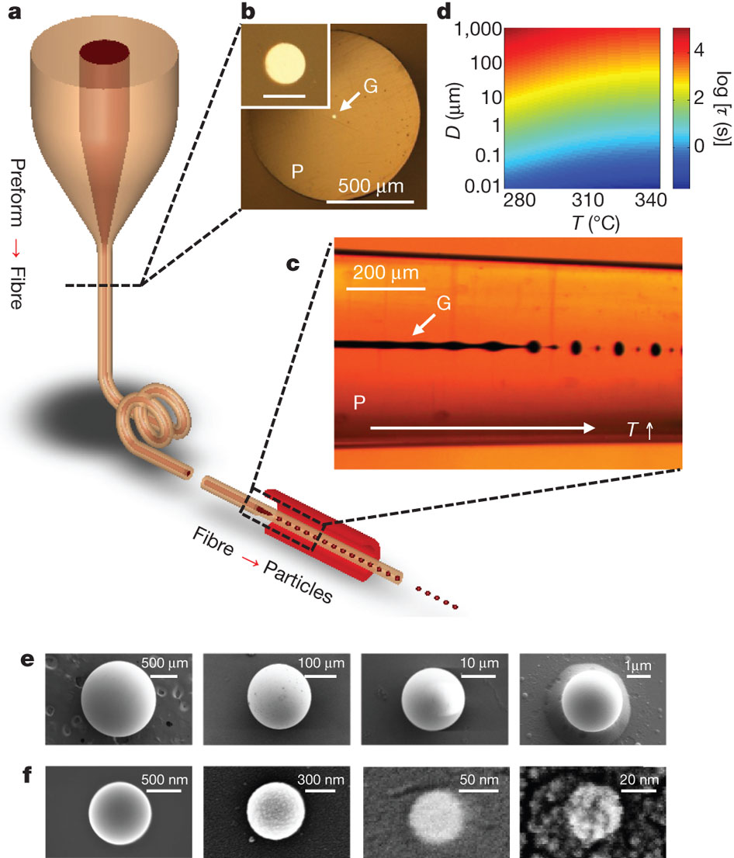
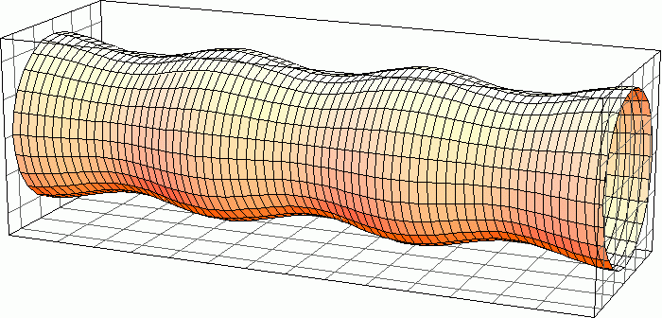
Surface energy driven material processing: nanoparticle synthesis using Rayleigh instability
Rayleigh-Plateau instability
Nature 487, 463 (2012); used with permission

Slide 18
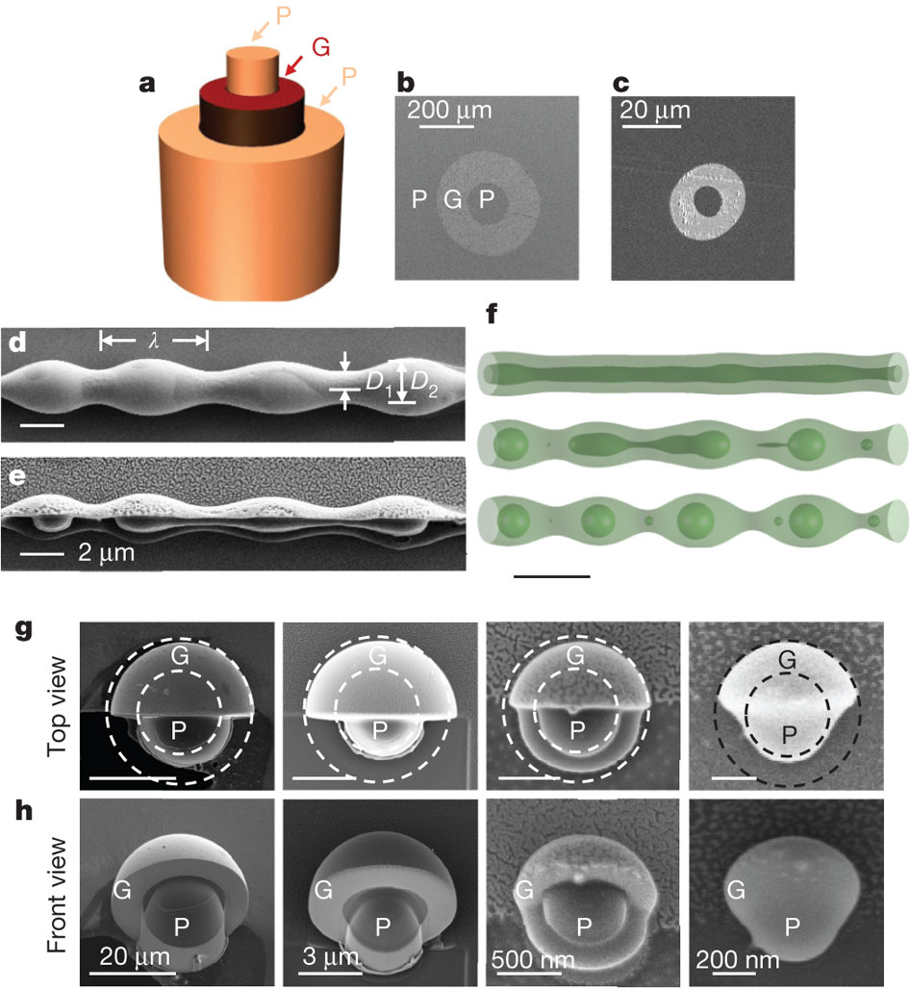
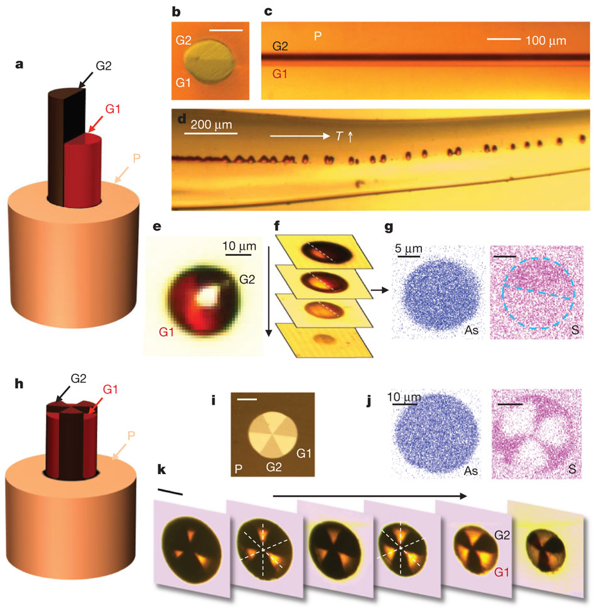
Surface energy driven material processing: nanoparticle synthesis using Rayleigh instability
Kaufman et al., Nature 487, 463 (2012); used with permission

Slide 19
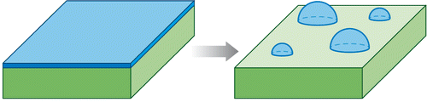
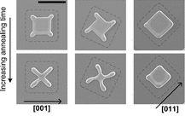
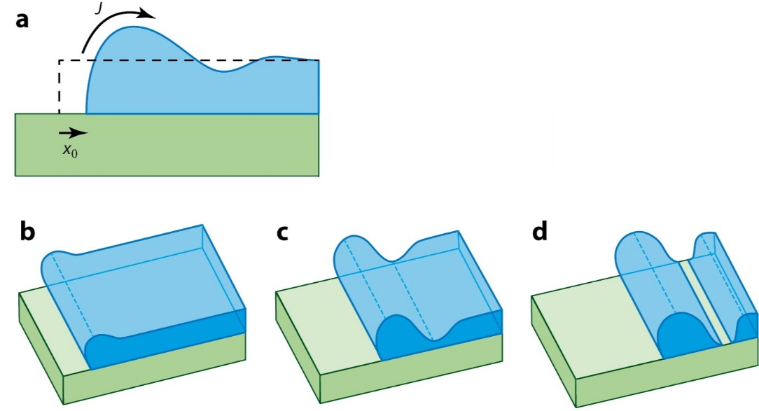
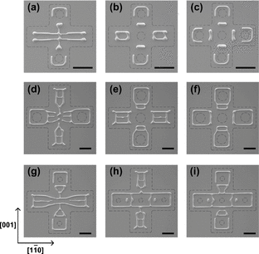
Surface energy driven material processing: nanoscale patterning based on templated dewetting
Solid-state dewetting of thin films
Curvature-induced diffusion and pattern edge retraction
C. Thompson, Annu. Rev. Mater. Res. 42, 399 (2012)

Slide 20
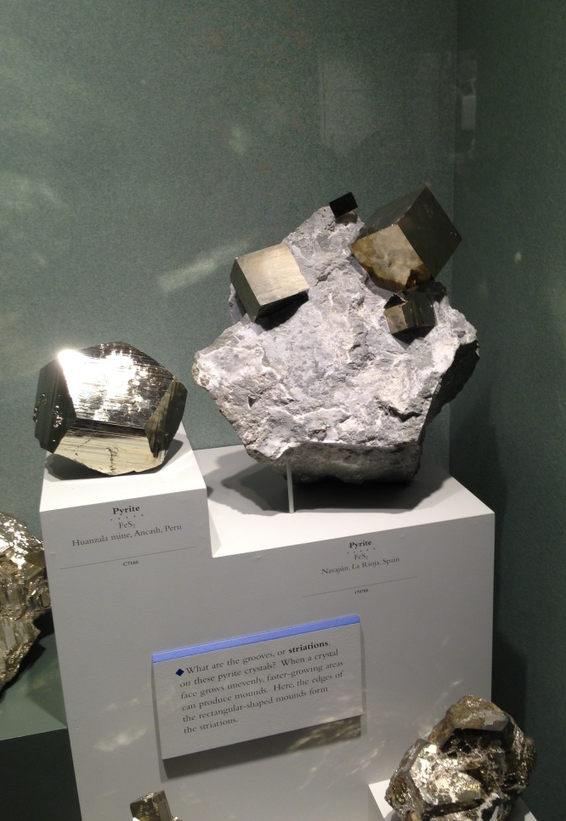
Summary
Broken bond model of surface energy
  Anisotropy of surface energy in crystals
  Wulff-Herring plot and equilibrium shape of crystals
  Reconstruction & adsorption
Surface energy ≠ surface tension
Chemical potential of small particles
  Vapor pressure dependence on particle size
Surface energy driven transport for nanomaterial processing
Pyrite (FeS₂) crystal
Simple cubic structure
© Juejun Hu
Smithsonian National Museum of Natural History

Slide 21
List of symbols
G – Gibbs free energy
S – entropy
T – temperature
V – volume
P – pressure or vapor pressure (slide 15)
dG_{surf} – Gibbs free energy change associated with surface energy
γ – surface energy
A – surface area
Γ – number of broken bonds per unit surface area

Slide 22
List of symbols
E_{b} – bond energy
a – lattice constant
θ – angle of surface with respect to a low-index plane
σ – surface tension (stress)
μ – chemical potential of a system with surface energy contribution
N – number of molecules
μ ^{(P)} – chemical potential without the surface energy contribution, i.e. chemical potential of a bulk system with a very small surface/volume ratio

Slide 23
List of symbols
r – radius of a spherical particle
C₀ – number concentration of molecules
ρ – density
M – molar mass
N_{A} – Avogadro constant
k – Boltzmann constant (1.38 × 10⁻²³ m² kg s⁻² K⁻¹)
P ^{(P)} – vapor pressure of a very large (“bulk”) particle where surface energy contribution is negligible
r₁ / r₂ – radii of curvature of a surface
b – edge length of a cubic particle

