Slide 1
MIT 3.022
Microstructural Evolution in Materials
8: Ionic Conductivity
Juejun (JJ) Hu
hujuejun@mit.edu

Slide 2

Electrically conductive glass?

Slide 3
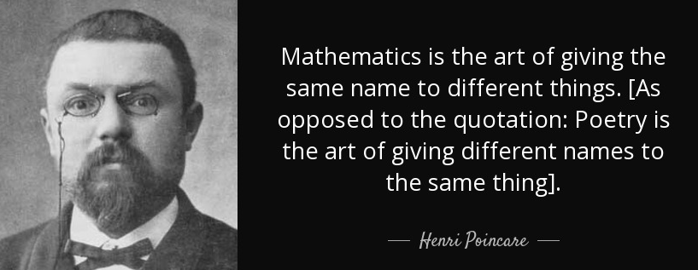
Chemical potential and electrochemical potential
Chemical potential: Gibbs free energy associated with one single particle in the absence of electric field
Electrochemical potential
Ideal solution:
And this thing is called “electrochemical potential”…
This is called “chemical potential” or “Fermi level” in 3.024!
Electrostatic potential energy

Slide 4
Thermodynamic driving force for diffusion
Average velocity of a diffusing species A
Thermodynamic driving force
For an ideal solution of A
Einstein relation

Slide 5
Driving force for ion migration
Flux of ion migration
Diffusion: net motion of ions driven by concentration (chemical potential) gradient
Drift: directional motion of ions driven by electric field (electrical conduction)
Diffusion term
Drift term

Slide 6
Ionic conductivity
Current density carried by drifting ions:
Total conductivity:
In the lecture notes:
Faraday constant
Notes:
The concentration in the lecture note is defined as mole per unit volume; and mobility has a unit of mole*m/N/s

Slide 7
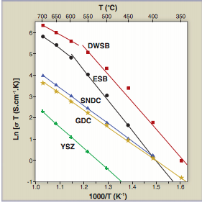
Temperature dependence of ionic conductivity
Intrinsic crystal:
Doped crystal:
Ionic conductivity of various solid electrolytes

Slide 8
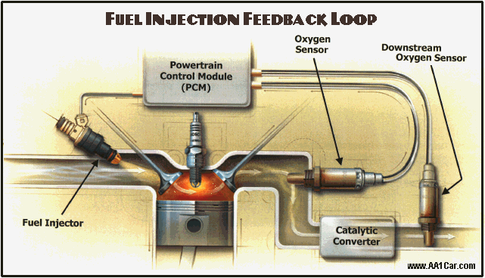
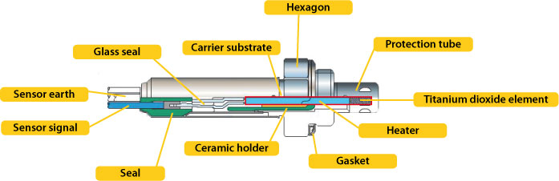
What do a 2012 Volkswagen Diesel Sedan and a TiO₂ crystal in equilibrium have in common?
They are both defective
© AA1Car.com
Resistive TiO₂ exhaust gas oxygen sensor
https://www.ngk.de
http://www.aa1car.com/library/o2sensor.htm
© NGK Spark Plug Europe

Slide 9
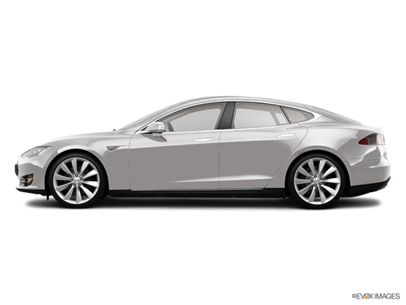


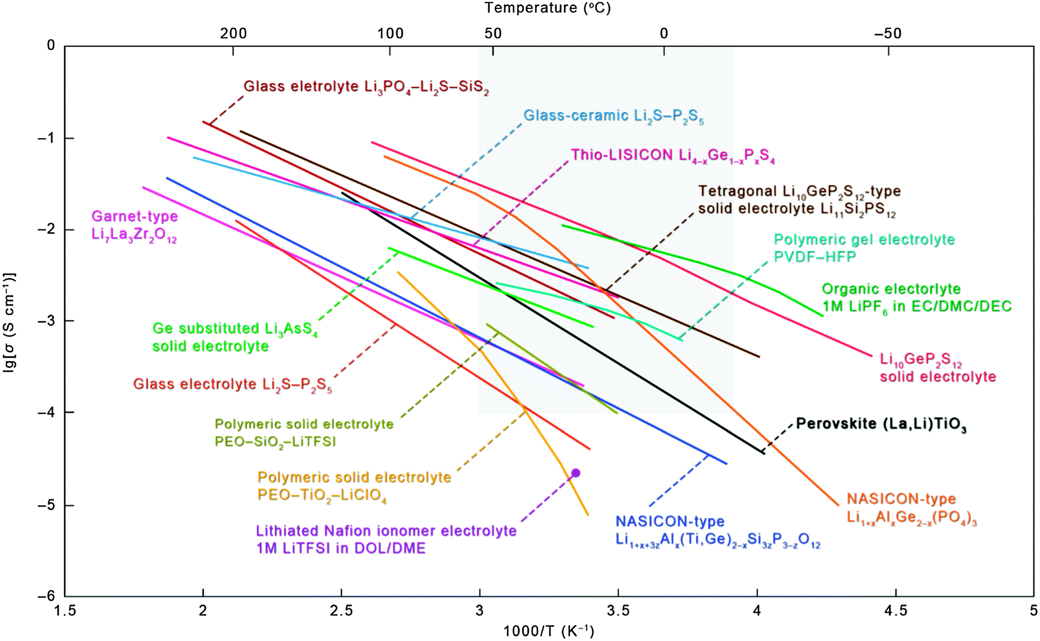
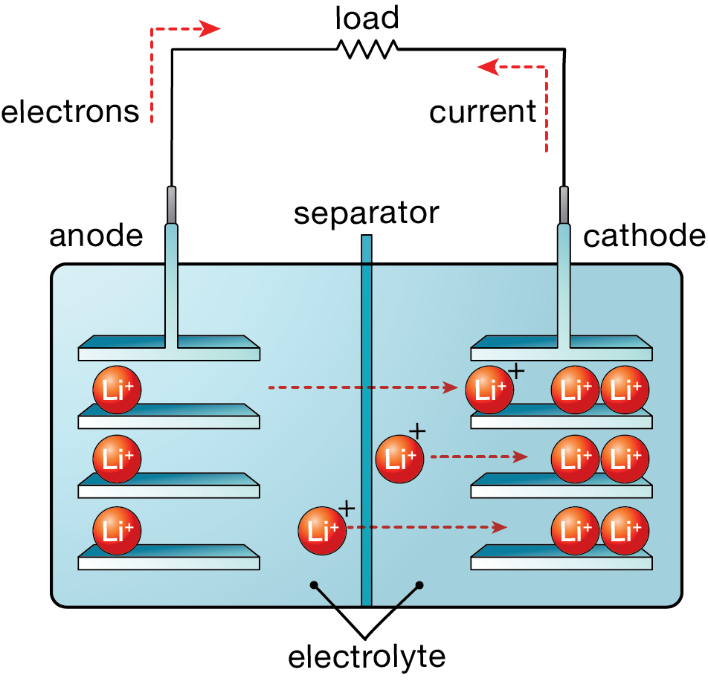
Solid electrolytes
01/01/2016, Norway
Chem. Soc. Rev. 44, 7968 (2015); used with permission from the Royal Society of Chemistry

Slide 10
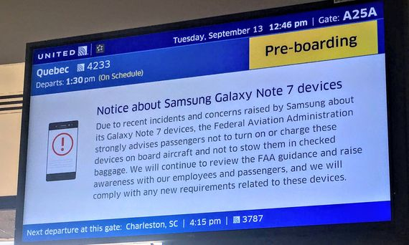

Solid electrolytes
Chem. Soc. Rev. 44, 7968 (2015); used with permission from the Royal Society of Chemistry

Slide 11
List of symbols
T – temperature
k – Boltzmann constant (1.38 × 10⁻²³ m² kg s⁻² K⁻¹)
μ_{A} – chemical potential of species A
μ_{A,0} – chemical potential of species A at a standard reference state
x_{A} – atomic fraction of species A in a solution
– electrochemical potential of species A
Z_{A} / Z_{i} – charge number of species A / i
e – elementary charge (1.602 × 10⁻¹⁹ C)
φ – electric potential

Slide 12
List of symbols
v_{A} – velocity of species A
M_{A} / M_{i} / M_{e} – mobility of species A / i / electron
F_{A} – driving force acting on species A
C_{A} / C_{i} – number concentration of species A / i
D_{A} – diffusion coefficient of species A
J_{A} – flux of species A
x – coordinate along the x-axis
E – electric field
I_{A} – electric current density carried by species A
σ – electric conductivity

Slide 13
List of symbols
σ_{A} / σ_{i} – electric conductivity contributed by species A / i
F – Faraday constant (96485.33 s A / mol)
E_{ID} – activation energy of ionic conductivity
E_{a} – activation energy of ionic diffusion
σ₀ – electrical conductivity at a standard reference state
ΔG_{f} – Gibbs free energy change due to formation of an ionic defect (that contributes to ionic conductivity) minus the configurational entropy contribution
n – free electron concentration

