Slide 1
MIT 3.022
Microstructural Evolution in Materials
7: Ionic Defects
Juejun (JJ) Hu
hujuejun@mit.edu

Slide 2
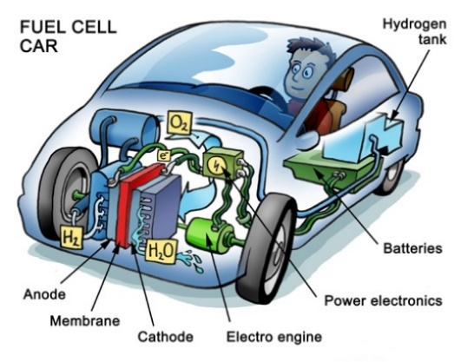
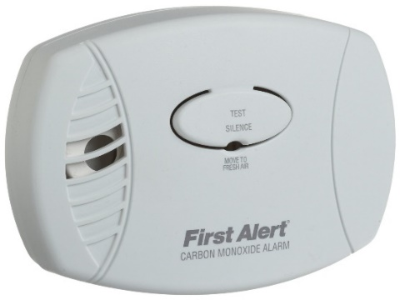
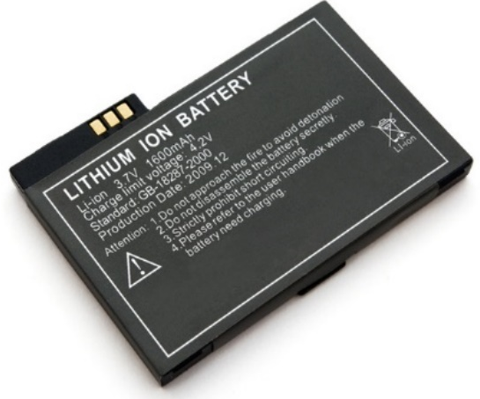
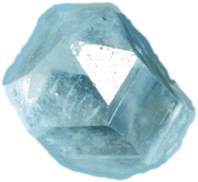
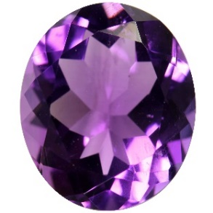
Gas sensor
Fuel cell
Defects are not always bad
© safety.com
By Peter Welleman
© Consumer Reports
© Butterfield Jewlers
Solid state battery
The Midas touch
Notes:
Turning quartz into amethyst using gamma radiation: http://hyperphysics.phy-astr.gsu.edu/hbase/minerals/amethyst.html

Slide 3
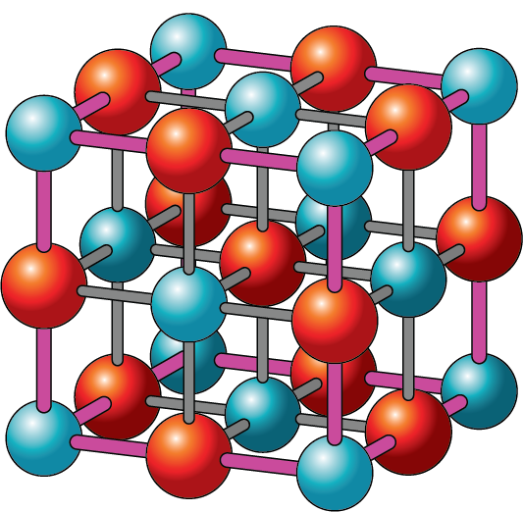
Charge neutrality
Site ratio conservation
Macroscopic electroneutrality
Consider a sphere made of sodium with radius R = 1 cm. What is the energy needed to remove 0.01% of valence electrons from the sphere?
The ratio of the number of regular cation sites to the number of regular anion sites remains constant
MgO crystal
# _{Mg} = # _{O}

Slide 4
Ionic defect types
Schottky defect (vacancy)
A
C
Frenkel defect (self-interstitial)
Substitutional atom
B
Foreign interstitial
D

Slide 5
Kroger-Vink notation
General form:
M – atom type; “V ” denotes vacancy
L – site in the original perfect lattice; “i ” denotes interstitial
C – effective charge (or relative charge), equaling to the difference in valence between the species on the site L and the atom that occupies the site in a perfect crystal
  Positive effective charge
  Negative effective charge
  Neutral defect
Quasi-free electron is denoted by ; hole is denoted by
Square brackets denotes defect fraction, e.g.

Slide 6
Examples of Kroger-Vink notation
Frenkel defect
Schottky defect
Substitutional atom
Foreign interstitial

Slide 7
Concentration of Frenkel defects
Configurational entropy
Gibbs free energy
Equilibrium fraction of Frenkel defects
Assume that there is one interstitial per lattice site
Dislodge n atoms from their sites
Place the atoms into n interstitials

Slide 8
Equilibrium constant of defect reactions
Frenkel defect formation
General defect reactions
e.g.
ΔG_{f} : Gibbs free energy of defect formation minus the configurational entropy term

Slide 9
Charge compensation in ionic solids
List all possible defect reactions when TiO₂ is doped into Al₂O₃ and determine the defect concentrations
List all charged species
List defect reactions based on charge compensation pairs
Native vacancies:
Foreign substitutional atom:
Interstitials:
Schottky defect
Notes:
Anions (except F) usually don’t form interstitials due to their large size

Slide 10
Charge compensation in ionic solids (cont’d)
List defect reactions based on charge compensation pairs
Frenkel defect
Foreign substitution
Foreign interstitial

Slide 11
Charge compensation in ionic solids (cont’d)
Combine all equations along with the overall charge neutrality condition to solve defect concentrations
5 equations, 5 unknown variables: a unique solution set
Question: is mass conservation taken into account?
Notes:
Mass conservation is taken into account through the equilibrium constants. In this example, K3 and K4 implicitly imply the amount of TiO2 added into the system.

Slide 12
Charge compensation in non-stoichiometric solids
List all possible defect reactions in non-stoichiometric TiO₂ and determine the defect concentrations
List all charged species
Native vacancies:
Electrons and holes:
List defect reactions based on charge compensation pairs
(1)
(2)
(3)
(4)
Not all reactions are independent: (4) = (1) + 4 × (2) – (3)

Slide 13
Charge compensation in non-stoichiometric solids
Combine all equations along with the overall charge neutrality condition to solve defect concentrations
Non-degenerate semiconductors
The defect concentration depends on oxygen partial pressure

Slide 14
Defect concentration: examples
Schottky defect
Frenkel defect
Electron-hole pair
ΔH (eV)
MgO | 6.6
CaO | 6.1
LiF | 2.34
LiCl | 2.12
LiBr | 1.8
LiI | 1.3
ΔH (eV)
CaF₂ | 2.8
SrF₂ | 2.3
BaF₂ | 1.9
AgCl | 1.6
AgBr | 1.2
β-AgI | 0.7
E_{g} (eV)
Si | 1.11
Ge | 0.67
MgO | 7.8
CaO | 7.1
ZnO | 3.2
α-TiO₂ | 3.0
For MgO at 1,000K:
Notes:
Data source: http://www.tf.uni-kiel.de/matwis/amat/def_en/index.html
The dominant interstitial atom type in Frenkel defects is labeled with red color
At room temperature, the entropy of defect formation has much smaller contribution to Gibbs free energy than that of enthalpy

Slide 15
Defect concentration: examples
Schottky defect
Frenkel defect
Electron-hole pair
ΔH (eV)
MgO | 6.6
CaO | 6.1
LiF | 2.34
LiCl | 2.12
LiBr | 1.8
LiI | 1.3
ΔH (eV)
CaF₂ | 2.8
SrF₂ | 2.3
BaF₂ | 1.9
AgCl | 1.6
AgBr | 1.2
β-AgI | 0.7
E_{g} (eV)
Si | 1.11
Ge | 0.67
MgO | 7.8
CaO | 7.1
ZnO | 3.2
α-TiO₂ | 3.0
For MgO at 1,000K:

Slide 16
The Brouwer approximation
One charged defect of each sign dominates over all others
Example: charge compensation in undoped MgO
  Regime 1:
  Regime 2:
  Regime 3:
  Regime 4:
High oxygen partial pressure
Low oxygen partial pressure
Schottky compensation
Electronic compensation
Solve the charge carrier concentrations in each regime at one specific temperature

Slide 17
The Brouwer approximation (cont’d)
Equilibrium constants
High oxygen partial pressure regime:

Slide 18
The Brouwer approximation (cont’d)
Low oxygen partial pressure regime:
Schottky compensation regime (intermediate oxygen partial pressure):
Notes:
In the intermediate regime, the charge neutrality condition does not necessarily mean n = p

Slide 19
log (defect concentration)
Notes:
Charge neutrality and the Brouwer approximation do not hold near the boundaries between regimes: the exact solutions do not exhibit the kinks

Slide 20
Brouwer diagram for doped crystals
Example: Al-doped stoichiometric MgO
  Neglect electronic carriers
  The primary defect in intrinsic MgO is Schottky defect
  Al-substitution of Mg dominates over interstitial formation
Charge compensation regimes (dependent on Al concentration)
  Regime 1 (intrinsic):
  Regime 2 (extrinsic):
(1)
(2)

Slide 21
log (defect concentration)
Intrinsic
Extrinsic

Slide 22
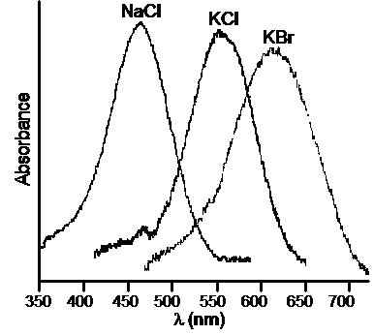
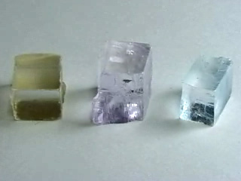
You can “see” ionic defects: F-centers
F-centers in NaCl crystal: electron trapped at an anion (halide) vacancy
Na
Cl
NaCl
KCl
KBr
http://education.mrsec.wisc.edu/background/F_center
Notes:
Top right: Figure 6.16, page 180, Materials Science Companion for Teaching General Chemistry Publisher: American Chemical Society
Bottom right: http://education.mrsec.wisc.edu/background/F_center/

Slide 23
Q & A about γ-ray irradiated table salt
Is it still edible?
  Yes. First of all, I tried it. Tastes just like regular table salt.
  Secondly, irradiated salt only contains a small fraction of vacancy defects [in the order of 10¹⁷ cm⁻³ according to J. Appl. Phys. 31, 1688 (1960)]. Since the crystal will ionize when dissolved, these point defects don’t make a difference.
  Lastly, γ-radiation normally does not trigger nuclear reactions [Nelson et al. “Gamma-Ray Interactions with Matter”], so we don’t need to worry about induced radioactivity.
Okay, it is fun – but why do we need to care?
  Table salt and doped salt are useful materials for radiation dosimetry. See for example: Radiat. Meas. 46, 1856 (2011).

Slide 24
Understanding defect reactions
Site ratio conservation
Charge neutrality
Equilibrium constant
Kroger-Vink notation
Frenkel & Schottky concentrations
Doping & non-stoichiometric defects
Defect concentration
Brouwer approximation
Brouwer diagram

Slide 25
List of symbols
Q – electric charge
C – capacitance (note the difference with C, Coulomb, unit of electric charge)
ε₀ – vacuum permittivity (8.85 × 10⁻¹² F/m)
e – elementary charge (1.602 × 10⁻¹⁹ C)
E – energy
T – temperature
k – Boltzmann constant (1.38 × 10⁻²³ m² kg s⁻² K⁻¹)
n – number of point defects in a solid (slide 7) or free electron concentration (in the discussion of defect equilibrium)

Slide 26
List of symbols
ΔS_{c} – configurational entropy change due to formation of a point defect
x_{f} – fractional of lattice sites populated with Frenkel defects
ΔG_{f} – Gibbs free energy change due to formation of a Frenkel defect minus the configurational entropy contribution
K – equilibrium constant of a defect reaction
p – hole concentration
N_{C} / N_{V} – effective density of states of conduction / valence band

Slide 27
List of symbols
E_{g} – band gap energy
N – number of atoms in a solid

