Slide 1
MIT 3.022
Microstructural Evolution in Materials
5: Diffusion
Juejun (JJ) Hu
hujuejun@mit.edu

Slide 2
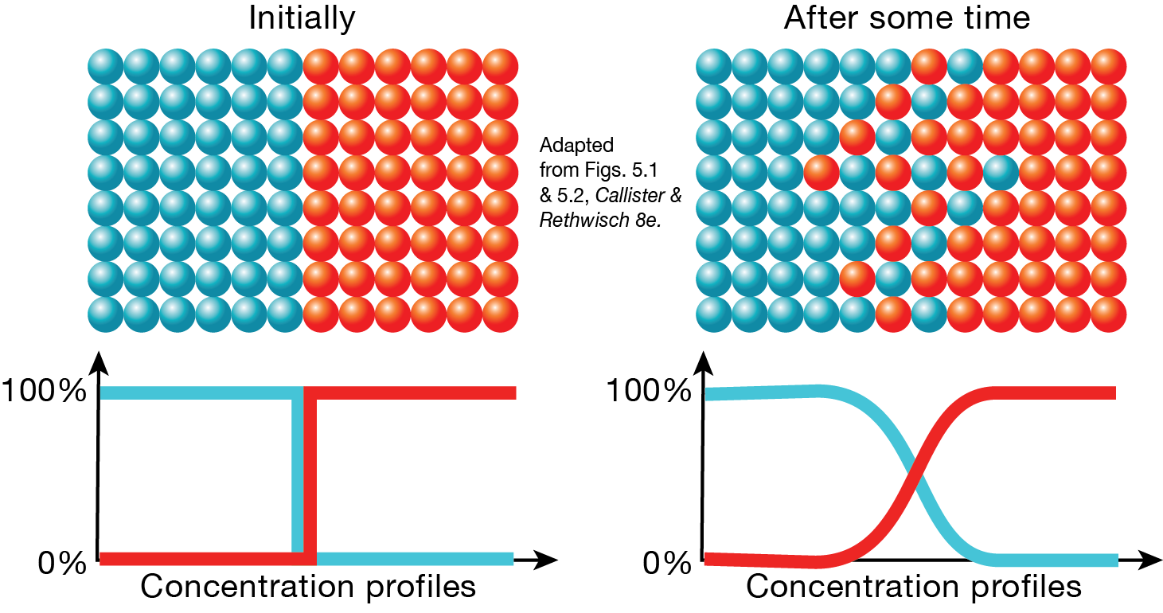
(Inter)diffusion
“Diffusion is the net movement of molecules or atoms from a region of high concentration (or high chemical potential) to a region of low concentration (or low chemical potential) as a result of random motion of the molecules or atoms.” – Wikipedia (after my edits ☺)

Slide 3
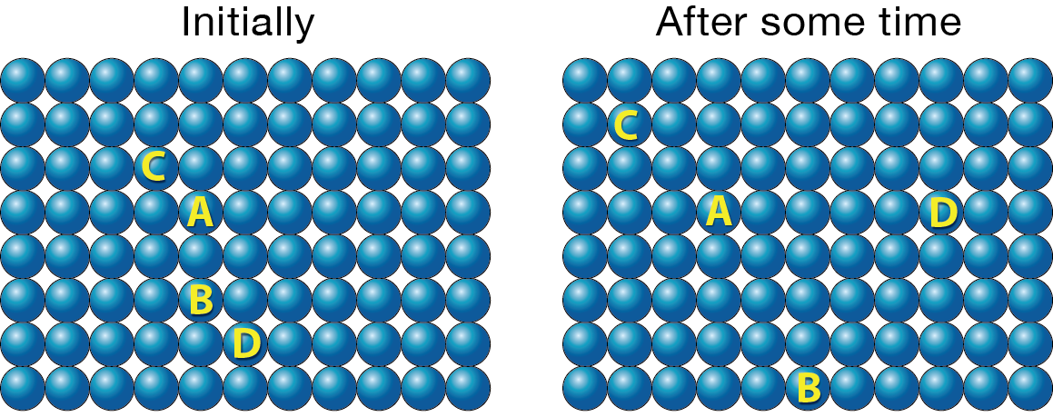
Self-diffusion
Migration of atoms in the absence of concentration gradient
Can be characterized using radioactive tracing

Slide 4
Microscopic diffusion mechanisms
Vacancy mechanism
(Substitutional self-diffusion)
Interstitial mechanism

Slide 5
Microscopic diffusion mechanisms
Vacancy mechanism
(Substitutional interdiffusion)
Interstitial mechanism

Slide 6
Interstitial diffusion
Atom vibration frequency:
Frequency of successful hops:
Energy
harmonic potential
Notes:
The probability of an harmonic oscillator having energy greater than E_a is given by summing up the occupation probabilities over all levels with higher energy, which gives exp(-E_a/kT)

Slide 7
Interstitial diffusion
Number of atoms hopped from plane 1 to 2 per unit time and per unit area:
Similarly, the flux from 2 to 1 is:
The net diffusion flux is:
Fick’s 1st law
Diffusivity (unit: m²/s)
1
2
Notes:
While the model here assumes a simple cubic structure, it applies to octahedral interstitial diffusion in FCC as well

Slide 8
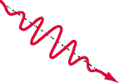
Interstitial diffusion
Atom vibration frequency:
Frequency of successful hops:
Typical value estimation:
Energy
harmonic potential
hν
Photon
at room temperature
at 1,000 °C

Slide 9
Interstitials in FCC crystals
Number of octahedral interstitial sites per unit cell: 4

Slide 10
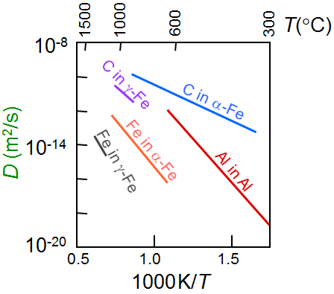
Interstitials in FCC crystals
Spacing between octahedral sites:
at 1,000 °C
a
Data from E.A. Brandes and G.B. Brook (Ed.) Smithells Metals Reference Book, 7th ed., 1992.
Notes:
C in gamma-iron is an example of octahedral interstitial diffusion

Slide 11
Deriving Fick’s 2nd law from Fick’s 1st law
1-d case: a rod with a constant cross-section area A
  Concentration of the diffusing atom: C(x, t)
  Diffusion flux:
x
A
C(x, t)

Slide 12
Deriving Fick’s 2nd law from Fick’s 1st law
Divide the rod into many small (virtual) sections dx
Diffusion flux at the junctions between sections:
Flux entering the section dx
Flux exiting the section dx
A
x
x + dx

Slide 13
Deriving Fick’s 2nd law from Fick’s 1st law
Net change of the amount of diffusant in the section over a period of dt :
Amount of diffusant entering the section dx
Amount of diffusant exiting the section dx
x
x + dx

Slide 14
Deriving Fick’s 2nd law from Fick’s 1st law
Net change of the amount of diffusant in the section over a period of dt :
Concentration change rate of the diffusing species:
Fick’s second law (note the sign)
Useful for solving non-steady-state diffusion problems

Slide 15
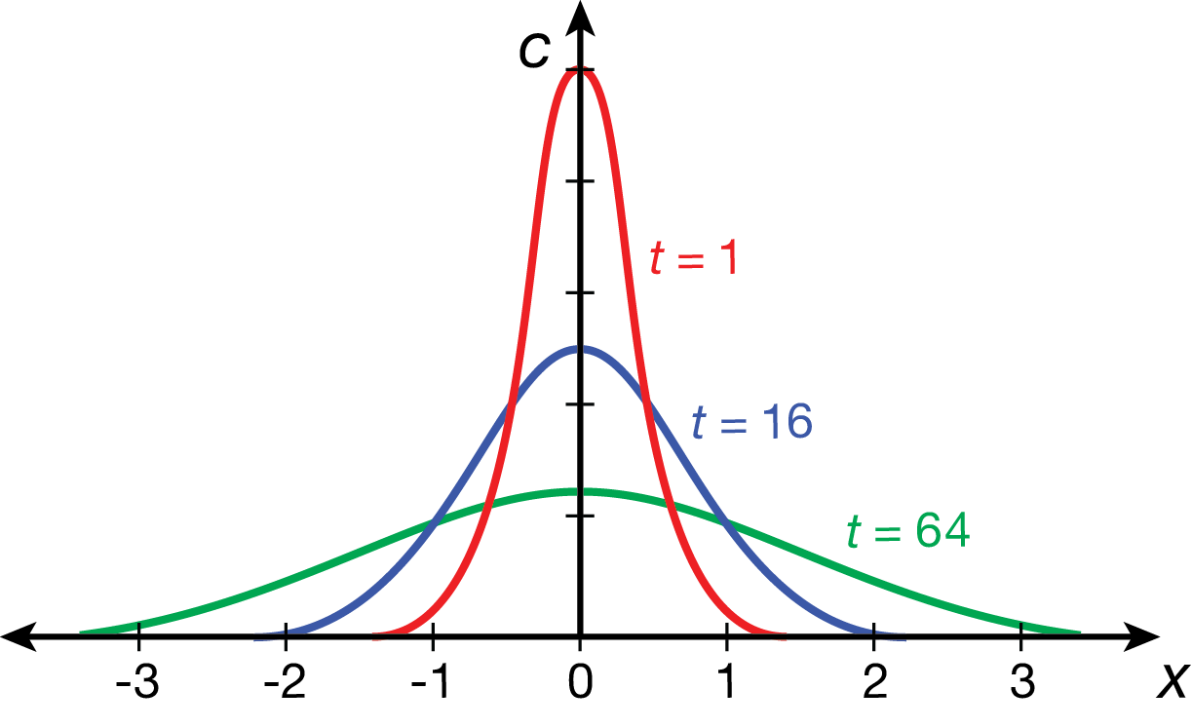
Point source diffusion
At t = 0, an amount q of diffusing species is placed on a plane of unit area at x = 0
Diffusion length
  A measure of how far the diffusing species has propagated in time t

Slide 16
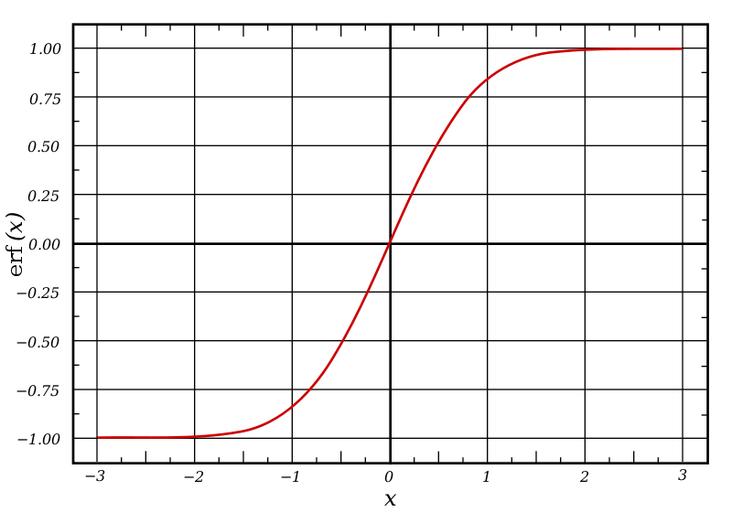
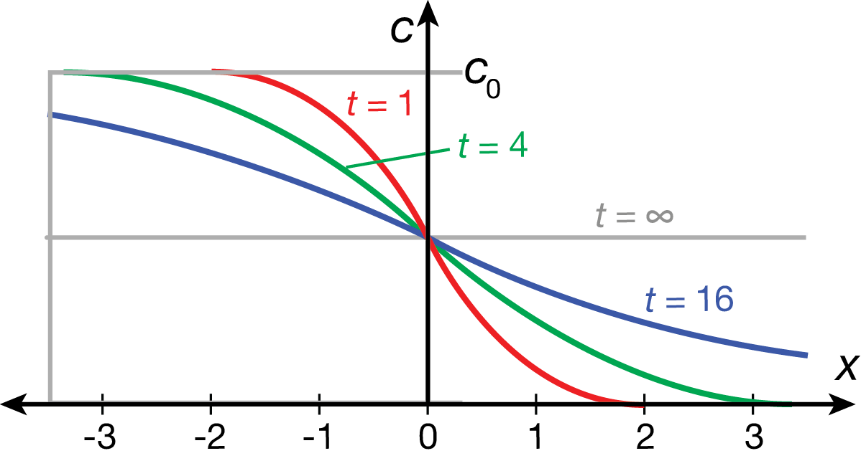
Step concentration diffusion
Initial concentration distribution:
Solution:
where
Error function
Error function

Slide 17
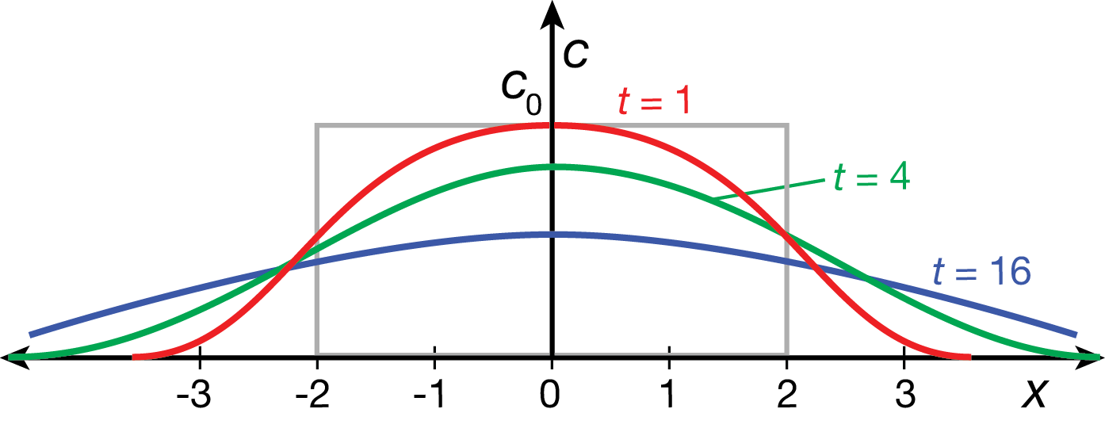
Diffusion from an extended source
Initial concentration distribution:
Solution:

Slide 18
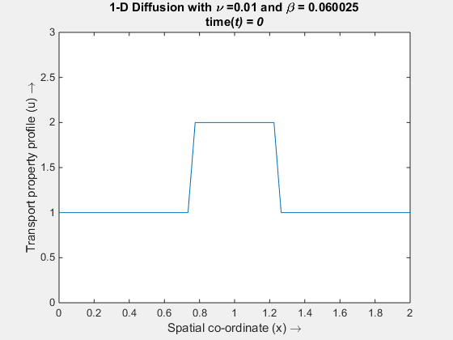
Diffusion from an extended source
1-D diffusion from an extended “box” source
http://www.mathworks.com/matlabcentral/fileexchange/38088-diffusion-in-1d-and-2d

Slide 19
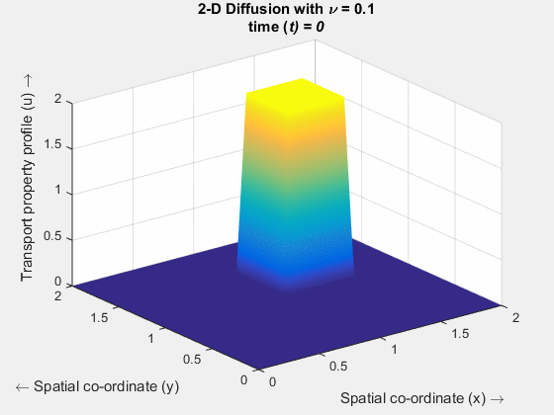
Diffusion from an extended source
2-D diffusion from an extended “box” source
http://www.mathworks.com/matlabcentral/fileexchange/38088-diffusion-in-1d-and-2d

Slide 20
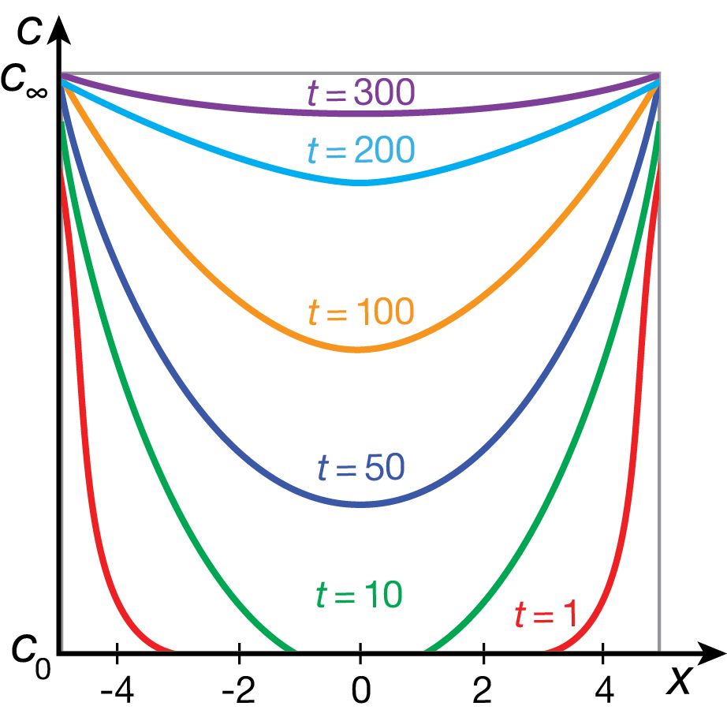
Diffusion into a plate
Initial concentration distribution:
Solution:

Slide 21
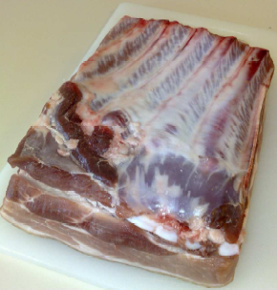
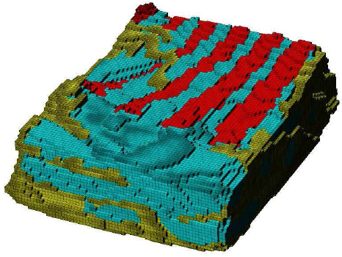
Example 1: making hams and bacons
Diffusion coefficient of salt in pork ~ 10⁻⁹ m²/s
How long does it take to salt a meat slice of 3 mm thickness?
Finite element modeling of salt diffusion using Fick’s 2nd law
J. Agric. Food Chem. 53, 7814 (2005).
© unknown

Slide 22
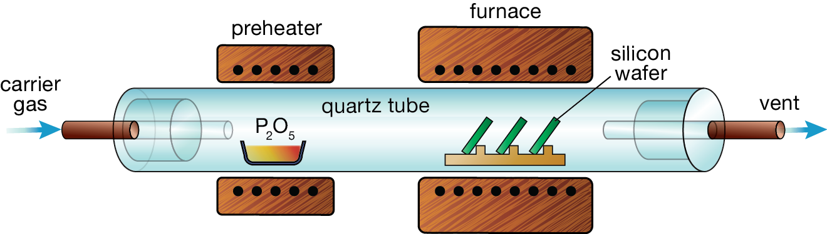
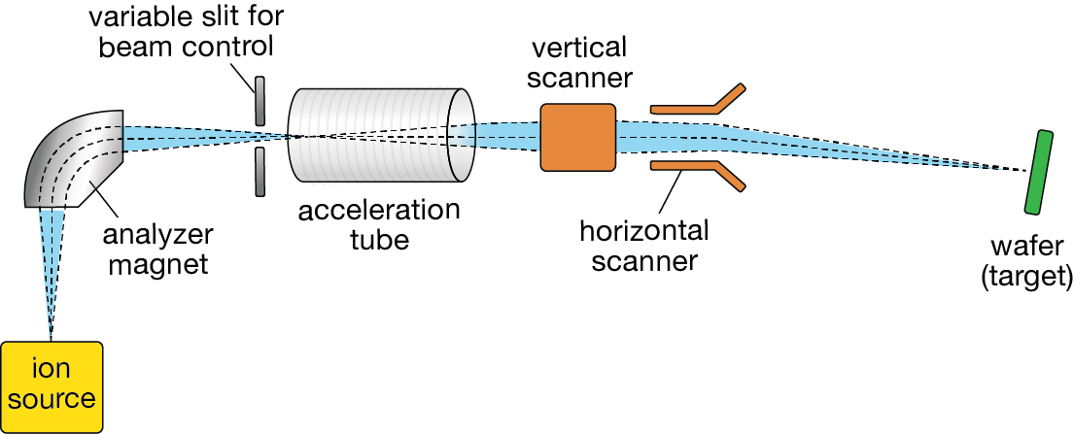
Example 2: doping semiconductors
Diffusion doping
Ion implantation
P₄O₁₀ gas
Mask
Mask
n-channel
p-Si
P ion
Mask
Mask
n-channel
p-Si

Slide 23
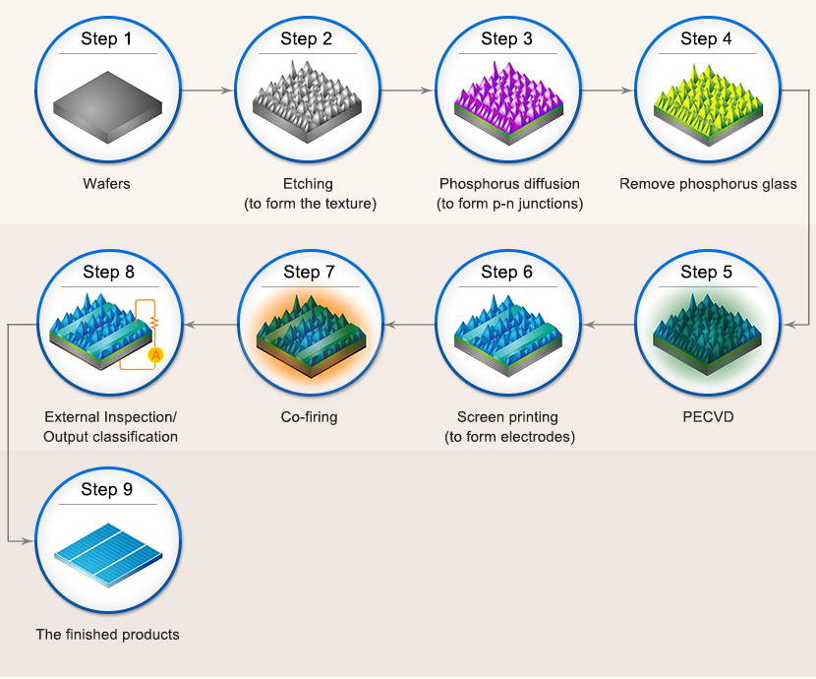
Example 2: doping semiconductors
Emitter diffusion
Furnace anneal:
4POCl₃ + 3O₂ → 2P₂O₅ + 6Cl₂
2P₂O₅ + 5Si → 5SiO₂ + 4P
In-line process:
2H₃PO₄ → P₂O₅ + 3H₂O
2P₂O₅ + 5Si → 5SiO₂ + 4P
Standard silicon solar cell manufacturing process

Slide 24
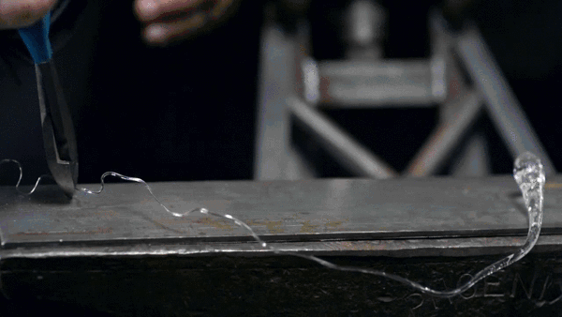
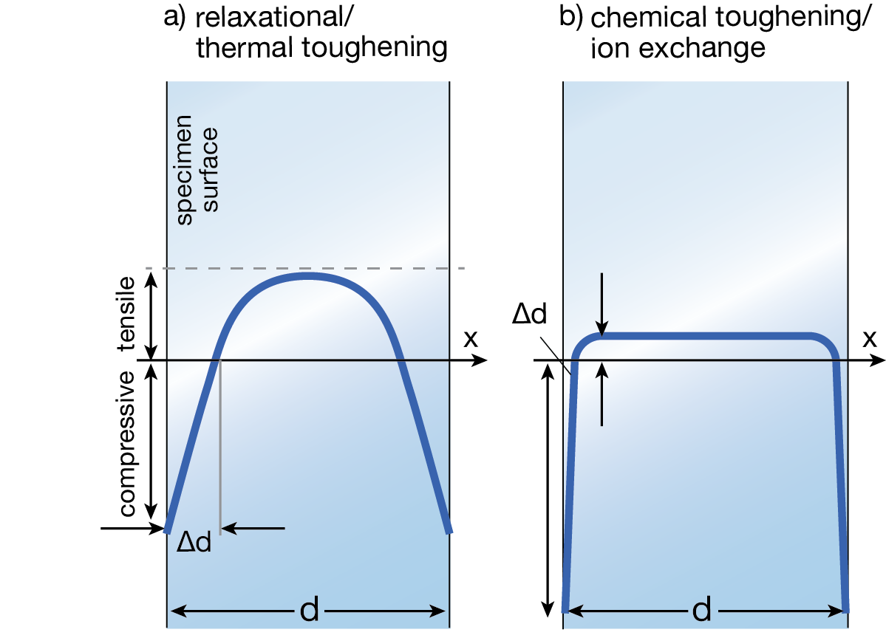

Example 3: chemical strengthening of glass
© Corning
Adv. Mater. 23, 4578 (2011)

Slide 25
Example 3: chemical strengthening of glass
Ion exchange in salt bath
Interdiffusion process
  Kinetics limited by slow-moving ion species
  Compressive strain impedes diffusion
Typical case depth in soda-lime glass: 25 to 35 μm
Only applies to alkali/alkali earth glasses
Int. J. Appl. Glass Sci. 1, 131 (2010)

Slide 26
Thermodynamic driving force for diffusion
Average velocity of a diffusing species A
Thermodynamic driving force
For an ideal solution of A
Einstein relation

Slide 27
Summary
Mechanisms of diffusion
  Vacancy & interstitial mechanisms
Microscopic model of diffusion:
Fick’s 1st law and 2nd law
Solutions to common diffusion problems
Examples of diffusion process
Einstein relation
for ideal solution

Slide 28
List of symbols
T – temperature
k – Boltzmann constant (1.38 × 10⁻²³ m² kg s⁻² K⁻¹)
m – mass of an atom
K – effective spring constant of the potential well where an atom is located
h – Planck constant (6.626 × 10⁻³⁴ J·s)
ν – vibrational frequency of an atom
ν_{h} – frequency of successful hops of an atom
E_{a} – activation energy of atomic hopping
J – diffusion flux of atoms

Slide 29
List of symbols
n₁ / n₂ – number of atoms per unit area on plane 1/2
x – coordinate along the x-axis
α – hopping distance (distance between neighboring interstitial sites for interstitial diffusion)
C – number concentration of atoms (i.e. number of atoms per unit volume in 1/m³)
D – diffusivity, diffusion coefficient
Z – number of nearest neighboring interstitial sites
a – lattice constant (note the difference with α )
t – time
A – cross-sectional area

Slide 30
List of symbols
d – diffusion length
– interdiffusion coefficient
v_{A} – average velocity of diffusing species A
M_{A} – mobility of diffusing species A
F_{A} – driving force of diffusion acting on species A
μ_{A} – chemical potential of diffusing species A
μ_{A,0} – chemical potential of diffusing species A at a standard reference state
x_{A} – atomic fraction of species A

