Slide 1
MIT 3.022
Microstructural Evolution in Materials
4: Heat capacity
Juejun (JJ) Hu
hujuejun@mit.edu

Slide 2
Material | Molar heat capacity c_{v} (J/mol K) | c_{v}/R | Type |  | Degrees of freedom
He | 12.5 | 1.5 |  | Monatomic gas | 3 translational Total 3
Ne | 12.5 | 1.5
Ar | 12.5 | 1.5
Gas
H₂ | 20.2 | 2.43 |  | Diatomic gas | 3 translational 2 rotational Total 5
O₂ | 20.2 | 2.43
N₂ | 19.9 | 2.39
H₂S | 26.7 | 3.22 |  | Triatomic gas | Depends on molecular geometry
CO₂ | 28.5 | 3.43
H₂O (100 °C) | 28.0 | 3.37
Non-metal
Arsenic | 24.6 | 2.96 |  | Atomic solid | 3 translational 3 vibrational Total 6
Diamond | 6.1 | 0.74
Antimony | 25.2 | 3.03
Copper | 24.5 | 2.95
Silver | 24.9 | 3.00
Metal
Mercury | 28.0 | 3.36 |  | Liquid | ?
H₂O | 75.3 | 9.06
Gasoline | 229 | 27.6
Liquid
The values are quoted for 25 °C and 1 atm pressure for gases unless otherwise noted

Slide 3

Molar heat capacity modeling
Molar heat capacity:
Deriving heat capacity:
  Determine system energy levels
  Derive partition function Z
  Calculate mean energy as a function of temperature
  Calculate heat capacity by taking derivative with respect to T
for condensed matter
Unregistered user at uncyclopedia.wikia.com; CC-BY-SA-NC 3.0
This mole has a large molar heat capacity

Slide 4
Non-interacting, distinguishable particles
Consider a system consisting of N identical but distinguishable particles
  Classical ideal gas
The system’s partition function is the product of individual particle’s partition function

Slide 5
Non-interacting, indistinguishable particles
Consider a system consisting of N indistinguishable particles
  Quantum ideal gas (with wave function overlap)
Permutation does not generate new states
The system’s partition function
The N! factor avoids over counting of microscopic states due to permutation
Notes:
Note that the latter expression comes from the classical limit of quantum statistics and only applies to dilute ideal gas!

Slide 6
Monatomic gas
Only consider translational degrees of freedom
Particle in a box model:
Particle partition function for translational motion along the x-direction

Slide 7
Monatomic gas (cont’d)
Particle partition function for translational motion
Partition function of the system consisting of N ideal gas particles
Average energy of the system
Distinguishability does not affect average energy

Slide 8
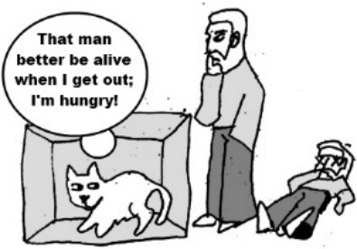
Monatomic gas (cont’d)
Molar heat capacity at constant volume
Each translational degree of freedom contributes average energy (energy equipartition)
Material | Molar heat capacity c_{v} (J/mol K) | c_{v}/R
He | 12.5 | 1.5
Ne | 12.5 | 1.5
Ar | 12.5 | 1.5

Slide 9
Heat capacity of an atomic solid
Harmonic oscillator model
  Each atom oscillates in its own potential well independent of other atoms
  Potential function
  Spring constant
  Oscillator angular frequency
Energy
harmonic potential
x
A
B
C

Slide 10
Heat capacity of a harmonic oscillator
Energy:
Partition function:
Mean energy:
Heat capacity:
Neglect zero point energy

Slide 11
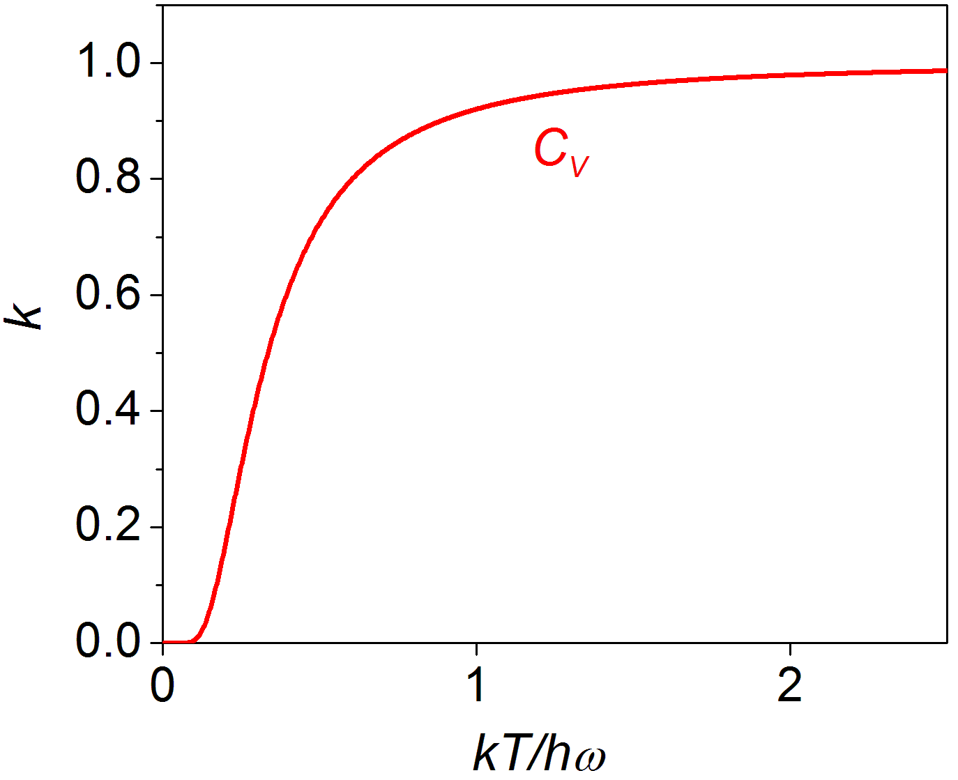
Heat capacity of a harmonic oscillator
High T limit
Low T limit
Notes:
High temperature limit obeys the energy equipartition theorem: there are two quadratic terms in the Hamiltonian of a harmonic oscillator (each should contribute 0.5 k heat capacity according to the theorem), and therefore the heat capacity is 2*0.5*k = k.

Slide 12
Heat capacity of a 3-D atomic solid
Partition function:
Mean energy:
Heat capacity:
Distinguishable atoms oscillating along x, y, and z directions
High T limit
(Dulong-Petit law)
Low T limit

Slide 13
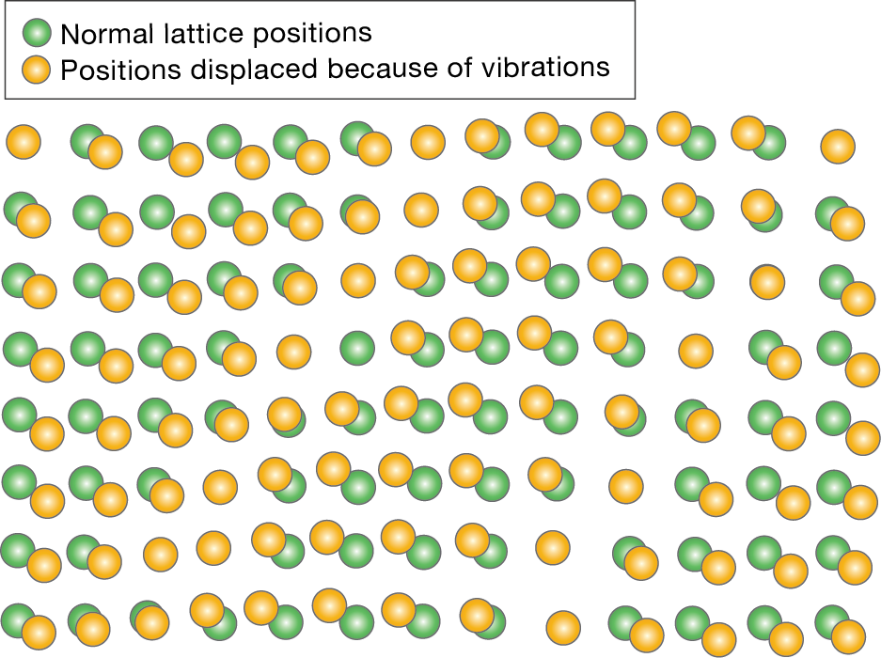
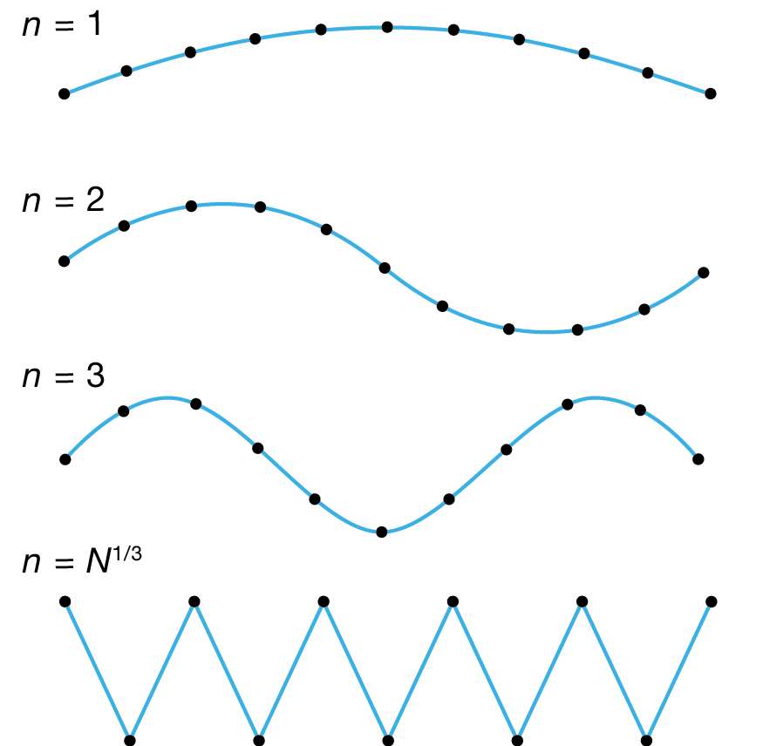
Normal modes (lattice waves)
Lattice waves can be decomposed to different normal modes: Fourier analysis
Normal modes of lattice wave:
in analogy to “particle-in-a-box”

Slide 14
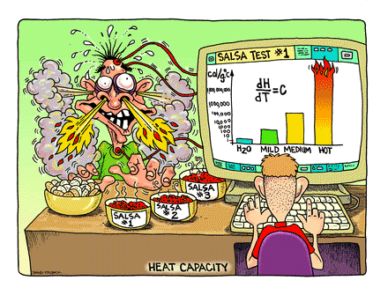
Everything you need to know about heat capacity
Partition function of systems composed of distinguishable and indistinguishable particles
Distinguishability does not affect average energy and heat capacity; however, it changes entropy and Z
Heat capacity of monatomic gas: energy equipartition
Heat capacity of harmonic oscillators
Heat capacity of atomic solids: the Einstein model

Slide 15
List of symbols
T – temperature
k – Boltzmann constant (1.38 × 10⁻²³ m² kg s⁻² K⁻¹)
R – Ideal gas constant (8.314 J mol⁻¹ K⁻¹)
β – defined as β = 1/kT
c_{V} / c_{P} – molar heat capacity at constant volume / pressure
C_{V} – heat capacity of a system (e.g. an oscillator)
– average energy of a system
N – Total number of particles in a system
N_{A} – Avogadro constant

Slide 16
List of symbols
Z_{par} / Z_{sys} – (canonical) partition function of an individual particle / a system consisting of N particles
E_{par} / E_{sys} – energy of an individual particle / a system consisting of N particles
n – quantum number (subscript x, y, or z denotes the direction)
L – linear dimension of the system (subscript x, y, or z denotes the direction)
h – Planck constant (6.626 × 10⁻³⁴ J·s)
ħ – reduced Planck constant (1.056 × 10⁻³⁴ J·s)
m – mass of particle

Slide 17
List of symbols
ϕ (x) – potential function of a harmonic oscillator
K – spring constant of a harmonic oscillator
ω – angular frequency of a harmonic oscillator

