Slide 1
MIT 3.022
Microstructural Evolution in Materials
3: Canonical Ensemble
Juejun (JJ) Hu
hujuejun@mit.edu

Slide 2
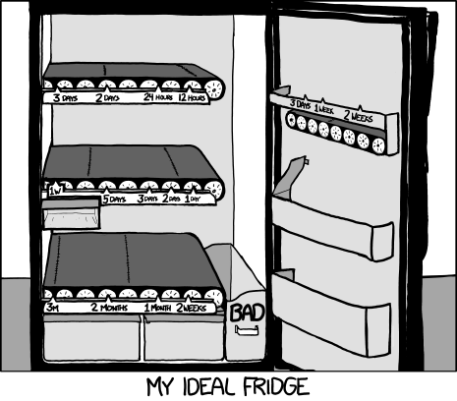
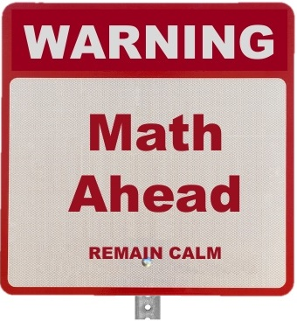
This lecture will tell you why fridge works!

Slide 3
Canonical ensemble
Boundary condition: system temperature and volume is kept constant
System energy is not fixed!
System in thermal equilibrium with heat reservoir held at T
Rigid, thermally conductive walls

Slide 4
Canonical ensemble
Boundary condition: system temperature and volume is kept constant
System energy is not fixed!
Gas molecule
Inelastic process
Rigid, thermally conductive walls

Slide 5
Model for deriving the canonical distribution
A composite system consisting of N (N is large) identical systems in thermal equilibrium with each other and isolated from the surroundings
For all systems:
Constraints:
Effectively, each system is in equilibrium with a large heat reservoir (consisting of N – 1 systems) at temperature T
…
…
…
…
…
…
…
…
…
Notes:
Here “identical” implies that all the systems have the same composition and are subjecting to the same macroscopic boundary condition of constant temperature; the systems can have different energies and can be in different microscopic states

Slide 6
Example: N = 5
Each system’s energies: 0, ε, 2ε, 3ε, 4ε, 5ε
Total energy of composite system: 5ε
Macrostate: energy distribution among the systems
e.g. one system with 5ε, four systems with 0
A
B
C
D
E
Energy level | 0 | ε | 2ε | 3ε | 4ε | 5ε
# of system | 4 | 0 | 0 | 0 | 0 | 1
Notes:
All systems are distinguishable; also the example is not an ensemble: the system has six energy levels so by definition its ensemble should contain at least six copies
The energy levels have no degeneracy in this example

Slide 7
Example: N = 5
Each system’s energies: 0, ε, 2ε, 3ε, 4ε, 5ε
Total energy of composite system: 5ε
Macrostate: energy distribution among the systems
e.g. one system with 5ε, four systems with 0
Microstate: a specific configuration of the ensemble
A
B
C
D
E
5ε
4ε
3ε
2ε
ε
Microstate (5 0 0 0 0):
0

Slide 8
Example: N = 5
Each system’s energies: 0, ε, 2ε, 3ε, 4ε, 5ε
Total energy of composite system: 5ε
Macrostate: energy distribution among the systems
e.g. one system with 5ε, four systems with 0
Microstate: a specific configuration of the ensemble
A
B
C
D
E
5ε
4ε
3ε
2ε
ε
Microstate (0 5 0 0 0):
0

Slide 9
Example: N = 5
A
B
C
D
E
Macrostate
Microstates:
(5 0 0 0 0), (0 5 0 0 0), (0 0 5 0 0), (0 0 0 5 0), (0 0 0 0 5)
Number of microstates: Ω = 5
Energy level | 0 | ε | 2ε | 3ε | 4ε | 5ε
# of system | 4 | 0 | 0 | 0 | 0 | 1

Slide 10
Example: N = 5
A
B
C
D
E
Macrostate
Microstates:
(4 1 0 0 0), (4 0 1 0 0), (4 0 0 1 0), (4 0 0 0 1), (1 4 0 0 0), (0 4 1 0 0), (0 4 0 1 0), (0 4 0 0 1), (1 0 4 0 0), (0 1 4 0 0), (0 0 4 1 0), (0 0 4 0 1), (1 0 0 4 0), (0 1 0 4 0), (0 0 1 4 0), (0 0 0 4 1), (1 0 0 0 4), (0 1 0 0 4), (0 0 1 0 4), (0 0 0 1 4)
Number of microstates: Ω = 20
Energy level | 0 | ε | 2ε | 3ε | 4ε | 5ε
# of system | 3 | 1 | 0 | 0 | 1 | 0

Slide 11
Example: N = 5
A
B
C
D
E
Macrostate
Microstate counting
Energy level | 0 | ε | 2ε | 3ε | 4ε | 5ε
# of system | N₀ | N₁ | N₂ | N₃ | N₄ | N₅
First pick N₀ systems out of the total of N systems and set them to 0 energy; then pick N₁ systems out of the remaining N-N₀ systems and set them to ε energy; and so on…
Number of microstates:

Slide 12
Example: N = 5
A
B
C
D
E
Macrostates
Macrostate [N₀, N₁, N₂, N₃, N₄, N₅] | Degeneracy Ω
[4, 0, 0, 0, 0, 1] | 5
[3, 1, 0, 0, 1, 0] | 20
[2, 2, 0, 1, 0, 0] | 30
[2, 1, 2, 0, 0, 0] | 30
[3, 0, 1, 1, 0, 0] | 20
[1, 3, 1, 0, 0, 0] | 20
[0, 5, 0, 0, 0, 0] | 1
The most probable states
Equilibrium state of macroscopic systems can be identified by finding the maximum of the probability distribution function

Slide 13
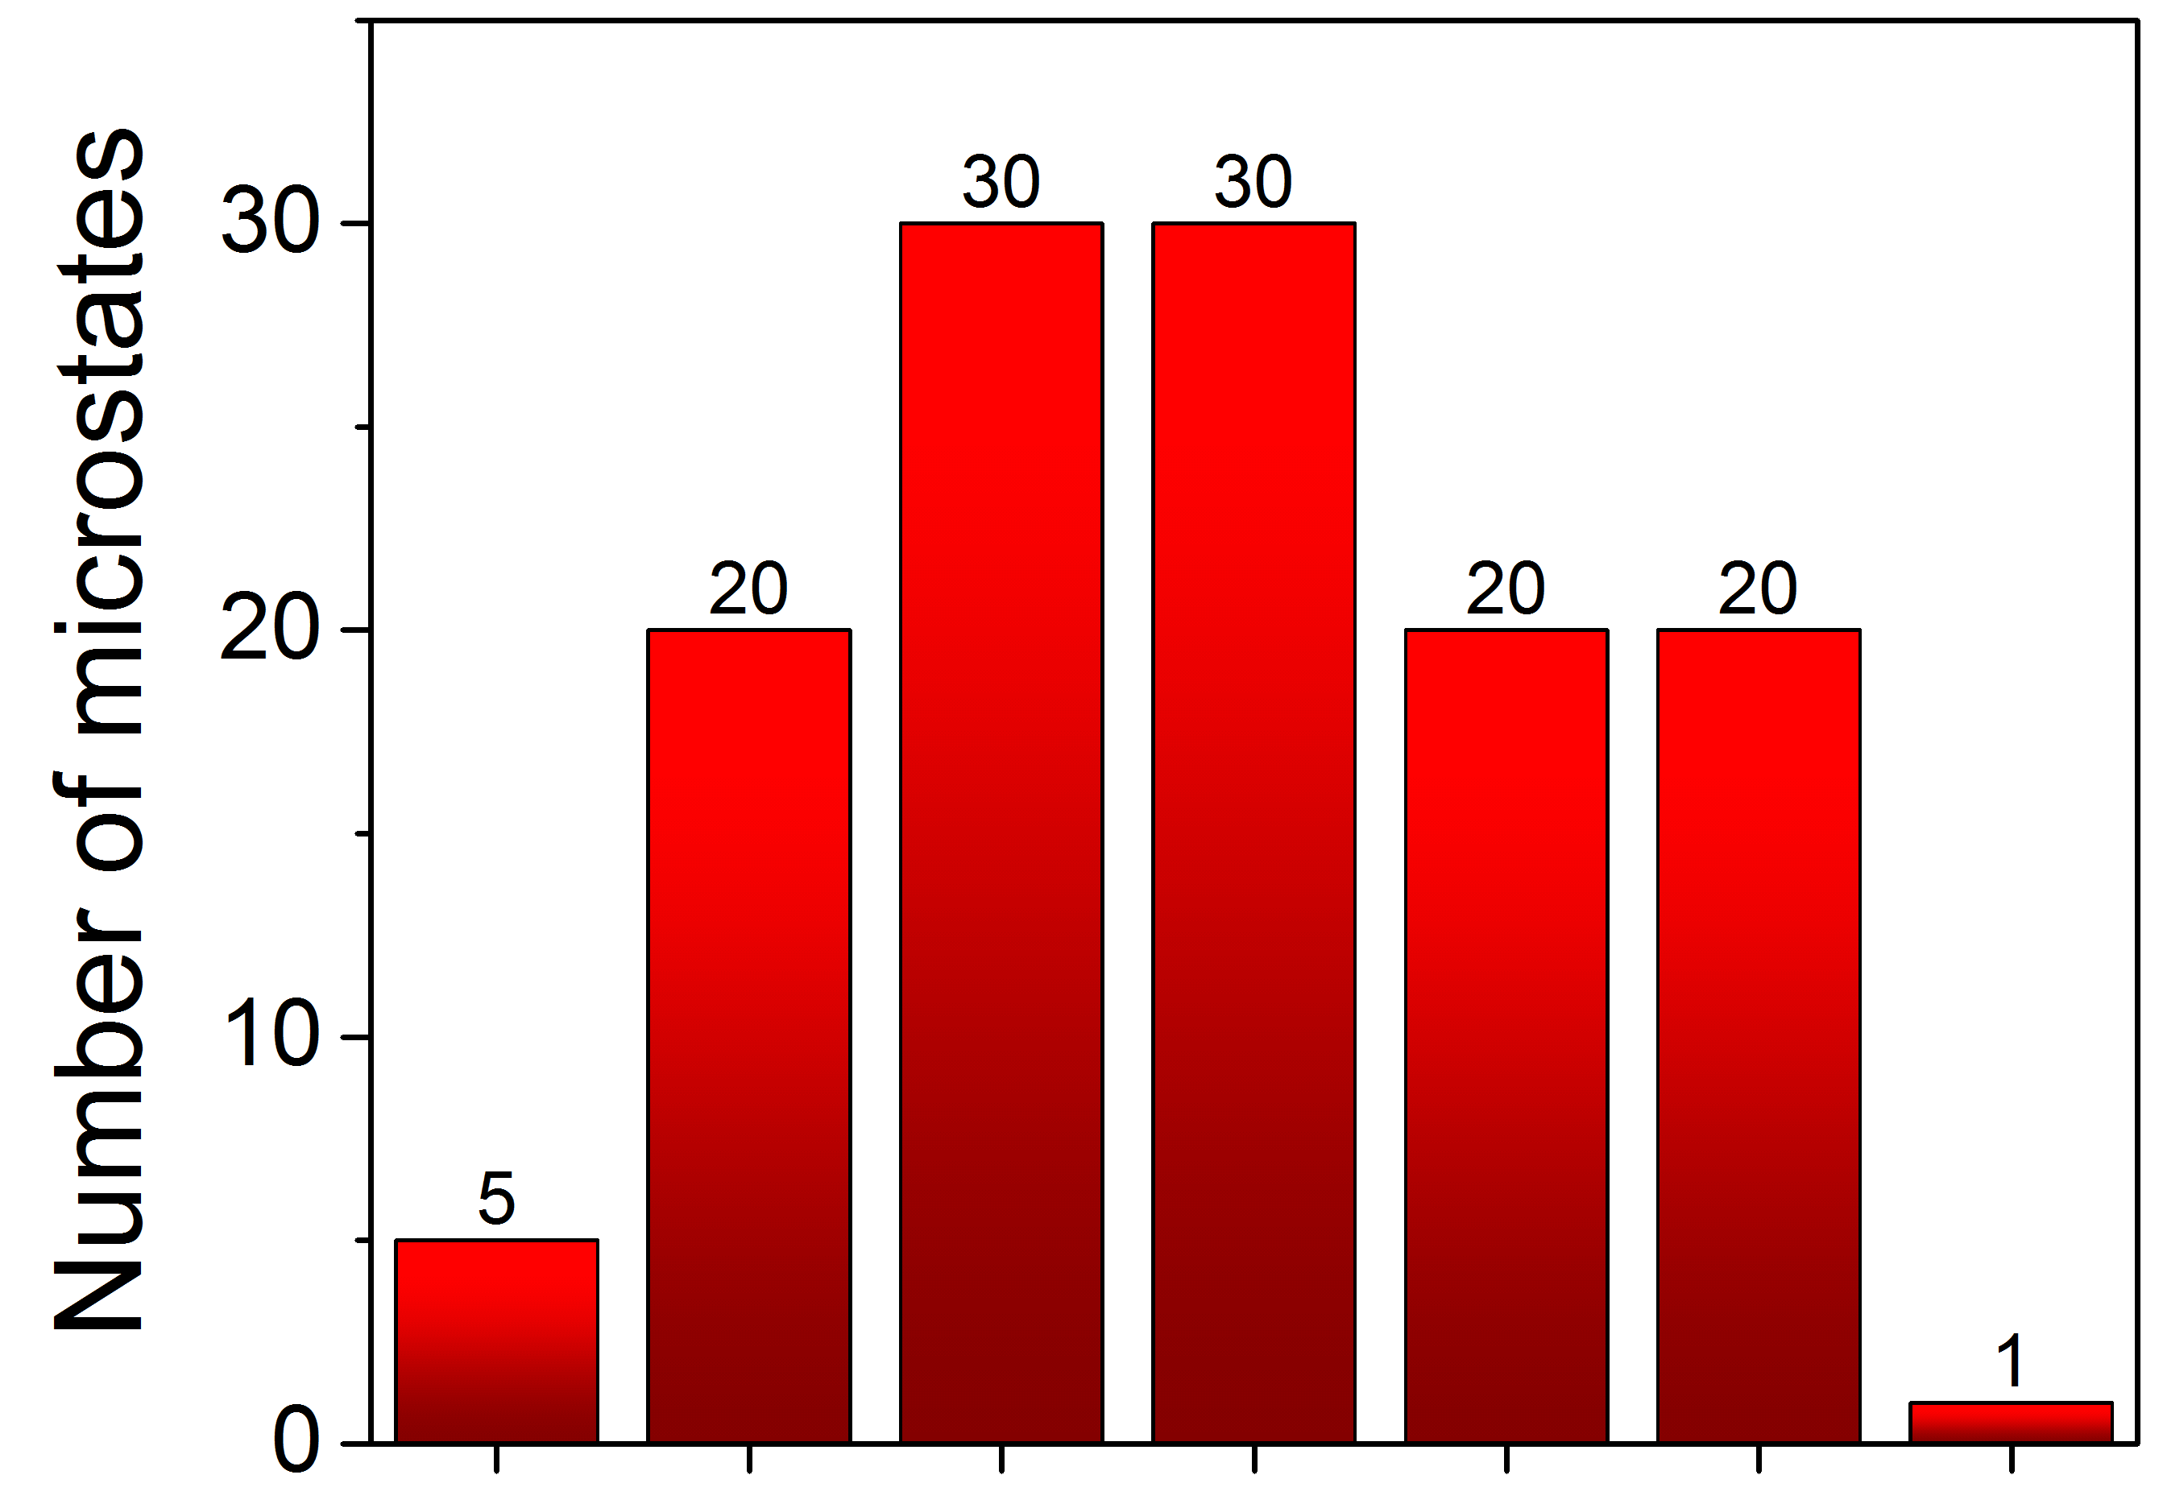
Example: N = 5
Small N: broad distribution
[400001]
[310010]
[220100]
[212000]
[301100]
[131000]
[050000]
Macrostates

Slide 14
Canonical distribution
Problem statement
  Derive the probability distribution of a system’s energy at constant temperature T
…
Approach
  Consider an ensemble of N systems subjecting to the constraints:
  Find the most probable macrostate, i.e. Ω = Ω_{max}
…
…
…
…
…
…
…
…
  The most probable macrostate represents the equilibrium probability distribution

Slide 15
Canonical distribution
Probability of a macrostate
Maximize Ω with constraints:
Lagrange multiplier: maximize a new function containing two undetermined constants α and β, and assume that all N_{i} have no constraints. In the end, α and β are chosen to meet both constraints.
The new function to maximize:
(for all m)

Slide 16
Canonical distribution
Assume that all N_{i} have no constraints

Slide 17
Canonical distribution
Now apply the constraints:
Canonical distribution
1)
Partition function
where
2)
(see lecture notes for detailed derivation)

Slide 18
Interpretation of partition function Z
The summation is over all states (not energy levels) of the system
At low T, the system is “frozen” at the ground state
At high T, all energy levels are equally likely to be occupied
Thus, the partition function gives an indication of the number of states that are accessible to the system at a given temperature.
Notes:
Helmholtz free energy F = -kT*lnZ

Slide 19
Properties of a canonical ensemble
Ensemble average of variables: probability weighted average
  Average energy
  A general extensive variable B

Slide 20
Effect of gravitational force on gas density
Example: density of gas held at constant temperature T subjected to gravitational force
Identify the system
We take a single gas molecule as the system
Determine Hamiltonian or energy levels
Calculate Z and canonical distribution
Calculate system properties
Density
F = mg
Rigid, thermally conductive walls
Notes:
If the system consists of more than one particle, then the system energy level is different from single particle energy levels!

Slide 21
Paramagnetism and the Curie’s Law
Consider one atom with a magnetic dipole:
Two states (+): , (-):
Probability (+): , (-):
Average magnetic dipole:
M
Curie’s law
H

Slide 22
Summary
Identify the system
Determine the system energy E_{i} at state i
Probability distribution:
Partition function (summing over all system states i):
Ensemble average of variables:

Slide 23
Microcanonical distribution
We use i to label a system’s microscopic state
Problem: when the system is held at constant energy E, what is the probability P_{i} of finding the system at a particular microscopic state i ?

Slide 24
Making sense of canonical distribution
We use i to label a system’s microscopic state
Problem: when the system is held at temperature T, what is the probability P_{i} of finding the system at a particular microscopic state i ?
If we make N (N is large) macroscopically identical copies of the system, then the number of copies N_{i} residing at the microscopic state i is:
We use the following relation to derive P_{i} :

Slide 25

Making sense of canonical distribution
Our story begins with a large family of macroscopically identical systems (the canonical ensemble)
I
JJ
E
K
D
The systems are all macroscopically identical but are distinguishable
C
B
We all look alike but have unique names!
System A

Slide 26
Making sense of canonical distribution
All systems happily share energy among them, but are isolated from the rest of the world
Walls (nothing can get through)
When alone I am “canonical”; but when a LARGE group of us are packed together we become “MICROcanonical” – the name doesn’t quite make sense, huh?

Slide 27
Making sense of canonical distribution
Some systems get a bit more energy than others. We call the energy distribution a macrostate.
E
…
Number of systems at microscopic state i
N_{i} = 1
E_{i}
N_{i-1} = 2
E_{i-1}
…
Macrostates do NOT assign energy values to specific systems; only the overall distribution of system over energy levels
N₁ = 2
E₁
We are NOT calling out any names yet!
N₀ = 4
E₀

Slide 28
Making sense of canonical distribution
This is a microstate
Each system is assigned to an energy level by name
D
E
…
N_{i} = 1
E_{i}
H
N_{i-1} = 2
A
E_{i-1}
…
B
N₁ = 2
E
E₁
N₀ = 4
E₀
G
C
JJ
F

Slide 29
Making sense of canonical distribution
The ensemble prefers some macrostates more than others: the most likely one represents the equilibrium distribution
E
…
N_{i} = 1
E_{i}
N_{i-1} = 2
We live happily ever after once this condition is met
E_{i-1}
…
N₁ = 2
E₁
Thermal equilibrium is the statistically most likely state.
N₀ = 4
E₀

Slide 30
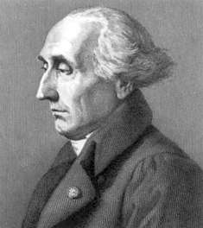
Making sense of canonical distribution
Now here comes the math
Joseph-Louis Lagrange (1736-1813)
Then a miracle occurs
And this guy’s name appears somewhere

Slide 31

Making sense of canonical distribution
Why higher energy states are less likely?
The other systems are now left with much less energy to spare and hence fewer microstates to access!
This system with high energy takes away energy from other systems in the ensemble

Slide 32
List of symbols
T – temperature
k – Boltzmann constant (1.38 × 10⁻²³ m² kg s⁻² K⁻¹)
Ω – Number of microscopic states / microstates
E_{i} – energy of the i-th energy level
N_{i} – number of systems at the i-th energy level
E_{tot} – total energy of all (sub-) systems combined, i.e. energy of the composite system
ε – some unit energy
N – Total number of (sub-)systems in the composite system

Slide 33
List of symbols
β – defined as β = 1/kT
α – defined by:
Z – (canonical) partition function
P_{i} – probability of a system residing at energy level i
– average energy of systems in an ensemble
m – mass of a gas molecule
g – gravitational acceleration
h – height
μ – magnetic dipole moment

Slide 34
List of symbols
μ_{H} – average magnetic dipole moment of an atom in a magnetic field
n – total number of magnetic dipoles in the material
H – magnetic field

