Slide 1
MIT 3.022
Microstructural Evolution in Materials
2: Solid Solutions
Juejun (JJ) Hu
hujuejun@mit.edu

Slide 2
Solid solution consisting of indistinguishable atoms
1
In classical mechanics, all particles are distinguishable
In quantum mechanics, two microscopic particles become indistinguishable if:
  The particles are identical
  The wave functions of the particles spatially overlap
Distinguishability does not affect energy but changes entropy
2
1+2

Slide 3

Selena & Eos Hu
Number of states from permutation:

Slide 4
Gibbs theorem
1
Solid 1 consisting of n₁ atoms on n₁ lattice sites
Solid 2 consisting of n₂ atoms on n₂ lattice sites
Solid solution with the same lattice structure and completely random distribution of atoms
  Inter-atomic force are the same for all three types of atomic pairs: 1-1, 2-2, and 1-2
2
1+2
Notes:
Assumptions: 1) no crystalline defects; 2) solids 1, 2 and their solution have the same crystal structure and the number of lattice sites is conserved; 3) all atoms distribute randomly on lattice (equal bonding energy for homopolar and heteropolar bonds)

Slide 5
Gibbs theorem
1
Ideal (random) solid solution
Entropy of mixing
2
1+2

Slide 6
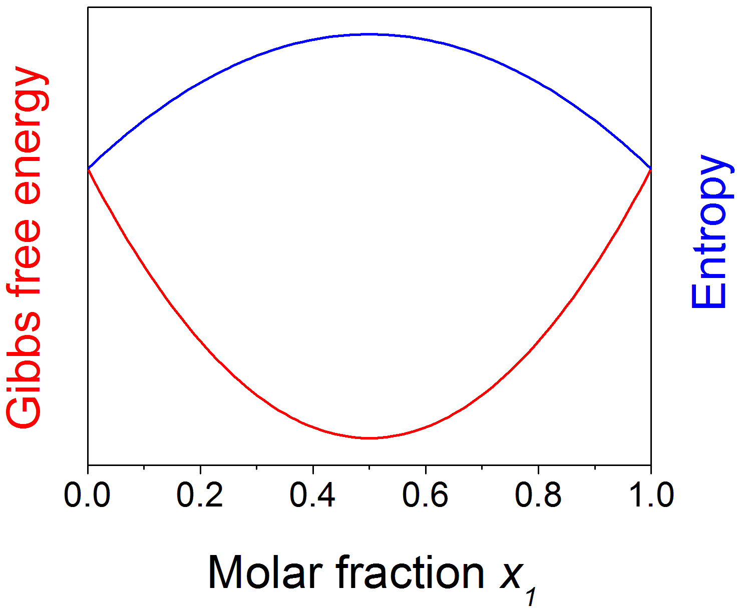
Ideal solid solutions
Inter-atomic force is the same for all types of bonds
Random mixing is always preferred!

Slide 7
Gibbs theorem for ideal gas
Entropy of mixing ideal gases (at the same T and P):
Derivation: # of spatial “sites” m >> # of molecules n for ideal gas (classical limit of quantum statistics)
T, P, n₁
T, P, n₂
Same T and P :

Slide 8
Regular binary solution theory
Assumptions:
  Random distribution of atoms
  Bond energy between 1-2 is different from those of 1-1 and 2-2
negative enthalpy of mixing: 1-2 type of hetero-polar bond energetically favorable
positive enthalpy of mixing: 1-1 and 2-2 types of homopolar bonds preferred
1
2
Site i
Site j

Slide 9
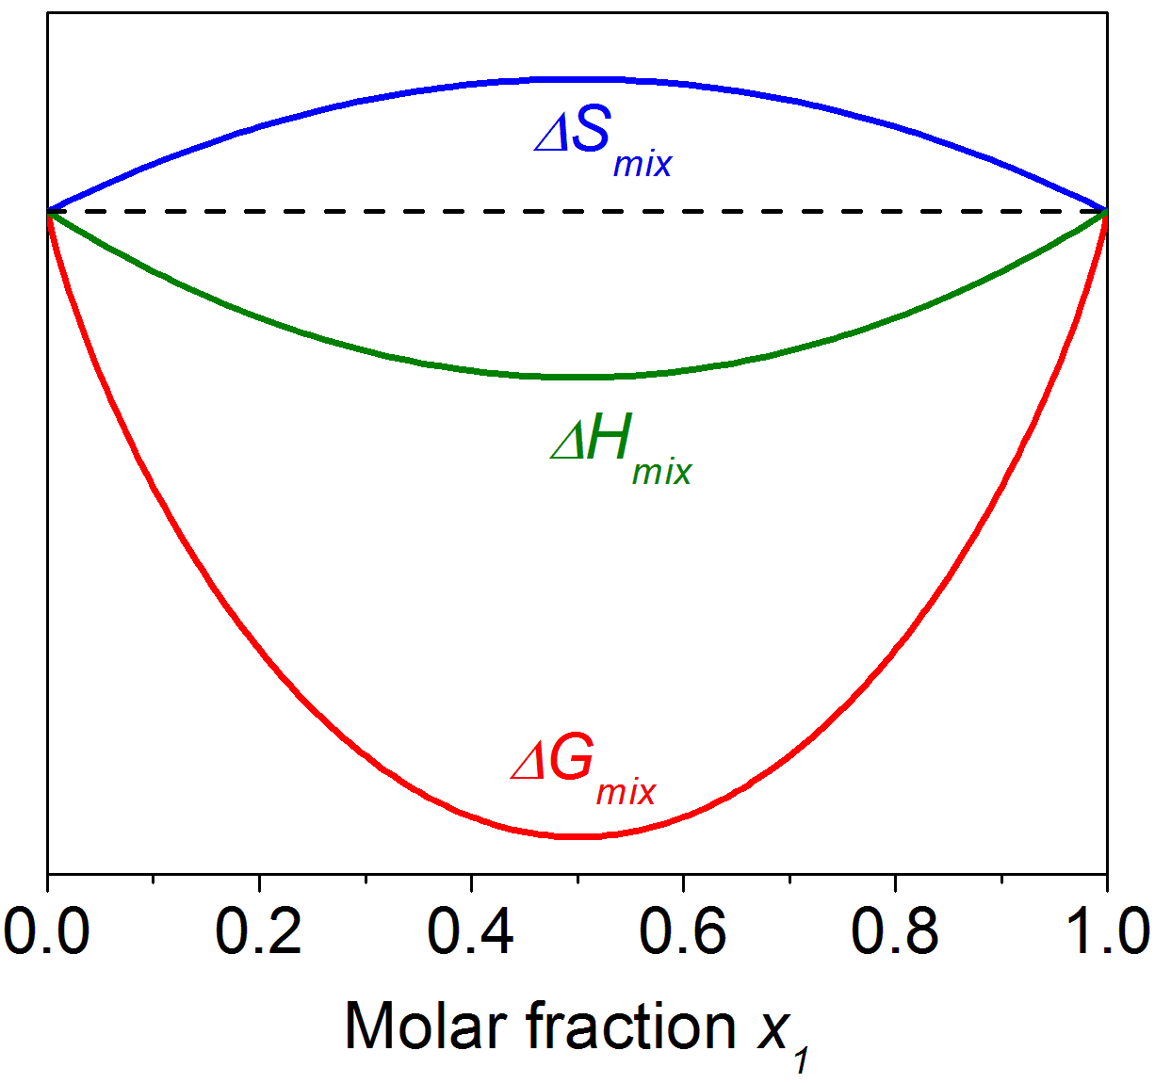
Negative enthalpy of mixing

Slide 10
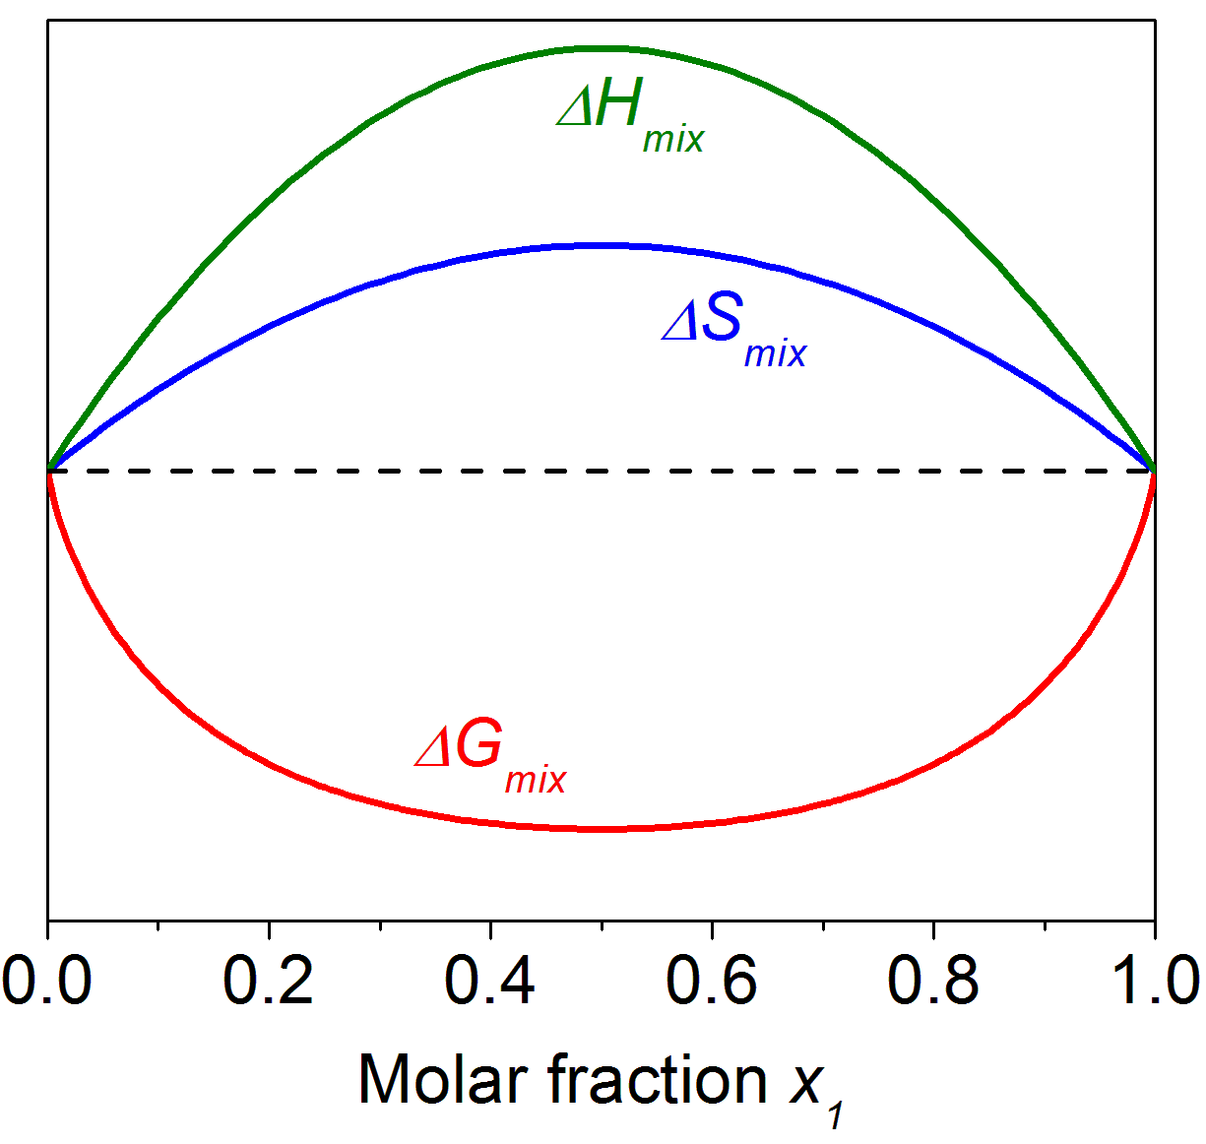
Positive enthalpy of mixing (high T)

Slide 11
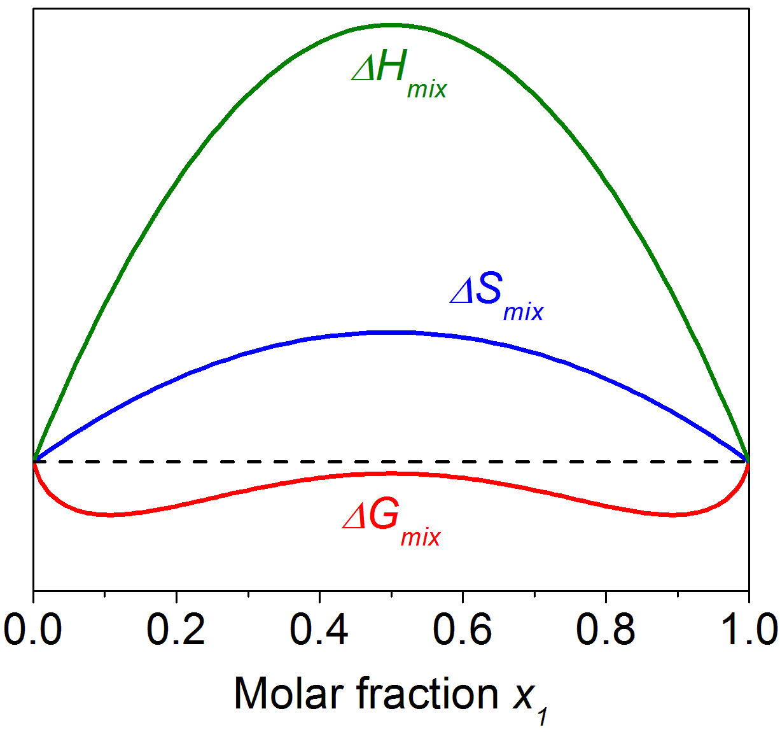
Positive enthalpy of mixing (intermediate T)

Slide 12
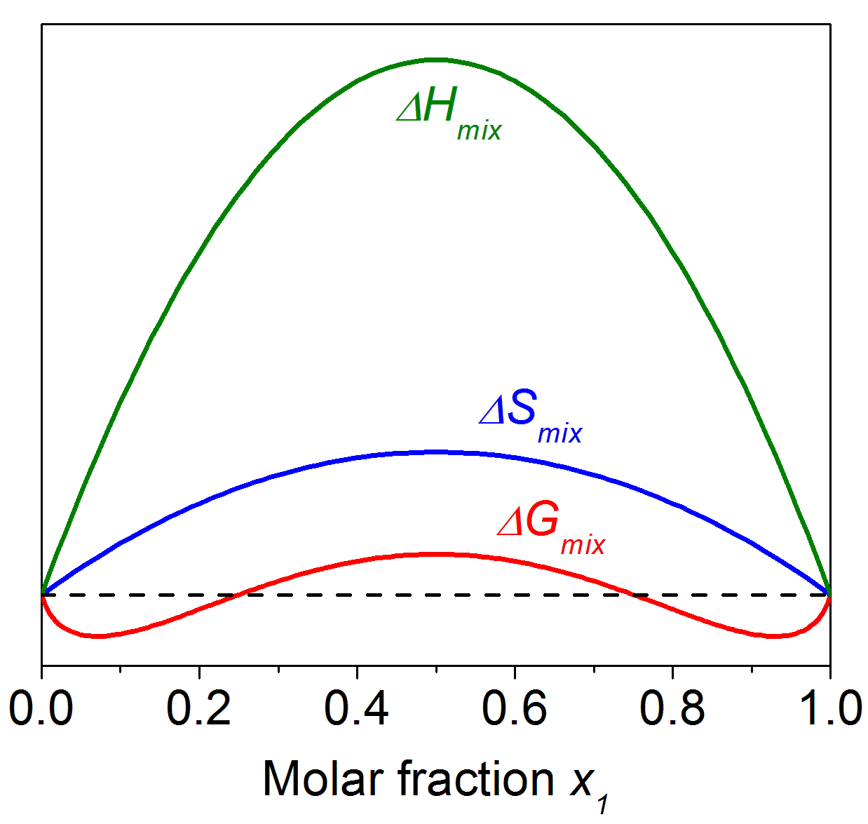
Positive enthalpy of mixing (low T)

Slide 13
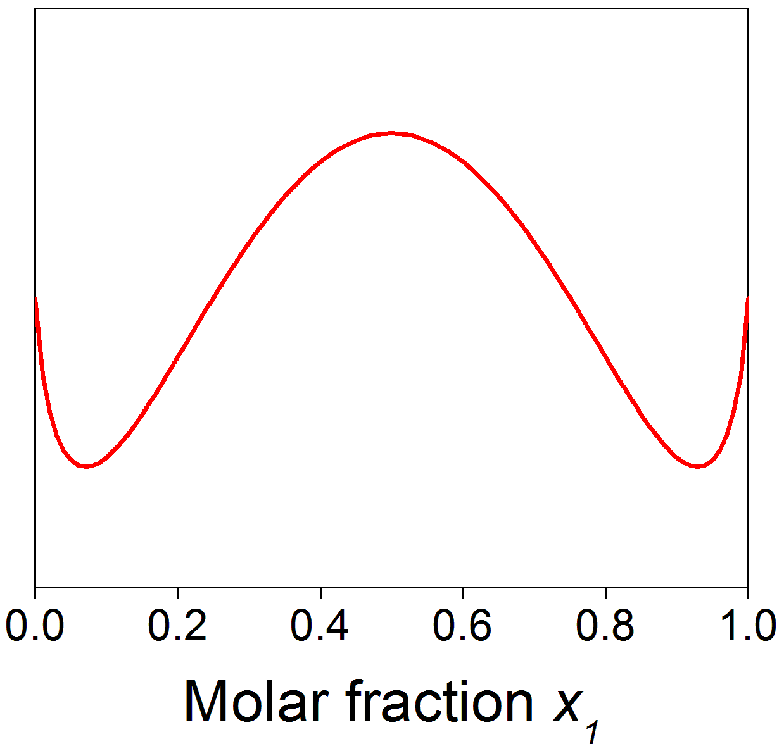
Phase composition determination
The composition of phases are determined by the common tangent lines on the Gibbs free energy curve
  Minimization of G
The curve is generally asymmetric for real solutions
ΔG_{mix} at T = T₀
α
β
μ₂
μ₁
x_{1,α}
x_{1,β}

Slide 14
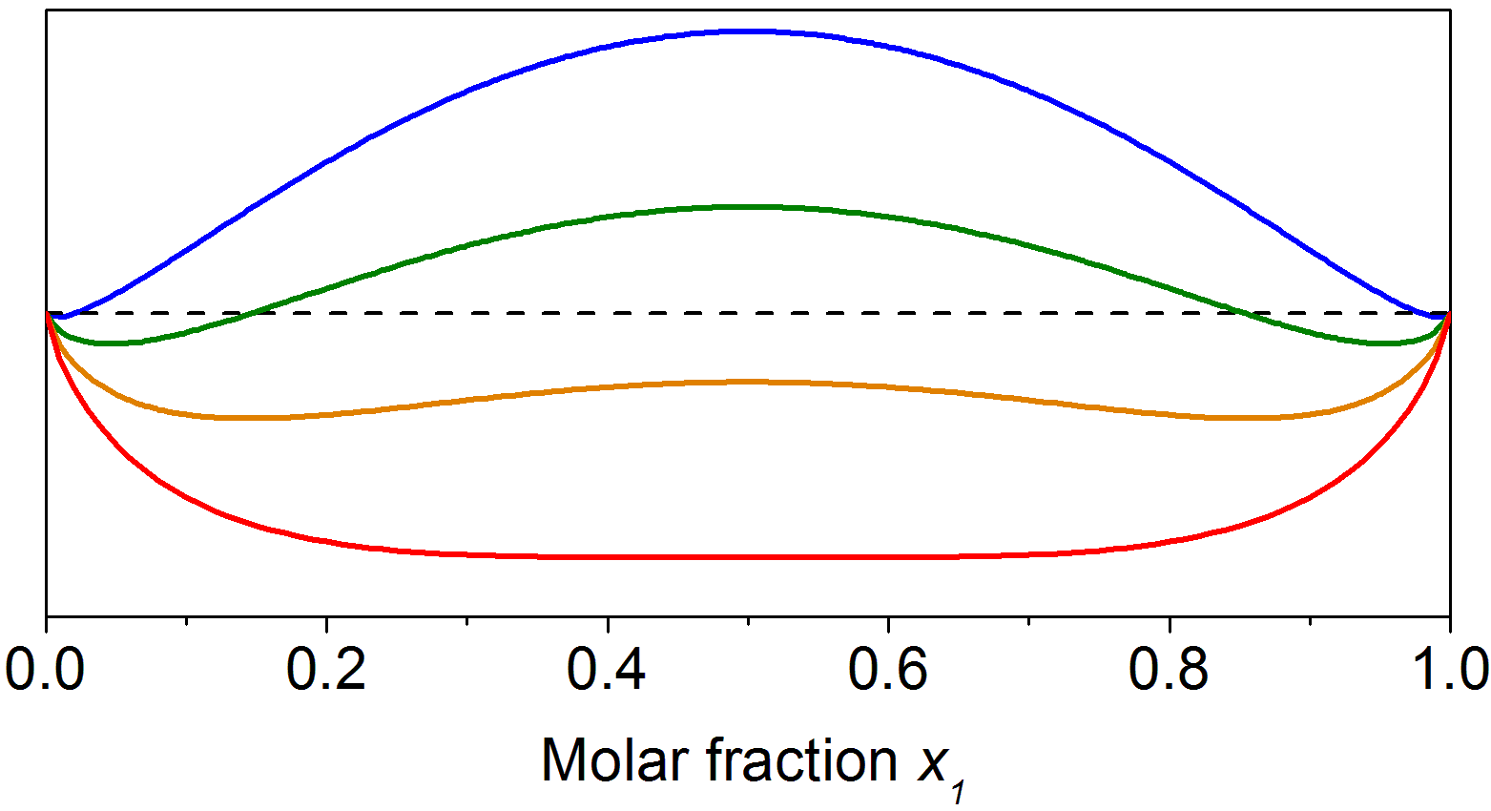
Miscibility gap
Phase diagram
Miscible region
Convex G curve: miscible solution
Gibbs free energy
Concave G curve: phase separation

Slide 15
Summary
Distinguishability of microscopic particles
Gibbs theorem
Ideal solid solution
Regular binary solution
  Negative enthalpy of mixing: single phase solution
  Positive enthalpy of mixing
    High temperature: single phase solution
    Low temperature: miscibility gap
when

Slide 16
List of symbols
S – entropy
k – Boltzmann constant (1.38 × 10⁻²³ m² kg s⁻² K⁻¹)
Ω – Number of microscopic states
n – number of atoms in solid solution
N – mole number of component in solid solution
R – Ideal gas constant (8.314 J mol⁻¹ K⁻¹)
V – Volume
x – Molar fraction of component
ΔS_{mix} / ΔH_{mix} / ΔG_{mix} – Entropy / enthalpy / Gibbs free energy of mixing

Slide 17
List of symbols
T – Temperature
P_{i} – Probability of atom site i being occupied by atom 1
w – A constant proportional to enthalpy of mixing: w < 0 corresponds to negative enthalpy of mixing, and w > 0 indicates positive enthalpy of mixing
μ_{1,α} – Chemical potential of component 1 in α phase

