Slide 1
MIT 3.022
Microstructural Evolution in Materials
17: The Science of Ice Cream
Ice Cream
Juejun (JJ) Hu
hujuejun@mit.edu

Slide 2
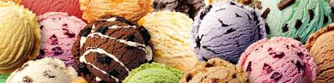
What is ice cream?
CFR 135.110: a frozen food product containing a minimum of 10% milkfat and 20% total milk solids (fat, protein, lactose and minerals), and has a minimum density of 0.54 kg/L
Main ingredients:
  10%-16% milkfat
  9%-12% non-fat milk solids
  ~0.5% flavor, stabilizer and emulsifier
  12%-16% sweeteners (sucrose)
  55%-70% water
Notes:
~75% of all water in ice cream is frozen as ice; ~25% stays in the matrix (liquid syrup) with sugar, stabilizers and milk proteins dispersed inside
Stabilizers are used to reduce ice cream melting rate
The milk solids-not-fat portion consists of protein (primarily casein and lactalbumin), carbohydrates (primarily lactose), and minerals (including calcium and phosphorus).

Slide 3
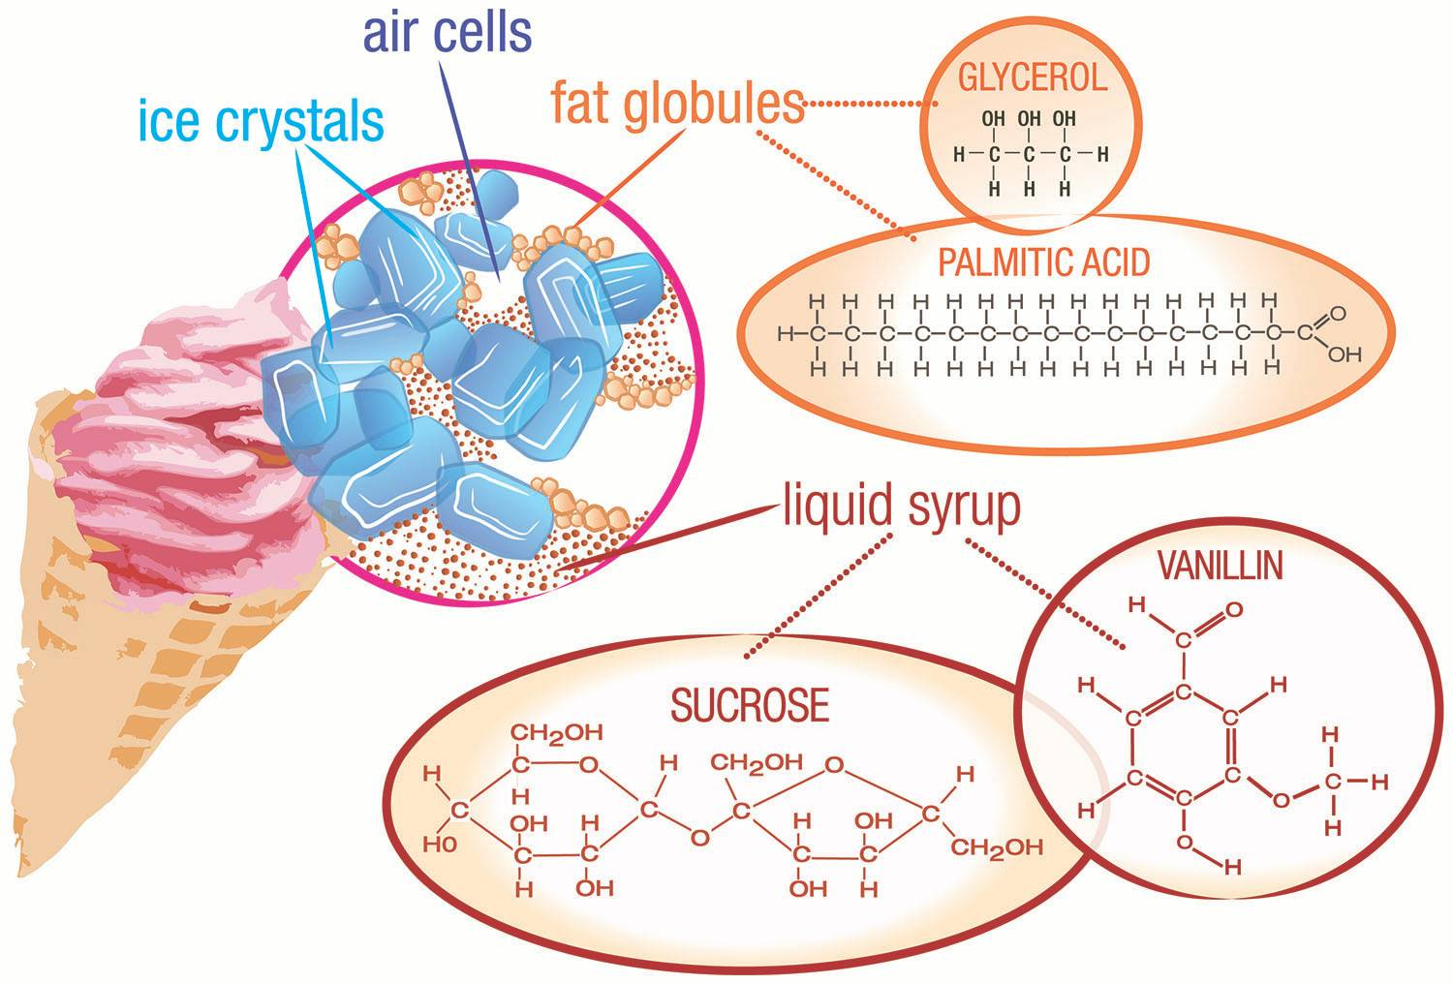
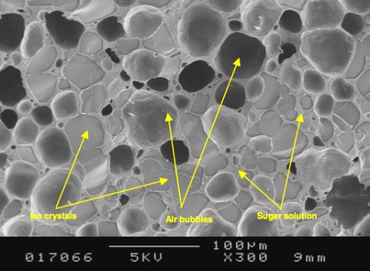
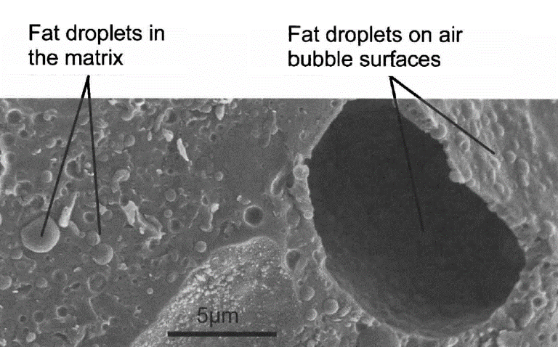
Microstructure of ice cream
Image from Ice, Cream... and Chemistry

Slide 4
Structure-property relationships
Component | Volume fraction (%) |  | Average size (μm) | Function
 | Standard ice cream | Premium ice cream
Ice | 30 | 35 | 50 | Cooling; determines texture and smoothness
Air | 50 | 35 | 40 | Improves softness
Fat | 5 | 10 | 1 | Stabilizes air bubbles; increases viscosity and reduces meltdown rate
Liquid syrup | 15 | 20 |  | Matrix of ice cream, provides sweetness and other flavors
Data from Goff & Hartel, Ice Cream, Springer (2013)

Slide 5
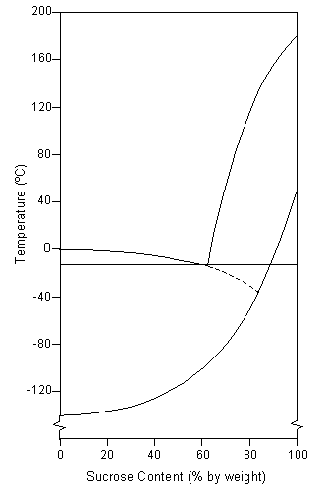
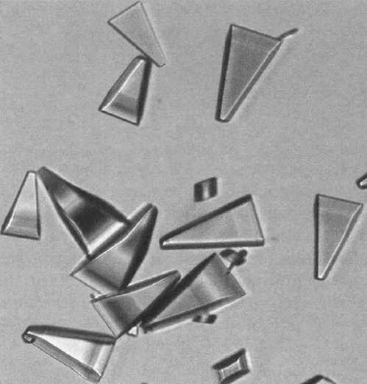
Thermodynamics of ice cream matrix
Freeze-concentration
  The syrup is supersatured
Glass transition
  Storage at -25 °C (close to T_{g}) prevents degradation
Liquid
Faceted growth of lactose crystals in ice cream matrix results in gritty mouthfeel
-9.5 °C
Glass
100 μm
Image from C. Clarke, The Science of Ice Cream, RSC (2005)

Slide 6
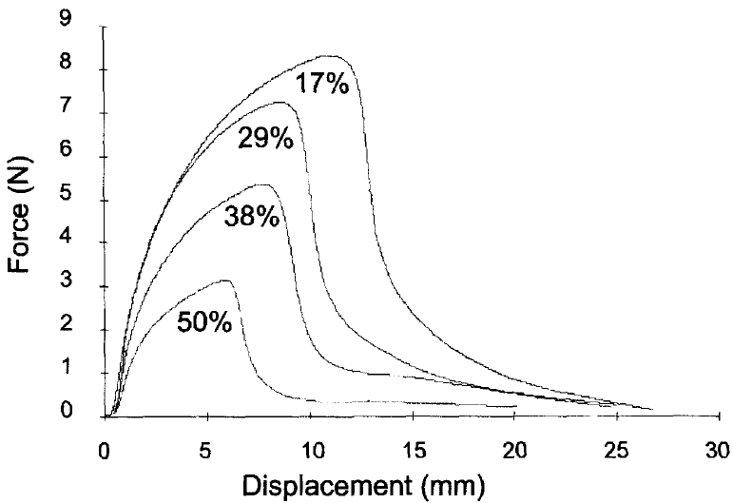
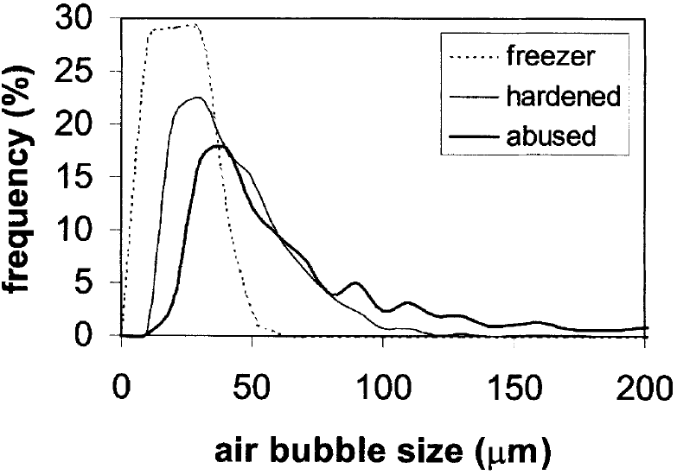
Air inclusion in ice cream
Air inclusion makes ice cream soft
Air bubble coarsening
  Coalescence
  Disproportionation: driven by Laplace pressure
Images from C. Clarke, The Science of Ice Cream, RSC (2005)
Notes:
Coalescence takes place when two bubbles come into close contact and the film between them ruptures
The recrystallization of ice crystals and the coarsening of air bubbles both lead to deterioration in the texture of ice cream

Slide 7
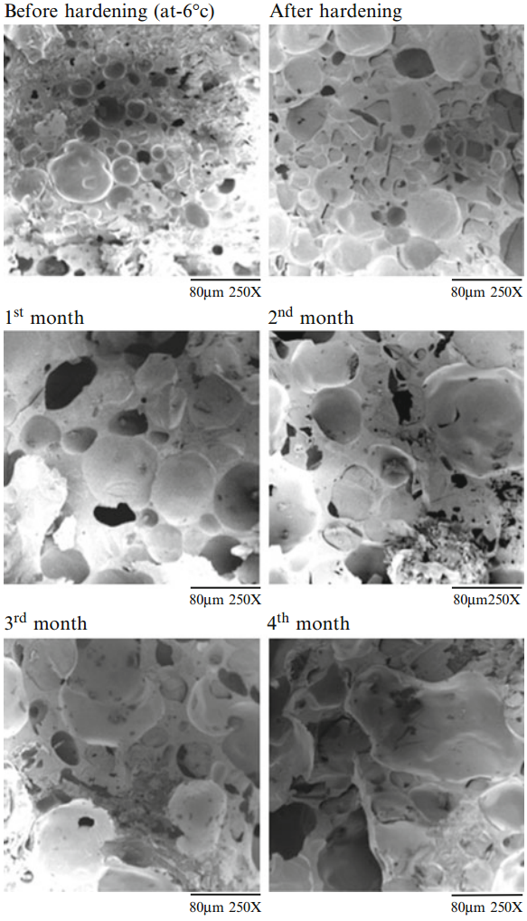
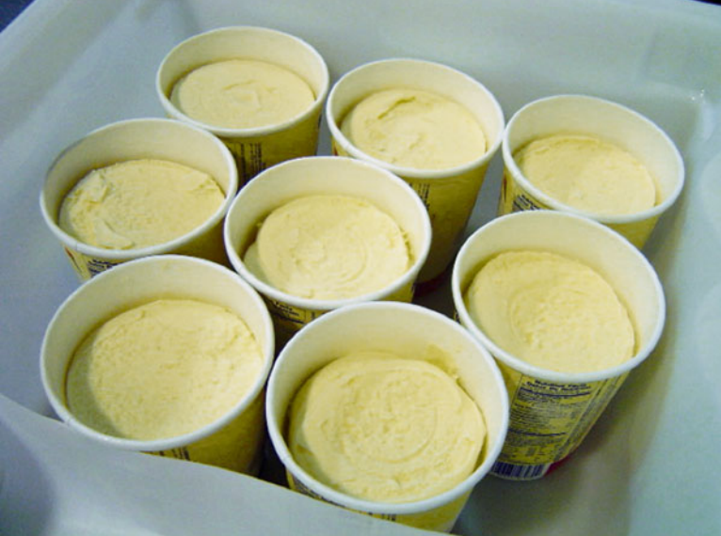
Air coarsening and shrinkage
At -15 °C
At -15 °C
At -15 °C
At -15 °C
Shrinkage in ice cream
Images from Goff & Hartel, Ice Cream, Springer (2013)
Notes:
Shrinkage results from bubble wall rupture and air release due to increased temperature/reduced ambient pressure; when the ice cream is returned to normal conditions, shrinkage results

Slide 8
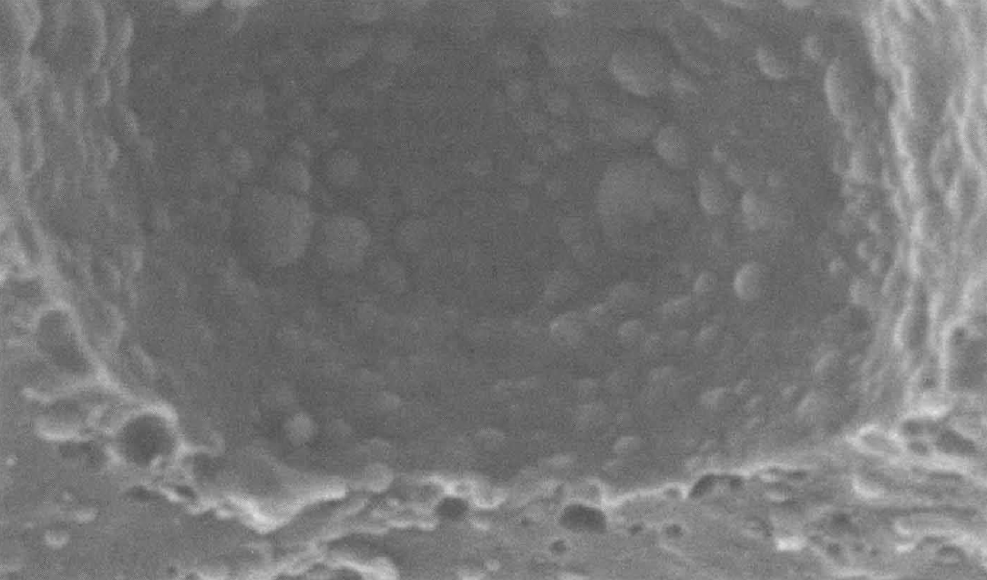
Fat droplets as air bubble stabilizer
Air bubbles stabilized by solid fat particles coated with milk protein
  Reduce driving force for coarsening: protein surfactants
  Kinetic inhibition: solid fat particles increase matrix viscosity
Air bubbles in an ice cream coated with partially coalesced fat droplets
2 μm
The Science of Ice Cream, RSC (2005)

Slide 9
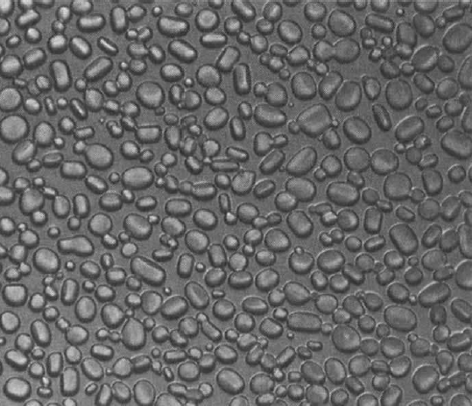
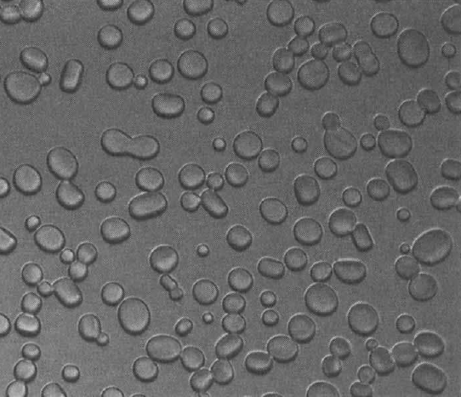
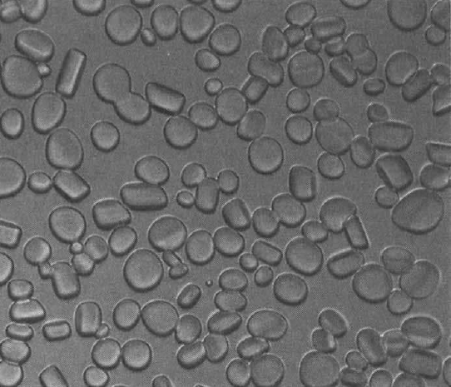
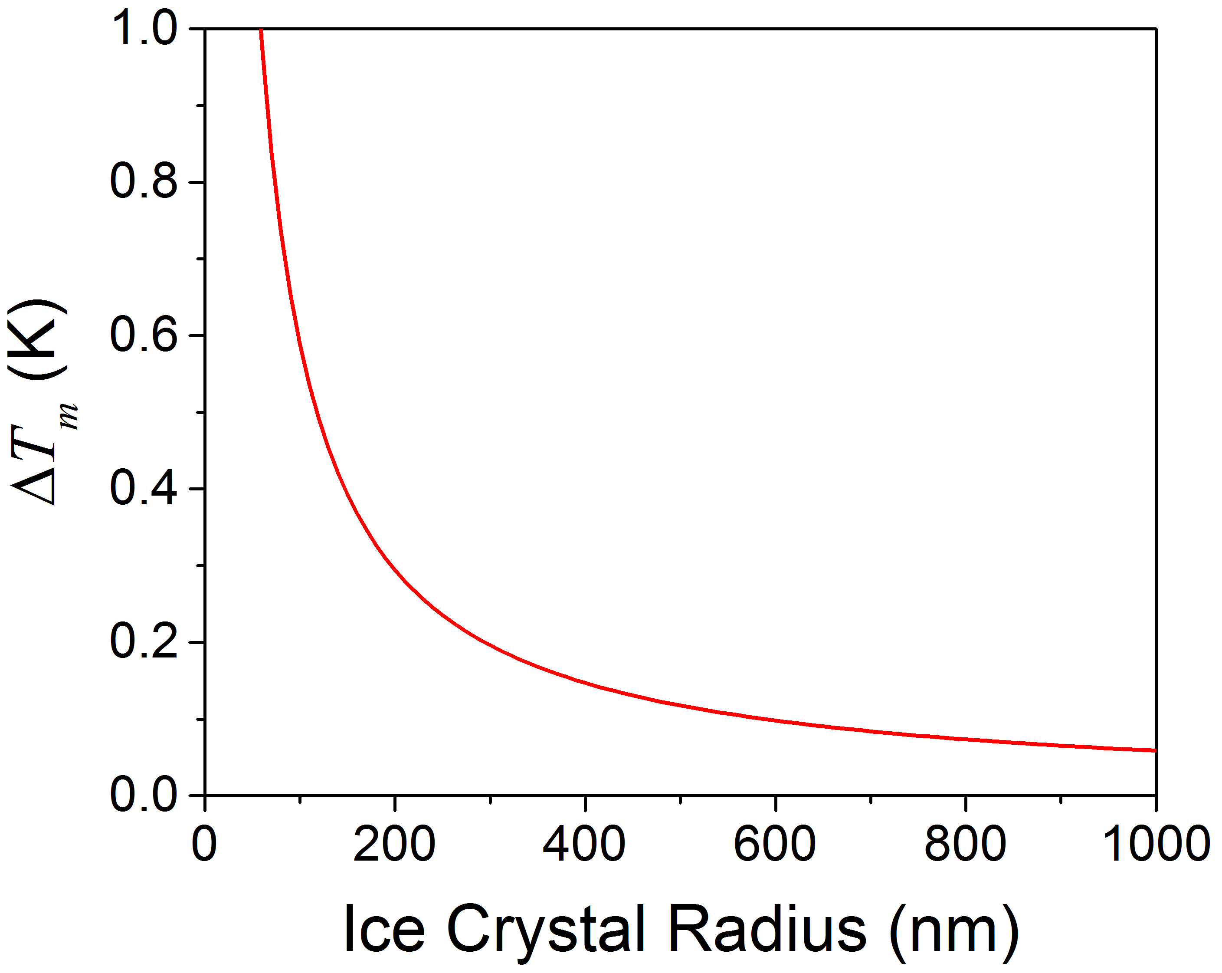
Ice crystal growth: temperature abuse
-10 °C
-7 °C
-10 °C
100 μm
100 μm
100 μm
Gibbs-Thomson effect is negligible
Melting of small crystals during temperature rise and insufficient supercooling for nucleation during temperature decrease result in ice crystal growth when ice cream is temperature abused
Notes:
The plot shows melting point depression (decrease) due to the Gibbs-Thomson effect

Slide 10
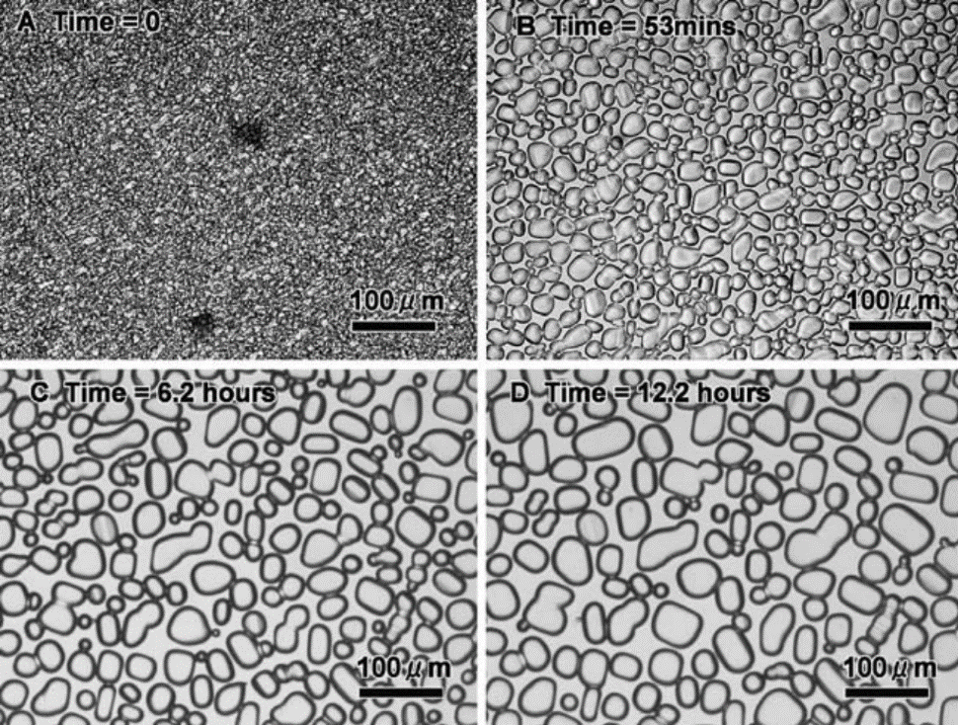
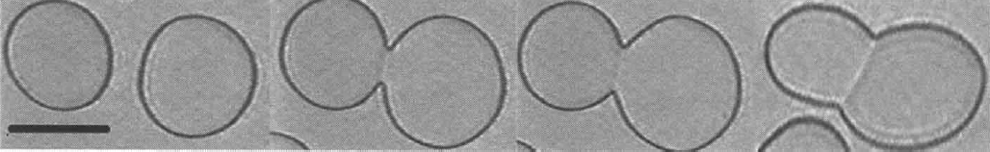
Ice crystal growth: Ostwald ripening
At low ice crystal density, Ostwald ripening drives crystal growth
At high ice crystal density, accretion becomes important
Ice crystal growth in freeze-concentrated 28.6% sucrose held at -8 °C
Accretion of ice crystals

Slide 11
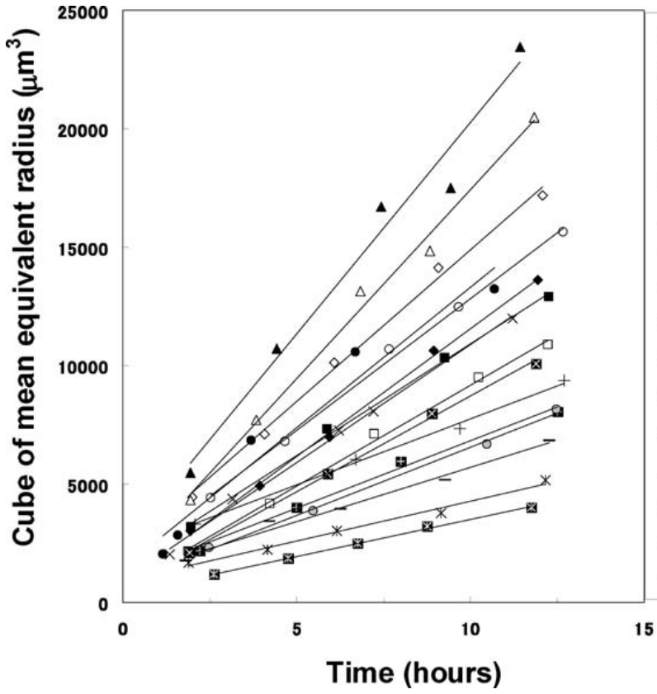
Ice crystal growth: Ostwald ripening
Ostwald ripening kinetics
Recrystallization rate:
Recrystallization rate scales with diffusivity
Food Biophys. 1, 74 (2006)

Slide 12
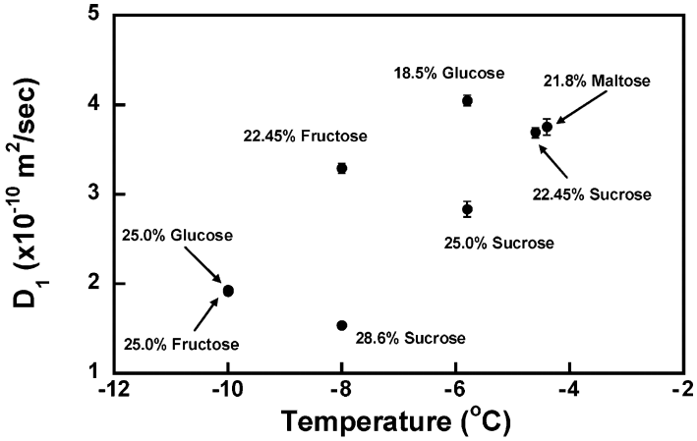
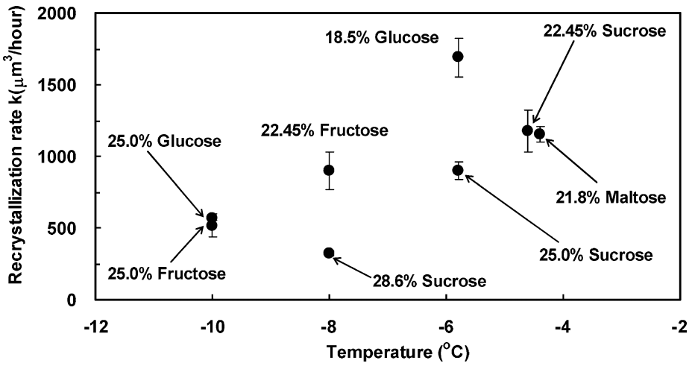
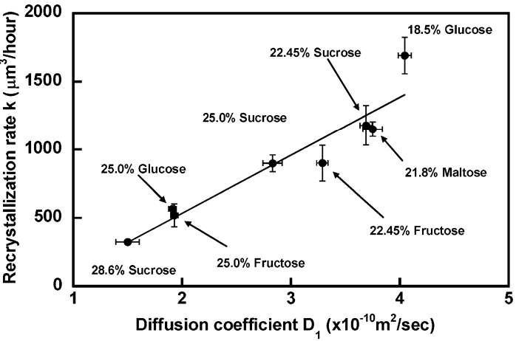
Ice crystal growth: Ostwald ripening
Ice crystal growth via water diffusion in the matrix

Slide 13
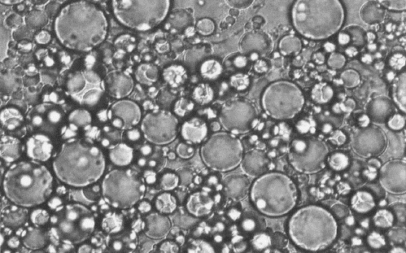
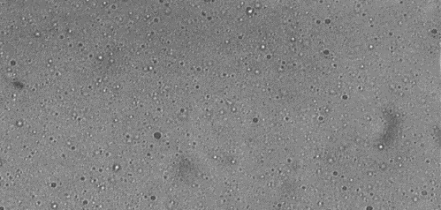
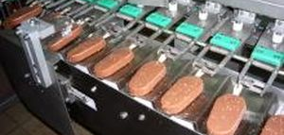
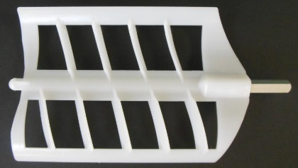
Ice cream processing
Mixing
Homogenization
Aging
  Creates fat droplets
  Allow emulsifiers to attach to fat droplet surfaces to reduce surface tension and stabilize the emulsion
100 μm
100 μm
Shaping
Hardening
Freezing
  Low-T extrusion
  Cool ice cream from about -5 °C to below -25 °C to kinetically inhibit degradation (e.g., coarsening)
  Aeration via a dasher

Slide 14
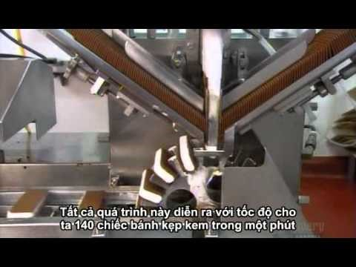
Ice cream processing

Slide 15
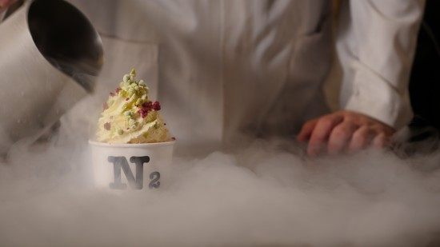
Liquid nitrogen ice cream
Effective bubble formation due to nitrogen vaporization
High cooling rate: small ice crystals and fine texture

Slide 16
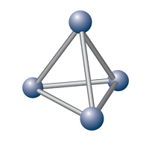

Structure
Multi-phase composite: air bubbles, ice crystals and fat particles embedded in a matrix
Processing
Properties
Homogenization: fat particles
Freezing & aeration: ice crystals & air bubbles
Hardening: matrix stabilization
Air: softness
Ice: cooling & texture
Fat: stabilization
Performance
Too cold!

Slide 17
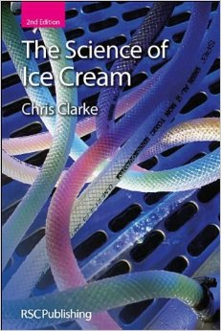
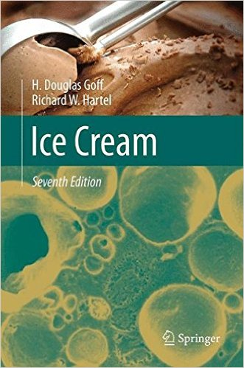
Further readings
Clarke, The Science of Ice Cream, RSC (2005)
Goff & Hartel, Ice Cream, Springer (2013)

