Slide 1
MIT 3.022
Microstructural Evolution in Materials
15: Glass Transition
Juejun (JJ) Hu
hujuejun@mit.edu

Slide 2
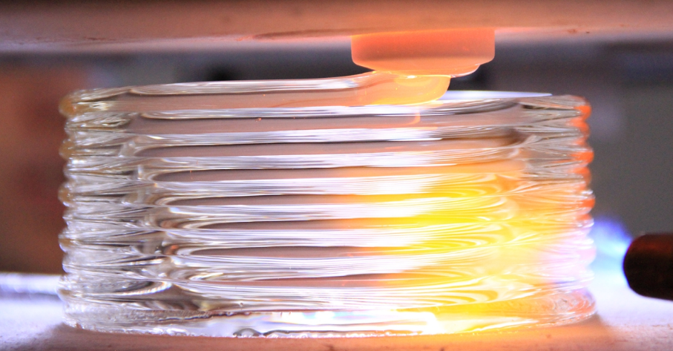

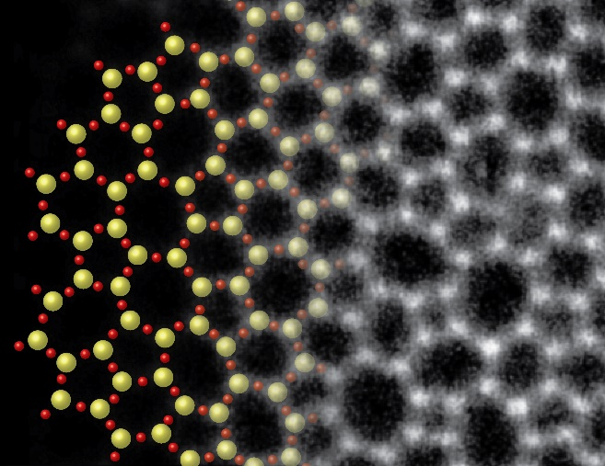
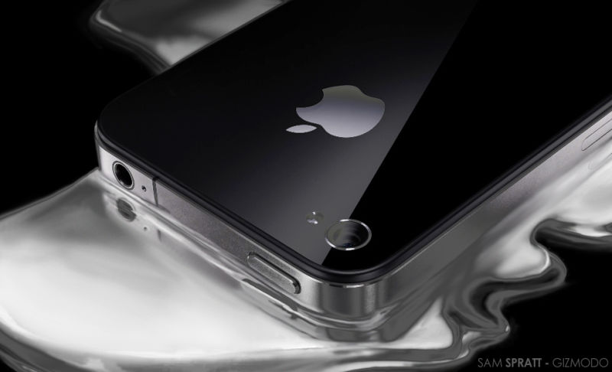
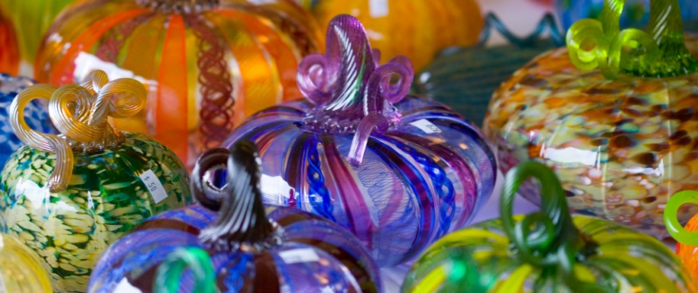

3.071 Amorphous Materials
3-d printing with glass
Sapphire vs. tempered glass: which is better?
Glass
What is Liquidmetal®?
Glass: where arts and science meet

Slide 3
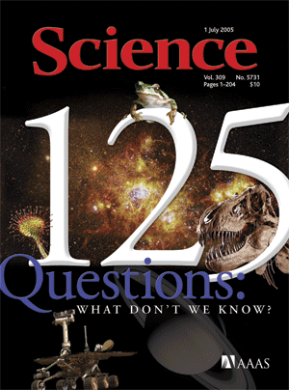
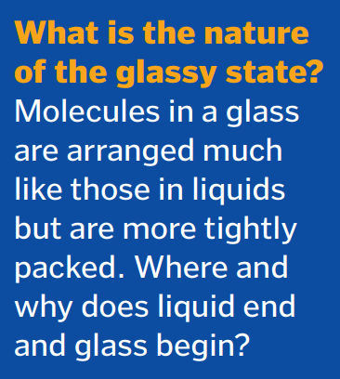
“The Nature of Glass Remains Anything but Clear”
“What don’t we know?” Science 309, 83 (2005)

Slide 4
Glass transition
H, V
Supercooled liquid
Liquid
Glass transition
Suppression of crystallization: glass formation
The glassy state is different from the supercooled liquid state
Fictive temperature
Glass
Crystal
T_{f}
T_{m}

Slide 5
Glass structures are dependent on history
H, V
Supercooled liquid
Liquid
Increasing
cooling rate
Glasses obtained at different cooling rates have different structures
Faster cooling results in higher Fictive temperature
3
2
1
T_{m}
T
Notes:
Questions to be addressed:
What is glass?
How fast is “fast enough” during cooling?
Why some materials easily form glass while others do not?
Why glass properties are dependent on thermal history?

Slide 6
What is glass?
A metastable solid which exhibits glass transition and has no long-range atomic order
G
Metastable glassy state
Thermodynamically stable crystalline state
Glasses are metastable with respect to their stable crystalline phase
Atoms can rearrange to form a more stable state given enough time and thermal energy
Structure

Slide 7
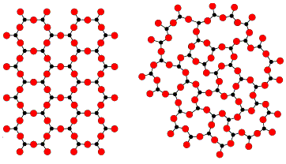
What is glass?
A metastable solid which exhibits glass transition and has no long-range atomic order
Short-range order is preserved (AO₃ triangles)
Long-range order is disrupted by changing bond angle (mainly) and bond length
Structure lacks symmetry and is usually isotropic
A fictitious A₂O₃ 2-D compound:
A₂O₃ crystal
A₂O₃ glass
Zachariasen's Random Network Theory (1932)
Notes:
Amorphous does not mean random

Slide 8
Potential energy landscape (PEL)
PE
Laboratory glass states
Ideal glass
Crystal
Atomic coordinates r₁, r₂, … r_{3N}

Slide 9
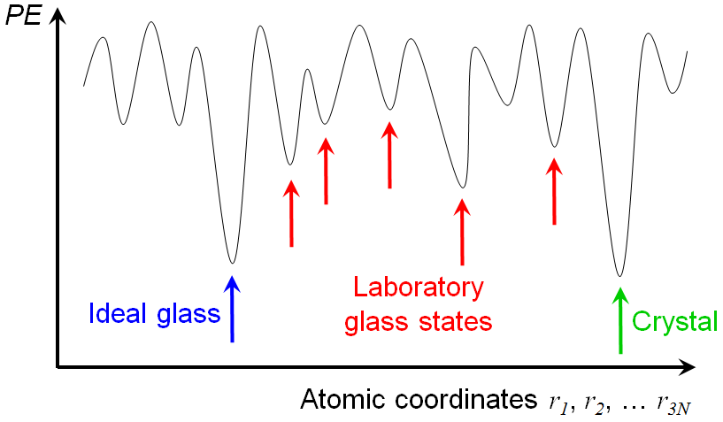
Laboratory glass transition: ergodicity breakdown
Liquid: ergodic
Glass: nonergodic, confined to a few local minima
Inter-valley transition time τ :
Glass
Liquid
E : barrier height
ν : attempt frequency

Slide 10
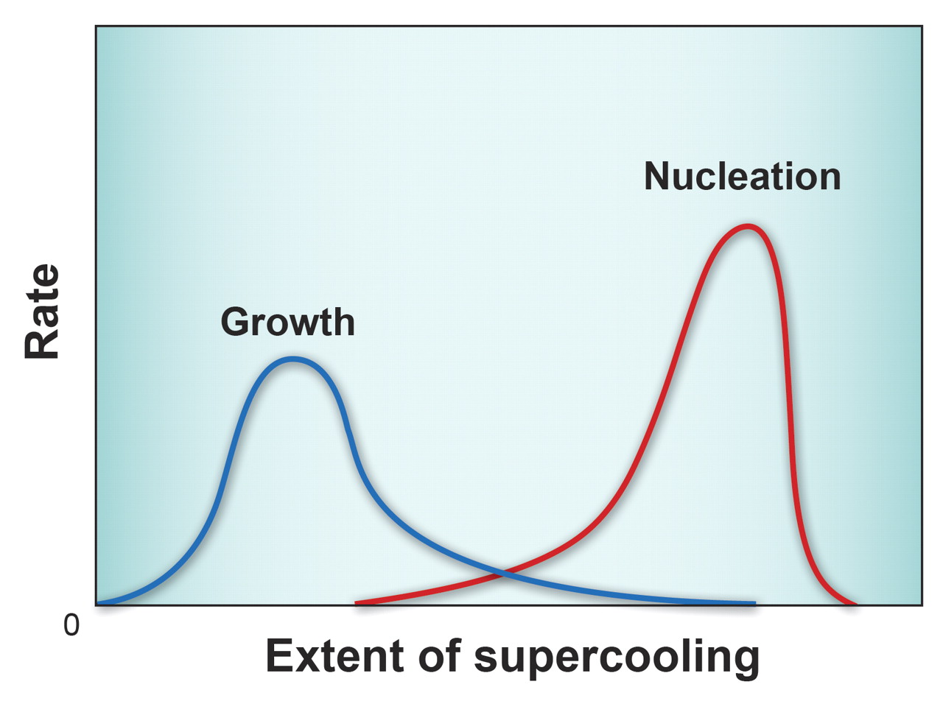
Crystal nucleation and growth
Metastable zone of supercooling
Driving force: supercooling
Both processes are thermally activated
T_{m}

Slide 11
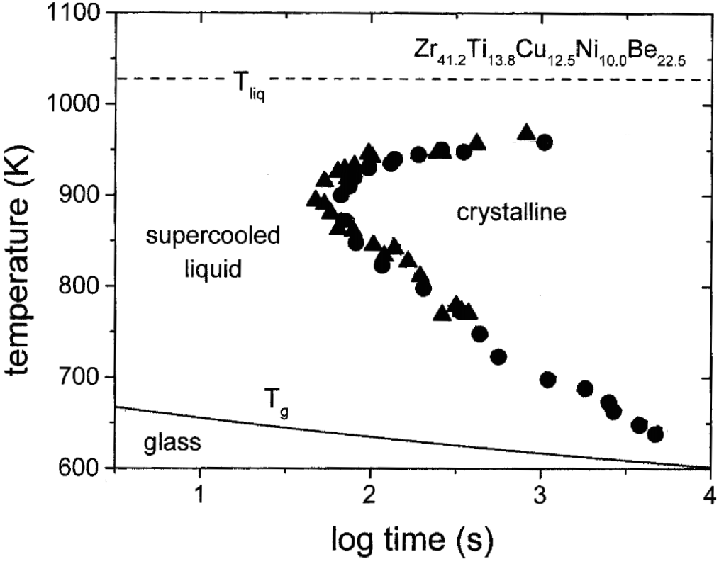
Time-temperature-transformation (TTT) diagram
Driving force (supercooling) limited
Diffusion limited
Critical cooling rate R_{c}
R. Busch, JOM 52, 39-42 (2000)

Slide 12
Critical cooling rate and glass formation
Material | Critical cooling rate (°C/s)
Silica | 9 × 10⁻⁶
GeO₂ | 3 × 10⁻³
Na₂O·2SiO₂ | 6 × 10⁻³
Salol | 10
Water | 10⁷
Vitreloy-1 | 1
Typical metal | 10⁹
Silver | 10¹⁰
Technique | Typical cooling rate (°C/s)
Air quench | 1-10
Liquid quench | 10³
Droplet spray | 10²-10⁴
Melt spinning | 10⁵-10⁸
Selective laser melting | 10⁶-10⁸
Vapor deposition | Up to 10¹⁴
Maximum glass sample thickness:
α : thermal diffusivity

Slide 13
Summary
What is glass?
  Metastable solids exhibiting glass transition and lacking long-range order
Why are glass properties history-dependent?
  Glass structure can be trapped in different metastable basins and is path-dependent
How to determine the cooling rate necessary for glass formation?
  Time-temperature-transformation (TTT) diagram

Slide 14
THE FOLLOWING PREVIEW HAS BEEN APPROVED FOR
ALL 3.022 PARTICIPANTS
R | RESTRICTED
 | VIEWERS WHO HAVEN’T TAKEN KINETICS REQUIRE ACCOMPANYING MIT DMSE STUDENTS
STRONG MATERIALS SCIENCE COMPONENTS
®
www.classratings.com
dmse.mit.edu

Slide 15
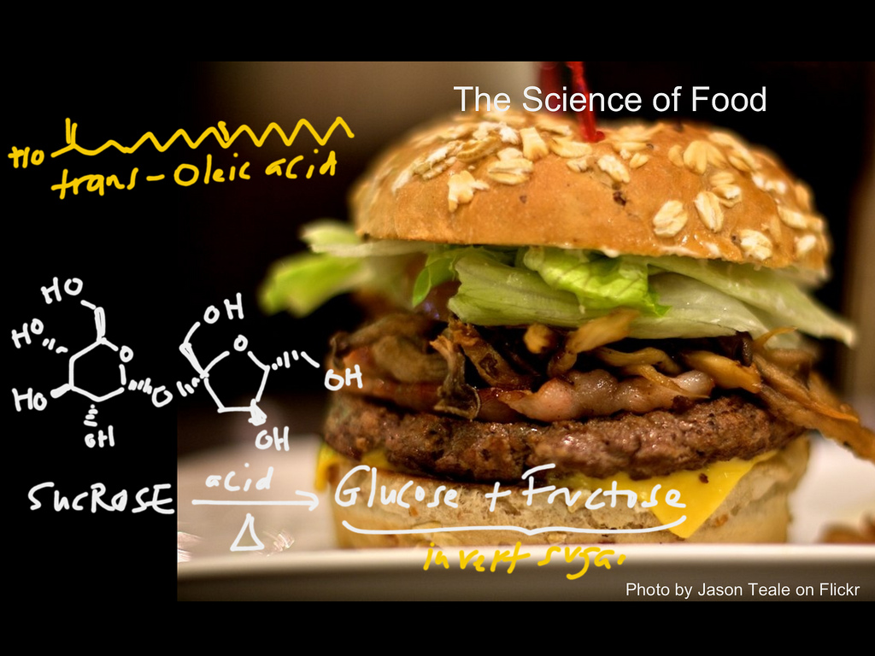
We proudly present
“Microstructural Evolution in Foods”
Image Credit: profkarim CC BY-SA 2.0

Slide 16
List of symbols
H – enthalpy
V – volume
T_{m} – melting point
T – temperature
T_{f} – Fictive temperature
G – Gibbs free energy
t_{obs} – observation time, duration of experimental observation
τ – intervalley transition time, time it takes for a system to transition from a local metastable energy basin to another
ν – attempt frequency or atomic vibrational frequency
k – Boltzmann constant (1.38 × 10⁻²³ m² kg s⁻² K⁻¹)

Slide 17
List of symbols
E – average energy barrier height between metastable states
T_{g} – glass transition temperature
R_{c} – critical cooling rate to prevent crystallization
ΔT – supercooling corresponding to the nose temperature
α – thermal diffusivity
d_{max} – maximum thickness of sample that can maintain a homogeneous glassy state

