Slide 1
MIT 3.022
Microstructural Evolution in Materials
13: Precipitate Growth
Juejun (JJ) Hu
hujuejun@mit.edu

Slide 2
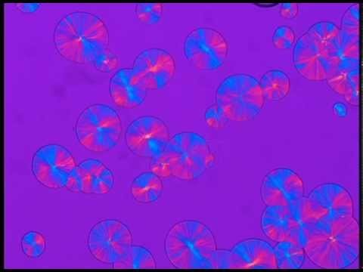
Spherulite nucleation and growth
Video credit: Ian Chesser

Slide 3
Classifications of precipitate growth
Growth from a single-component solution
  Faceted precipitates: 2-D nucleation controlled
  Precipitates with atomically rough surfaces: interface kinetics controlled
Growth from a binary system with miscibility gap
  Diffusion controlled
Faceted surface

Slide 4
Classifications of precipitate growth
Growth from a single-component solution
  Faceted precipitates: 2-D nucleation controlled
  Precipitates with atomically rough surfaces: interface kinetics controlled
Growth from a binary system with miscibility gap
  Diffusion controlled
Non-faceted surface
Temperature
α
ΔT
β
100% A
100% B

Slide 5
Continuous growth
Non-faceted surface
Continuous growth on atomically rough surface: plenty of surface sites for atom attachment
Growth rate determined by atom attaching rate ν _{h}
E_{a}
Liquid
Gibbs free energy
Solid
Atomic location

Slide 6
Continuous growth
Non-faceted surface
Volumetric Gibbs free energy change
Growth rate (interface velocity)
E_{a}
Liquid
Gibbs free energy
Solid
Atomic location

Slide 7
Growth rate dependence on supercooling
Driving force limited regime
Growth rate
Diffusion limited regime
Supercooling ΔT
There is no supercooling threshold for continuous growth

Slide 8
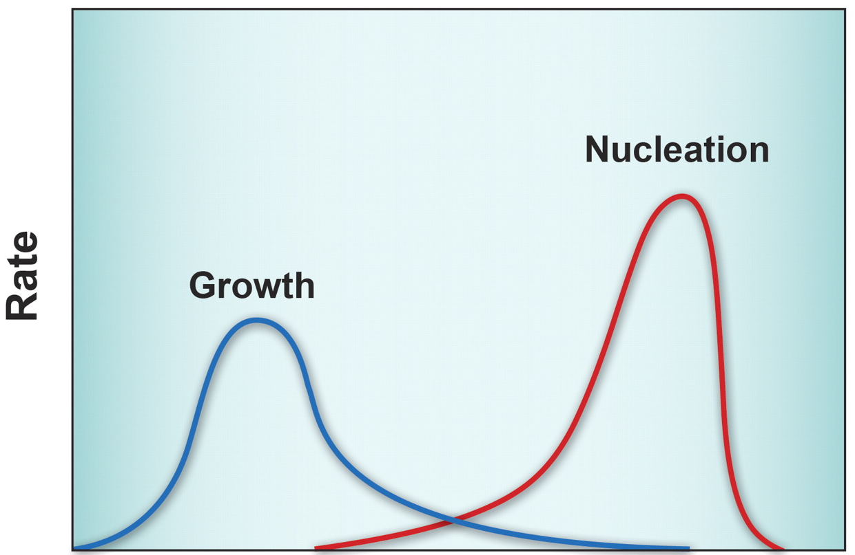
Impact of supercooling on nucleation and growth
Metastable zone of supercooling
Phase transition
Driving force: supercooling
Both processes are thermally activated
T_{m}
Supercooling
Notes:
Here a continuous growth mode is assumed (i.e. no 2-D nucleation is required for growth)

Slide 9
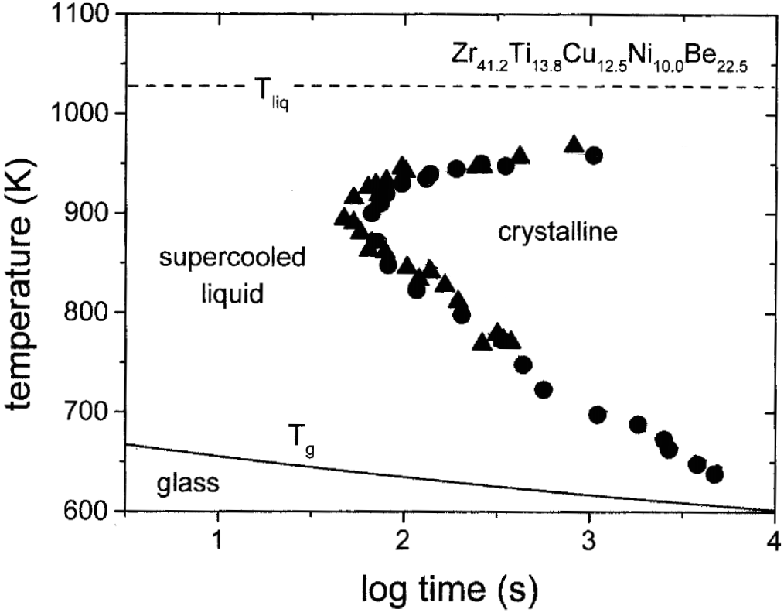
Time-temperature-transformation (TTT) diagram
Driving force (supercooling) limited
Diffusion limited
R. Busch, JOM 52, 39-42 (2000)

Slide 10

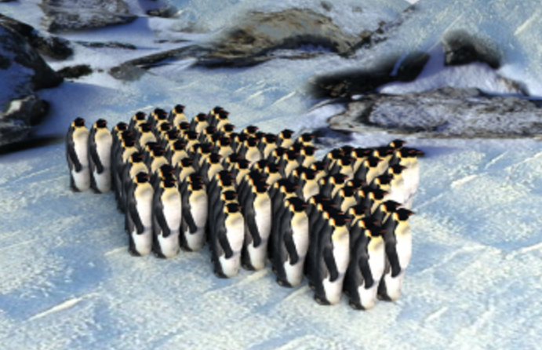
2-D nucleation on faceted surfaces
Faceted surface
Large surface area
2-D nucleus
2-D nucleus
R. Gerum et al. 2013 New J. Phys. 15, 125022, CC-BY 3.0
“The origin of traveling waves in an emperor penguin huddle,” New J. Phys. 15, 125022 (2013)

Slide 11
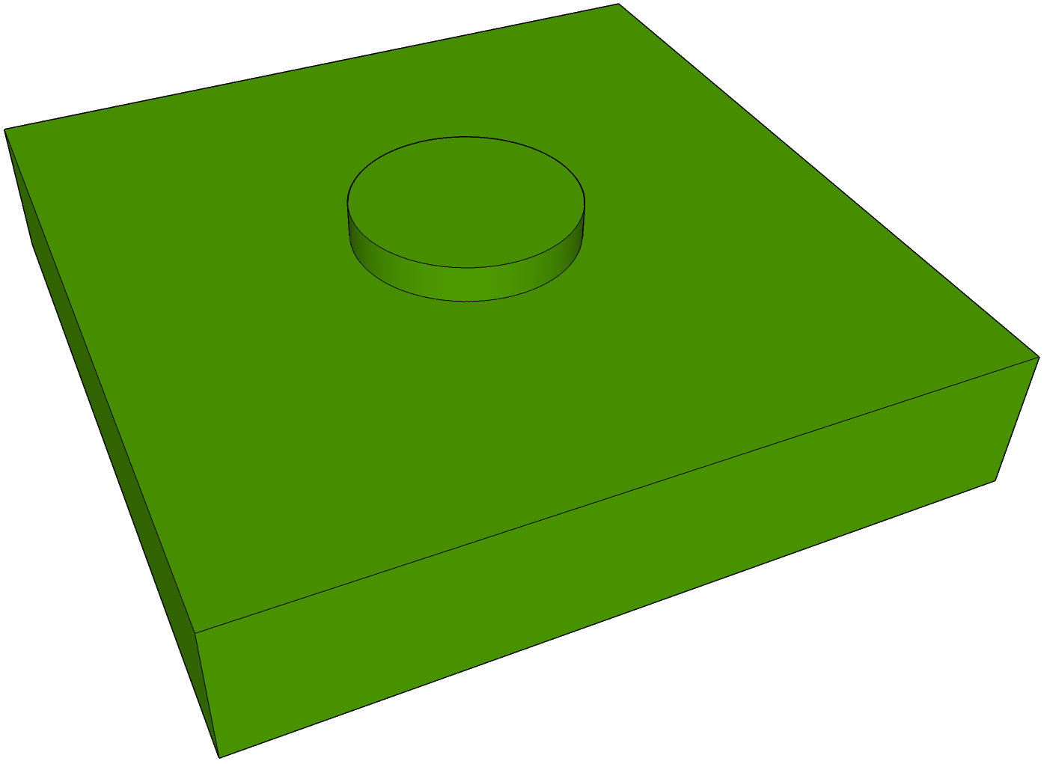
Free energy barrier for 2-D nucleation
Gibbs free energy change of cluster formation
  “Volumetric” term
  “Surface” term
r
h
2-D nucleus
Crystal precipitate

Slide 12
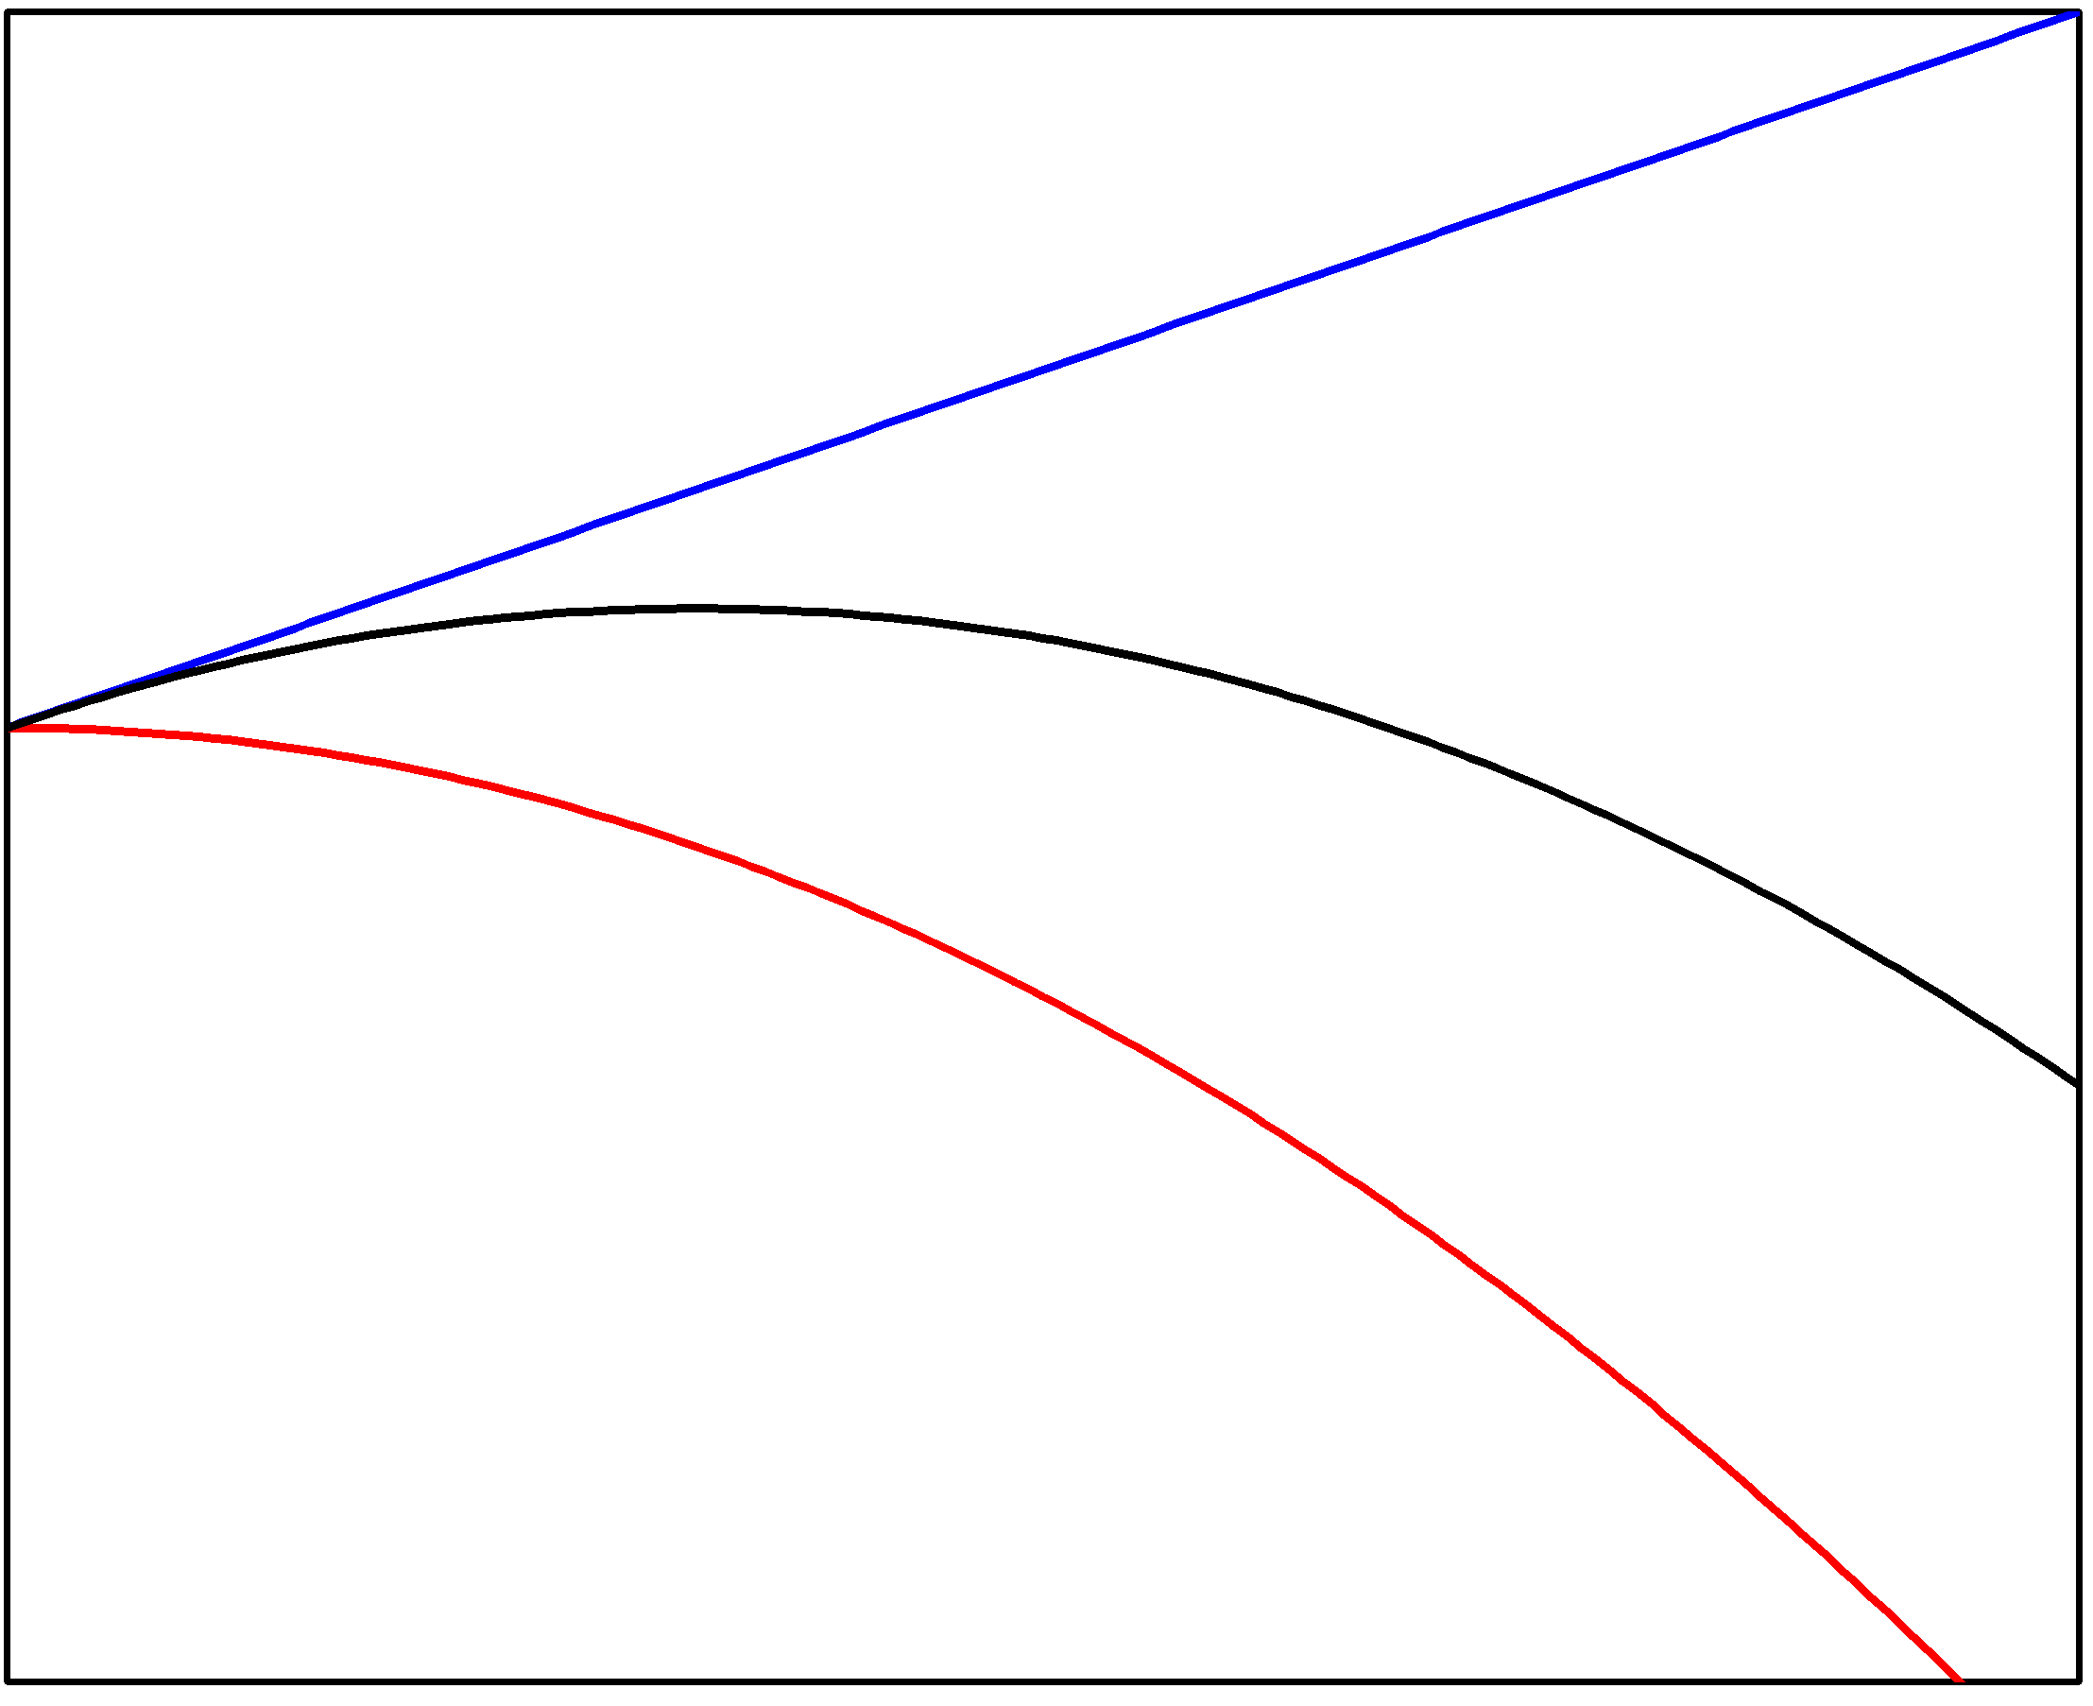
Free energy barrier for 2-D nucleation
Gibbs free energy change of cluster formation
  “Volumetric” term
  “Surface” term
ΔG_{2D}
Nucleus radius r

Slide 13
Growth rate on faceted planes
In-plane growth rate is much higher than nucleation rate
Growth rate scales with 2-D nucleation rate
Nucleation rate I_{2D}
  Number of 2-D nuclei with size just under r*_{2D} × Rate of atoms hopping to the nuclei
2-D nucleus
Driving force term
Diffusion term

Slide 14
Growth rate dependence on supercooling
2-D nucleation
Continuous growth
Diffusion limited regime
Growth rate
Supercooling ΔT
Supercooling threshold

Slide 15
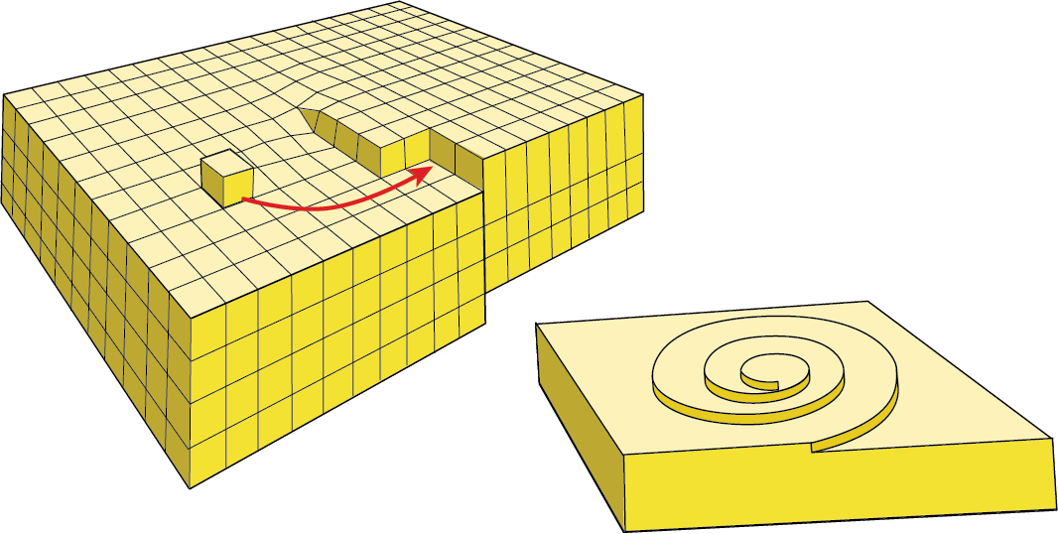

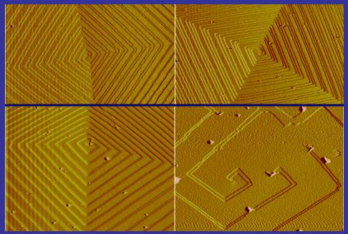
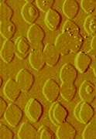
Screw dislocation assisted growth on facets
Growth via atom attachment to the ledge around a screw dislocation without requiring 2-D nucleation
Growth rate
Spiral growth
2-D nucleation
Image Credit: H. Henry Teng
http://home.gwu.edu/~hteng/resareaone.html
Notes:
With increasing supercooling, 2-D nucleation starts to become important (the images are calcite crystal surfaces)

Slide 16
Precipitate growth from a binary solution
Precipitates generally have compositions different from the solution
Mass transport via diffusion is the rate limiting step
Continuous phase α
β
B
β
β
Temperature
Concentration of B
β
α
ΔT
β
α
100% A
100% B
α – β interface

Slide 17
Precipitate growth kinetics
Local equilibrium assumption
The phases α and β are in chemical equilibrium with each other locally on the α – β interface
C_{β}
C₀
C₀
Concentration of B
β
α
ΔT
β
C_{α}
α
A
C_{α}
C_{β}
B
x_{α–β}

Slide 18
Precipitate growth kinetics
Linear concentration assumption
Flux of B atoms:
Growth rate (interface velocity):
C_{β}
L
C₀
Concentration of B
β
C_{α}
α
x_{α–β}

Slide 19
Precipitate growth kinetics
Mass conservation
Excess B in the β phase all comes from the α phase
C_{β}
L
C₀
Concentration of B
where
β
C_{α}
α
x_{α–β}

Slide 20
Precipitate growth kinetics
Concentration relationships
C₀
ΔT
α
β
A
C_{α}
C_{β}
B

Slide 21
Growth rate dependence on supercooling
Driving force limited regime
Diffusion limited regime
Growth rate
Supercooling ΔT
There is no supercooling threshold for diffusion-limited growth

Slide 22
Summary
Type of precipitate | Single-component system |  | Binary system
 | Faceted (defect-free) | Non-faceted
Rate limiting factor | 2-D nucleation | Interface kinetics | Diffusion
Growth rate
Supercooling threshold | Yes | No | No
Comments | 1) Presence of screw dislocations can lead to spiral growth; 2) Transition to continuous growth can occur at large supercooling |  | The formalism above does not apply to the Spinodal region

Slide 23
List of symbols
ΔT – supercooling, defined as the difference between the equilibrium and the actual phase transition temperatures
T – temperature
k – Boltzmann constant (1.38 × 10⁻²³ m² kg s⁻² K⁻¹)
ν – vibrational frequency of an atom
ν_{h} – frequency of successful hops of an atom, i.e. atom attaching rate to an atomically rough surface
ν_{L→S} / ν_{S→L} – frequency of successful hops of an atom from the liquid / solid phase to the solid / liquid phase
E_{a} – activation energy of atomic hopping from the liquid phase to the solid phase
γ – surface/interface energy

Slide 24
List of symbols
– volumetric Gibbs free energy difference of an atom in solid and liquid phases
ΔH_{m} – enthalpy of fusion per unit volume
T_{m} – melting point
R – precipitate growth rate measured by the velocity of the solid-liquid interface
– volume occupied by one atom
ρ_{S} – surface density of atoms, i.e. number of atoms per unit surface area
ΔG_{V} / ΔG_{S} – volumetric / surface contributions to Gibbs free energy change of phase transition

Slide 25
List of symbols
r – radius of a 2-D nucleus
h – height of a 2-D nucleus
ΔG_{2D} – Gibbs free energy change associated with formation of a 2-D nucleus
– critical 2-D nucleus size
– energy barrier towards 2-D nucleation
I_{2D} – 2-D nucleation rate
E_{a,2D} – activation energy of atomic diffusion to 2-D nuclei
C₀ / C_{α} / C_{β} – concentration of component B in the sample / in the precipitate phase β / in the continuous phase α that equilibrates with the precipitate phase β

Slide 26
List of symbols
F_{B} – diffusion flux of component B
D_{B} – diffusion coefficient of component B in the α phase
t – time
L – length of the region near the surface of β phase precipitates where the α phase composition deviates from the bulk continuous phase composition
x_{α−β} – size of the precipitate, defined by the position of the interface between the precipitate and continuous phases
E_{a,B} – activation energy of diffusion for component B

