Slide 1
MIT 3.022
Microstructural Evolution in Materials
11: Growth and Ripening
Juejun (JJ) Hu
hujuejun@mit.edu

Slide 2
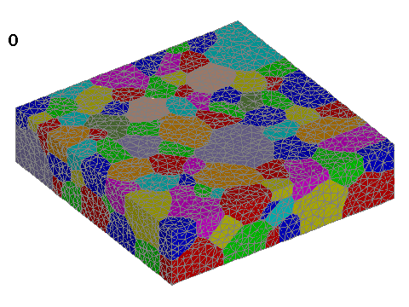
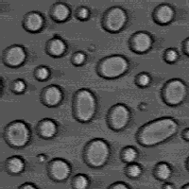
We are not talking about strawberries here…
© LaGriT - Los Alamos National Laboratory
© Joel Stavans, Weizmann Institute of Science
Grain growth
Ostwald ripening

Slide 3
2-D grain growth
Grain 1
Grain 2
Flux
Boundary velocity
Driving force for grain growth: interface curvature
Notes:
The prime sign represents quantities associated with atomic motion in grain boundaries
Note that there is a factor of 2 difference between the equations and the formalism in the lecture notes since here we assume 2-D grain growth

Slide 4
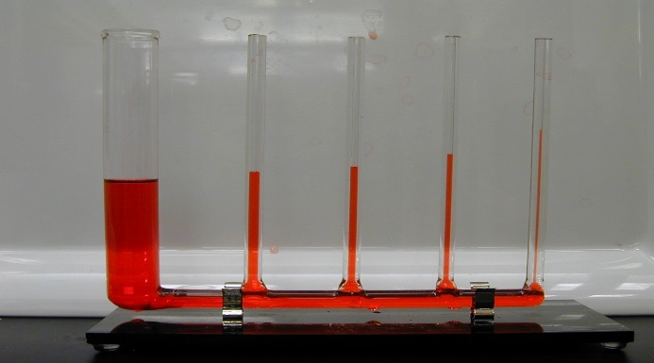
2-D grain growth: grain boundary motion
Grain 1
Grain 2
Laplace pressure σ :
Boundary mobility
Driving force for grain boundary motion: Laplace pressure

Slide 5
Scaling behavior and grain growth kinetics
t = t₁
t = t₂
Large grains grow/shrink slower compared to small grains

Slide 6
Scaling behavior and grain growth kinetics
t = t₁
t = t₂
Square of (average) grain size grows linearly with time

Slide 7
Ostwald ripening: local equilibrium assumption
Particles are in equilibrium with their local solution environment
Solution phase
Flux
a
Gibbs-Thomson Equation
Smaller particles locally equilibrate with more concentrated solution
Particles
Notes:
The 2γV/kT term in the exponent of G-T eq. is called “capillary length” and is usually in the order of 1 nm

Slide 8

Ostwald ripening: mean field approximation
Particles exchange solute with a large bath of continuous, uniform solution phase via diffusion
Diffusion near a single particle in a spherical coordinate system
Solution phase
$$C\left(∞\right)$$
Particles

Slide 9
Ostwald ripening: mean field approximation
Particles exchange solute with a large bath of continuous, uniform solution phase via diffusion
Diffusion near a single particle in a spherical coordinate system
Solution phase
$$C\left(∞\right)$$
Particles

Slide 10
Ostwald ripening: particle coarsening
Correlate diffusion flux with particle size evolution
Solution phase
$$C\left(∞\right)$$
“For unto every one that hath shall be given, and he shall have abundance: but from him that hath not shall be taken even that which he hath.”
Particles

Slide 11
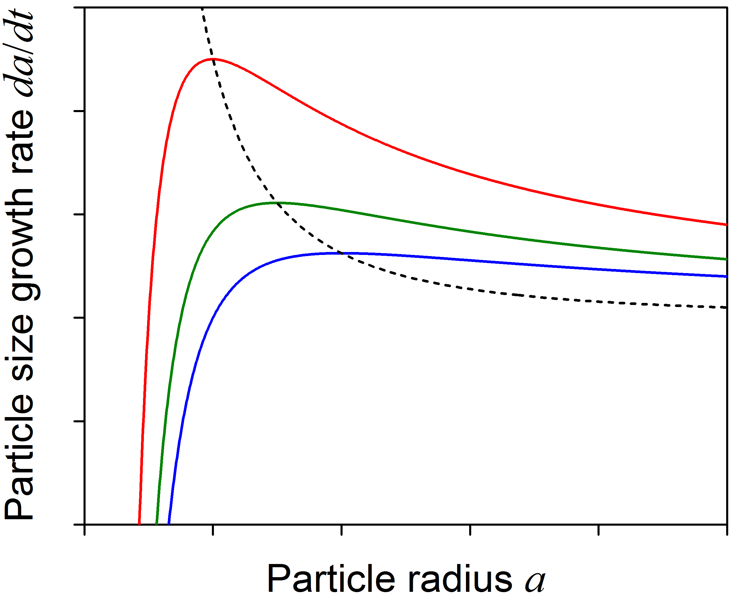
Ostwald ripening: particle coarsening
Maximum growth rate:
Average particle size:

Slide 12
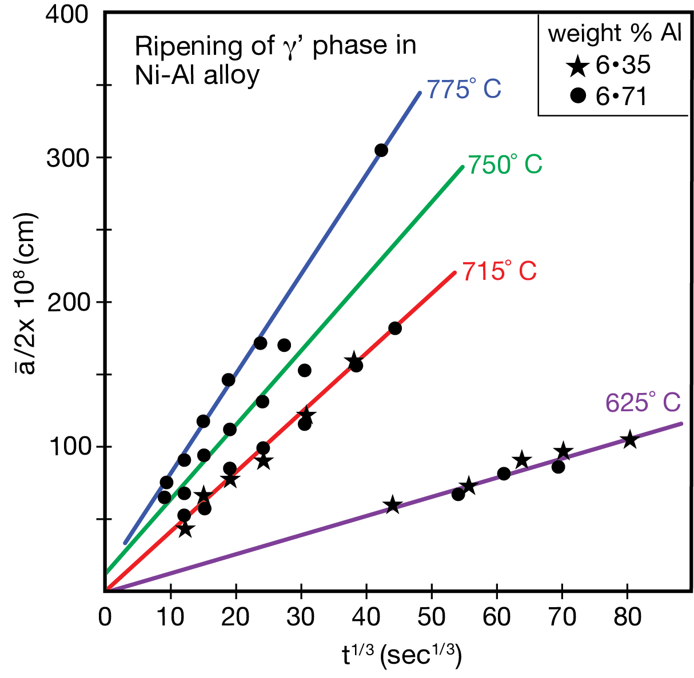
Ostwald ripening: Lifshitz-Slyozov-Wagner theory
Limitations:
MFA neglects local environment fluctuations
Nonlinear terms in the Gibbs-Thomson equation are missing
A. J. Ardell, “Mechanism of Phase Trans-formations in Crystalline Solids”, p. 111.

Slide 13
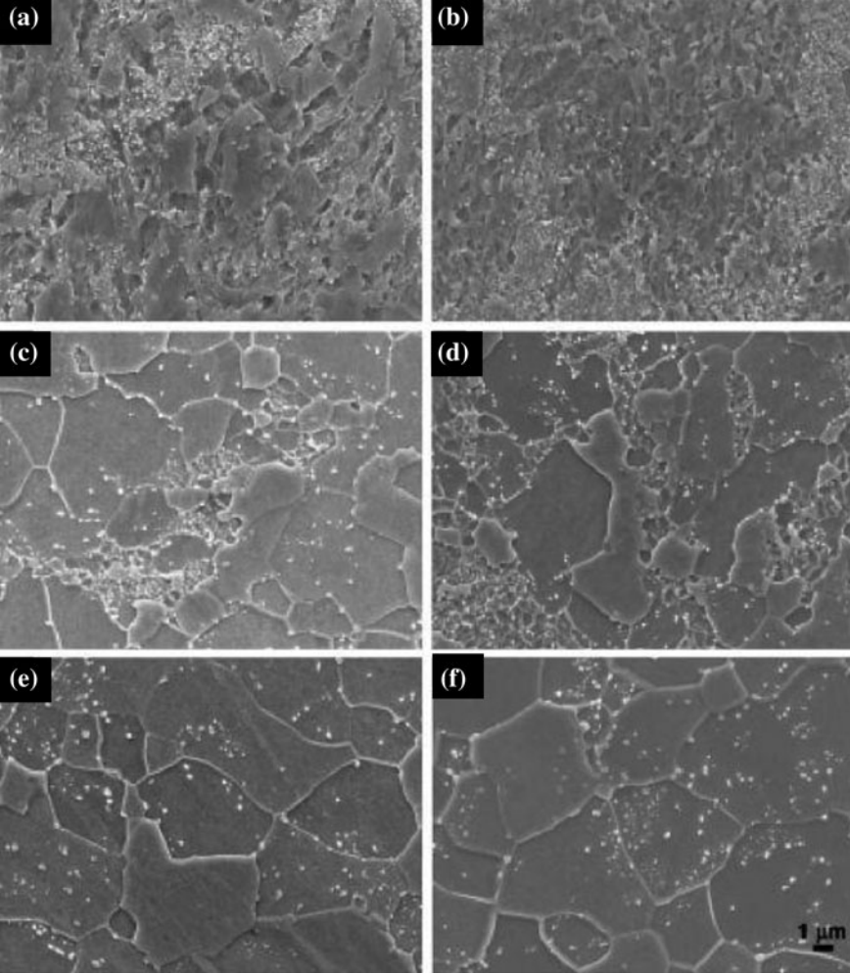
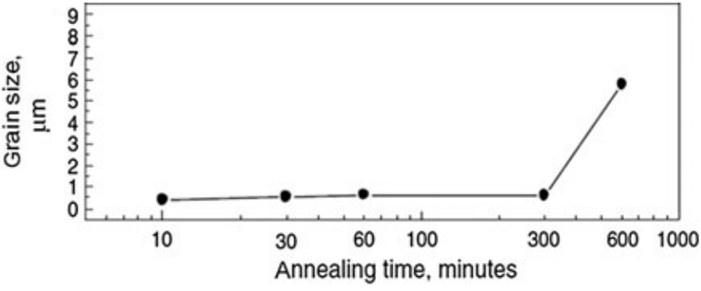
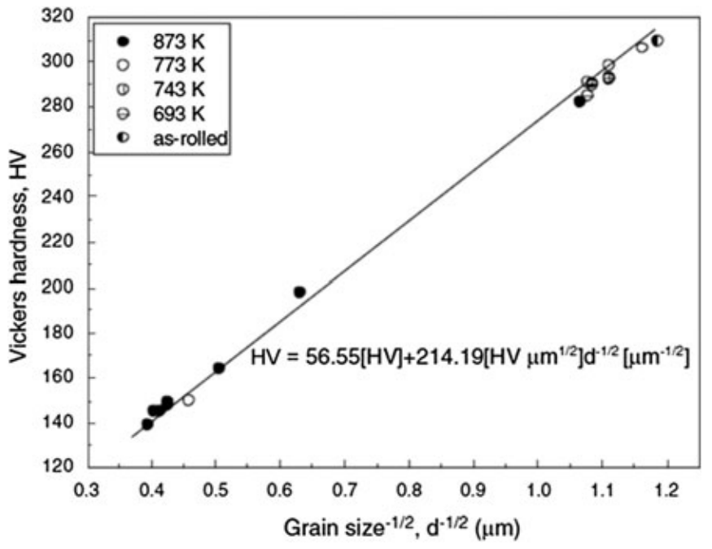
Grain growth and mechanical properties
Ultra-Fine-Grained Steel
T. Hanamura and H. Qiu, Analysis of Fracture Toughness Mechanism in Ultra-fine-grained Steels

Slide 14
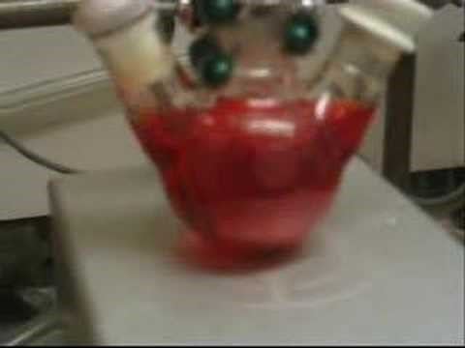
Ostwald ripening in nanoparticle synthesis
Used with permission of Wen Liu

Slide 15
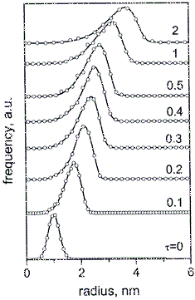
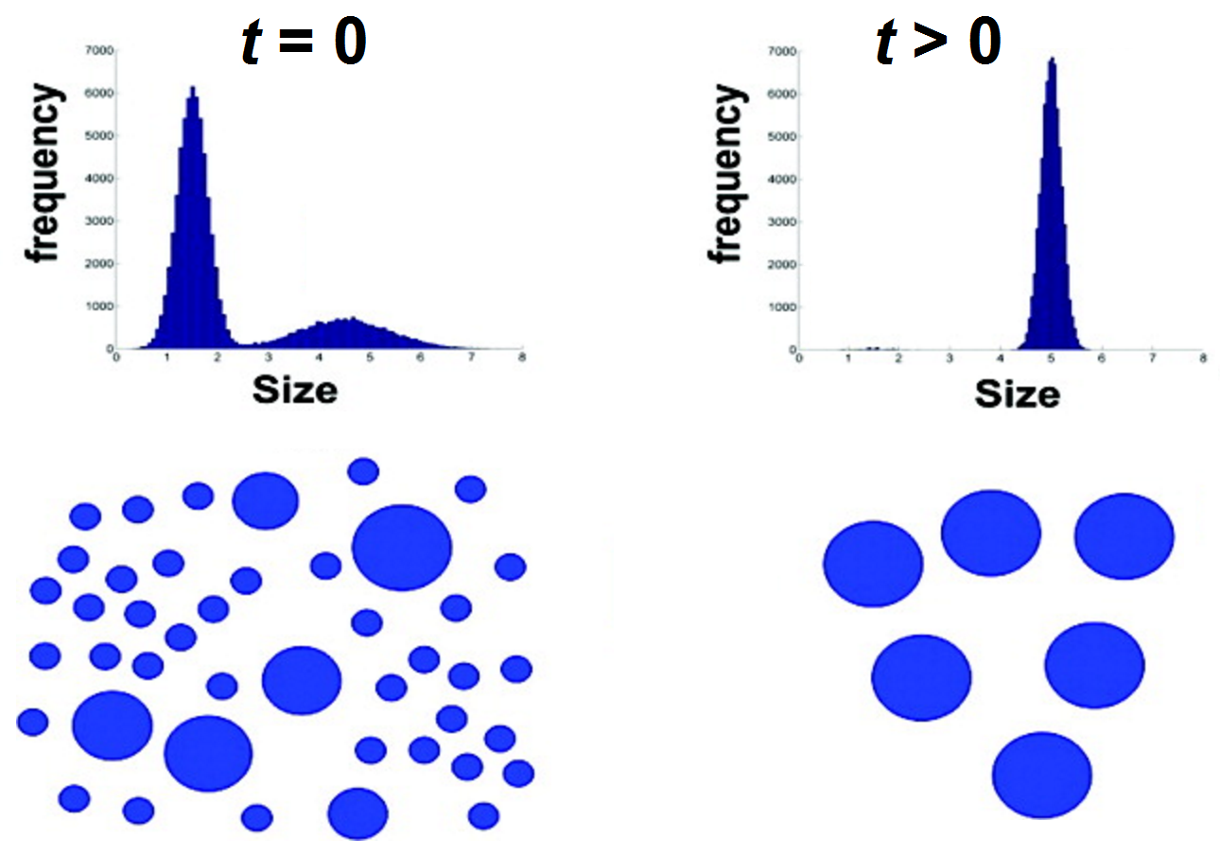
Ostwald ripening in nanoparticle synthesis
Talapin et al., J. Phys. Chem. B 105, 12278 (2001);
Dagtepe et al., J. Phys. Chem. C 114, 16263 (2010).

Slide 16
Summary
Interface energy drives growth and ripening
Both processes are diffusion controlled*
General grain growth equation
Ostwald ripening
  Gibbs-Thomson equation and local equilibrium
  Mean field approximation (MFA)
  Lifshitz-Slyozov-Wagner (LSW) theory
*In practice this is not necessarily the case.
Notes:
For example, Ostwald ripening can be surface reaction controlled.

Slide 17
List of symbols
T – temperature
k – Boltzmann constant (1.38 × 10⁻²³ m² kg s⁻² K⁻¹)
μ – chemical potential
F – driving force for diffusion
μ₁ / μ₂ – chemical potential in grain 1/2
d_{gb} – thickness of grain boundary
γ – grain boundary energy (in grain growth) or interface energy (in Ostwald ripening)
r – radius of curvature of a grain boundary (in grain growth) or distance from the center of a particle (in Ostwald ripening)

Slide 18
List of symbols
C₀ – number density of molecules/atoms
v – velocity of diffusing molecules/atoms
M’ – mobility of molecules/atoms inside grain boundary
D’ – diffusion coefficient of molecules/atoms inside grain boundary
J – diffusion flux
v_{gb} – moving velocity of grain boundary
σ – Laplace pressure exerted by a curved surface
A – area
x – coordinate along the x-axis

Slide 19
List of symbols
ΔG – Gibbs free energy change
L – average grain size
L₁ / L₂ – characteristic size of grain 1/2
Γ – a scaling factor defined by
K – a geometric factor depending on the shape of the grain
t – time
M_{gb} – mobility of grain boundary defined by
μ ^{(P)} – chemical potential without the surface energy contribution, i.e. chemical potential of a bulk system with a very small surface/volume ratio

Slide 20
List of symbols
– volume occupied by one molecule/atom:
a – radius of a particle in Ostwald ripening
C ^{(P)} – concentration of molecules/atoms in the continuous phase in equilibrium with a very large (“bulk”) particle
C – concentration of molecules/atoms in the continuous phase
C(a) – concentration of molecules/atoms on the surface of a particle with radius a
J(a) – diffusion flux on the surface of a particle with radius a

Slide 21
List of symbols
C(r) – concentration of molecules/atoms in the continuous phase at a distance r away from the center of the particle
D – diffusion coefficient of molecules/atoms in the continuous phase
– average size of particles
– maximum grow rate of particle size

