Slide 1
MIT 3.022
Microstructural Evolution in Materials
10: Faceted and Non-Faceted Growth
Juejun (JJ) Hu
hujuejun@mit.edu

Slide 2
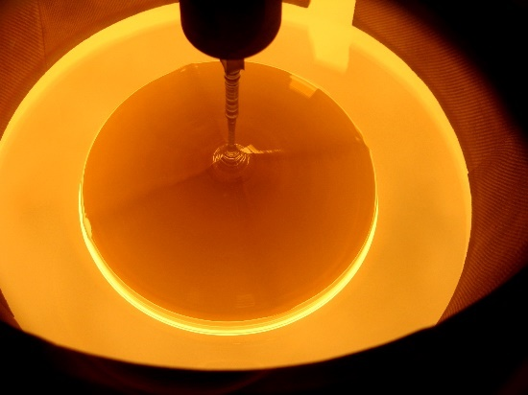
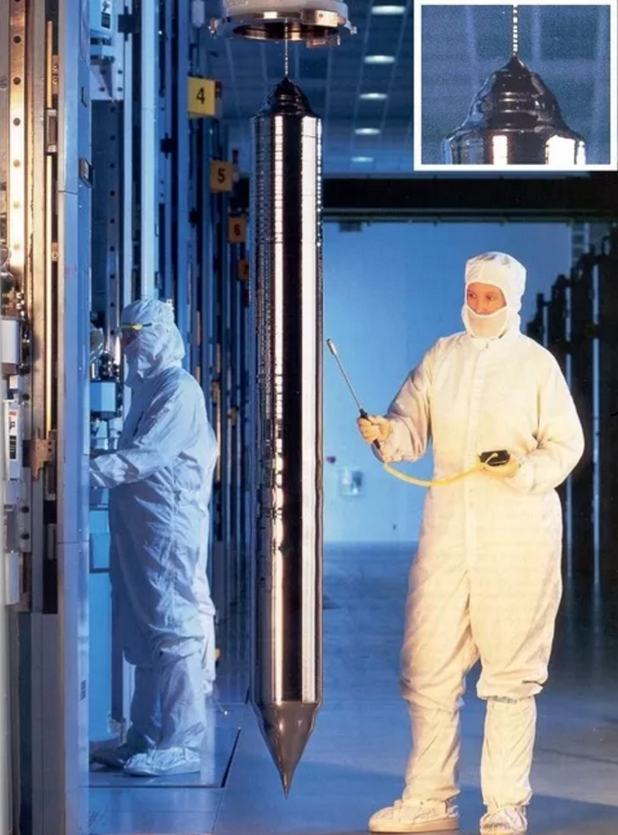
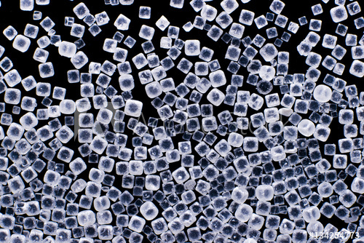
Faceted vs. non-faceted crystal growth
Credit: Qwazzy CC BY-SA 3.0
Si ingot
Salt crystals
Curved surface
© WaferPro

Slide 3
Atomically smooth vs. atomically rough surfaces
Energy increases
Entropy increases

Slide 4
The Jackson model of crystal growth
n atoms
N sites
Consider a single layer of adsorbed atoms on a flat surface
−ΔE₀ : energy decrease due to bond formation with atoms in the crystal
−ΔE₁ : energy decrease due to bond formation with other adsorbed atoms
+TΔS_{t} : entropy decrease due to phase transition
−TΔS_{c} : entropy increase due to random arrangement of adsorbed atoms
−PΔV : volume decrease due to phase transition (for gas condensation)

Slide 5
The Jackson model of crystal growth
n atoms
N sites
Consider a single layer of adsorbed atoms on a flat surface
where
L₀ : internal energy released per atom on condensation/freezing
Z₀ : number of bonds between the adsorbed atom and atoms in the crystal
Z : total coordination number
Notes:
2 atoms share one chemical bond in the crystal, and hence the factor of 2

Slide 6
The Jackson model of crystal growth
n atoms
N sites
Consider a single layer of adsorbed atoms on a flat surface
where
L₀ : internal energy released per atom on condensation/freezing
Z₁ : number of “in-plane” chemical bonds between adsorbed atoms
θ : surface coverage ratio (fraction of sites being occupied)

Slide 7
The Jackson model of crystal growth
n atoms
N sites
Consider a single layer of adsorbed atoms on a flat surface
L : enthalpy change per atom on condensation/freezing
T_{t} : phase transition (melting or sublimation) temperature
for gas condensation
for liquid freezing

Slide 8
The Jackson model of crystal growth
Consider the liquid freezing case where
Jackson factor:
A measure of the relative magnitude of energy and entropy contributions

Slide 9
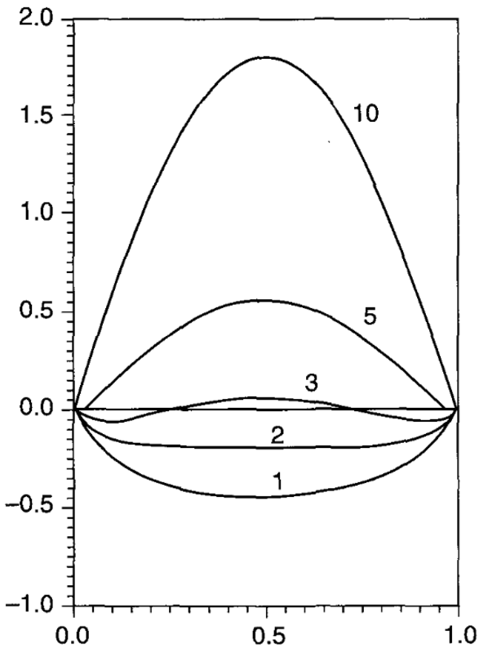
Jackson factor and surface smoothness
Non-faceted growth: α < 2
  Entropy term dominates
  Weak chemical bonds
  High temperature
Faceted growth: α > 2
  Energy term dominates
  Strong chemical bonds
  Low temperature
  Close-packed plane
Normalized ΔG
Surface coverage ratio θ

Slide 10
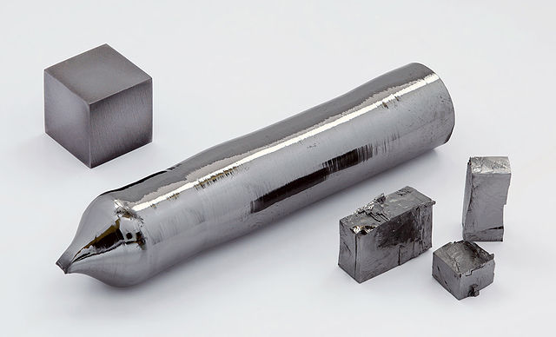
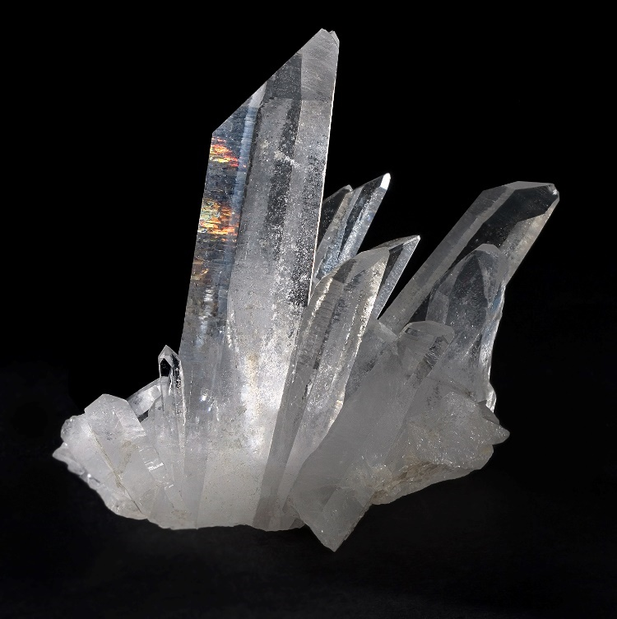
Morphology of crystals grown from melt
Natural quartz (SiO₂)
Single crystal tantalum
Image credit: Alchemist-hp (www.pse-mendelejew.de) CC BY-NC-ND 3.0
Image credit: JJ Harrison (jjharrison89@facebook.com) CC BY-SA-2.5

Slide 11
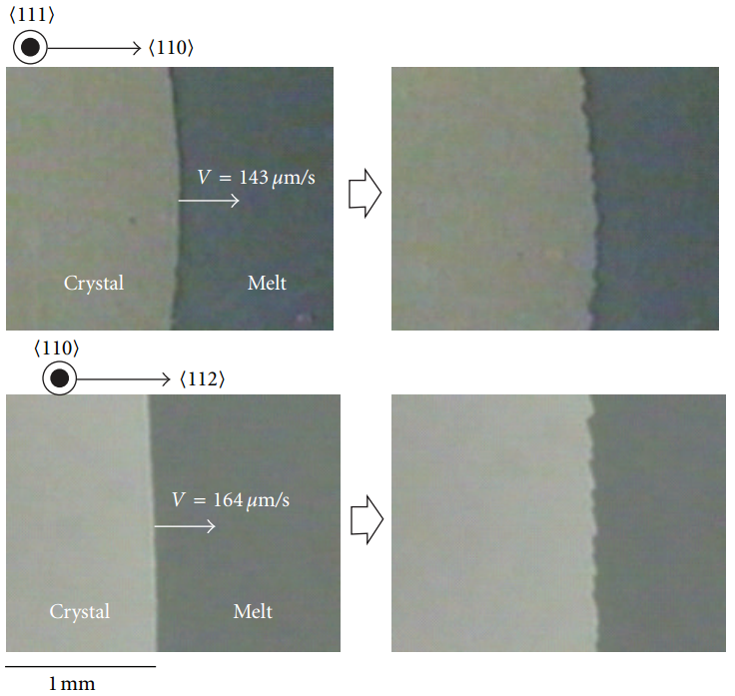
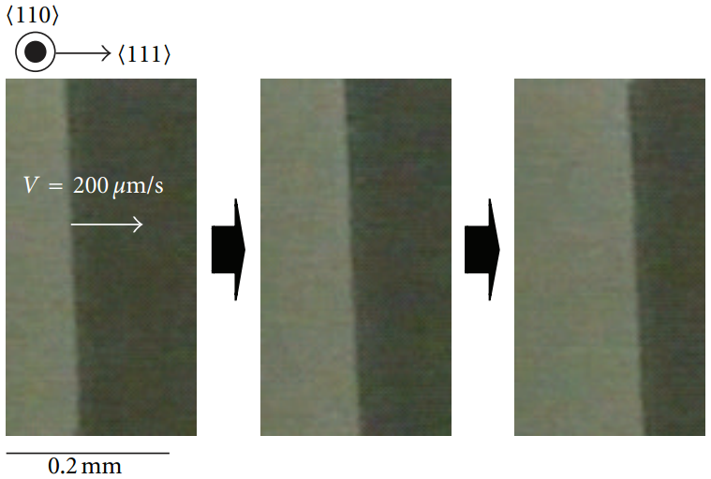
Single crystal silicon growth from the melt
t = 0 s
t = 1.5 s
t = 0 s
t = 1 s
t = 2 s
t = 0 s
t = 1.5 s
“… the Si (111) planar interface is atomically smooth…. the (110), (112) and (100) planes, are atomically rough, and thus morphological transformation occurs.”
K. Fujiwara et al., Acta Mater. 59, 4700 (2011)
Used with permission from Elsevier

Slide 12

Faceted cherries vs. non-faceted grapes
α > 2
α < 2
Photo by Sam Belden @ Madrid

Slide 13
List of symbols
γ – surface energy
S – entropy
ΔG – Gibbs free energy change due to a single layer of atoms adsorbed onto a flat crystal surface
ΔE₀ – energy change due to bond formation with atoms in the crystal
ΔE₁ – energy change due to bond formation with other adsorbed atoms on the crystal surface
T – temperature at which the crystal growth takes place
ΔS_{t} – entropy change of crystallization

Slide 14
List of symbols
ΔS_{c} – configurational entropy associated with the single layer of adsorbed atoms
P – pressure
n – number of adsorbed atoms in the single layer
N – number of adsorption sites on the crystal surface
E_{b} – bond energy
Z – coordination number
Z₀ – number of bonds between an adsorbed atom and atoms in the crystal
Z₁ – number of bonds between adsorbed atoms in a single monolayer

Slide 15
List of symbols
L₀ – internal energy released per atom upon crystallization
L – enthalpy change per atom upon crystallization; from liquid-solid phase transition
θ – surface coverage ratio (fraction of sites being occupied) defined as n / N
T_{t} – melting point or sublimation point
α – Jackson factor, defined as

