Slide 1
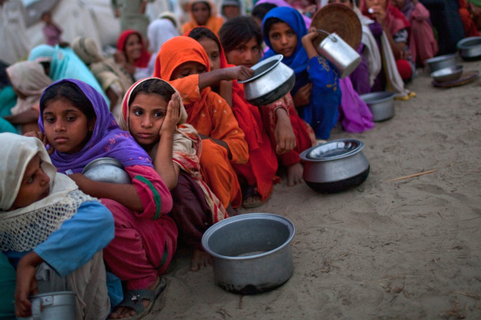
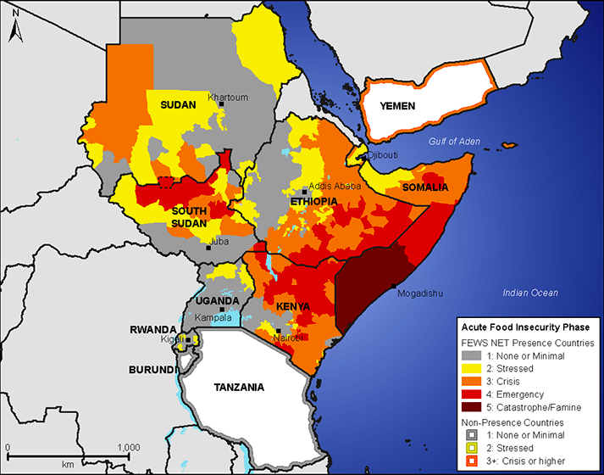
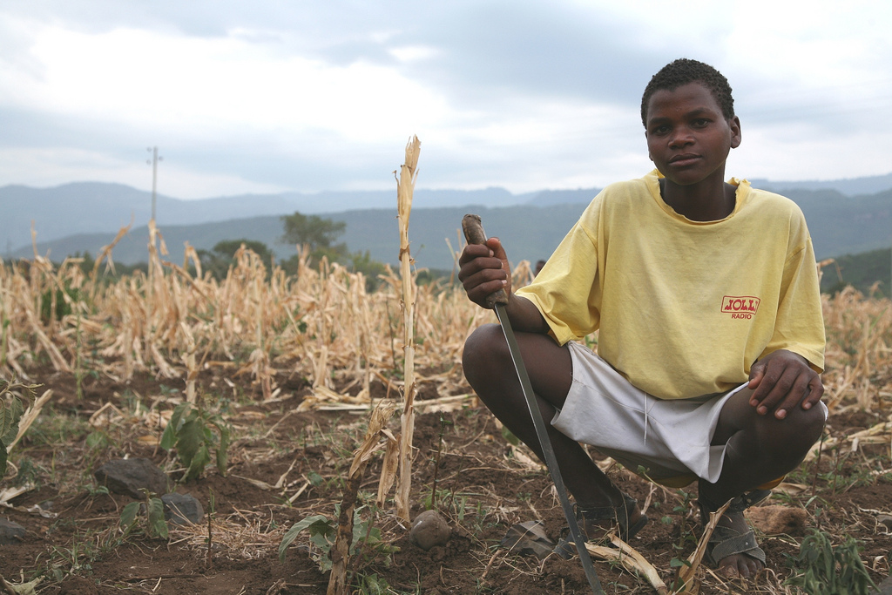

Mission 2019:
Global Food Security in the 21st century

Slide 2
Mission 2019
Your mission is to design a plan that will produce and distribute enough food to feed the planet over the next century, while ensuring that efficiency and equity are maximized and reducing agriculture’s toll on the environment.

Slide 3
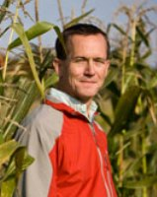
Mission 2019 Panelists
Prof. Timothy Griffin
Tufts University
Friedman School of Nutrition Science
and Policy
Director of Agriculture, Food and
Environment Program
http:

Slide 4
Mission 2019 Panelists
Research interests:
Development and implementation of sustainable production systems
Environmental impacts of agriculture
Impacts of policy on adoption of agricultural practices and systems
Development and implementation of equitable food systems at the local to regional scales
http:

Slide 5
Mission 2019 Panelists
Past research includes field and lab components addressing:
crop management
alternative crop development
management strategies to improve soil quality
soil carbon sequestration and cycling emission of greenhouse gases from high-value production systems
grain production for organic dairy systems
http:

Slide 6
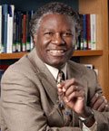
Mission 2019 Panelists
Prof. Calestous Juma
Professor of the Practice of International Development
Harvard Kennedy School, Belfer Center for Science and International Affairs
Director of:
Science, Technology, Globalization Project
Agricultural Innovation Policy in Africa Project
Health Innovation Policy in Africa project
Member, National Academy of Sciences & Royal Society

Slide 7
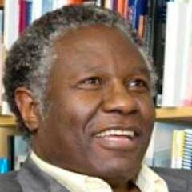

The New Harvest: Agricultural Innovation in Africa. New York: Oxford University Press, January 2011. (Full text available at 2nd link below)
http://belfercenter.ksg.harvard.edu/experts/231/calestous_juma.html
http://belfercenter.ksg.harvard.edu/publication/20504/new_harvest.html
http://belfercenter.ksg.harvard.edu/publication/20685/africa_can_feed_itself_in_a_generation.html

Slide 8
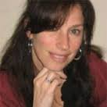
Mission 2019 Panelists
Irit Tamir
Oxfam America
Senior Campaigns and Advocacy Advisor for Oxfam America’s Private Sector Department
Policy lead for Oxfam’s Behind the Brands campaign

Slide 9
Mission 2019 Panelists
http://politicsofpoverty.oxfamamerica.org/author/itamir/
Works with companies to ensure that their business practices result in positive social and environmental impacts for vulnerable communities throughout the world.

Slide 10
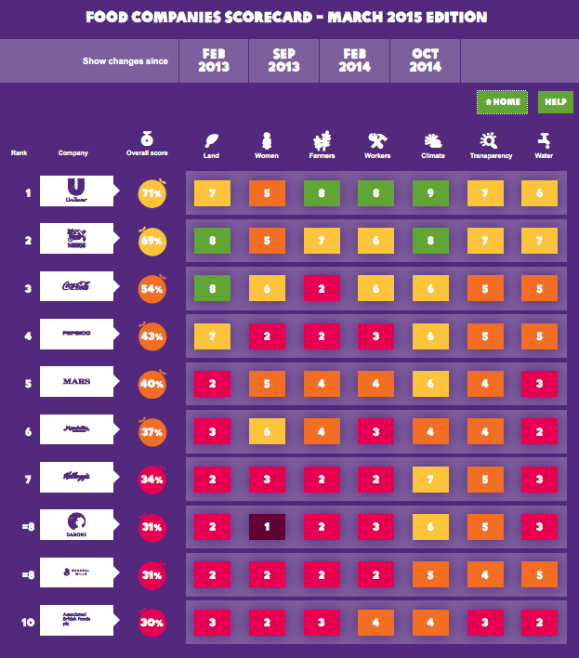

Slide 11
Food security innovation brainstorming session
Wednesday, Nov. 18, 3-4 pm
Meet in 4-402
Mission + 3 design/hands-on FAS + food
Focus: What are needs for technological innovation related to this year’s mission?

