Slide 1
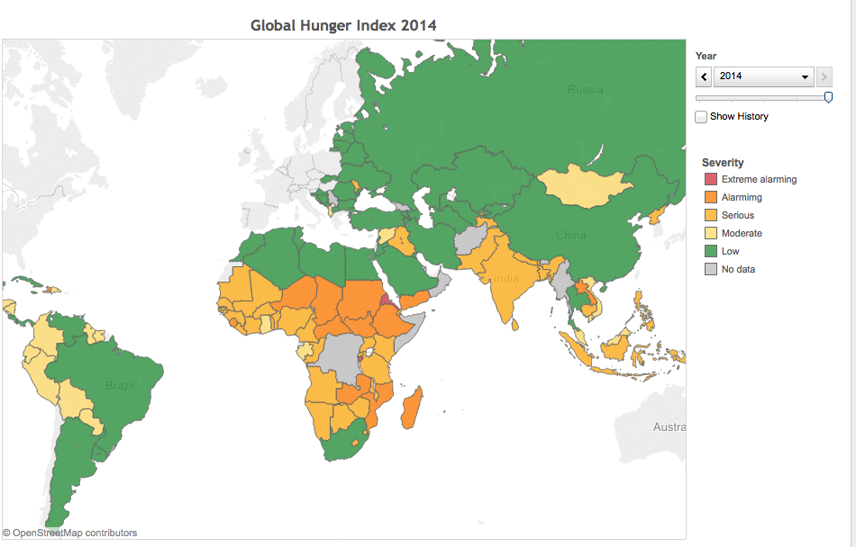
Mission 2019 Mini-project 2:
Food security and environmental stewardship in Mozambique
www.foodsecurityportal.org

Slide 2
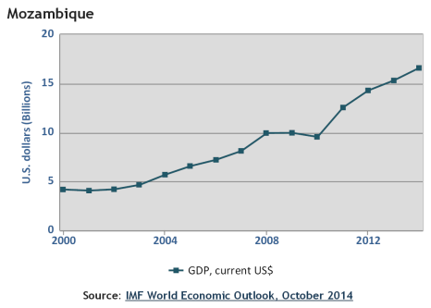
Why Mozambique?
Politically fairly stable since end of civil war in 1992
GDP growing due to foreign investment in extraction industries (coal, titanium, aluminum)

Slide 3
Why Mozambique?
178th out of 187 countries in UNDP 2014 Human Development Index
1/3 of population chronically food-insecure
Child (<5 yrs) malnutrition 43%
Child (<5 yrs) Vitamin A and iron deficiency 69% and 74%, respectively
https://www.wfp.org/countries/mozambique

Slide 4
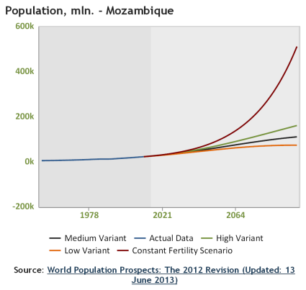
Why Mozambique?
Quickly growing population
Units in thousands
(so 200k = 200M)
Current pop: 24.5M
2100 pop: >100M

Slide 5
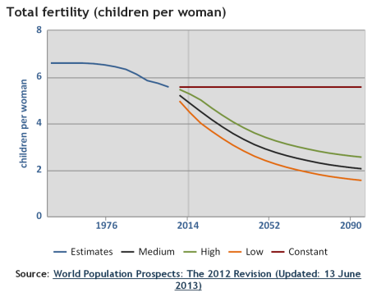
Why Mozambique?
Quickly growing population

Slide 6
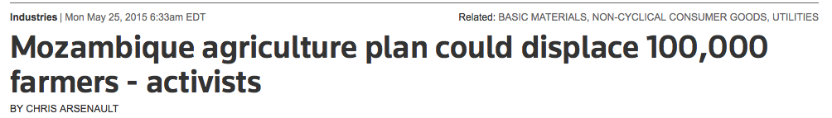
Why Mozambique?
Conflict between foreign investment aimed at producing cash crops for export vs. traditional subsistence farmers
http://www.reuters.com/article/2015/05/25/mozambique-land-food-idUSL5N0YC35120150525

Slide 7
Why Mozambique?
High incidence of flooding/drought coupled with low resilience

Slide 8
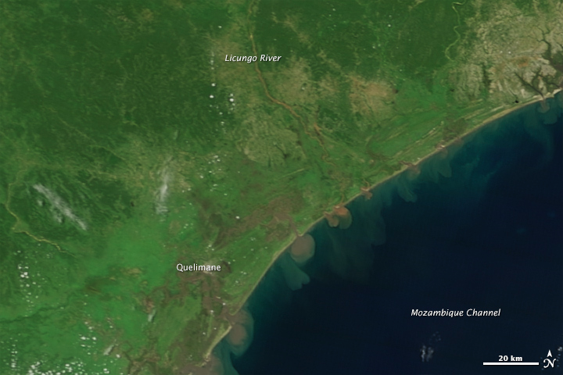
February 2014
High incidence of flooding/drought coupled with low resilience
earthobservatory.nasa.gov/IOTD/view.php?id=85145

Slide 9
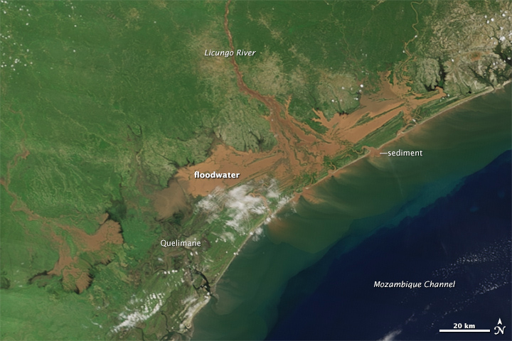
January 2015
High incidence of flooding/drought coupled with low resilience
earthobservatory.nasa.gov/IOTD/view.php?id=85145

Slide 10
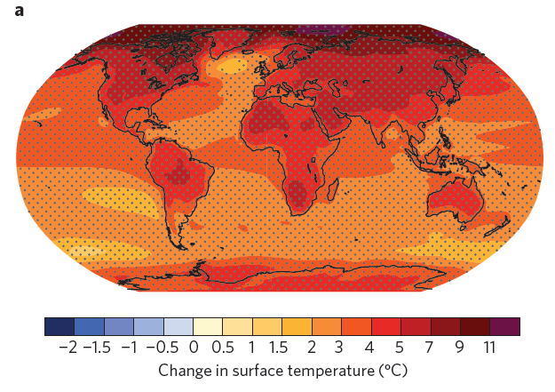
Why Mozambique?
Strong warming predicted in 21st century
Shepherd, Nature Geoscience 2014

Slide 11
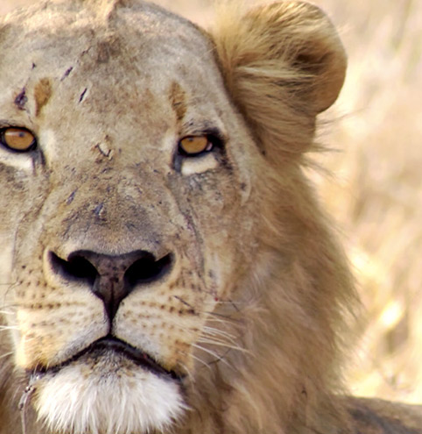
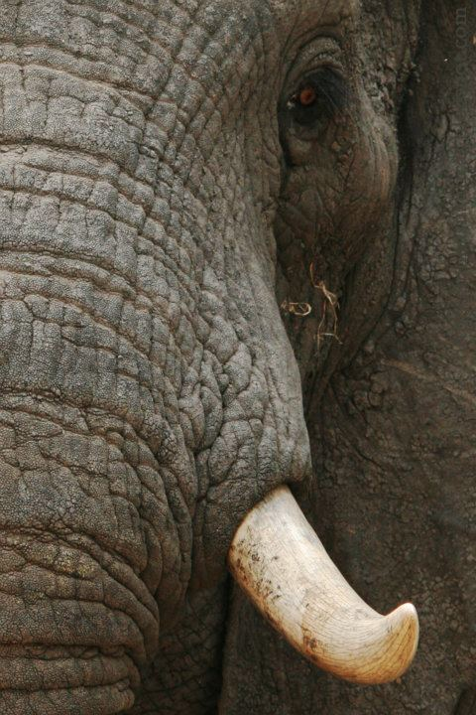
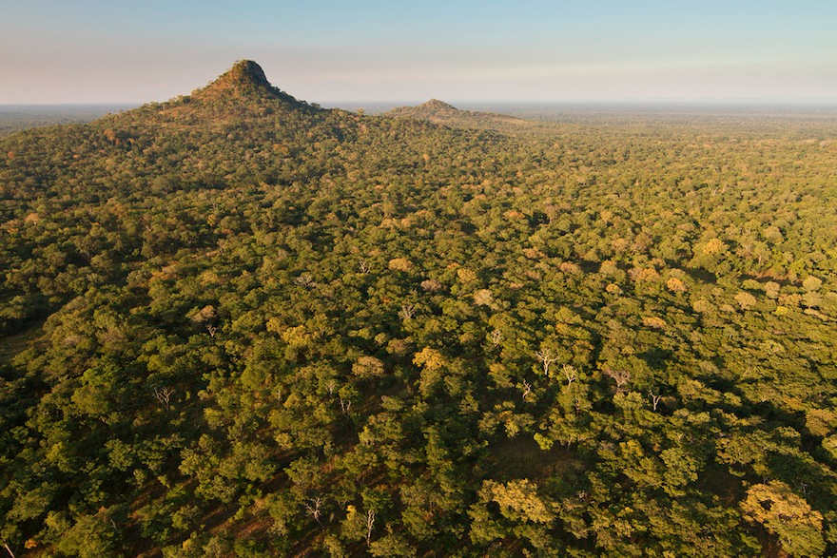
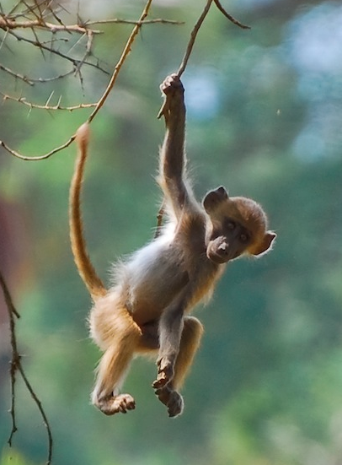
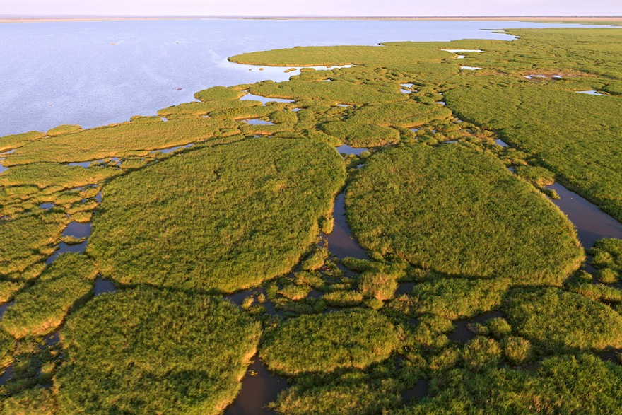
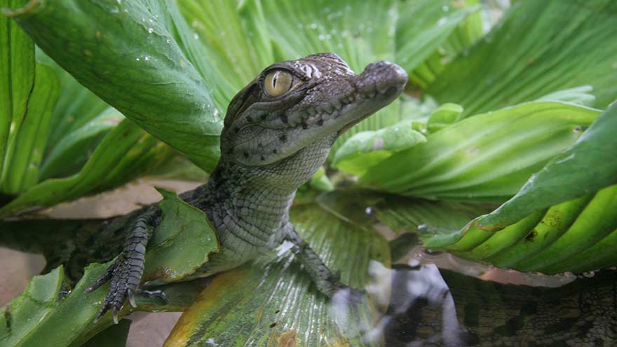
Why Mozambique?
Endangered species habitat: e.g. Gorongosa National Park
www.gorongosa.org

Slide 12
Mini-project 2
Develop an integrated plan for Mozambique’s development over the coming 15 years that sets the country up for minimizing food insecurity and the environmental impact of agriculture in the 21st century.
Develop quantitative goals that would allow you to see if your plan worked after 15 years.
Present your plan on Friday, October 9.

Slide 13
mozambique.opendataforafrica.org

Slide 14
The coming week
Monday: Group work day
Wednesday: Visit by Terrascope mentor Hal Gustin
Friday: Group work day

