Slide 1
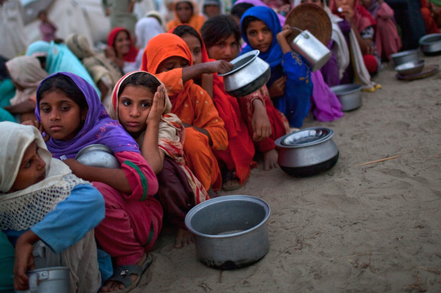
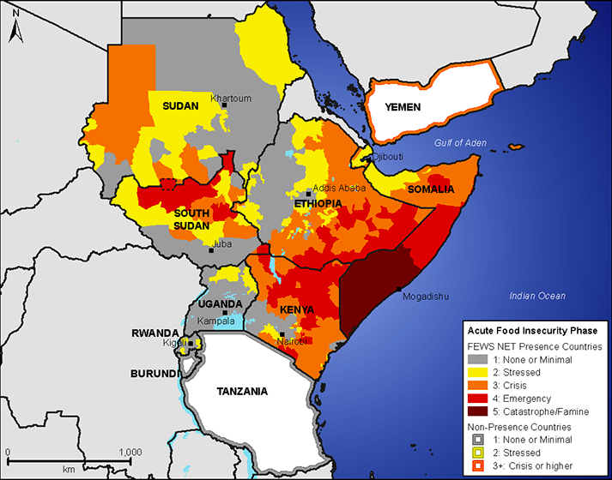
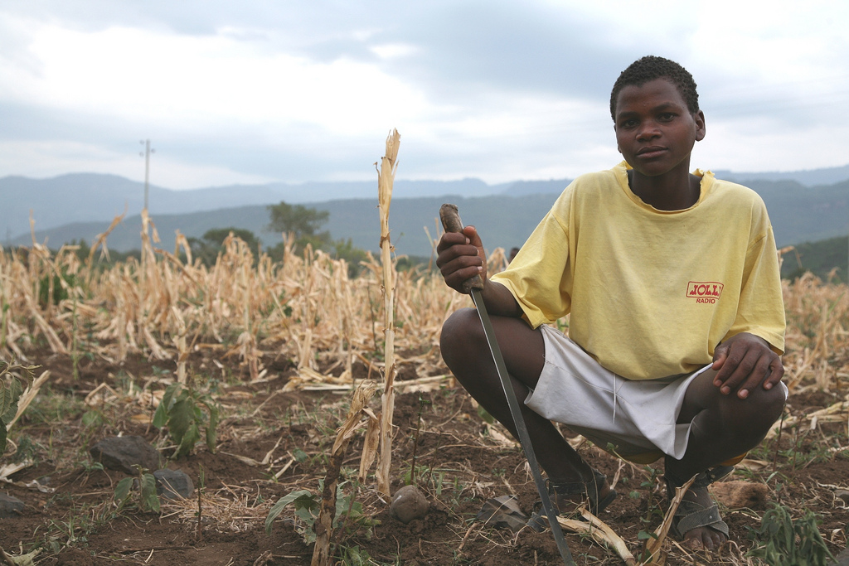
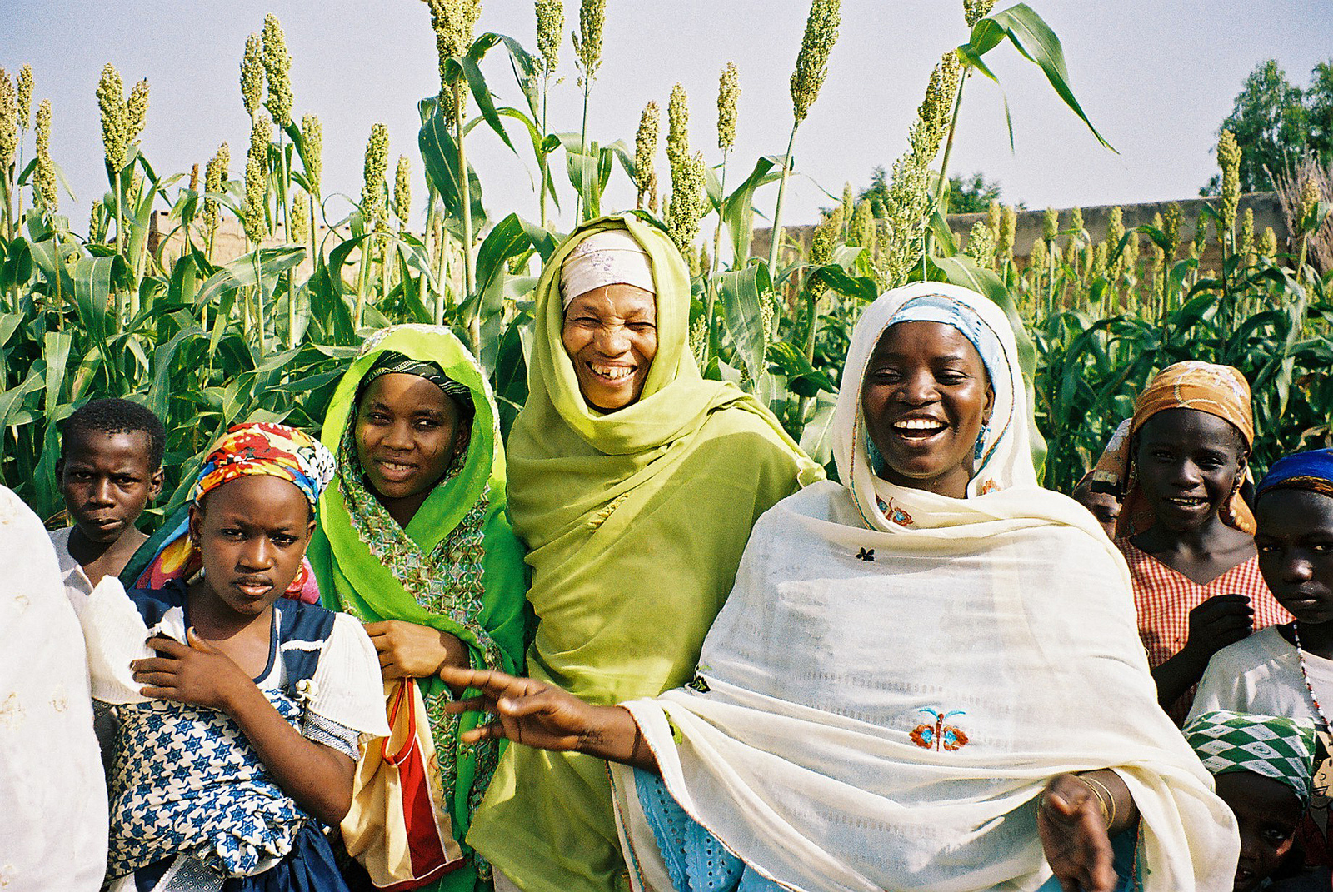
Mission 2019:
Global Food Security in the 21st century

Slide 2

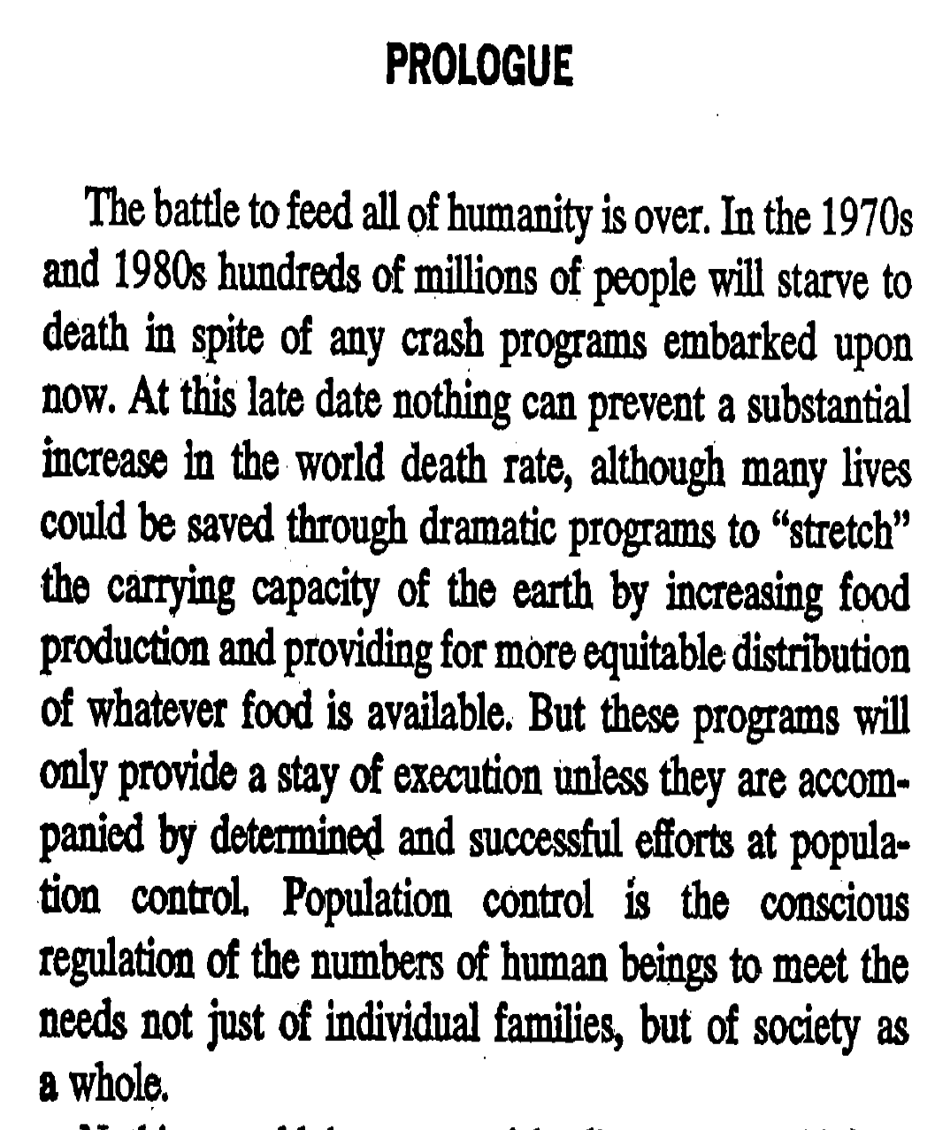
Published 1968

Slide 3
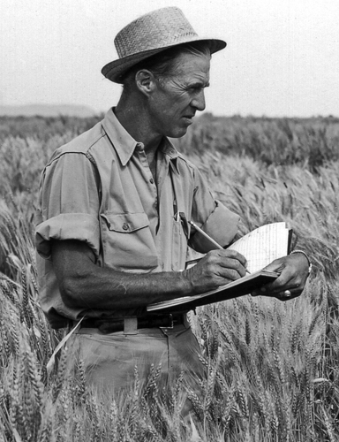
The “Green Revolution”
Norman Borlaug (1914-2009):
Wheat breeder and 1970 Nobel Peace Prize winner
“The Man Who Saved a Billion Lives”

Slide 4
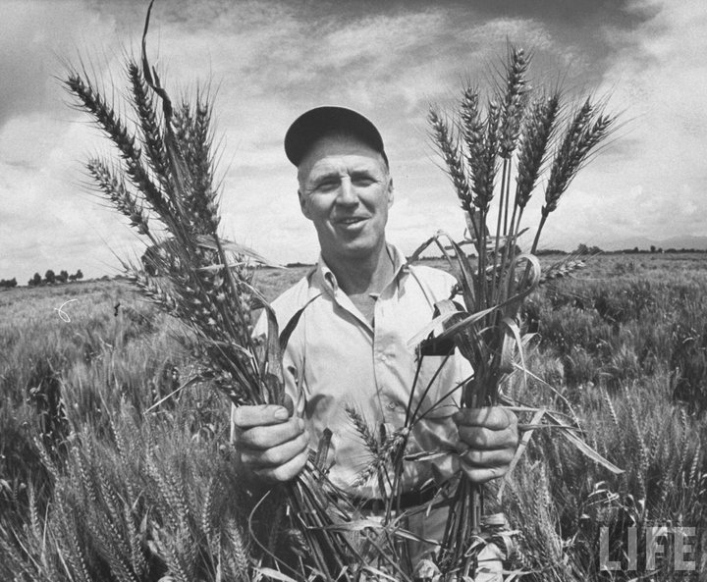
Developed fast-growing, high-yield, disease-resistant, fertilizer-tolerant wheat varieties
Inspired similar efforts for rice and other grains

Slide 5
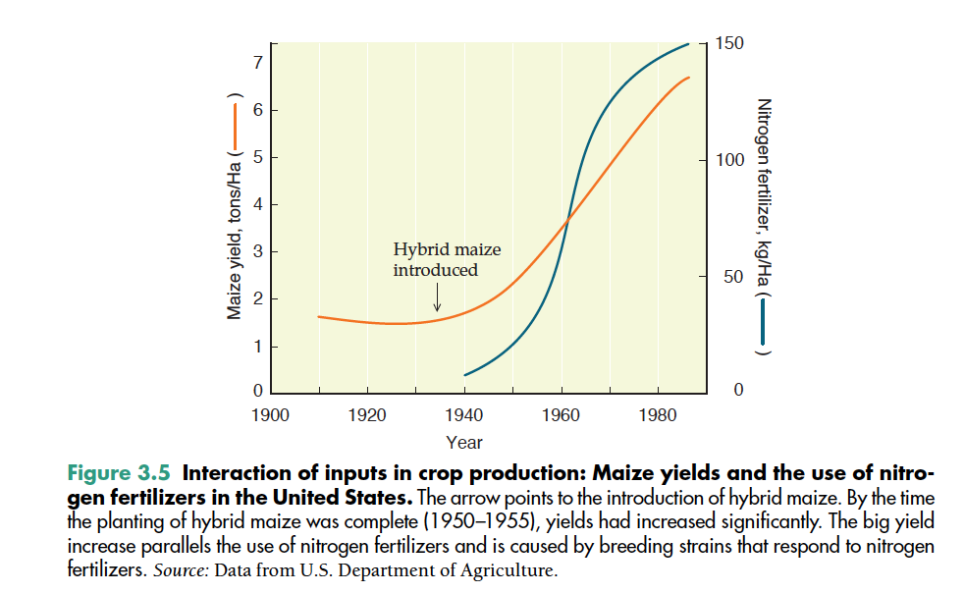
Chrispeels & Sadava, Plants, Genes, and Crop Biotechnology, 2nd ed. Jones & Bartlett, 2003

Slide 6
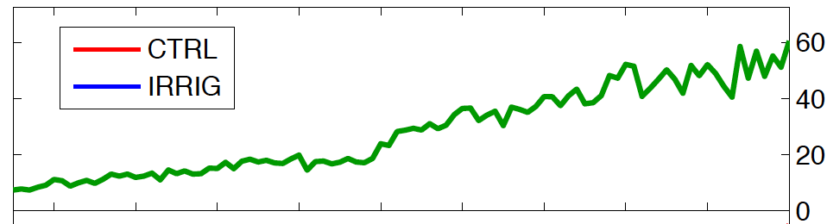
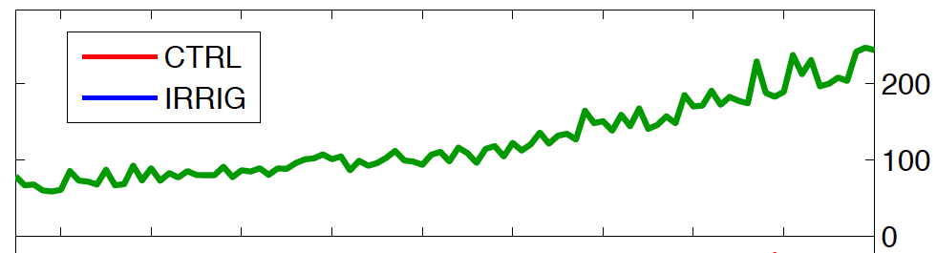
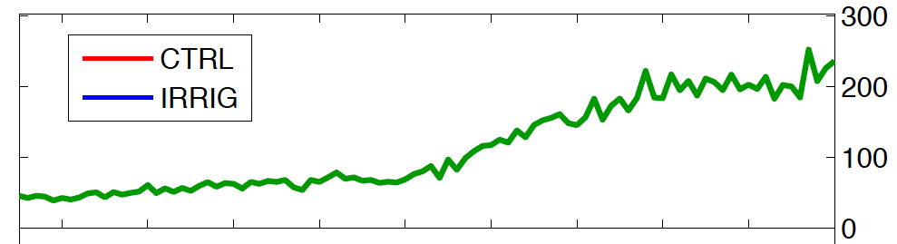
JJA Irrigation (km³)
Western NA
India
China
Source:
Puma & Cook, J. Geophys. Res. 2010

Slide 7
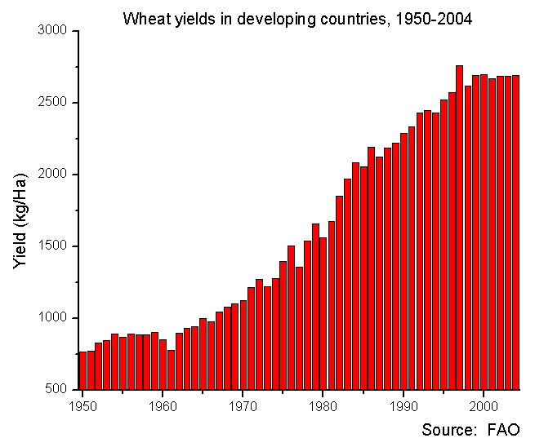
The “Green Revolution”
Global wheat production increased 2x faster than population from 1975-1985
Figure: Wikipedia commons

Slide 8
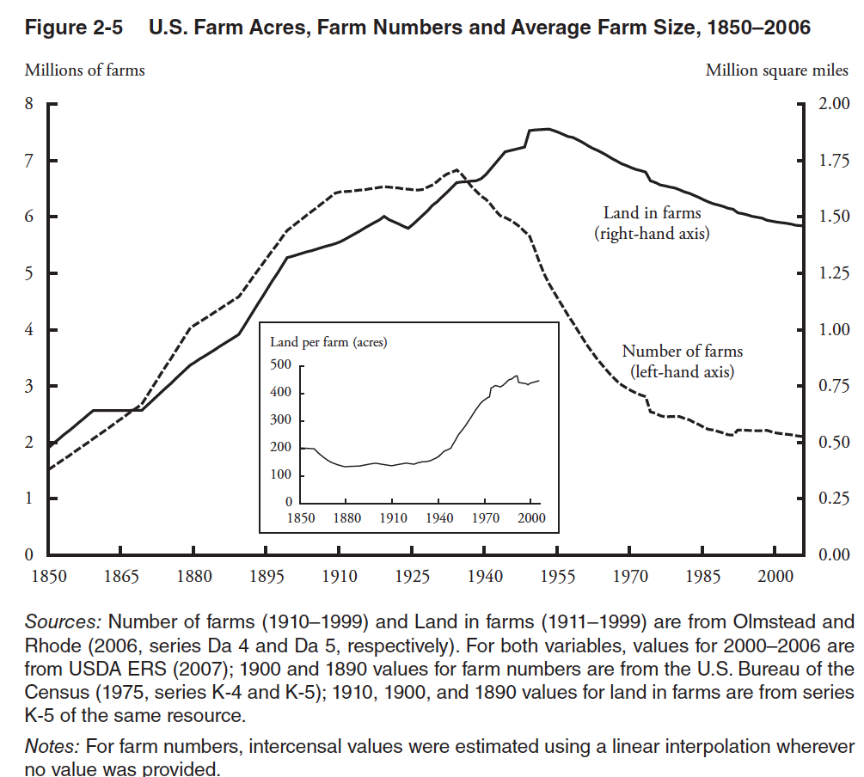
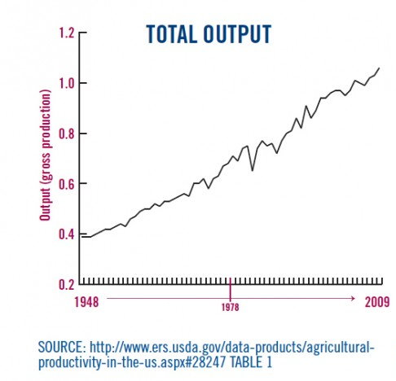
US: Increases in total production despite decline in land farmed
Production = yield x area
Yield = f(technical developments, inputs)
http://www.ers.usda.gov

Slide 9
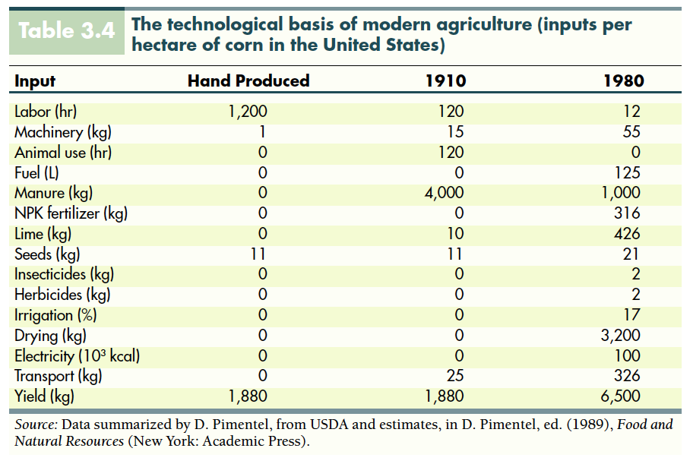
Chrispeels & Sadava, Plants, Genes, and Crop Biotechnology, 2nd ed. Jones & Bartlett, 2003

Slide 10
The “Green Revolution”: Key elements
High-yield varieties (HYVs) of key crops created by traditional cross-breeding techniques
Irrigation development
Increased fertilizer use
Increased pesticide use
Substantial public investment in
  infrastructure for irrigation and transport
  credit for purchasing inputs
  price guarantees.

Slide 11
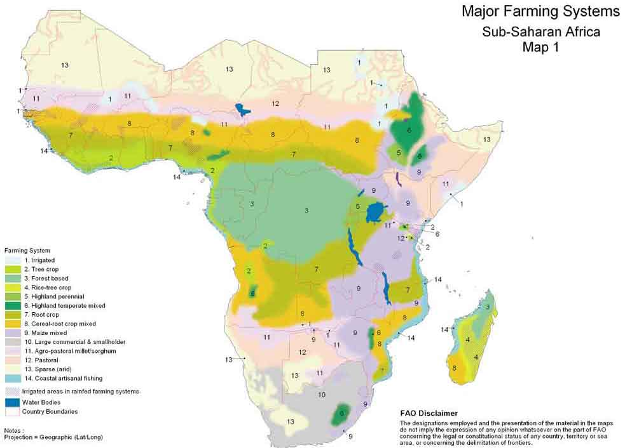
The “Green Revolution”: Key elements

Slide 12
Mini-project 1
Produce an oral report for the rest of the class on the Green Revolution in one of the following countries:
  Mexico
  Philippines
  Malawi
  India
  Brazil
  Kenya
  United States

Slide 13
Mini-project 1
Your report should answer the following questions:
  How has agriculture in your country changed since 1950?
  What have been the benefits of these changes?
  What are the negative outcomes of these changes?
  Does the history of the last 65 years provide any lessons for the future?

Slide 14
Mini-project 1
Your report should be 5-6 minutes long (i.e., 5-6 content slides).
Be prepared to present your report in class on Monday, September 21.
Upload your report (pptx or pdf) under “Mini-project 1” in Stellar by 12 pm on Monday, Sept. 21. It should be Mac-compatible.
Include references

Slide 15
Unsolicited advice
It will be impossible to tell the whole story of 65 years of a country’s agricultural history in 6 minutes! Choose the points you think are most important for the rest of the class to understand.
Think about the design of your slides to most effectively communicate your content.

Slide 16
The coming week
Wednesday: Room ____. Librarian Chris Sherratt will give a short presentation about library resources. Rest of the class is for group work.
Friday: Up to your group! 3-270 and E25-117 are available for your use.
Please have your group email me and Mike Eddy a progress report or draft of your presentation by Friday afternoon at 5 pm; this progress report/draft will be shared with mentors.
A brief journal entry will be due by Wednesday, Sept. 23.

