Slide 1
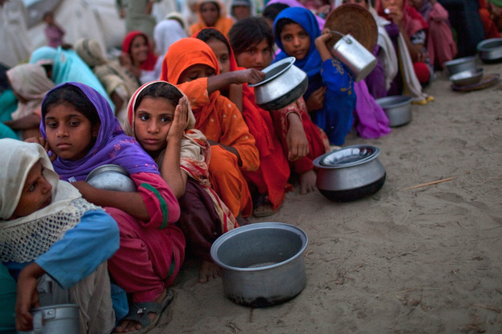
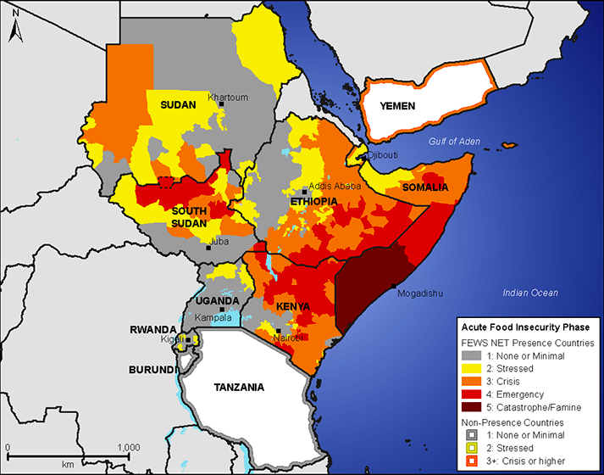
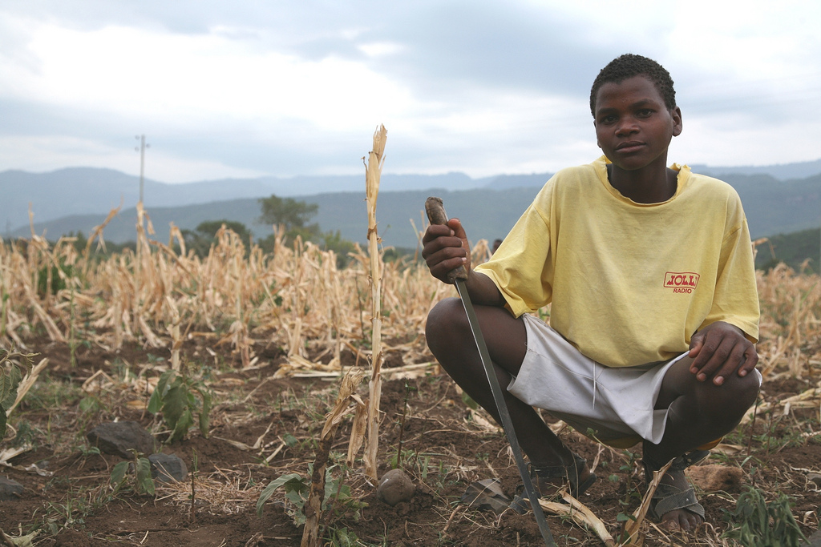
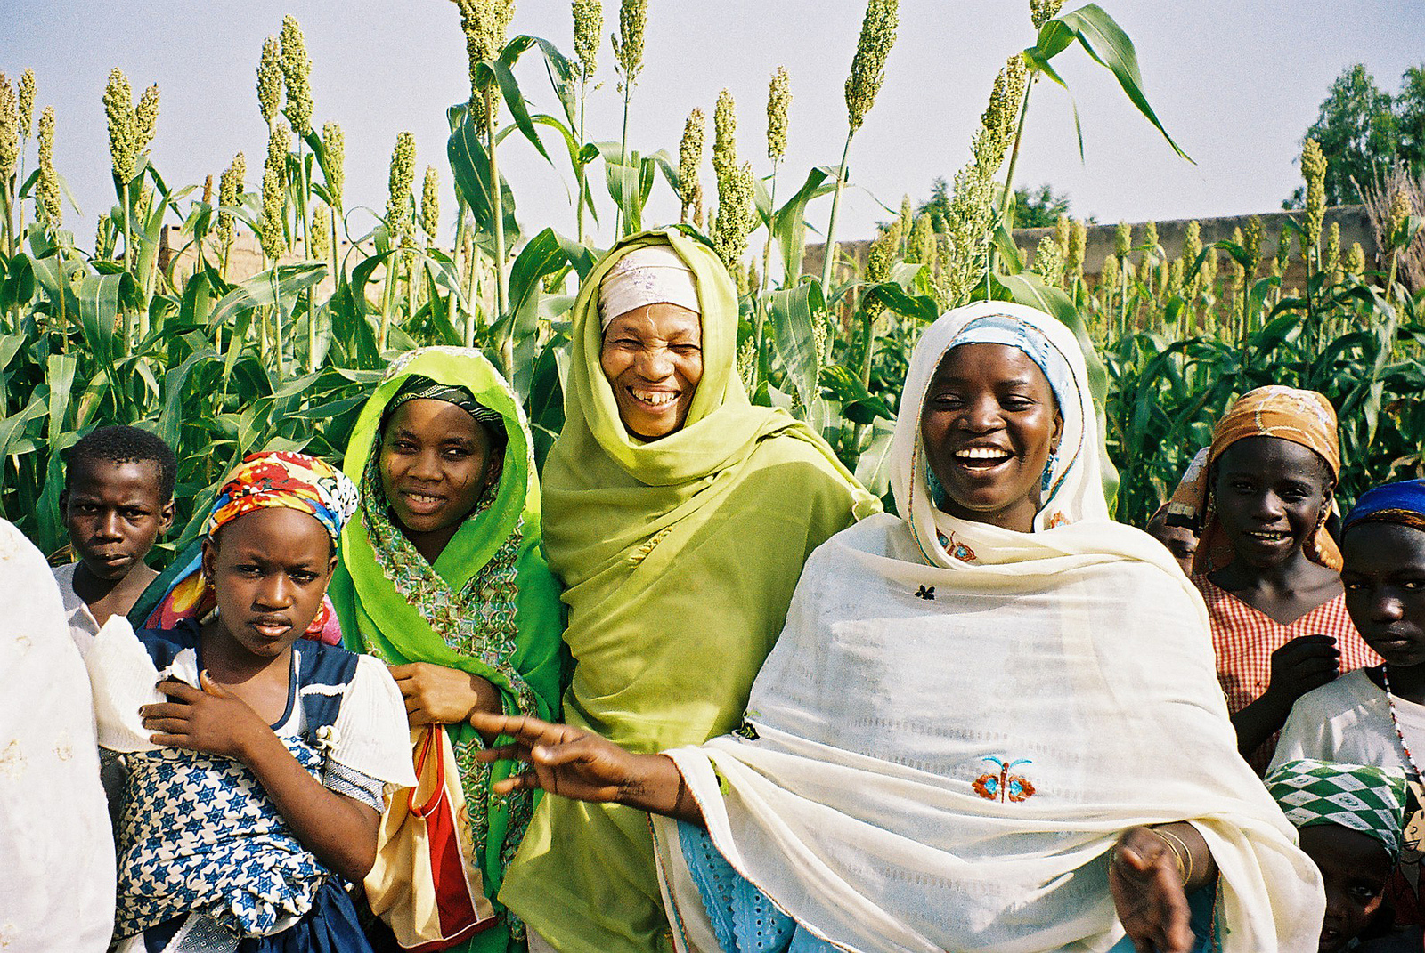
Mission 2019:
Global Food Security in the 21st century

Slide 2
Terrascope – Academic Structure
First Semester
Solving Complex Problems--Mission 20xx
Second Semester
1.016
Terrascope Field Experience (Spring Break)
Terrascope Radio (SP.360, HASS, CI-H)

Slide 3
Terrascope – Social Structure
First year learning community
You will develop friendships and bonds that last for your time at MIT and beyond
Terrascope Room 16-168: a place to study, hang out, interact, cook, eat, SLEEP, always someone around to talk to
Terrascope lunches: see calendar—eat, listen (or not), learn
Special activities: movie nights, special dinners, weekend trip, and ideas?

Slide 4
Solving Complex Problems
Multidisciplinary, project-based learning experience
Students work toward a solution to a interdisciplinary problem related to Earth’s environment
Each year’s theme is different and referred to as “Mission XXXX”, where XXXX refers to the graduation year of the class involved

Slide 5
Solving Complex Problems--Motivation
To build in you the capacity to tackle the “big”
problems that confront society
To encourage you to take charge of the learning
process
To show you how to do independent
research, to evaluate the quality of information
sources, and to synthesize different information
streams

Slide 6
Solving Complex Problems--Motivation
To encourage you to think about optimal solutions rather than correct solutions
To help you learn how to work effectively as
part of a team
To improve your communication skills using two
media: the web site and the formal oral
presentation
To convince you of your potential!!

Slide 7
Past Missions
Develop a viable plan for the exploration of Mars with the aim of finding evidence for life
Design permanent, manned, underwater research laboratories and develop detailed research plans for the first six months of their operation
Design the most environmentally sensitive strategy for hydrocarbon resource extraction from the Arctic National Wildlife Refuge and determine whether or not the value of the resource exceeds its financial and environmental cost

Slide 8
Past Missions
To develop strategies for developing countries in the Pacific basin to cope with tsunami hazards and disasters. Due to the unique needs of each country, we specifically focused on developing plans for Peru and Micronesia.
To develop a plan for the reconstruction of New Orleans and the management of the Mississippi River and the Gulf coast. The reconstruction of New Orleans and the management of the Mississippi River and the Gulf coast.

Slide 9
Past Missions
To develop strategies to deal with the collapse of the global fisheries and the general health of the oceans
To develop a plan to ensure the availability of fresh clean water for western North America for the next 100 years.
Propose an integrated global solution to the rapid rise in atmospheric CO₂ that will stabilize concentrations at an economically viable and internationally acceptable level.
Notes:
9

Slide 10
Subject Structure
Problem divided into approximately five to ten tasks; students divided into teams
Each team assigned an Undergraduate Teaching Fellow (UTF), Alumni Mentors, and have access to library staff
First few weeks-month is focused on smaller-scale group projects, with students taking more and more control by the middle of the term

Slide 11
Subject Deliverables
Weekly individual journal entries
Each team will communicate its progress to the rest of the class regularly throughout the term
Mini-projects during first half of term
The class describes and justifies its overall plan in a web site
The class explains the design in a two-hour presentation before a panel of experts and a general audience; this presentation is also webcast around the world.

Slide 12
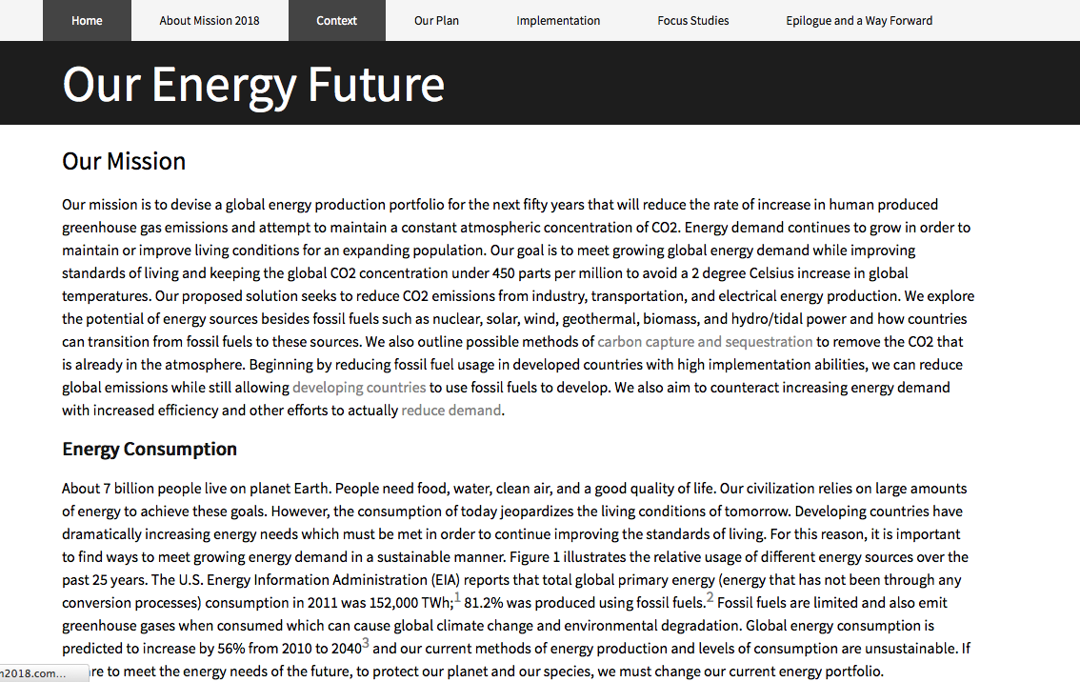
Mission 2018
(www.mission2018.com)
https://www.dropbox.com/s/56fa9k7wg5z4u9f/Screenshot%202015-09-08%2011.08.16.png?dl=0

Slide 13
“What I have learned is that passion, along with curiosity, drives science. Passion is the mysterious force behind nearly every scientific breakthrough. Perhaps it’s because without it you might never be able to tolerate the huge amount of hard work and frustration that scientific discovery entails….
“For the next four years you will get to poke around the corridors of your college, listen to any lecture you choose, work in a lab. The field of science you fall in love with may be so new it doesn’t even have a name yet. You may be the person who constructs a new biological species, or figures out how to stop global warming, or aging. Maybe you’ll discover life on another planet. My advice to you is this: Don’t settle for anything less.”
Nancy Hopkins, a professor of biology at M.I.T., has been teaching since 1973.
Extracted from Op-Ed contribution in the New York Times, September 5 2009
A few words on the bigger picture…

Slide 14
“Better is possible. It does not take genius. It takes diligence. It takes moral clarity. It takes ingenuity. And above all, it takes a willingness to try.”
Atul Gawande in Better: A Surgeon’s Notes on Performance
“Vocation is the place where our deep gladness meets the world's deep need.”
Friedrich Buechner
A few words on the bigger picture…

Slide 15
Meet the staff and UTFs!

Slide 16
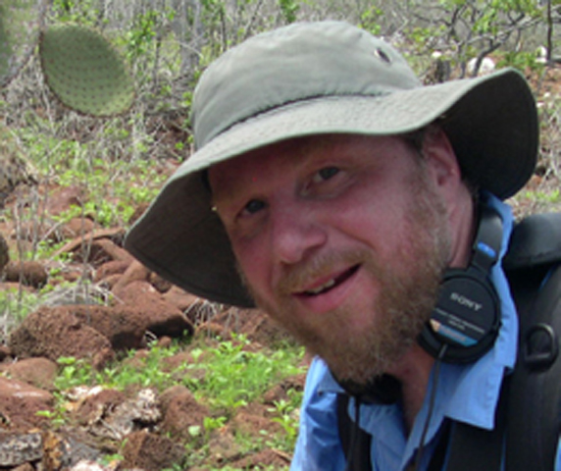
Staff
Ari Epstein

Slide 17
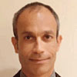


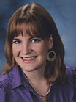

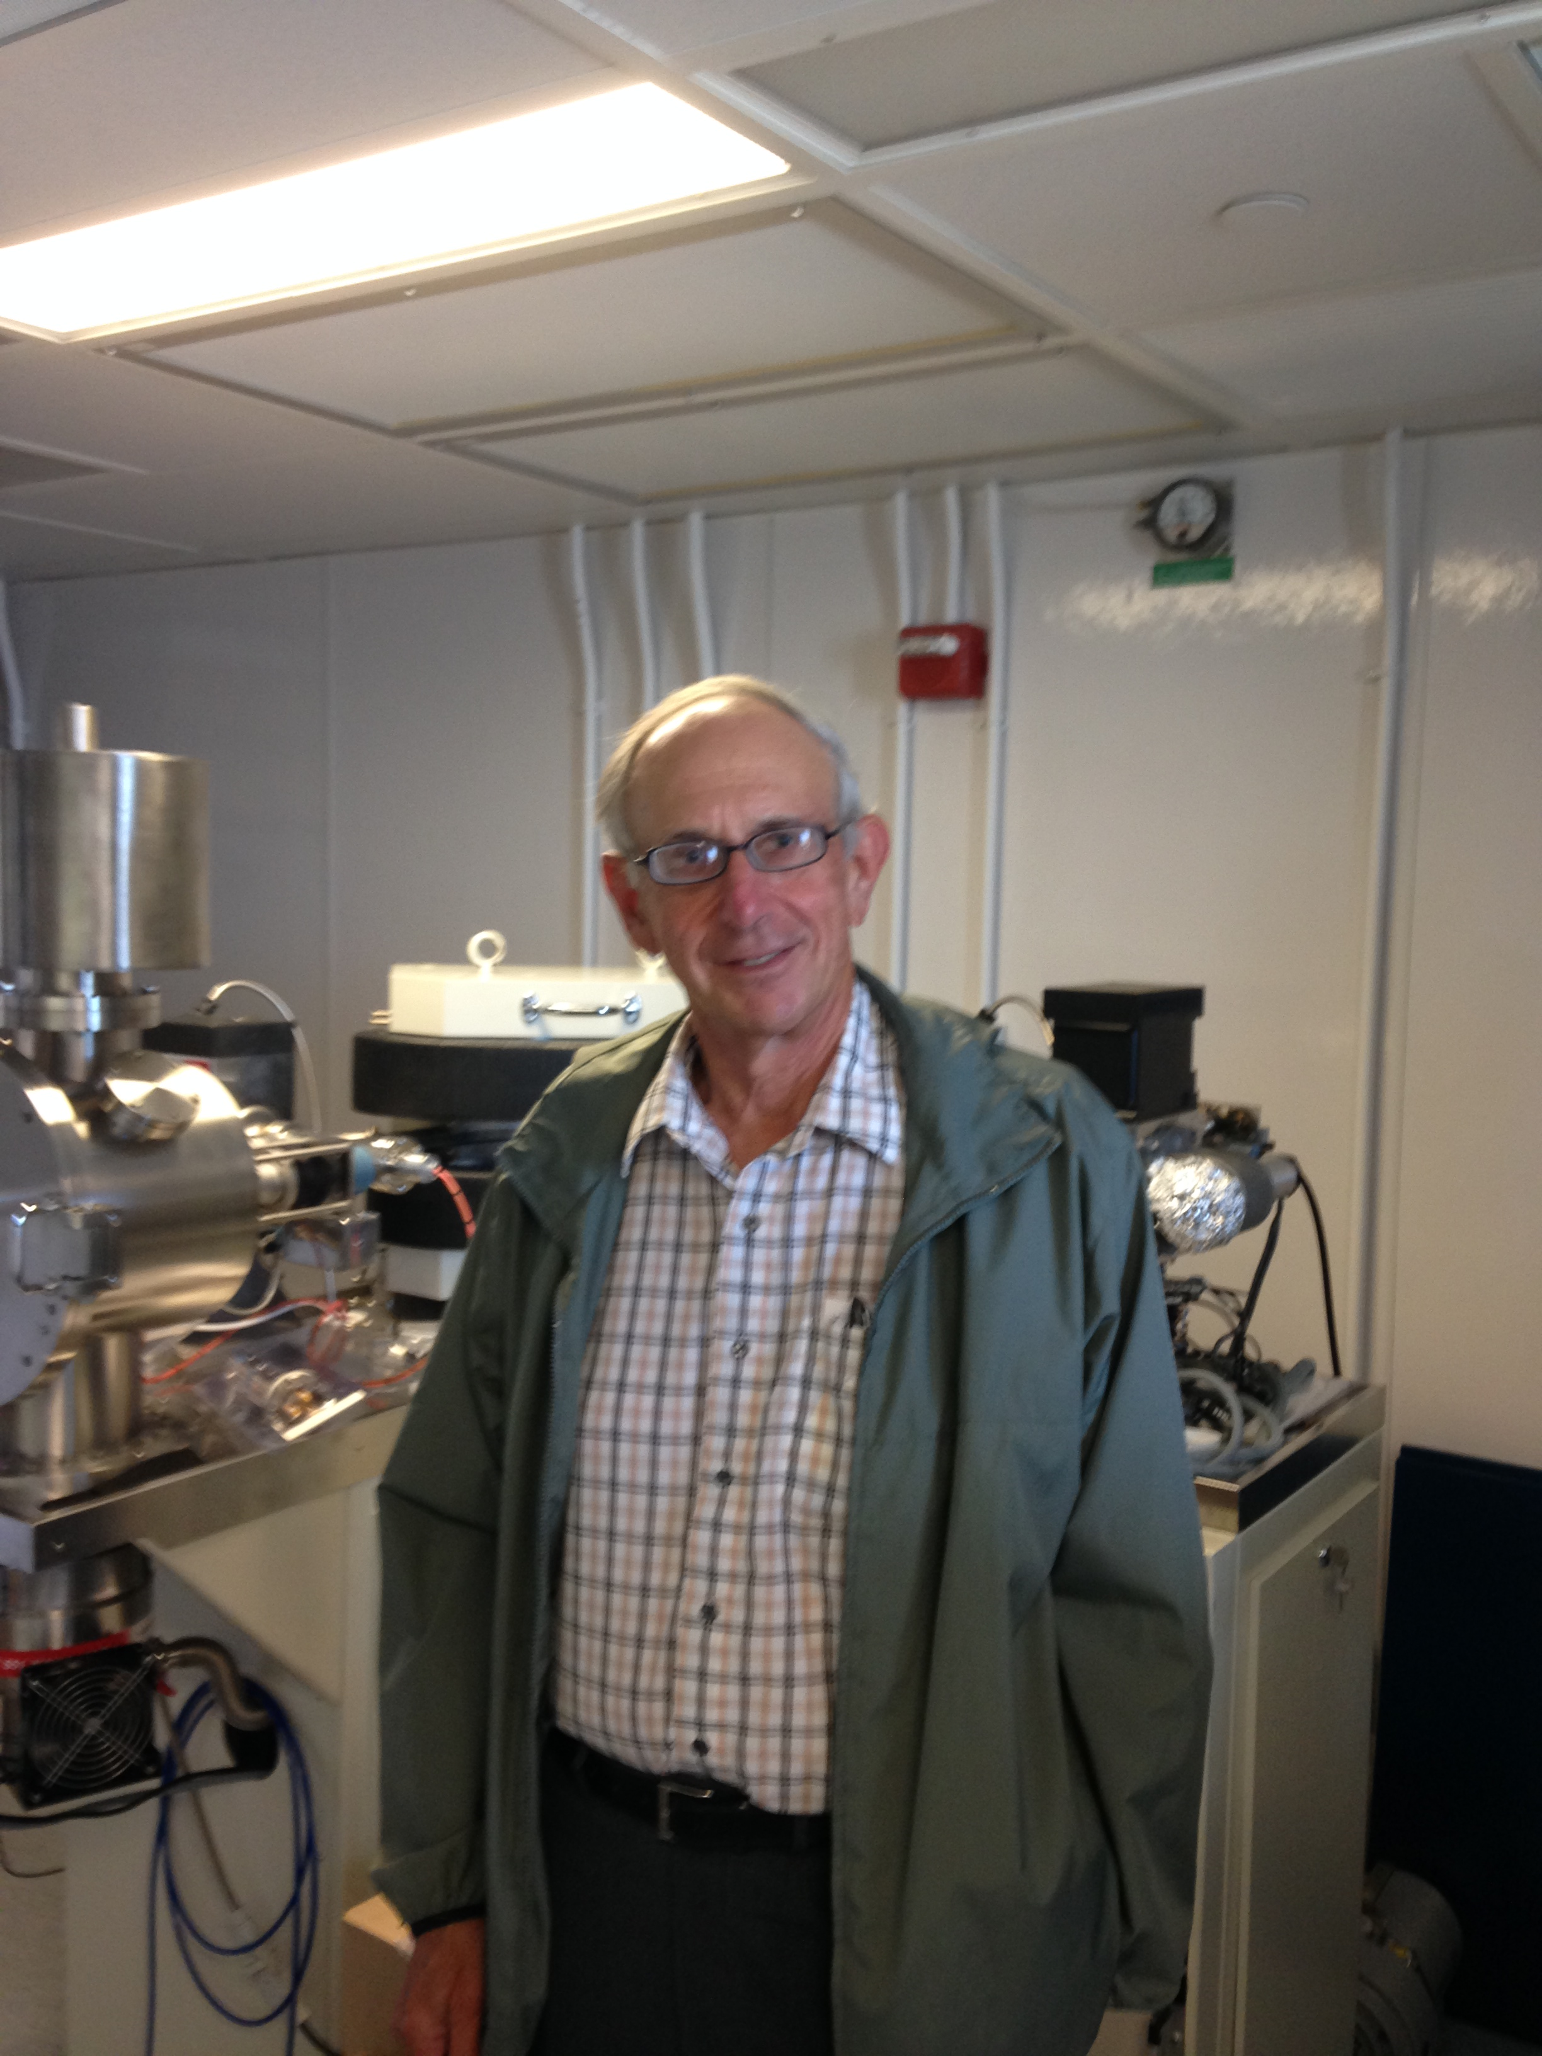






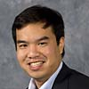

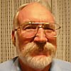
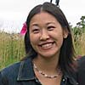
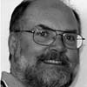
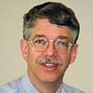
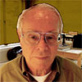
Alumni Mentors – an invaluable resource
Bob Gurnitz,
chief mentor

Slide 18
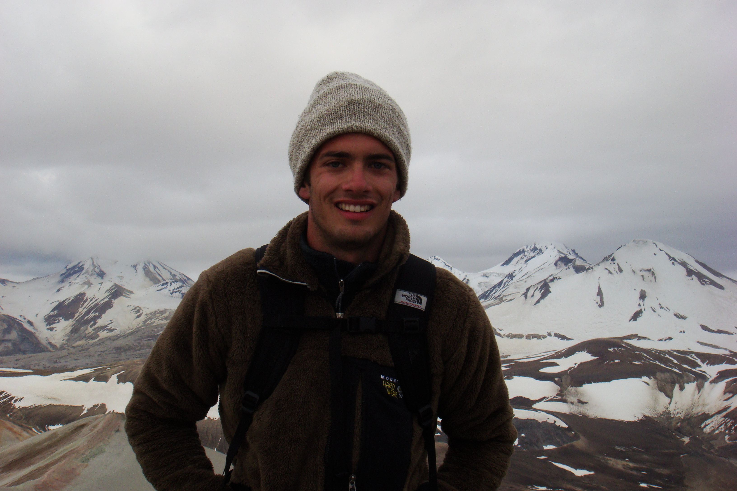
TA: Mike Eddy

Slide 19
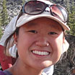

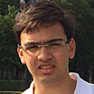
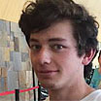
UTFs
Judy Pu
Dirk
Stahlecker
Ishan
Meswani
Jake Burga

Slide 20


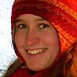
UTFs
Anthony
Occidentale
Anna
Jungbluth
Laurel
Regibeau-
Rockett

Slide 21
Important Contacts
Michael Eddy, Teaching Assistant:
mpeddy@mit.edu
Ari Epstein, Terrascope staff:
awe@mit.edu
Chris Sherratt, Librarian:
gcsherra@mit.edu
Daniel Sheehan, GIS specialist:
dsheehan@mit.edu
David McGee, Instructor & Director: davidmcg@mit.edu

Slide 22
Subject Grading
Individual performance (30%)
Team performance (30%)
Class accomplishment (40%)

Slide 23
Mission 2019
Your mission is to design a plan that will produce and distribute enough food to feed the planet over the next century, while ensuring that efficiency and equity are maximized and reducing agriculture’s toll on the environment.

Slide 24
A four-part problem: Part 1
~800 million people are undernourished at present, even though global food production is greater than or equal to global food requirements.

Slide 25
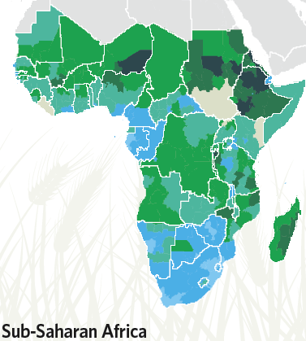
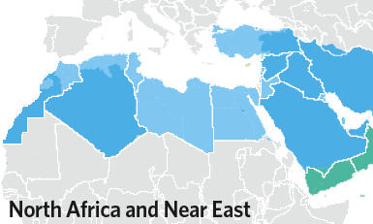
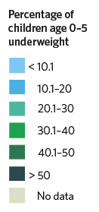
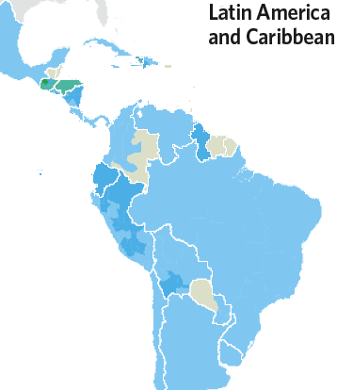
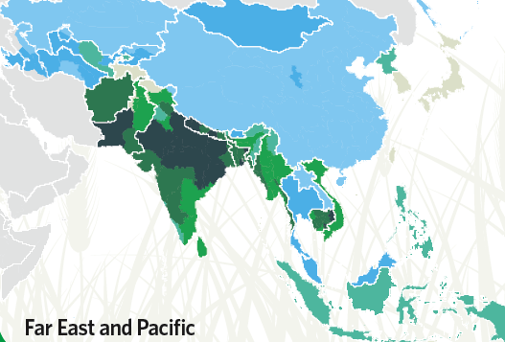
Undernourishment tracks with poverty--not necessarily with lack of food.
Nature 2010, v. 466, p. 546-547

Slide 26
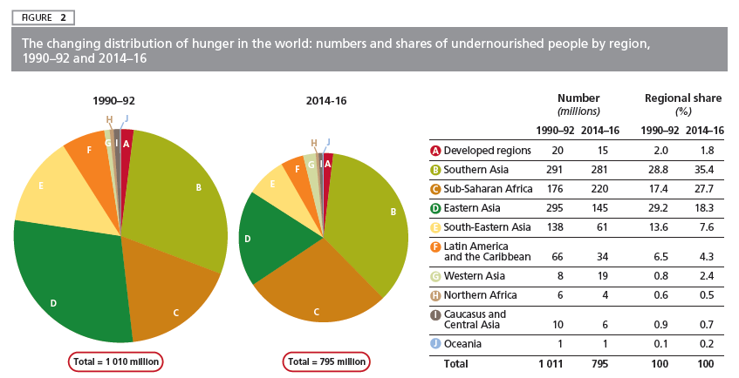
Undernourishment tracks with poverty--not necessarily with lack of food.
UN FAO, The State of Food Security in the World 2015

Slide 27
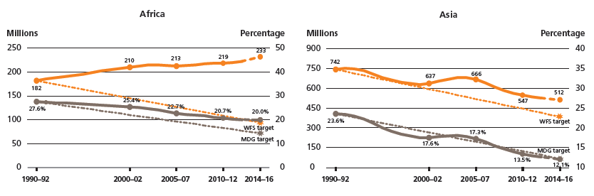
The number of hungry people has been dropping steadily for decades, but not in all regions
Orange: Numbers
Grey: Percentage
World Food Summit target: ½ of number of hungry by 2015
Millennium Development Goals target: ½ of percentage of hungry by 2015
(both relative to 1990 levels)
UN FAO, The State of Food Security in the World 2015

Slide 28
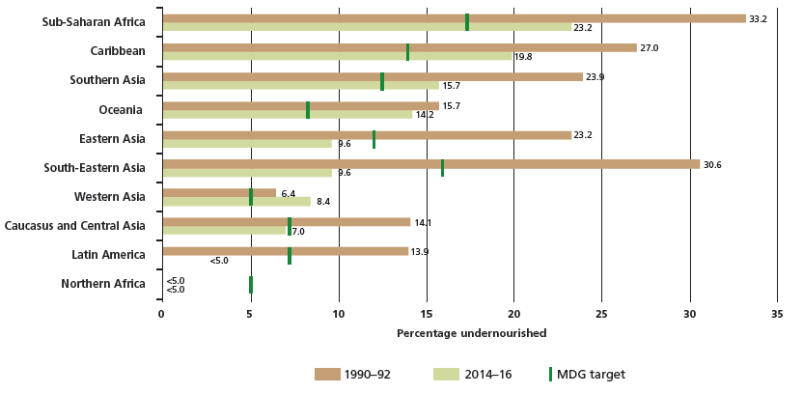
The number of hungry people has been dropping steadily for decades, but not in all regions
UN FAO, The State of Food Security in the World 2015

Slide 29
70% of the world’s food is produced by smallholder farmers – i.e. those with <5 acres of land.
Most of the world’s hungry are farmers.
UN FAO, The State of Food Security in the World 2015

Slide 30
A four-part problem: Part 2
Population growth and increasing per capita demand require a ~60-100% increase in global food production by 2050.

Slide 31
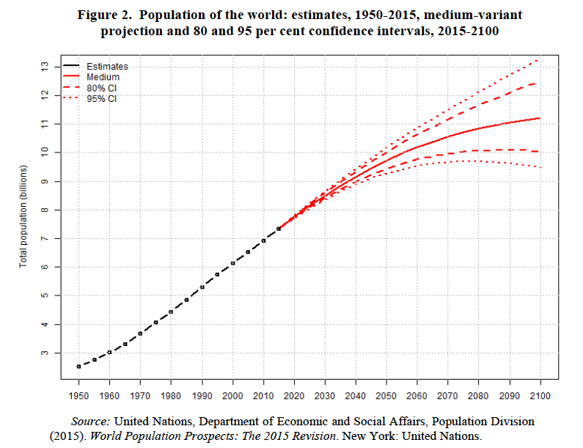
Population estimates: 11B people by 2100
Notes:
31

Slide 32
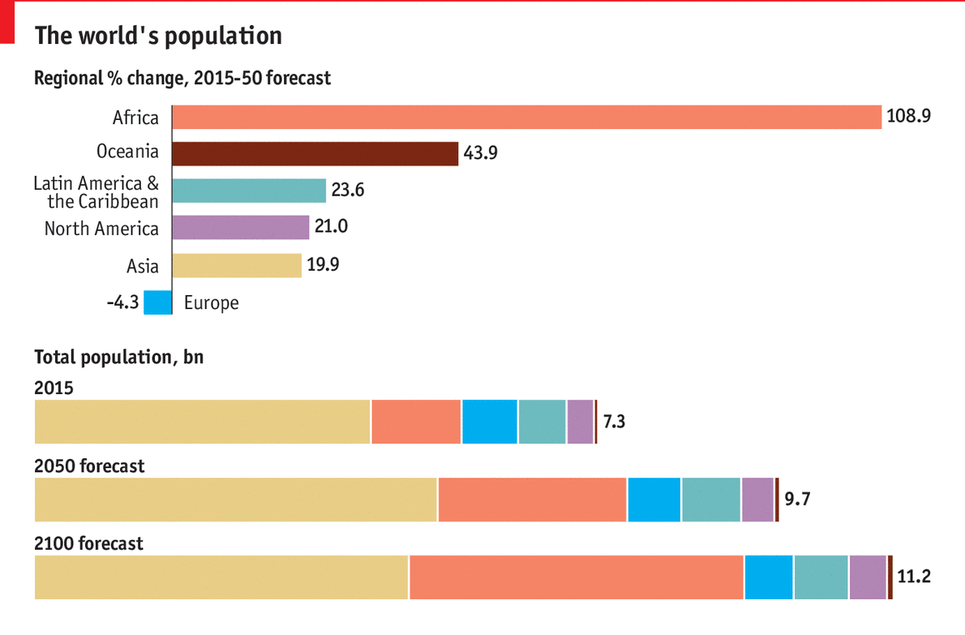
Most of this growth will be in Africa
http://www.economist.com/blogs/graphicdetail/2015/08/daily-chart-growth-areas
Notes:
32

Slide 33
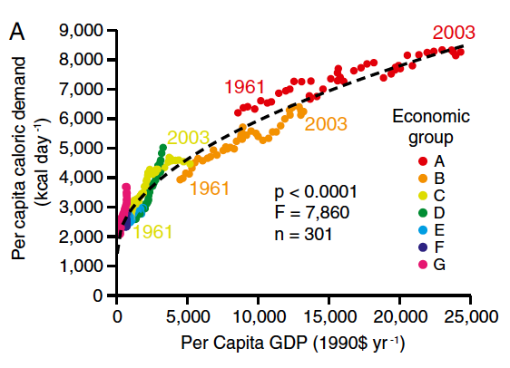
Increasing food demand with rising GDP
Tilman et al., PNAS 2011
Notes:
33

Slide 34
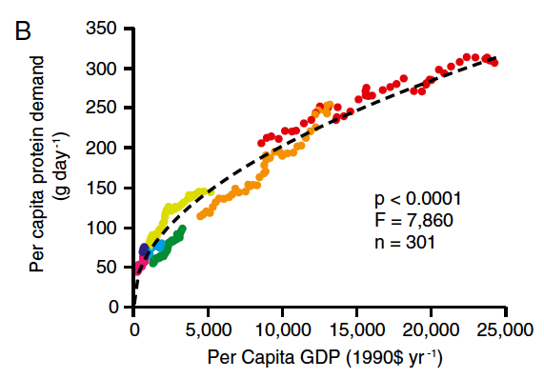
Increasing food demand with rising GDP
Tilman et al., PNAS 2011
Notes:
34

Slide 35
A four-part problem: Part 3
Agriculture as currently practiced relies on unsustainable use of soil, water, fossil fuels and other resources.

Slide 36
A four-part problem: Part 3
Agriculture as currently practiced relies on unsustainable use of soil, water, fossil fuels and other resources.

Slide 37
Agriculture’s impacts
“Agricultural systems are...the single largest source of human-induced environmental change.”
-J. Sachs, The Age of Sustainable Development (Columbia U Press, 2015)

Slide 38
The anthropogenic footprint
~40% of all land not covered by ice is devoted to agriculture (UN FAO, 2013).
Notes:
38

Slide 39
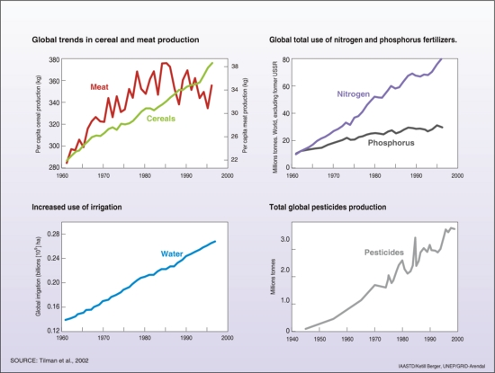
Reaching natural limits

Slide 40
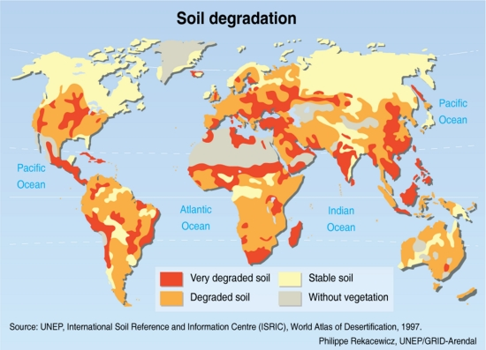
Reaching natural limits

Slide 41
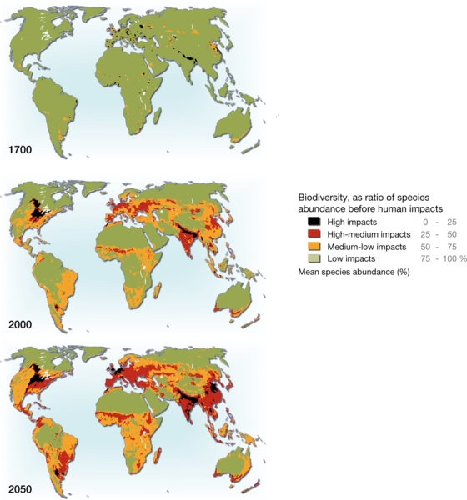
Reaching natural limits

Slide 42
The anthropogenic footprint
Suppose we put all humans on a scale,
then all domesticated animals,
then all wild terrestrial mammals.
Which would weigh the most?
What would be the relative proportions?
Notes:
42

Slide 43
The anthropogenic footprint
Wild
mammals
(11 Mt)
Humans
(120 Mt)
Domesticated animals
(270 Mt)
Smil, V. Harvesting the Biosphere. Cambridge, MA: MIT Press, 2012.
Notes:
43

Slide 44
A four-part problem: Part 4
Climate change is projected to have negative impacts on food production, with particularly large impacts in areas with current food deficits.

Slide 45
Impacts of climate change on agriculture
“Farm systems, more than any other human activity, are dependent on the climate and environment we know and have had for centuries.”
-J. Sachs, The Age of Sustainable Development (Columbia U Press, 2015)

Slide 46
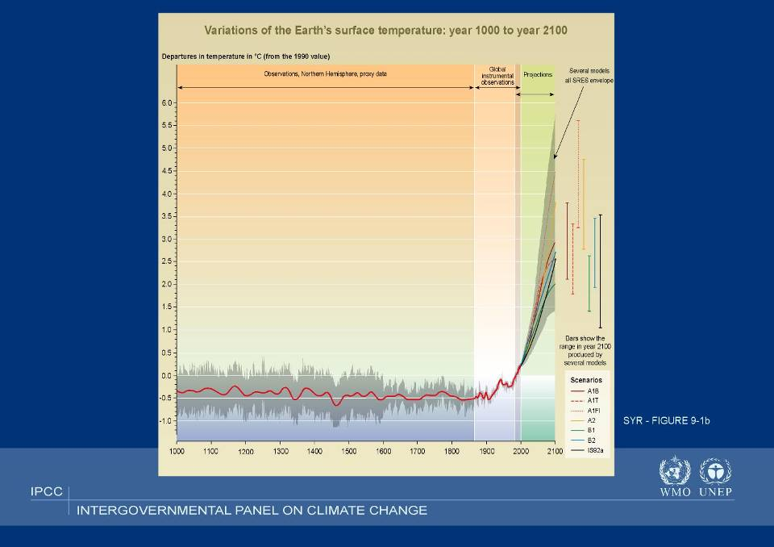

Slide 47
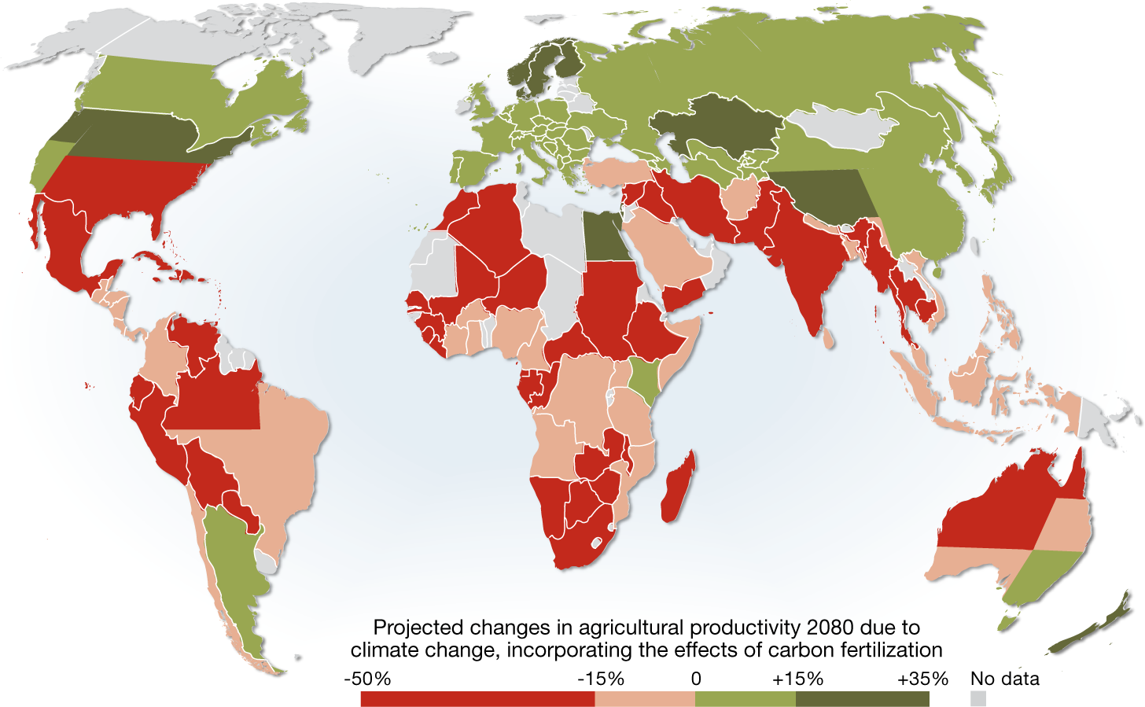
Projected impact of climate change on agriculture
Cline, W. R. 2007. Global Warming and Agriculture: Impact Estimates by Country. Washington D.C., USA: Peterson Institute.
Notes:
47

Slide 48
Class Structure
After a set of introductory exercises, we will brainstorm possible team roles and allow you to “self-organize”
Each of you will be assigned to a team, and each team will be assigned at least one upperclass teaching fellow (UTF), a library liaison, and multiple alumni mentors
Each team will be responsible for proposing to the class one or more options for its assigned part of the solution
Teams will work independently and will be responsible for their own solutions, although mentors and volunteer faculty resources may be called upon as “sounding boards”.

Slide 49
First Assignment (Due this Friday by 12 PM)
Reading on Stellar site
Answer questions in first assignment (also posted to Stellar)
Hand in assignment via Stellar by Friday 9/11 at 12 PM

Slide 50
Meeting Places
Class will meet in three different places, so consult the “Calendar” page before each class meeting to see where you will go
THIS FRIDAY WE MEET in 3-270
http://web.mit.edu/mission/www/m2019/
https://stellar.mit.edu/S/course/12/fa15/12.000/index.html

Slide 51

New views of a planet we aren’t changing

