Slide 1
Applications of Spectral Matrix Theory in Computational Biology
By: Soheil Feizi
Final Project Presentation
18.338
MIT

Slide 2
The multi-layered organization of information in living systems
EPIGENOME
DNA
CHROMATIN
HISTONES
Genes
GENOME
DNA
cis-regulatory elements
TRANSCRIPTOME
RNA
miRNA
piRNA
mRNA
ncRNA
PROTEOME
R₁
R₂
S₁
S₂
M₁
M₂
PROTEINS
Transcription factors
Signaling proteins
Metabolic Enzymes

Slide 3
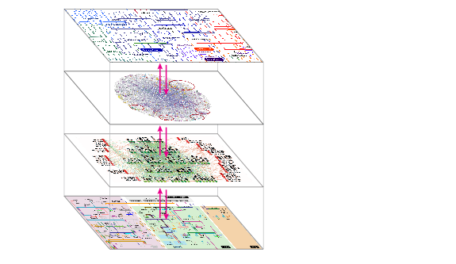
Biological networks at all cellular levels
Dynamics
Metabolic
networks
Modification
Protein & signaling
networks
Proteins
Translation
Post-transcriptional
gene regulation
RNA
Transcription
Transcriptional
gene regulation
Genome

Slide 4
Matrix Theory applications and Challenges
Systems-level views
Functional/physical datasets
Network inference
TF binding
Regulator
(TF)
TF binding
Expression
target gene
TF motifs
Gene
Disease datasets:
GWAS, OMIM
Human
Fly
Worm
Goals:
Global structural properties of regulatory networks
  How eigenvalues are distributed?
  Positive and negative eigenvalues
Finding modularity structures of regulatory networks using spectral decomposition
Finding direct interactions and removing transitive noise using spectral network deconvolution

Slide 5
Structural properties of networks using spectral density function
Spectral density function:
Converges as
k-th moment:
NM_{k}: number of directed loops of length k
Zero odd moments: Tree structures
Semi-circle law?

Slide 6
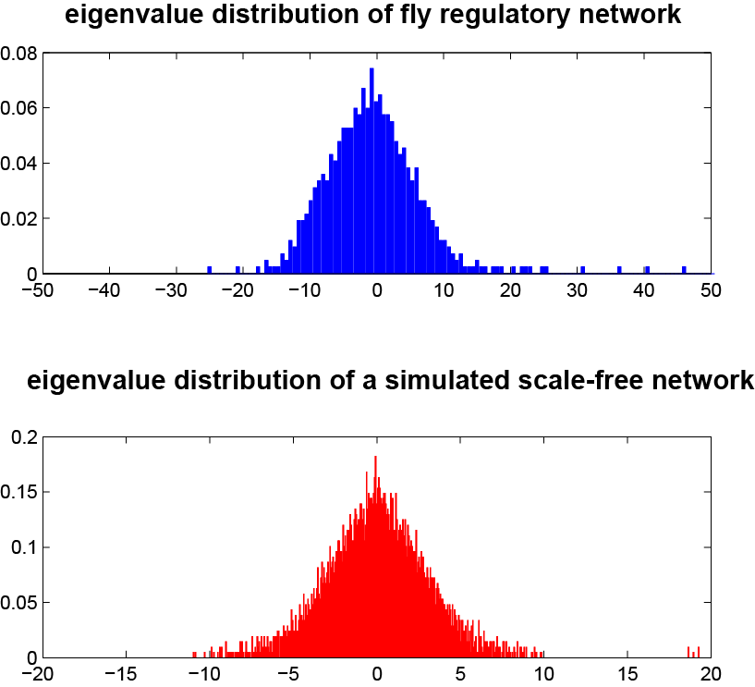
Regulatory networks have heavy-tailed eigenvalue distributions
Eigenvalue distribution is asymmetric with heavy tails
Scale-free network structures, there are some nodes with large connectivity
Modular structures: positive and negative eigenvalues

Slide 7
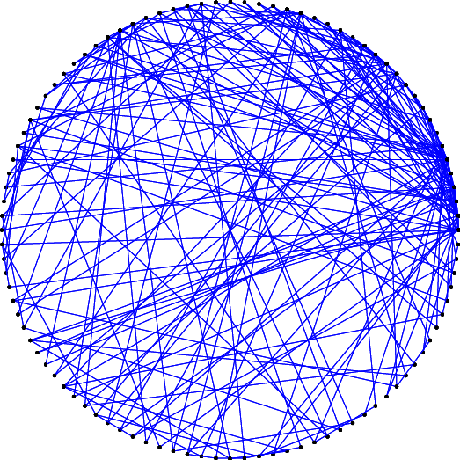
An example of scale-free network structures
Scale-free networks
Power-law degree distribution
High degree nodes
Preferential attachment

Slide 8
Key idea: use systems-level information:
Network modularity, spectral methods
Idea:
Represent regulatory networks using regulatory modules
Robust and informative compared to edge representation
Method:
Spectral modularity of networks
Highlight modules and discover them

Slide 9
Key idea: use systems-level information:
Network modularity, spectral methods
Idea:
Represent regulatory networks using regulatory modules
Robust and informative compared to edge representation
Method:
Spectral modularity of networks
Highlight modules and discover them

Slide 10
Eigen decomposition of the modularity matrix
adjacency
matrix
modularity
matrix
eigenvector
matrix
Modularity
profile matrix
degree vector
Total number
of edges
positive
eigenvalues
Method:
Compute modularity matrix of the network
Decompose modularity matrix to its eigenvalues and eigenvectors
For modularity profile matrix using eigenvectors with positive eigenvalues
Compute pairwise distances among node modularity profiles

Slide 11
why does it work?
Probabilistic definition of network modularity [Newman]
Modularity matrix:
Probabilistic background
model
For simplicity, suppose we want to divide network into only two modules characterized by S:
Contribution of node 1
in network modularity
+1
+1
-1
k₁
S=
-1
+1
k₂
1
k₃
k_{n}

Slide 12
why does it work?
Linear Algebra: Network modularity is maximized if S is parallel to the largest eigenvector of M
However, S is binary and with high probability cannot be aligned to the largest eigenvector of M
Considering other eigenvectors with positive eigenvalues gives more information about the modularity structure of the network
Idea (soft network partitioning): if two nodes have similar modularity profiles, they are more likely to be in the same module
adjacency
matrix
modularity
matrix
eigenvector
matrix
modularity profile
matrix

Slide 13
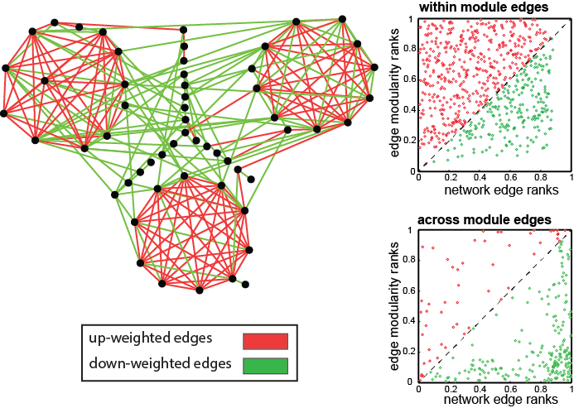
Spectral modularity over simulated networks

Slide 14
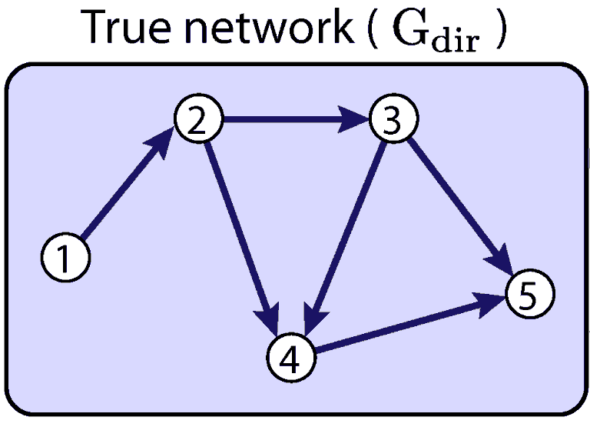
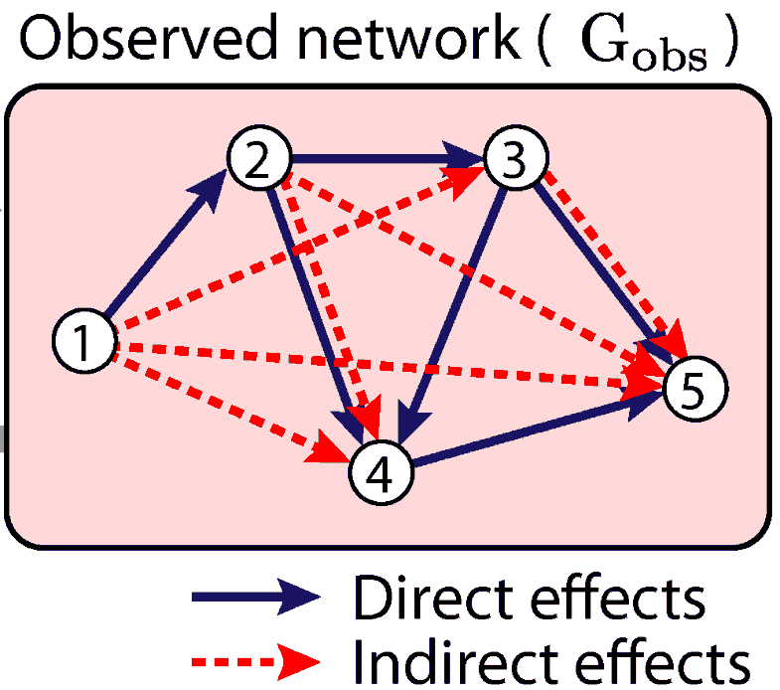
Observed network: combined direct and indirect effects
Transitive
Effects
Indirect edges may be entirely due to second-order, third-order, and higher-order interactions (e.g. 1→4)
Each edge may contain both direct and indirect components (e.g. 2→4)

Slide 15
Model indirect flow as power series of direct flow
Transitive
Closure
indirect effects
k₁
i
k₂
j
converges with
correct scaling
2nd order
3nd order
k_{n}
This model provides information theoretic min-cut flow rates
Linear scaling so that max absolute eigenvalue of direct matrix <1
  Indirect effects decay exponentially with path length
  Series converges
Inverse problem: G_{dir} is actually unknown, only G_{obs} is known

Slide 16
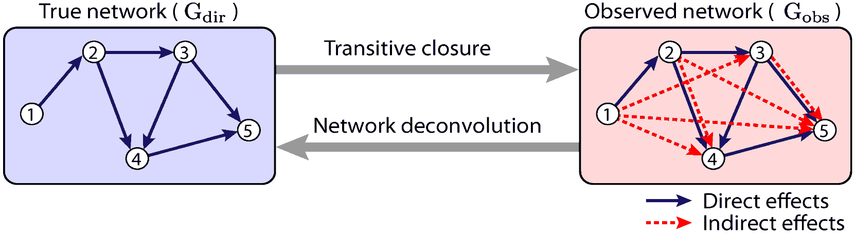
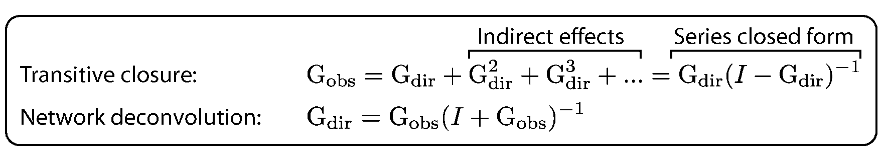
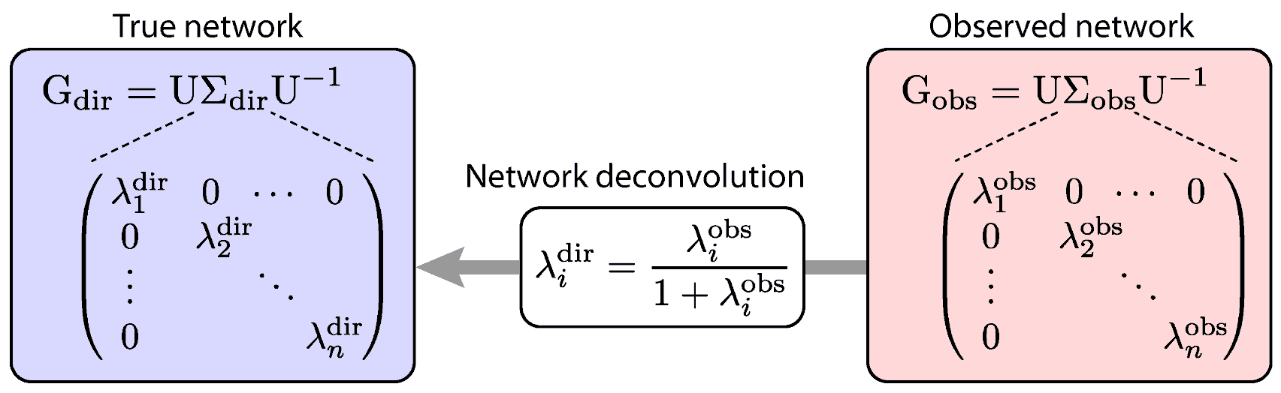
Network deconvolution framework

Slide 17
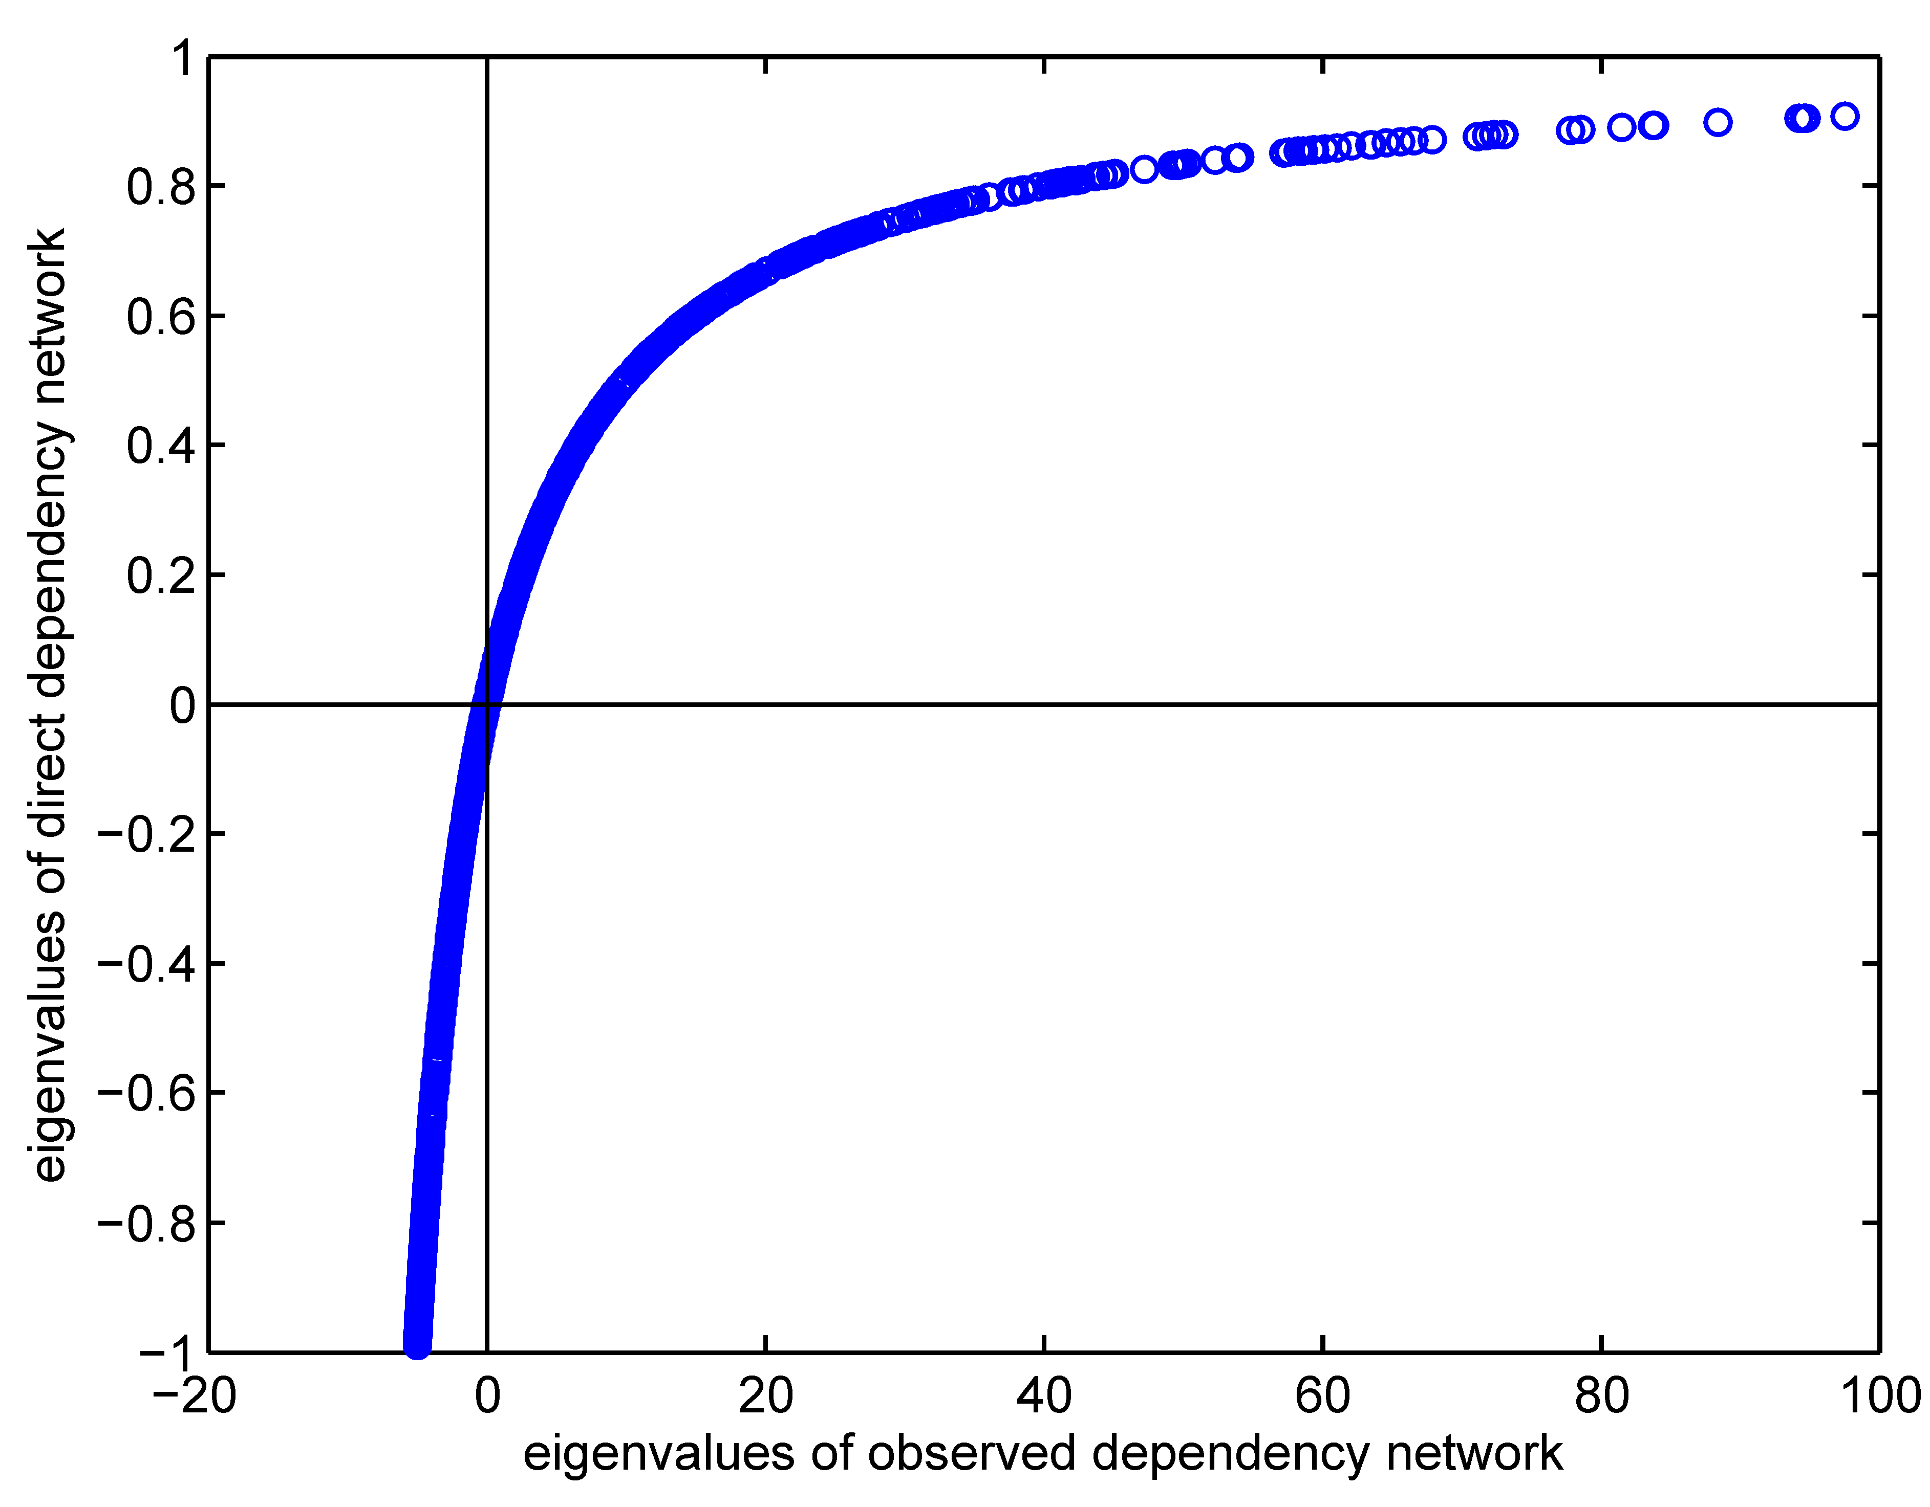
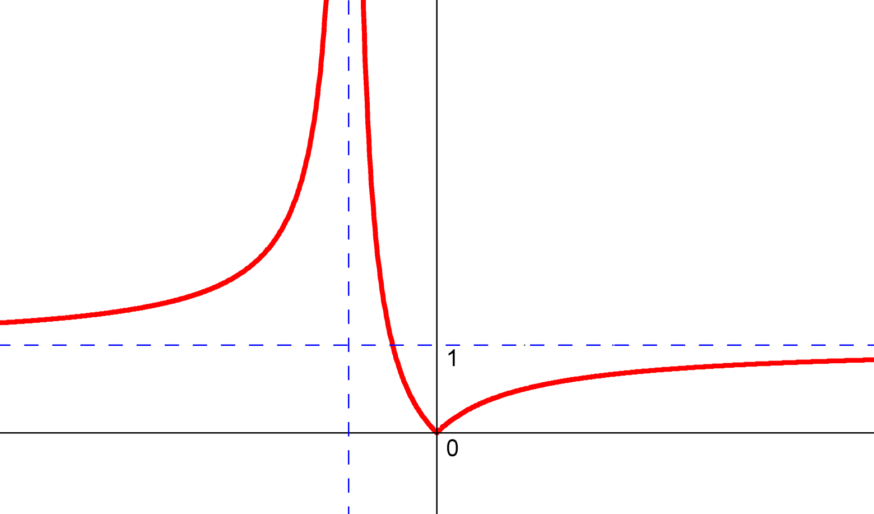
ND is a nonlinear filter in eigen space
Theorem
Suppose and are the largest positive and smallest negative eigenvalues of . Then, by having the largest absolute eigenvalue of will be less than or equal to
Intuition:

Slide 18
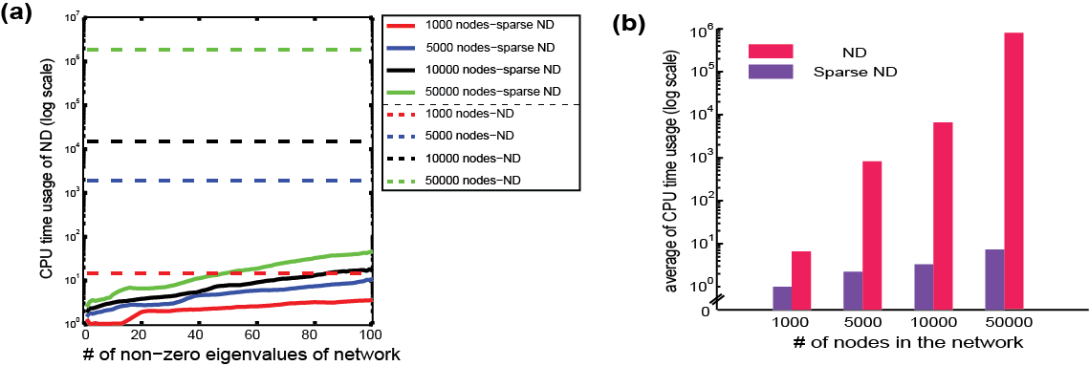
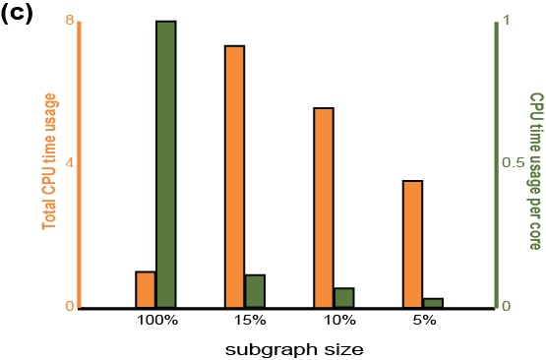
Scalability of spectral methods
O(n³) computational complexity for full-rank networks
O(n) computational complexity for low-rank networks
Local deconvolution of sub-networks of the network
Parallelizing network deconvolution

Slide 19
Conclusions
Eigenvalue distribution of regulatory networks is similar to scale-free ones and has a heavy positive tail.
Regulatory networks have scale-free structures.
Eigen decomposition of probabilistic modularity matrix can be used to detect modules in the networks
Network deconvolution: a spectral method to infer direct dependencies and removing transitive information flows

