Slide 1
Are we BREAKing the ivory ceiling?
Women and minorities in philosophy
Sally Haslanger
MIT Linguistics and Philosophy
shaslang@mit.edu
(c) Sally Haslanger 2011

Slide 2
Outline
Why do we care? How do we proceed?
Some data
Possible explanations
  Native differences in ability
  Structural barriers
  Outright discrimination
  Micro-messages
  Implicit bias
    Reliance on faulty schemas
    Conflicts between schemas
  Climate
    Departments as social spaces
    Stereotype threat
Strategies for change

Slide 3
Why do we Care? How to proceed?
Moral considerations: justice
Professional considerations: philosophical excellence
Personal considerations: success
Legal considerations: liability?
Methods:
  Data collection in philosophy
  Research on social psychology
  Research on other disciplines where women and minorities appear to be underrepresented

Slide 4
What can we do?
Admittedly there are pipeline issues, but why is the pipeline so leaky? And what other factors play a role?
We need to identify the hurdles women, minorities (and others) face so we are better prepared to avoid or overcome them.
The hurdles differ for each of us; understanding the variety of hurdles will help us each individually, and will help us help others.
Dwelling upon the negative isn’t helpful, but gaining knowledge and agency is.

Slide 5
Data…
Or “the philosophy Exception”

Slide 6
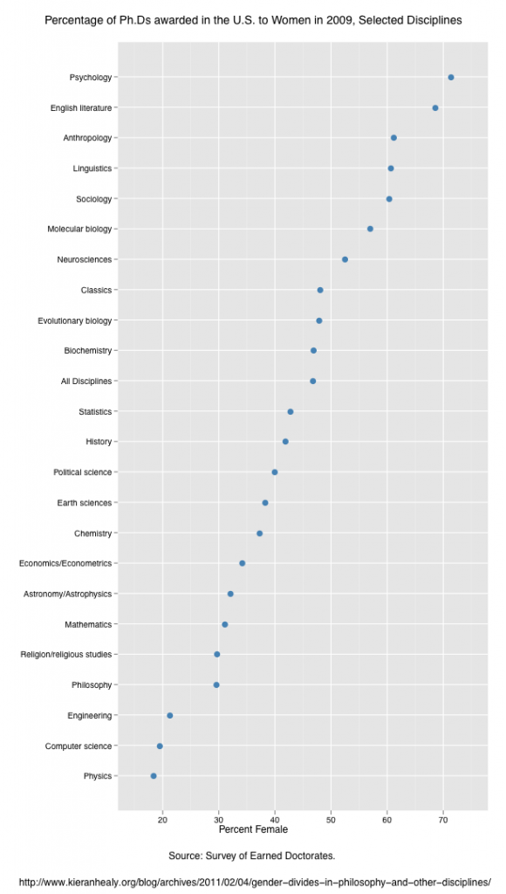
Earned Doctorates 2009
Philosophy

Slide 7
Women Faculty in philosophy (2006)

Slide 8
Women Faculty in Philosophy (2009)

Slide 9
Women in Continental Departments 2010
School | Women | Total | % Women
Brown University | 4 | 16 | 25%
Cambridge University | 8 | 27 | 29%
Columbia University | 9 | 30 | 30%
Georgetown University | 7 | 30 | 23%
Indiana University, Bloomington | 5 | 14 | 35%
New York University | 4 | 27 | 15%
Syracuse University | 2 | 19 | 10%
University at Stony Brook, SUNY | 6 | 24 | 25%
University College Dublin | 3 | 16 | 19%
University of California, Riverside | 4 | 18 | 22%
University of Chicago | 5 | 28 | 18%
University of Essex | 4 | 17 | 23%
University of Notre Dame | 6 | 40 | 15%
University of Southampton | 3 | 11 | 27%
University of Warwick | 5 | 26 | 19%

Slide 10
Pipeline Study by Paxson, Figdor & Tiberius (2011)
98 registrars/departments granting philosophy PhDs (33% return rate)
64 registrars/philosophy departments of liberal arts schools (38% return rate)
A total of 56 institutions (total n = 167)
  11,246 students in intro level philosophy classes
  3,443 philosophy majors
  1,359 philosophy graduate students
  711 full-time faculty members

Slide 11
Pipeline leaks ?

Slide 12
Racial minorities in Philosophy
Only 50 out of 14,000 professors in Britain are black.
  As far as anyone has been able to determine, none of the 50 black professors in the UK specializes in philosophy.
  The data in item #1 is reported in the Guardian: http://www.guardian.co.uk/education/2011/may/27/only-50-black-british-professors?intcmp=239, http://www.guardian.co.uk/education/mortarboard/2011/may/27/black-professor-shortage-failure-to-nurture-talent.
Fewer than 125 out of 11,000 American philosophers are black.
Fewer than 30 out of 11,000 American philosophers are black women.
  The data in items #2 and #3 are drawn from the work of Prof. Kathryn T. Gines (2011) “Being a black woman philosopher: Reflections on founding the Collegium of Black Women Philosophers.” Hypatia 26(2): 429-43.

Slide 13
Data on publications (2002-2007)
Articles:
% men: 95.56
% women: 4.44
Discussions/Symposia
% men: 90.20
% women: 9.80

Slide 14
Journals 2008-11
Journal | % articles by women 2002-7 | % articles by women 2008-11
Ethics | 19% | 14% v
J Phil | 13% | 15% ^
Mind | 6% | 9.5% ^
Noûs | 12% | 11% v
Phil & Public Affairs | 14% | ??
Phil & Phenom Research | 12% | ??
Phil Review | 11% | 18% ^
Overall | 12.36% | 13.5% ^

Slide 15
Explanations ?

Slide 16
Native differences in ability: SEM
Mean scores between males and females on tests of analytical reasoning and math are very close and are converging.*
  Upper tail m/f ratio in 1970’s: 13:1
  Upper tail m/f ratio in 2005: 3:1
Professionals in SEM fields are not mainly those on the upper tail of the bell curve.*
Even controlling for mathematical ability, less than half as many women as men pursue SEM careers.*
For understanding mathematical concepts there is no sex difference at any age level.**
Individual performance is always a result of complex physical and contextual factors.
* Beyond Bias and Barriers, NAS/NAE/IM 2006, p. 2-8. ** Ibid. p. 2-10.

Slide 17
Structural Issues
Work-life balance, etc. – common across academic disciplines and other work environments.
Any structural issues specific to philosophy?
Some “top” journals in analytic philosophy do not do anonymous refereeing (J Phil recently changed policy).
Some “top” journals are selective in the articles that are anonymously refereed.
    Editor selects which submissions will be refereed, and which rejected outright (desk rejections).
    This selection happens when the author’s name is known.

Slide 18
Disaffection
When…women enter the workforce, they all begin with a common assumption: I have a chance. They believe that their degrees, their raw talent, their ingenuity, and their industry will be the keys to their success. Then somewhere along the way, the women—especially the black women—begin to see that people still question their intelligence, and discount what they think. They are told to wait for opportunities, to prove themselves. So they wait. They continue to prove themselves….They take on leadership positions, and they put in excessive time, often to the detriment of their personal lives. Yet even the most successful women reach the point where they realize that their own expectations have not been met. That the rewards are not always commensurate with the costs. Many keep searching—and aching—for an answer. Others find this too toxic, and regrettably, bow out.
Beyond Bias and Barriers, National Academy of Science, 2006.

Slide 19
Outright discrimination
Devaluation
  Work undervalued, misinterpreted, ignored.
  Denied terms and gestures of respect
  Success attributed to luck or circumstance rather than ability
  Assertiveness cast as aggressiveness
Gender Stereotyping
  Sexist assumptions re family status, mobility, commitment
  Assignment to gender-stereotypical tasks
  Pressure to enter gendered specialties such as ethics, history of philosophy, feminist philosophy
Exclusion
  Rude, disparaging, disrespectful remarks; bullying.
  Inappropriate humor
Backlash
  Hostility due to imagined advantages

Slide 20
Chilly climate: Behavioral Dimensions
When we speak, we assume that others take their message from our words. However, we communicate using more than words.
Implicit attitudes (biases) are more often expressed in body language than in speech, even by those who do not consciously endorse the bias.
Micromessages can say: “you don’t belong here.”
  Eye contact, open/closed body language, expressions of interest, follow-up questions, subtle affirmations and withdrawals.
  Allocation of space, invitations, job assignments, offers of help or collaboration.
  Topics of conversation, choice of time/place/content of collective activities.

Slide 21
Micromessaging
Accumulation of negative micromessages causes increasing dissatisfaction with work/study environment over time.
It may be a steady accumulation of seemingly trivial things.
Messages can be positive or negative resulting in micro-inequity or micro-advantage. Micro-inequities can be countered by micro-affirmations.

Slide 22
Small differences add up
65% men, 35% women
15%
1% m/f variance
50% men, 50% women

Slide 23
Schemas
The best explanation of implicit bias is that it arises from reliance on problematic schemas.
A schema is a simplified representation of a kind or type that
  Organizes our perceptions and beliefs about things of that kind
  Guides our expectations, predictions
  Supplies missing context (explanatory, interpretive)
Schemas are mostly unconscious; they are plausibly the base for many of our dispositions to respond to things differently in light of their kind.

Slide 24
Schemas are widely shared
Research shows that we all – regardless of gender or race – perceive and treat people based on schemas associated with their race/gender/social group.
    Both men and women hold them about gender
    Both whites and people of color hold them about race
People are typically not aware of them, but with effort can become aware of them and change them.
Implicit association test:
  https://implicit.harvard.edu/implicit/
Fiske (2002). Current Directions in Psychological Science, 11, 123-128.

Slide 25
Reliance on Schemas
Schemas are valuable and our reliance on them is inevitable. However, problems arise when:
  We rely on a schema that is not apt for the context (even though it may be apt in many contexts).
    Birds fly
  There are sometimes conflicts between schemas resulting in cognitive dissonance.
    Women in the military

Slide 26
When Schemas conflict….
Disappear the difficult cases, by ignoring them or forcing them out. (Or as in military, rule them out by fiat.)
Find ways to pretend that false assumptions of the schemas are preserved. (Successful women philosophers aren’t really women, or they aren’t really doing philosophy.)
Allow exceptions to the rule (tokenism), but maintain barriers to limit access. (Of course we would hire another woman, if we could find one like Sally.)
Change the schemas.

Slide 27

Schemas and Evaluation
Applicants with African American-sounding names had to send 15 resumes to get a callback, compared to 10 for applicants with white-sounding names.
White names counted as an additional 8 years of experience.
The higher the resume quality, the greater the gap in callback rate.
Jamal
Greg
Bertrand & Mullainathan (2004) Poverty Action Lab, 3, 1-27.
When evaluating identical application packages, male and female university psychology professors preferred 2:1 to hire “Brian” (or “Barack”?) over “Karen.”
Steinpreis, Anders, & Ritzke (1999) Sex Roles, 41, 509.

Slide 28
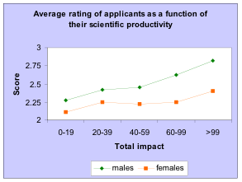
Evaluation of Applications
“…the success rate of female scientists applying for postdoctoral fellowships at the [Swedish Medical Research Council] during the 1990s has been less than half that of male applicants.”
Results of study: Women applying for a post- doctoral fellowship had to be 2.5 times more productive to receive the same reviewer rating as the average male applicant.
Similar findings:
USA/GAO report on Peer Review in Federal Agency Grant Selection (1994)
European Molecular Biology Organization Reports (2001)
NIH Pioneer Awards: Journal of Women’s Health (2005) & Nature (August 2006)
Wenneras & Wold (1997) Nature, 387, 341.

Slide 29
Gender Schemas in Recommendations for Successful Medical School Faculty Applicants
Letters for men:
Longer
More references to CV, Publications, Patients, Colleagues
Letters for women:
Shorter
More references to personal life
More “doubt raisers,” including hedges, faint praise, and irrelevancies (e.g., “It’s amazing how much she’s accomplished.” “It appears her health is stable.” “She is close to my wife.”)
Trix & Psenka (2003) Discourse & Society, 14(2): 191-220, 2003.

Slide 30
Schemas play a significant role when there is:
The response is quick, rushed, or given insufficient time for consideration.
Full attention is not given to the task.
Decisions are not held accountable.
The individual being evaluated is a member of a group that is a significant minority in the field, with the tipping point somewhere around 25-30%.
The evaluator is unaware of common errors concerning reasoning about the group so does not correct for them.

Slide 31
evaluation bias
Race and gender stereotypes/schemas often lead to different standards of assessment.
Women and minorities are more easily judged competent (she’s good…for a woman);
But standards for excellence are set higher than for men and whites (but is she really good?).
Biernat & Kobrynowicz, 1997

Slide 32
Accumulation of disadvantage feedback loop
Lowered career success rate
Affects educational opportunities, publication rate, funding, climate of support, etc.
“Confirms” schema
Lack of critical mass
Performance is underestimated
Evaluation Bias

Slide 33
Disrupting the feedback loop
Improved
LOWERED CAREER SUCCESS RATE
Affects educational opportunities, publication rate, funding, climate of support, etc.
Lack of critical mass
“Confirms” schema
Creates
Disconfirms
Valued appropriately
Performance is underestimated
Evaluation Bias

Slide 34
CHILLY CLIMATE: Social Dimensions
Philosophy departments often are hypermasculine places.
    competitive, combative, (non-nurturing),
    highly judgmental,
    oriented toward individual accomplishment and individual intelligence,
    hostile to femininity.
Philosophy departments often are socially dysfunctional places.
  Women, socially, are responsible for maintaining good social dynamics. Typically in philosophy departments, women either are
    burdened by this sense of responsibility or
    alienated by the atmosphere where ordinary social norms are not recognized.

Slide 35
Stereotype Threat
Stereotype threat occurs when individuals are stereotyped as poor performers in a domain and their performance may seem to confirm the negative stereotype.
  Performance decreases on computational and recall tasks.
  Conscious awareness of the threat is not necessary for effects.
  Threat can be activated with little or no explicit mention of stereotyped group. If the stereotype is culturally ubiquitous or if there are implicit cues.
Stereotype threat is situational: performance decreases ONLY in settings where the stereotype is activated.
Stereotype threat can be deactivited by education about its effects.

Slide 36
Solo Status
Solo status occurs when one is the only member of one’s social group in a setting.
Solo status increases the risk of stereotype threat; public settings also exacerbate the effects.
Precise explanation of stereotype threat is contested, but all accounts suggest that time and energy consuming meta-cognition is responsible.
Addressing solo status can reduce stereotype threat.

Slide 37
How to combat stereotype threat: RE-AIM
Reframe the task
  Does it have to be viewed as diagnostic of your abilities? Is it really a “test”?
Explain the anxiety in ways that don’t validate the stereotype
  Attribute struggle to “an external, temporary cause.”
  Reframe the anxiety as a potential performance enhancer.
  Affirm/embrace complex identities: “Reducing the salience of a threatened identity appears to serve a protective function, supporting continued high performance...”
  Embrace an identity that is non-stereotyped.
  Identify with a characteristic shared across ingroup/outgroup.
  Affirm your valued and unique characteristics.
http://www.reducingstereotypethreat.org/reduce.html

Slide 38
Combat Stereotype Threat, continued
Adopt an incremental approach to intelligence.
  Is intelligence is “fixed” (not changing over time or context) or “like a muscle” that can strengthen and develop?
  There is empirical support for the idea that intelligence is not fixed but can be developed.
  Those who accept the latter “incremental view” are less susceptible to stereotype threat; they are “likely to increase effort to further learning and to overcome obstacles.” (Dweck & Sorich, 1999; Mueller & Dweck 1998).
Seek out counter-stereotypical role models.
http://www.reducingstereotypethreat.org/reduce.html

Slide 39
A Few Recommendations

Slide 40
Recommendations: GENERAL
Challenge the myth of non-bias
  Even individuals who are strongly egalitarian may still rely on problematic schemas.
  Confidence in your own fairness may prevent you from being as fair as you aim to be. E.g., If you assume you are always fair, then it is tempting to conclude that others’ weaknesses must be their own fault.

Slide 41
Recommendations: Climate
  Leadership of Department Head and Faculty is crucial
  Educate everyone about the value of inclusion
  Gather information through surveys: assess current climate
  Don’t accept that “women are different” or expect women to conform to dominant models. Work for “congruence,” i.e., breaking down of in-group vs. out-group understandings, putting everyone on the same “team”.
  Consider creating gender-specific support groups.

Slide 42
Recommendations:
Disrupt Schemas, change climate
Do not disappear, ignore, or redescribe women and minorities in philosophy.
Make explicit and defuse the schemas for gender, race, class, and philosophy.
Don’t acquiesce in the masculinization of philosophy spaces. Find ways to discourage antisocial behavior. Encourage a sense of belonging. (Provide food.)
Broaden the philosophical understanding of intelligence.

Slide 43
Recommendations: RECRUITMENT & Retention
Identify “feeder schools” and reach out to them
Make a specific effort to identify good women and URM’s through friends and colleagues at other schools. Cultivate talent.
Aim for a critical mass of women and URMs. Avoid putting people in solo status. Explicitly counter stereotype threat and educate broadly about these phenomena.
Develop explicit, empirically tested, mentoring policies

Slide 44
Recommendations: Organize!
Establish contexts where women philosophers and philosophers of color are in the majority.
Establish contexts where feminist philosophy and philosophy of race is valued.
Establish systems for accountability and support.
Learn about broader institutional (college/university/nationwide) resources that may be useful.
[Insert your solution here….]

Slide 45
Summing up: BASIC strategies
Outright discrimination
  Use institutional means of redress
Structural barriers
  Demand institutional change; convert barriers to bridges
Schemas and implicit bias
  Slow down; hold evaluators accountable; build critical mass
Stereotype threat (RE-AIM)
  Reframe the task; Explain anxiety; activate Alternative identities; adopt Incremental view of intelligence; find role Models.

Slide 46
Links
Implicit Bias and Philosophy International Research Project: http://biasproject.org
Gender Equity Project (Virginia Valian): http://www.hunter.cuny.edu/genderequity/
ADVANCE portal: http://www.portal.advance.vt.edu/
Women in Philosophy Task Force: http://web.mit.edu/wphtf/

Slide 47
Thank you for your attention
And special thanks to:
Samantha Brennan Hazel Sive
Thomas F. DeFrantz Abigail Stewart
Deborah K. Fitzgerald JoAnne Yates
for their contributions.
For full references to the research cited, please go to: http://www.portal.advance.vt.edu/index.php/categories/resources/reading-lists
And select: Faculty Recruitment Workshop, Articles by Topic
Or choose from several annotated bibliographies.

Slide 48
The End

