Slide 1
Information Theory for Mobile Ad-Hoc Networks (ITMANET): The FLoWS Project
Thrust 3
Application Metrics and Network Performance
Asu Ozdaglar and Devavrat Shah

Slide 2
MANET Metrics
New Paradigms
for Upper
Bounds
Constraints
Capacity and Fundamental Limits
Capacity
Delay
Models and
Dynamics
Upper
Bound
Layerless
Dynamic
Networks
Lower
Bound
Degrees of
Freedom
Energy
Application
Metrics and
Network
Performance
End-to-End Performance
and Network Utility
Capacity
(C*,D*,E*)
Delay
Utility=U(C,D,E)
FLoWS
Energy/SNR
Metrics
Fundamental Limits
of Wireless Systems
Models
New MANET Theory
Application Metrics

Slide 3
Thrust Motivation
Fundamental problem of MANET
  (Some form of) dynamic resource allocation

Slide 4

Thrust Motivation
Fundamental problem of MANET
  (Some form of) dynamic resource allocation
Information theory
  Fundamental limitations (Thrust 1)
  Dealing with unreliability (Thrust 2)
Information Theory
Capacity and fundamental limits
and codes

Slide 5
Thrust Motivation
Fundamental problem of MANET
  (Some form of) dynamic resource allocation
Control
  Understanding and controlling system dynamics
Information Theory
Capacity and fundamental limits
and codes
Control
Dynamical systems
Feedback, Stabilization and Controlability

Slide 6
Thrust Motivation
Fundamental problem of MANET
  (Some form of) dynamic resource allocation
Economics
  Extracts effect of non co-operative behavior and `manage’ it
Information Theory
Capacity and fundamental limits
and codes
Control
Dynamical systems
Feedback, Stabilization and Controlability
Economics
Multi-agent systems
Equilibrium and Mechanism design

Slide 7
Thrust Motivation
Fundamental problem of MANET
  (Some form of) dynamic resource allocation
Networks
  Captures uncertainty through stochastics and queuing
  “Technological” constrains driven architecture
    Implementable, distributed or message-passing network algorithms
Information Theory
Capacity and fundamental limits
and codes
Control
Dynamical systems
Feedback, Stabilization and Controlability
Economics
Multi-agent systems
Equilibrium and Mechanism design
Networks
Resource Allocation
Queues and algorithms

Slide 8
Thrust Motivation
Fundamental problem of MANET
  (Some form of) dynamic resource allocation
Information Theory
Capacity and fundamental limits
and codes
Information Theory
Capacity and fundamental limits
and codes
Economics
Multi-agent systems
Equilibrium and Mechanism design
Control
Dynamical systems
Feedback, Stabilization and Controlability
Economics
Multi-agent systems
Equilibrium and Mechanism design
Control
Dynamical systems
Feedback, Stabilization and Controlability
Networks
Resource Allocation
Queues and algorithms
Networks
Resource Allocation
Queues and algorithms
Robust against non-cooperative behavior
Queuing, distributed algorithms
Optimization and Dynamic Stability
Physical layer considerations
General application metrics
Thrust 3
Application Metrics and Network Performance

Slide 9
Thrust Motivation
Fundamental problem of MANET
  (Some form of) dynamic resource allocation
Information Theory
Capacity and fundamental limits
and codes
Information Theory
Capacity and fundamental limits
and codes
Economics
Multi-agent systems
Equilibrium and Mechanism design
Control
Dynamical systems
Feedback, Stabilization and Controlability
Economics
Multi-agent systems
Equilibrium and Mechanism design
Control
Dynamical systems
Feedback, Stabilization and Controlability
Networks
Resource Allocation
Queues and algorithms
Networks
Resource Allocation
Queues and algorithms
Robust against non-cooperative behavior
Queuing, distributed algorithms
Optimization and Dynamic Stability
Physical layer considerations
General application metrics
Thrust 3
Application Metrics and Network Performance
Thrust Objective: Develop a framework for resource allocation with heterogeneous and dynamically varying application metrics while ensuring efficient (stable) operation of decentralized networks with uncertain capabilities

Slide 10
Thrust achievements: thus far
Network Resource Allocation
Different metrics require different methodology
Optimization
Stochastics
Game Theory
Cognitive radio design
Topology formation
Wireless Dynamic NUM
Goldsmith, Johari
Distributed algorithms
Johari
Integration of macro level control and micro level system design
Noncooperative scheduling
Boyd, Goldsmith
Ozdaglar, Shah
Ozdaglar
Cross-Layer Optimization
Noncooperative coding
Johari, Meyn, Shah
Boyd, Goldsmith, Medard, Ozdaglar
Effros

Slide 11
Thrust achievements: recent
Network Resource Allocation
Different metrics require different methodology
Optimization
Stochastics
Game Theory
Info. Theory
Supermodular Games
Wireless, Distributed Dynamic NUM
Fundamental Overhead in Distributed Algorithm
Near Potential Games
Johari
Distributed CSMA
Ozdaglar
Shah
Boyd, Goldsmith
El Gamal
Power Control & Potential Games
Ozdaglar
Q-learning for network resource allocation
Capacity with Coding
Large Dynamic Stochastic Games
Medard
Meyn
Dynamic Resource Allocation Game
Johari
Ozdaglar

Slide 12
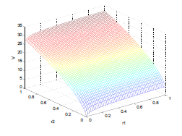
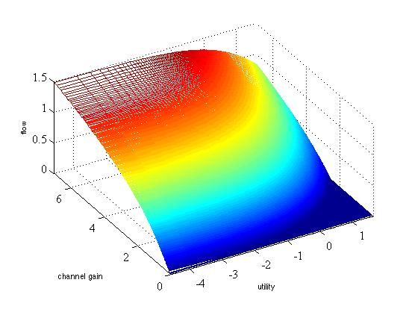
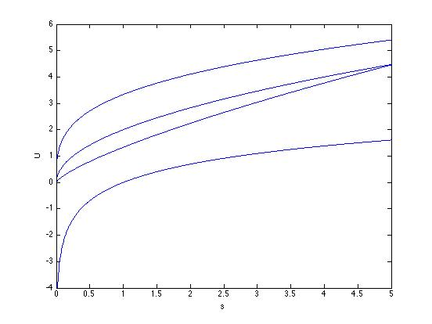
Recent Thrust Achievements
Optimization Methods for General Application Metrics
Wireless Stochastic Resource Allocation (WNUM)
Distributed Wireless Network Utility Maximization (Goldsmith)
  To optimize the rate-reliability tradeoff in wireless networks
  Stochastic approximation to establish convergence
  Promising simulation study
Full Stochastic Control Problem (Boyd)
  To optimize power control and capacity allocation
    With utilities being smooth functions of flow rates
  Exact characterization of “no transmit” region
    Optimal things to do : no power utilization !
  Approximation dynamic programming techniques

Slide 13

Recent Thrust Achievements
Optimization Methods for General Application Metrics
Wireless Stochastic Resource Allocation (WNUM)
Dynamic Resource Allocation (Ozdaglar)
  Proportional fair allocation of capacity
  Existence and uniqueness of Nash Equilibrium
  Fluid model approximation

Slide 14
Recent Thrust Achievements
Network Games
Network games and non-cooperative behavior
Two benchmark model for networked systems
  Supermodular and Potential games
    Both admit simple, learning rules to reach Nash Equilibrium
    Provide insights in understanding more complex setup
Supermodular Games (Johari)
  Largest Nash Equilibrium
    Pareto optimal under positive externalities
    Player action determined by the “centrality”
    Relation to the connectivity of an agent
…
…
…
…
1

Slide 15



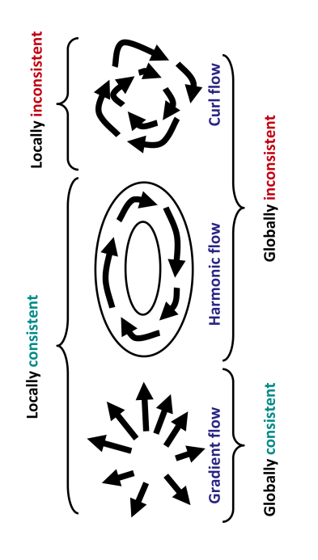
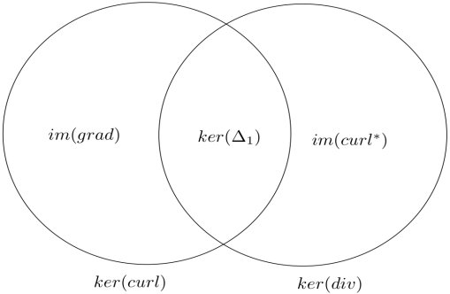
Recent Thrust Achievements
Network Games
Network games and non-cooperative behavior
Two benchmark model for networked systems
  Supermodular and Potential games
    Both admit simple, learning rules to reach Nash Equilibrium
    Provide insights in understanding more complex setup
Potential Games (Ozdaglar)
  Power control in a multi-cell CDMA system
  Analysis through an “approximate” potential game
  Ingredient:
    Lyapunov analysis
  More in Focus Talk.
Near Potential Games (Ozdaglar)
  Decomposition of games
Power control game
approximate
Potential game
Lyapunov
analysis
pricing
Optimal power allocation

Slide 16
Recent Thrust Achievements
Network Games
Network games and non-cooperative behavior
Large Dynamic Stochastic Games (Johari)
  Study of Oblivious Equilibrium (OE)
    Aggregate effect of the large number of agents
  Exogenous conditions on model primitives
    OE approximates Markov perfect equilibrium
General Stochastic Games
Competitive Model
Non-cooperative games.
Sub modular payoff
Existence results for OE.
AME property.
Coordination Model
Cooperative games.
Super modular payoff structure.
Results for special class of linear quadratic games.

Slide 17
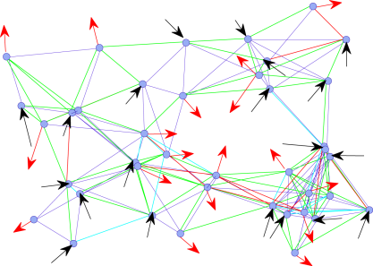
Recent Thrust Achievements
Stochastic Network and Control
Network resource allocation algorithm
Q-learning (Meyn)
  Characterization of optimal policy for Markovian system
    By means of system observation under non-optimal policy
  Broadening the domain of application, including
    Network resource allocation scenario

Slide 18
Recent Thrust Achievements
Stochastic Network and Control
Network resource allocation algorithm
Capacity under immediate decoding (Medard)
  Characterization through conflict graphs
  When tractable
    Outperforms naïve routing based approach

Slide 19
Recent Thrust Achievements
Stochastic Network and Control
Network resource allocation algorithm
Medium Access Control (MAC) protocol (Shah)
  Asynchronous, distributed and extremely simple
  Like classical backoff protocol
    Backoff probabilities are function of queue-sizes
  Efficient
    Resolves a long standing intellectual challenge in networks and information theory
  Utilizes insights from statistical physics and Markov chain mixing time
  Adjudged Kenneth Sevic Outstanding Student Paper at ACM Sigmetrics ‘09
    See Poster by Jinwoo Shin
1/1+log q
log q/1+log q

Slide 20
Achievements Overview (Last Year)
Optimization
Distributed and dynamic algorithms for resource allocation
Boyd: Efficient methods for large scale network utility maximization
Goldsmith: Layered broadcast source-channel coding
Medard, Ozdaglar: Cross-Layer optimization for different application delay metrics and block-by-block coding schemes
Medard, Shah: Distributed functional compression
Boyd, Goldsmith: Wireless network utility maximization (dynamic user metrics, random environments and adaptive modulation )
Medard, Ozdaglar: Efficient resource allocation in non-fading and fading MAC channels using optimization methods and rate-splitting
Ozdaglar: Distributed optimization algorithms for general metrics and with quantized information
Goldsmith, Johari: Game-theoretic model for cognitive radio design with incomplete channel information
Shah: Capacity region characterization through scaling for arbitrary node placement and arbitrary demand
Johari: Local dynamics for topology formation
Shah: Low complexity throughput and delay efficient scheduling
Ozdaglar: Competitive scheduling in collision channels with correlated channel states
Meyn: Generalized Max-Weight policies with performance optim- distributed implementations
Stochastic Network Analysis
Flow-based models and queuing dynamics
Game Theory
New resource allocation paradigm that focuses on hetereogeneity and competition

Slide 21
Achievements Overview (Most Recent)
Optimization
Distributed and dynamic algorithms for resource allocation
Boyd, Goldsmith: Wireless network utility maximization as a stochastic optimal control problem
Ozdaglar: Distributed second order methods for network optimization
El Gamal: Overhead in distributed algorithms
Shah: Distributed MAC using queue based feedback
Medard: Decoding and network scheduling for increased capacity
Ozdaglar: Noncooperative power control using potential games
Johari: Large network games
Ozdaglar: Near potential games for network analysis
Meyn: Q-learning for network optimization
Johari: Supermodular games
Effros: Noncooperative network coding
Stochastic Network Analysis
Flow-based models and queuing dynamics
Game Theory
New resource allocation paradigm that focuses on hetereogeneity and competition

Slide 22
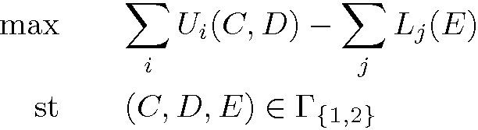


Thrust Synergies: An Example
Combinatorial algorithms for upper bounds
Thrust 1
Upper Bounds
Effros: Noncooperative network coding
(C*,D*,E*) optimal solution of
Meyn: Q-learning for network resource allocation
Capacity
Delay
Thrust 3
Application Metrics and Network Performance
Ozdaglar: Wireless power control through potential games
Upper
Bound
T3 solves this problem:
Using distributed algorithms
Considering stochastic changes, physical layer constraints and micro-level considerations
Modeling information structures (may lead to changes in the performance region)
Lower
Bound
Moulin: Interference mitigating mobility
Energy
Boyd, Goldsmith: Wireless network utility maximization as a stochastic optimal control problem
Capacity
Delay
(C*,D*,E*)
Thrust 2
Layerless Dynamic Networks
El Gamal: Information theory capacity and overhead introduced by distributed protocols.
Energy
Medard: (De)coding with scheduling to increase capacity
Algorithmic constraints and sensitivity analysis may change the dimension of performance region
Shah: Capacity region for large wireless networks accompanied by efficient, distributed MAC
Notes:
Algorithmic interface operates independent of channel capacities
The network capacities developed in Upper Bounds Thrust will be used to improve the performance of our Thrust’s network algorithms
Combining our results with the approaches in the Layerless Dynamic Networks Thrust will enable fully decentralized, end-to-end optimized network operation

Slide 23
FLoWS Phase 3 and 4 Progress Criteria : Thrust 3
Specific challenges/goals : currently addressed via some examples
  Develop new achievability results for key performance metrics based on networks designed as a single probabilistic mapping with dynamics over multiple timescales
    Stochastic NUM for hard delay constraints and dynamic channel variation
    Distributed medium access control via reversible dynamics
  Develop a generalized theory of rate distortion and network utilization as an optimal and adaptive interface between networks and applications that results in maximum performance regions
    Potential game approach for dynamically achieving general system objective
    Supermodular games and complementarities over networks
  Demonstrate the consummated union between information theory, networks, and control; and why all three are necessary ingredients in this union
    Q-learning for dynamic network control
    Bringing together coding, dynamics and queuing

Slide 24
Thrust Challenges: Going Forward
Distributed networks
  Fundamental limitations using information theoretic approaches
  Interplay between game theory and distributed optimization ?
Different delay metrics and robustness
  Going beyond hard delay constraints ?
  Multi-resolution algorithm design and effect of feedback
  “Universality” of system design with respect to uncertainty
Effect of dynamics at different “time scales”
  Topological : incremental versus abrupt changes
  Scheduling : dynamics over evolving queues
Consummating the union : an example
  Use of (de)coding for better distributed MAC

