Slide 1
Information Theory for Mobile Ad-Hoc Networks (ITMANET):
The FLoWS Project
FLoWS Program and
Thrust Updates
Andrea Goldsmith
Phase 4 Kickoff
May 24-25, 2010

Slide 2
FLoWS Challenge and Progress
Develop and exploit a more powerful information theory for mobile wireless networks.
New theory within and between thrust areas has emerged, along with blurring lines between thrusts.
Phase 3 progress criteria met
  Revolutionize upper bounds
  Determine optimal channel/network “coding” and its gap to capacity
  Determine new achievability results based on key performance metrics for dynamic networks
  Develop a generalized theory of rate distortion and network utilization

Slide 3
MANET Metrics
New Paradigms
for Upper
Bounds
Constraints
Capacity and Fundamental Limits
Capacity
Delay
Models and
Dynamics
Upper
Bound
Layerless
Dynamic
Networks
Lower
Bound
Degrees of
Freedom
Power
Application
Metrics and
Network
Performance
Application and
Network Optimization
Capacity
(C*,D*,E*)
Delay
Utility=U(C,D,E)
FLoWS
Metrics
Power
Models
Fundamental Limits
of Wireless Systems
New MANET Theory
Application Metrics

Slide 4
Thrust Synergies and New Intellectual Tools
Thrust 1
Equivalence
Classes
Code Construction
Combinatorial
Tools
Thrust 2
Dynamic
Network IT
Optimization
Structured
Coding
Thrust 3
CSI, Feedback,
and Robustness
Stochastic
Network
Analysis
Optimization
Game Theory

Slide 5
Thrust 0 Recent Achievements
Models
Coleman, Effros, Goldsmith, Medard, Zheng:
Channels and Networks with Feedback
Effros: networks with side information
Cover: Coordinated Networks
El Gamal: More than 3 users
Moulin: Mobility
Goldsmith: Cognitive Nodes
Medard, Zheng: Distortion-Outage tradeoff
Effros, Goldsmith: Expectation and
Outage in Capacity and Distortion
Zheng: UEP
Goldsmith: Diversity/multiplexing/delay tradeoffs
Medard: delay/energy minimization
Medard: Stability Regions
Shah: multicast capacity
Metrics

Slide 6
Thrust 1 Recent Achievements
New bounding techniques
Goldsmith, Medard: Analog Network Coding in the High-SNR Regime
El Gamal: Interference Decoding
for Deterministic Channels
Code construction
Network information theory
Cover: Coordination via Communication
Moulin: Nonasymptotic Universal Coding
Goldsmith: Cognitive and Cooperative Relaying
Coleman: On Reversible Markov Chains
and Maximization of Directed Information
Medard: Scalar-linear Network
Coding in Wireless Networks
Moulin: MANET Capacity Under Severe Outage
Networking
and optimization
Combinatorial Tools

Slide 7
Thrust 2 Recent Achievements
Dynamic Network Information Theory
Coleman: Mutual Information Saddle Points
in Channels of Exponential Family Type
Goldsmith: Exploiting Randomness in MUD via Compressed Sensing
Cover: Coordination via Communication
Moulin: Interference Management through Backbone of Cooperative Mobile Relays
Zheng: Coding with Dynamic Metrics
Coleman: On Reversible Markov Chains
and Maximization of Directed Information
Moulin: Nonasymptotic Universal Coding
Medard: Scalar-linear Network
Coding in Wireless Networks
El Gamal: Interference Decoding for Deterministic Channels
El Gamal: Wiretap Channel with Causal CSI
Coleman: Source Coding with Feedforward Using the Posterior Matching Scheme
Effros: Rate-tradeoffs for Source
Networks with Limited Feedback
Effros: On the Separation of Lossy Source-Network Coding and Channel Coding in Wireline Networks
CSI, feedback, and robustness
Structured coding

Slide 8
Thrust 3 Recent Achievements
Optimization
Distributed and dynamic algorithms for resource allocation
Boyd: Adaptive Modulation
with Smoothed Utility Flow
Ozdaglar: A Distributed Newton Method
for Network Utility Maximization
Goldsmith: Optimal control of
ARQ interference networks
Medard, Ozdoglar, Effros: Optimal Reverse Carpooling Over Wireless Networks - A Distributed Optimization Approach
Shah: Efficient Medium Access
Ozdaglar: Dynamic Resource Allocation for Delay Sensitive Applications
Johari: Mean Field Equilibrium in
Dynamic Games with Complementarities
Meyn: Optimal Cross-layer Wireless
Control Policies using TD Learning
Ozdaglar: Near-Optimal Power Control in Wireless Networks: A Potential Game Approach
Stochastic Network Analysis
Flow-based models and queuing dynamics
Game Theory
New resource allocation paradigm that focuses on hetereogeneity and competition

Slide 9
Key New Theory and Insights
Thrust 0
  New definitions of reliable communications in the face of uncertainty
  Performance over finite time windows
Thrust 1
  Network Equivalence
  Network Coding in Noise/Loss
  Multiterminal Strong Converses
Thrust 2
  Layered and structured codes
  Control/Capacity connections for time-varying channels with noisy and/or rate-constrained feedback
  Generalized capacity and separation
Thrust 3
  Stochastic Multi-period Network Utility Maximization
  Relaxation and distributed techniques for network optimization
  Mean Field Equilibrium for Stochastic games
  Learning in dynamic environments
Interthrust
  Coordination via Communication
  Relaying, cooperation and cognition
  Network coding
  Capacity regions for more than 3 users

Slide 10
Wish List for New Theory and Insights
  Coding with noisy/rate constrained feedback
  Demonstrate gains in practice (e.g. analog network coding)
  Multiuser capacity under delay
  MANET layering: cost based on mobility timescales; layer dichotomy; layer interface; separation optimality
  How broad is the class of problems to which the tools of network equivalence applies
  Characterizing distortion over networks
  All joint distributions you can achieve over a networks

Slide 11
Thrust Synergies: An Example
Thrust 1
Upper Bounds
Koetter, Medard: stability region of networks with instantaneous decoding
Cover: capacity of coordinated actions
Effros: polarization codes
Medard: Collision helps
Moulin: towards harnessing relay mobility in MANETs
Thrust 3
Application Metrics and Network Performance
El Gamal: more than 3 users DM-BC and wiretap; sum rate of cyclically symmetric interference channels
Zheng, Medard: low-SNR multiple resolution and multiple description
Goldsmith: joint source-channel coding with limited feedback; capacity and achievable rates for the interference channel; multicasting with a relay; the multi-way relay channel; transmission over composite channels with combined source channel outage
El Gamal: distributed lossy averaging
Thrust 2
Layerless Dynamic Networks
Notes:
Algorithmic interface operates independent of channel capacities
The network capacities developed in Upper Bounds Thrust will be used to improve the performance of our Thrust’s network algorithms
Combining our results with the approaches in the Layerless Dynamic Networks Thrust will enable fully decentralized, end-to-end optimized network operation

Slide 12
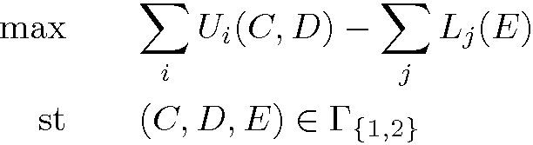


Thrust Synergies: Another Example
Combinatorial algorithms for upper bounds
Thrust 1
Upper Bounds
Effros: Noncooperative network coding
(C*,D*,E*) optimal solution of
Meyn: Q-learning for network resource allocation
Capacity
Ozdaglar: Wireless power control through potential games
Upper
Bound
Delay
Thrust 3
Application Metrics and Network Performance
T3 solves this problem:
Using distributed algorithms
Considering stochastic changes, physical layer constraints and micro-level considerations
Modeling information structures (may lead to changes in the performance region)
Lower
Bound
Moulin: Interference mitigating mobility
Energy
Boyd, Goldsmith: Wireless network utility maximization as a stochastic optimal control problem
Capacity
Delay
(C*,D*,E*)
Thrust 2
Layerless Dynamic Networks
El Gamal: Information theory capacity and overhead introduced by distributed protocols.
Energy
Medard: (De)coding with scheduling to increase capacity
Algorithmic constraints and sensitivity analysis may change the dimension of performance region
Shah: Capacity region for large wireless networks accompanied by efficient, distributed MAC
Notes:
Algorithmic interface operates independent of channel capacities
The network capacities developed in Upper Bounds Thrust will be used to improve the performance of our Thrust’s network algorithms
Combining our results with the approaches in the Layerless Dynamic Networks Thrust will enable fully decentralized, end-to-end optimized network operation

Slide 13
Progress Criteria 1:
Revolutionize upper bounding techniques through
new and different approaches that go beyond the classical MIN-CUT bounds and Fano's inequality
that have dominated capacity bounds for the last several decades.

Slide 14
Progress 1 Criteria Met
Network Capacity Equivalence
Towards Strong Converses for MANETs
MANET Capacity Under Severe Outage
Time-Reversibility and Fundamental Limits of MANETs with Dynamics and Feedback
Performance Bounds for the Interference Channel with a Relay

Slide 15
Network Capacity Equivalence. R. Koetter, M. Effros and M. Medard.
FLOWS ACHIEVEMENT(S)
We prove an equivalence between networks of noisy channels and networks of noiseless capacitated channels.
Initial results treated point-to-point networks. Now expanded to degraded broadcast and degraded message-set multiple access channels.
Given network of noiseless capacitated channels,
network capacity becomes a network coding problem.
How it works:
R_{noiseless} ⊆ R_{noisy} Easy. Maximum rate for noiseless transmission equals the capacity on the noisy link.
R_{noisy} ⊆ R_{noiseless} Harder. Must show that capacity region is not increased by transmitting over links at rates higher than the noisy link capacity. Proved using theory of "types" to show equivalent capacity.
Assumptions and limitations:
Originally constrained to non-interfering point-to-point links. Now expanded to degraded broadcast and degraded message-set multiple access.
Assumes links are memoryless and discrete.
Assumes we can solve combinatorial network coding problem (high complexity for large networks).
Metrics other than capacity may not be the same for both networks (e.g., error exponents).
Extend to multiple access channels and possibly broadcast channels, and multihop networks.
Possible bounds on general broadcast, general multiple access, and multihop are topics of continuing research
Determine capacity orderings for networks where equivalence cannot be established
Build tools for network coding equivalence. Results to date include
Line network equivalence for independent sources
Extensions: some dependent sources
Example loss bounds when decomposition fails
STATUS QUO
Finding capacity for MANETs is difficult.
Lack good achievability results due to
network challenges (relaying, interference, etc.).
Lack good upper bounds since tools are limited and the usual cutset bounds are loose.
Tight bounds are available for only very limited scenarios (e.g., very noisy channel networks, lossless networks with multicast demands).
IMPACT
=
Dual to Shannon Theory
Dual to Shannon Theory:
Emulate noisy channels using noiseless channels with the same link capacities.
Apply existing tools for noiseless channels (e.g., network coding) to obtain results for noiseless links.
Build new network coding results through network coding equivalences.
N
X
X
+
Y
Throughput C
C=I(X;Y)
Shannon Theory
NEW INSIGHTS
Graduate level: Identify additional equivalences and hierarchies.
Prize level: Understand limits of capacity ordering as a practical intellectual tool.
Prize level: Complete hierarchy of network coding equivalences and implications.
NEXT-PHASE GOAL
Equivalence classes provide a new paradigm for characterizing capacity limits
Notes:
The “noisy” links are the classical model, i.e. with analog noise
The equivalence is the dual of Shannon’s theory, which states that you can communicate over a channel as if it didn’t have noise if you transmit at rates below capacity. The dual says that you can model these noisy channels as noiseless channels at the same capacity, then obtain network capacity results based on these noiseless links.
The notion of capacity ordering is related to this achievement (if you can’t find an exact equivalence class where capacity of the network you are interested in is exactly the same as an equivalent network, you can order network capacity by classes). However, the ordering didn’t seem to fit into the new insights/tools box, so I put it under end-of-phase goals, when equivalence cannot be established.
1. What technical challenge is being undertaken on behalf of the project
2. Why is it hard and what are the open problems
3. How has this problem been addressed in the past
4. What new intellectual tools are being brought to bear on the problem
5. What is the main intermediate achievement
6. How and when does this achievement align with the project roadmap (end-of-phase or end-of-project goal)
7. What are the even long-term objectives and consequences?
8. Which thrusts and SOW tasks does this contribution fit under and why?
PUBLICATIONS?

Slide 16
Towards Strong Converses for MANETs: Moulin
[UPPER BOUNDS]
The conventional approach used for deriving (weak) converses, based on Fano’s inequality, is insufficient.
There remains a gap between inner (achievable) and outer rate regions.
MAIN ACHIEVEMENT:
Derived capacity region for multiple-access Gelfand-Pinsker channel. The GP channel models transmission in the presence of known interference
HOW IT WORKS:
A set of typical channel outputs is defined.
A sphere packing analysis is conducted to bound the number of codewords that can be packed based on the requirement that the error probability is small for exponentially many codewords.
The approach is based on elementary statistics of the difference between empirical mutual informations (aka “self-informations” of codewords, or “information densities”)
ASSUMPTIONS AND LIMITATIONS:
Memoryless channel, but this is not a fundamental limitation of the approach
The approach could potentially be extended to the broadcast channel and possibly to complex networks
First item planned. Extend approach to degraded broadcast channel.
Second item planned. Extend approach to more complex networks.
STATUS QUO
IMPACT
• This has been verified for a few problems (Verdu’s information spectrum, and Moulin’s fingerprinting problem)
For MACs, the strong converse with maximum-error criterion seems to be more tractable than average-error criterion
Some creativity is needed to guess a suitable reference distribution over output space
NEXT-PHASE GOALS
Extend this technique to more general networks
NEW INSIGHTS
New tools are needed to derive tighter outer bounds on capacity regions
Notes:
The main technical challenge here is to strengthen the outer bounds that can be obtained using conventional methods (based on Fano’s inequality) and see whether the improved boounds match established inner regions.
2. A strong converse is generally viewed as being harder than a weak converse. Use of the conventional average-error criterion requires the use of advanced combinatorial methods for multi-user communication problems (see Ahlswede’s work).
3. Strong converses have been established for several point-to-point communication problems and for a few multi-user communication problems, including the MAC without side information (Ahlswede)
4. A new trick has been introduced to deal with the maximum-error criterion. One can exploit the requirement that error probability is small for exponentially many codewords.
5. Two open problem have been solved: the strong converse for the 1980 Gelfand-Pinsker channel, and the capacity region for the multiuser extension of this problem. This work has been submitted to ISIT 2009.
6. This achievement is in line with the grand goal of finding alternative methods to characterize outer rate regions and possibly determine capacity regions for complex networks
7. The objective is to extend this work to more complex networks, starting from the degraded broadcast chanel
8. This work falls under the “Upper Bounds” thrust

Slide 17
Progress Criteria 2:
Determine the optimal channel/network “coding” that achieves these capacity upper bounds when possible, and characterize for which classes of networks gaps still exist between achievability and upper bounds, and why.

Slide 18
Progress 2 Criteria Met
Analog Network Coding in the High-SNR Regime
Noisy Network Coding
Linear Representation in Network Coding
Cognitive and Cooperative Relaying in Broadcast Channels
Multiway Relaying
Multicasting with a Relay
Multicast Capacity Region of a Large Wireless Network
Decentralized control via coding

Slide 19
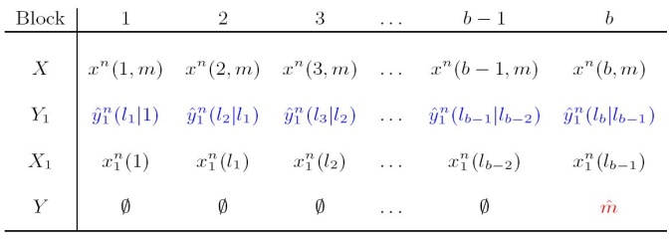
Noisy Network Coding: El Gamal
M₁,M₂
FLoWS ACHIEVEMENT
New coding strategy for noisy multisource, multicast networks
Simplified and unified coding scheme for noisy multisource, multicast networks
Strictly better than current achievable schemes
M₂
MAIN ACHIEVEMENT:
New achievable rate for noisy, multisource, multicast networks
Includes all previous achievable schemes
In particular, includes noiseless networks (network coding), deterministic multicast networks and erasure networks as special cases
Shown to be strictly better than current schemes for some networks
HOW IT WORKS:
Source node(s) sends message b times
Relay nodes use compress-forward
Decoders use simultaneous decoding
ASSUMPTIONS AND LIMITATIONS:
Does not include decode--forward
M₁
M₁,M₂
STATUS QUO
No general network coding result for noisy network
Capacity results for multisource, multicast networks known only for some special cases
M₁,M₂
IMPACT
Network coding and its extensions to deterministic and erasure networks are special cases of compress– forward coding technique
New coding technique provides a simple and unified proofs of all previous results
Relay
Source
Destination
Application of noisy network coding to wireless networks
Combine noisy network coding with decode (compute)-forward
NEW INSIGHTS
NEXT-PHASE GOALS
Network coding and its extensions are special cases of compress-forward
Notes:
19
Include notes that would be helpful to the reader or someone (other than yourself) who needs to understand the details. Ideally the chart will be useful even without the author to explain the details. Also include references to published papers plus URLs to online versions if available.
Keep in mind that somewhere or other in this chart, each of these questions should be answered:
What technical challenge is being undertaken on behalf of the project. Generalization of network coding to noisy networks
2. Why is it hard and what are the open problems. Generalization not known
3. How has this problem been addressed in the past. Yes for very special classes of channel.
4. What new intellectual tools are being brought to bear on the problem. New coding scheme that unifies results on network coding and its extensions to erasure and deterministic networks.
5. What is the main intermediate achievement. A general purpose coding scheme and a corresponding inner bound on the capacity of general multiple source noisy networks
6. How and when does this achievement align with the project roadmap (end-of-phase or end-of-project goal)
7. What are the even long-term objectives and consequences? Developing implementable schemes for noisy networks
8. Which thrusts and SOW tasks does this contribution fit under and why?

Slide 20
Multicast Capacity Region of a Large Wireless Network: Shah
ACHIEVEMENT
Optimal two-layer network co-operative scheme for any traffic demand built on multi-hop and hierarchical scheme
Geometry of capacity region: it is nice and round
MAIN ACHIEVEMENT:
Characterization of dim. multicast region
Easily computable in terms of 2n `weighted cuts’
Under Gaussian fading channel model
HOW IT WORKS:
Achievability
Realize `tree’ network using co-operative relay built on multi-hop and hierarchical (virtual MAC and BC) depending upon channel characteristics
Use this as multicast `tree’
Converse
Establish tightness of 2n cuts, each of them corresponds to a `node’ of tree
ASSUMPTIONS AND LIMITATIONS:
Random node placement
STATUS QUO
Very little known about multicast capacity region of wireless network of n nodes
It is dimensional
Lack of fundamental understanding of co-operative relay schemes
IMPACT
NEXT-PHASE GOALS
NEW INSIGHTS
Equivalence relation
Wireless network = “tree-structure”
This decides optimal structure for network-wide co-operation
Multicast capacity scaling
Arbitrary node placement
Complete characterization of multicast capacity region: separation of NET and PHY layer
Notes:
URL’s
U. Niesen, P. Gupta, D. Shah. The Balanced Unicast and Multicast Capacity Regions of Large Wireless
Networks, accepted for publication in IEEE Transactions on Information Theory, October 2009. Preliminary version appeared in parts in IEEE INFOCOM, 2009 and Allerton Conference on Communication, Control and Computation, 2008.
Arxiv: http://arxiv.org/abs/0809.1344
U. Niesen, P. Gupta, D. Shah. On Capacity Scaling in Arbitrary Wireless Networks, IEEE Transactions on Information Theory, September 2009. Preliminary version appeared in parts in IEEE ISIT 2008 and Information Theory Workshop 2008.
Arxiv: http://arxiv.org/abs/0711.2745
--------
1. What technical challenge is being undertaken on behalf of the project ? Determining the capacity region of wireless network with Gaussian fading channel model.
2. Why is it hard and what are the open problems? Well, it has been the holygrail of information theory/communications for more than 6 decades ! As it is well documented, exact capacity region of even three node network is not known in general. Intellectually, the problem is hard because of two conflicting issues that need resolving in determining network capacity: (i) co-operation gain and (ii) interference management.
3. How has this problem been addressed in the past? It seems that the goal of exact determination of capacity region is rather a show stopper. This realization has led various researchers in recent years (roughly 10 years back) to undertake approximation or what is known as scaling laws as an approach to make progress towards this hard problem. However, in very limited scenarios (random traffic, random node placement) this problem is resolved.
4. What new intellectual tools are being brought to bear on the problem? This work determines scaling or approximate characterization of entire unicast and multicast capacity region for large wireless network. In that sense, it brings us quite close to resolving the holygrail of information theory, at least in approximate sense. Key novelty lies in an equivalence concept that we introduce: the capacity region of wireless network scales in exactly the same way as a tree structured, capacitated wired network. Establishing this equivalence comes from combination of network geometry, co-operative communication and hierarchical decompositions.
5. What is the main intermediate achievement? The main immediate achievement is the precise scaling characterization of the unicast and multicast capacity region for large wireless network in terms of only 2n inequalities. It is somewhat remarkable that an exponential large (in number of nodes n) dimensional region is characterized by only linearly many inequalities.
6. How and when does this achievement align with the project roadmap (end-of-phase or end-of-project goal) ? This work, in some sense, has been a central question of interest to this project. On one hand, this work provides approximate characterization of capacity region. On the other hand, provides insights into how to operate large network in a co-operative manner.
7. What are the even long-term objectives and consequences? The long-term objective is to complete this program of approximate characterization of capacity region for arbitrary network models. As a byproduct, it is likely to lead to universal operating schemes in the wireless network.
8. Which thrusts and SOW tasks does this contribution fit under and why? This work fits thrusts one and three. This is because, the first thrusts has been about upper bounds and the third thrust has been about algorithms/achievable schemes. And characterizing capacity region approximately involves both of these elements.

Slide 21
Progress Criteria 3:
Develop new achievability results for key performance metrics based on networks designed as a single probabilistic mapping with dynamics over multiple timescales

Slide 22
Progress 3 Criteria Met
Relaying for Multiple Communicating Pairs
Unequal Error Protection: Application and Performance Limits:
Layered Source-Channel Schemes: A Distortion-
Diversity Perspective:
Joint Source/Channel Coding with Limited Feedback
Tilted Matching for Feedback Channels
Diversity-Multiplexing-Delay Tradeoff in MIMO Multihop Networks
Feedback and Network Coding
Time-Reversibility and Fundamental Limits of MANETs with Dynamics and Feedback
Near-Optimal Power Control in Wireless Networks: A Potential Game Approach:

Slide 23
Layered Source-Channel Schemes: A Distortion-
Diversity Perspective: Medard, Zheng
ACHIEVEMENT DESCRIPTION
Three-layer scheme dominates previous double-layer schemes
Distortion-diversity tradeoff provides useful comparison in different operating regions
MAIN ACHIEVEMENT:
A three-layer source-channel scheme, which includes previous multi-resolution-based and multi-description-based schemes as special cases
HOW IT WORKS:
Multi-description source code with a common refinement component
Superposition coding with successive interference cancellation
Joint source-channel decoding exploits source code correlation
ASSUMPTIONS AND LIMITATIONS:
Quasi-static block-fading channel
Receivers have perfect channel state information, but the transmitter only has statistical knowledge of the channel
STATUS QUO
IMPACT
Conventional source-channel scheme achieves a single level of reconstruction
Diversity is usually achieved in the channel coding component
Diversity can be achieved through source coding techniques, like multiple description codes
We characterize source-channel schemes with distortion-diversity tradeoff
NEXT-PHASE GOALS
NEW INSIGHTS
Extend multi-description-based source-channel scheme while preserving the interface between source and channel coding
More general channel model
Distortion-diversity tradeoff better characterizes layered source-channel schemes
Notes:
Include notes that would be helpful to the reader or someone (other than yourself) who needs to understand the details. Ideally the chart will be useful even without the author to explain the details. Also include references to published papers plus URLs to online versions if available.
Keep in mind that somewhere or other in this chart, each of these questions should be answered:
What technical challenge is being undertaken on behalf of the project
The project investigates the performance of multi-layer source-channel schemes in the nonergodic faded broadcast network. In particular, we seek multi-layer source-channel schemes with end-to- end performance gracefully degrade with channel fading (without channel state information at the transmitter).
2. Why is it hard and what are the open problems
Since the transmitter has no instantaneous channel state information, the transmitted sequences need to be structured appropriately to both represent the source sequence and effectively combat the nonergodic fading. It is not clear whether it is optimal to achieve this goal in the source code layer, in the channel code layer or in both layers simultaneously.
3. How has this problem been addressed in the past
In the existing literature, graceful degraded performance is usually achieved in the channel coding level, via the so-called diversity-embedded channel codes. However, it has been shown that
a price has to be paid if we are constrained to manipulate the channel codes only. Thus advanced source coding techniques could potentially help improve the end-to-end performance.
4. What new intellectual tools are being brought to bear on the problem
A new performance metric, namely the distortion-diversity tradeoff, has been proposed to better characterize multi-layer source-channel schemes in the nonergodic setting.
5. What is the main intermediate achievement
We have proposed a new performance metric, namely the distortion diversity tradeoff, to study source-channel schemes under nonergodic fading. We have demonstrated the effectiveness of this performance metric by comparing two existing source-channel schemes, which are indistinguishable under the commonly used average distortion (exponent) metric. Moreover, we have proposed a unifying scheme which dominates both existing schemes as special cases.
6. How and when does this achievement align with the project roadmap (end-of-phase or end-of-project goal)
In this project, we have proposed a new performance metric, which is expected to be very handy in studying multi-layer source-channel scheme in nonergodic settings. Moreover, a new source- channel scheme is proposed which dominates existing schemes and is potentially extensible to more general settings (like MIMO channels).
7. What are the even long-term objectives and consequences?
In the long term, we would seek a new source-channel scheme that preserves the digital source-channel interface and still outperforms the existing multi-resolution-based scheme in certain operating regions.
8. Which thrusts and SOW tasks does this contribution fit under and why?
This fits under thrusts 1 and 2, since it considers layerless design as well as fundamental metrics for comparing performance (the noel distortion-diversity trade-off).

Slide 24
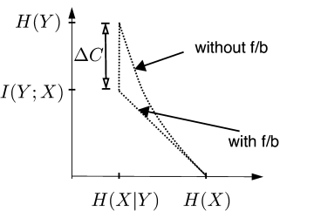
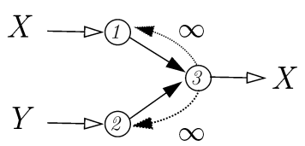
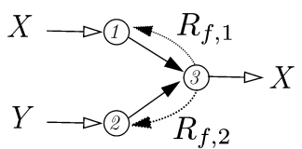
Feedback and Network Coding
Effros and Bakshi
ACHIEVEMENT DESCRIPTION
Increase in capacity is potentially unbounded.
Power consumption by remote sources can be decreased by employing feedback from the central receivers.
MAIN ACHIEVEMENT:
In several examples networks, the capacity with feedback is strictly bigger than that without feedback
- Butterfly network
- Source coding with coded side information
- Multiterminal source coding
HOW IT WORKS:
Receiver sends back everything it knows to the transmitter nodes.
e.g.
- Encoder 2 knows X after the feedback.
- Sum rate required is only H(X)
ASSUMPTIONS AND LIMITATIONS:
Feedback links are assumed to have infinite capacity
Sources nodes are assumed to have sufficient processing power
STATUS QUO
In today’s networks, bulk of transmission from sources to sinks
• Remote sources have often lesser power available than sinks
• Feedback is studied mostly in the context of channel knowledge, not source knowledge
IMPACT
Feedback increases the capacity region.
By knowing what the receiver already knows from other sources, source nodes can avoid unnecessary transmission.
NEXT-PHASE GOALS
NEW INSIGHTS
Cost of feedback?.
• Feedback links may not always be “free”
Feedback increases the capacity of networks
Notes:
What technical challenge is being undertaken on behalf of the project? We’re studying the effect of feedback from sinks to sources on the rate/capacity region of networks.
2. Why is it hard and what are the open problems? It is difficult to characterize in general how many sessions of feedback are required and what is the optimal order in which the sources should transmit.
3. How has this problem been addressed in the past? Feedback has been studied mostly in the context of channel coding.
4. What new intellectual tools are being brought to bear on the problem? By allowing the receiver to send everything it knows back to all the sources and studying just one feedback session, we simplify the problem.
5. What is the main intermediate achievement? Characterization of capacity region of several source networks and showing that the gains due to feedback are potentially unbounded.
6. How and when does this achievement align with the project roadmap (end-of-phase or end-of-project goal)? This work focuses on simple networks to gain insight on how feedback may help in more general networks.
7. What are the even long-term objectives and consequences? To study more general networks and limiting the amount of feedback.
8. Which thrusts and SOW tasks does this contribution fit under and why? Not sure

Slide 25
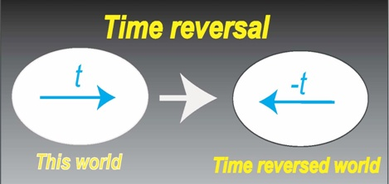
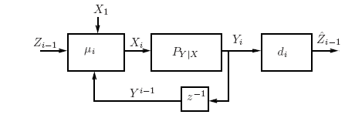
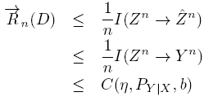
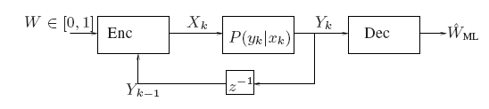
Time-Reversibility and Fundamental Limits of MANETs with Dynamics and Feedback: Coleman
FLOWS ACHIEVEMENT
MAIN RESULT:
A sufficient condition that characterizes:
capacity of channels with infinite memory
Sequential rate-distortion function for causal joint-source channel coding with feedback
in terms of the time-reversibility of a Markov chain (X).
HOW IT WORKS:
Generalize the proof of Burke’s theorem in queuing theory to this more general context. Next state value (X[i]) is independent of all possible channel outputs
ASSUMPTIONS AND LIMITATIONS:
Requires algebraic structure of dynamical system and time-reversibility condition to hold
Fundamental Limits
Provides capacity for a general class of channels with memory by taking insights from time-reversibility
Complexity: Provides source-channel matching conditions to understand in what contexts a very simple, “stationary Markov policy” controllers and time-invariant estimator are optimal
STATUS QUO
Time-reversibility plays fundamental role in governing physical systems with dynamics
How does time-reversibility of Markov chains relate to fundamental limits of MANETs with dynamics?
  Not much known at all.
IMPACT
Consider stochastic dynamical systems, get insight from Burke’s theorem: “current state of the system is independent of all previous outputs” .
Related to the posterior matching principle for commumication w/ feedback?
Extend to tree-like structures in networked systems
Understand more issues of decentralized control to understand how to manage dynamics in MANETS
NEW INSIGHTS
NEXT-PHASE GOALS
Time-Reversibility in Dynamical Systems allows for characterizing fundamental Limits and ensuring low-complexity solutions are optimal for MANETs with Dynamics
Notes:
What technical challenge is being undertaken on behalf of the project
To characterize fundamental limits and identify when low-complexity, time-invariant controllers/estimators are optimal for MANETs that are stochastic and have dynamics
2. Why is it hard and what are the open problems
Channels with memory are fundamentally hard to understand their limits, and identifying conditions when low-complexity schemes are optimal lacks a simple, unified way to ensure sufficient conditions
3. How has this problem been addressed in the past
Many different techniques, tailored to specific problem instantiations, have been provided
4. What new intellectual tools are being brought to bear on the problem
We make two high-level observations. (1): time-reversibility plays a fundamental role in governing physical systems w/ dynamics. (2): Directed information characterizes the fundamental limits of stochastic systems with dynamics and feedback. We ask a natural question: can the time-reversibility of a Markov chain somehow be wed to ensuring that we are optimally operating MANETs with dynamics?
5. What is the main intermediate achievement
We provide a sufficient condition for when a Markov chain’s time-reversibility does two things: (1) provides the capacity of a channels with infinite memory; (2) provides a source-channel matching condition to characterize when low-complexity, stationary Markov policy controllers and time-invariant estimators are optimal for sequential joint source-channel coding with feedback.
6. How and when does this achievement align with the project roadmap (end-of-phase or end-of-project goal)
Developing new strategies for node encoding and decoding in MANETS is a core part of the project roadmap.
7. What are the even long-term objectives and consequences?
Long term objective is to continue to leverage insights between other disciplines (e.g. physics, control theory) to understand MANETs with dynamics.
8. Which thrusts and SOW tasks does this contribution fit under and why?
This work falls under thrusts 1 and 2, finding better upper bounds for MANETs and novel encoding strategies that come close to achieving these upper bounds. The SOW task for this work is to find n(n-1) capacity regions for small networks.

Slide 26
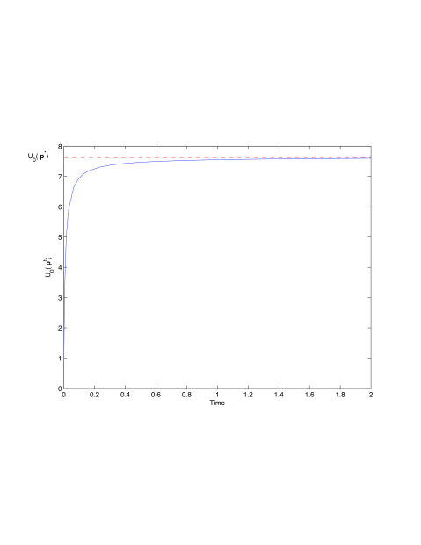

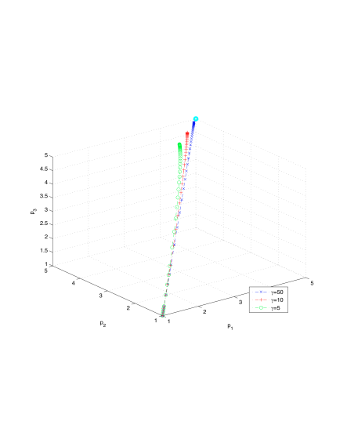
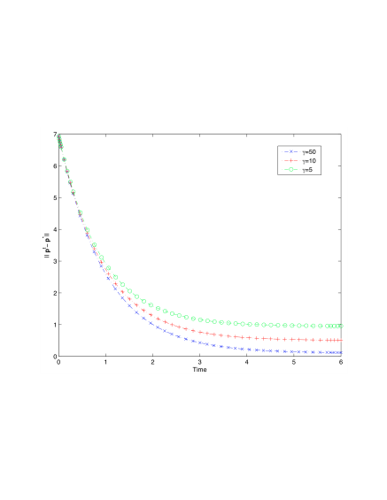
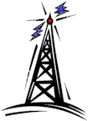

Near-Optimal Power Control in Wireless Networks: A Potential Game Approach: Candogan, Menache, Ozdaglar, Parrilo
$$
$
Simple pricing scheme for any system objective
Near optimal performance in networks
Suggests a new paradigm for regulation of wireless networks
$
MAIN ACHIEVEMENT:
Potential-game approach for distributed power allocation, (approximately) enforces any power-dependent system-objective
HOW IT WORKS:
Approximate the underlying power control game with a “close” potential game
Derive prices that induce an optimal power allocation in the potential game
The proximity of the original game to the approximate game establishes near optimal performance in the original game
ASSUMPTIONS AND LIMITATIONS:
Single channel network is studied
Minimum power requirement
Pricing is used in the presence of selfish agents to regulate communication networks:
-No general framework for achieving (near) optimal performance for any given underlying system objective
The evolution of power levels
Distance between current and desired power allocation
Pricing and best response dynamics
Power control game
approximate
Potential game
Lyapunov
analysis
pricing
Approximations of games with potential games
Easier study of dynamics and equilibria
Simple pricing mechanisms
Optimal power allocation
Extend the results to approximation and pricing in multichannel networks
Distributed implementation of pricing is of interest
Approximations with potential games lead to simple pricing schemes for any system objective.
Notes:
26
What technical challenge is being undertaken on behalf of the project?
We study power control in a multi-cell CDMA wireless system whereby self-interested users share a common spectrum and interfere with each other. Our objective is to design a power control scheme that achieves a (near) optimal power allocation with respect to any predetermined network objective (such as the maximization of sum-rate, or some fairness criterion).
2. Why is it hard and what are the open problems?
The power control problem, even when formulated as a centralized optimization problem with full information, is a fairly complex problem. For example, in general-topology CDMA network with multiple transmitters and receivers, each transmitter affects each of the receivers in a different manner, therefore it is not a priori clear how to assign the transmission powers in a system-efficient manner. Specifically, basic system objectives, such as the sum-rate, turn out to be difficult-to-solve optimization problems.
An additional concern within the power allocation framework is the possible selfish behavior of mobiles, who may autonomously control their transmission power to satisfy their own interests. Pricing is used to regulate the system in the presence of noncooperative agents,
A general framework for achieving (near) optimal performance for any given underlying system objective in the noncooperative setting was not addressed before.
3. How has this problem been addressed in the past?
There has been much work in the literature on pricing in communication networks in general, and wireless networks in particular. However, to the best of our knowledge, there is no general framework that tackles the problem of achieving (near) optimal performance for any given underlying system objective. One branch of this literature focuses on the profit maximization objective where service providers price usage of network resources to maximize their profits. Another branch assumes that prices are set by a social planner to regulate selfish user behavior and drive the system to a more desirable operating point
4. What new intellectual tools are being brought to bear on the problem?
We are using tools from the theory of potential games, Lyapunov analysis and dynamical systems.
5. What is the main intermediate achievement:
A new framework for regulation of networks with selfish agents is developed. Potential-game approach leads to simple pricing scheme for any system objective.
6. How and when does this achievement align with the project roadmap (end-of-phase or end-of-project goal)
This work considers network regulation schemes for any system objective in the presence of self interested users. Therefore, it is well-aligned with the project goals.
7. What are the even long-term objectives and consequences?
The long-term goal is to extend the current work to the case of multiple channels and possibly develop distributed implementation of the pricing scheme.
8. Which thrusts and SOW tasks does this contribution fit under and why?
This contribution fits under Thrust 3: Application Metrics and Network Performance. We are addressing problems such as resource allocation in the presence of interference among self interested users.
Publications:
U. O. Candogan, I. Menache, A. Ozdaglar, P. A. Parrilo, “Near-Optimal Power Control in Wireless Networks: A Potential Game Approach”, Infocom 2010.

Slide 27
Progress Criteria 4:
Develop a generalized theory of rate distortion and network utilization as an optimal and adaptive interface between networks and applications that results in maximum performance regions.

Slide 28
Progress 3 Criteria Met
Network Aware Design: Dynamic/Stochastic NUM
Adaptive modulation with smoothed flow utility
Dynamic Resource Allocation for Delay-Sensitive
Applications
A Distributed Newton Method for Network Utility Maximization
Learning for optimization in wireless networks:

Slide 29

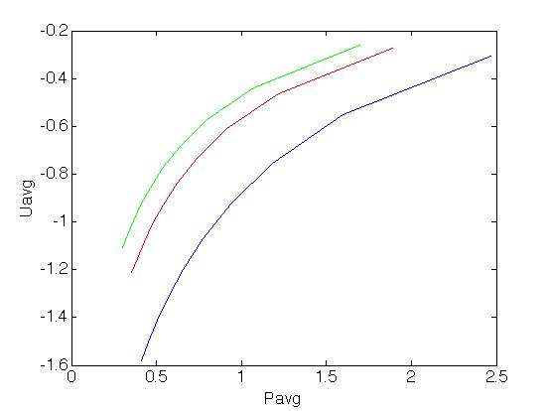
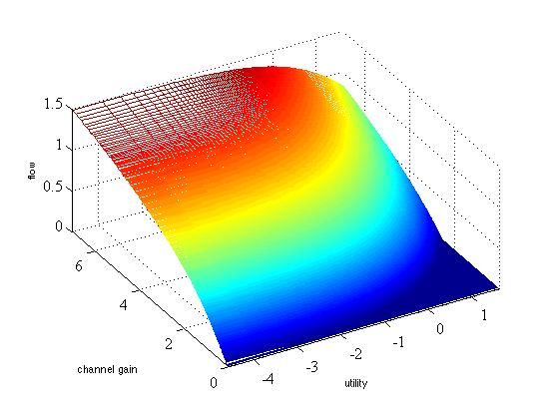
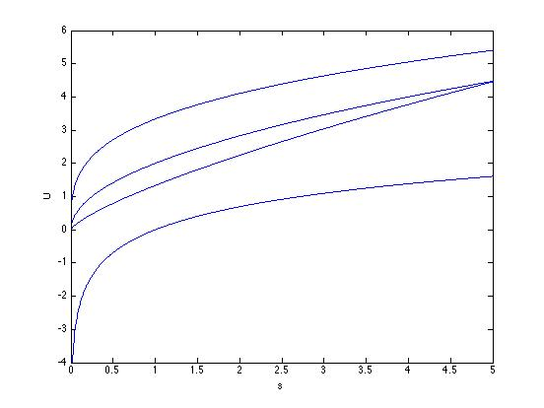
Adaptive modulation with smoothed flow utility: Boyd
ACHIEVEMENT DESCRIPTION
Different levels of smoothing lead to different optimal policies; different trade offs
MAIN RESULT:
Flow allocation to optimally trade off average smoothed flow utility and power.
HOW IT WORKS:
Optimal flow policy is a complicated function of smoothed flow and channel gain
ASSUMPTIONS AND LIMITATIONS:
Utilities are strictly concave, power is strictly convex; linear dynamics represent time averaging
At each time period, assumes the transmitter learns random channel state through feedback
STATUS QUO
Prevailing wireless network utility maximization and resource allocation methods focus on per period optimization
These methods ignore the heterogeneous time scales over which network applications need resources
IMPACT
Network Utility Maximization
Stochastic Control Theory
NEXT-PHASE GOALS
Derive network utility from smoothed flows
Smoothing allows us to model the demands of an application that can tolerate variations in flow it receives over a time interval
Dynamic Optimization
NEW INSIGHTS
Approximate dynamic programming (ADP) for MANETs
• computationally tractable
Optimally trade off average utility and power using smoothed flow utilities
Notes:
1. What technical challenge is being undertaken on behalf of the
project?
A: Choose transmit power(s) and flow rate(s) to optimally tradeoff average
utility and power on a wireless link, accounting for varying (stochastically) channel gains and application demands.
2. Why is it hard and what are the open problems?
A: MANETs are complex systems- complicated interactions of an arbitrary
number of users in a shared medium with randomly available resources.
For example, for almost 40 years now, the general rate region of a two-user interference channel remains open; establishing definitive performance metrics is difficult.
3. How has this problem been addressed in the past?
A: Per period iterative algorithms that may or may not work
4. What new intellectual tools are being brought to bear on the problem?
A: We are using a smoothed flow utility approach.
5. What is the main intermediate achievement?
A: We characterize the optimal flow rate policy for different levels of smoothing.
6. How and when does this achievement align with the project roadmap
(end-of-phase or end-of-project goal)?
A: This work extends WNUM and DNUM to infinite horizon problems.
7. What are the even long-term objectives and consequences?
A: Develop more precise metrics with smoothed network constraints. Solve large problems using approximate dynamic programming.
8. Which thrusts and SOW tasks does this contribution fit under and why?
A: Application metrics and network performance utilities
Submitted Journal Papers:
1. A. Zymnis, N. Trichakis, S. Boyd and D. O'Neill, “An Interior-Point Method
for Large Scale Network Utility Maximization," Submitted to Operations
Research Letters, 2007.
Published Journal Papers:
1. Y. Wang and S. Boyd, “Performance Bounds for Linear Stochastic Control”,
Systems and Control letters, 58(3):178-182, March 2009.
Accepted/Published Conference Papers:
1. D. O’Neill, E. Akuiyibo, A. J. Goldsmith and S. Boyd, “Optimizing Adaptive
Modulation in Wireless Networks via Multi-Period Network Utility Maximization,”
Accepted to appear in IEEE International Conference on Communications (ICC),
Cape Town, South Africa, May 2010.
2. D. O'Neill, B. S. Thian, A. Goldsmith, and S. P. Boyd, “Wireless NUM: Rate and
Reliability tradeoffs in Random Environments,” Accepted to appear in IEEE Wireless Communications and Networking Conference, 2009, Budapest Hungary.
3. D. O'Neill, A. Goldsmith, and S. P. Boyd, " Extending Network Utility Maximization Random, Time Varying Environments in Mobile Ad-hoc Networks,” Military Communications Conference ﾊ(MILCOM), San Diego, CA, November 2008.
4. D. O'Neill, A. Goldsmith, and S. P. Boyd, “Cross-Layer Design with Adaptive Modulation: Delay, Rate, Energy Tradeoffs,” IEEEﾊ Global Communications Conference (Globecom), New Orleans, LA, November 2008.
5. D. O'Neill, Boon Sim Thian, A.Goldsmith, and S.P. Boyd, “Wireless NUM: Rate and Reliability tradeoffs in Random Environments,” Allerton Conference on Communication, Control, and Computing, Monticello IL, September 2008.
6. N. Trichakis, A. Zymnis and S. Boyd, “Dynamic Network Utility Maximization with Delivery Contracts,” Proceedings IFAC World Congress, pages 2907-2912, Seoul, July 2008.
7. D. O’Neill, A. J. Goldsmith and S. Boyd, “Optimizing Adaptive Modulation in Wireless Networks via Utility Maximization,” IEEE
International Conference on Communications (ICC), Beijing, China, May 2008.
-------------------------------------------------------------------------------

Slide 30
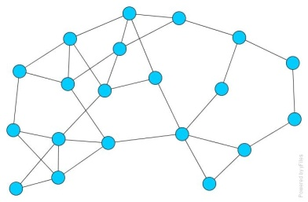
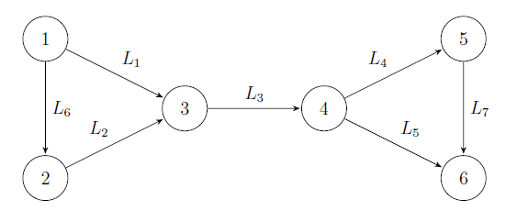
A Distributed Newton Method for Network Utility Maximization: Wei, Ozdaglar
FLOWS ACHIEVEMENT
MAIN ACHIEVEMENT:
A Newton method that solves general network utility maximization problems in a distributed manner
Simulations indicate the superiority of the distributed Newton method over dual subgradient methods
HOW IT WORKS:
Turning inequality constraints into barrier functions
Employing matrix splitting techniques on the dual graph to solve the dual Newton step
Using a consensus-based local averaging scheme, which requires local information only
ASSUMPTIONS AND LIMITATIONS:
Routing information and capacity constraints are fixed
Dual and primal steps are computed separately
STATUS QUO
Most existing distributed optimization algorithms rely on first order methods
• These algorithms are easy to distribute
• However, they can be quite slow to converge, limiting their use in rapidly changing dynamic networks
IMPACT
Significant improvements with the distributed Newton method compared to subgradient methods
Combine Newton (second order) methods with consensus policies to distribute the computations associated with the dual Newton step
NEW INSIGHTS
Second order methods for distributed network utility maximization
Prove convergence and rate of convergence of our methods
Understand the impact of network topology on algorithm performance
Design algorithms that compute primal and dual steps simultaneously
NEXT-PHASE GOALS
Novel Distributed Second Order Methods for Network Utility Maximization Problems
Notes:
30
What technical challenge is being undertaken on behalf of the project
This project develops new distributed second order Newton methods to solve network utility maximization problem. Work in this area focuses on first order methods which are easy to distribute, but have slow convergence properties.
Why is it hard and what are the open problems
This is the first attempt for solving the general network utility maximization problem (with inequality constraints) using decentralized second order algorithms, which converge much faster than the existing first order subgradient methods.
How has this problem been addressed in the past
Previous works use dual decomposition and first order (subgradient) methods, which have slow convergence properties.
What new intellectual tools are being brought to bear on the problem
We combined matrix splitting ideas from complementarity problems and a constrained Newton method, together with consensus algorithms from cooperative control literature.
What is the main intermediate achievement
We turned inequality constraints into barrier functions, employed matrix splitting techniques on the dual graph to solve the dual Newton step and used a consensus-based local averaging scheme, which requires local information only.
How and when does this achievement align with the project roadmap (end-of-phase or end-of-project goal)
The method achieves superior performance with respect to classical methods, and its development therefore aligns with the project goals and roadmap.
What are the even long-term objectives and consequences?
Our next objective is to provide analytical convergence results and rate of convergence bounds for our methods, and understand how network topology affects the performance. This will also shed light into how networks should be designed to realize faster convergence. Our longer term goal is to use distributed Newton methods in the context of other wireless resource allocation problems and in dynamic environments (with dynamically changing channels and dynamic user performance metrics).
Which thrusts and SOW tasks does this contribution fit under and why?
This contribution fits under Thrust 3 since it addresses the development of efficient and distributed optimization algorithms for optimizing heterogeneous performance metrics.

Slide 31
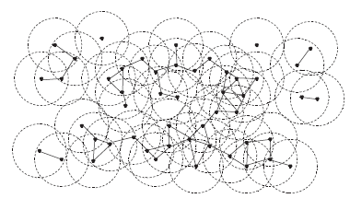
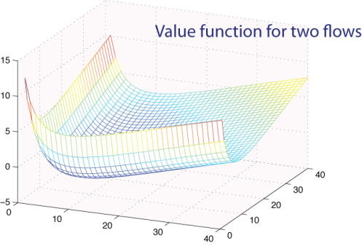
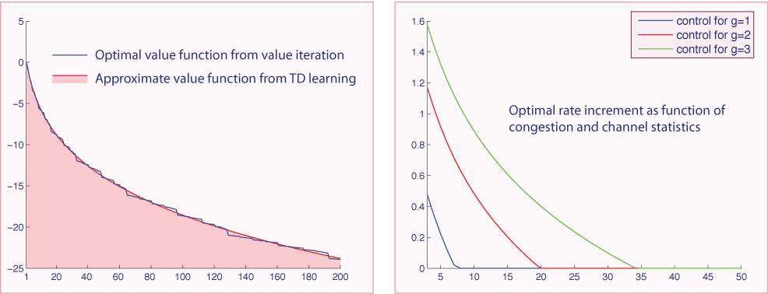
Learning for optimization in wireless networks:
Chen, O’Neill and Meyn
FLoWS ACHIEVEMENT
MAIN ACHIEVEMENT:
Analytic methods for understanding optimal policies in multi flow networks
Analysis leads to architecture for TD learning algorithms to approximate optimal policy
Approach is adaptive – based on online measurements
HOW IT WORKS: Approximate models capture important aspects of dynamic programming equation. Further simplification from separation of time scale – state space collapse.
ASSUMPTIONS AND LIMITATIONS: Caveat: Learning takes time!
STATUS QUO
Nearly optimal network control policies
Intuitive control architecture
  Tractable error bounds
  TD learning policies adapt to dynamic environment
Methodology is likely to have impact in many other fields
Single time scale models
  Physical Layer
  Upper Layer
Upper layers respond to short term traffic behavior
Many assumptions on source of randomness
IMPACT
Formulation as Markov decision process natural, but intractable.
Resolution: Idealized models used to form architecture for learning algorithms, such as TD learning to obtain an approximately optimal policy.
Extensions and refinements for multi-link networks
On-line policy estimation and approximation
State space collapse in complex networks: What really matters?
NEXT-PHASE GOALS
NEW INSIGHTS
Crosslayer optimization of wireless networks is possible via TD learning when the learning architecture is informed by insight from idealized models
Notes:
31
References available at https://netfiles.uiuc.edu/meyn/www/spm_pubs.html
W. Chen, D. Huang, A. Kulkarni, J. Unnikrishnan, Q. Zhu, P. Mehta, S. Meyn, and A. Wierman. Approximate dynamic programming using fluid and diffusion approximations with applications to power management. Proceedings of the 48th IEEE Conference on Decision and Control, December 16-18 2009.
P. Mehta and S. Meyn. Q-learning and Pontryagin’s Minimum Principle. Proceedings of the 48th IEEE Conference on Decision and Control, December 16-18 2009.
D. O’Neill, A. Goldsmith, and S. Boyd. Cross-layer design with adaptive modulation: Delay, rate, and energy tradeoffs. In Global Telecommunications Conference, 2008. IEEE GLOBECOM 2008. IEEE, pages 1–6, 30 2008-Dec. 4 2008.

Slide 32
Phase 4 Progress Criteria
  Demonstrate the consummated union between information theory, networks, and control; and why all three are necessary ingredients in this union.
    Discussion during team meeting; have identified synergies completed and under investigation.
  Write a monograph to be published by NOW jointly in Foundations and Trends in Information Theory and in Foundations and Trends in Networks on our new information theory for MANETs. Also publish a shorter version in IEEE Proceedings.
    Team meeting discussed book outline; proposal to be developed for publication by Cambridge U. Press
  Use our results to provide challenges and solutions for the broader community that designs and builds MANETs

Slide 33
Project Impact To Date
Recent Plenary Talks
  Boyd: Stevun Lec.’08, CNLS’08, ETH’08, ISACCP’09, ISMP’09, ICOCA’09, CCCSP’09
  Goldsmith: Gomachtech’08, ISWPC’08, Infocom’08, RAWC’09, WCNC’09, ICCCN’09
  Medard: IT Winter School’08, UIUC Student Conference’08, Wireless Network Coding’08, ITC.09, ITW’09
  Meyn: Erlang Centennial’09, Yale Workshop’09, Diaconis Symp.’09
  Ozdaglar: ACC 2009, NecSys'09 , ASMD’08
  Johari: World Congress of the Game Theory Society’08
  El-Gamal: Allerton’09, Padovani Lecture’09, Brice Lecture’09
  Shah: Net Coop’09, Winedale’09
Conference Session/Program Chairs/Panels
  CTW’09, ITW’09, ISMP’09, INFORMS’09, ITW’10, CTW’10
Recent Tutorials
  Meyn: Mathematics of OR’09,
  Shah: CDC’09,
Invited/award winning journal papers
  “Breaking spectrum gridlock through cognitive radios: an information-theoretic approach”, Goldsmith, Jafar, Maric, Srinivasa, IEEE Proc’09.
  “A Random Linear Network Coding Approach to Multicast”, Ho , Medard , Koetter, Karger, Effros, Shi, and Leong, Joint IT/Comsoc Paper Award 2009.
  "XORs in the Air: Practical Wireless Network Coding“, Katti, Rahul, Hu, Katabi, Medard, and Crowcroft. Bennett Prize in Communications Networking 2009.

Slide 34
Publications to date
30 accepted journal papers, 17 more submitted
150 conference papers (published or to appear)
SciAM paper appeared in April
Comm. Magazine paper to appear
Book on FLoWS vision and results under development
  Alternative to NoW Foundations and Trends article
Publications website:
  http://www.stanford.edu/~adlakha/ITMANET/flows_publications.htm

Slide 35
Work Products for Phase 4
Book
  Edited book with chapters on each major topics within FLoWS
  Unified treatment showing unification of information theory, optimization, and control to determine performance upper bounds of MANETs
Community Website
Survey paper
  Short version of book
Tutorials (for web and IT school)
  In each thrust area
  In overall project

Slide 36
PI Talks
Moulin: Nonasymptotic universal coding
Coleman: Reversible Markov Chains, feedback, and directed information
Medard: Analog network coding in the low, the high and the ugly regimes
Shah: Medium access with collisions
El Gamal: Noisy Network Coding (40 min)
Effros: Equivalence Frameworks for Networks
Boyd: Adaptive Modulation with Smooth Flow Utility
Johari: Mean Field Equilibrium for Large Scale Stochastic Games

Slide 37
Posters
"Wiretap Channel with Causal State Information", Yeow Khiang Chia and Abbas El Gamal
"Interference Decoding for Deterministic Channels", Bernd Bandemer and Abbas El Gamal
“Coordination via Communication” by Gowtham Kumar, Lei Zhao, and Tom Cover.
“Mean Field Equilibrium in Dynamic Games with Complementarities”, Sachin Adlakha and Ramesh Johari
“Adaptive Modulation with Smooth Flow Utility”, Stephen Boyd.
“Optimal control of ARQ interference networks”, Marco Levorato and Andrea Goldsmith
“Exploiting Randomness in Multiuser Detection through Compressed Sensing,” Yao Xie, Yonina Eldar, and Andra Goldsmith
“Analog Network Coding in the High-SNR Regime”, Ivana Marić, Andrea Goldsmith and Muriel Mèdard.
“Scalar-linear Network Coding in Wireless Networks" Anthony Kim and Muriel Mèdard
"Optimal Reverse Carpooling Over Wireless Networks - A Distributed Optimization Approach” by A. ParandehGheibi, A. Ozdaglar, M. Effros, M. Médard
"Coding with Dynamic Metrics", Lizhong Zheng
“Efficient Medium Access Protocol”, Jinwoo Shin and Devavrat Shah
"Rate-tradeoffs for Source Networks with Limited Feedback", Mayank Bakshi and Michelle Effros
“On the Separation of Lossy Source-Network Coding and Channel Coding in Wireline Networks” by Shirin Jalali and Michelle Effros
"Interference Management through Backbone of Cooperative Mobile Relays", Rohit Naini and Pierre Moulin
“Nonasymptotic Universal Coding”, Pierre Moulin
"Mutual Information Saddle Points in Channels of Exponential Family Type", Todd P. Coleman and M. Raginsky
"On Reversible Markov Chains and Maximization of Directed Information", S. K. Gorantla and Todd P. Coleman
"Source Coding with Feedforward Using the Posterior Matching Scheme", Hani Ebeid and Todd P. Coleman
“Optimal Cross-layer Wireless Control Policies using TD Learning”, Sean Meyn, Dan O’Neill and Wei Chen

Slide 38
Summary
Significant progress in and across all thrust areas
Ongoing and fruitful collaborations between PIs
Powerful new theory has been developed that goes beyond traditional Information Theory and Networking
Significant impact of FLoWS research on the broader research community (IT, communications, networking, and control/optimization)
Want to maximize research impact in the final phases of the project by identifying new theory to be developed, final goals, work products, and community challenges.

