Slide 1










Information Theory for Mobile Ad-Hoc Networks (ITMANET): The FLoWS Project
Thrusts 0 and 1
Metrics and Upper Bounds
Muriel Medard, Michelle Effros and Ralf Koetter

Slide 2
Thrust Areas
Metric design
Define relevant metrics that reconcile capacity with network-centric views of throughput and delay :
  Consider information-theoretic concepts of performance: capacity, error exponents, outage capacity, distortion within a finite time
  Consider network-centric performance issues: delay until download completion, in-order packet delay
New bounding techniques
Consider techniques that move away from a layered approach and that build upon the designed metrics:
  Equivalence theory
  Analog network coding
  Unification of information-theoretic and network-centric metrics
  Characterization of effect of side information on networks
Combinatorial approaches
Isolate the combinatorial nature of some of 2 and propose new approaches in cases:
  Separate combinatorial difficulty from statistical methods
  Create constructive coding approaches from induced combinatorial method
4. Code construction and network information theory
Create new approaches to constructing codes based on metrics and bounding techniques
  Characterization of regions in which linear network coding suffices
  Broadcast capacity of low-SNR timing channels
  Use of likelihood forwarding rather than decoding
  Creation of new approaches that unify multiple description and multiresolution approaches
  Continuity theory of source coding
  New approaches to redefine space of separation and use it
  Create synergies with thrust 2
5. Networking and optimization
Use optimization techniques to create bounds using new techniques for the metrics we designed
  Optimize metrics from 1
  Create synergies with thrust 3

Slide 3
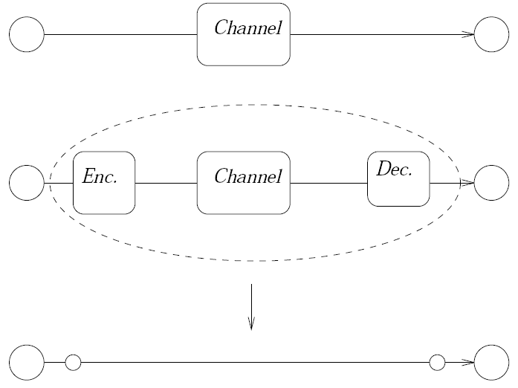
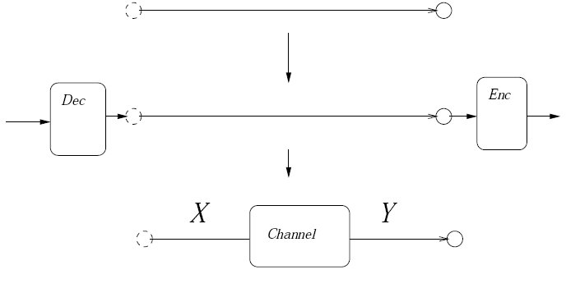
Thrust Achievement
General theory of equivalence (Koetter, Effros, Medard 08)
Information theory takes a statistical view of throughput which is very successful in point-to-point and ancillary settings
Network information theory has had significant difficulty in extending this view with the same success
We consider equivalence in both directions
The difficulty in characterizing networks is not of statistical but of combinatorial nature (and NP- hard)‏
Extensions to broadcast, MAC, dependent channels etc… are possible (see Ralf’s focus talk)
This leads to a general approach:
  Given an arbitrary network it is possible to construct a network of error free bitpipes so that achievability of a rate point in one network implies achievability in the other
  Without solving the combinatorial problem we can investigate the rate-region of networks within an equivalence theory.
A bit-pipe can be used to emulate the statistical
relationship between X and Y if the bit pipe rate
is at least as large as I(X;Y)‏
A channel can operate as arbitrarily reliable bit-pipe
at the channel’s capacity

Slide 4
Going from channels to bit pipes
Assume there exists a sequence
of transmissions in the network of
DMCs that achieves a certain rate point
->
there exists a sequences of trasnmissions
in the bit-pipe network that also achieves
this rate point.
will be typical w.h.p. => we can emulate
the behavior of the trasnmission with a bit
pipe of width N I(X;Y)‏

Slide 5
Thrust Achievement
A continuity theory of source coding over networks (Effros 08)
Main challenge: As “functions”of distortion vector and source distribution, are achievable rate regions continuous?
Main achievements:
  Prove continuity with respect to distortion vector
  Prove continuity with respect to source distribution for super-source networks
  Prove inner semi-continuity with respect to source distribution for the following three categories:
    Lossless non-functional
    Lossy non-functional
    Lossy functional
  Study the outer semi-continuity with respect to source distribution and conjecture that this property holds

Slide 6
Thrust Achievement
Cutset bounds and side information (Effros 08)
Main challenge: How does side information impact capacity?
  SI often present in networks - use it to lower the rates.
  Satisfy demands through multiple sessions of transmission by using the demands met in the previous session as SI.
Main achievements:
  Cutset bounds are tight for characterizing achievable rates for multicast with SI present only at the sinks. Further, linear codes suffice
  Upper bounds on achievable rates for networks where side-information present at non-sink nodes and networks with non-multicast demands
How it works:
  Multicast with SI present only at the sinks: random linear coding at each node.
  Side-information present at non-sink: SI encoded into separate codewords for each subset of the sinks; transmit each codeword using multicast to the desired sinks.
  For non-multicast demands, transmit each source one-by-one to the desired sinks using multicast while treating the previously received sources at the sinks as SI
SI

Slide 7
Thrust achievement
Capacity-queue stability equivalence in time-varying multiple-access channels (Ozdaglar, Medard 08)
Capacity is an information-theoretic notion
Stability emerges from queueing theory
How do we reconcile the two?
For a point-to-point channel or multiple-access channel, equivalence
M. Médard, J. Huang, A. Goldsmith, S. Meyn, and T. Coleman,“Capacity of Time-slotted ALOHA Packetized Multiple-Access Systems over the AWGN Channel,” IEEE Transactions on Wireless Communications, Vol. 3, Issue 2, pp. 486-499, March 2004.
This also holds for a fading multiple access channel
A. ParandehGheibi, A. Eryilmaz, A. Ozdaglar, and M. Médard, “Information Theory vs. Queueing Theory for Resource Allocation in Multiple Access Channels”, invited paper, PIMRC, September 2008
Moreover, an information-theoretic approach without queue information may outperform, in terms of convergence speed, a queueing-centric approach, which requires global queue-length information – see Thrust 3 talk

Slide 8
Thrust achievement
Separation optimality and generalized source-channel coding (Goldsmith 08)
Shannon capacity based on asymptotically small error and infinite delay
  Has enabled great insight and design inspiration
  Shannon’s focus was stationary and ergodic channels
Alternative capacity & end-to-end distortion metrics
  Coding theorems for capacity versus outage
  A framework to encompass known strategies of expected capacity
  A general upper bound for expected capacity
  Match channel codes with corresponding source codes
Source-channel coding for general communication systems
  Separation optimality – under alternative metrics
  Joint source-channel coding – interface
Separation is not the same as isolation - exchange of parameters is useful in constructing codes

Slide 9

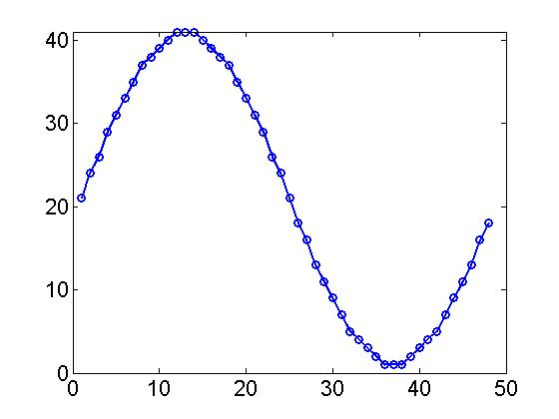
Where does Shannon capacity lead us?
Channel gain
Slow fading channel
time
receiver
Notes:
9
This is an example to see where Shannon capacity leads us. Here is the classical Lena picture used in image processing. We want to transmit it over a fading channel, where the channel gain changes slowly with time.

Slide 10

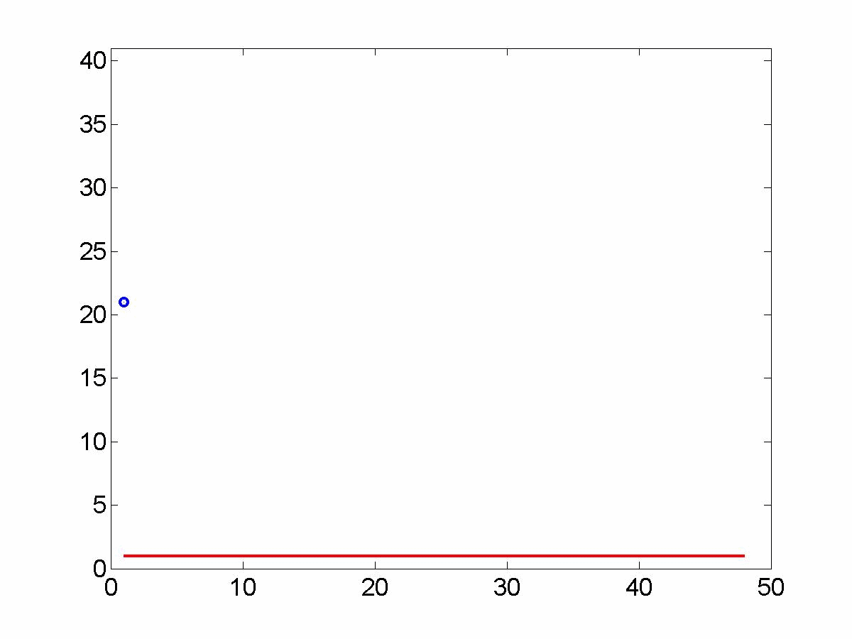
Drawbacks of looking at achievable rate only
Reconstructed image
Channel gain
time
Notes:
10
You can imagine, we have to transmit assuming the worst state. Most of the time the channel is not that bad, we are stuck with this blurred image. Are we satisfied? Probably not.

Slide 11

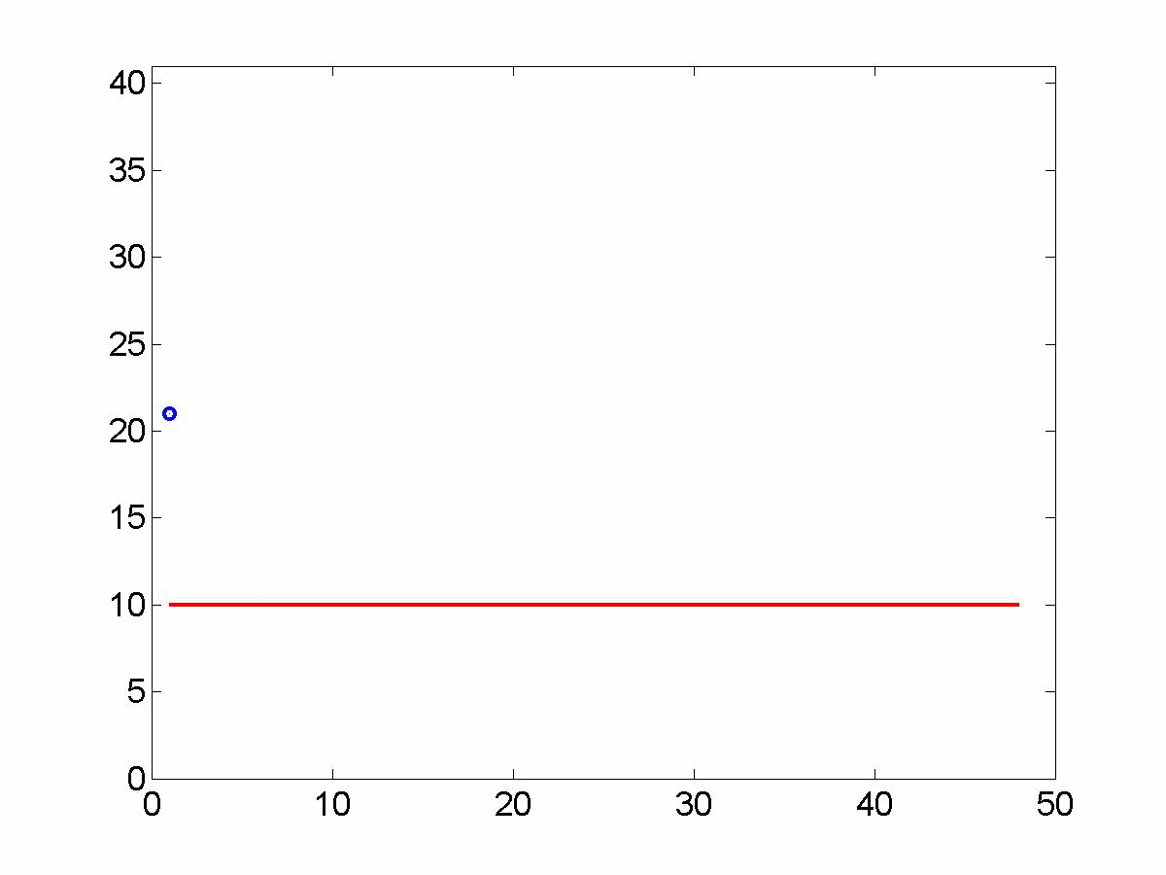
Image transmission: channel code for outage
Reconstructed image
Channel gain
time
Notes:
11
Let’s bring back our Lena. Would the outage channel code do a better job?
We target at this channel state. In non outage states we get a much better picture. In outage states, unfortunately, totally blank.

Slide 12
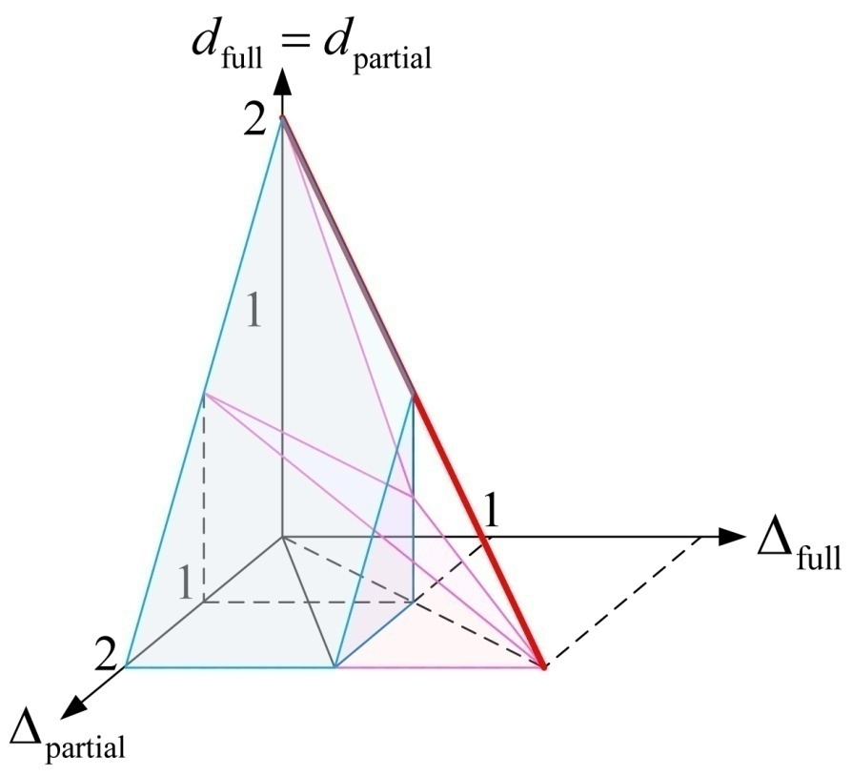
Thrust Achievement
Unified view of multiple description and multiple resolution codes for distortion-diversity trade-off (Zheng, Medard 08)
Source and channel coding in time-varying channel without transmitter CSI when we cannot average over many realizations;
  Channel coding: outage capacity
  Source coding: multiple description coding (MDC) or successive refinement (SR)
  Main idea: use layered coding schemes [Diggavi et al’03]
What are natural ways of bringing together source and channel coding?
We introduce a new approach that brings together MDC with SR to obtain outer bounds
We consider
  Multiple description coding with joint decoding (MDC-JD)
  Successive refinement with superposition coding (SR-SPC)

Slide 13
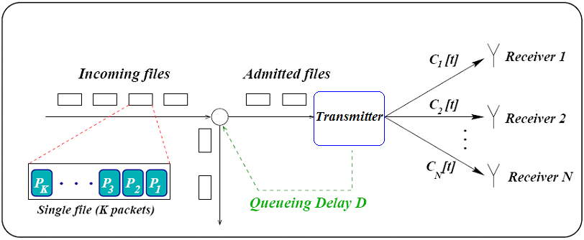
Thrust Achievement
Delay scaling laws for elastic traffic (Ozdaglar, Medard 07, 08 – joint with CBMANET)
Consider delay metric when we have completion of download by several users
Files are broadcast in a FIFO fashion:
  Transmission of the next file starts only after the transmission of the current file is complete
Each receiver sends an ACK once it can reconstruct all the packets in the file
Elastic Traffic: users have no delay constraint, hence every incoming user is admitted for service (usual approach for scaling laws)
Mean delay for elastic traffic, the gain of random linear network coding versus round robin packet transmission is:
There is no scaling gain per se yet gains are unbounded
We can extend this to general networks using layering
Files (Users) arrive according to a Poisson process with rate γ
Each file contains K packets to be broadcast to all receivers
A single packet can be transmitted in one time slot
Users are admitted/rejected based on their delay constraints.
Channel states are i.i.d. Bernoulli(c) distributed and unknown

Slide 14
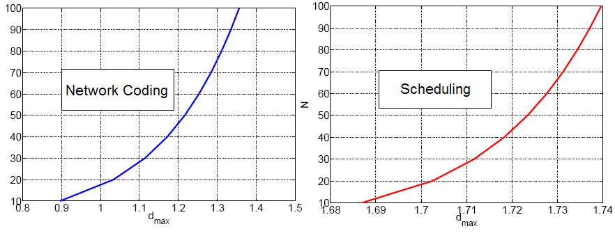
Thrust Achievement
Delay scaling for inelastic traffic (Ozdaglar, Medard 07, 08 – joint with CBMANET)
Inelastic Traffic: each user has a delay constraint associated with it and is admitted only if the mean waiting time is lower than its constraint
Scaling laws cannot be applied here
Each user has a delay constraint Θ that is distributed uniformly between 0 and d_{max}
x 10⁷
Number of supportable users as a function of delay constraints for random network coding and round robin for K=20

Slide 15
Achievements Overview
New bounding techniques
Zheng: error exponents UEP
Effros, Koetter: source coding region for “line networks”
Effros: source coding continuity
Effros: effect of side information on network capacity
Koetter: likelihood forwarding
Code construction
Network information theory
Zheng, Medard: unifying MDC and MR, distortion-diversity
Moulin: covert channel by timing information
Goldsmith: Interference channel with cognitive user, “asymmetric” cooperation
Koetter, Effros, Medard: Equivalence classes of networks, including multipoint channels
Coleman: Broadcast timing
channel capacity
Goldsmith: generalized source-channel coding
Effros: linear network coding
Goldsmith, Medard, Katabi: analog network coding
Metrics
Ozdaglar, Medard: Cross-layer optimization under different metrics
Ozdaglar, Medard: Network coding for downloading delay
Ozdaglar, Medard: Rate allocation in multiple access networks
Medard, Koetter: network coding capacity based on conflict graphs
Networking
and optimization
Combinatorial Tools

Slide 16
Thrust Synergies – Alignment with Phase 2 Goals
Evolve results in all thrust areas to examine more complex models, robustness/security, more challenging dynamics, and larger networks.
  Scaling laws for large networks
  Dynamic time-varying settings
  Low-SNR broadcast capacity region of timing channels
Demonstrate synergies between thrust areas: compare and tighten upper bounds and achievability results for specific models and metrics; apply generalized theory of distortion and utility based on performance regions developed in Thrusts 1-2:
  Rate allocation rate for time-varying MAC: thrust 1-3 interaction
  New approach to distortion-diversity trade-off and generalized separation: thrust 1-2 interaction
  New delay metrics lead to new directions in thrust 3
Demonstrate that key synergies between information theory, network theory, and optimization/control lead to at least an order of magnitude performance gain for key metrics:
  Unbounded scaling in completion delay with size of file for elastic traffic
  Several orders of magnitude improvement in delay for inelastic traffic
  Order of magnitude improvement in rate of convergence using greedy algorithms instead of approaches based on queue-length information

Slide 17
Cross-thrust synergies
-New bounds unifying
MDC and MR
-Generalized separation
(Thrust 1)
Layerless approaches
redefining the interaction
between source and channel
coding
(Thrust 2)

Slide 18
Cross-thrust synergies
New approach to resources
allocation
in time-varying multiple
access channels
(Thrust 1)
Superior rate of convergence
performance
for limited duration
communication sessions
(Thrust 3)

Slide 19
Main accomplishments
Make connection between information theory and combinatorial nature of networks
Make connection between queuing theory and capacity
Consider scaling laws not in terms of traditional rates but rather in terms of delay gains and admitted users
Strong connection with other thrusts, with theory and techniques deeply intertwined (constructive approaches)

