Slide 1
President’s Day Lecture: Advanced Nearest Neighbor Search
[Advanced Algorithms, Spring’17]

Slide 2
Announcements
Evaluation on CourseWorks
If you think homework is too easy (or too hard):
mark “appropriateness of workload”

Slide 3
Time-Space Trade-offs (Euclidean)
space
query
time
Space | Time | Comment | Reference
$$≈n$$ | $$n^{σ}$$ | $$σ=2.09/c$$ | [Ind’01, Pan’06]
low
high
 |  | $$σ=O(1/c^{2})$$ | [AI’06]
$$n^{1+ρ}$$ | $$n^{ρ}$$ | $$ρ=1/c$$ | [IM’98, DIIM’04]
medium
medium
 |  | $$ρ=1/c^{2}$$ | [AI’06]
 |  | $$ρ≥1/c^{2}$$ | [MNP’06, OWZ’11]
$$n^{1+o({1/c}^{2})}$$ | ω(1) memory lookups | [PTW’08, PTW’10]
1 mem lookup
$$n^{4/ε^{2} }$$ | $$O(d log n)$$ | $$c=1+ε$$ | [KOR’98, IM’98, Pan’06]
high
low
$$n^{o(1{/ε}^{2})}$$ | ω(1) memory lookups | [AIP’06]

Slide 4
Near-linear Space for ${\left\{0,1\right\}}^{d}$
[Indyk’01, Panigrahy’06]
Setting:
Close: $r=\frac{d}{2c}$ $⇒$ $P_{1}=1−\frac{1}{2c}$
Far: $cr=\frac{d}{2}$ $⇒$ $P_{2}=\frac{1}{2}$
Algorithm:
Use one hash table with $k=\frac{\log{n}}{\log{1/P_{2}}}=α⋅ln n$
On query $q$:
compute $w=g\left(q\right)∈{\left\{0,1\right\}}^{k}$
Repeat ${R=n}^{σ}$ times:
$w^{′}:$ flip each $w_{j}$ with probability $1−P_{1}$
look up bucket $w^{′}$ and compute distance to all points there
If found an approximate near neighbor, stop
Sample a few buckets in the same hash table!

Slide 5
Near-linear Space
Theorem: for $σ=Θ\left(\frac{\log{c}}{c}\right)$, we have:
Pr[find an approx near neighbor]$≥0.1$
Expected runtime: $O(n^{σ})$
Proof:
Let $p^{∗}$ be the near neighbor: $||q−p^{∗}||≤r$
$w=g(q)$, $t=||w−g\left(p^{∗}\right)||_{1}$
Claim 1: $\underset{g}{Pr}\left[t≤\frac{k}{c}\right]≥\frac{1}{2}$
Claim 2: ${\underset{g,w′}{Pr}\left[w^{′}=g\left(p\right) ∣ ||q−p||_{1}≥\frac{d}{2}\right]≤\frac{1}{n}}_{ }$
Claim 3: $\operatorname{Pr}{[w^{′}=g\left(p^{∗}\right)∣Claim 1]}≥2n^{−σ}$
If $w^{′}=g(p^{∗})$ at least for one $w′$, we are guaranteed to output either $p^{∗}$ or an approx. near neighbor

Slide 6
Beyond LSH
Space | Time | Exponent | $$c=2$$ | Reference
Hamming
space
$$n^{1+ρ}$$ | $$n^{ρ}$$ | $$ρ=1/c$$ | $$ρ=1/2$$ | [IM’98]
LSH
 |  | $$ρ≥1/c$$ |  | [MNP’06, OWZ’11]
$$n^{1+ρ}$$ | $$n^{ρ}$$ | $$ρ≈\frac{1}{2c−1}$$ | $$ρ=1/3$$ | [AINR’14, AR’15]
Euclidean
space
$$n^{1+ρ}$$ | $$n^{ρ}$$ | $$ρ≈1/c^{2}$$ | $$ρ=1/4$$ | [AI’06]
LSH
 |  | $$ρ≥1/c^{2}$$ |  | [MNP’06, OWZ’11]
$$n^{1+ρ}$$ | $$n^{ρ}$$ | $$ρ≈\frac{1}{2c^{2}−1}$$ | $$ρ=1/7$$ | [AINR’14, AR’15]

Slide 7
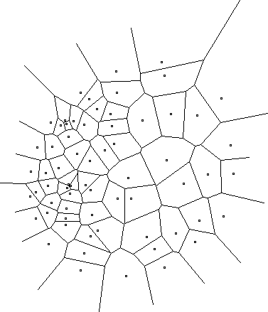
New approach?
A random hash function, chosen after seeing the given dataset
Efficiently computable
Data-dependent hashing
Notes:
Example: Voronoi diagram
but expensive to compute the hash function

Slide 8
Construction of hash function
[A.-Indyk-Nguyen-Razenshteyn’14, A.-Razenshteyn’15]
Two components:
Nice geometric structure
Reduction to such structure
has better LSH
data-dependent

Slide 9
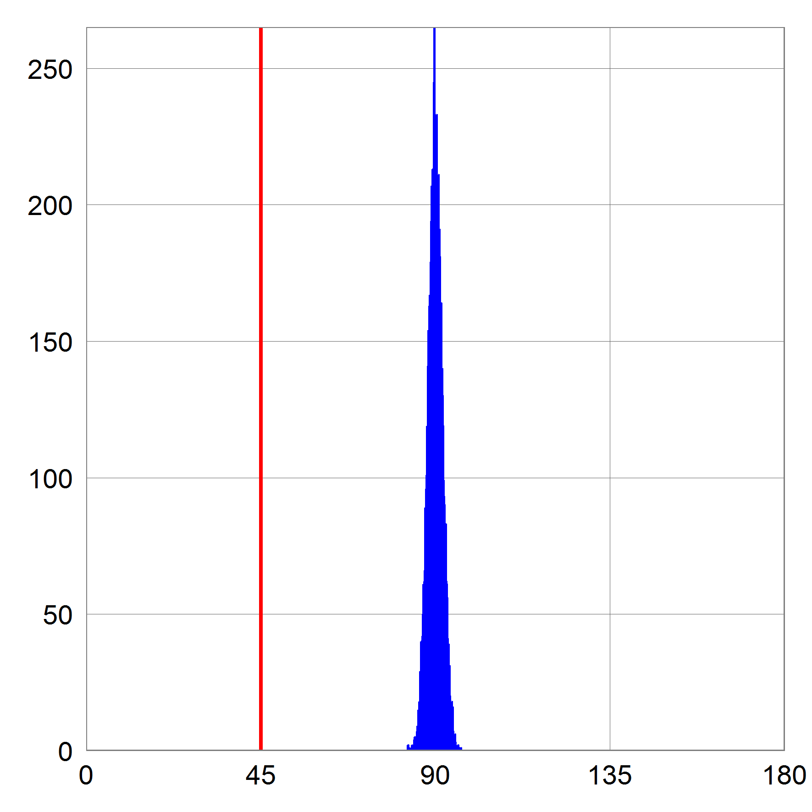
Nice geometric structure
Points on a unit sphere, where
$cr≈\sqrt{2}$, i.e., far pair is (near) orthogonal
this would be distance if the dataset were random on sphere
Close pair: $r=\sqrt{2}/c$
Query:
at angle 45’ from near-neighbor
$$cr≈\sqrt{2}$$
$$r=\sqrt{2}/c$$

Slide 10
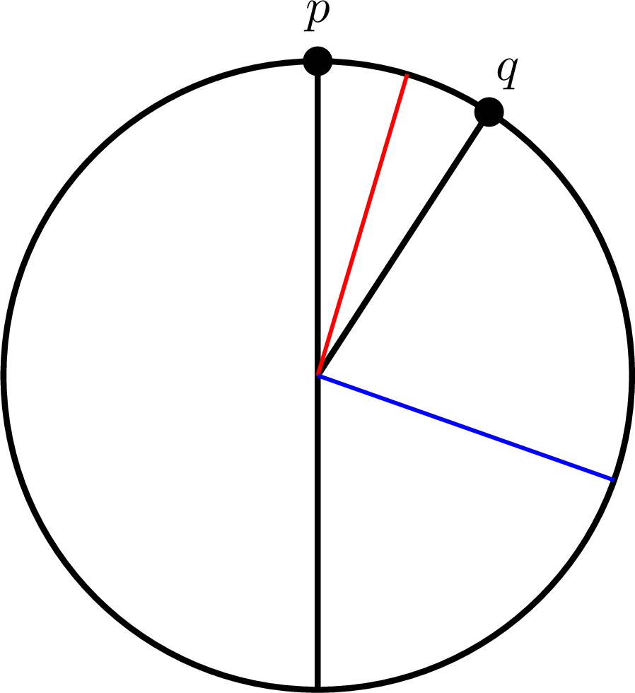
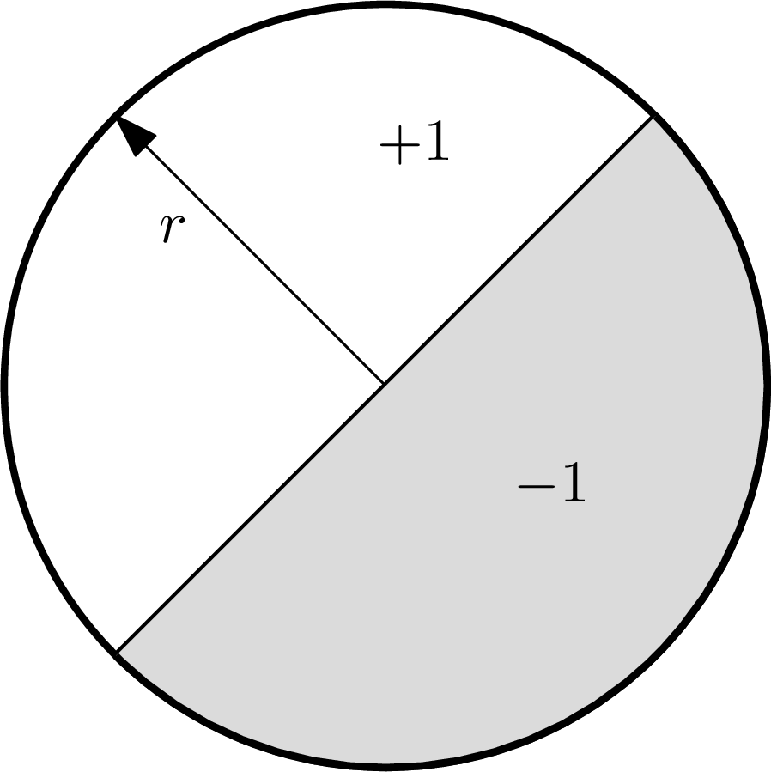
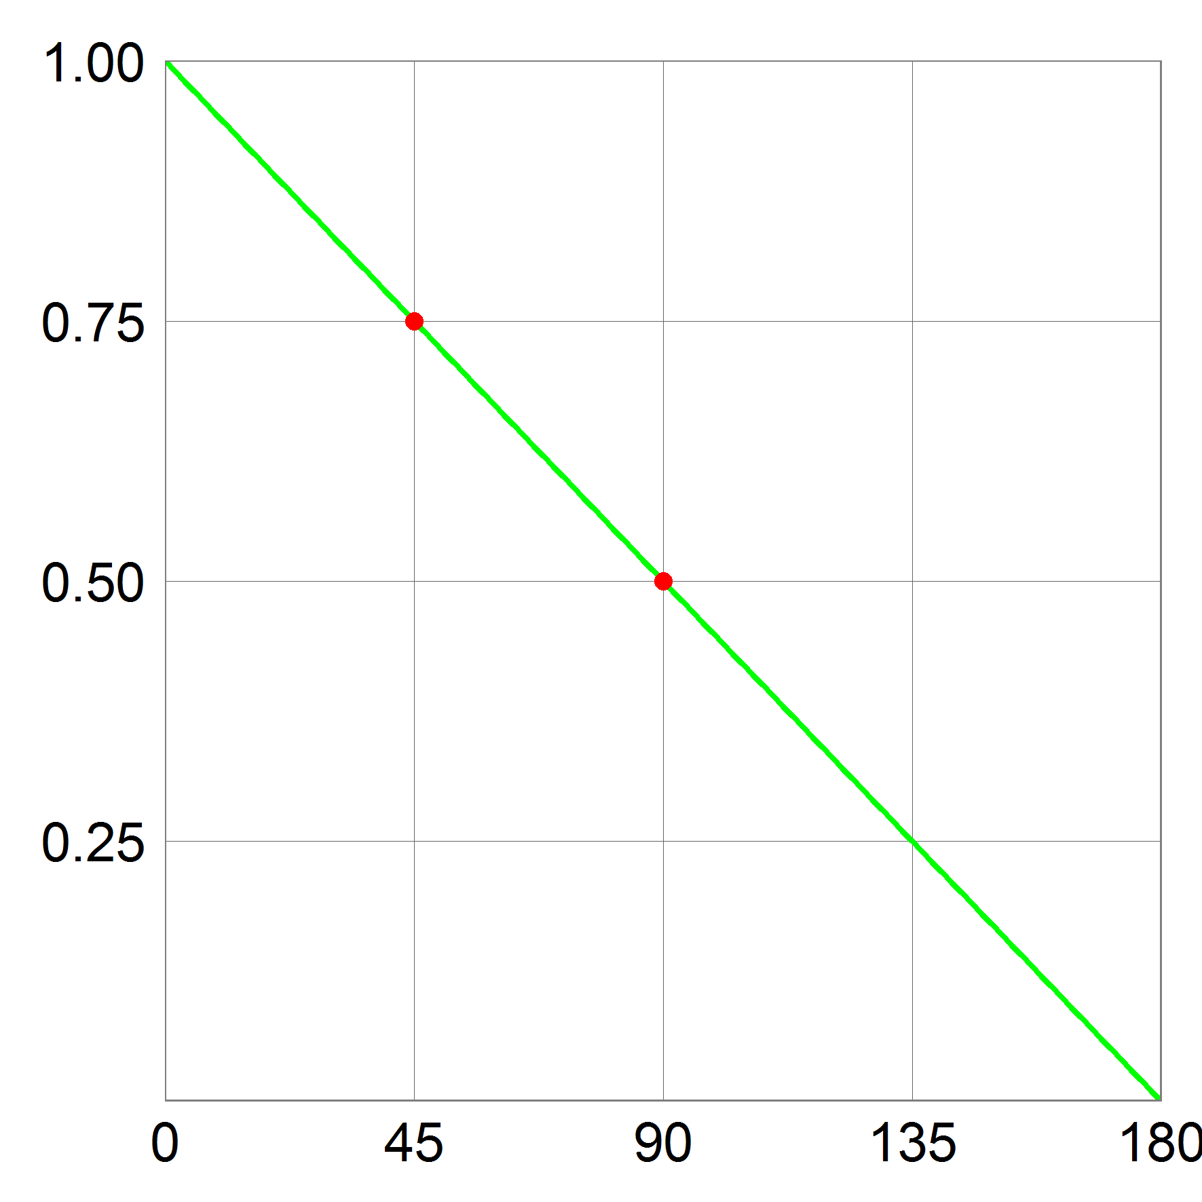
Alg 1: Hyperplanes
Sample unit $r$ uniformly, hash $p$ into $sgn〈r, p〉$
$Pr⁡[h(p) = h(q)]$ ?
$= 1 – α / π$
where $α$ is the angle between $p$ and $q$
$P_{1}=3/4$
$P_{2}=1/2$
$ρ≈0.42$
[Charikar’02]

Slide 11
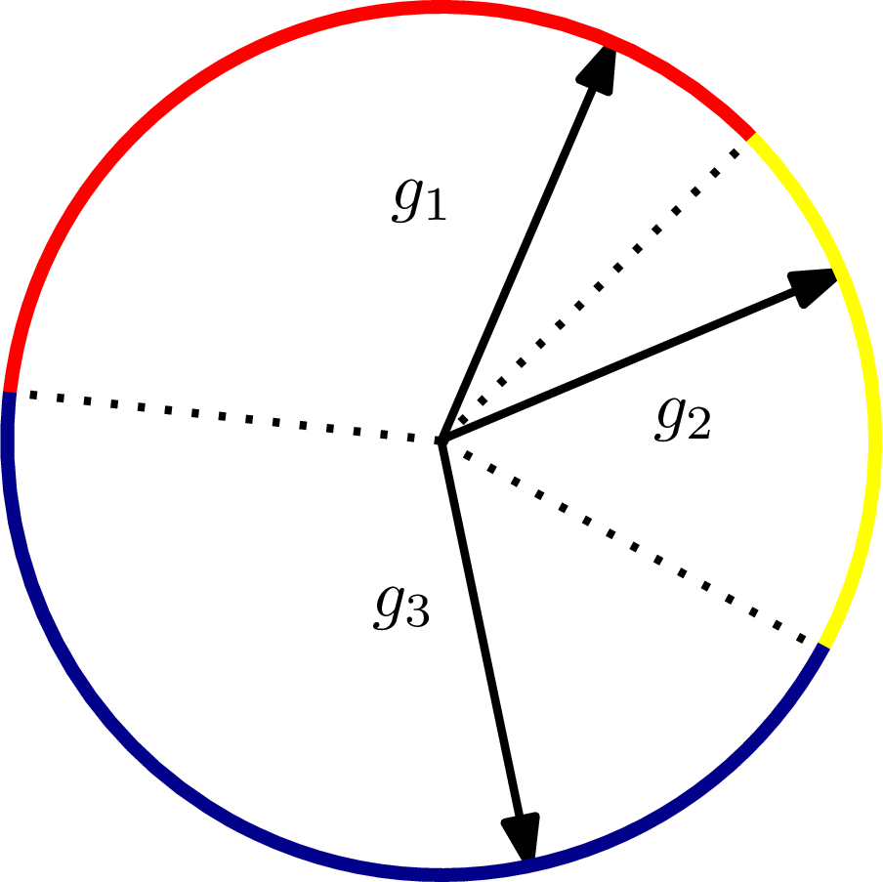
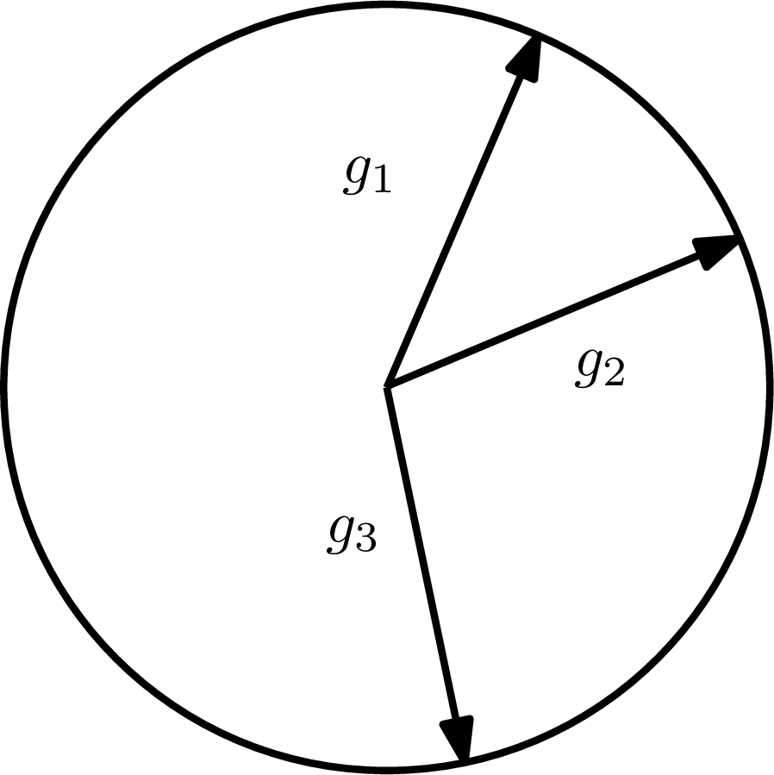
Alg 2: Voronoi
Sample $T$ i.i.d. standard $d$-dimensional Gaussians
$$g_{1}, g_{2}, …, g_{T}$$
Hash $p$ into
$h\left(p\right)= argmax_{1≤i≤T}〈p, g_{i}〉$
$T=2$ is simply Hyperplane LSH
[A.-Indyk-Nguyen-Razenshteyn’14] based on [Karger-Motwani-Sudan’94]

Slide 12
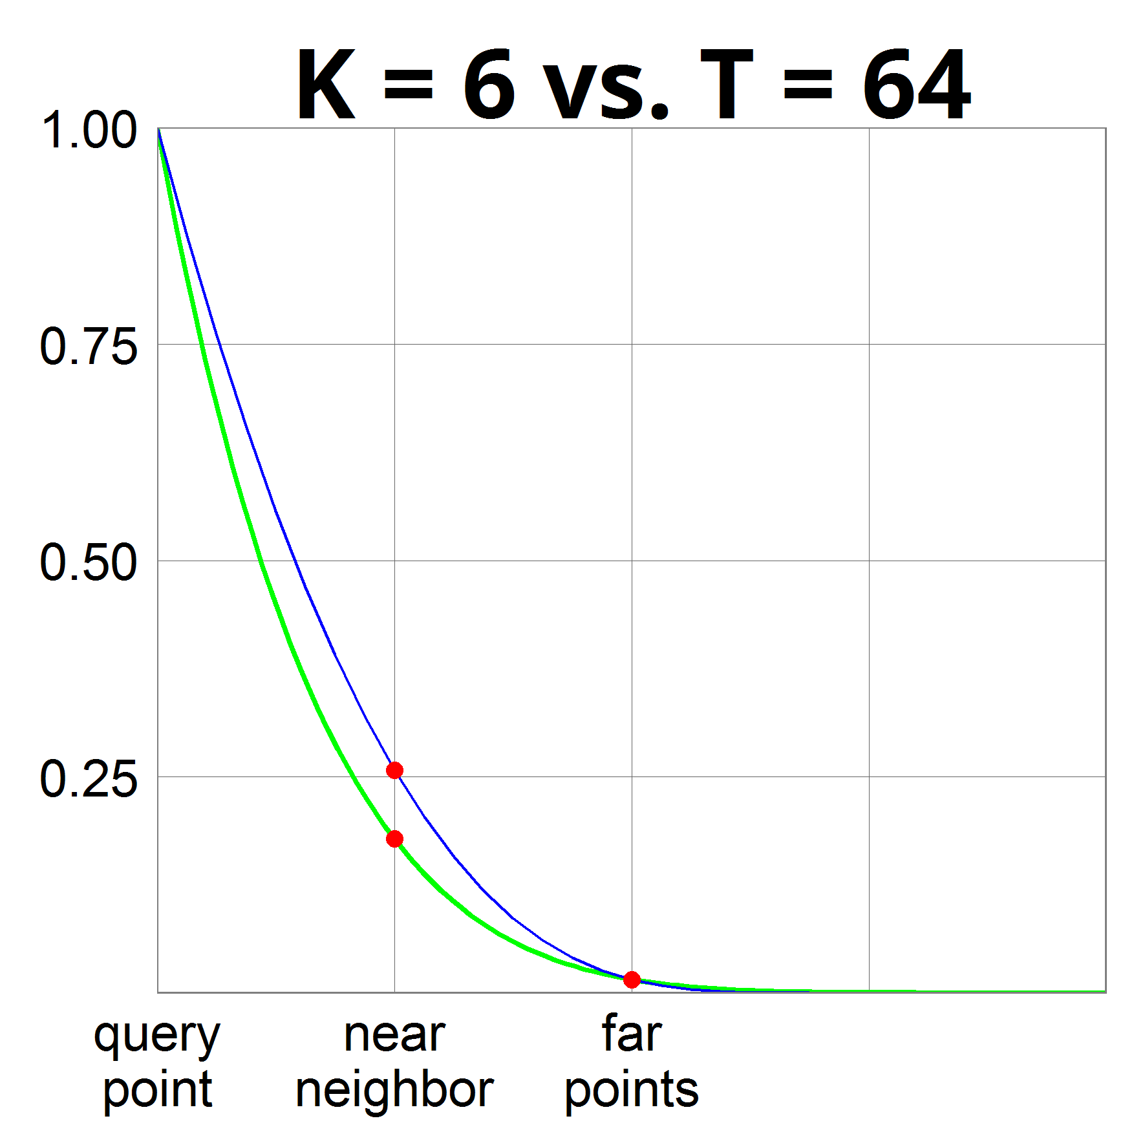
Hyperplane vs Voronoi
Hyperplane with $k=6$ hyperplanes
Means we partition space into $2^{6}=64$ pieces
Voronoi with $T=2^{k}=64$ vectors
$ρ=0.18$
grids vs spheres

Slide 13
Reduction to nice structure (very HL)
Idea:
iteratively decrease the radius of minimum enclosing ball OR make more isotopic
Algorithm:
find dense clusters
with smaller radius
large fraction of points
recurse on dense clusters
apply VoronoiLSH on the rest
recurse on each “cap”
eg, dense clusters might reappear
Why ok?
Why ok?
no dense clusters
like “random dataset” with radius=$100cr$
even better!
radius = $100cr$
radius = $99cr$
*picture not to scale & dimension

Slide 14
Hash function
Described by a tree (like a hash table)
radius = $100cr$
*picture not to scale&dimension

Slide 15
Dense clusters
$$\left(\sqrt{2}−ε\right)R$$
Current dataset: radius $R$
A dense cluster:
Contains $n^{1−δ}$ points
Smaller radius: $\left(1−Ω\left(ε^{2}\right)\right)R$
After we remove all clusters:
For any point on the surface, there are at most $n^{1−δ}$ points within distance $\left(\sqrt{2}−ε\right)R$
The other points are essentially orthogonal !
When applying Cap Carving with parameters $(P_{1},P_{2})$:
Empirical number of far pts colliding with query: $nP_{2}+n^{1−δ}$
As long as $nP_{2}≫n^{1−δ}$, the “impurity” doesn’t matter!
$ε$ trade-off
$δ$ trade-off
?

Slide 16
Tree recap
During query:
Recurse in all clusters
Just in one bucket in VoronoiLSH
Will look in >1 leaf!
How much branching?
Claim: at most ${\left(n^{δ}+1\right)}^{O(1/ε^{2})}$
Each time we branch
at most $n^{δ}$ clusters ($+1$)
a cluster reduces radius by $Ω(ε^{2})$
cluster-depth at most $100/Ω\left(ε^{2}\right)$
Progress in 2 ways:
Clusters reduce radius
CapCarving nodes reduce the # of far points (empirical $P_{2}$)
A tree succeeds with probability $≥n^{−\frac{1}{2c^{2}−1}−o(1)}$
$δ$ trade-off

Slide 17
NNS: conclusion
1. Via sketches
2. Locality Sensitive Hashing
Random space partitions
Better space bound
Even near-linear!
3. Data-dependent hashing even better
Used in practice a lot these days

