Slide 1
Nearest Neighbor Search in High-Dimensional Spaces
Alexandr Andoni
(Microsoft Research Silicon Valley)

Slide 2
Nearest Neighbor Search (NNS)
Preprocess: a set D of points
Query: given a new point q, report a point p∈D with the smallest distance to q
p
q

Slide 3
Motivation
Generic setup:
  Points model objects (e.g. images)
  Distance models (dis)similarity measure
Application areas:
  machine learning: k-NN rule
  data mining, speech recognition, image/ video/music clustering, bioinformatics, etc…
Distance can be:
  Euclidean, Hamming, ℓ∞, edit distance, Ulam, Earth-mover distance, etc…
Primitive for other problems:
  find the closest pair in a set D, MST, clustering…
000000
011100
010100
000100
010100
011111
000000
001100
000100
000100
110100
111111
p
q

Slide 4
Further motivation?
eHarmony: 29 Dimensions® of Compatibily

Slide 5
Plan for today
1. NNS for basic distances
2. NNS for advanced distances: reductions
3. NNS via composition

Slide 6
Plan for today
1. NNS for basic distances
2. NNS for advanced distances: reductions
3. NNS via composition

Slide 7
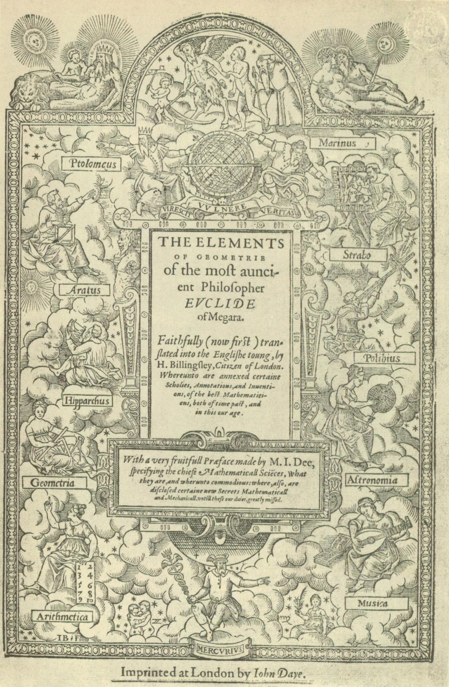
Euclidean distance

Slide 8
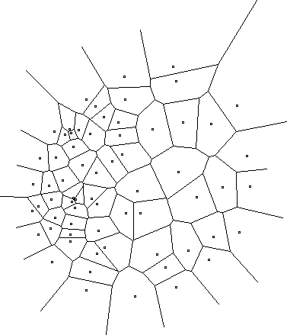
2D case
Compute Voronoi diagram
Given query q, perform point location
Performance:
  Space: O(n)
  Query time: O(log n)

Slide 9
High-dimensional case
All exact algorithms degrade rapidly with the dimension d
In practice:
  When d is “medium”, kd-trees work better
  When d is “high”, state-of-the-art is unsatisfactory
Algorithm | Query time | Space
Full indexing | O(d*log n) | n^{O(d)} (Voronoi diagram size)
No indexing – linear scan | O(dn) | O(dn)

Slide 10

Approximate NNS
c-approximate
r-near neighbor: given a new point q, report a point p∈D s.t. ||p-q||≤r
Randomized: a near neighbor returned with 90% probability
cr
as long as there exists
a point at distance ≤r
r
p
cr
q

Slide 11
Alternative view: approximate NNS
c-approximate
r-near neighbor: given a new point q, report a set L with
  all points point p∈D s.t. ||p-q||≤r (each with 90% probability)
  may contain some approximate neighbors p∈D s.t. ||p-q||≤cr
Can use as a heuristic for exact NNS
r
p
cr
q

Slide 12
Approximation Algorithms for NNS
A vast literature:
  with exp(d) space or Ω(n) time:
    [Arya-Mount’93], [Clarkson’94], [Arya-Mount-Netanyahu-Silverman-We’98], [Kleinberg’97], [Har-Peled’02],…
  with poly(n) space and o(n) time:
    [Indyk-Motwani’98], [Kushilevitz-Ostrovsky-Rabani’98], [Indyk’98, ‘01], [Gionis-Indyk-Motwani’99], [Charikar’02], [Datar-Immorlica-Indyk-Mirrokni’04], [Chakrabarti-Regev’04], [Panigrahy’06], [Ailon-Chazelle’06], [A-Indyk’06]…

Slide 13
The landscape: algorithms
Space | Time | Comment | Reference
Space: poly(n).
Query: logarithmic
n^{4/ε2}+nd | O(d*log n) | c=1+ε | [KOR’98, IM’98]
Space: small poly
(close to linear).
Query: poly
(sublinear).
n^{1+ρ} +nd | dn^{ρ} | ρ≈1/c | [IM’98, Cha’02, DIIM’04]
n^{1+ρ} +nd | dn^{ρ} | ρ≈1/c | [IM’98, Cha’02, DIIM’04]
 |  | ρ=1/c² +o(1) | [AI’06]
 |  | ρ=1/c² +o(1) | [AI’06]
Space: near-linear.
Query: poly
(sublinear).
nd*logn | dn^{ρ} | ρ=2.09/c | [Ind’01, Pan’06]
 |  | ρ=O(1/c²) | [AI’06]

Slide 14
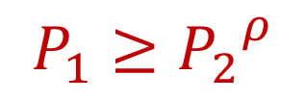
Locality-Sensitive Hashing
[Indyk-Motwani’98]
q
Random hash function g: R^{d}→Z s.t. for any points p,q:
  For a close pair p,q: ||p-q||≤r, Pr[g(p)=g(q)] is “high”
  For a far pair p,q: ||p-q||>cr, Pr[g(p)=g(q)] is “small”
Use several hash
tables
p
q
P₁=
“not-so-small”
P₂=
Pr[g(p)=g(q)]
: n^{ρ}, where ρ<1 s.t.
1
P₁
P₂
||p-q||
r
cr

Slide 15
Example of hash functions: grids
[Datar-Immorlica-Indyk-Mirrokni’04]
Pick a regular grid:
  Shift and rotate randomly
Hash function:
  g(p) = index of the cell of p
Gives ρ ≈ 1/c
p

Slide 16
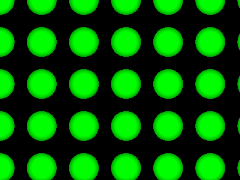
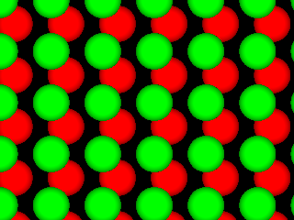
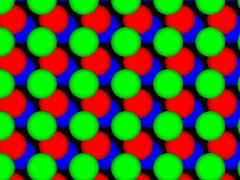
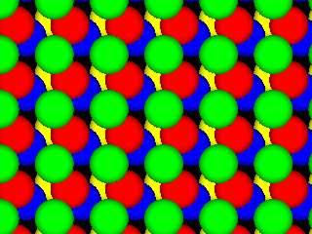
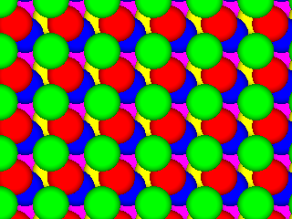
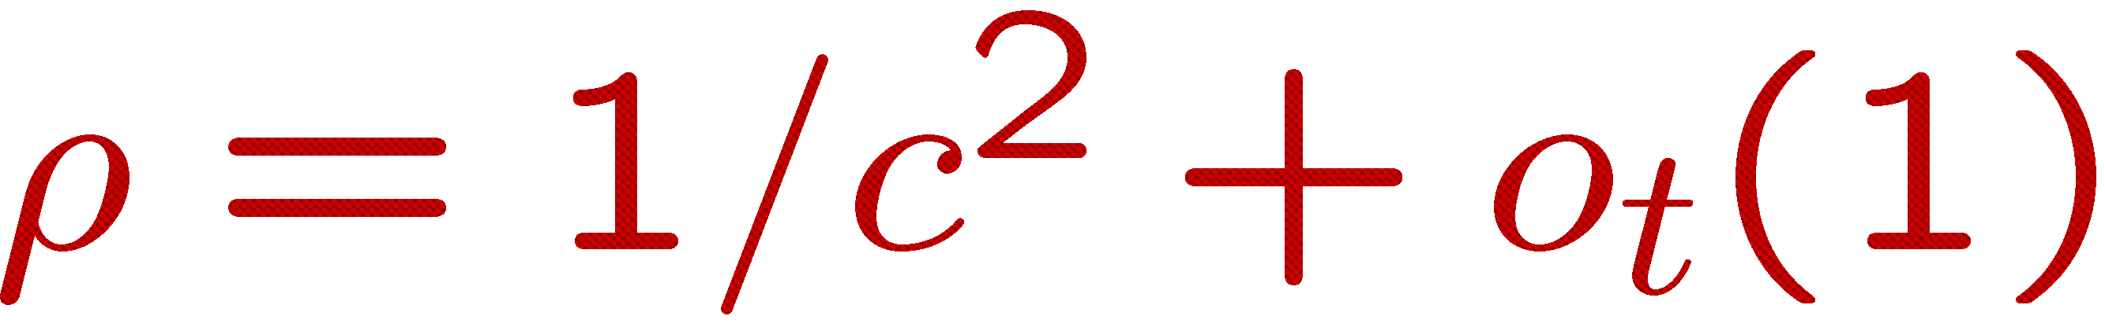
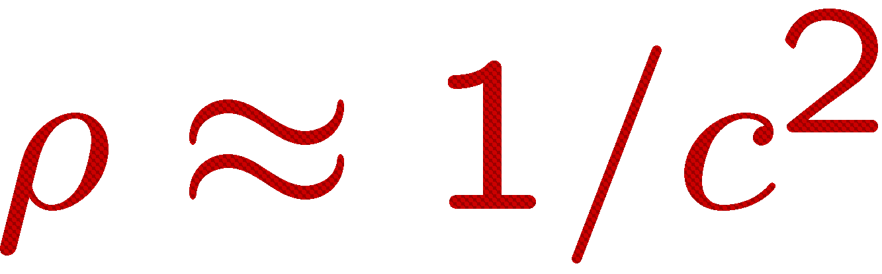
Near-Optimal LSH
[A-Indyk’06]
Regular grid → grid of balls
  p can hit empty space, so take more such grids until p is in a ball
Need (too) many grids of balls
  Start by projecting in dimension t
Analysis gives
Choice of reduced dimension t?
  Tradeoff between
    # hash tables, n^{ρ}, and
    Time to hash, t^{O(t)}
  Total query time: dn^{1/c2+o(1)}
p
2D
p
R^{t}

Slide 17

Proof idea
p
Claim: , i.e.,
  P(r)=probability of collision when ||p-q||=r
Intuitive proof:
  Projection approx preserves distances [JL]
  P(r) = intersection / union
  P(r)≈random point u beyond the dashed line
  Fact (high dimensions): the x-coordinate of u has a nearly Gaussian distribution
  → P(r) ≈ exp(-A·r²)
r
q
p
q
P(r)
x
$P\left(r\right)=\exp\left(−Ar^{2}\right)={\left[exp⁡(−A{(cr)}^{2}\right]}^{1/c^{2}}={P(cr)}^{1/c^{2}}$
u

Slide 18
Challenge #1:
More practical variant of above hashing?
Design space partitioning of R^{t} that is
  efficient: point location in poly(t) time
  qualitative: regions are “sphere-like”
c²
[Prob. needle of length 1 is not cut]
≥
[Prob needle of length c is not cut]

Slide 19
The landscape: lower bounds
1 mem lookup
Space | Time | Comment | Reference
Space: poly(n).
Query: logarithmic
n^{4/ε2}+nd | O(d*log n) | c=1+ε | [KOR’98, IM’98]
n^{o(1/ε2)} | ω(1) memory lookups | [AIP’06]
Space: small poly
(close to linear).
Query: poly
(sublinear).
n^{1+ρ} +nd | dn^{ρ} | ρ≈1/c | [IM’98, Cha’02, DIIM’04]
 |  | ρ=1/c² +o(1) | [AI’06]
 |  | ρ≥1/c² | [MNP’06, OWZ’10]
n^{1+o(1/c2)} | ω(1) memory lookups | [PTW’08, PTW’10]
Space: near-linear.
Query: poly
(sublinear).
nd*logn | dn^{ρ} | ρ=2.09/c | [Ind’01, Pan’06]
 |  | ρ=O(1/c²) | [AI’06]

Slide 20
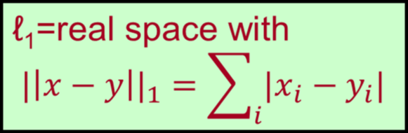
Other norms
Euclidean norm (ℓ₂)
  Locality sensitive hashing
Hamming space (≅ℓ₁)
  also LSH
  (in fact in original [IM98])
Max norm (ℓ∞)
  Don’t know of any LSH
  next…
ℓ∞=real space with distance: ||x-y||∞=max_{i} |x_{i}-y_{i}|

Slide 21
NNS for ℓ∞ distance
ℓ∞=real space with distance: ||x-y||∞=max_{i} |x_{i}-y_{i}|
[Indyk’98]
Thm: for ρ>0, NNS for ℓ∞^{d} with
  O(d * log n) query time
  n^{1+ρ} space
  O(lg_{1+ρ} lg d) approximation
The approach:
  A deterministic decision tree
    Similar to kd-trees
  Each node of DT is “q_{i} < t”
  One difference: algorithms goes down the tree once
  (while tracking the list of possible neighbors)
[ACP’08]: optimal for deterministic decision trees!
q₁<5 ?
Challenge #2:
Obtain O(1) approximation with n^{O(1)} space,
and sublinear query time NNS under ℓ∞ .
Yes
No
q₂<4 ?
q₂<3 ?
Yes
No
q₁<3 ?

Slide 22
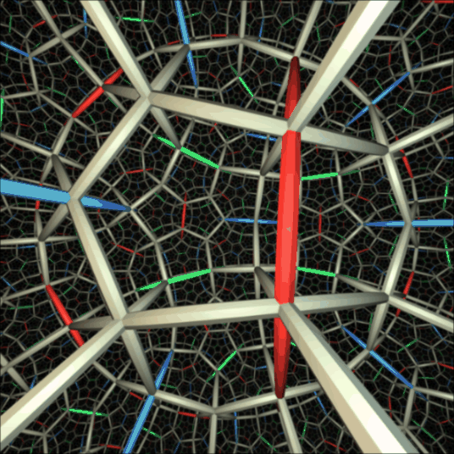
Plan for today
1. NNS for basic distances
2. NNS for advanced distances: reductions
3. NNS via composition

Slide 23


What do we have?
Classical ℓ_{p} distances:
  Euclidean (ℓ₂), Hamming (ℓ₁), ℓ∞
How about other distances?
E.g.:
  Edit (Levenshtein) distance: ed(x,y) = minimum number of insertions/deletions/substitutions operations that transform x into y.
    Very similar to Hamming distance…
  or Earth-Mover Distance…

Slide 24


Earth-Mover Distance
Definition:
  Given two sets A, B of points in a metric space
  EMD(A,B) = min cost bipartite matching between A and B
Which metric space?
  Can be plane, ℓ₂, ℓ₁…
Applications in image vision

Slide 25
Embeddings: as a reduction
For each X∈M, associate a vector f(X), such that for all X,Y∈M
  ||f(X) - f(Y)|| approximates original distance between X and Y
  Has distortion A ≥ 1 if
  d_{M}(X,Y) ≤ ||f(X)-f(Y)|| ≤ A*d_{M}(X,Y)
Reduce NNS under M to NNS for Euclidean space!
Can also consider other “easy” distances between f(X), f(Y)
  Most popular host: ℓ₁≡Hamming
f
f

Slide 26
Earth-Mover Distance over 2D into ℓ₁
[Charikar’02, Indyk-Thaper’03]
Sets of size s in [1…s]x[1…s] box
Embedding of set A:
  impose randomly-shifted
  grid
  Each grid cell gives
  a coordinate:
  f (A)_{c}=#points in the cell c
  Subpartition the grid
  recursively, and assign
  new coordinates for each
  new cell (on all levels)
Distortion: O(log s)
0
0
0
0
0
2
1
1
1
2
2
2
0
1
2
0
0
1
0
0

Slide 27
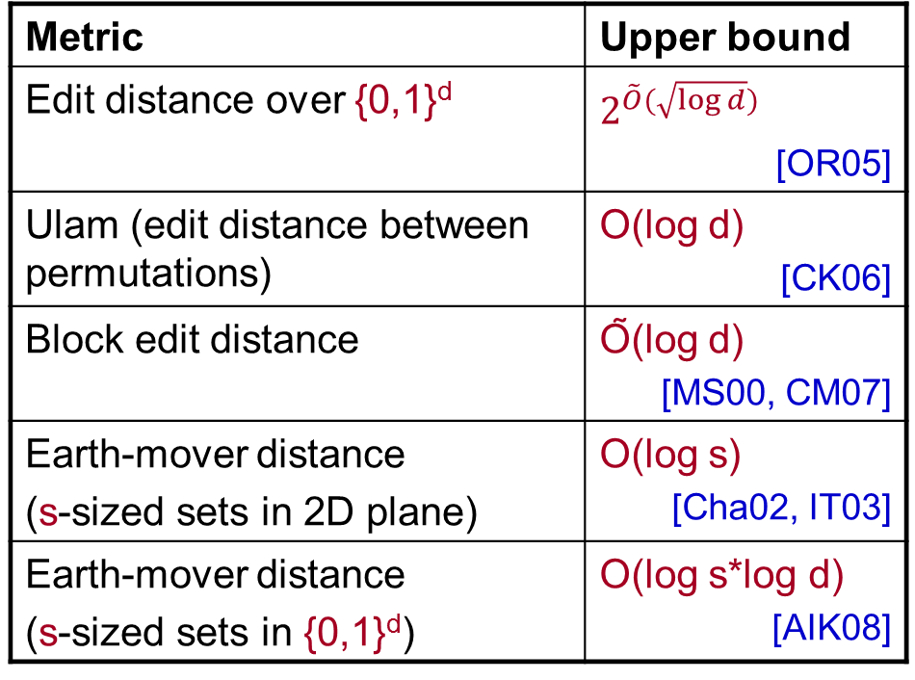
Embeddings of various metrics
Embeddings into Hamming space (ℓ₁)
Metric | Upper bound
Edit distance over {0,1}^{d}
Ulam (edit distance between permutations) | O(log d) [CK06]
Block edit distance | Õ(log d) [MS00, CM07]
Earth-mover distance (s-sized sets in 2D plane) | O(log s) [Cha02, IT03]
Earth-mover distance (s-sized sets in {0,1}^{d}) | O(log s*log d) [AIK08]
Challenge 3:
Improve the distortion of embedding
edit distance, EMD into ℓ₁

Slide 28
Are we done?
“just” remains to find an embedding with low distortion…
No, unfortunately

Slide 29
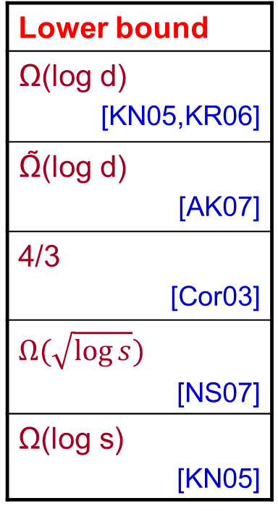
A barrier: ℓ₁ non-embeddability
Embeddings into ℓ₁
Metric | Upper bound
Edit distance over {0,1}^{d}
Ulam (edit distance between permutations) | O(log d) [CK06]
Block edit distance | Õ(log d) [MS00, CM07]
Earth-mover distance (s-sized sets in 2D plane) | O(log s) [Cha02, IT03]
Earth-mover distance (s-sized sets in {0,1}^{d}) | O(log s*log d) [AIK08]
Lower bound
Ω(log d) [KN05,KR06]
Ω̃(log d) [AK07]
4/3 [Cor03]
Ω(log s) [KN05]

Slide 30
Other good host spaces?
What is “good”:
  is algorithmically tractable
  is rich (can embed into it)
ℓ₂, ℓ₁
sq-ℓ₂
ℓ∞
, etc
sq-ℓ₂=real space with distance: ||x-y||₂²
sq-ℓ₂, hosts with very good LSH (lower bounds via communication complexity)
Metric | Lower bound into ℓ₁
Edit distance over {0,1}^{d} | Ω(log d) [KN05,KR06]
Ulam (edit distance between permutations) | Ω̃(log d) [AK07]
Earth-mover distance (s-sized sets in {0,1}^{d}) | Ω(log s) [KN05]
̃
[AK’07]
[AK’07]
[AIK’08]

Slide 31
Plan for today
1. NNS for basic distances
2. NNS for advanced distances: reductions
3. NNS via composition

Slide 32

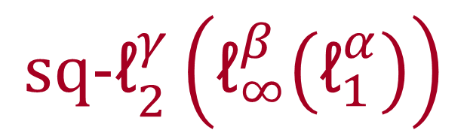
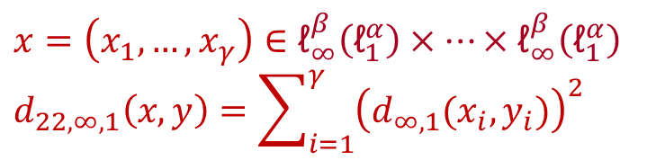
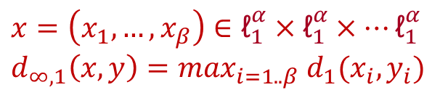
Meet our new host
α
d₁
[A-Indyk-Krauthgamer’09]
d₁
…
d₁
…
β
…
Iterated product space
$${\text{sq}\text{−ℓ}}_{2}^{γ}\left({\text{ℓ}}_{∞}^{β}\left({\text{ℓ}}_{1}^{α}\right)\right)$$
d_{∞,1}
d_{22,∞,1}
d_{∞,1}
d_{∞,1}
γ
$$x=\left(x_{1},…,x_{α}\right)∈R^{α}$$
$$d_{1}\left(x,y\right)=\sum_{i=1}^{α}{|x_{i}−y_{i}|}$$
$$x=\left(x_{1},…,x_{β}\right)∈{\text{ℓ}}_{1}^{α}×{\text{ℓ}}_{1}^{α}×…{\text{ℓ}}_{1}^{α}$$
$$d_{∞,1}\left(x,y\right)=\max_{i=1..β} d_{1}(x_{i},y_{i})$$
$$x=\left(x_{1},…,x_{γ}\right)∈{\text{ℓ}}_{∞}^{β}\left({\text{ℓ}}_{1}^{α}\right)×…×{\text{ℓ}}_{∞}^{β}\left({\text{ℓ}}_{1}^{α}\right)$$
$$d_{22,∞,1}\left(x,y\right)=\sum_{i=1}^{γ}{{\left(d_{∞,1}(x_{i},y_{i})\right)}^{2}}$$

Slide 33
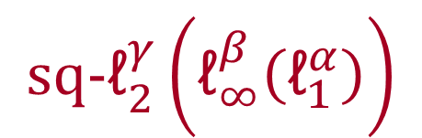
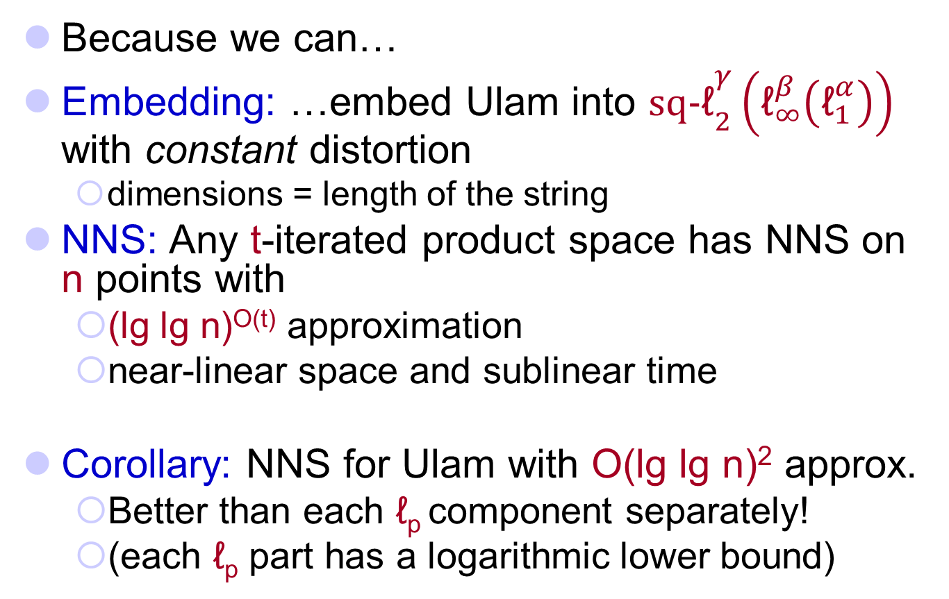
Why ?
$${\text{sq}\text{−ℓ}}_{2}^{γ}\left({\text{ℓ}}_{∞}^{β}\left({\text{ℓ}}_{1}^{α}\right)\right)$$
[A-Indyk-Krauthgamer’09, Indyk’02]
edit distance between permutations
ED(1234567,
7123456) = 2
Because we can…
Embedding: …embed Ulam into ${\text{sq}\text{−}\text{ℓ}}_{2}^{γ}\left({\text{ℓ}}_{∞}^{β}\left({\text{ℓ}}_{1}^{α}\right)\right)$ with constant distortion
  dimensions = length of the string
NNS: Any t-iterated product space has NNS on n points with
  (lg lg n)^{O(t)} approximation
  near-linear space and sublinear time
Corollary: NNS for Ulam with O(lg lg n)² approx.
  Better than each ℓ_{p} component separately!
  (each ℓ_{p} part has a logarithmic lower bound)
Rich
Algorithmically
tractable

Slide 34
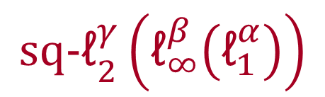
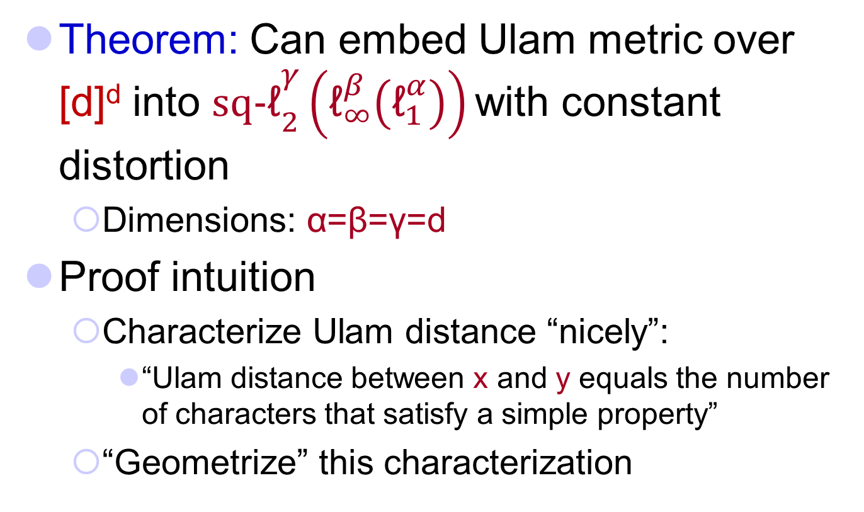
Embedding into
$${\text{sq}\text{−ℓ}}_{2}^{γ}\left({\text{ℓ}}_{∞}^{β}\left({\text{ℓ}}_{1}^{α}\right)\right)$$
Theorem: Can embed Ulam metric over [d]^{d} into ${\text{sq}\text{−}\text{ℓ}}_{2}^{γ}\left({\text{ℓ}}_{∞}^{β}\left({\text{ℓ}}_{1}^{α}\right)\right)$ with constant distortion
  Dimensions: α=β=γ=d
Proof intuition
  Characterize Ulam distance “nicely”:
    “Ulam distance between x and y equals the number of characters that satisfy a simple property”
  “Geometrize” this characterization

Slide 35
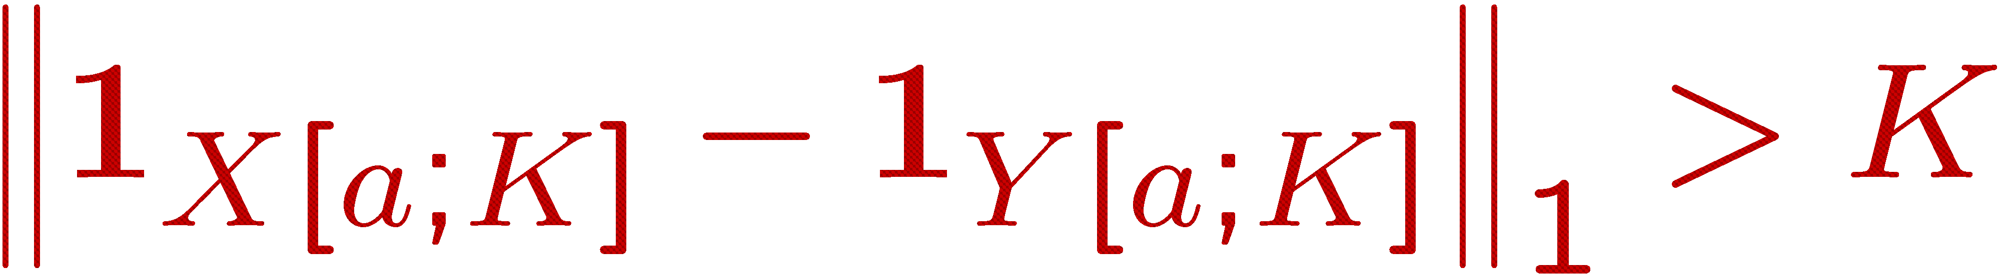
Ulam: a characterization
E.g., a=5; K=4
[Ailon-Chazelle-Commandur-Lu’04, Gopalan-Jayram-
Krauthgamer-Kumar’07, A-Indyk-Krauthgamer’09]
X[5;4]
Lemma: Ulam(x,y) approximately equals the number of “faulty” characters a satisfying:
  there exists K≥1 (prefix-length) s.t.
  the set of K characters preceding a in x differs much from
  the set of K characters preceding a in y
x=
123456789
y=
123467895
Y[5;4]

Slide 36
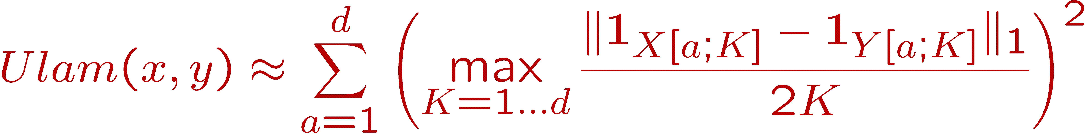
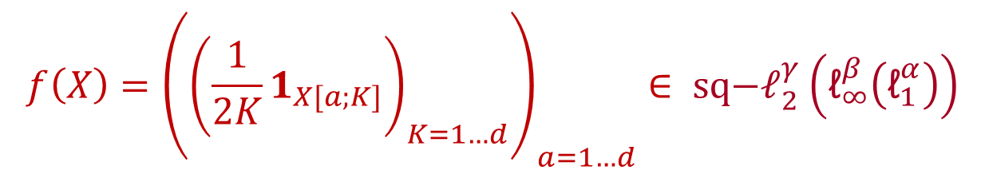
Ulam: the embedding
X[5;4]
123456789
“Geometrizing” characterization:
Gives an embedding
123467895
Y[5;4]
$$f\left(X\right)={\left({\left(\frac{1}{2K}1_{X[a;K]}\right)}_{K=1…d}\right)}_{a=1…d}∈ {\text{sq}\text{−}\text{ℓ}}_{2}^{γ}\left({\text{ℓ}}_{∞}^{β}\left({\text{ℓ}}_{1}^{α}\right)\right)$$

Slide 37
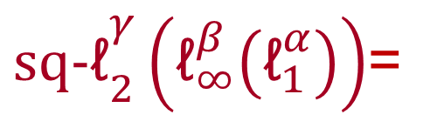
Distance as low-complexity computation
Gives more computational view of embeddings
Ulam characterization is related to work in the context of sublinear (local) algorithms: property testing & streaming [EKKRV98, ACCL04, GJKK07, GG07, EJ08]
sum of squares (sq-ℓ₂)
edit(P,Q)
${\text{sq}\text{−}\text{ℓ}}_{2}^{γ}\left({\text{ℓ}}_{∞}^{β}\left({\text{ℓ}}_{1}^{α}\right)\right)$=
max (ℓ∞)
sum (ℓ₁)
X
Y

Slide 38
Challenges 4,…
Embedding into product spaces?
  Of edit distance, EMD…
NNS for any norm (Banach space) ?
  Would help for EMD (a norm in fact!)
  A first target: Schatten norms (e.g., trace of a matrix)
Other uses of embeddings into product spaces?
  Related work: sketching of product spaces, used in streaming applications [JW’09, AIK’08, AKO’11]

Slide 39
Some aspects I didn’t mention yet
NNS with black-box distance function, assuming a low intrinsic dimension:
  [Clarkson’99], [Karger-Ruhl’02], [Hildrum-Kubiatowicz-Ma-Rao’04], [Krauthgamer-Lee’04,’05], [Indyk-Naor’07],…
Lower bounds for deterministic and/or exact NNS:
  [Borodin-Ostrovsky-Rabani’99], [Barkol-Rabani’00], [Jayram-Khot-Kumar-Rabani’03], [Liu’04], [Chakrabarti-Chazelle-Gum-Lvov’04], [Pătraşcu-Thorup’06],…
NNS with random input:
  [Alt-Heinrich-Litan’01], [Dubiner’08],…
Solving other problems via reductions from NNS:
  [Eppstein’92], [Indyk’00],…
Many others !

Slide 40
Some highlights of approximate NNS
Iterated product spaces
Locality-Sensitive Hashing
Decision trees
Euclidean space ℓ₂
Hamming space ℓ₁
Max norm ℓ∞
logarithmic (or more) distortion
Edit distance
Hausdorff distance
Earth-Mover Distance
constant distortion
Ulam distance

Slide 41
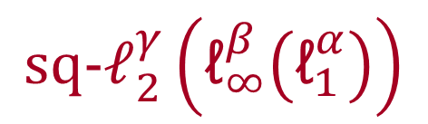
Some challenges
1. Design qualitative, efficient space partitioning in Euclidean space
2. O(1) approximation NNS for ℓ∞
3. Embeddings with improved distortion of edit distance, Earth-Mover Distance:
  into ℓ₁
  into product spaces
4. NNS for any norm: e.g. trace norm?
$${\text{sq}\text{−ℓ}}_{2}^{γ}\left({\text{ℓ}}_{∞}^{β}\left({\text{ℓ}}_{1}^{α}\right)\right)$$

