Slide 1
Data-dependent Hashing for
Similarity Search
Alex Andoni
(Columbia University)

Slide 2
Nearest Neighbor Search (NNS)
Preprocess: a set $P$ of points
Query: given a query point $q$, report a point $p^{∗}∈P$ with the smallest distance to $q$
$$p^{∗}$$
$$q$$

Slide 3
Motivation
Generic setup:
  Points model objects (e.g. images)
  Distance models (dis)similarity measure
Application areas:
  machine learning: k-NN rule
  speech/image/video/music recognition, vector quantization, bioinformatics, etc…
Distances:
  Hamming, Euclidean,
  edit distance, earthmover distance, etc…
Core primitive: closest pair, clustering, etc…
000000
011100
010100
000100
010100
011111
000000
001100
000100
000100
110100
111111
$$p^{∗}$$
$$q$$

Slide 4
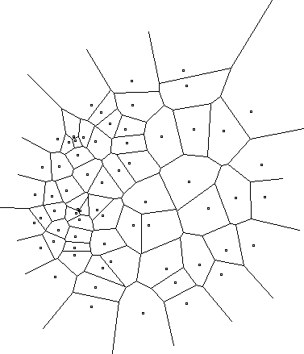
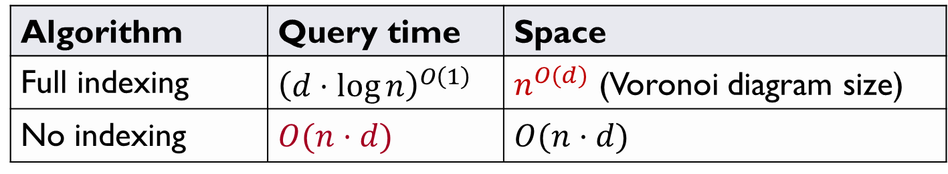
Curse of Dimensionality
$$d=2$$
Hard when $d≫\log{n}$
Algorithm | Query time | Space
Full indexing | $${\left(d⋅\log{n}\right)}^{O\left(1\right)}$$ | $n^{O(d)}$ (Voronoi diagram size)
No indexing | $$O(n⋅d)$$ | $$O(n⋅d)$$
Refutes Strong ETH
[Wil’04]
$$n^{0.99}$$ | $$n^{O\left(1\right)}$$

Slide 5
Approximate NNS
$c$-approximate
$r$-near neighbor: given a query point $q$, report a point $p^{′}∈P$ s.t. $\left\|p′−q\right\|≤r$
  as long as there is some point within distance $r$
Practice: use for exact NNS
  Filtering: gives a set of candidates (hopefully small)
$$cr$$
$$r$$
$$p^{∗}$$
$$cr$$
$$q$$
$$p^{′}$$

Slide 6
Plan
Space decompositions
Structure in data
  PCA-tree
No structure in data
  Data-dependent hashing
Towards practice

Slide 7
Plan
Space decompositions
Structure in data
  PCA-tree
No structure in data
  Data-dependent hashing
Towards practice

Slide 8
It’s all about space decompositions
Approximate space decompositions
    [Arya-Mount’93], [Clarkson’94], [Arya-Mount-Netanyahu-Silverman-We’98], [Kleinberg’97], [Har-Peled’02],[Arya-Fonseca-Mount’11],…
Random decompositions == hashing
    [Kushilevitz-Ostrovsky-Rabani’98], [Indyk-Motwani’98], [Indyk’01], [Gionis-Indyk-Motwani’99], [Charikar’02], [Datar-Immorlica-Indyk-Mirrokni’04], [Chakrabarti-Regev’04], [Panigrahy’06], [Ailon-Chazelle’06], [A.-Indyk’06], [Terasawa-Tanaka’07], [Kapralov’15], [Pagh’16], [Becker-Ducas-Gama-Laarhoven’16], [Christiani’17], …
for low-dimensional
for high-dimensional

Slide 9

Low-dimensional
kd-trees, approximate Voronoi,…
$c=1+ε$
Usual factor: $\frac{1}{ε^{O(d)}}$

Slide 10

High-dimensional
Locality-Sensitive Hashing (LSH)
Space partitions: fully random
  Johnson-Lindenstrauss Lemma: project to random subspace
LSH runtime: $n^{1/c}$ for $c$ approximation

Slide 11
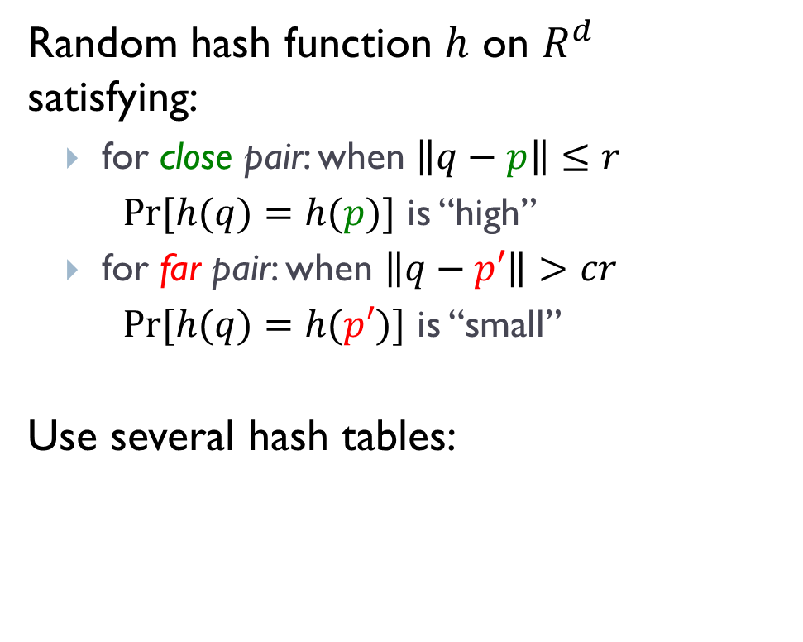
Locality-Sensitive Hashing
[Indyk-Motwani’98]
$$q$$
$$p′$$
Random hash function $h$ on $R^{d}$ satisfying:
  for close pair: when $\left\|q−p\right\|≤r$
  $Pr⁡[h(q)=h(p)]$ is “high”
  for far pair: when $\left\|q−p′\right\|>cr$
  $Pr⁡[h(q)=h(p′)]$ is “small”
Use several hash tables:
$$p$$
$$q$$
$$P1=$$
“not-so-small”
$$P2=$$
$$Pr⁡[g(q)=g(p)]$$
$$ρ=\frac{\log{1/P_{1}}}{\log{1/P_{2}}}$$
1
$nρ$, where
$$P1$$
$$P2$$
$$\left\|q−p\right\|$$
$$r$$
$$cr$$

Slide 12
LSH Algorithms
Space | Time | Exponent | $$c=2$$ | Reference
Hamming
space
$$n^{1+ρ}$$ | $$n^{ρ}$$ | $$ρ=1/c$$ | $$ρ=1/2$$ | [IM’98]
 |  | $$ρ≥1/c$$ |  | [MNP’06, OWZ’11]
Euclidean
space
$$n^{1+ρ}$$ | $$n^{ρ}$$ | $$ρ=1/c$$ | $$ρ=1/2$$ | [IM’98, DIIM’04]
 |  | $$ρ≈1/c^{2}$$ | $$ρ=1/4$$ | [AI’06]
 |  | $$ρ≥1/c^{2}$$ |  | [MNP’06, OWZ’11]
Notes:
Other ways to use LSH

Slide 13
vs Practice
My dataset is not worse-case
Data-dependent partitions
  optimize the partition to your dataset
  PCA-tree [S’91, M’01, VKD’09]
  randomized kd-trees [SAH08, ML09]
  spectral/PCA/semantic/WTA hashing [WTF08, CKW09, SH09, YSRL11]
  …

Slide 14
Practice vs Theory
Data-dependent partitions often outperform (vanilla) random partitions
But no guarantees (correctness or performance)
  Hard to measure progress, understand trade-offs
JL generally optimal [Alo’03, JW’13]
  Even for some NNS regimes! [AIP’06]
Why do data-dependent partitions outperform random ones ?

Slide 15
Plan
Space decompositions
Structure in data
  PCA-tree
No structure in data
  Data-dependent hashing
Towards practice

Slide 16
How to study phenomenon:
Because of further special structure in the dataset
“Intrinsic dimension is small”
  [Clarkson’99,Karger-Ruhl’02, Krauthgamer-Lee’04, Beygelzimer-Kakade-Langford’06, Indyk-Naor’07, Dasgupta-Sinha’13,…]
But, dataset is really high-dimensional…
Why do data-dependent partitions outperform random ones ?

Slide 17

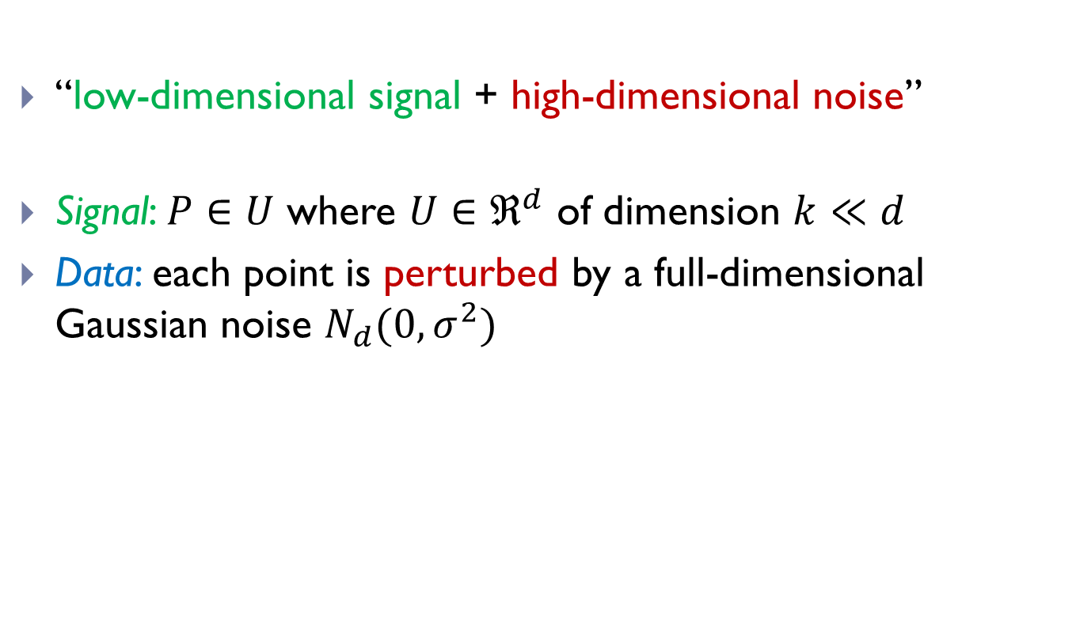
Towards higher-dimensional datasets
[Abdullah-A.-Krauthgamer-Kannan’14]
“low-dimensional signal + high-dimensional noise”
Signal: $P∈U$ where $U∈ℜ^{d}$ of dimension $k≪d$
Data: each point is perturbed by a full-dimensional Gaussian noise $N_{d}(0,σ^{2})$
$$U$$

Slide 18
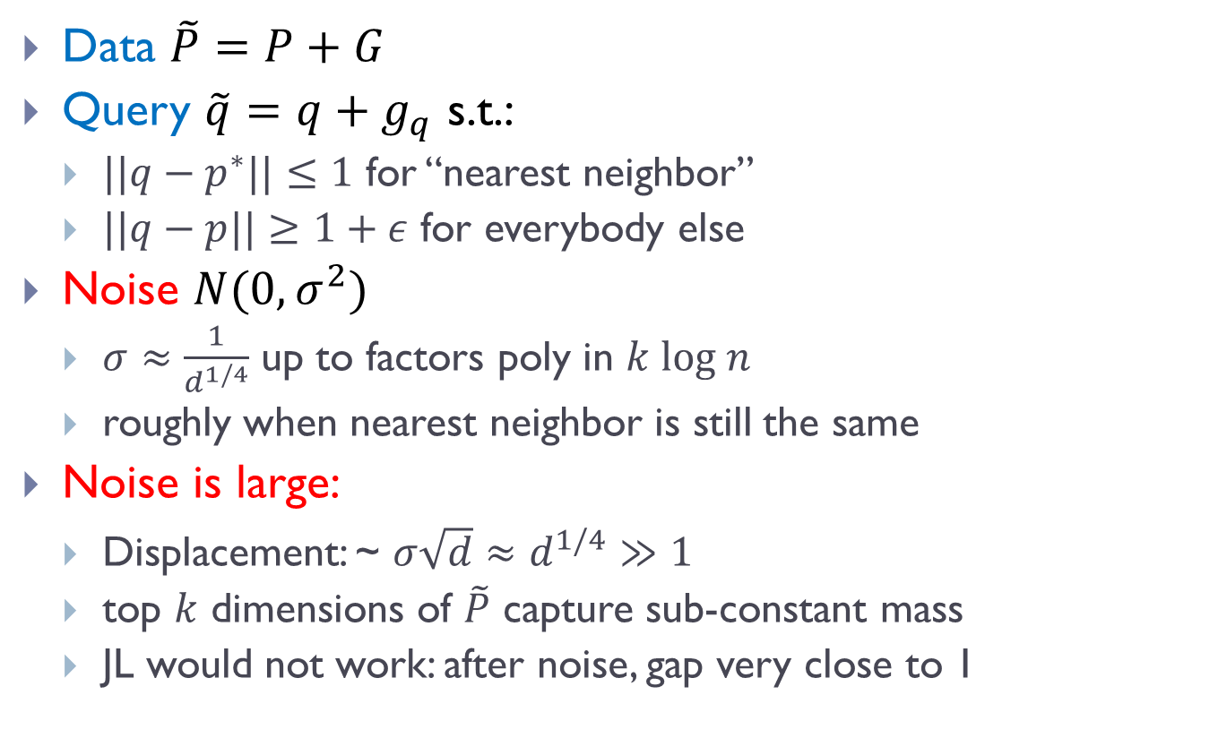
Model properties
Data $\tilde{P}=P+G$
Query $\tilde{q}=q+g_{q}$ s.t.:
  $||q−p^{∗}||≤1$ for “nearest neighbor”
  $||q−p||≥1+ε$ for everybody else
Noise $N(0,σ^{2})$
  $σ≈\frac{1}{d^{1/4}}$ up to factors poly in $k log n$
  roughly when nearest neighbor is still the same
Noise is large:
  Displacement: ~ $σ\sqrt{d}≈d^{1/4}≫1$
  top $k$ dimensions of $\tilde{P}$ capture sub-constant mass
  JL would not work: after noise, gap very close to 1

Slide 19
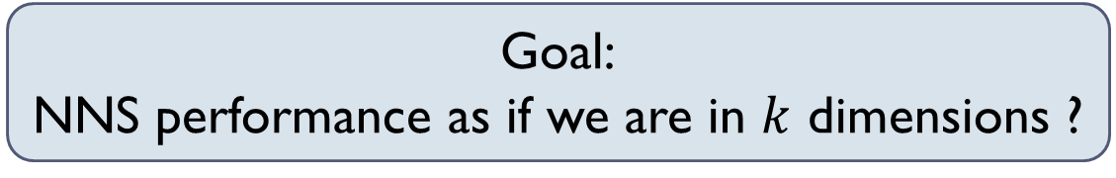

NNS in this model
Best we can hope:
  dataset contains a “worst-case” $k$-dimensional instance
Reduction from dimension $d$ to $k$
Spoiler: Yes, we can do it!
Goal:
NNS performance as if we are in $k$ dimensions ?

Slide 20
Tool: PCA
Principal Component Analysis
  like Singular Value Decomposition
  Top PCA direction: direction maximizing variance of the data

Slide 21

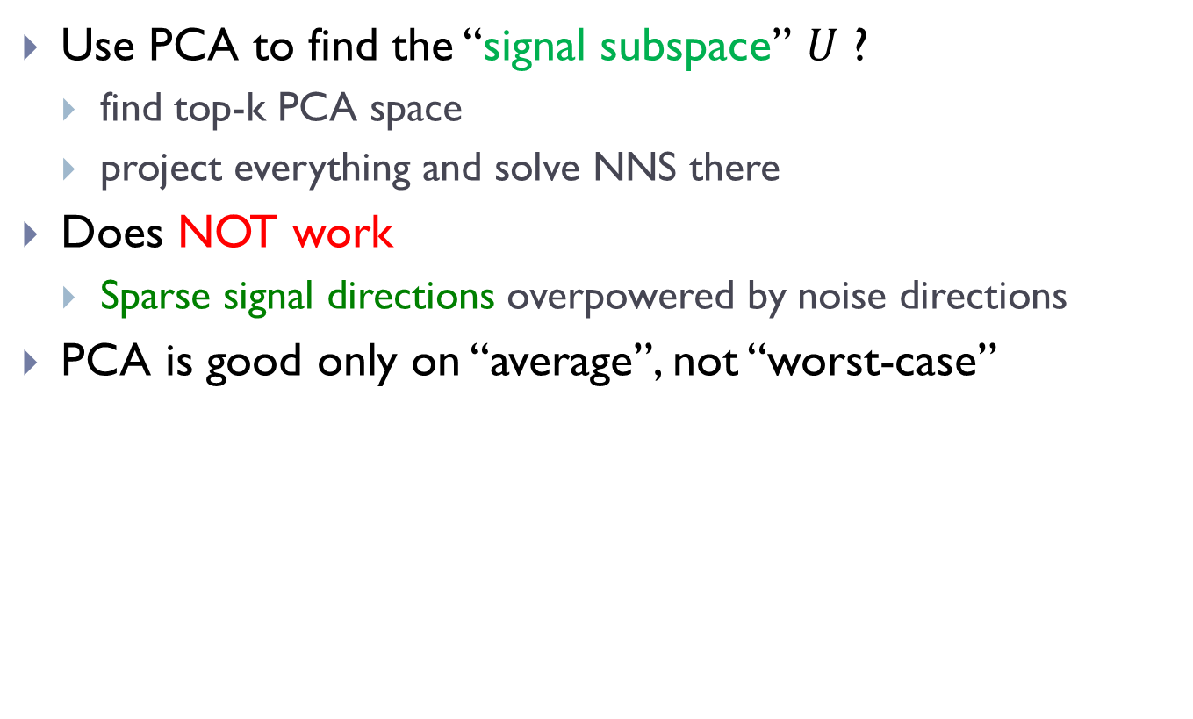
Naïve: just use PCA?
Use PCA to find the “signal subspace” $U$ ?
  find top-k PCA space
  project everything and solve NNS there
Does NOT work
  Sparse signal directions overpowered by noise directions
PCA is good only on “average”, not “worst-case”
$$p^{∗}$$

Slide 22
Our algorithms: intuition
Extract “well-captured points”
  points with signal mostly inside top PCA space
  should work for large fraction of points
Iterate on the rest
Algorithm1: iterative PCA
Algorithm 2: (modified) PCA-tree
Analysis: via [Davis-Kahan’70, Wedin’72]
$$p^{∗}$$

Slide 23
Plan
Space decompositions
Structure in data
  PCA-tree
No structure in data
  Data-dependent hashing
Towards practice
What if data has no structure?
(worst-case)

Slide 24
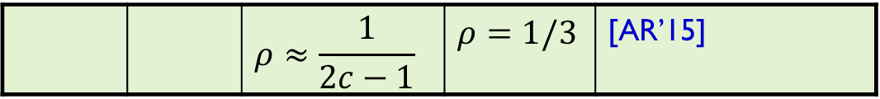

Back to worst-case NNS
Space | Time | Exponent | $$c=2$$ | Reference
Hamming
space
$$n^{1+ρ}$$ | $$n^{ρ}$$ | $$ρ=1/c$$ | $$ρ=1/2$$ | [IM’98]
LSH
 |  | $$ρ≥1/c$$ |  | [MNP’06, OWZ’11]
$$n^{1+ρ}$$ | $$n^{ρ}$$ | complicated | $$ρ=1/2−ε$$ | [AINR’14]
 |  | $$ρ≈\frac{1}{2c−1}$$ | $$ρ=1/3$$ | [AR’15]
Random hashing is not optimal!
Euclidean
space
$$n^{1+ρ}$$ | $$n^{ρ}$$ | $$ρ≈1/c^{2}$$ | $$ρ=1/4$$ | [AI’06]
LSH
 |  | $$ρ≥1/c^{2}$$ |  | [MNP’06, OWZ’11]
$$n^{1+ρ}$$ | $$n^{ρ}$$ | complicated | $$ρ=1/4−ε$$ | [AINR’14]
 |  | $$ρ≈\frac{1}{2c^{2}−1}$$ | $$ρ=1/7$$ | [AR’15]

Slide 25
Beyond Locality Sensitive Hashing
A random hash function, chosen after seeing the given dataset
Efficiently computable
Data-dependent hashing
(even when no structure)
Notes:
Example: Voronoi diagram
but expensive to compute the hash function

Slide 26
Construction of hash function
[A.-Indyk-Nguyen-Razenshteyn’14]
Two components:
  Nice geometric structure
  Reduction to such structure
Like a (weak) “regularity lemma” for a set of points
has better LSH
data-dependent

Slide 27
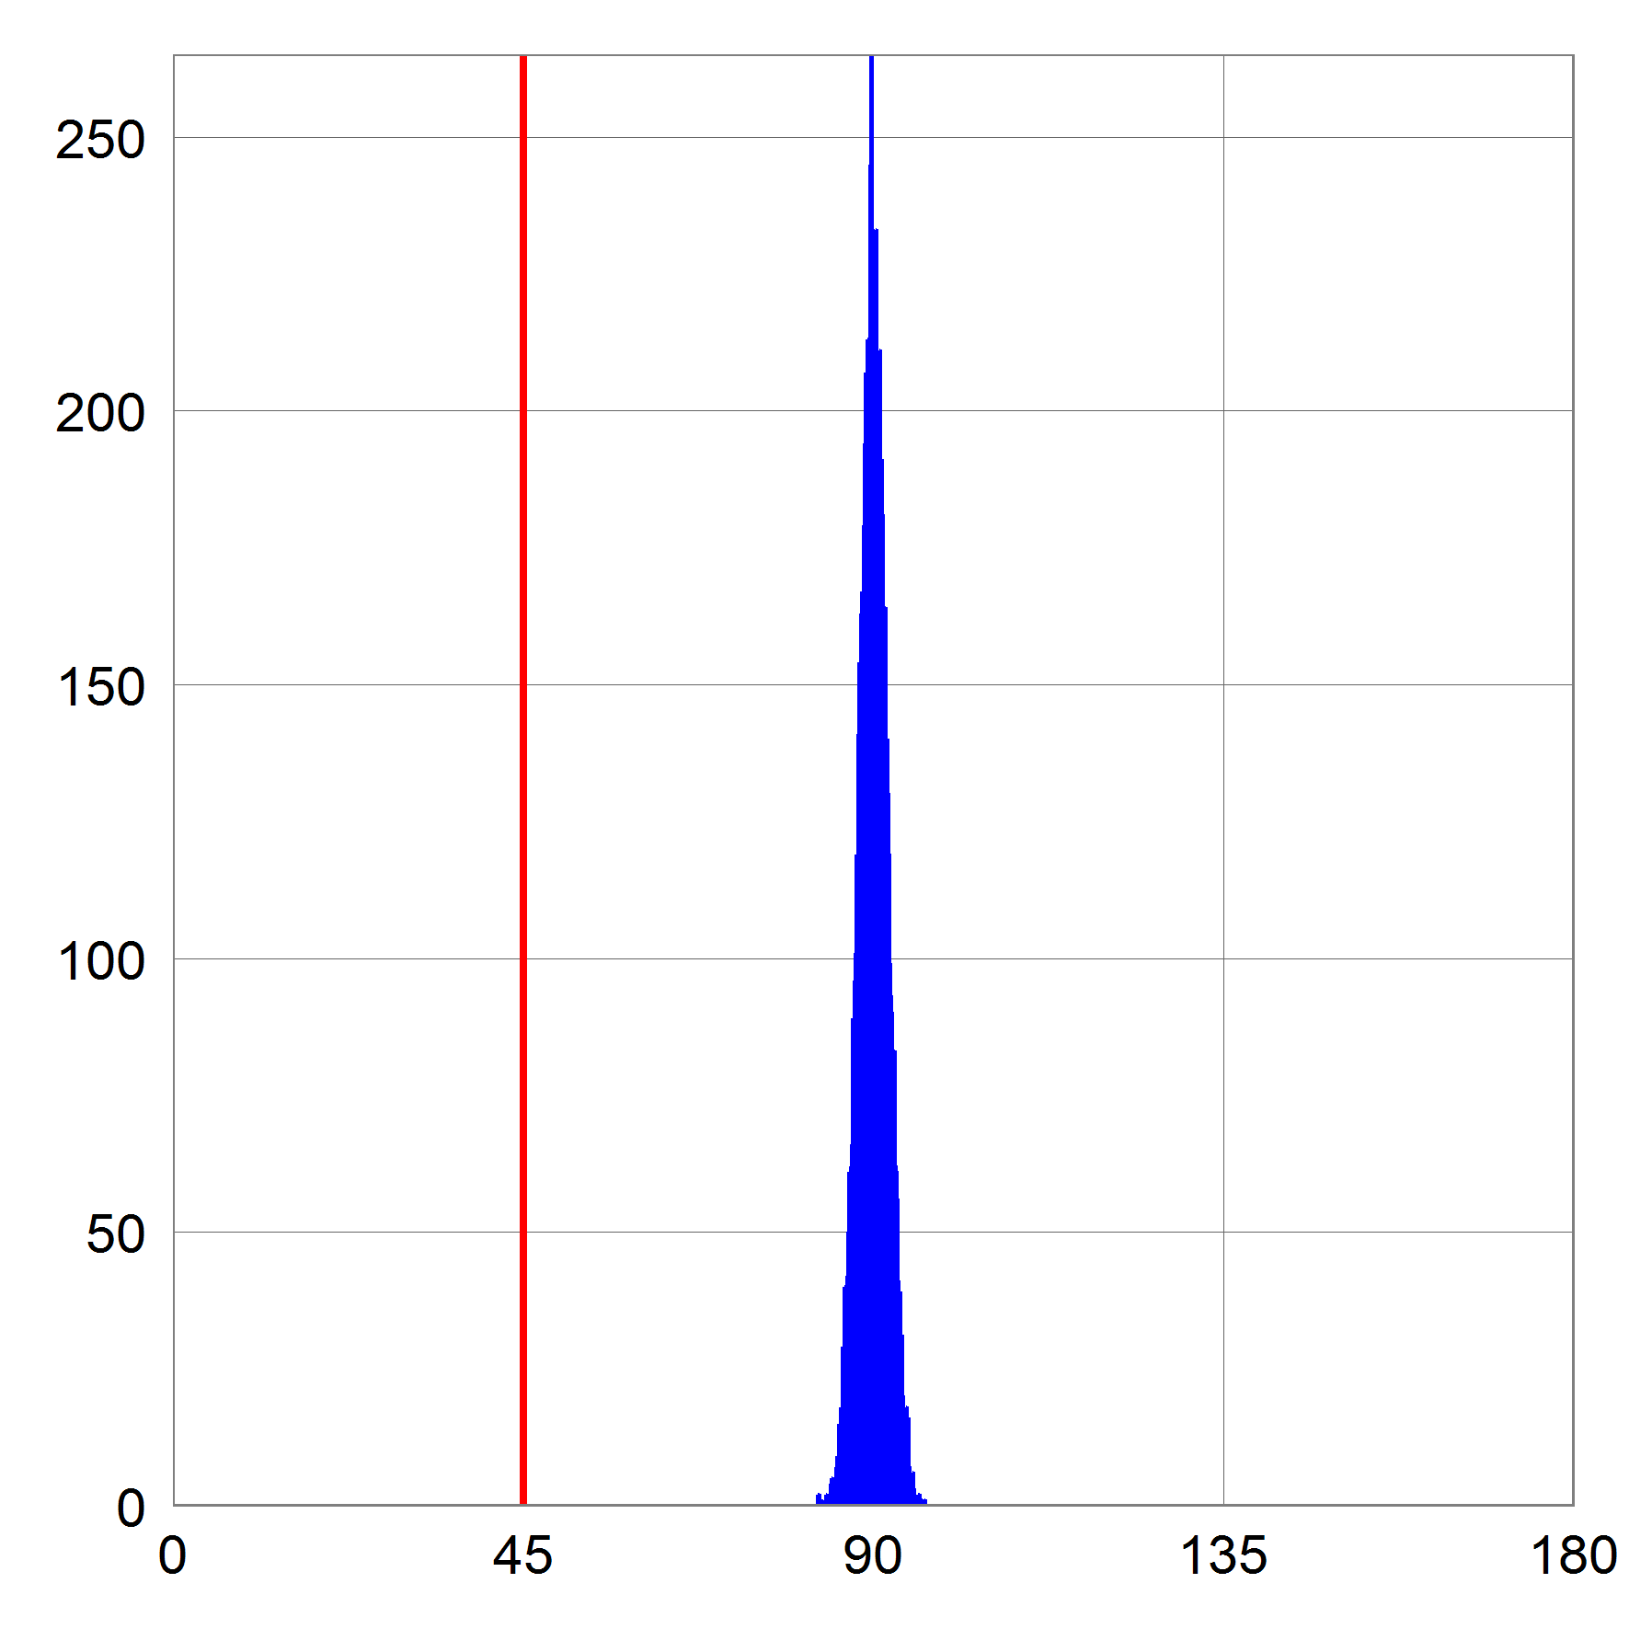



Nice geometric structure
Pseudo-random configuration:
  Far pair is (near) orthogonal (@distance $cr$)
  as when the dataset is random on the sphere
  close pair (distance $r$)
Lemma: $ρ=\frac{1}{2c^{2}−1}$
  via Cap Carving
$$cr$$
$$cr/\sqrt{2}$$

Slide 28



Reduction to nice configuration
[A.-Razenshteyn’15]
Idea:
  iteratively make the pointset more isotopic by narrowing a ball around it
Algorithm:
  find dense clusters
    with smaller radius
    large fraction of points
  recurse on dense clusters
  apply Cap Hashing on the rest
    recurse on each “cap”
    eg, dense clusters might reappear
Why ok?
no dense clusters
remainder near- orthogonal (radius=$100cr$)
even better!
radius = $100cr$
radius = $99cr$
*picture not to scale & dimension

Slide 29
Hash function
Described by a tree (like a hash table)
radius = $100cr$
*picture not to scale&dimension

Slide 30


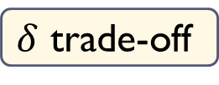
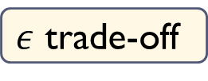
Dense clusters
$$\left(\sqrt{2}−ε\right)R$$
Current dataset: radius $R$
A dense cluster:
  Contains $n^{1−δ}$ points
  Smaller radius: $\left(1−Ω\left(ε^{2}\right)\right)R$
After we remove all clusters:
  For any point on the surface, there are at most $n^{1−δ}$ points within distance $\left(\sqrt{2}−ε\right)R$
  The other points are essentially orthogonal !
When applying Cap Carving with parameters $(P_{1},P_{2})$:
  Empirical number of far pts colliding with query: $nP_{2}+n^{1−δ}$
  As long as $nP_{2}≫n^{1−δ}$, the “impurity” doesn’t matter!
$ε$ trade-off
$δ$ trade-off
?

Slide 31
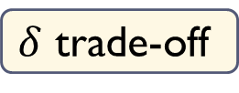
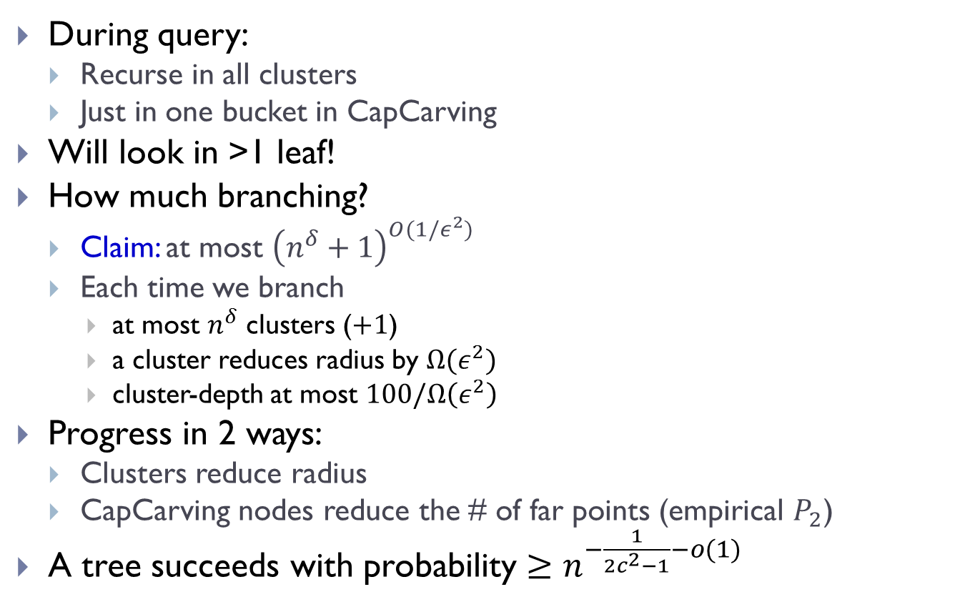
Tree recap
During query:
  Recurse in all clusters
  Just in one bucket in CapCarving
Will look in >1 leaf!
How much branching?
  Claim: at most ${\left(n^{δ}+1\right)}^{O(1/ε^{2})}$
  Each time we branch
    at most $n^{δ}$ clusters ($+1$)
    a cluster reduces radius by $Ω(ε^{2})$
    cluster-depth at most $100/Ω\left(ε^{2}\right)$
Progress in 2 ways:
  Clusters reduce radius
  CapCarving nodes reduce the # of far points (empirical $P_{2}$)
A tree succeeds with probability $≥n^{−\frac{1}{2c^{2}−1}−o(1)}$
$δ$ trade-off

Slide 32
Plan
Space decompositions
Structure in data
  PCA-tree
No structure in data
  Data-dependent hashing
Towards practice

Slide 33
Towards (provable) practicality 1
Two components:
  Nice geometric structure: spherical case
  Reduction to such structure
practical variant
[A-Indyk-Laarhoven-Razenshteyn-Schmidt’15]

Slide 34
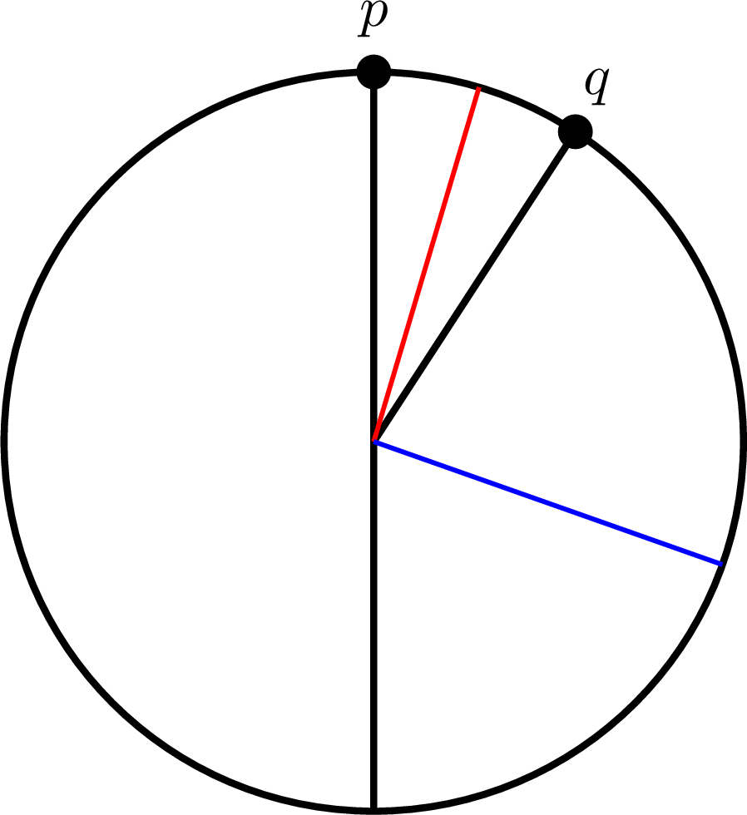
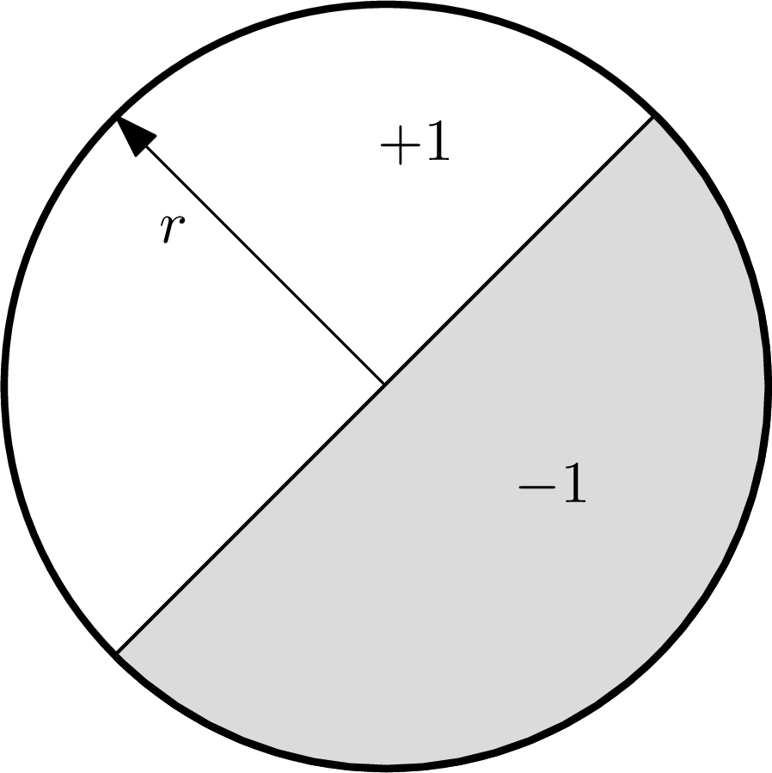
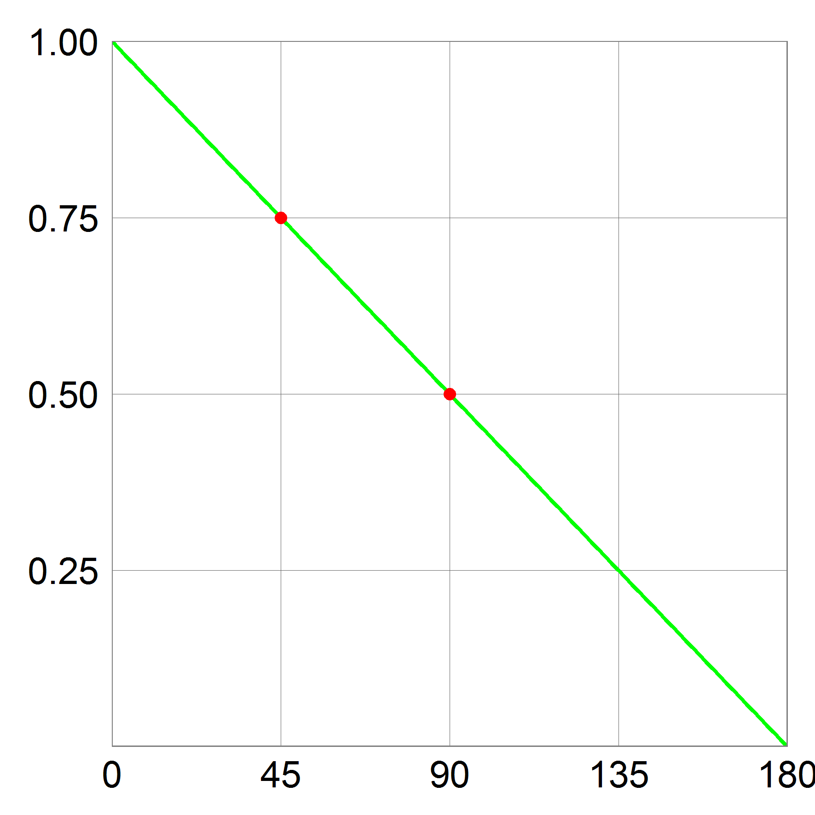

Classic LSH: Hyperplane [Charikar’02]
Charikar’s construction:
  Sample $r$ uniformly
  $h\left(p\right)=sign〈p,r〉$
  $\operatorname{Pr}\left[h\left(p\right)= h\left(q\right)\right]= 1 – \frac{α(p,q)}{π}$
Performance:
  $P_{1}=3/4$
  $P_{2}=1/2$
  Query time: $≈n^{0.42}$

Slide 35
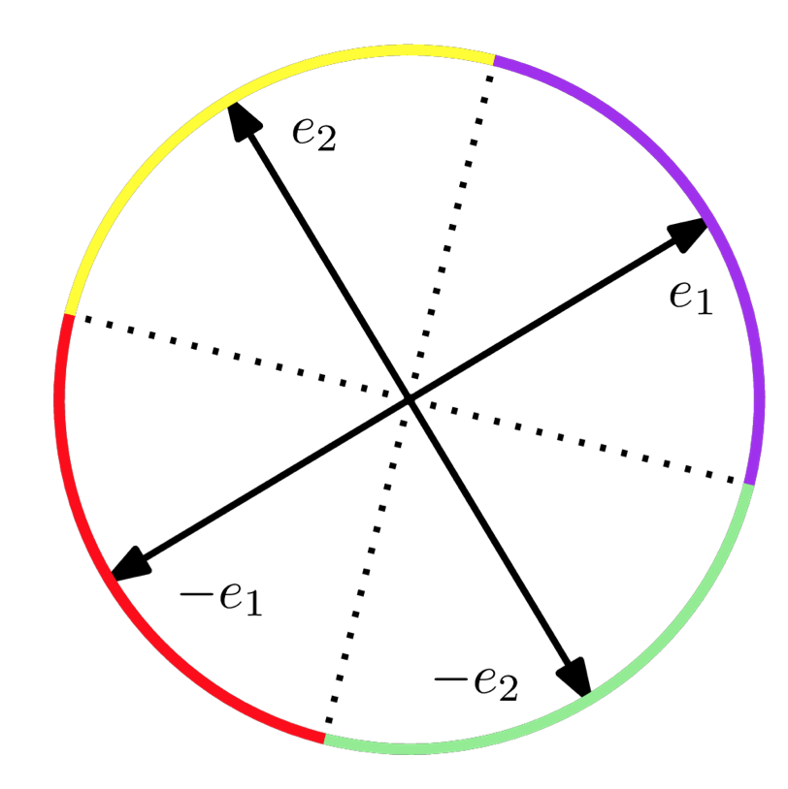
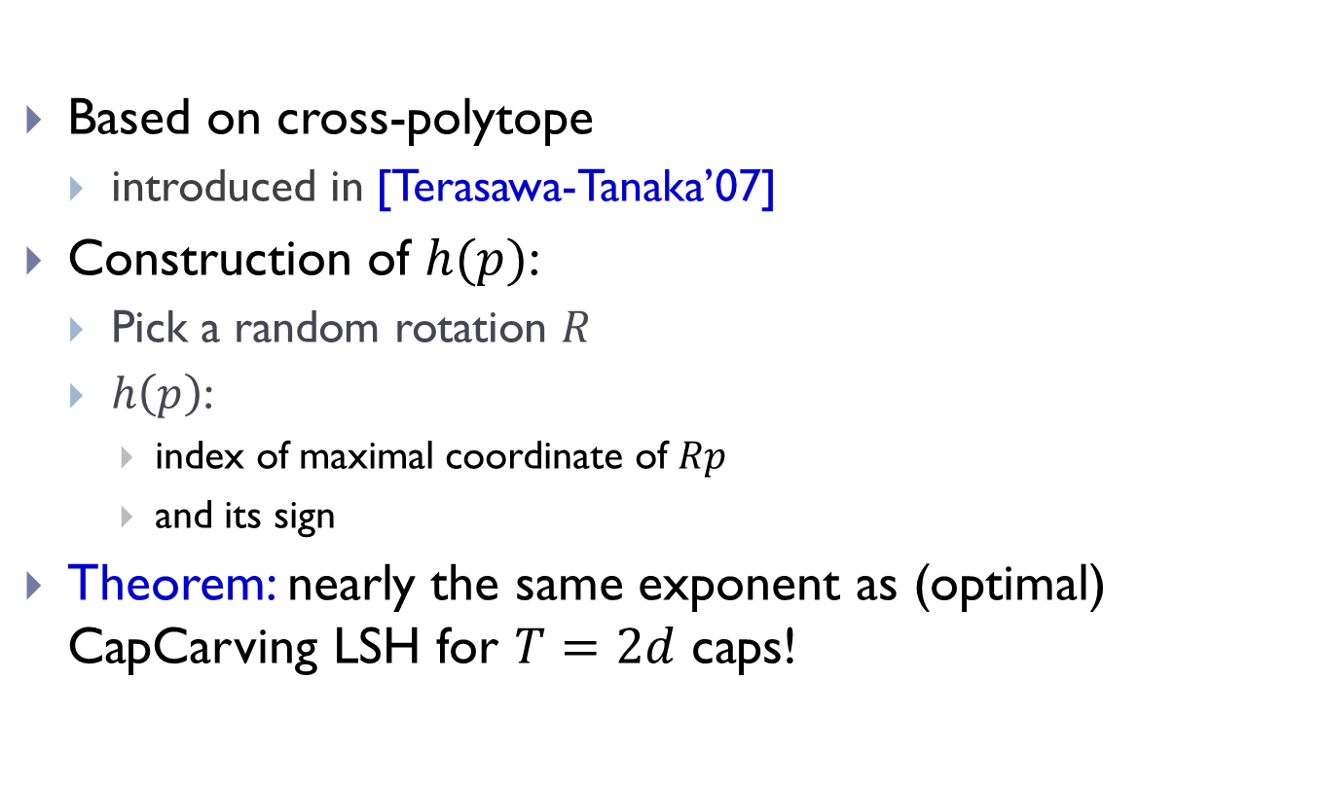
Our algorithm
[A-Indyk-Laarhoven-Razenshteyn-Schmidt’15]
Based on cross-polytope
  introduced in [Terasawa-Tanaka’07]
Construction of $h(p)$:
  Pick a random rotation $R$
  $h\left(p\right)$:
    index of maximal coordinate of $Rp$
    and its sign
Theorem: nearly the same exponent as (optimal) CapCarving LSH for $T=2d$ caps!

Slide 36
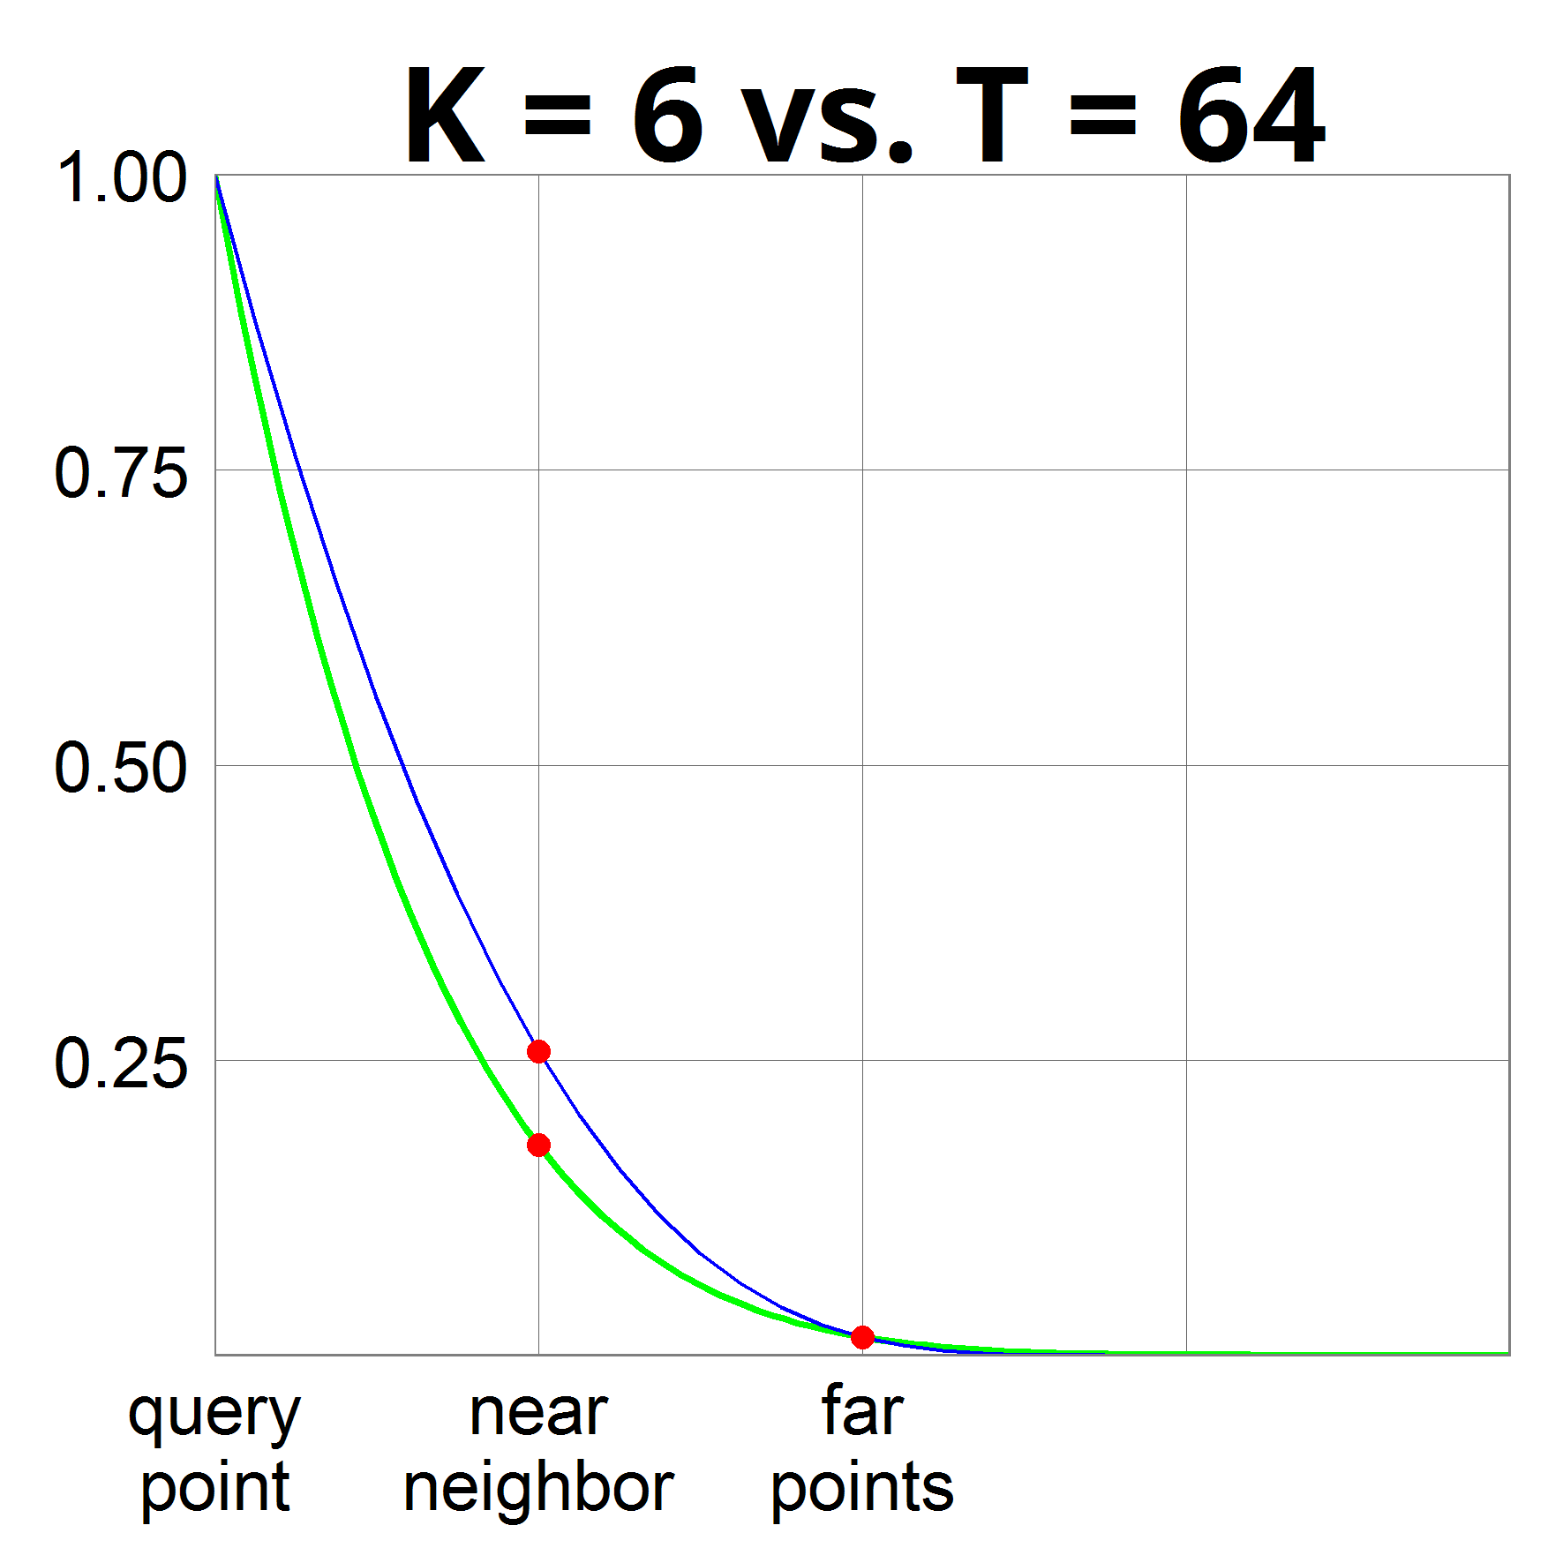

Comparison: Hyperplane vs CrossPoly
Fix probability of collision for far points $=2^{−6}=1/64$
  Equivalently: partition space into $2^{6}=64$ pieces
Hyperplane LSH:
  with $k=6$ hyperplanes
  implies $T=2^{k}=64$ parts
  Exponent $ρ=0.42$
CrossPolytope LSH:
  with $T=2d=64$ parts
  Exponent $ρ=0.18$

Slide 37
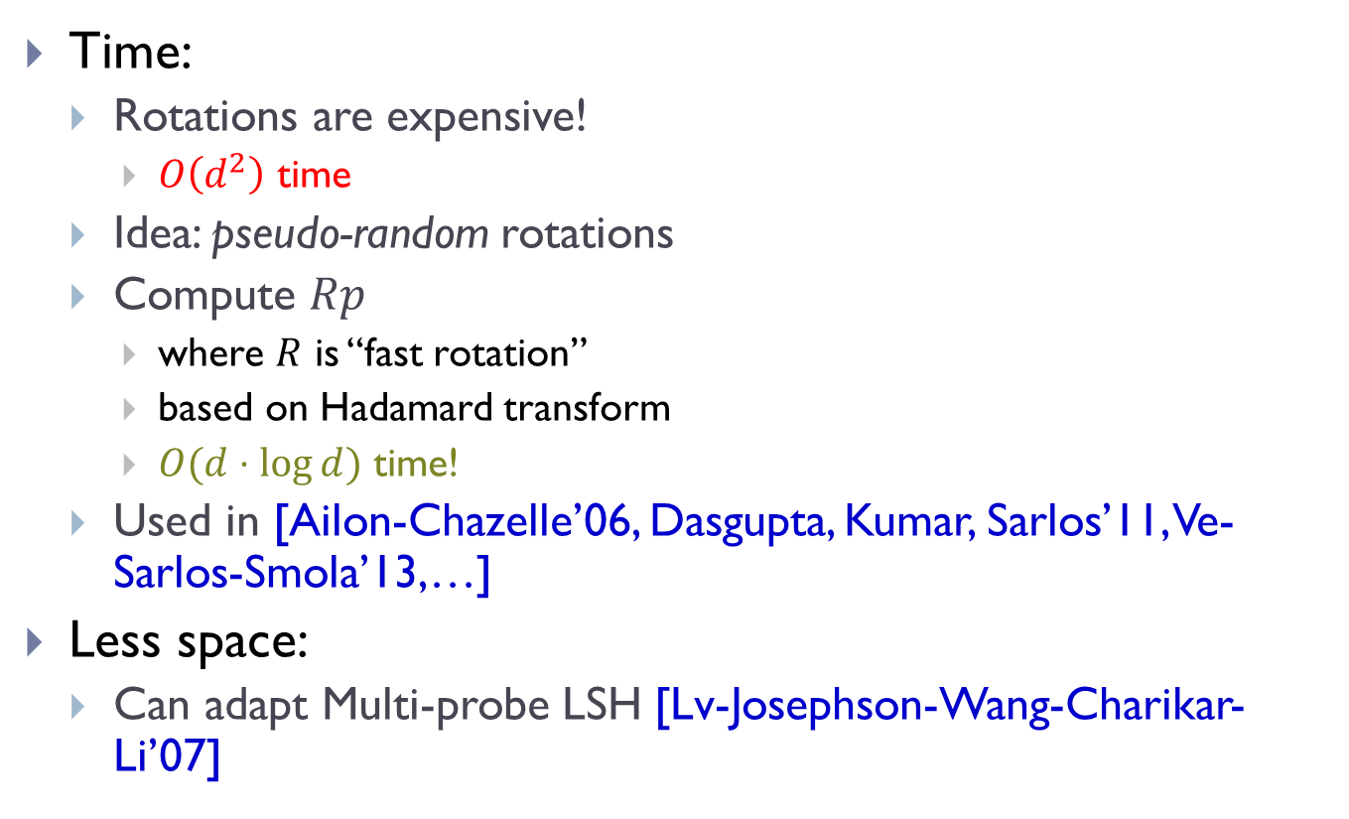
Complexity of our scheme
Time:
  Rotations are expensive!
    $O\left(d^{2}\right)$ time
  Idea: pseudo-random rotations
  Compute $Rp$
    where $R$ is “fast rotation”
    based on Hadamard transform
    $O(d⋅\log{d})$ time!
  Used in [Ailon-Chazelle’06, Dasgupta, Kumar, Sarlos’11, Ve-Sarlos-Smola’13,…]
Less space:
  Can adapt Multi-probe LSH [Lv-Josephson-Wang-Charikar-Li’07]

Slide 38
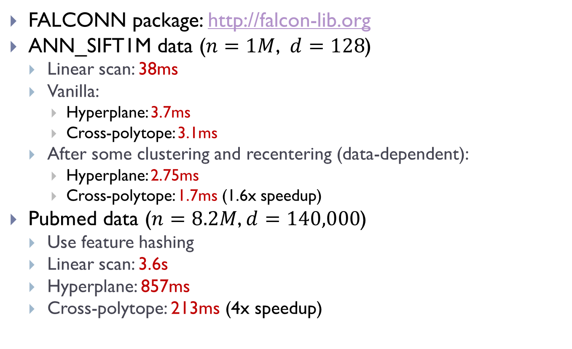
Code & Experiments
FALCONN package: http://falcon-lib.org
ANN_SIFT1M data ($n=1M$, $d=128$)
  Linear scan: 38ms
  Vanilla:
    Hyperplane: 3.7ms
    Cross-polytope: 3.1ms
  After some clustering and recentering (data-dependent):
    Hyperplane: 2.75ms
    Cross-polytope: 1.7ms (1.6x speedup)
Pubmed data ($n=8.2M$, $d=140,000$)
  Use feature hashing
  Linear scan: 3.6s
  Hyperplane: 857ms
  Cross-polytope: 213ms (4x speedup)

Slide 39
Towards (provable) practicality 2
Two components:
  Nice geometric structure: spherical case
  Reduction to such structure
a partial step
[A – Razenshteyn – Shekel-Nosatzki’17]

Slide 40


LSH Forest++
[A.-Razenshteyn-Shekel-Nosatzki’17]
Hamming space
  $n^{ρ}$ random trees, of height $k$
  in each node sample a random coordinate
LSH Forest++:
  LSH Forest [Bawa-Condie-Ganesan’05]
    In a tree, split until $O(1)$bucket size
  ++: store $t$ points closest to the mean of P
    query compared against the $t$ points
Theorem: obtains $ρ≈\frac{0.72}{c}$
  for $t,c$ large enough
  =performance of IM98 on random data
$$n^{1+ρ}$$ | $$n^{ρ}$$ | $$ρ=1/c$$ | [Indyk-Motwani’98]
$$x=00110110$$
coor 3
coor 2
coor 5
coor 7

Slide 41

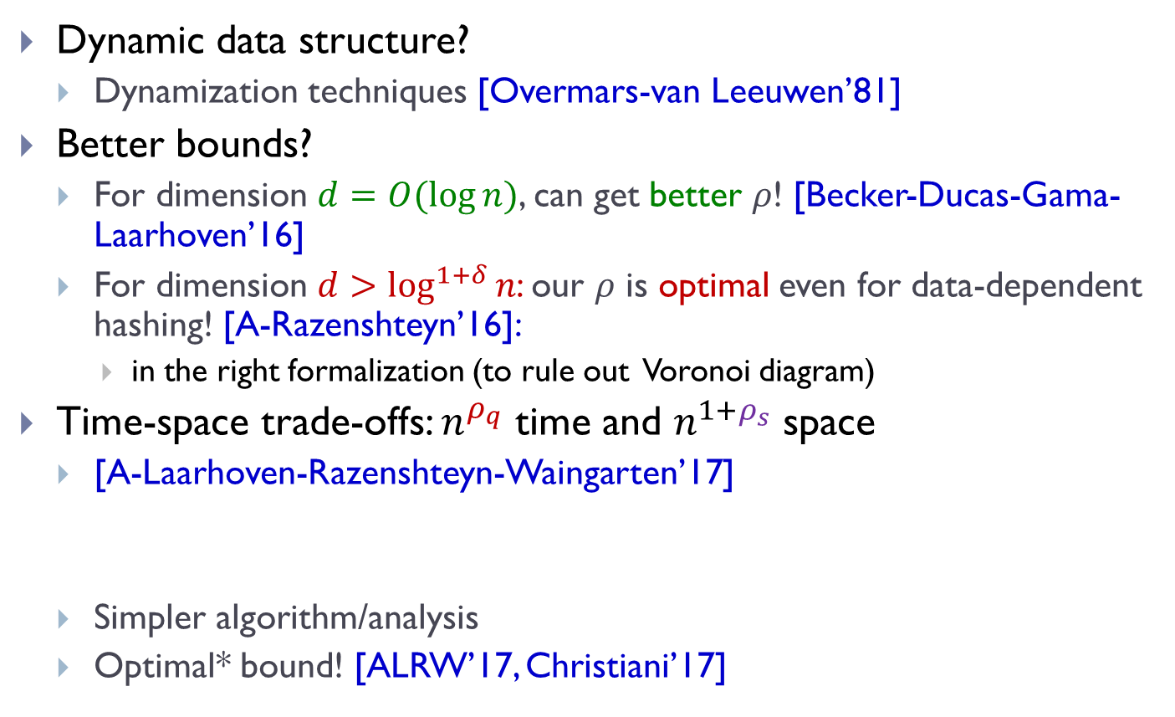
Follow-ups
Dynamic data structure?
  Dynamization techniques [Overmars-van Leeuwen’81]
Better bounds?
  For dimension $d=O(\log{n})$, can get better $ρ$! [Becker-Ducas-Gama-Laarhoven’16]
  For dimension $d>\log^{1+δ}{n}$: our $ρ$ is optimal even for data-dependent hashing! [A-Razenshteyn’16]:
    in the right formalization (to rule out Voronoi diagram)
Time-space trade-offs: $n^{ρ_{q}}$ time and $n^{1+ρ_{s}}$ space
  [A-Laarhoven-Razenshteyn-Waingarten’17]
  Simpler algorithm/analysis
  Optimal* bound! [ALRW’17, Christiani’17]
$$c^{2}\sqrt{ρ_{q}}+\left(c^{2}−1\right)\sqrt{ρ_{s}}≤\sqrt{2c^{2}−1}$$

Slide 42
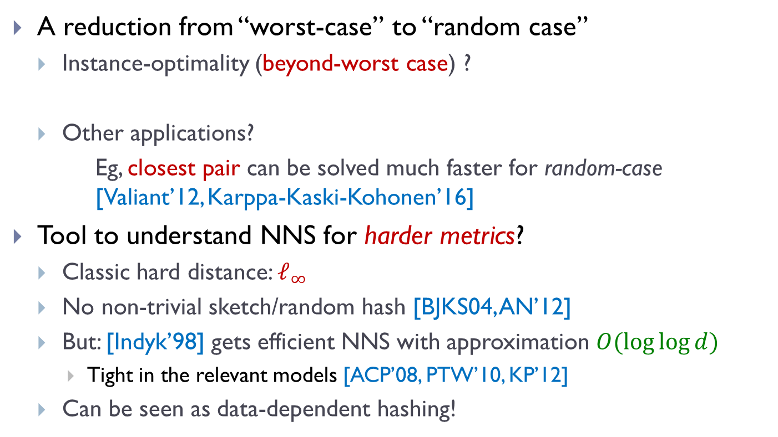
Finale: Data-dependent hashing
A reduction from “worst-case” to “random case”
  Instance-optimality (beyond-worst case) ?
  Other applications?
  Eg, closest pair can be solved much faster for random-case [Valiant’12, Karppa-Kaski-Kohonen’16]
Tool to understand NNS for harder metrics?
  Classic hard distance: $ℓ_{∞}$
  No non-trivial sketch/random hash [BJKS04, AN’12]
  But: [Indyk’98] gets efficient NNS with approximation $O(\log{\log{d}})$
    Tight in the relevant models [ACP’08, PTW’10, KP’12]
  Can be seen as data-dependent hashing!
Algorithms with worst-case guarantees, but great performance if dataset is “nice” ?
NNS for any norm (eg, matrix norms, EMD) or metric (edit d)?

