Slide 1


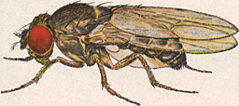
A bit of everything: dim-reduction, sketching, nearest neighbor search, and fruit flies
Alex Andoni

Slide 2
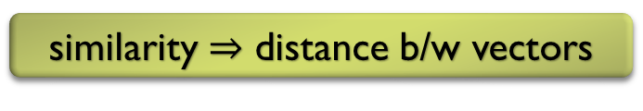



Computational problem: Similarity search
000000
011100
010100
000100
010100
011111
000000
001100
000100
000100
110100
111111
objects $⇒$ high-dimensional vectors
$${\left\{0,1\right\}}^{d}$$
Hamming distance
$$R^{d}$$
Euclidean distance
similarity $⇒$ distance b/w vectors
Similarity Search
Nearest Neighbor Search
Notes:
A typical task on large datasets is the similarity search task: preprocess a dataset of objects (like images above), so given a new object, find the most similar ones from the dataset. This is perhaps one of the simplest ways to do classification.
How do we model the objects and similarity? The standard way is is to transform data objects into feature vectors (like the 0/1’s for an image in the slide: a coordinate/feature per pixel). Then we can compare objects by computing the Hamming distance. But Hamming distance is just one way to represent objects (even images): e.g., one can pass the images via a trained neural net to get Euclidean vectors (comparable with Euclidean distance), or define a more specialized distance metric on the images like the Earth-Mover Distance.
The above task of similar search is then modeled formally by the NNS problem.

Slide 3

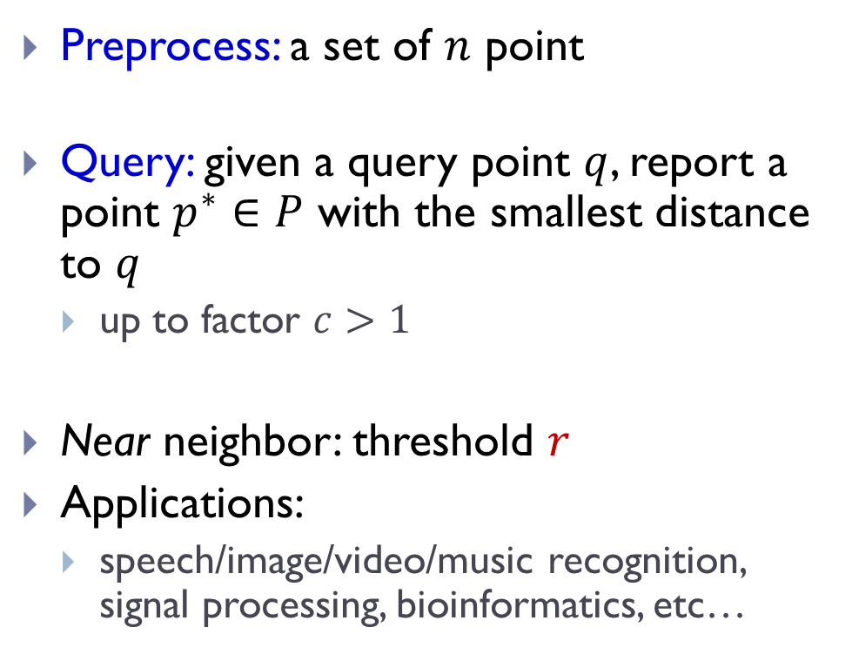




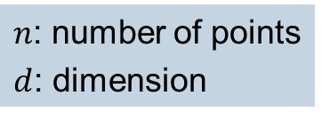
Approximate Near Neighbor Search
Preprocess: a set of $n$ point
Query: given a query point $q$, report a point $p^{∗}∈P$ with the smallest distance to $q$
  up to factor $c>1$
Near neighbor: threshold $r$
Applications:
  speech/image/video/music recognition, signal processing, bioinformatics, etc…
$$r$$
$$p^{∗}$$
$$cr$$
$$q$$
$$p^{′}$$
$n$: number of points
$d$: dimension

Slide 4





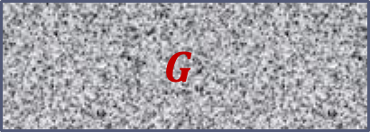
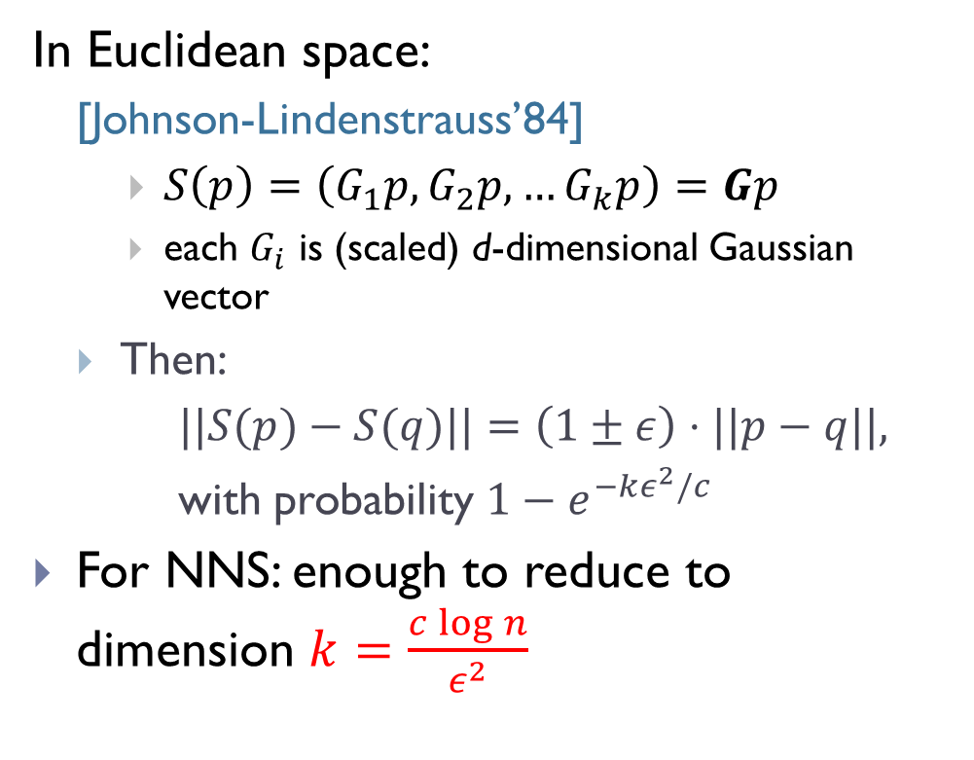

Idea 1: random dimension reduction
000000
011100
010100
000100
010100
011111
000000
011100
010100
000100
010100
011111
In Euclidean space:
  [Johnson-Lindenstrauss’84]
    $S\left(p\right)=\left(G_{1}p, G_{2}p,…G_{k}p\right)=Gp$
    each $G_{i}$ is (scaled) d-dimensional Gaussian vector
  Then:
  $||S(p)−S(q)||=\left(1±ε\right)⋅||p−q||,$
  with probability $1−e^{−kε^{2}/c}$
For NNS: enough to reduce to dimension $k=\frac{c\log{n}}{ε^{2}}$
$$≈$$
000000
001100
000100
000100
110100
111111
000000
001100
000100
000100
110100
111111
$$≈$$
$$d$$
$$G$$
$$p$$
$$k$$

Slide 5
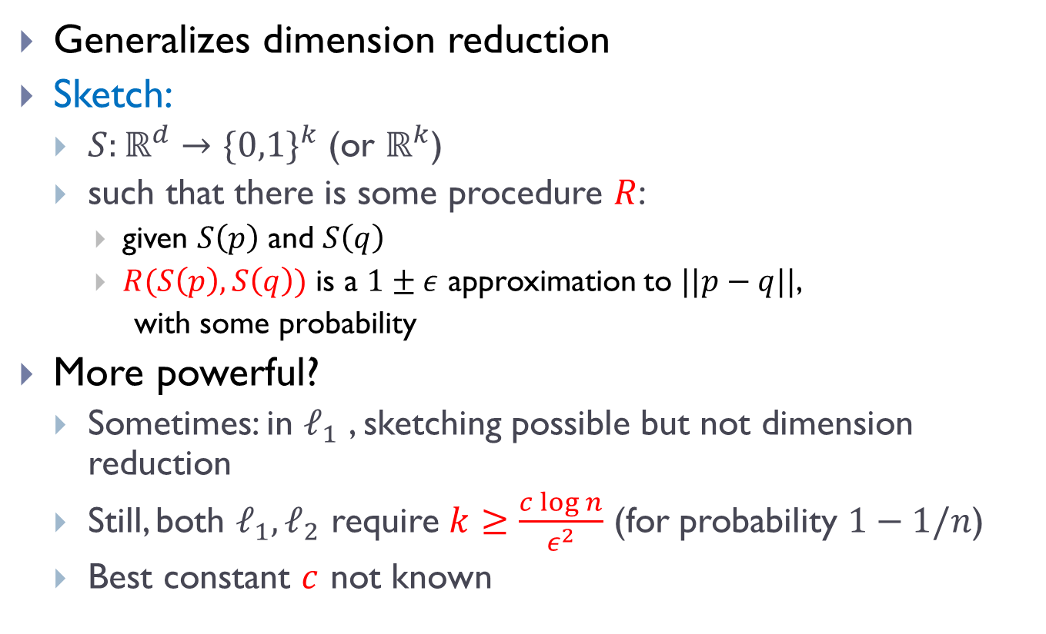
Idea 2: Sketching
Generalizes dimension reduction
Sketch:
  $S:ℝ^{d}→{\{0,1\}}^{k}$ (or $ℝ^{k}$)
  such that there is some procedure $R$:
    given $S\left(p\right)$ and $S\left(q\right)$
    $R(S\left(p\right),S\left(q\right))$ is a $1±ε$ approximation to $||p−q||$,
    with some probability
More powerful?
  Sometimes: in $ℓ_{1}$ , sketching possible but not dimension reduction
  Still, both $ℓ_{1},ℓ_{2}$ require $k≥\frac{c\log{n}}{ε^{2}}$ (for probability $1−1/n$)
  Best constant $c$ not known

Slide 6

Fruit Fly Olfactory System
all but top 5%
strongest
are inhibited
[Dasgupta-Stevens-Navlakha’18]
random, sparse
connections (6/50)
$$p$$
normalization
0
0
0
0
Random dimension reduction?
Seems like dimension “increasing”
0
0
0
0.7
DSN: akin to Locality-Sensitive Hashing?
0
0
0
0
0
Winner-Take-All (WTA):
why useful?
0
0
0
0
odorant
receptors
~50 types
projection
neurons
~50
0
0
0
Kenyon cells
~2000

Slide 7
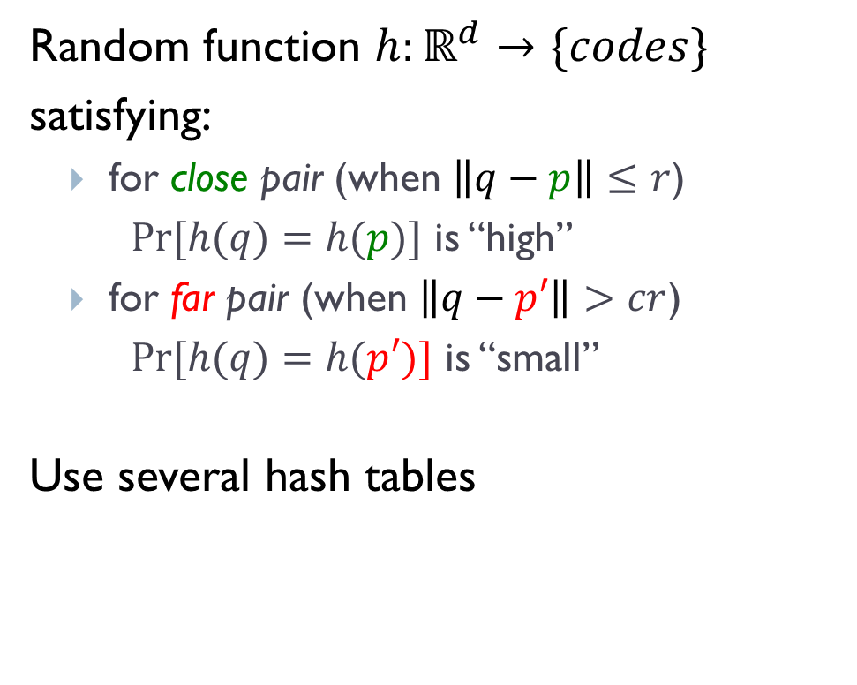
Idea 3: Locality-Sensitive Hashing
[Indyk-Motwani’98]
$$q$$
Random function $h:ℝ^{d}→\{codes\}$
satisfying:
  for close pair (when $\left\|q−p\right\|≤r$)
  $Pr⁡[h(q)=h(p)]$ is “high”
  for far pair (when $\left\|q−p′\right\|>cr$)
  $Pr⁡[h(q)=h(p′)]$ is “small”
Use several hash tables
$$p′$$
$$p$$
$$q$$
$$P1=$$
“not-so-small”
$$P2=$$
$$Pr⁡[h(q)=h(p)]$$
$$ρ=\frac{\log{1/P_{1}}}{\log{1/P_{2}}}$$
1
$nρ$, where
$$P1$$
$$P2$$
$$\left\|q−p\right\|$$
$$r$$
$$cr$$

Slide 8
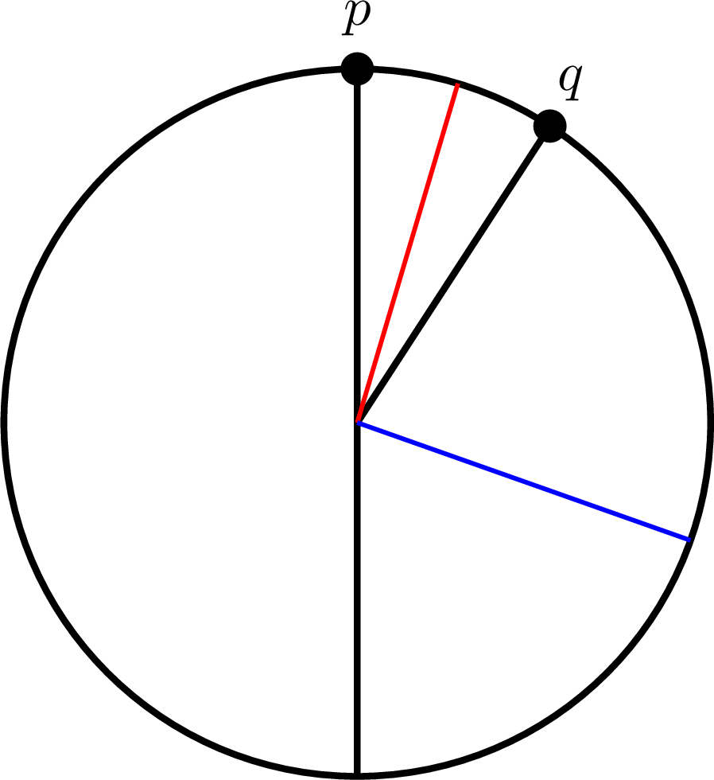
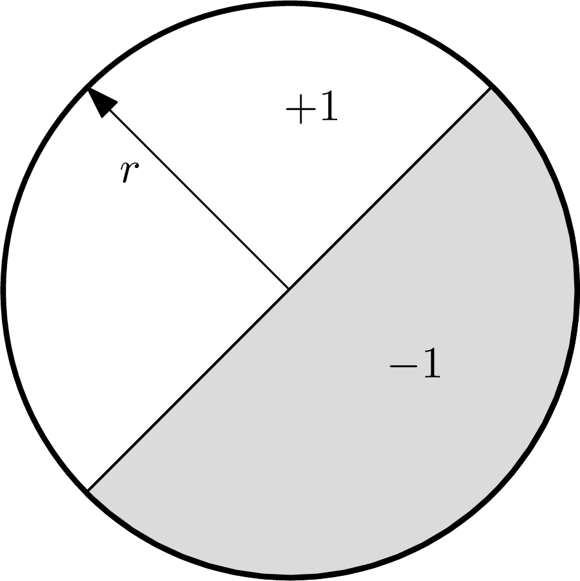
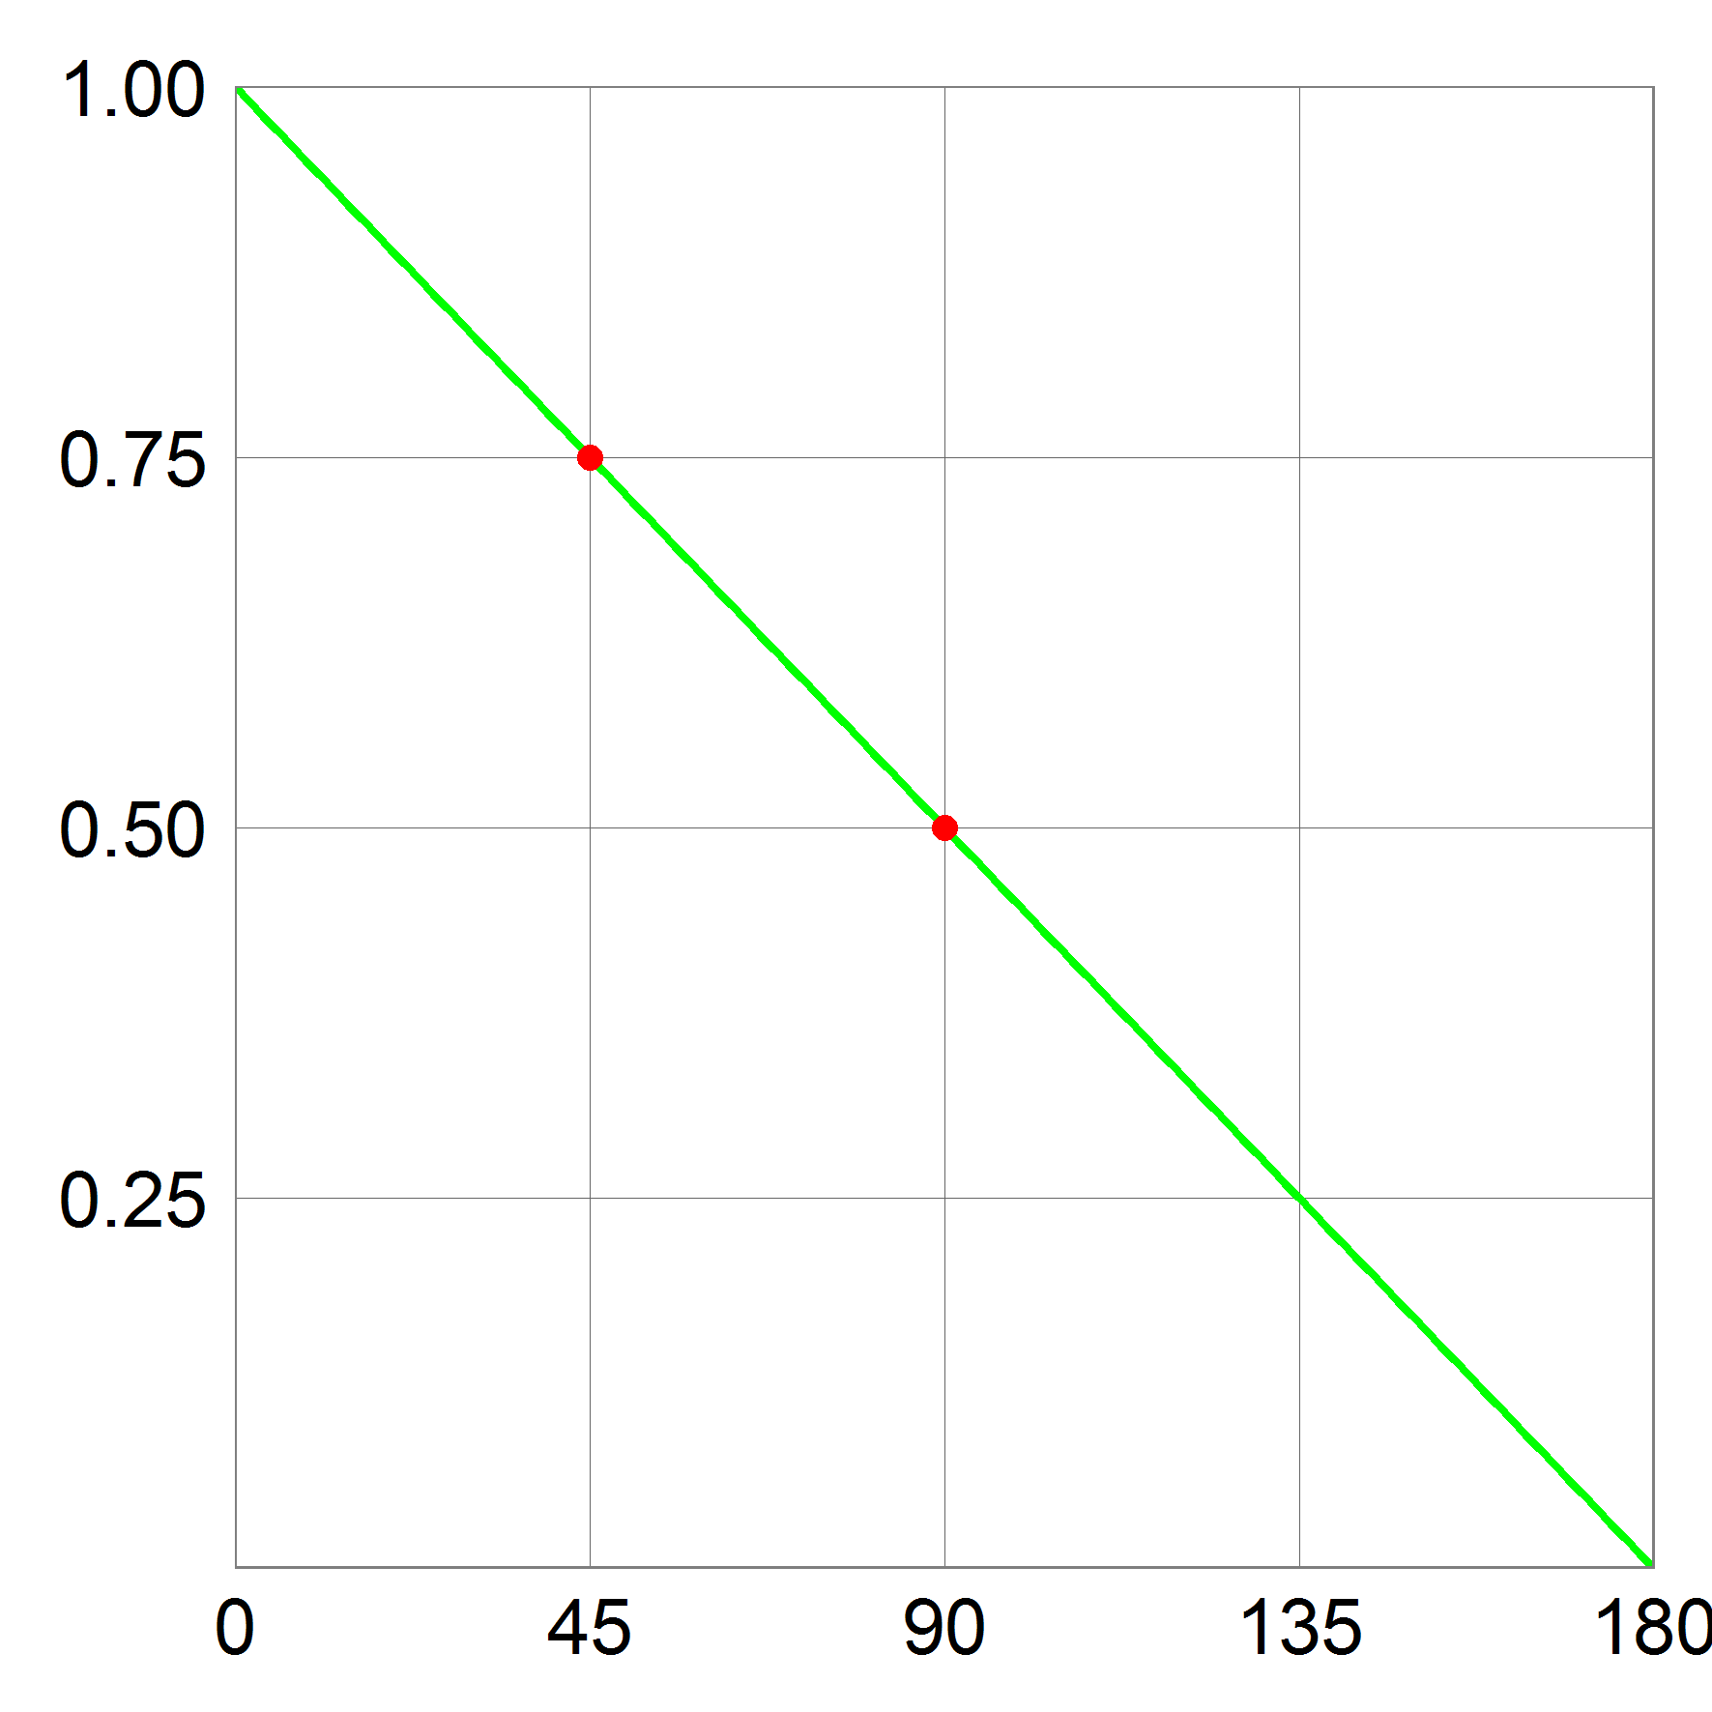
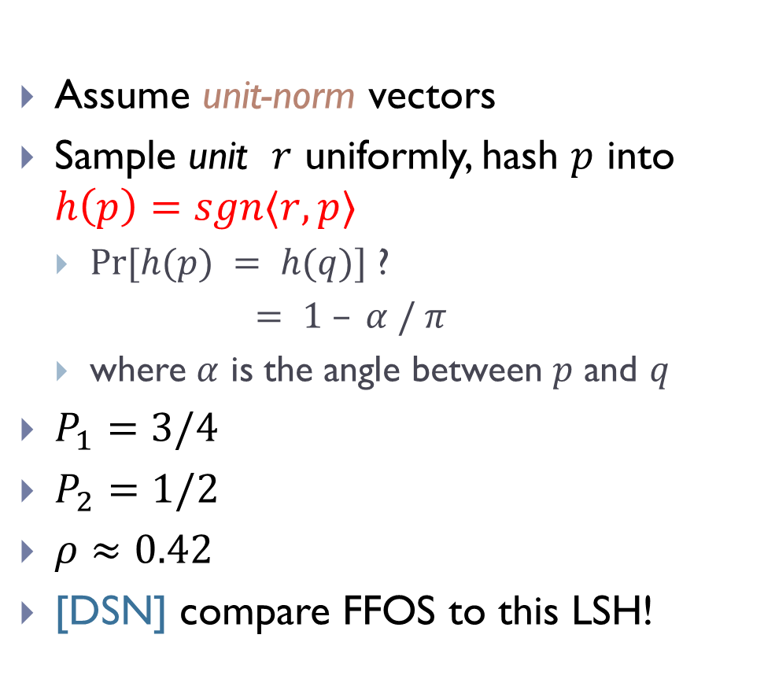
Example LSH: Hyperplane
Assume unit-norm vectors
Sample unit $r$ uniformly, hash $p$ into $h\left(p\right)=sgn〈r, p〉$
  $Pr[h(p) = h(q)]$ ?
  $= 1 – α / π$
  where $α$ is the angle between $p$ and $q$
$P_{1}=3/4$
$P_{2}=1/2$
$ρ≈0.42$
[DSN] compare FFOS to this LSH!
[Charikar’02]

Slide 9
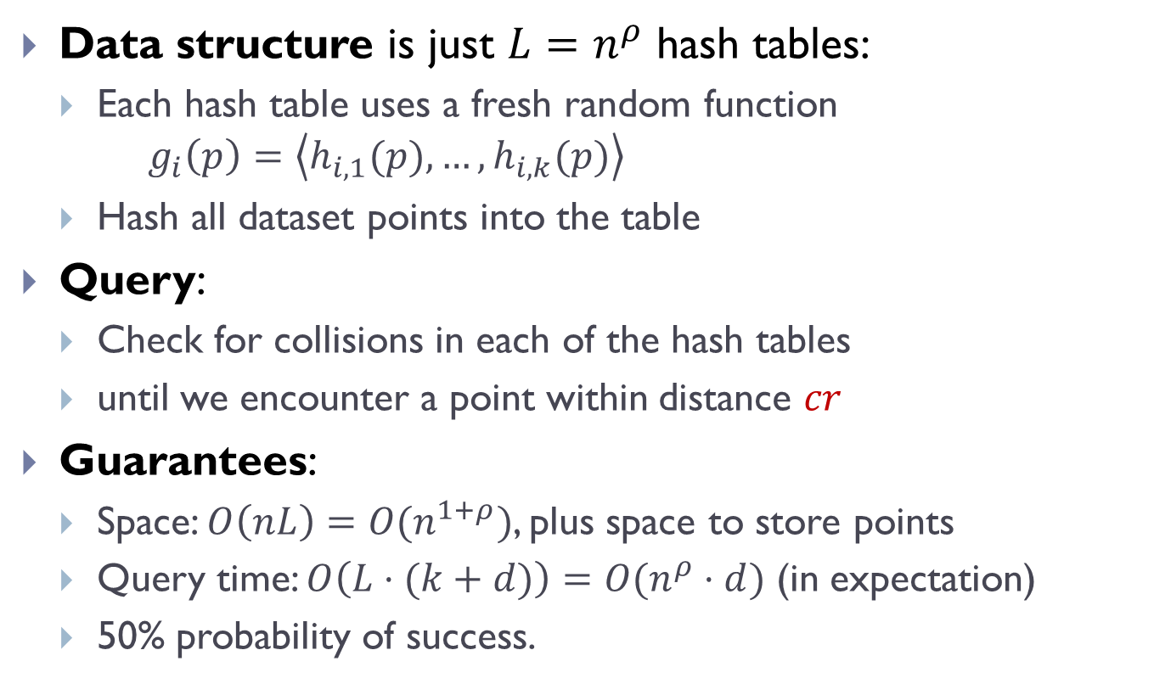
Full algorithm
Data structure is just $L=n^{ρ}$ hash tables:
  Each hash table uses a fresh random function $g_{i}\left(p\right)=\left\langle h_{i,1}(p),…,h_{i,k}(p)\right\rangle$
  Hash all dataset points into the table
Query:
  Check for collisions in each of the hash tables
  until we encounter a point within distance $cr$
Guarantees:
  Space: $O\left(nL\right)=O(n^{1+ρ})$, plus space to store points
  Query time: $O\left(L⋅(k+d)\right)=O(n^{ρ}⋅d)$ (in expectation)
  50% probability of success.
Notes:
Draw L hash tables

Slide 10






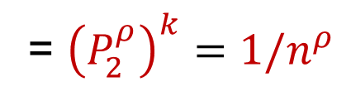

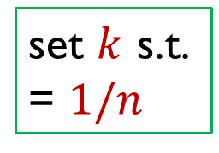


Analysis of LSH Scheme
Choice of parameters $k,L$ ?
  $L$ hash tables with $g\left(p\right)=\left\langle h_{1}(p),…,h_{k}(p)\right\rangle$
Pr[collision of far pair] = $P_{2}^{k}$
Pr[collision of close pair] = $P_{1}^{k}$
Hence $L=O(n^{ρ})$ “repetitions” (tables) suffice!
set $k$ s.t.
= $1/n$
= ${\left(P_{2}^{ρ}\right)}^{k}={1/n}^{ρ}$
$$P_{1}$$
$$P_{1}^{2}$$
$$P_{2}$$
$$k=1$$
$$P_{2}^{2}$$
$$k=2$$
$$r$$
$$cr$$

Slide 11
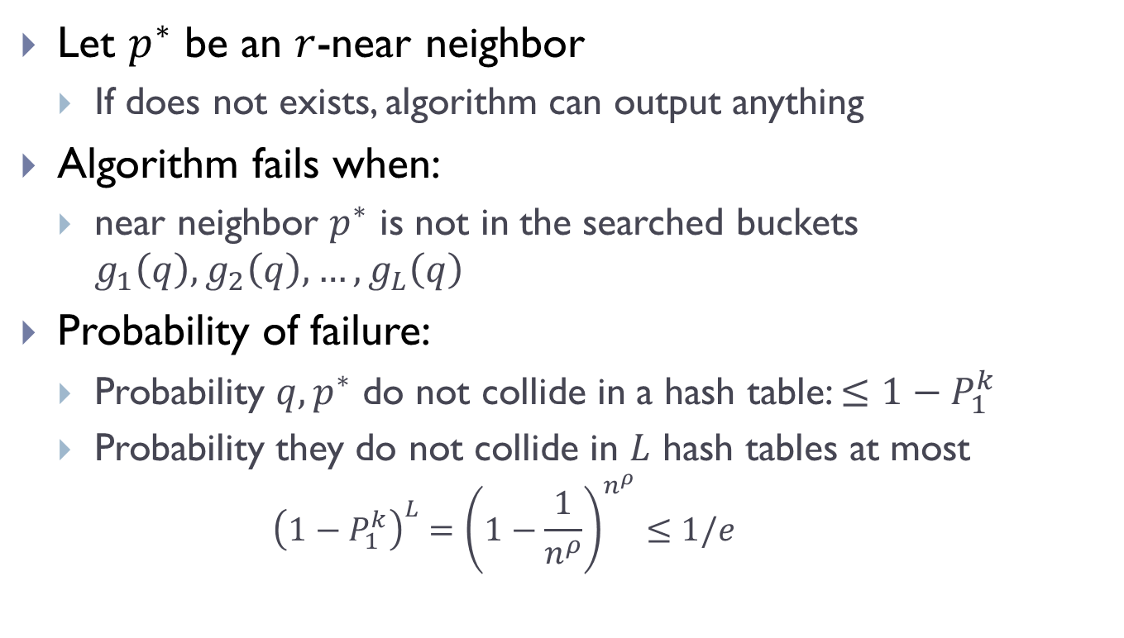
Analysis: Correctness
Let $p^{∗}$ be an $r$-near neighbor
  If does not exists, algorithm can output anything
Algorithm fails when:
  near neighbor $p^{∗}$ is not in the searched buckets $g_{1}\left(q\right), g_{2}\left(q\right), …,g_{L}\left(q\right)$
Probability of failure:
  Probability $q,p^{∗}$ do not collide in a hash table: $≤1−P_{1}^{k}$
  Probability they do not collide in $L$ hash tables at most
    $${\left(1−P_{1}^{k}\right)}^{L}={\left(1−\frac{1}{n^{ρ}}\right)}^{n^{ρ}}≤1/e$$

Slide 12
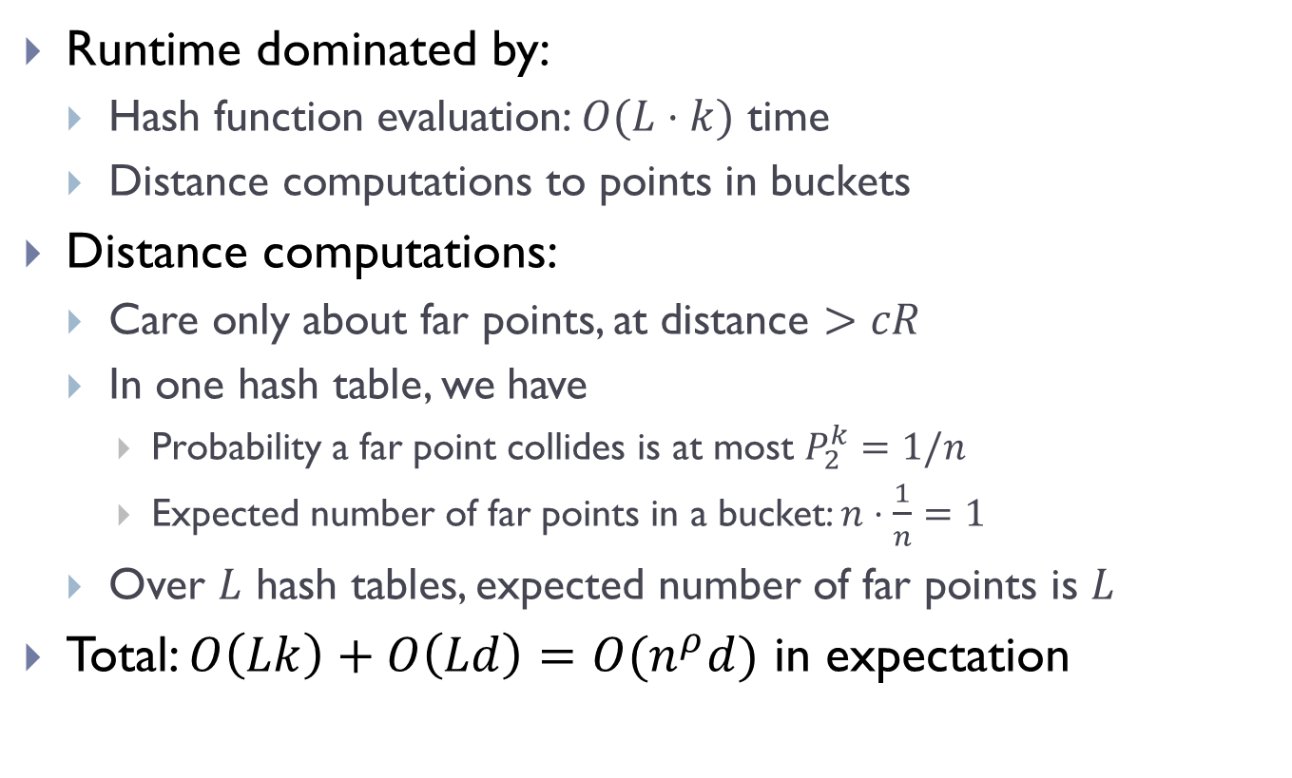
Analysis: Runtime
Runtime dominated by:
  Hash function evaluation: $O(L⋅k)$ time
  Distance computations to points in buckets
Distance computations:
  Care only about far points, at distance $>cR$
  In one hash table, we have
    Probability a far point collides is at most $P_{2}^{k}=1/n$
    Expected number of far points in a bucket: $n⋅\frac{1}{n}=1$
  Over $L$ hash tables, expected number of far points is $L$
Total: $O\left(Lk\right)+O\left(Ld\right)=O(n^{ρ}d)$ in expectation

Slide 13
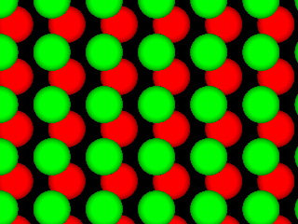
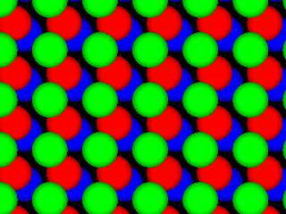
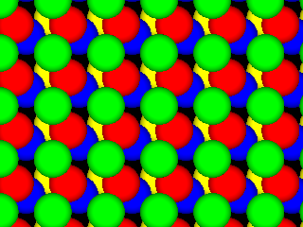
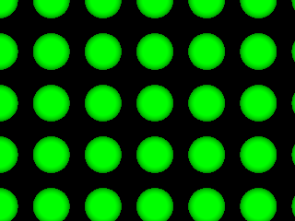
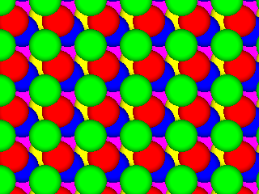






LSH functions: Euclidean space
[Indyk-Motwani’98, Datar-Indyk-Immorlica-Mirrokni’04, A.-Indyk’06]
Space | Time | Exponent | $$c=2$$
$$n^{1+ρ}$$ | $$n^{ρ}$$ | $$ρ=1/c$$ | $$ρ=1/2$$
 |  | $$ρ≈1/c^{2}$$ | $$ρ=1/4$$
$$q$$
$$p$$
 |  | $$ρ≥1/c^{2}$$
Even better LSH maps?
NO: example of isoperimetry
[Motwani-Naor-Panigrahy’06, O’Donell-Wu-Zhou’11]

Slide 14
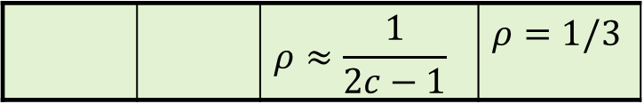
Better NNS possible!
[A.-Indyk-Nguyen-Razenshteyn’14, A.-Razenshteyn’15,
A-Indyk-Laarhoven-Razenshteyn-Schmidt’15]
Two components:
Space | Time | Exponent | $$c=2$$
If hashing is
data-dependent !
$$n^{1+ρ}$$ | $$n^{ρ}$$ | $$ρ=1/c$$ | $$ρ=1/2$$
 |  | $$ρ≈1/c^{2}$$ | $$ρ=1/4$$
 |  | $$ρ≥1/c^{2}$$
 |  | $$ρ≈\frac{1}{2c−1}$$ | $$ρ=1/3$$
1) if data is “pseudorandom” => better partitions!
2) can always reduce any worst-case dataset to the “pseudorandom” case

Slide 15
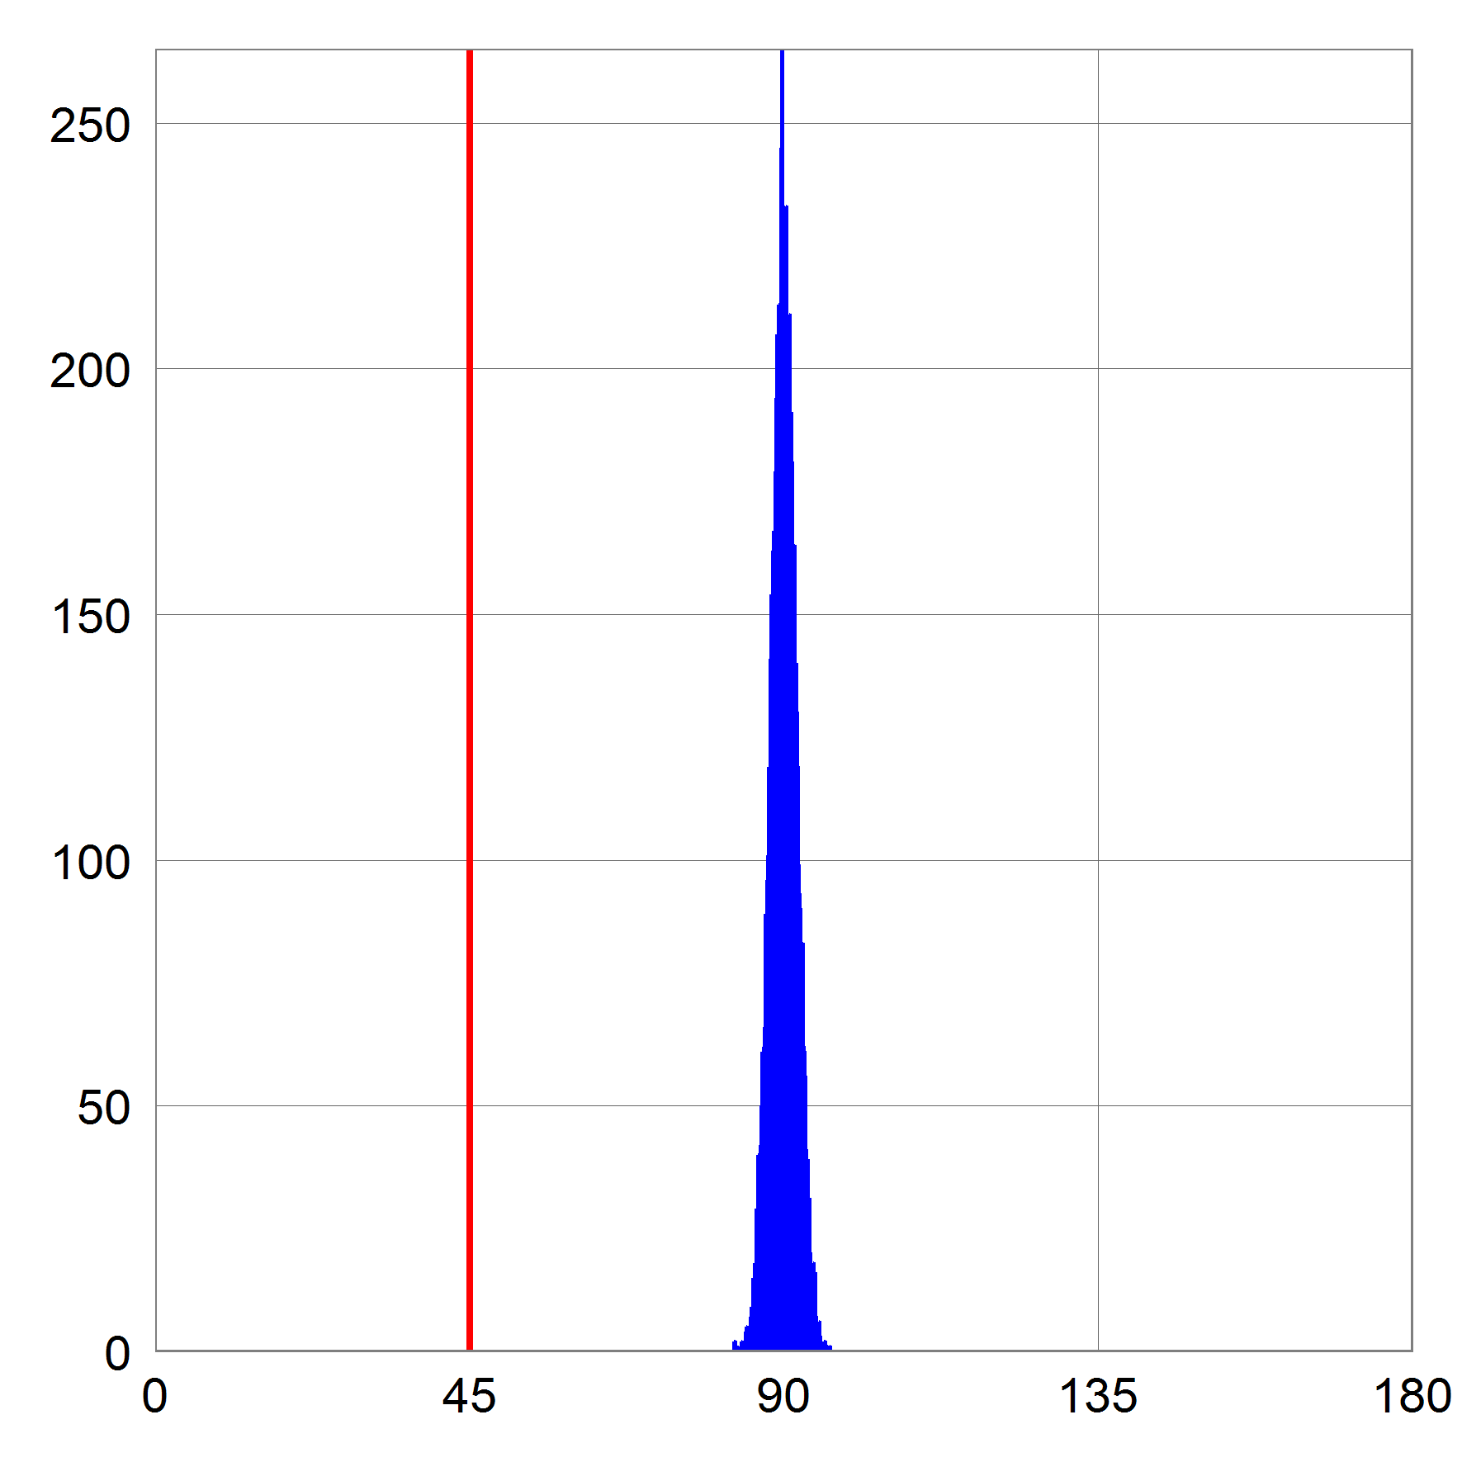


“Pseudo-random” case (isotropic)
Isotropic case:
  Far pair is (near) orthogonal (@distance $cr$)
  equivalent to when dataset is random on the sphere
  close pair (distance $r$)
Lemma: exists LSH with $ρ=\frac{1}{2c^{2}−1}$
  best possible! [A-Razenshteyn’16]
$$cr$$

Slide 16
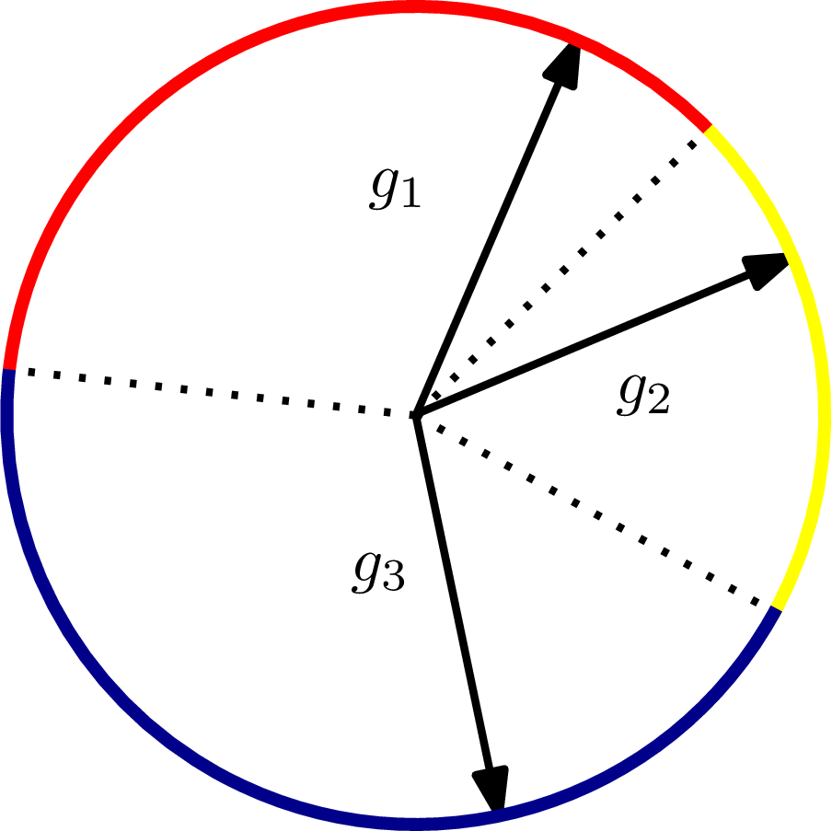
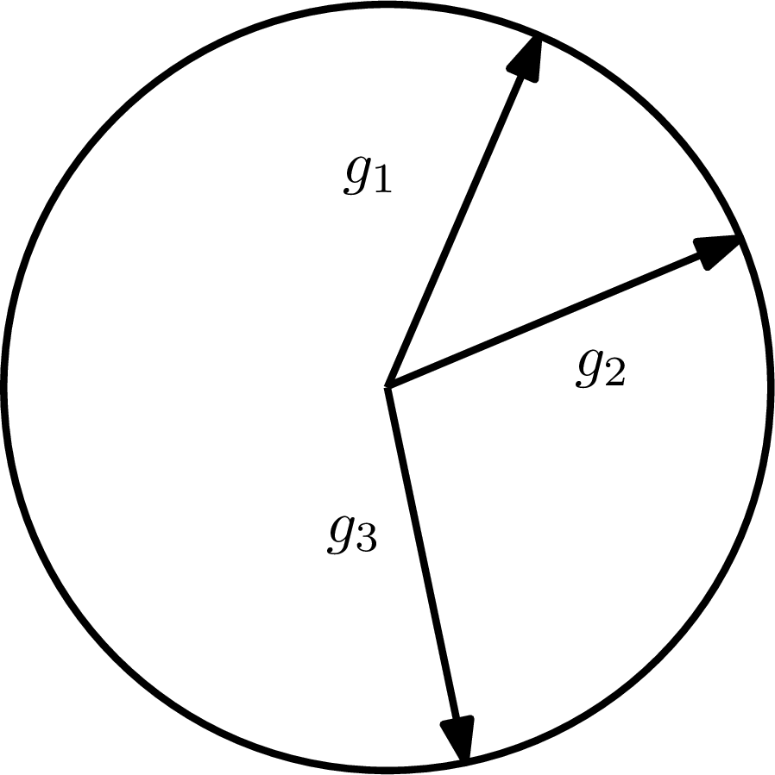
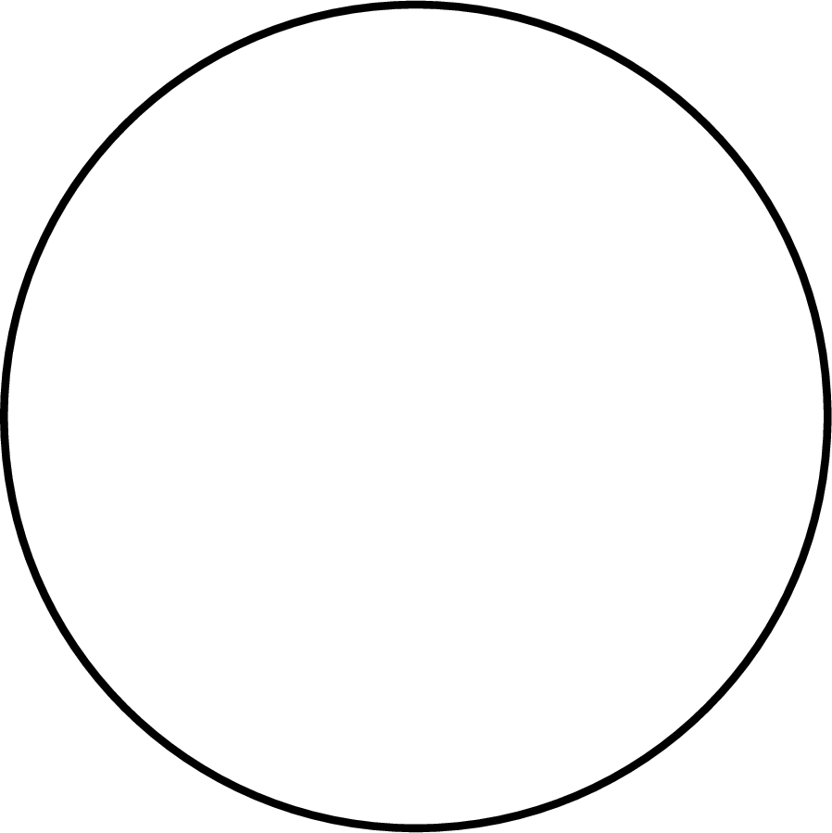
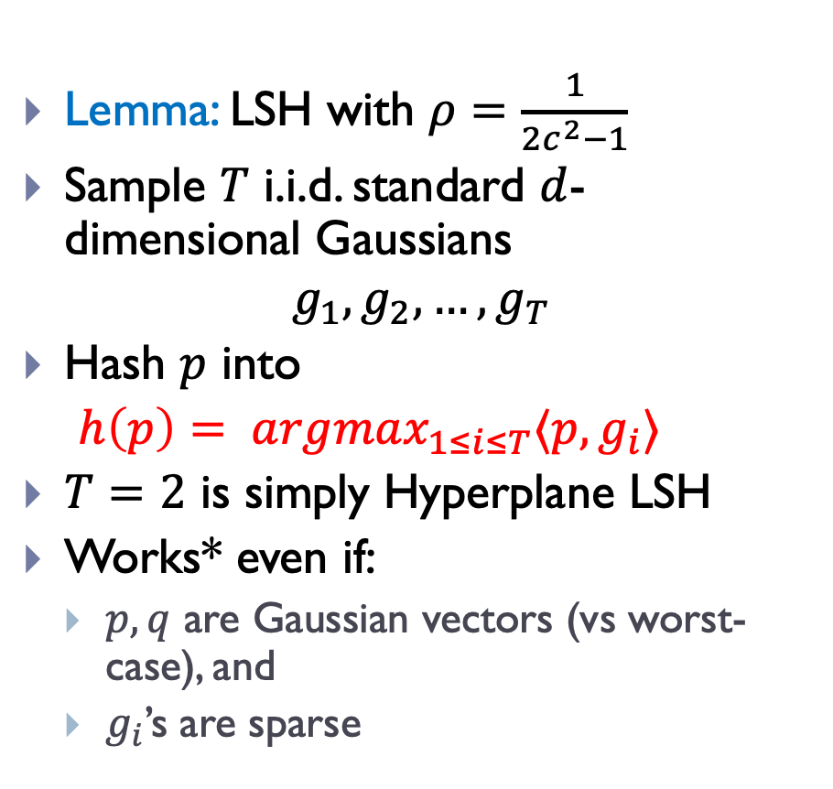
Better LSH for isotropic case
Lemma: LSH with $ρ=\frac{1}{2c^{2}−1}$
Sample $T$ i.i.d. standard $d$-dimensional Gaussians
$$g_{1}, g_{2}, …, g_{T}$$
Hash $p$ into
$h\left(p\right)= argmax_{1≤i≤T}〈p, g_{i}〉$
$T=2$ is simply Hyperplane LSH
Works* even if:
  $p,q$ are Gaussian vectors (vs worst-case), and
  $g_{i}$’s are sparse
Winner-Take-All!

Slide 17
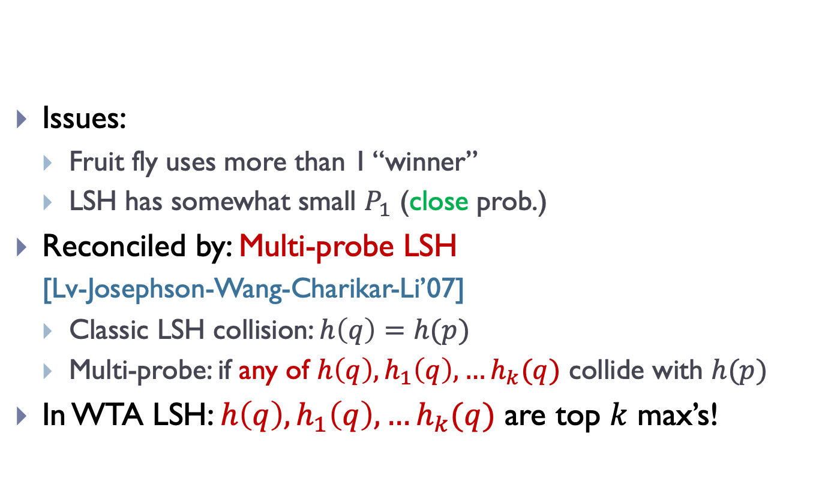
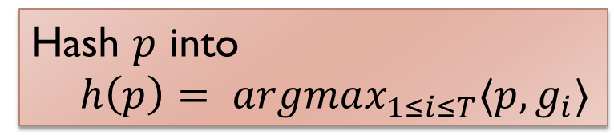
WTA LSH for isotropic case
Issues:
  Fruit fly uses more than 1 “winner”
  LSH has somewhat small $P_{1}$ (close prob.)
Reconciled by: Multi-probe LSH
  [Lv-Josephson-Wang-Charikar-Li’07]
  Classic LSH collision: $h\left(q\right)=h(p)$
  Multi-probe: if any of $h\left(q\right),h_{1}\left(q\right),…h_{k}(q)$ collide with $h(p)$
In WTA LSH: $h\left(q\right),h_{1}\left(q\right),…h_{k}(q)$ are top $k$ max’s!
Hash $p$ into
$h\left(p\right)= argmax_{1≤i≤T}〈p, g_{i}〉$
0
0
0
0
0
0
0
0.7
0
0
0
0
0
0
0
0
0
0
0
0

Slide 18
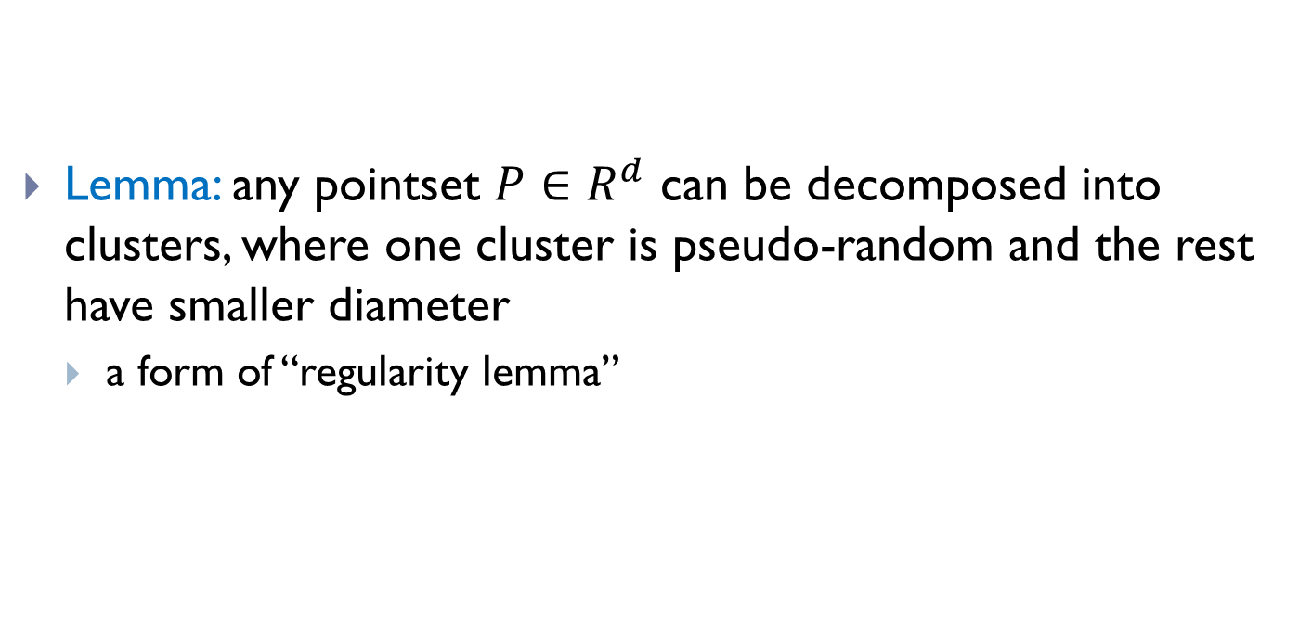
The data-dependent part
2) can reduce any worst-case dataset to the “pseudorandom” case
Lemma: any pointset $P∈R^{d}$ can be decomposed into clusters, where one cluster is pseudo-random and the rest have smaller diameter
  a form of “regularity lemma”

Slide 19
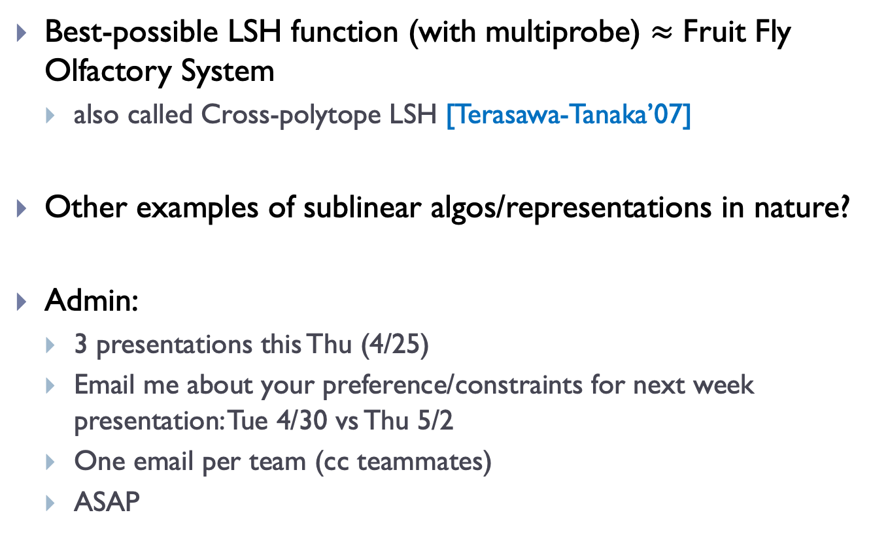
Finale
Best-possible LSH function (with multiprobe) $≈$ Fruit Fly Olfactory System
  also called Cross-polytope LSH [Terasawa-Tanaka’07]
Other examples of sublinear algos/representations in nature?
Admin:
  3 presentations this Thu (4/25)
  Email me about your preference/constraints for next week presentation: Tue 4/30 vs Thu 5/2
  One email per team (cc teammates)
  ASAP

