Slide 1
Lecture 9:
Fast Dimension Reduction
Sketching
Notes:
Left to the title, a presenter can insert his/her own image pertinent to the presentation.

Slide 2
Plan
PS2 due tomorrow, 7pm
My office hours after class
Fast Dimension Reduction
Sketching
Scriber?
  Due on Fri eve

Slide 3
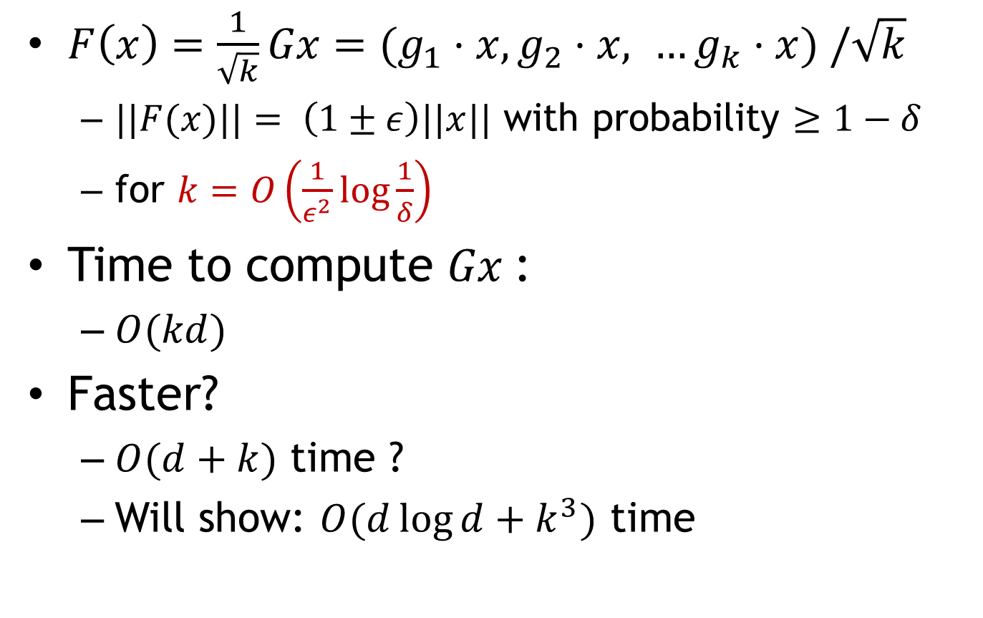
Johnson Lindenstrauss Lemma
$F\left(x\right)=\frac{1}{\sqrt{k}}Gx=(g_{1}⋅x, g_{2}⋅x, …g_{k}⋅x) /\sqrt{k}$
  $||F(x)||= \left(1±ε\right)||x||$ with probability $≥1−δ$
  for $k=O\left(\frac{1}{ε^{2}}log\frac{1}{δ}\right)$
Time to compute $Gx$:
  $O(kd)$
Faster?
  $O(d+k)$ time ?
  Will show: $O(d\log{d}+k^{3})$ time

Slide 4


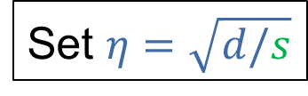

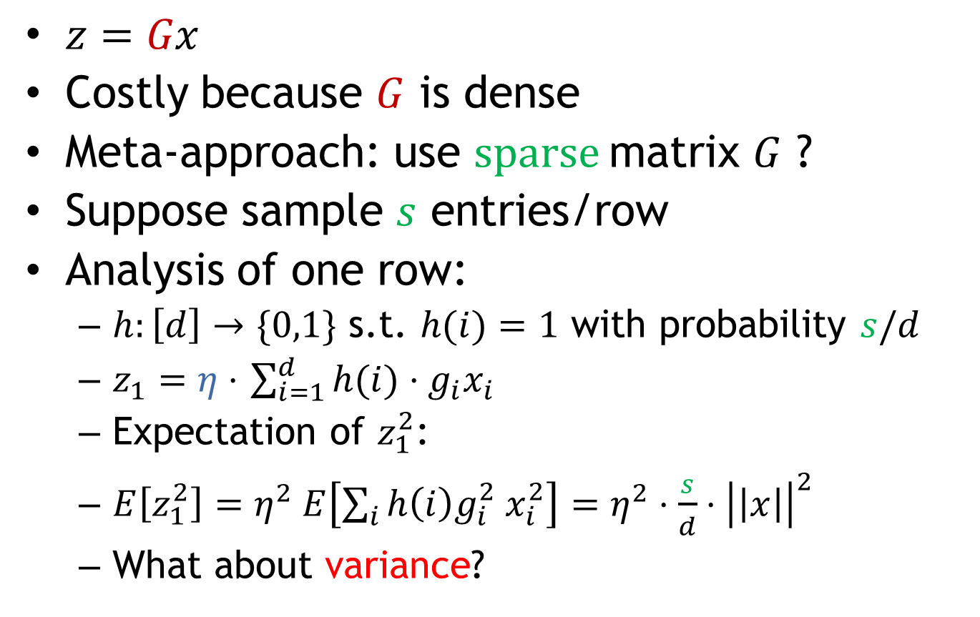



Fast JL Transform
$$d$$
$z=Gx$
Costly because $G$ is dense
Meta-approach: use $sparse$matrix $G$ ?
Suppose sample $s$ entries/row
Analysis of one row:
  $h:\left[d\right]→\{0,1\}$ s.t. $h(i)=1$ with probability $s/d$
  $z_{1}=η⋅$ $\sum_{i=1}^{d}{h(i)}⋅g_{i}x_{i}$
  Expectation of $z_{1}^{2}$:
  $E\left[z_{1}^{2}\right]=η^{2} E\left[\sum_{i}{h\left(i\right)g_{i}^{2} x_{i}^{2}}\right]=η^{2}⋅\frac{s}{d}⋅{\left|\left|x\right|\right|}^{2}$
  What about variance?
$$G$$
$$G$$
$$x$$
$$k$$
Set $η=\sqrt{d/s}$
normalization constant

Slide 5

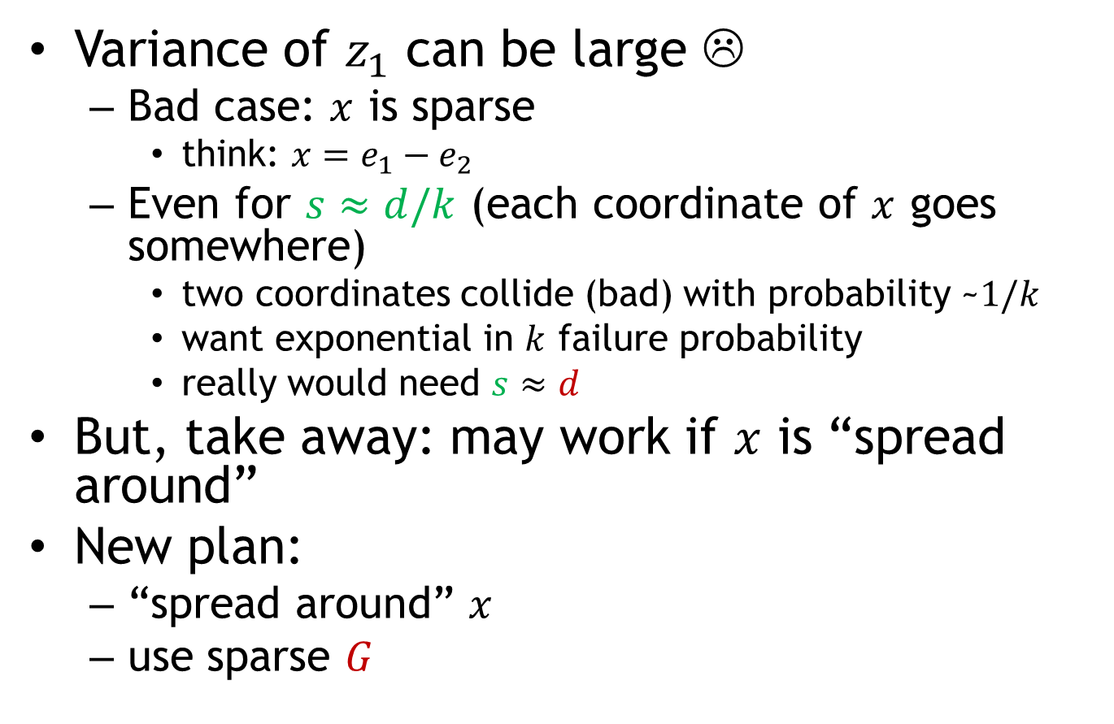


Fast JLT: sparse projection
$$d$$
Variance of $z_{1}$ can be large ☹
  Bad case: $x$ is sparse
    think: $x=e_{1}−e_{2}$
  Even for $s≈d/k$ (each coordinate of $x$ goes somewhere)
    two coordinates collide (bad) with probability ~$1/k$
    want exponential in $k$ failure probability
    really would need $s≈d$
But, take away: may work if $x$ is “spread around”
New plan:
  “spread around” $x$
  use sparse $G$
$$G$$
$$x$$
$$k$$

Slide 6
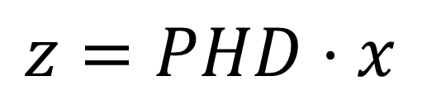

FJLT: construction
$$z=PHD⋅x$$
$D$ = matrix with random $±1$ on diagonal
$H$= Hadamard matrix (Fourier transform)
  A non-trivial rotation
  $Hx$ can be computed in time $O(d⋅log d)$
$P$ = projection matrix: sparse matrix as before, with size $k^{′}×d$, with $k^{′}≈k^{2}$
“spreading around”
Projection:
sparse matrix
Hadamard
(Fast Fourier Transform)
Diagonal

Slide 7


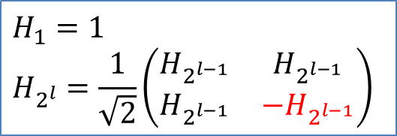
Spreading around: intuition
$$z=PHD⋅x$$
$y=HDx$
Idea for Hadamard/Fourier Transform:
  “Uncertainty principle”: if the original $x$ is sparse, then the transform is dense!
  Though can “break” $x$’s that are already dense
“spreading around”
Projection:
sparse matrix
Hadamard
(Fast Fourier Transform)
Diagonal
$$H_{1}=1$$
$$H_{2^{l}}=\frac{1}{\sqrt{2}}\left(\begin{matrix}H_{2^{l−1}} & H_{2^{l−1}} \\ H_{2^{l−1}} & −H_{2^{l−1}}\end{matrix}\right)$$
$H_{d}$ composed of $±\frac{1}{\sqrt{d}}$

Slide 8
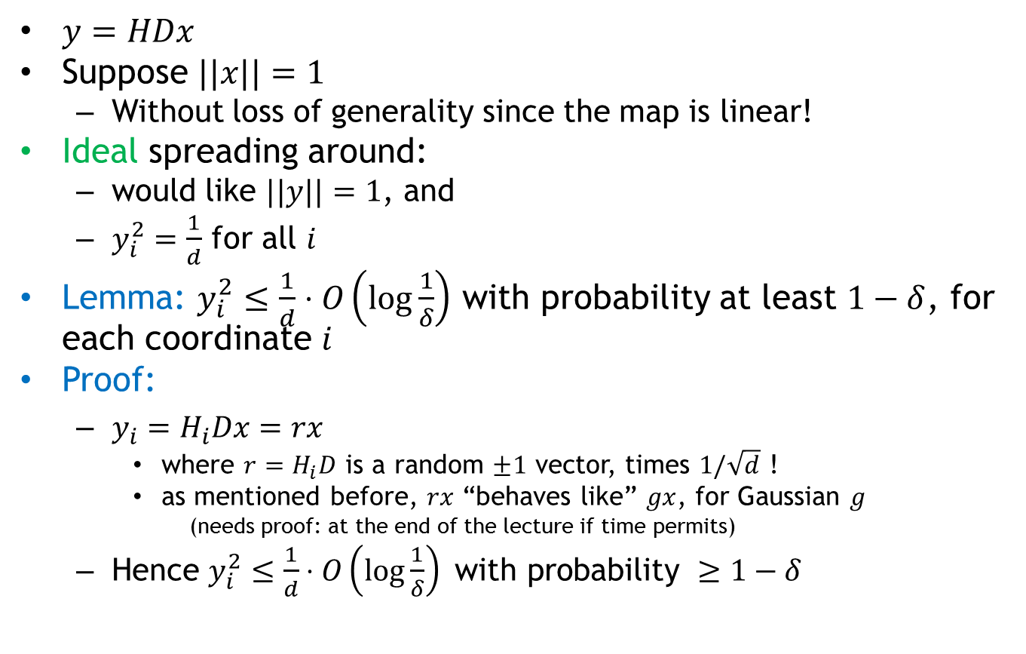
Spreading around: proof
$y=HDx$
Suppose $||x||=1$
  Without loss of generality since the map is linear!
Ideal spreading around:
  would like $||y||=1$, and
  $y_{i}^{2}=\frac{1}{d}$ for all $i$
Lemma: $y_{i}^{2}≤\frac{1}{d}⋅O\left(\log{\frac{1}{δ}}\right)$ with probability at least $1−δ$, for each coordinate $i$
Proof:
  $y_{i}=H_{i}Dx=rx$
    where $r=H_{i}D$ is a random $±1$ vector, times $1/\sqrt{d}$ !
    as mentioned before, $rx$ “behaves like” $gx$, for Gaussian $g$
      (needs proof: at the end of the lecture if time permits)
  Hence $y_{i}^{2}≤\frac{1}{d}⋅O\left(\log{\frac{1}{δ}}\right) \text{with} \text{probability} ≥1−δ$

Slide 9
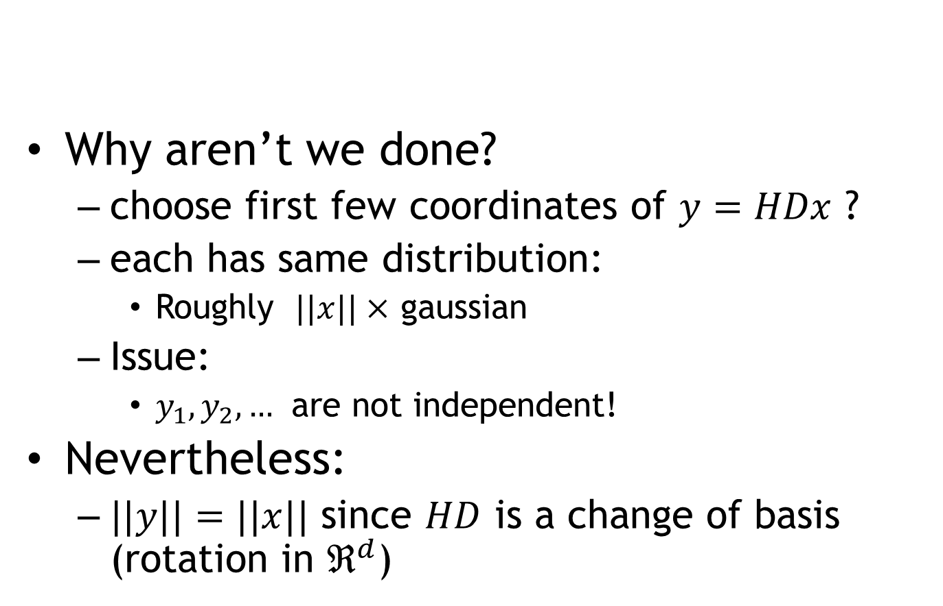

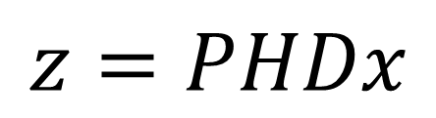
Why projection $P$ ?
Why aren’t we done?
  choose first few coordinates of $y=HDx$ ?
  each has same distribution:
    Roughly $||x||×$ gaussian
  Issue:
    $y_{1}, y_{2},…$ are not independent!
Nevertheless:
  $||y||=||x||$ since $HD$ is a change of basis (rotation in $ℜ^{d}$)
$$z=PHDx$$

Slide 10
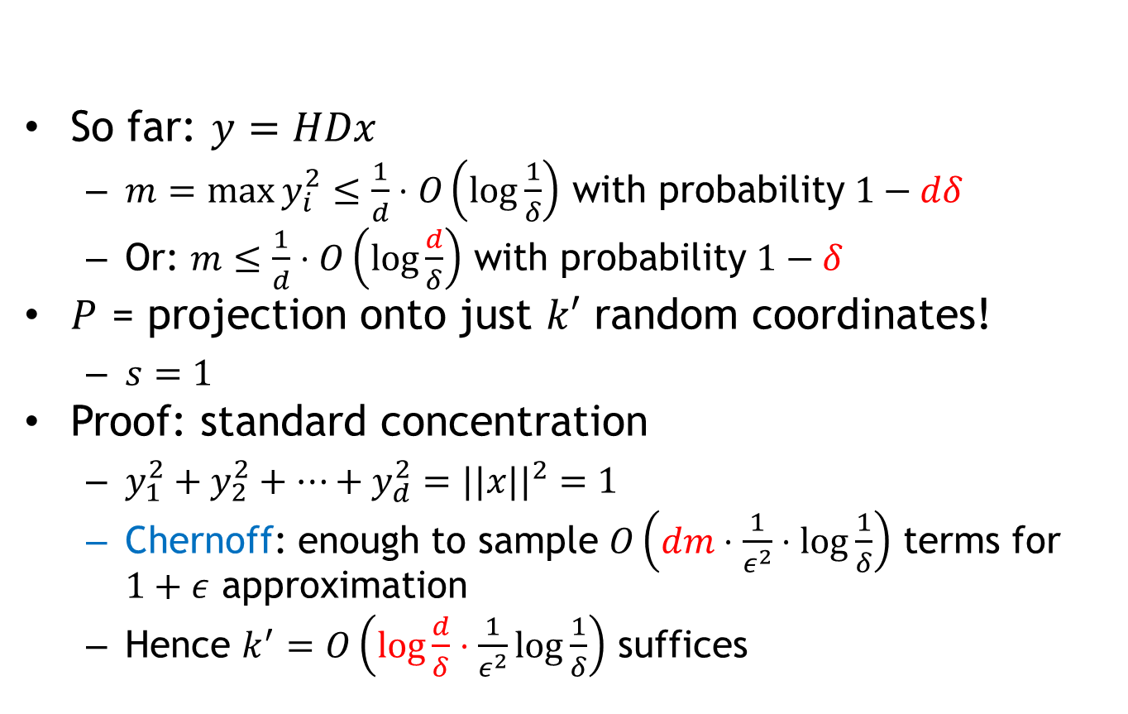

Projection $P$
So far: $y=HDx$
  $m=\max{y_{i}^{2}}≤\frac{1}{d}⋅O\left(\log{\frac{1}{δ}}\right)$ with probability $1−dδ$
  Or: $m≤\frac{1}{d}⋅O\left(\log{\frac{d}{δ}}\right)$ with probability $1−δ$
$P$ = projection onto just $k′$ random coordinates!
  $s=1$
Proof: standard concentration
  $y_{1}^{2}+y_{2}^{2}+…+y_{d}^{2}=||x||^{2}=1$
  Chernoff: enough to sample $O\left(dm⋅\frac{1}{ε^{2}}⋅log\frac{1}{δ}\right)$ terms for $1+ε$ approximation
  Hence $k^{′}=O\left(log\frac{d}{δ}⋅\frac{1}{ε^{2}}\log{\frac{1}{δ}}\right)$ suffices
$$z=PHDx$$

Slide 11
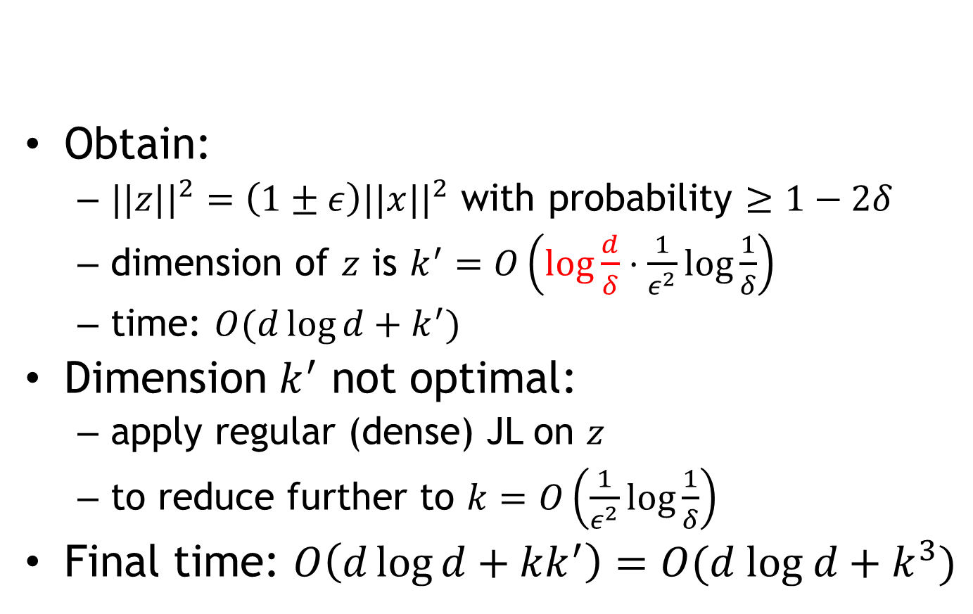
FJLT: wrap-up
Obtain:
  $||z||^{2}=\left(1±ε\right)||x||^{2}$ with probability $≥1−2δ$
  dimension of $z$ is $k^{′}=O\left(log\frac{d}{δ}⋅\frac{1}{ε^{2}}\log{\frac{1}{δ}}\right)$
  time: $O(d\log{d}+k^{′})$
Dimension $k^{′}$ not optimal:
  apply regular (dense) JL on $z$
  to reduce further to $k=O\left(\frac{1}{ε^{2}}log\frac{1}{δ}\right)$
Final time: $O\left(d\log{d}+kk^{′}\right)=O(d log d+k^{3})$
$$z=PHDx$$

