Slide 1
Lecture 24:
MapReduce Algorithms
Wrap-up
Notes:
Left to the title, a presenter can insert his/her own image pertinent to the presentation.

Slide 2
Admin
PS2-4 solutions
Project presentations next week
  20min presentation/team
  10 teams => 3 days
  3rd time: Fri at 3-4:30pm
  sign-up sheet online
Today:
  MapReduce algorithms
  Wrap-up

Slide 3

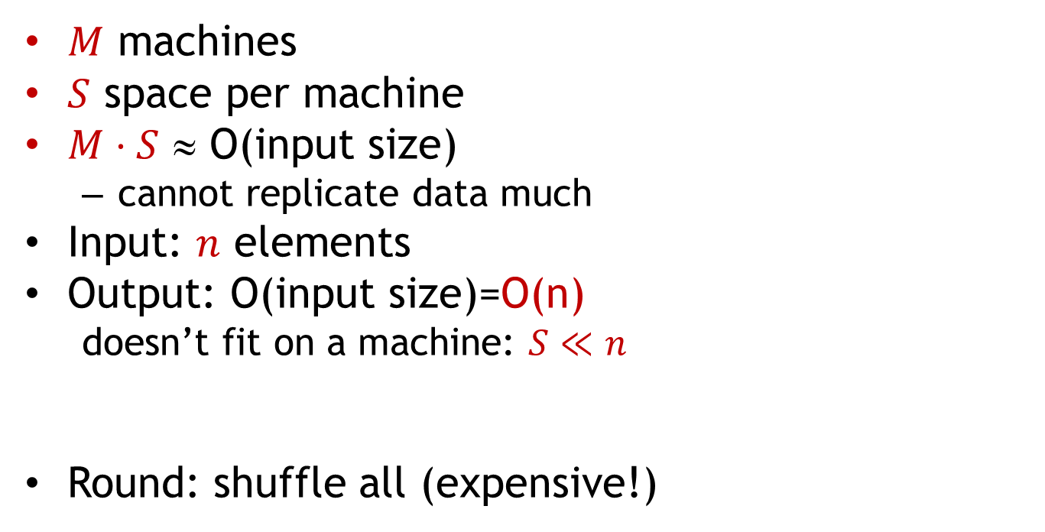
Computational Model
$M$ machines
$S$ space per machine
$M⋅S$ ≈ O(input size)
  cannot replicate data much
Input: $n$ elements
Output: O(input size)=O(n)
  doesn’t fit on a machine: $S≪n$
Round: shuffle all (expensive!)
Notes:
Machines churning data

Slide 4

Model Constraints
Main goal:
  number of rounds $R=O(1)$
  for $S≥n^{δ}$
    e.g., $S>\sqrt{n}$ when $S>M$
Local resources bounded by $S$
  $O(S)$ in-communication per round
  ideally: linear run-time/round
Model culmination of:
  Bulk-Synchronous Parallel [Valiant’90]
  Map Reduce Framework [Feldman-Muthukrishnan-Sidiropoulos-Stein-Svitkina’07, Karloff-Suri-Vassilvitskii’10, Goodrich-Sitchinava-Zhang’11]
  Massively Parallel Computing (MPC) [Beame-Koutis-Suciu’13]

Slide 5
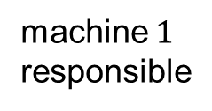
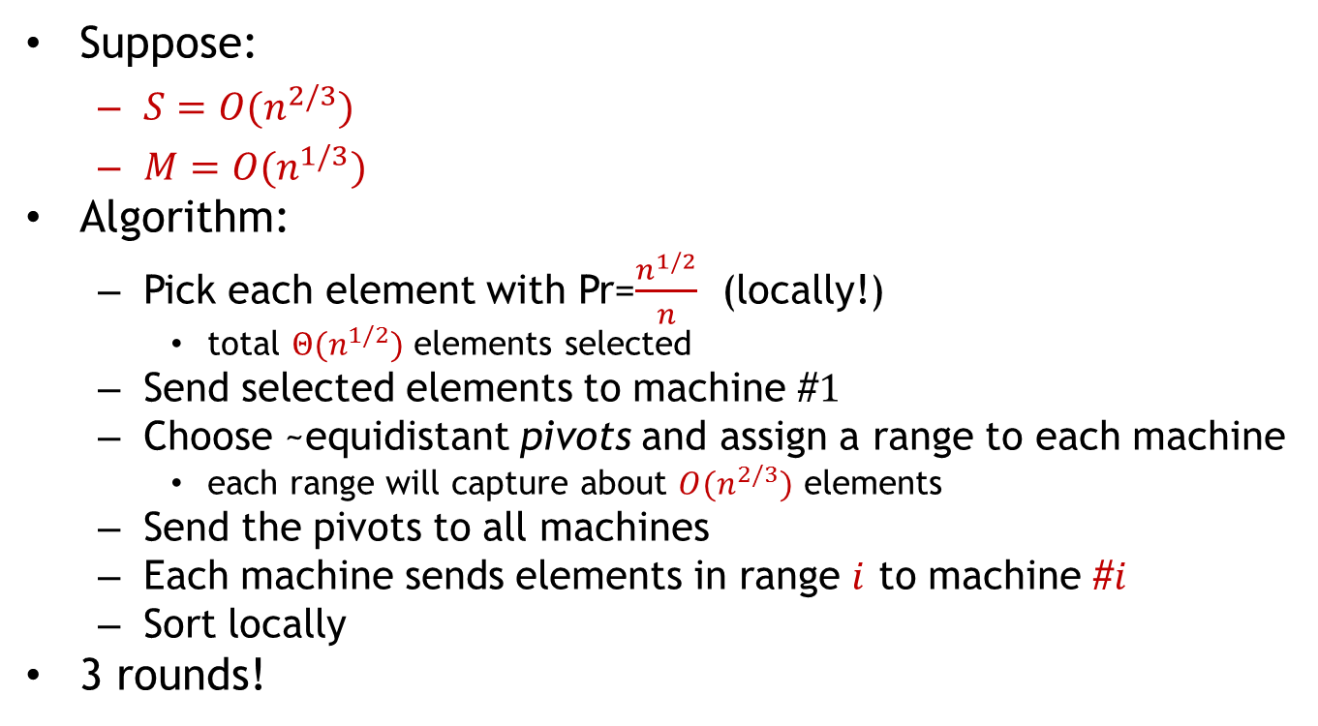
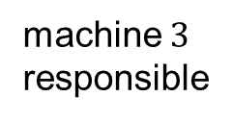
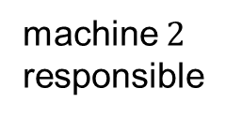
Problem 1: sorting
Suppose:
  $S={O(n}^{2/3})$
  $M={O(n}^{1/3})$
Algorithm:
  Pick each element with Pr=$\frac{n^{1/2}}{n}$ (locally!)
    total $Θ(n^{1/2})$ elements selected
  Send selected elements to machine #$1$
  Choose ~equidistant pivots and assign a range to each machine
    each range will capture about $O(n^{2/3})$ elements
  Send the pivots to all machines
  Each machine sends elements in range $i$ to machine #$i$
  Sort locally
3 rounds!
machine $1$
responsible
machine $2$
responsible
machine $3$
responsible

Slide 6
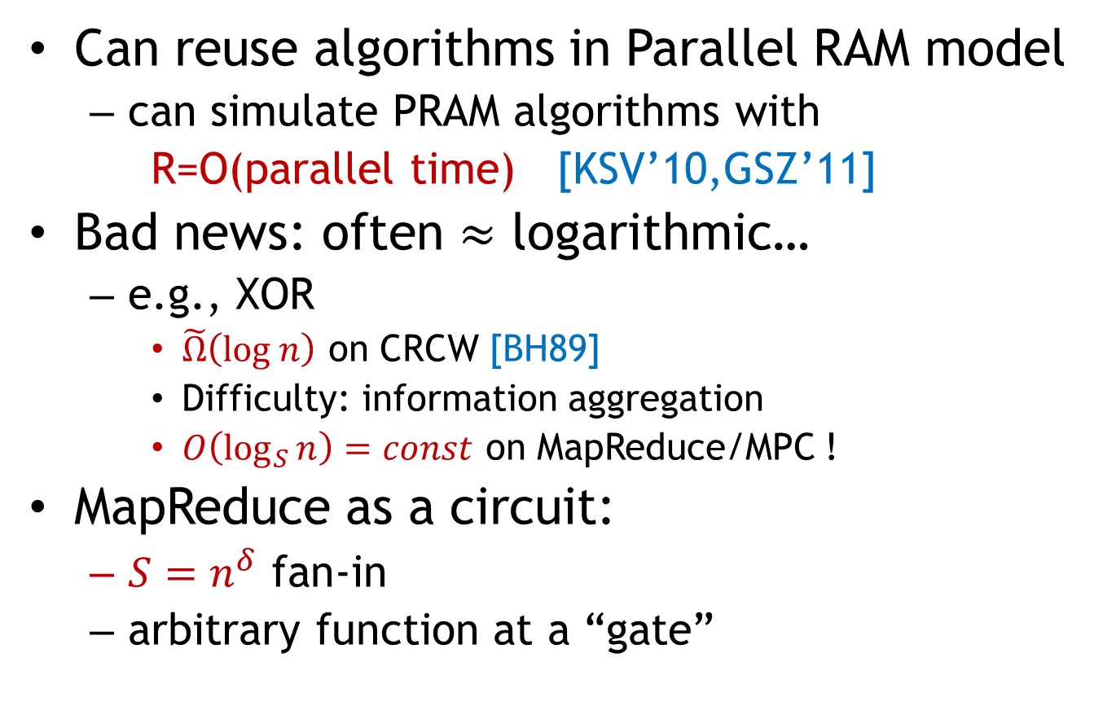
Parallel algorithms from 80-90’s
Can reuse algorithms in Parallel RAM model
  can simulate PRAM algorithms with
  R=O(parallel time) [KSV’10,GSZ’11]
Bad news: often $≈$ logarithmic…
  e.g., XOR
    $\tilde{Ω}\left(log n\right)$ on CRCW [BH89]
    Difficulty: information aggregation
    $O\left(\log_{S}{n}\right)=const$ on MapReduce/MPC !
MapReduce as a circuit:
  $S=n^{δ}$ fan-in
  arbitrary function at a “gate”

Slide 7
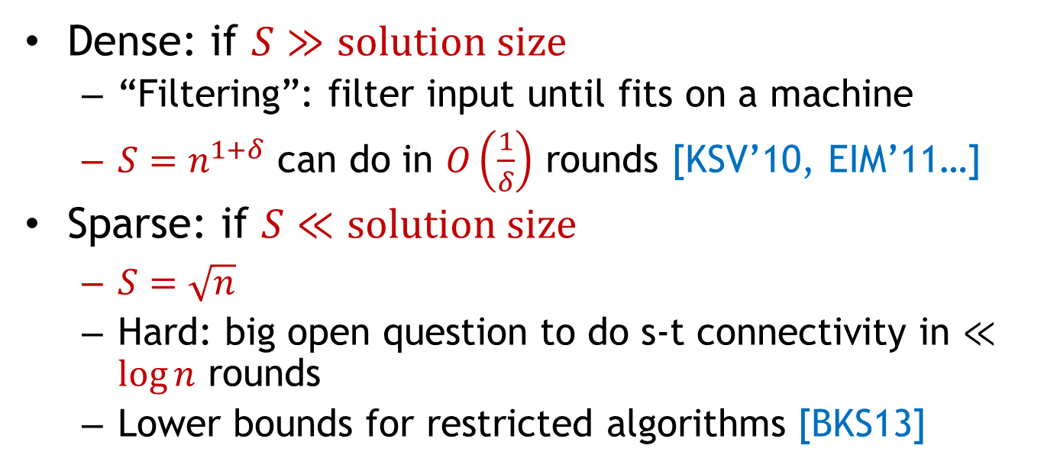
Graph problems: connectivity
Dense: if $S≫solution size$
  “Filtering”: filter input until fits on a machine
  $S=n^{1+δ}$ can do in $O\left(\frac{1}{δ}\right)$ rounds [KSV’10, EIM’11…]
Sparse: if $S≪solution size$
  $S=\sqrt{n}$
  Hard: big open question to do s-t connectivity in $≪\log{n}$ rounds
  Lower bounds for restricted algorithms [BKS13]
VS

Slide 8
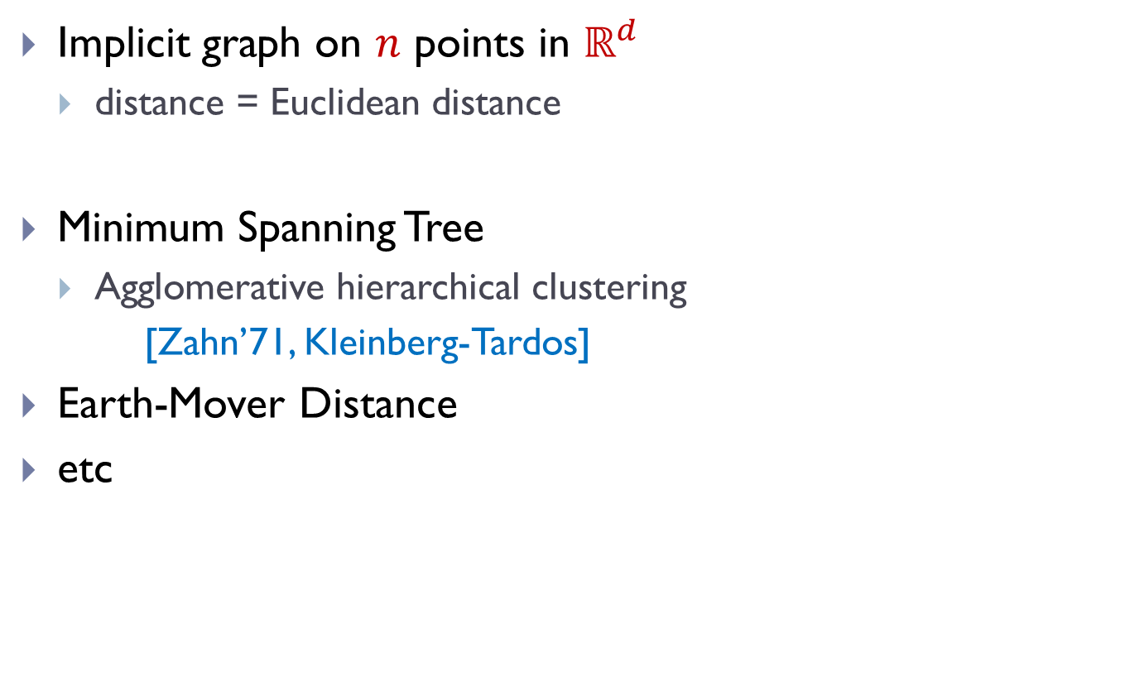
Geometric Graphs
Implicit graph on $n$ points in $ℝ^{d}$
  distance = Euclidean distance
Minimum Spanning Tree
  Agglomerative hierarchical clustering
  [Zahn’71, Kleinberg-Tardos]
Earth-Mover Distance
etc
Notes:
pictures of problems!

Slide 9
Geometric Graphs
Implicit graph on $n$ points in $ℝ^{d}$
  distance = Euclidean distance
Minimum Spanning Tree
  Agglomerative hierarchical clustering
  [Zahn’71, Kleinberg-Tardos]
Earth-Mover Distance
etc
Notes:
pictures of problems!

Slide 10
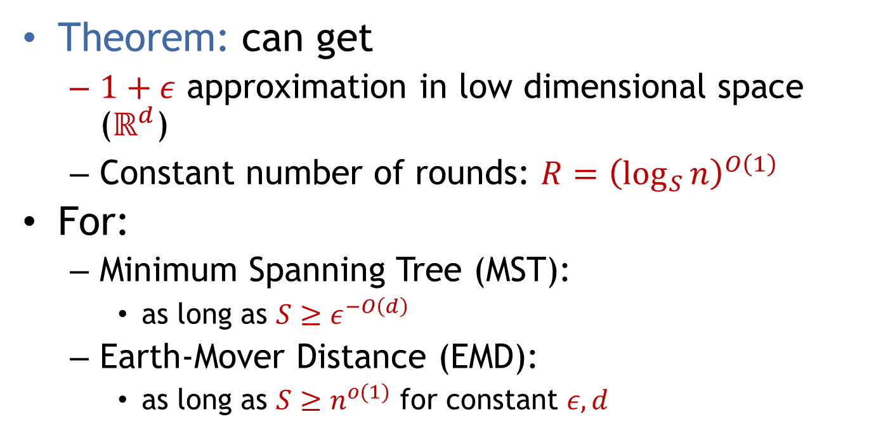
Results: MST & EMD algorithms
[A-Nikolov-Onak-Yaroslavtsev’14]
Theorem: can get
  $1+ε$ approximation in low dimensional space ($ℝ^{d}$)
  Constant number of rounds: $R={\left(\log_{S}{n}\right)}^{O\left(1\right)}$
For:
  Minimum Spanning Tree (MST):
    as long as $S≥ε^{−O\left(d\right)}$
  Earth-Mover Distance (EMD):
    as long as $S≥n^{o(1)}$ for constant $ε, d$

Slide 11
Framework: Solve-And-Sketch
Partition the space hierarchically in a “nice way”
In each part
  Compute a pseudo-solution for the local view
  Sketch the pseudo-solution using small space
  Send the sketch to be used in the next level/round

Slide 12
MST algorithm: attempt 1
quad trees!
Partition the space hierarchically in a “nice way”
In each part
  Compute a pseudo-solution for the local view
  Sketch the pseudo-solution using small space
  Send the sketch to be used in the next level/round
local MST
send any point as a representative

Slide 13
Difficulties
Quad tree can cut MST edges
  forcing irrevocable decisions
Choose a wrong representative

Slide 14

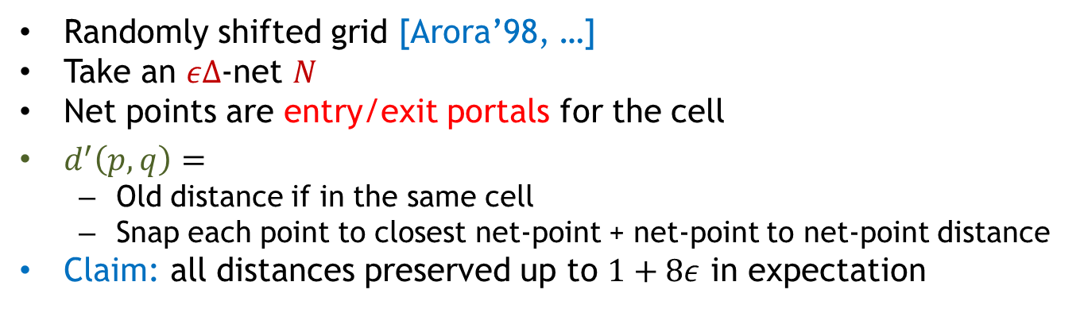
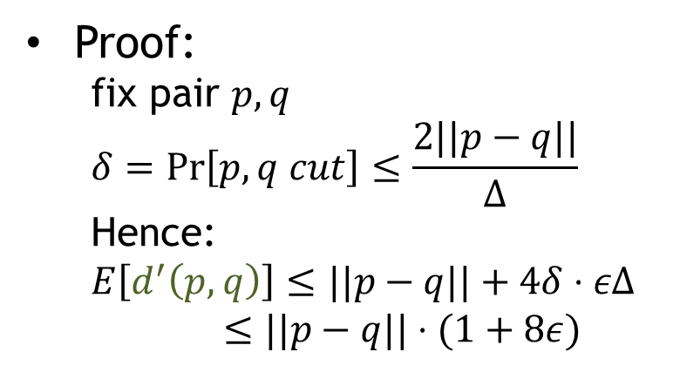
New Partition: Grid Distance
Randomly shifted grid [Arora’98, …]
Take an $εΔ$-net $N$
Net points are entry/exit portals for the cell
$d^{′}\left(p,q\right)=$
  Old distance if in the same cell
  Snap each point to closest net-point + net-point to net-point distance
Claim: all distances preserved up to $1+8ε$ in expectation
$$Δ$$
Proof:
  fix pair $p,q$
  $$δ=\operatorname{Pr}\left[p,q cut\right]≤\frac{2||p−q||}{Δ}$$
  Hence:
  $$E\left[d^{′}\left(p,q\right)\right]≤||p−q||+4δ⋅εΔ$$
  $≤||p−q||⋅(1+8ε)$

Slide 15

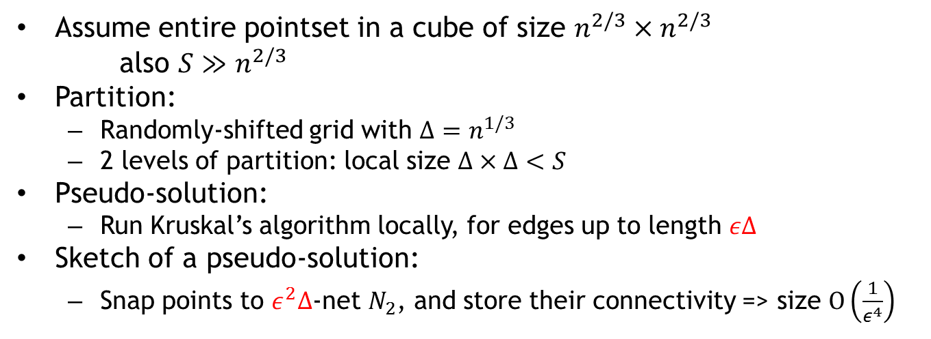
MST Algorithm: Final
Assume entire pointset in a cube of size $n^{2/3}×n^{2/3}$
also $S≫n^{2/3}$
Partition:
  Randomly-shifted grid with $Δ=n^{1/3}$
  2 levels of partition: local size $Δ×Δ<S$
Pseudo-solution:
  Run Kruskal’s algorithm locally, for edges up to length $εΔ$
Sketch of a pseudo-solution:
  Snap points to $ε^{2}Δ$-net $N_{2}$, and store their connectivity => size $O\left(\frac{1}{ε^{4}}\right)$
Kruskal’s MST algorithm: connect the points with the shortest edge that does not introduce a cycle
$$Δ$$

Slide 16
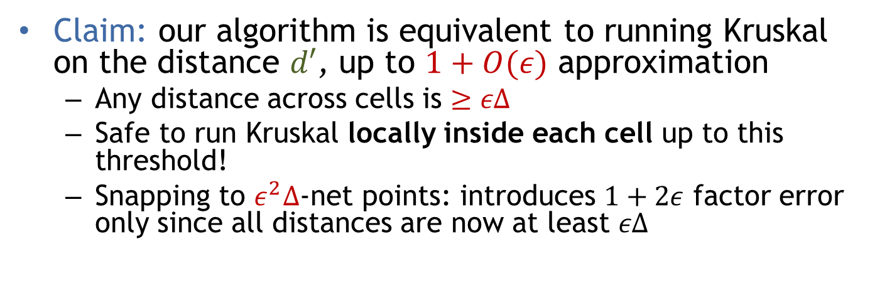
MST Analysis
Kruskal’s MST algorithm: connect the points with the shortest edge that does not introduce a cycle
Claim: our algorithm is equivalent to running Kruskal on the distance $d′$, up to $1+O(ε)$ approximation
  Any distance across cells is $≥εΔ$
  Safe to run Kruskal locally inside each cell up to this threshold!
  Snapping to $ε^{2}Δ$-net points: introduces $1+2ε$ factor error only since all distances are now at least $εΔ$

Slide 17
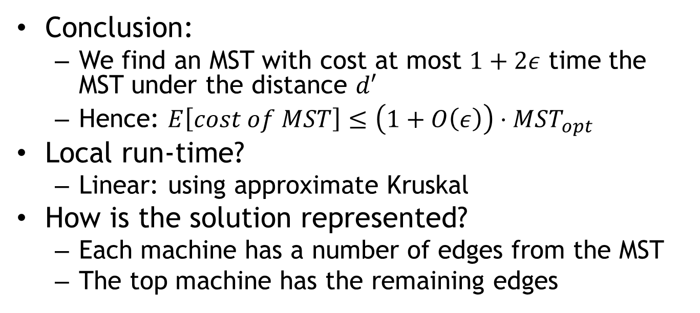
MST Wrap-up
Conclusion:
  We find an MST with cost at most $1+2ε$ time the MST under the distance $d′$
  Hence: $E\left[cost of MST\right]≤\left(1+O\left(ε\right)\right)⋅MST_{opt}$
Local run-time?
  Linear: using approximate Kruskal
How is the solution represented?
  Each machine has a number of edges from the MST
  The top machine has the remaining edges

Slide 18
Wrap-up

Slide 19


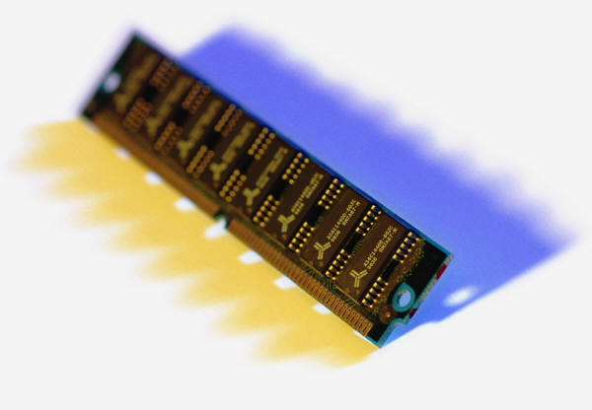
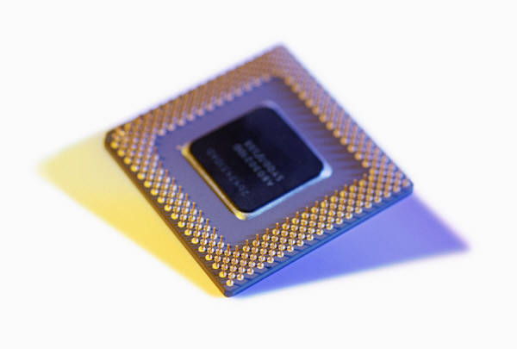
1) Streaming algorithms
Streaming algorithms
Frequency moments, heavy hitters
Graph algorithms
Algorithms for lists: Median selection, longest increasing sequence
Algorithms for geometric objects: clustering, MST, various approximation algorithms
2
IP | Frequency
160.39.142.2 | 3
18.9.22.69 | 2
80.97.56.20 | 2

Slide 20
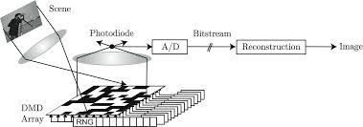
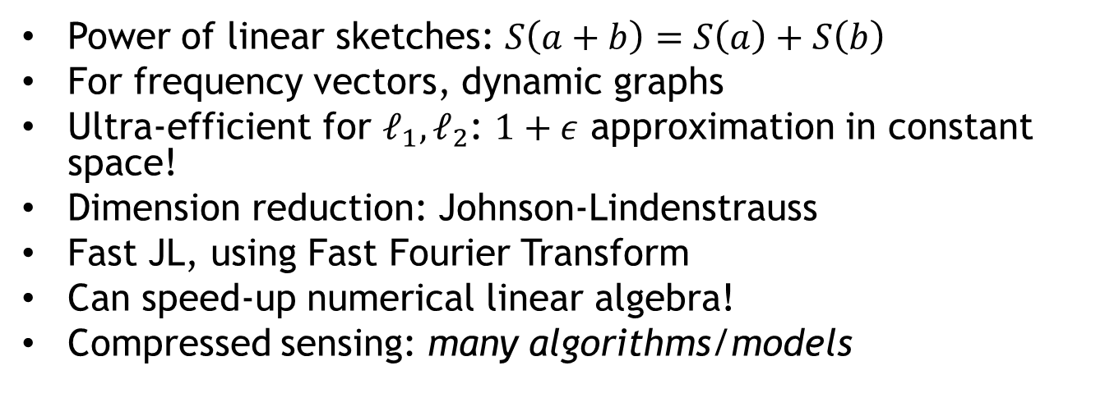
Sketching &dimension reduction
Power of linear sketches: $S\left(a+b\right)=S\left(a\right)+S\left(b\right)$
For frequency vectors, dynamic graphs
Ultra-efficient for $ℓ_{1},ℓ_{2}$: $1+ε$ approximation in constant space!
Dimension reduction: Johnson-Lindenstrauss
Fast JL, using Fast Fourier Transform
Can speed-up numerical linear algebra!
Compressed sensing: many algorithms/models
d
a
a
t
D
T
A
source: http://dsp.rice.edu/sites/dsp.rice.edu/files/cs/cscam-SPIEJan06.pdf
A

Slide 21


Nearest Neighbor Search
Can use sketching for NNS
Even better via Locality Sensitive Hashing
Data-dependent LSH
Embeddings: reduce harder
distances to easier ones
NNS for general metrics
Complexity dependent on
“intrinsic dimension”
000000
011100
010100
000100
010100
011111
000000
001100
000100
000100
110100
111111
$$p$$
$$q$$

Slide 22
Sampling, property testing
Distribution testing:
  Get samples from a distribution, deduce its properties
  Uniformity, identity
  Many others in the literature!
  Instance optimal: better for easier distributions
Property testing:
  Is this graph connected or far
  from connected?
  For dense graphs: regularity lemma
Sublinear time approximation:
  Estimate the MST cost, matching
  size, etc

Slide 23
Parallel algorithms: MapReduce
Model: limited space/machine
Filtering: throw away part of the input locally, send only important stuff
Dense graph algorithms
Solve-And-Sketch:
  find a partial solution locally
  sketch the solution
  work with sketches up
Good for problems on points

Slide 24


Algorithms for massive data
Computer resources << data
Access data in a limited way
  Limited space (main memory << hard drive)
  Limited time (time << time to read entire data)
Introduction to
Sublinear Algorithms
power of randomization
and approximation

