Slide 1
sparse codes from quantum circuits
arXiv:1411.3334
Dave Bacon
Steve Flammia
Aram Harrow
Jonathan Shi
Coogee
23 Jan 2015

Slide 2
QECC
[n,k,d] code: encode k logical qubits in n physical
qubits and correct errors on <d/2 positions.
[n,k,d,w]: ...using a decoding procedure that
requires measurements of ≤w qubits at a time.
w=O(1) “LDPC” (low-density parity check)
Classically, possible with k, d = Ω(n).
WWSD principle → qLDPC

Slide 3
qLDPC?
k
random
w» n
d ≤ n^{1-1/D}
in D-dim
O(n)
hyperbolic
GL’14
TZ’09
BH’14
w»n^{1/2}
2-d gauge
B‘10
TZ+us
kd^{2/(D-1)} ≤ n
for stabilizer
D dim
us
O(1)
toric code
hyperbolic
FML’02
d
O(n^{0.3})
O(n^{1/2})
O(n^{1-1/D-ε})
O(n)
O((n log(n))^{1/2})
O(n^{1-ε})

Slide 4
main results
More general theorem: Given an [n,k,d] stabilizer code with a size-S Fault-Tolerant Error-Detecting Circuit we can construct an [n’=O(S), k, d, w’=O(1)] subsystem code.
Main Theorem: Given an [n,k,d] stabilizer code with stabilizer weights w_{1,} ..., w_{n-k}, we can construct an
[n’, k, d, w’=O(1)] subsystem code with n’ = O(n + ∑_{i} w_{i}).
Subsystem codes exist with
k=1, w=O(1),
Also needed: New F-T E-D circuit for measuring a weight-w stabilizer using O(w) gates.

Slide 5
stabilizer codes
S = subgroup of ±{I, X, XZ, Z}^{n}
codespace V = {|ψ⟩ : s|ψ⟩=|ψ⟩ for all s∈S}
Paulis anticommuting with some s∈S are detected
logical operators commute with all of S
3-bit repetition code
S = <ZZI, IZZ> = <I⊗Z⊗Z, Z⊗Z⊗I>
V = span{|000>, |111>}
logical operators <XXX, ZII>
4-qubit code, distance 2
stabilizer generators |  | logical qubit 1 |  | logical qubit 2
XX XX | ZZ ZZ | ZI ZI | XX I I | IZ IZ | I I XX

Slide 6
subsystem/gauge codes
Replace some logical qubits with “gauge” qubits:
  Like logical qubits: Commute with stabilizers and errors. Contents can be arbitrary for logical code states.
  Like stabilizer qubits: Don’t care about preserving.
  Can (and should) measure during decoding.
Advantages: sparsity, simpler decoding,
(sometimes) better thresholds
4-qubit code, distance 2
stabilizer generators. logical qubit. gauge qubit.
XX
XX
ZZ
ZZ
ZI
ZI
XX
I I
ZZ
I I
XI
XI

Slide 7
structure of subsystem codes
Gauge group G ≤ ±{I, X, XZ, Z}^{n}.
Center is stabilizer group: S ≅ Z(G)/{±1}
Normalizer is logical group: L ≅ N(G)/S
Paulis
X₁ | Z₁
X₂ | Z₂
... | ...
X_{n} | Z_{n}
4-qubit code
XI
XI
IX
IX
ZZ
I I
I I
ZZ
gauge generators
stabilizer subgroup
generated by
XX
XX
ZZ
ZZ
stabilizers | errors
logical X operators | logical Z operators
gauge X operators | gauge Z operators
logical group
generated by
ZI
ZI
XX
I I

Slide 8


From Codes to Circuits to Codes Again…
Begin with a stabilizer code of your choice
Write a quantum circuit for measuring the stabilizers of this code.
00 0
11 1
time
data
input
postselected
measurement
ancilla
preparation

Slide 9
From Codes to Circuits to Codes Again…
Begin with a stabilizer code of your choice
Write a quantum circuit for measuring the stabilizers of this code.
Turn the circuit elements into input/output qubits
00 0
11 1

Slide 10
From Codes to Circuits to Codes Again…
Begin with a stabilizer code of your choice
Write a quantum circuit for measuring the stabilizers of this code.
Turn the circuit elements into input/output qubits
Add gauge generators via Pauli circuit identities.
00 0
11 1

Slide 11
From Codes to Circuits to Codes Again…
Begin with a stabilizer code of your choice
Write a quantum circuit for measuring the stabilizers of this code.
Turn the circuit elements into input/output qubits
Add gauge generators via Pauli circuit identities.
00 0
11 1

Slide 12
From Codes to Circuits to Codes Again…
Begin with a stabilizer code of your choice
Write a quantum circuit for measuring the stabilizers of this code.
Turn the circuit elements into input/output qubits
Add gauge generators via Pauli circuit identities.
00 0
11 1

Slide 13
From Codes to Circuits to Codes Again…
Begin with a stabilizer code of your choice
Write a quantum circuit for measuring the stabilizers of this code.
Turn the circuit elements into input/output qubits
Add gauge generators via Pauli circuit identities.
00 0
11 1

Slide 14
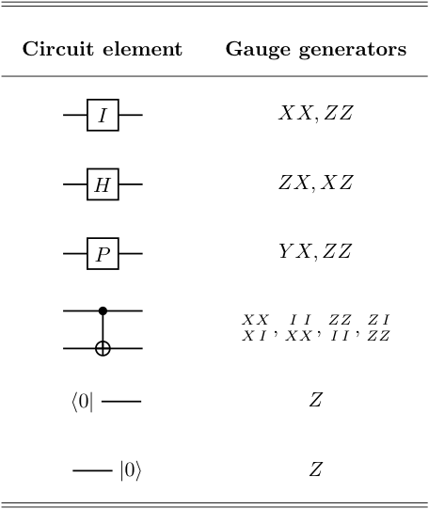
From Codes to Circuits to Codes Again…
Begin with a stabilizer code of your choice
Write a quantum circuit for measuring the stabilizers of this code.
Turn the circuit elements into input/output qubits
Add gauge generators via Pauli circuit identities
This defines the code
Bravyi 2011 does something similar with “generalized Bacon-Shor” codes

Slide 15



Properties of this Construction
Circuits as linear operators preserving the code space
V is an error-detecting
circuit
General condition:
V is E-D iff

Slide 16
Properties of this Construction
Circuits as linear operators preserving the code space
Gauge equivalence of errors:
E
Apply gauge operators…

Slide 17
Properties of this Construction
Circuits as linear operators preserving the code space
Gauge equivalence of errors:
Squeegee lemma: using gauge operations, we can localize errors to the initial data qubits

Slide 18
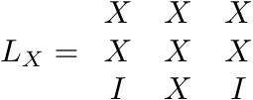
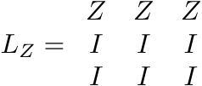
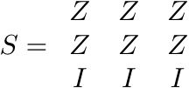
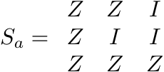
Stabilizer and Logical Operators
Spackling: like squeegee, but you leave a residue
Spackling of logical operators gives the new logical operators
Spackling of stabilizers on the inputs and ancillas are the new stabilizers
Everything else is gauge or detectable error
…what about distance?
*even/odd effect means that
circuits wires must have odd length

Slide 19
Code Distance and Fault Tolerance
For most error-detecting circuits, the new code is uninteresting (i.e. has bad distance).
Theorem: If we use a fault-tolerant circuit then we preserve the code distance
Fault tolerance definition: for every error pattern E, either VE = 0 or there exists E’ on inputs s.t. V E’=VE and |E’ |≤|E|.
Idiosyncratic constraints:
  Circuit must be Clifford (so no majority vote)
  No classical feedback or post-processing allowed
  However, we only need to detect errors

Slide 20
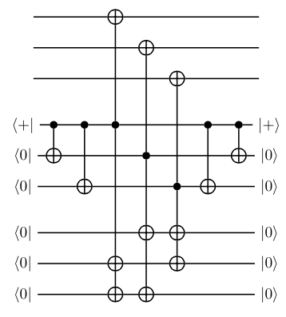
Fault-Tolerant Gadgets
Use modified Shor/DiVincenzo cat states
Build a cat, and postselect …not fault tolerant
Redeem this idea by coupling to expanders
constant-degree expanders exist with sufficient edge expansion to make this fault tolerant
data
cat
ancilla

Slide 21
expander gadgets
data qubits ≅ {1, ..., n}
cat qubits ≅ V, |V|=n
ancilla qubits ≅ E
Recipe: multiple-CNOT from each v to corresponding data qubit and all incident edges.
Requirement: Edge expansion ≥ 1 means X errors on cat qubits cause more errors on ancillas.
Corresponds to classical ECC with “energy barrier”.

Slide 22

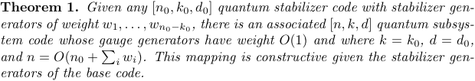
Wake Up!
Created sparse subsystem codes with the same k and d parameters as the base code
Used fault-tolerant circuits in a new way, via expanders
Extra ancillas are required according to the circuit size

Slide 23
Almost “Good” Sparse Subsystem Codes
Start with an [n0,1,d0] random stabilizer code
(so that d0=O(n0) with high probability)
Concatenate this m times to get an [n₀^{m},1,d₀^{m}] code
Stabilizers: n₀^{j} of weight ≤n₀^{m-j+1}.
Total weight m∙n₀^{m+1}
Apply Theorem 1 with m = (log n)^{1/2}
Sparse subsystem codes exist with
d = O(n^{1-ε}) and ε = O(1/√log n).
____
Best previous distance for sparse codes was
d = O(√n log n ) by Freedman, Meyer, Luo 2002
______
*Thank you
Sergei Bravyi!

Slide 24
Spatially Local Subsystem Codes Without Strings
Take the circuit construction from the previous result
Using SWAP gates and wires, spread the circuit over the vertices of a cubic lattice in D dimensions
Let n=L^{D} be the total number of qubits
Local subsystem codes exist with
d = O(L^{D-1-ε}) and ε = O(1/√log n).
____

Slide 25
Compared to Known Bounds
Local subsystem codes in D dimensions
d ≤ O(L^{D-1})
  Our code: d=Ω(L^{D-1-ε})
Best known local stabilizer codes: d=O(L^{D/2})
Local commuting projector codes
kd^{2/(D-1)}≤O(n)
  Our codes: kd^{2/(D-1)}=Ω(n)
  (use the hypergraph product codes and our main theorem)
*ε = O((log n)^{-1/2})
Bravyi & Terhal 2009;
Bravyi, Poulin, Terhal 2010;
Tillich & Zémor 2009

Slide 26
Conclusion & Open Questions
Showed a generic way to turn stabilizer codes into sparse subsystem codes
New connection between quantum error correction & fault-tolerant quantum circuits
What are the limits for sparse stabilizer codes?
Self-correcting memory from the gauge Hamiltonian?
Efficient, fault-tolerant decoding for these codes?
Improve the rate? (Bravyi & Hastings 2013)
Extend these results to allow for subsystem codes?
Holography? ???
See arxiv:1411.3334 for more details!

Slide 27
The Best Sparse Codes
Code | k | d | Subsystem? | Decoder?
Z2-systolic codes (Freedman, Meyer, Luo 2002) | O(1) | O(√n log n)
4D Hyperbolic (Hastings 2013) | O(n) | O(log n)
4D Arithmetic Hyperbolic (Guth & Lubotzky 2013) | O(n) | O(n^{0.3})
Hypergraph Product (Tillich & Zémor 2009) | O(n) | O(n^{0.5})
BFHS 2014 (this talk)* | O(1) | O(n^{1-ε}) | yes
Homological Product† (Bravyi & Hastings 2013) | O(n) | O(n)
*subsystem code, ε = O(1/√log n); †sparsity s = O(√n); .

Slide 28
The Best (Euclidean) Local Codes
n=L^{D}
Code | D | k | d | Subsystem? | Decoder?
Toric Code (Kitaev 1996) | ≥2 | O(1) | O(√n)
Generalized Bacon-Shor (Bravyi 2011) | 2 | O(L) | O(L) | yes
Welded Code (Michnicki 2012) | 3 | 1 | O(L^{4/3})
Embedded Fractal (Brell 2014) | 3’ish | O(n) | O(n^{0.5})
Gauge Color Codes (Bombin 2013) | 3 | O(n) | O(n) | yes
Gauge Color Codes (Bombin 2013) | 3 | O(n) | O(n) | yes
BFHS 2014 (this talk)* | ≥2 | O(1) | O(L^{D-1-ε}) | yes
*subsystem code, ε = O(1/√log n); †sparsity s = O(√n); .

Slide 29
Local Subsystem Codes Without Strings
Specialize to D=3
Sparse subsystem code on a lattice with [L³,O(1),L^{2-ε}]
No strings, either for bare or dressed logical operators
  cf. Bombin’s gauge color codes
…on the other hand it’s a subsystem code
How does this compare to other candidate self-correcting quantum memories?

Slide 30
Comparing Candidate Self-Correcting Memories
Code | Self-correcting? | Comments
3D Bacon-Shor (Bacon 2005) | no | No threshold, so no self-correction (Pastawski et al. 2009)
Welded Code (Michnicki 2014) | no | See Brown et al. 2014 review article for discussion
Cubic Code (Haah 2011) | marginal | poly(L) memory lifetime for L< e^{β/3} (Bravyi & Haah 2013)
Embedded Fractal Product Codes (Brell 2014) | maybe | very large ground-state degeneracy?
Gauge Color Codes (Bombin 2013) | ??? | Does have a threshold, also has string-like dressed operators
This talk (BFHS 2014) | ??? | No strings, concatenated codes have a threshold
Not depicted: Codes with long-range couplings (e.g. several works by the Loss group) or Hamma et al. 2009 See the talk by Olivier Landon-Cardinal on Friday for more discussion of these types of codes.

Slide 31
Challenges with Gauge Hamiltonians
Gauge Hamiltonians are sometimes gapped:
(Kitaev 2005; Brell et al. 2011; Bravyi et al. 2013)
…but sometimes not:
(Bacon 2005; Dorier, Becca, & Mila 2005)
The simplest example of our code (a wire) reduces to Kitaev’s quantum wire, which is gapped as long as the couplings aren’t equal in magnitude
Our codes are a vast generalization of Kitaev’s wire to arbitrary circuits!
This undoubtedly has a rich phase diagram… might there be a gapped self-correcting phase, or something more?
Kitaev 2001; Lieb, Schultz, & Mattis 1961

