Slide 1

Quantum Information Theory in
Quantum Hamiltonian Complexity
Aram Harrow (MIT)
Simons Institute
16 Jan 2014

Slide 2
Entanglement
Original motivation for quantum computing [Feynman ‘82]
Nature isn't classical, dammit, and if you want to make a simulation of Nature, you'd better make it quantum mechanical, and by golly it's a wonderful problem, because it doesn't look so easy.
N systems in product state → O(N) degrees of freedom
N entangled systems → exp(N) degrees of freedom
Describes cost of simulating dynamics or even describing a state.
This talk: can we do better when a system is only lightly entangled?

Slide 3
success story: quantum circuits
n qubits
T gates
Classical simulation possible in time O(T)⋅exp(k), where
k = treewidth [Markov-Shi ‘05]
k = max # of gates crossing any single qubit
[Yoran-Short ’06, Jozsa ‘06]
+ Complexity interpolates between linear and exponential.
- Treating all gates as “potentially entangling” is too pessimistic.

Slide 4
success story: 1-D systems
n qudits
H₁₂
H₂₃
H₃₄
H₄₅
…
H_{n-1,n}
H = H₁₂ + H₂₃ + … + H_{n-1,n}
Classically easy to minimize energy, calculate tr e^{-H/T}, etc.
Quantumly QMA-complete to estimate ground-state energy
(to precision 1/poly(n) for H with gap 1/poly(n)).
[Landau-Vazirani-Vidick, ‘13]
n qudits with gap λ and precision ε →
runtime exp(exp(d/λ)log(n)) poly(1/ε)
Extension to trees:
[Caramanolis, Hayden, Sigler]
intuition:
Hastings ‘07, etc.
exponential
decay of
correlations
efficient
MPS
decsription
spectral
gap of H
entanglement
area law
Hastings ‘03
Brandão-Horodecki ‘12
Verstraete-Cirac ‘05

Slide 5


meta-strategy
solve trivial special case
(e.g. non-interacting theory)
treat corrections to theory
as perturbations

Slide 6
partial success: stabilizer circuits
exact version:
Clifford gates on n qubits = {U s.t. UPU† is a Pauli for all Paulis P}
Generated by various single-qubit gates and CNOTs.
[Gottesman-Knill ’98] Clifford circuits simulable in time Õ(nT).
intuition: Paulis ≅ 𝔽₂^{2n}, Cliffords ≅ Sp_{2n}(𝔽₂)
interpolation theorem [Aaronson-Gottesman ‘04]
Circuits with k non-Clifford gates simulable in time Õ(nT exp(k)).
+ Can simulate some highly entangled computations including most quantum error-correction schemes.
- Almost all single-qubit gates are non-Clifford gates.

Slide 7
partial success: high-degree graphs
Theorem [Brandão-Harrow, 1310.0017]
If H is a 2-local Hamiltonian on a D-regular graph of n qudits with H = 𝔼_{i»j}H_{i,j} and each ||H_{i,j}||≤1, then there exists a product state
|ψ⟩ = |ψ₁⟩ ­ … ­ |ψ_{n}⟩ such that
λ_{min} ≤ ⟨ψ|H|ψ⟩ ≤ λ_{min} ⁺ O(d^{2/3} / D^{1/3})
Corollary
The ground-state energy can be approximated to accuracy
O(d^{2/3} / D^{1/3}) in NP.
interpretation: quantum PCP [tomorrow] impossible unless D = O(d²)

Slide 8
intuition from physics: mean-field approximation
∞-D
used in limit of high degree, e.g.
1-D
2-D
Bethe
lattice
:=
Cayley
graph
3-D

Slide 9
clustered approximation
Given a Hamiltonian H on a graph G with vertices
partitioned into m-qudit clusters (X₁, …, X_{n/m}), can
approximateλ_{min} to error
with a state that has no
entanglement between clusters.
good approximation if
X₃
expansion is o(1)
degree is high
entanglement satisfies
subvolume law
X₂
X₁
X₄
X₅

Slide 10
proof sketch
mostly following [Raghavendra-Tan, SODA ‘12]
Chain rule Lemma:
I(X:Y₁…Y_{k}) = I(X:Y₁) + I(X:Y₂|Y₁) + … + I(X:Y_{k}|Y₁…Y_{k-1})
→ I(X:Y_{t}|Y₁…Y_{t-1}) ≤ log(d)/k for some t≤k.
Decouple most pairs by conditioning:
Choose i, j₁, …, j_{k} at random from {1, …, n}
Then there exists t<k such that
Discarding systems j₁,…,j_{t} causes error ≤k/n and leaves a distribution q for which

Slide 11
Does this work quantumly?
What changes?
😊 Chain rule, Pinsker, etc, still work.
😧 Can’t condition on quantum information.
😥 I(A:B|C)_{ρ} ≈ 0 doesn’t imply ρ is approximately separable
[Ibinson, Linden, Winter ‘08]
Key technique: informationally complete measurement
maps quantum states into probability distributions with poly(d) distortion.
d⁻³ || ρ – σ ||₁ ≤ || M(ρ) – M(σ) ||₁ ≤ || ρ - σ ||₁
quantum
trace
distance
quantum
trace
distance
classical
variational
distance

Slide 12
Proof of qPCP no-go
Measure εn qudits and condition on outcomes.
Incur error ε.
Most pairs of other qudits would have mutual information
≤ log(d) / εD if measured.
Thus their state is within distance d²(log(d) / εD)^{1/2} of product.
Witness is a global product state. Total error is
ε + d²(log(d) / εD)^{1/2}.
Choose ε to balance these terms.

Slide 13

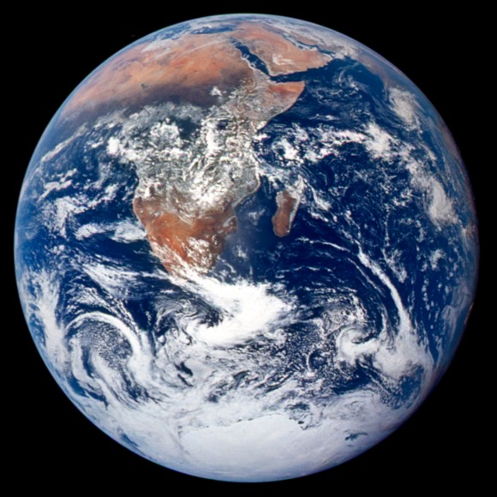
NP vs QMA
Here is the QCD Hamiltonian. Can you decribe the wavefunction of the proton in a way that will let me compute its mass?
Can you give me some description I can use to get a 0.1% accurate estimate using fewer than 10⁵⁰ steps?
No.
Greetings! The proton is the ground state of the u, u and d quarks.
I can, however, give you many protons, whose mass you can measure.

Slide 14
better approximation?
- There is no guaranteed way to improve the approximation with a larger witness.
Approximation quality depends on:
degree (fixed)
average expansion (can change, but might always be high)
average entropy (can change, but might always be high)
SDP hierarchy:
variables = {density matrices for all sets of ≤k qubits}
constraints = overlap compatibility + global PSD constraint (tomorrow)
Can prove this finds a good product state when k ≫ poly(threshold rank).
Clearly converges to the true ground state energy as k→n.
SDP relaxation ≤ true ground state energy ≤ variational bounds
improves with k
need better ansatz, eg MPS

Slide 15
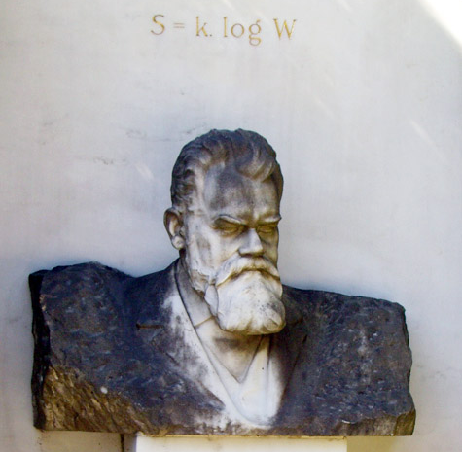

quantifying entanglement
bipartite pure states – the nice case
λ₁ ≥ λ₂ ≥ … ≥ λ_{d} ≥ 0 determine equivalence under local unitaries
LOCC can modify λ according to majorization partial order
entanglement can be quantified by [Rènyi] entropies of λ
asymptotic entanglement determined by H(λ) = S(ψ^{A}) = S(ψ^{B})
“entropy of entanglement” → entanglement as resource
[Bennett, Bernstein, Popescu, Schumacher ‘95]

Slide 16
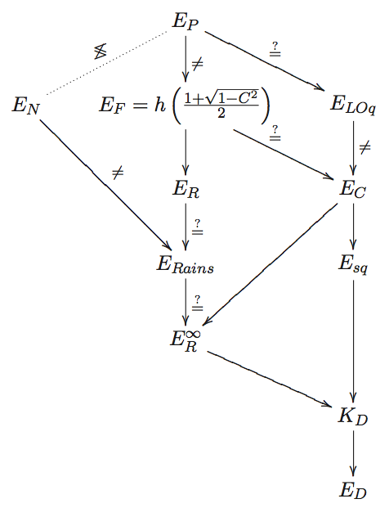
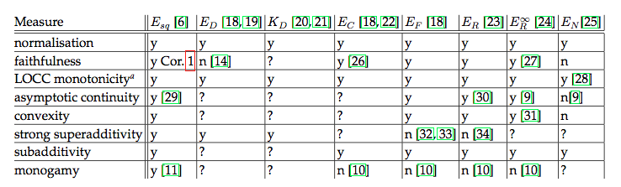
mixed / multipartite
mixed-state and/or multipartite entanglement measures form a zoo
relating to pure bipartite entanglement (formation/distillation)
distance to separable states (relative entropy of entanglement, squashed ent.)
easy to compute but not operational (log negativity, concurrence)
operational but hard to compute (distillable key, geometric measure, tensor rank)
not really measuring entanglement (ent. of purification, ent. of assistance)
regularized versions of most of the above
Generally “entropic” i.e. match on pure states.
Hopefully convex, continuous, monotonic, etc.
Brandão-Christandl-Yard ‘10
Christandl ‘06

Slide 17
conditional mutual information and Markov states
I(A:B|C) = H(A|C) + H(B|C) – H(AB|C)
= H(AC) + H(BC) – H(ABC) – H(C)
= ∑_{c} p(C=c) I(A:B)_{p(⋅, ⋅|C=c)} only true classically!
≥ 0 still true quantumly
Classical
Quantum
TFAE:
I(A:B|C)=0
p(a,b,c) = p₁(c) p₂(a|c) p₃(b|c)
p = exp(H_{AC} + H_{BC}) for some H_{AC}, H_{BC}
[Hammersley-Clifford]
A & B can be reconstructed from C
I(A:B|C)=0
[Hayden, Jozsa,
Petz, Winter ‘04]
ρ^{AB} is separable

Slide 18
conditional mutual information
I(A:B|C)=0 ⇔ ρ is a Markov state
I(A:B|C)=ε ⇔ ρ is an approximate Markov state?
Classical
Quantum
I(A:B|C)_{ρ} ≤ min_{σ Markov} D(ρ||σ)
I(A:B|C)_{p} = min_{q Markov} D(p || q)
I(A:B|C) can be ≪ RHS
[Ibinson, Linden, Winter ’06]
I(A:B|C) small → can
approximately reconstruct
A,B from C.
ρ^{AB} can be far from separable
in trace distance but not 1-LOCC
distance. [Brandão,Christandl,Yard ‘10]
approximate reconstruction? [Winter]
application to Hamiltonians?
[Poulin, Hastings ‘10] [Brown, Poulin ‘12]

Slide 19
approximate quantum Markov state
three possible definitions
1. I(A:B|C)_{ρ} ≤ small
2. min_{σ Markov} D(ρ||σ) ≤ small
conjecture [Winter]
3. reconstruction:
There exists a map T:C→BC such that T(ρ^{AC}) ≈ ρ^{ABC}
ρ^{AB} is
≈ k-extendable

Slide 20
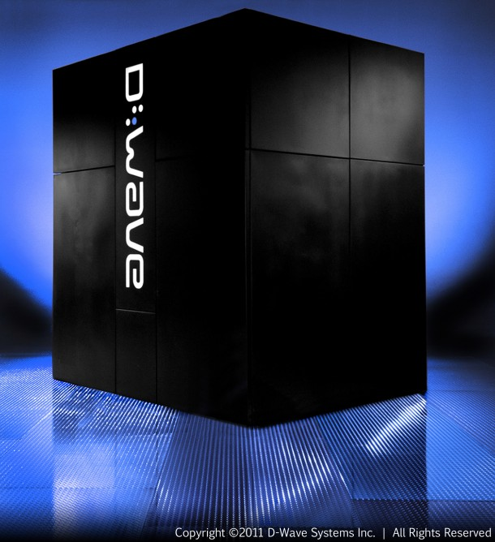
dynamics
Time evolution of quantum systems
Can we simulate lightly entangled dynamics?
i.e. given the promise that entanglement is always “≤ k” is there
a simulation that runs with overhead exp(k)?
noise per gate
0
10⁻²-ish
≈0.3
classical
simulation
possible
1
ideal
QC
FTQC
possible
?
?
Notes:
[McClean, Parkhill, Aspuru-Guzik ‘13]

Slide 21
open question
If exponential quantum speedup/hardness is due to
entanglement, then can we make this quantitative?
Answer may include:
saving the theory of entanglement measures from itself
new classical ways to describe quantum states (e.g. MPS)
conditional mutual information
the right definition of “approximate quantum Markov states”

